Slide 1
Graves into Gardens
(Elevation Worship)

Slide 2
I searched the World but it couldn’t fill me. Man’s empty praise and treasures that fade Are never

Slide 3
Enough. Then you came along and put me back together And every desire Is now satisfied here in

Slide 4
Your love. Oh’ there’s nothing better than you. There’s nothing better than you. Lord there’s nothing

Slide 5
Nothing is better than you. Im not afraid to show you my weakness. My failures and flaws Lord you’ve

Slide 6
Seen them all and you still call me friend.Cause the God of the mountain. Is the God of the Valley.

Slide 7
There’s not a place. Your mercy and grace. Wont find me again. Oh there’s nothing better than you. There’s

Slide 8
Nothing better than you. Lord there’s nothing. Nothing is better than you. Oh there’s nothing better

Slide 9
Better than you. There’s nothing better than you. Lord’ there’s nothing. Nothing is better than you.

Slide 10
You turn mourning to dancing. You give beauty for ashes. You turn shame into glory. You’re the only one

Slide 11
Who can. You turn mourning to dancing. You give beauty for ashes. You turn shame into glory. You’re

Slide 12
The only one who can. You turn graves into gardens. You turn bones into armies. You turn seas into

Slide 13
Highways. You’re the only one who can you’re the only one who can. Oh there’s nothing better than you

Slide 14
There’s nothing better than you. Lord there’s nothing. Nothing is better than you. Oh there’s nothing better

Slide 15
Than you. There’s nothing better than you. Lord, there’s nothing. Nothing is better than you. You turn

Slide 16
Graves into gardens. You turn bones into armies. You turn seas into highways. You’re the only one who

Slide 17
Can. You turn graves into gardens. You turn bones into armies. You turn seas into highways you’re the

Slide 18
Only one who can. You’re the only one who. You’re the only one who can.

Slide 19
Open Up The Heavens

Slide 20
We waited for this day. Were gathered in your name Calling out to you. With Glory like a fire.

Slide 21
awakening desire Will burn our hearts with truth
You're the reason we're here You're the reason we're

Slide 22
Singing Open up the heavens, we wanna see You
Open up the floodgates, a mighty river Flowing from

Slide 23
Your heart, filling every part of our praise Your presence in this place Your glory on our face

Slide 24
We're looking to the sky. Descending like a cloud
You're standing with us now. Lord unveil our eyes

Slide 25
You're the reason we're here You're the reason we're singing So open up the heavens, we wanna

Slide 26
See You Open up the floodgates, a mighty river
Flowing from Your heart, filling every part of our

Slide 27
Praise. Open up the heavens, we wanna see You
Open up the floodgates, a mighty river Flowing from

Slide 28
Your heart, filling every part of our praise Show us, show us Your glory Show us, show us Your power

Slide 29
Show us,show us your glory, Lord. We want to see you, Lord. Show us,show us your glory. Show

Slide 30
Us, show us your power. Show us,show us your glory, Lord. We want to see you, Lord. Open up

Slide 31
The heavens we want to see you. Open up the floodgates a mighty river flowing from our hearts and

Slide 32
Filling every part of our praise. Yes open up the heavens we want to see you open up the floodgates

Slide 33
A mighty river flowing from our hearts and filling every part of our praise.

Slide 34
Man Of Your Word

Slide 35
All things are possible when we believe. Old chains are breakable when we receive. Yahweh, You keep

Slide 36
Your promises If you said it, we believe it, if you said it. If you said it we believe it. You’re a man of your

Slide 37
Word. If you said it , we believe it. If you said it, we believe it. You’re a man of your word. All things are

Slide 38
Possible when we believe. Old chains are breakable When we receive. Yahweh, you keep your promises

Slide 39
If you said it , we believe it. If you said it, we believe it. If you said it, we believe it. If you said it we believe

Slide 40
It. You’re a man of your word. If you said it we believe it. If you said it we believe it . You’re a man of

Slide 41
Your word. All things are possible when we believe. Old chains are breakable when we receive. Yahweh,

Slide 42
You keep your promises. If you said, We believe it, If you said it. If you said it, we believe it. If you said it,

Slide 43
We believe it. You’re a man of your word. If you said it, we believe it. If you said it, we believe it. You’re a

Slide 44
Man of your word. We have this confidence. You’ll finish what you started. God, you have never failed

Slide 45
You wont start with me. Your’re present in every step patient in every heartache. God, you have never

Slide 46
Failed you wont start with me. . If you said it, We believe it, If you said it we believe it. You’re a man of

Slide 47
Your word.If you said it, we believe it. If you said it, we believe it. You’re a man of your word. We have

Slide 48
this confidence. You’ll finish what you started. God, you have never failed. You wont start with me. You’re

Slide 49
Your’re present in every step patient in every heartache. God, you have never failed . You won’t

Slide 50
start with me. If you said it, we believe it. If you said it, we believe it. You’re a man of your word. If you

Slide 51
said it, we believe it. If you said it, we believe it. You’re a man of your word. If you said it we believe

Slide 52
it. If you said it, we believe it. You’re a man of your word.

Slide 53
Cornerstone

Slide 54
My hope is built on nothing less. Than Jesus blood and righteousness. I dare not trust the sweetest

Slide 55
frame. But wholly trust in Jesus name. My hope is built on nothing less. Than Jesus blood and

Slide 56
righteousness. I dare not trust the sweetest frame Burt wholly trust in Jesus name. Christ alone,

Slide 57
Cornerstone weak made strong in the Savior’s love. Through the storm, He is Lord. Lord of all. When

Slide 58
Darkness seems to hide his face. I rest on his unchanging grace. In every high and stormy gale my

Slide 59
anchor holds within the Veil. My anchor holds within the veil. Christ alone Cornerstone.Weak made strong

Slide 60
in the Savior’s love. Through the storm, He is Lord. Lord of all. He is Lord, Lord of all. Christ alone

Slide 61
Cornerstone, weak made strong in the Savior’s love. Through the storm, He is Lord. Lord of all. When he

Slide 62
Shall come with trumpet sound. Oh may I then in him be found. Dressed in His righteousness alone.

Slide 63
Faultless stand before the throne. Christ alone, Cornerstone. Weak made stong in the Savior’s love.

Slide 64
Through the storm, He is Lord lord of all.

Slide 65
“Great are you Lord”
(All Sons and Daughters)

Slide 66
You give life, You are love. You bring light in the darkness. You give hope, You restore

Slide 67
Every heart that is broken. And great are you Lord. It’s your breath in our lungs so we

Slide 68
Pour out our praise. We pour out our praise.
It’s your breath in our lungs. So we pour out

Slide 69
Our praise to you only. You give life, you are love. You bring light to the darkness. You

Slide 70
Give hope, You restore. Every heart that is broken. Great are you Lord. It’s your breath

Slide 71
In our lungs. So we pour out our praise we pour out our praise. It’s your breath in our

Slide 72
Lungs so we pour out our praise to you only. It’s your breath in our lungs. So we

Slide 73
Pour out our praise we pour out our praise. It’s your breath in our lungs. So we pour out

Slide 74
Our praise to you only. And all the earth will shout your praise. Our hearts will cry, these

Slide 75
Bones will sing. Great are You, Lord. And all the earth will shout your praise. Our hearts

Slide 76
Will cry these bones will sing. Great are you,Lord. And all the earth will shout your

Slide 77
Praise Our hearts will cry these bones will sing. Great are you, Lord. It’s your breath in

Slide 78
Our Lungs. So we pour out our praise. We pour out our praise. It’s your breath in our

Slide 79
Lungs so we pour out our praise to you only. Great are you, Lord. It’s your breath in

Slide 80
Our lungs so we pour out our praise. Pour out our praise. It’s your breath in our lungs

Slide 81
So we pour out our praise to you only. Great are you , Lord.

Slide 82
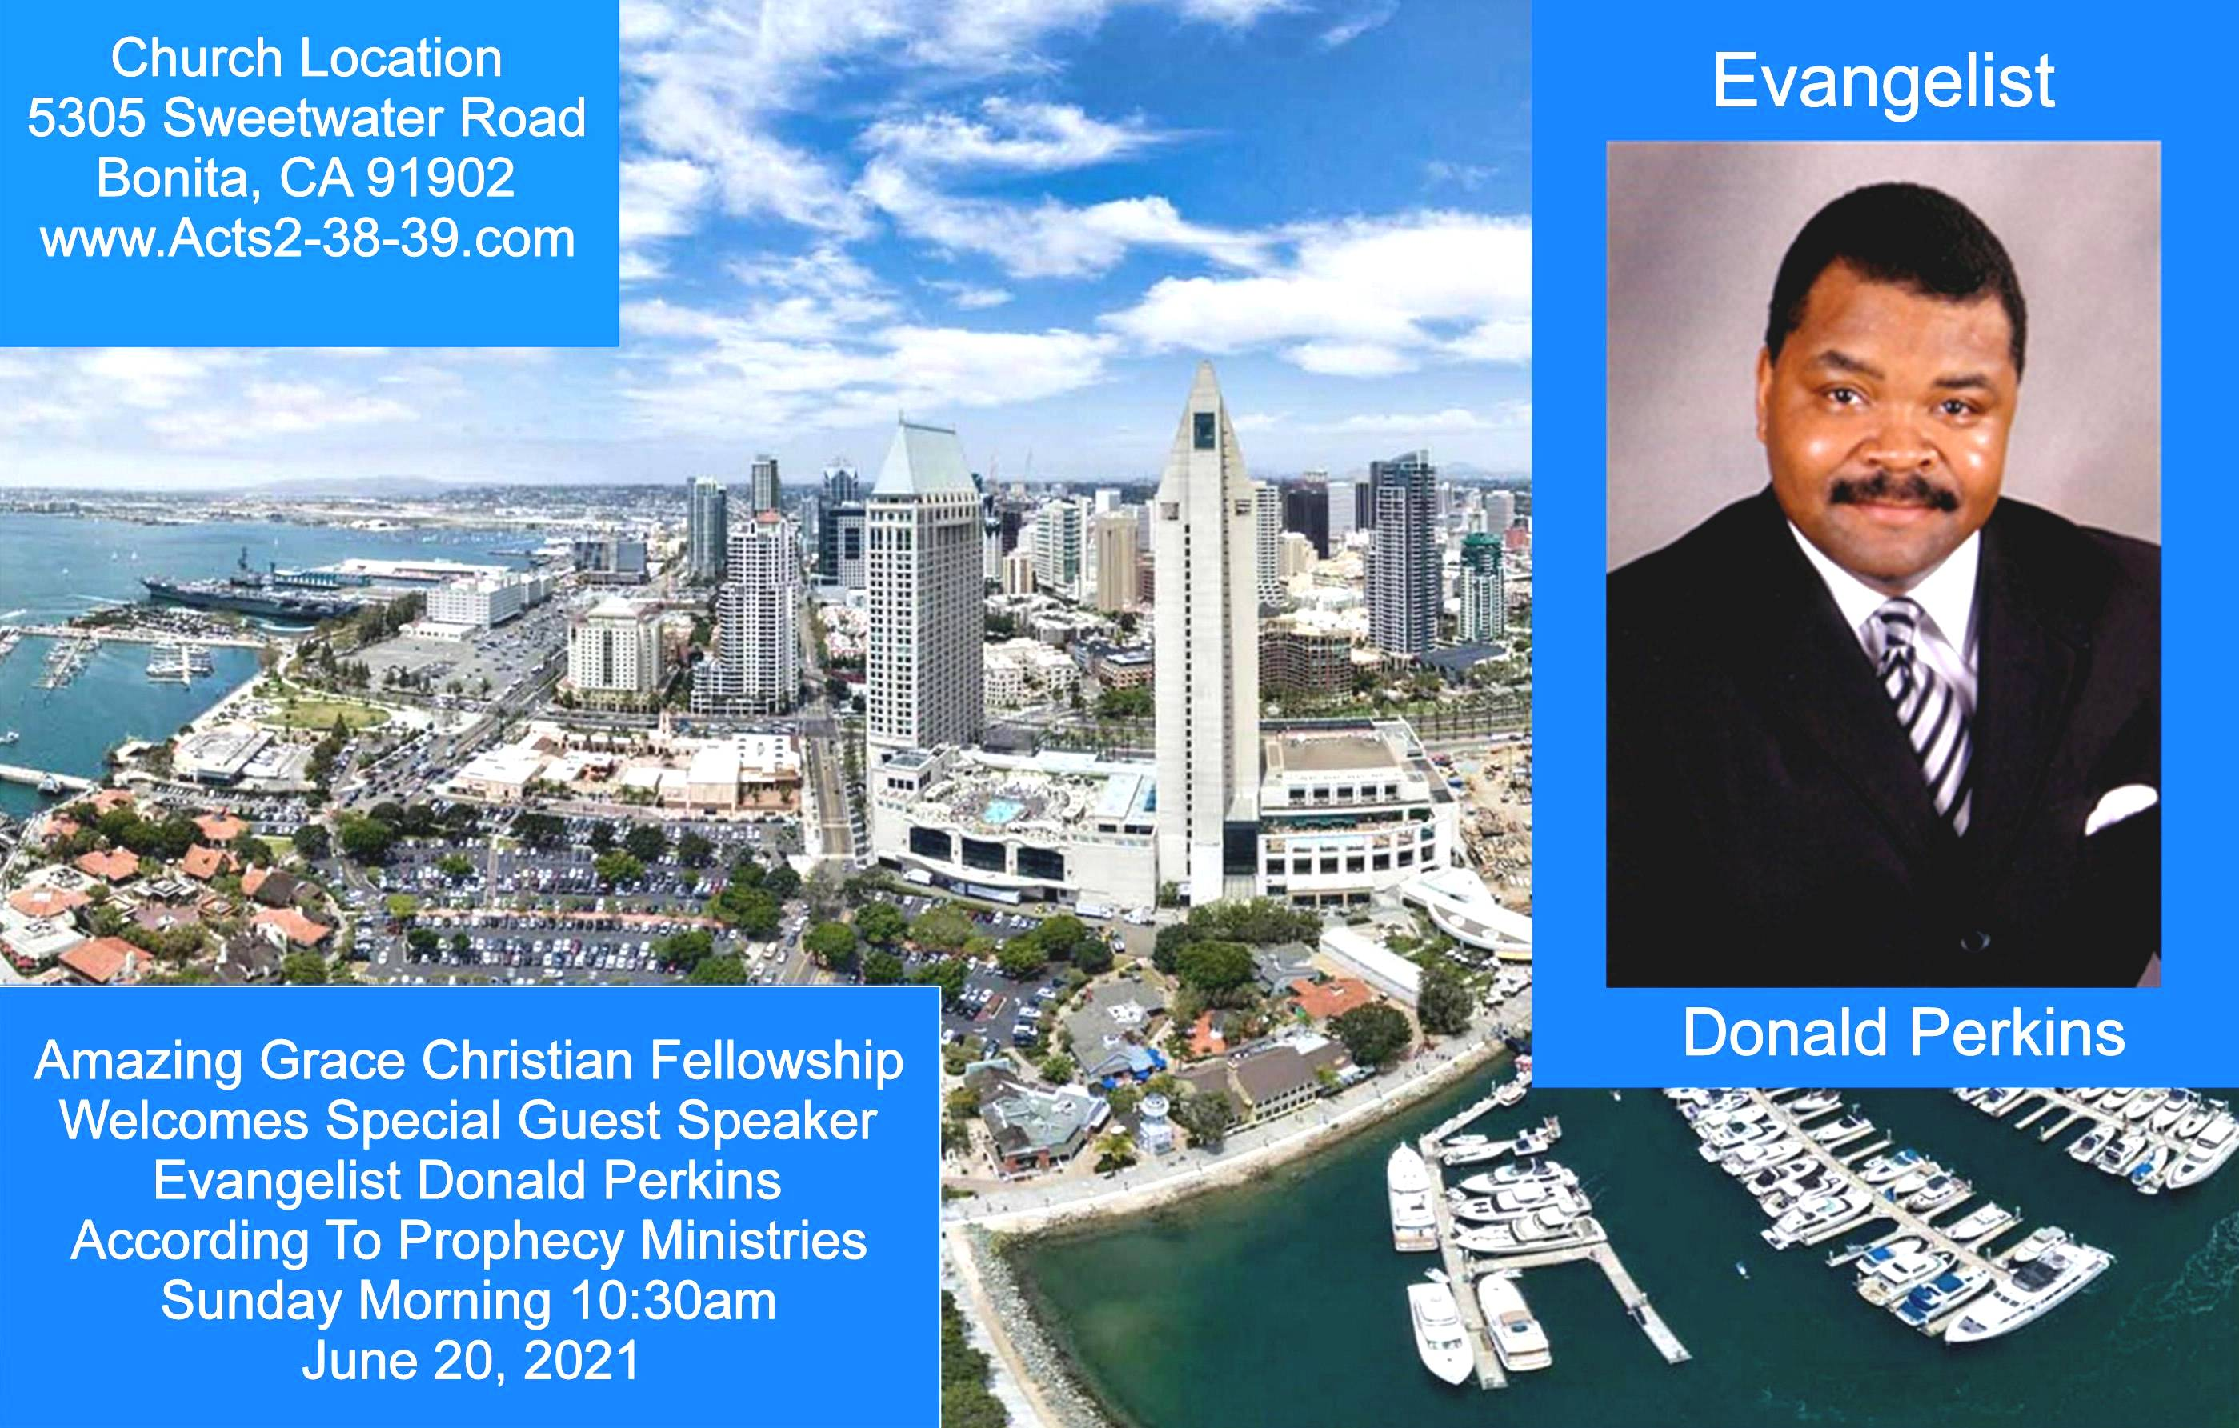
Exodus 23:14-16
14 "Three times you shall keep a feast to Me in the year: 15 You shall keep the Feast of Unleavened Bread (you shall eat unleavened bread seven days, as I commanded you, at the time appointed in the month of Abib, for in it you came out of Egypt; none shall appear before Me empty);

Slide 83


Slide 84
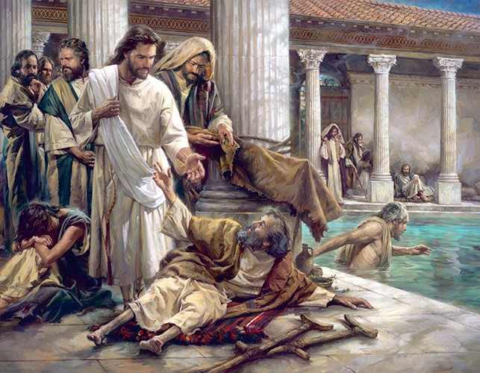

Jesus Still Heals Today
by Pastor Fee Soliven
Malachi 4:1-4
Sunday Morning
May 30, 2021

Slide 85
Malachi 4:1-4
1 "For behold, the day is coming, Burning like an oven, And all the proud, yes, all who do wickedly will be stubble. And the day which is coming shall burn them up," Says the LORD of hosts, "That will leave them neither root nor branch. 2 But to you who fear My name The Sun of Righteousness shall arise With healing in His wings; And you shall go out And grow fat like stall-fed calves.

Slide 86
3 You shall trample the wicked, For they shall be ashes under the soles of your feet On the day that I do this," Says the LORD of hosts. 4 "Remember the Law of Moses, My servant, Which I commanded him in Horeb for all Israel, With the statutes and judgments.

Slide 87
1. The Source of Sickness and Disease

Slide 88
Romans 5:12-16
12 Therefore, just as through one man sin entered the world, and death through sin, and thus death spread to all men, because all sinned-- 13(For until the law sin was in the world, but sin is not imputed when there is no law.

Slide 89
14 Nevertheless death reigned from Adam to Moses, even over those who had not sinned according to the likeness of the transgression of Adam, who is a type of Him who was to come. 15 But the free gift is not like the offense. For if by the one man's offense many died, much more the grace of God and the gift by the grace of the one Man, Jesus Christ, abounded to many.

Slide 90
Deuteronomy 7:12-16
12 "Then it shall come to pass, because you listen to these judgments, and keep and do them, that the LORD your God will keep with you the covenant and the mercy which He swore to your fathers. 13 And He will love you and bless you and multiply you; He will also bless the fruit of your womb and the fruit of your land, your grain and your new wine and your oil, the increase of your cattle and the offspring of your flock, in the land of which He swore to your fathers to give you.

Slide 91
14 You shall be blessed above all peoples; there shall not be a male or female barren among you or among your livestock. 15 And the LORD will take away from you all sickness, and will afflict you with none of the terrible diseases of Egypt which you have known, but will lay them on all those who hate you. 16 And you shall destroy all the peoples whom the LORD your God delivers over to you; your eye shall have no pity on them; nor shall you serve their gods, for that will be a snare to you.

Slide 92
Sickness Can Also Be a Result of
Cursing Ourselves

Slide 93
Deuteronomy 28:58-61
58 "If you do not carefully observe all the words of this law that are written in this book, that you may fear this glorious and awesome name, THE LORD YOUR GOD, 59 then the LORD will bring upon you and your descendants extraordinary plagues--great and prolonged plagues--and serious and prolonged sicknesses. 60 Moreover He will bring back on you all the diseases of Egypt, of which you were afraid, and they shall cling to you.

Slide 94
Exodus 20:4-6
5 you shall not bow down to them nor serve them. For I, the LORD your God, am a jealous God, visiting the iniquity of the fathers on the children to the third and fourth generations of those who hate Me, 6 but showing mercy to thousands, to those who love Me and keep My commandments.

Slide 95
2. Spirits of Infirmity

Slide 96
Luke 13:10-17
10 Now He was teaching in one of the synagogues on the Sabbath. 11 And behold, there was a woman who had a spirit of infirmity eighteen years, and was bent over and could in no way raise herself up. 12 But when Jesus saw her, He called her to Him and said to her, "Woman, you are loosed from your infirmity."

Slide 97
13 And He laid His hands on her, and immediately she was made straight, and glorified God. 14 But the ruler of the synagogue answered with indignation, because Jesus had healed on the Sabbath; and he said to the crowd, "There are six days on which men ought to work; therefore come and be healed on them, and not on the Sabbath day."

Slide 98
15 The Lord then answered him and said, "Hypocrite! Does not each one of you on the Sabbath loose his ox or donkey from the stall, and lead it away to water it? 16 So ought not this woman, being a daughter of Abraham, whom Satan has bound--think of it--for eighteen years, be loosed from this bond on the Sabbath?"

Slide 99
17 And when He said these things, all His adversaries were put to shame; and all the multitude rejoiced for all the glorious things that were done by Him.

Slide 100
Matthew 8:16-17
16 When evening had come, they brought to Him many who were demon-possessed. And He cast out the spirits with a word, and healed all who were sick, 17 that it might be fulfilled which was spoken by Isaiah the prophet, saying: "He Himself took our infirmities And bore our sicknesses."

Slide 101
Matthew 12:22-32
22 Then one was brought to Him who was demon-possessed, blind and mute; and He healed him, so that the blind and mute man both spoke and saw. 23 And all the multitudes were amazed and said, "Could this be the Son of David?"

Slide 102
24 Now when the Pharisees heard it they said, "This fellow does not cast out demons except by Beelzebub, the ruler of the demons." 25 But Jesus knew their thoughts, and said to them: "Every kingdom divided against itself is brought to desolation, and every city or house divided against itself will not stand.

Slide 103
26 If Satan casts out Satan, he is divided against himself. How then will his kingdom stand? 27 And if I cast out demons by Beelzebub, by whom do your sons cast them out? Therefore they shall be your judges. 28 But if I cast out demons by the Spirit of God, surely the kingdom of God has come upon you.

Slide 104
29 Or how can one enter a strong man's house and plunder his goods, unless he first binds the strong man? And then he will plunder his house. 30 He who is not with Me is against Me, and he who does not gather with Me scatters abroad. 31 "Therefore I say to you, every sin and blasphemy will be forgiven men, but the blasphemy against the Spirit will not be forgiven men.

Slide 105
32 Anyone who speaks a word against the Son of Man, it will be forgiven him; but whoever speaks against the Holy Spirit, it will not be forgiven him, either in this age or in the age to come.

Slide 106
Our Healing Was Paid In Full

Slide 107
Isaiah 53:4-5
4 Surely He has borne our griefs And carried our sorrows; Yet we esteemed Him stricken, Smitten by God, and afflicted. 5 But He was wounded for our transgressions, He was bruised for our iniquities; The chastisement for our peace was upon Him, And by His stripes we are healed.

Slide 108
1 Peter 2:21-25
21 For to this you were called, because Christ also suffered for us, leaving us an example, that you should follow His steps: 22 "Who committed no sin, Nor was deceit found in His mouth"; 23 who, when He was reviled, did not revile in return; when He suffered, He did not threaten, but committed Himself to Him who judges righteously;

Slide 109
24 who Himself bore our sins in His own body on the tree, that we, having died to sins, might live for righteousness--by whose stripes you were healed. 25 For you were like sheep going astray, but have now returned to the Shepherd and Overseer of your souls.

Slide 110
Jesus Gave His Church The Authority To Heal

Slide 111
Matthew 10:7-8
7 And as you go, preach, saying, 'The kingdom of heaven is at hand.' 8 "Heal the sick, cleanse the lepers, raise the dead, cast out demons. Freely you have received, freely give.

Slide 112
Mark 16:14-20
14 Later He appeared to the eleven as they sat at the table; and He rebuked their unbelief and hardness of heart, because they did not believe those who had seen Him after He had risen. 15 And He said to them, "Go into all the world and preach the gospel to every creature.

Slide 113
16 He who believes and is baptized will be saved; but he who does not believe will be condemned. 17 And these signs will follow those who believe: In My name they will cast out demons; they will speak with new tongues; 18 they will take up serpents; and if they drink anything deadly, it will by no means hurt them; they will lay hands on the sick, and they will recover."

Slide 114
19 So then, after the Lord had spoken to them, He was received up into heaven, and sat down at the right hand of God. 20 And they went out and preached everywhere, the Lord working with them and confirming the word through the accompanying signs. Amen.

Slide 115
Jesus Ultimately Came To Destroy The Works Of The Devil!

Slide 116
1 John 3:6-9
6 Whoever abides in Him does not sin. Whoever sins has neither seen Him nor known Him. 7 Little children, let no one deceive you. He who practices righteousness is righteous, just as He is righteous.

Slide 117
8 He who sins is of the devil, for the devil has sinned from the beginning. For this purpose the Son of God was manifested, that He might destroy the works of the devil. 9 Whoever has been born of God does not sin, for His seed remains in him; and he cannot sin, because he has been born of God.

Slide 118
Common Blockages to Healing

Slide 119
1. Lack of Faith

Slide 120
Mark 6:4-6
4 But Jesus said to them, "A prophet is not without honor except in his own country, among his own relatives, and in his own house." 5 Now He could do no mighty work there, except that He laid His hands on a few sick people and healed them. 6 And He marveled because of their unbelief. Then He went about the villages in a circuit, teaching.

Slide 121
Hebrews 11:6
"But without faith it is impossible to please Him, for he who comes to God must believe that He is, and that He is a rewarder of those who diligently seek Him."

Slide 122
2. Unforgiveness in The Heart

Slide 123
Matthew 6:14-15
14 "For if you forgive men their trespasses, your heavenly Father will also forgive you. 15 But if you do not forgive men their trespasses, neither will your Father forgive your trespasses.

Slide 124
3. Unconfessed Sin

Slide 125
1 John 1:9-10
9 If we confess our sins, He is faithful and just to forgive us our sins and to cleanse us from all unrighteousness. 10 If we say that we have not sinned, we make Him a liar, and His word is not in us.

Slide 126
James 5:13-17
13 Is anyone among you suffering? Let him pray. Is anyone cheerful? Let him sing psalms. 14 Is anyone among you sick? Let him call for the elders of the church, and let them pray over him, anointing him with oil in the name of the Lord.

Slide 127
15 And the prayer of faith will save the sick, and the Lord will raise him up. And if he has committed sins, he will be forgiven. 16 Confess your trespasses to one another, and pray for one another, that you may be healed. The effective, fervent prayer of a righteous man avails much.

Slide 128
1. How are you supposed to ask in faith, and receive, if you aren't really sure that God will heal you?

Slide 129
2. What kind of faith is that?

Slide 130
Romans 10:17
“So then faith comes by hearing, and hearing by the word of God”

Slide 131
Now is the time to ask Jesus to heal, deliver and set you free from any bondage you may be under!

Slide 132
1 Thessalonians 4:13-18
13 But I do not want you to be ignorant, brethren, concerning those who have fallen asleep, lest you sorrow as others who have no hope. 14 For if we believe that Jesus died and rose again, even so God will bring with Him those who sleep in Jesus.

Slide 133
15 For this we say to you by the word of the Lord, that we who are alive and remain until the coming of the Lord will by no means precede those who are asleep. 16 For the Lord Himself will descend from heaven with a shout, with the voice of an archangel, and with the trumpet of God. And the dead in Christ will rise first.

Slide 134
17 Then we who are alive and remain shall be caught up together with them in the clouds to meet the Lord in the air. And thus we shall always be with the Lord. 18 Therefore comfort one another with these words.

Slide 135
1 Corinthians 15:50-54
50 Now this I say, brethren, that flesh and blood cannot inherit the kingdom of God; nor does corruption inherit incorruption. 51 Behold, I tell you a mystery: We shall not all sleep, but we shall all be changed-- 52 in a moment, in the twinkling of an eye, at the last trumpet. For the trumpet will sound, and the dead will be raised incorruptible, and we shall be changed.

Slide 136
53 For this corruptible must put on incorruption, and this mortal must put on immortality. 54 So when this corruptible has put on incorruption, and this mortal has put on immortality, then shall be brought to pass the saying that is written: "Death is swallowed up in victory."

Slide 137

20 Again, when a righteous man turns from his righteousness and commits iniquity, and I lay a stumbling block before him, he shall die; because you did not give him warning, he shall die in his sin, and his righteousness which he has done shall not be remembered; but his blood I will require at your hand.

Slide 138
Acts 2:38-39
38 Then Peter said to them, "Repent, and let every one of you be baptized in the name of Jesus Christ for the remission of sins; and you shall receive the gift of the Holy Spirit. 39 For the promise is to you and to your children, and to all who are afar off, as many as the Lord our God will call."

Slide 139


