Slide 1
“This Is Amazing Grace/Who you Are to me”
(Phil Wickham/Chris Tomlin)

Slide 2
Your Amazing, Faithful, Loves open door. When I’m empty you fill me with hunger for more. Of your

Slide 3
Mercy, Your Goodness. Lord you’re the air that I breathe It’s who you are to me.

Slide 4
Who breaks the power of sin and darkness? Who’s love is mighty and so much stronger? The King of

Slide 5
Glory the king above all Kings. Who shakes the whole earth with holy thunder? Who leaves us

Slide 6
Breathless in awe and wonder? The King of Glory the King above all Kings. This is amazing Grace.

Slide 7
This is unfailing love. That you would take my place. That you would bear my cross. You lay down your

Slide 8
Life that I would be set free. Jesus I sing for all that you’ve done for me. Who brings our Chaos back into

Slide 9
Order? Who makes an Orphan a son and daughter?
The King of Glory, The King of Glory. Who rules the

Slide 10
Nations with truth and justice. Shines like the sun in
All of it’s brilliance. The King of Glory, the King

Slide 11
Above all Kings. This Is Amazing Grace. This is unfailing Love. That you would take my place.

Slide 12
That you would bear my Cross. You laid down your life. That I would be set free. Jesus I sing for all that

Slide 13
you’ve done for me. Worthy is the Lamb who was slain. Worthy is the King who Conquered the Grave.

Slide 14
Worthy is the Lamb Who was slain. Worthy is the King who conquers the Grave. Worthy is the Lamb

Slide 15
who was slain. And Worthy is the King who conquers the grave. Worthy is the Lamb who slain. Worthy

Slide 16
Worthy Worthy. This Is amazing Grace. This is unfailing love that you would take me place that you

Slide 17
would bear my cross. You laid down your life. That I would be set free. Jesus I sing for all that all that

Slide 18
you’ve done for me. Your Amazing, Faithful, Loves open door. When I’m empty you fill me with hunger

Slide 19
for more. Of your Mercy, Your Goodness. Lord you’re the air that I breathe It’s who you are. You’re

Slide 20
Amazing,Faithful, Loves open door. When I’m empty you fill me. With hunger for more. Of your Mercy your

Slide 21
Goodness. Lord You’re the air that I breathe it’s who you are to me. This is amazing Grace. This is

Slide 22
Unfailing Love.That You would take my place. That you would bear my cross. You laid down your life.

Slide 23
That I would be setFree. Jesus I sing for all that you’ve done for me.

Slide 24
Free. Jesus I sing for all that you’ve done for me.

Slide 25
Graves into Gardens
(Elevation Worship)

Slide 26
I searched the World but it couldn’t fill me. Man’s empty praise and treasures that fade Are never

Slide 27
Enough. Then you came along and put me back together And every desire Is now satisfied here in

Slide 28
Your love. Oh’ there’s nothing better than you. There’s nothing better than you. Lord there’s nothing

Slide 29
Nothing is better than you. Im not afraid to show you my weakness. My failures and flaws Lord you’ve

Slide 30
Seen them all and you still call me friend.Cause the God of the mountain. Is the God of the Valley.

Slide 31
There’s not a place. Your mercy and grace. Wont find me again. Oh there’s nothing better than you. There’s

Slide 32
Nothing better than you. Lord there’s nothing. Nothing is better than you. Oh there’s nothing better

Slide 33
Better than you. There’s nothing better than you. Lord’ there’s nothing. Nothing is better than you.

Slide 34
You turn mourning to dancing. You give beauty for ashes. You turn shame into glory. You’re the only one

Slide 35
Who can. You turn mourning to dancing. You give beauty for ashes. You turn shame into glory. You’re

Slide 36
The only one who can. You turn graves into gardens. You turn bones into armies. You turn seas into

Slide 37
Highways. You’re the only one who can you’re the only one who can. Oh there’s nothing better than you

Slide 38
There’s nothing better than you. Lord there’s nothing. Nothing is better than you. Oh there’s nothing better

Slide 39
Than you. There’s nothing better than you. Lord, there’s nothing. Nothing is better than you. You turn

Slide 40
Graves into gardens. You turn bones into armies. You turn seas into highways. You’re the only one who

Slide 41
Can. You turn graves into gardens. You turn bones into armies. You turn seas into highways you’re the

Slide 42
Only one who can. You’re the only one who. You’re the only one who can.

Slide 43
"Something has to break”
(Essential Worship and Red Rocks Worship)

Slide 44
I feel it in this room. Holy spirit move. Cause when you have your way. Something has to break. Tear

Slide 45
Down every lie. Set the wrong thing right. Cause when you have your way. Something has to break.

Slide 46
Something has to break. I feel it in this room. Holy spirit move. Cause when you have your way

Slide 47
Something has to break. Tear down every lie. Set the wrong thing right. Cause when you have your way

Slide 48
Something has to break. Something has to break.
Right now in you name. Something has to break.

Slide 49
Something has to break. Something has to break.
Right now in your name. Something has to break.

Slide 50
I believe you’ll get me to it. I believe you’ll get me through it. I believe that you will do it right now.

Slide 51
Something has to break. I believe you’ll get me to it. I believe you’ll get me through it. I believe that you will

Slide 52
do it right now. Something has to break. I believe you’ll get me to it. I believe you’ll get me through it. I

Slide 53
believe that you will do it right now. Something has to break. Something has to break. Right now in your

Slide 54
name. Something has to break. Something has to break. Something has to break. Right now in your

Slide 55
Name. Something has to break.

Slide 56
“Because of who you Are”
(Martha Munizzi)

Slide 57
Because of who you are, I give you glory. Because of who you are, I give you praise. Because of who you

Slide 58
Are , I will lift my voice and say. Lord, I worship you because of who you are. Lord, I worship you

Slide 59
Because of who you are. Jehovah Jireh, my provider. Jehovah Nissi, Lord you Reign in Victory. Jehovah

Slide 60
Shalom, my Prince of Peace. And I worship you because of who you are. Because of who you are, I

Slide 61
give you glory. Because of who you are, I give you praise. Because of who you Are , I will lift my voice

Slide 62
and say. Lord, I worship you because of who you are. Lord, I worship you because of who you are.

Slide 63
Jehovah Jireh, my provider. Jehovah Nissi, Lord you Reign in Victory. Jehovah Shalom, my Prince of

Slide 64
Peace. And I worship you because of who you are. Because of who you are, I worship you because of

Slide 65
Who you are.

Slide 66
“Open the eyes of my heart”

Slide 67
Open the eyes of my heart Lord. Open the eyes of my heart. I want to see you. I want to see you.

Slide 68
Open the eyes of my heart Lord. Open the eyes of my heart. I want to see you. I want to see you.

Slide 69
To see you high and lifted up shining in the light of your glory. Pour out your pour and Love. As we sing

Slide 70
Holy holy holy. I want to see you . Open the eyes of my heart Lord. Open the eyes of my heart. I want to

Slide 71
See you. I want to see you . Open the eyes of my heart Lord open the eyes of my heart I want to see

Slide 72
You. I want to see you. To see you high nd lifted up. Shining in the light of your glory. Pour out your power

Slide 73
And love as we sing holy holy holy. To see you high and lifted up. Shining in the light of your glory. Pour

Slide 74
Out your power and love as we sing holy holy holy. We sing holy holy. Holy holy holy. Holy holy holy. I

Slide 75
Want to see you. I want to see you.

Slide 76
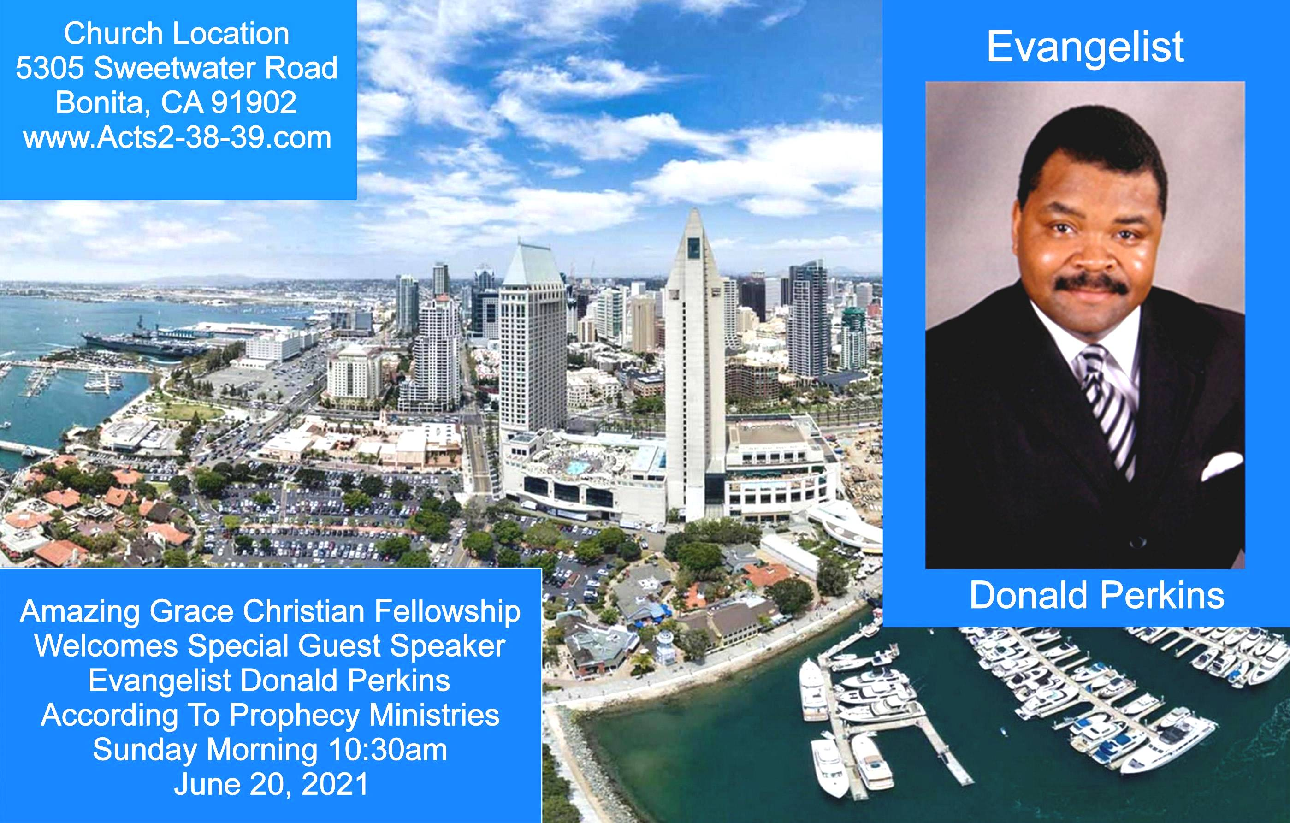
Exodus 23:14-16
14 "Three times you shall keep a feast to Me in the year: 15 You shall keep the Feast of Unleavened Bread (you shall eat unleavened bread seven days, as I commanded you, at the time appointed in the month of Abib, for in it you came out of Egypt; none shall appear before Me empty);

Slide 77

Exodus 23:14-16
14 "Three times you shall keep a feast to Me in the year: 15 You shall keep the Feast of Unleavened Bread (you shall eat unleavened bread seven days, as I commanded you, at the time appointed in the month of Abib, for in it you came out of Egypt; none shall appear before Me empty);

Slide 78


Slide 79
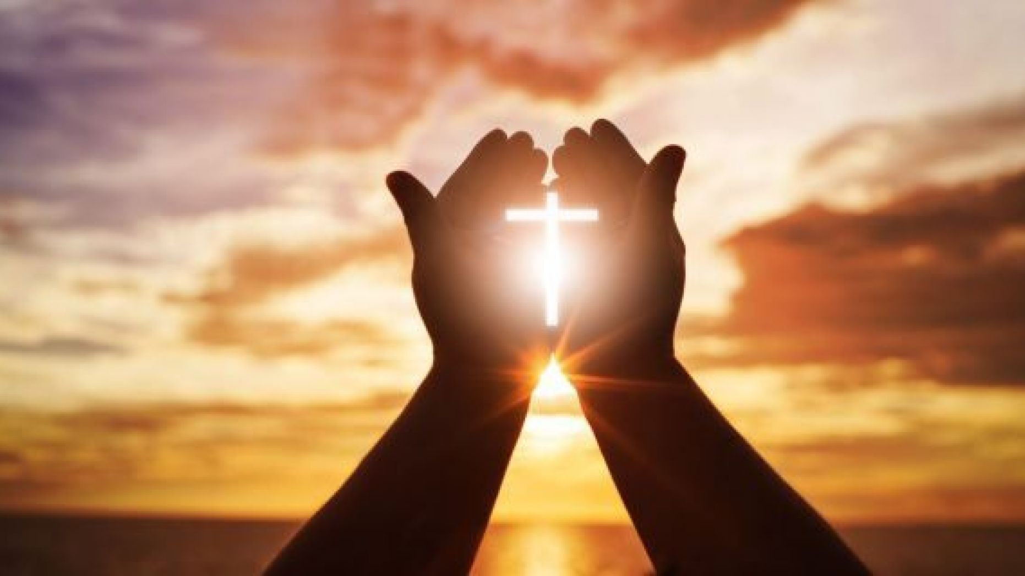

Believe God and Live
by Pastor Fee Soliven
Acts 4:1-4
Sunday Morning
June 6, 2021

Slide 80
Acts 4:1-4
1 Now as they spoke to the people, the priests, the captain of the temple, and the Sadducees came upon them, 2 being greatly disturbed that they taught the people and preached in Jesus the resurrection from the dead. 3 And they laid hands on them, and put them in custody until the next day, for it was already evening. 4 However, many of those who heard the word believed; and the number of the men came to be about five thousand.

Slide 81
As Christians we should have some Godly Convictions that define who we are and determine our lifestyle and choices

Slide 82
John 16:8
And He, when He comes, will convict the world concerning sin and righteousness and judgment;

Slide 83
1 Thessalonians 1:5
“for our gospel did not come to you in word only, but also in power and in the Holy Spirit and with full conviction; just as you know what kind of men we proved to be among you for your sake”

Slide 84
Romans 14:22
“The faith which you have, have as your own conviction before God. Happy is he who does not condemn himself in what he approves”

Slide 85
Hebrews 11:1
“Now faith is the assurance of things hoped for, the conviction of things not seen”

Slide 86
Acts 4:19-22
19 But Peter and John answered and said to them, "Whether it is right in the sight of God to listen to you more than to God, you judge. 20 For we cannot but speak the things which we have seen and heard."

Slide 87
21 So when they had further threatened them, they let them go, finding no way of punishing them, because of the people, since they all glorified God for what had been done. 22 For the man was over forty years old on whom this miracle of healing had been performed.

Slide 88
1. A guilty verdict handed down in court—as in a conviction for a crime.

Slide 89
2. A firmly held belief—as in the certainty that our Lord Jesus Christ is the resurrected Son of God and the only way to heaven.

Slide 90
3. A feeling of guilt given by the Holy Spirit—He convicts the world of sin, righteousness, and judgment

Slide 91
John 16:8
And He, when He comes, will convict the world concerning sin and righteousness and judgment;

Slide 92
The Difference Between Convictions and Preferences

Slide 93
Preferences

Slide 94
Ephesians 4:14-15
14 that we should no longer be children, tossed to and fro and carried about with every wind of doctrine, by the trickery of men, in the cunning craftiness of deceitful plotting, 15 but, speaking the truth in love, may grow up in all things into Him who is the head—Christ…

Slide 95
James 1:6-8
6 But let him ask in faith, with no doubting, for he who doubts is like a wave of the sea driven and tossed by the wind. 7 For let not that man suppose that he will receive anything from the Lord; 8 he is a double-minded man, unstable in all his ways.

Slide 96
Conviction
A conviction is a solid, immovable belief based on confidence in God’s Word, being so thoroughly convinced of its absolute truth that we are willing to take a stand regardless of the consequences.

Slide 97
1 Corinthians 15:58
Therefore, my beloved brethren, be steadfast, immovable, always abounding in the work of the Lord, knowing that your labor is not in vain in the Lord.

Slide 98
Hebrews 11:6
“But without faith it is impossible to please Him, for he who comes to God must believe that He is, and that He is a rewarder of those who diligently seek Him.”

Slide 99
Characteristics of a Person with Convictions

Slide 100
Acts 16:16-34
16 Now it happened, as we went to prayer, that a certain slave girl possessed with a spirit of divination met us, who brought her masters much profit by fortune-telling. 17 This girl followed Paul and us, and cried out, saying, "These men are the servants of the Most High God, who proclaim to us the way of salvation."

Slide 101
18 And this she did for many days. But Paul, greatly annoyed, turned and said to the spirit, "I command you in the name of Jesus Christ to come out of her." And he came out that very hour. 19 But when her masters saw that their hope of profit was gone, they seized Paul and Silas and dragged them into the marketplace to the authorities.

Slide 102
20 And they brought them to the magistrates, and said, "These men, being Jews, exceedingly trouble our city; 21 and they teach customs which are not lawful for us, being Romans, to receive or observe." 22 Then the multitude rose up together against them; and the magistrates tore off their clothes and commanded them to be beaten with rods.

Slide 103
23 And when they had laid many stripes on them, they threw them into prison, commanding the jailer to keep them securely. 24 Having received such a charge, he put them into the inner prison and fastened their feet in the stocks.25 But at midnight Paul and Silas were praying and singing hymns to God, and the prisoners were listening to them.

Slide 104
26 Suddenly there was a great earthquake, so that the foundations of the prison were shaken; and immediately all the doors were opened and everyone's chains were loosed. 27 And the keeper of the prison, awaking from sleep and seeing the prison doors open, supposing the prisoners had fled, drew his sword and was about to kill himself.

Slide 105
28 But Paul called with a loud voice, saying, "Do yourself no harm, for we are all here." 29 Then he called for a light, ran in, and fell down trembling before Paul and Silas. 30 And he brought them out and said, "Sirs, what must I do to be saved?"31 So they said, "Believe on the Lord Jesus Christ, and you will be saved, you and your household."

Slide 106
32 Then they spoke the word of the Lord to him and to all who were in his house. 33 And he took them the same hour of the night and washed their stripes. And immediately he and all his family were baptized. 34 Now when he had brought them into his house, he set food before them; and he rejoiced, having believed in God.

Slide 107
Sense of Purpose

Slide 108
Faith in God

Slide 109
Courage

Slide 110
Big Picture Thinking

Slide 111
Unusual Strength

Slide 112
Ephesians 4:30
“And do not grieve the Holy Spirit of God, by whom you were sealed for the day of redemption”

Slide 113
John 14:26
But the Helper, the Holy Spirit, whom the Father will send in My name, He will teach you all things, and bring to your remembrance all things that I said to you

Slide 114
Foresight

Slide 115
Philippians 1:9–10
9 And it is my prayer that your love may abound more and more, with knowledge and all discernment, 10 so that you may approve what is excellent, and so be pure and blameless for the day of Christ.

Slide 116
Causes of Compromise of Our Convictions

Slide 117
What motivates us to do wrong even when we know what’s right?

Slide 118
Fear of Criticism

Slide 119
Romans 1:16-17
16 For I am not ashamed of the gospel of Christ, for it is the power of God to salvation for everyone who believes, for the Jew first and also for the Greek. 17 For in it the righteousness of God is revealed from faith to faith; as it is written, "The just shall live by faith."

Slide 120
Fear of Rejection

Slide 121
1 Peter 3:15-17
15 But sanctify the Lord God in your hearts, and always be ready to give a defense to everyone who asks you a reason for the hope that is in you, with meekness and fear; 16 having a good conscience, that when they defame you as evildoers, those who revile your good conduct in Christ may be ashamed. 17 For it is better, if it is the will of God, to suffer for doing good than for doing evil.

Slide 122
Fear of Loss

Slide 123
Philippians 3:7-11
7 But what things were gain to me, these I have counted loss for Christ. 8 Yet indeed I also count all things loss for the excellence of the knowledge of Christ Jesus my Lord, for whom I have suffered the loss of all things, and count them as rubbish, that I may gain Christ

Slide 124
9 and be found in Him, not having my own righteousness, which is from the law, but that which is through faith in Christ, the righteousness which is from God by faith; 10 that I may know Him and the power of His resurrection, and the fellowship of His sufferings, being conformed to His death, 11 if, by any means, I may attain to the resurrection from the dead.

Slide 125
1. What unwavering convictions do you have that govern your life?

Slide 126
2. What conditions or situations might tempt you to compromise your standards?

Slide 127
3. How would a long-term perspective help you courageously stand firm in your convictions?
4

Slide 128
What negative consequences might result from your compromise?

Slide 129
5. What are the long-term benefits of staying true to Christ and His Word?

Slide 130
1 Thessalonians 4:13-18
13 But I do not want you to be ignorant, brethren, concerning those who have fallen asleep, lest you sorrow as others who have no hope. 14 For if we believe that Jesus died and rose again, even so God will bring with Him those who sleep in Jesus.

Slide 131
15 For this we say to you by the word of the Lord, that we who are alive and remain until the coming of the Lord will by no means precede those who are asleep. 16 For the Lord Himself will descend from heaven with a shout, with the voice of an archangel, and with the trumpet of God. And the dead in Christ will rise first.

Slide 132
17 Then we who are alive and remain shall be caught up together with them in the clouds to meet the Lord in the air. And thus we shall always be with the Lord. 18 Therefore comfort one another with these words.

Slide 133
1 Corinthians 15:50-54
50 Now this I say, brethren, that flesh and blood cannot inherit the kingdom of God; nor does corruption inherit incorruption. 51 Behold, I tell you a mystery: We shall not all sleep, but we shall all be changed-- 52 in a moment, in the twinkling of an eye, at the last trumpet. For the trumpet will sound, and the dead will be raised incorruptible, and we shall be changed.

Slide 134
53 For this corruptible must put on incorruption, and this mortal must put on immortality. 54 So when this corruptible has put on incorruption, and this mortal has put on immortality, then shall be brought to pass the saying that is written: "Death is swallowed up in victory."

Slide 135

20 Again, when a righteous man turns from his righteousness and commits iniquity, and I lay a stumbling block before him, he shall die; because you did not give him warning, he shall die in his sin, and his righteousness which he has done shall not be remembered; but his blood I will require at your hand.

Slide 136
Acts 2:38-39
38 Then Peter said to them, "Repent, and let every one of you be baptized in the name of Jesus Christ for the remission of sins; and you shall receive the gift of the Holy Spirit. 39 For the promise is to you and to your children, and to all who are afar off, as many as the Lord our God will call."

Slide 137


