Slide 1
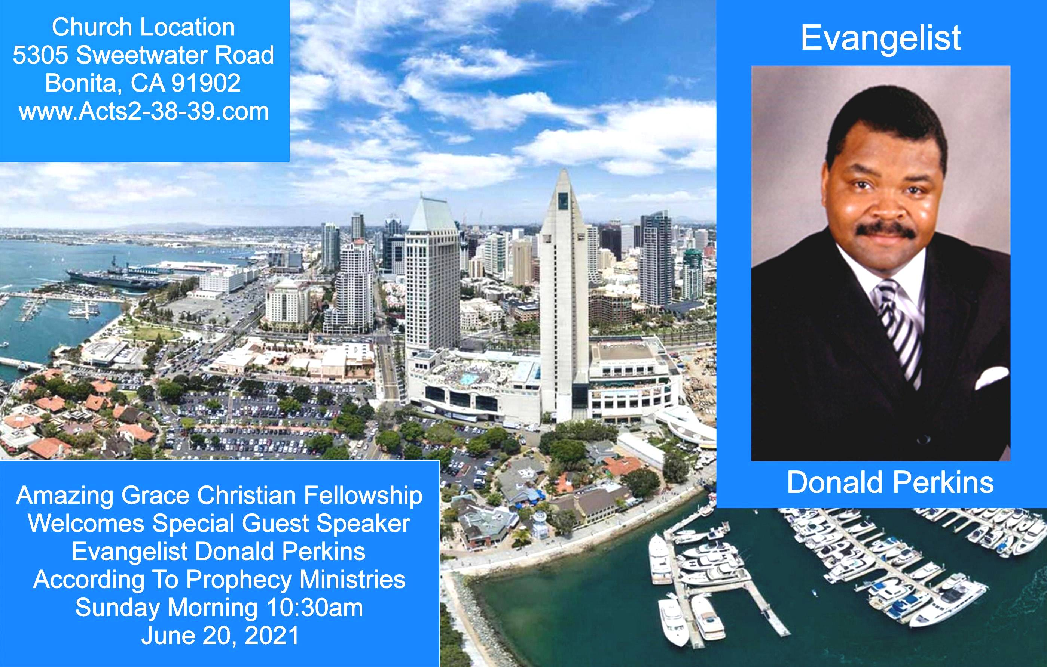
Ephesians 6:18-24
18 praying always with all prayer and supplication in the Spirit, being watchful to this end with all perseverance and supplication for all the saints-- 19 and for me, that utterance may be given to me, that I may open my mouth boldly to make known the mystery of the gospel, 20 for which I am an ambassador in chains; that in it I may speak boldly, as I ought to speak.

Slide 2



Chosen and Highly Favored
by Pastor Fee Soliven
1 Peter 2:9-17
Wednesday Evening
June 2, 2021

Slide 3
1 Peter 2:9-17
9 But you are a chosen generation, a royal priesthood, a holy nation, His own special people, that you may proclaim the praises of Him who called you out of darkness into His marvelous light; 10 who once were not a people but are now the people of God, who had not obtained mercy but now have obtained mercy.

Slide 4
11 Beloved, I beg you as sojourners and pilgrims, abstain from fleshly lusts which war against the soul, 12 having your conduct honorable among the Gentiles, that when they speak against you as evildoers, they may, by your good works which they observe, glorify God in the day of visitation. 13 Therefore submit yourselves to every ordinance of man for the Lord's sake, whether to the king as supreme,

Slide 5
14 or to governors, as to those who are sent by him for the punishment of evildoers and for the praise of those who do good. 15 For this is the will of God, that by doing good you may put to silence the ignorance of foolish men-- 16 as free, yet not using liberty as a cloak for vice, but as bondservants of God. 17 Honor all people. Love the brotherhood. Fear God. Honor the king.

Slide 6
9 But you are a chosen generation, a royal priesthood, a holy nation, His own special people, that you may proclaim the praises of Him who called you out of darkness into His marvelous light;

Slide 7
1 Corinthians 1:26-29
26 For you see your calling, brethren, that not many wise according to the flesh, not many mighty, not many noble, are called. 27 But God has chosen the foolish things of the world to put to shame the wise, and God has chosen the weak things of the world to put to shame the things which are mighty;

Slide 8
28 and the base things of the world and the things which are despised God has chosen, and the things which are not, to bring to nothing the things that are, 29 that no flesh should glory in His presence.

Slide 9
Exodus 19:5-6
5 Now therefore, if you will indeed obey My voice and keep My covenant, then you shall be a special treasure to Me above all people; for all the earth is Mine. 6 And you shall be to Me a kingdom of priests and a holy nation.' These are the words which you shall speak to the children of Israel."

Slide 10
Hebrews 4:15-16
15 For we do not have a High Priest who cannot sympathize with our weaknesses, but was in all points tempted as we are, yet without sin. 16 Let us therefore come boldly to the throne of grace, that we may obtain mercy and find grace to help in time of need.

Slide 11
2 Corinthians 5:18-21
18 Now all things are of God, who has reconciled us to Himself through Jesus Christ, and has given us the ministry of reconciliation, 19 that is, that God was in Christ reconciling the world to Himself, not imputing their trespasses to them, and has committed to us the word of reconciliation.

Slide 12
20 Now then, we are ambassadors for Christ, as though God were pleading through us: we implore you on Christ's behalf, be reconciled to God. 21 For He made Him who knew no sin to be sin for us, that we might become the righteousness of God in Him.

Slide 13
Malachi 3:17-18
17 "They shall be Mine," says the LORD of hosts, "On the day that I make them My jewels. And I will spare them As a man spares his own son who serves him." 18 Then you shall again discern Between the righteous and the wicked, Between one who serves God And one who does not serve Him.

Slide 14
10 who once were not a people but are now the people of God, who had not obtained mercy but now have obtained mercy.

Slide 15
Hosea 2:19-23
19 "I will betroth you to Me forever; Yes, I will betroth you to Me In righteousness and justice, In lovingkindness and mercy; 20 I will betroth you to Me in faithfulness, And you shall know the LORD. 21 "It shall come to pass in that day That I will answer," says the LORD; "I will answer the heavens, And they shall answer the earth.

Slide 16
22 The earth shall answer With grain, With new wine, And with oil; They shall answer Jezreel. 23 Then I will sow her for Myself in the earth, And I will have mercy on her who had not obtained mercy; Then I will say to those who were not My people, 'You are My people!' And they shall say, 'You are my God!' "

Slide 17
Romans 9:25-26
25 As He says also in Hosea: "I will call them My people, who were not My people, And her beloved, who was not beloved." 26 "And it shall come to pass in the place where it was said to them, 'You are not My people,' There they shall be called sons of the living God."

Slide 18
11 Beloved, I beg you as sojourners and pilgrims, abstain from fleshly lusts which war against the soul,

Slide 19
Psalm 39:12
"Hear my prayer, O LORD, And give ear to my cry; Do not be silent at my tears; For I am a stranger with You, A sojourner, as all my fathers were.

Slide 20
12 having your conduct honorable among the Gentiles, that when they speak against you as evildoers, they may, by your good works which they observe, glorify God in the day of visitation.

Slide 21
Matthew 5:16
“Let your light so shine before men, that they may see your good works and glorify your Father in heaven”

Slide 22
13 Therefore submit yourselves to every ordinance of man for the Lord's sake, whether to the king as supreme, 14 or to governors, as to those who are sent by him for the punishment of evildoers and for the praise of those who do good.

Slide 23
Romans 13:1-2
1 Let every soul be subject to the governing authorities. For there is no authority except from God, and the authorities that exist are appointed by God. 2 Therefore whoever resists the authority resists the ordinance of God, and those who resist will bring judgment on themselves.

Slide 24
15 For this is the will of God, that by doing good you may put to silence the ignorance of foolish men—

Slide 25
16 as free, yet not using liberty as a cloak for vice, but as bondservants of God.

Slide 26
17 Honor all people. Love the brotherhood. Fear God. Honor the king.

Slide 27
1 Thessalonians 4:13-18
13 But I do not want you to be ignorant, brethren, concerning those who have fallen asleep, lest you sorrow as others who have no hope. 14 For if we believe that Jesus died and rose again, even so God will bring with Him those who sleep in Jesus.

Slide 28
15 For this we say to you by the word of the Lord, that we who are alive and remain until the coming of the Lord will by no means precede those who are asleep. 16 For the Lord Himself will descend from heaven with a shout, with the voice of an archangel, and with the trumpet of God. And the dead in Christ will rise first.

Slide 29
17 Then we who are alive and remain shall be caught up together with them in the clouds to meet the Lord in the air. And thus we shall always be with the Lord. 18 Therefore comfort one another with these words.

Slide 30
1 Corinthians 15:50-54
50 Now this I say, brethren, that flesh and blood cannot inherit the kingdom of God; nor does corruption inherit incorruption. 51 Behold, I tell you a mystery: We shall not all sleep, but we shall all be changed-- 52 in a moment, in the twinkling of an eye, at the last trumpet. For the trumpet will sound, and the dead will be raised incorruptible, and we shall be changed.

Slide 31
53 For this corruptible must put on incorruption, and this mortal must put on immortality. 54 So when this corruptible has put on incorruption, and this mortal has put on immortality, then shall be brought to pass the saying that is written: "Death is swallowed up in victory."

Slide 32

20 Again, when a righteous man turns from his righteousness and commits iniquity, and I lay a stumbling block before him, he shall die; because you did not give him warning, he shall die in his sin, and his righteousness which he has done shall not be remembered; but his blood I will require at your hand.

Slide 33
Acts 2:38-39
38 Then Peter said to them, "Repent, and let every one of you be baptized in the name of Jesus Christ for the remission of sins; and you shall receive the gift of the Holy Spirit. 39 For the promise is to you and to your children, and to all who are afar off, as many as the Lord our God will call."

Slide 34


