Slide 1
Exodus 23:14-16
14 "Three times you shall keep a feast to Me in the year: 15 You shall keep the Feast of Unleavened Bread (you shall eat unleavened bread seven days, as I commanded you, at the time appointed in the month of Abib, for in it you came out of Egypt; none shall appear before Me empty);

Slide 2
Exodus 23:14-16
14 "Three times you shall keep a feast to Me in the year: 15 You shall keep the Feast of Unleavened Bread (you shall eat unleavened bread seven days, as I commanded you, at the time appointed in the month of Abib, for in it you came out of Egypt; none shall appear before Me empty);

Slide 3
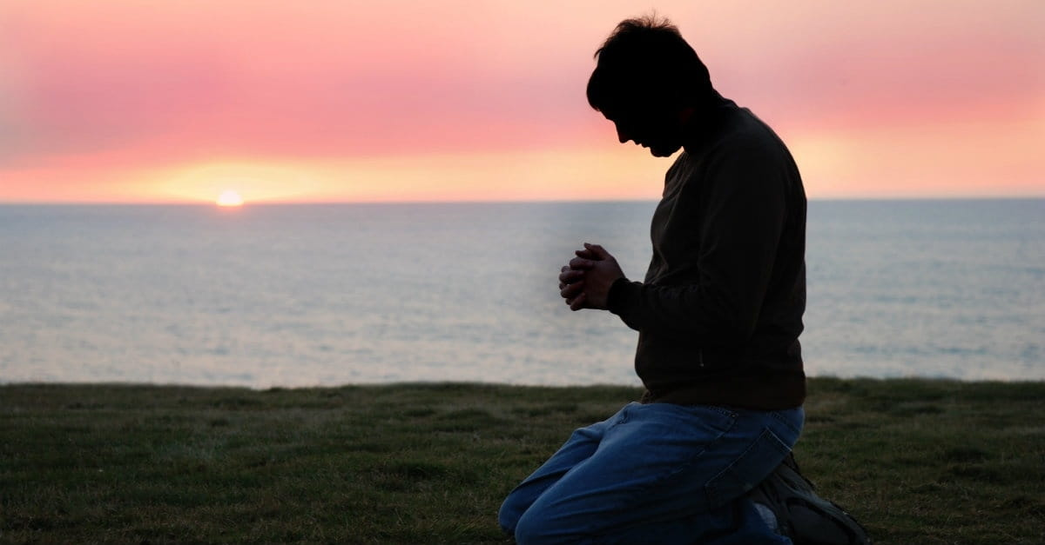
Every Knee Shall Bow
by Pastor Fee Soliven
Philippians 2:5-11
Wednesday Evening
May 9, 2021

Slide 4
Philippians 2:5-11
5 Let this mind be in you which was also in Christ Jesus, 6 who, being in the form of God, did not consider it robbery to be equal with God, 7 but made Himself of no reputation, taking the form of a bondservant, and coming in the likeness of men. 8 And being found in appearance as a man, He humbled Himself and became obedient to the point of death, even the death of the cross.

Slide 5
9 Therefore God also has highly exalted Him and given Him the name which is above every name, 10 that at the name of Jesus every knee should bow, of those in heaven, and of those on earth, and of those under the earth, 11 and that every tongue should confess that Jesus Christ is Lord, to the glory of God the Father.

Slide 6
5 Let this mind be in you which was also in Christ Jesus,

Slide 7
1 John 2:3-6
3 Now by this we know that we know Him, if we keep His commandments. 4 He who says, "I know Him," and does not keep His commandments, is a liar, and the truth is not in him. 5 But whoever keeps His word, truly the love of God is perfected in him. By this we know that we are in Him. 6 He who says he abides in Him ought himself also to walk just as He walked.

Slide 8
1 Thessalonians 4:1-8
1 Finally then, brethren, we urge and exhort in the Lord Jesus that you should abound more and more, just as you received from us how you ought to walk and to please God; 2 for you know what commandments we gave you through the Lord Jesus.

Slide 9
3 For this is the will of God, your sanctification: that you should abstain from sexual immorality; 4 that each of you should know how to possess his own vessel in sanctification and honor, 5 not in passion of lust, like the Gentiles who do not know God;

Slide 10
6 that no one should take advantage of and defraud his brother in this matter, because the Lord is the avenger of all such, as we also forewarned you and testified. 7 For God did not call us to uncleanness, but in holiness. 8 Therefore he who rejects this does not reject man, but God, who has also given us His Holy Spirit.

Slide 11
6 who, being in the form of God, did not consider it robbery to be equal with God,

Slide 12
Isaiah 9:6
“For unto us a Child is born, Unto us a Son is given; And the government will be upon His shoulder. And His name will be called Wonderful, Counselor, Mighty God, Everlasting Father, Prince of Peace”

Slide 13
7 but made Himself of no reputation, taking the form of a bondservant, and coming in the likeness of men.

Slide 14
Isaiah 53:2
“For He shall grow up before Him as a tender plant, And as a root out of dry ground. He has no form or comeliness; And when we see Him, There is no beauty that we should desire Him”

Slide 15
Mark 10:45
“For even the Son of Man did not come to be served, but to serve, and to give His life a ransom for many."

Slide 16
1 John 3:16
“By this we know love, because He laid down His life for us. And we also ought to lay down our lives for the brethren”

Slide 17
8 And being found in appearance as a man, He humbled Himself and became obedient to the point of death, even the death of the cross.

Slide 18
2 Corinthians 5:21
“He made Him who knew no sin to be sin on our behalf, so that we might become the righteousness of God in Him”

Slide 19
But why did Jesus have to become human and have to die?

Slide 20
Why blood?

Slide 21
Romans 8:3
“For what the law could not do in that it was weak through the flesh, God did by sending His own Son in the likeness of sinful flesh, on account of sin: He condemned sin in the flesh”

Slide 22
9 Therefore God also has highly exalted Him and given Him the name which is above every name,

Slide 23
Acts 2:33
“Therefore being exalted to the right hand of God, and having received from the Father the promise of the Holy Spirit, He poured out this which you now see and hear”

Slide 24
Ephesians 1:20-23
“20 which He worked in Christ when He raised Him from the dead and seated Him at His right hand in the heavenly places, 21 far above all principality and power and might and dominion, and every name that is named, not only in this age but also in that which is to come.

Slide 25
22 And He put all things under His feet, and gave Him to be head over all things to the church, 23 which is His body, the fullness of Him who fills all in all”

Slide 26
Hebrews 1:3-4
3 who being the brightness of His glory and the express image of His person, and upholding all things by the word of His power, when He had by Himself purged our sins, sat down at the right hand of the Majesty on high, 4 having become so much better than the angels, as He has by inheritance obtained a more excellent name than they.

Slide 27
John 5:27
“and has given Him authority to execute judgment also, because He is the Son of Man”

Slide 28
Matthew 28:18
And Jesus came and spoke to them, saying, "All authority has been given to Me in heaven and on earth.”

Slide 29
Romans 14:9
“For to this end Christ died and rose and lived again, that He might be Lord of both the dead and the living”

Slide 30
10 that at the name of Jesus every knee should bow, of those in heaven, and of those on earth, and of those under the earth,

Slide 31
Ephesians 4:9-10
9(Now this, "He ascended"--what does it mean but that He also first descended into the lower parts of the earth? 10 He who descended is also the One who ascended far above all the heavens, that He might fill all things.)

Slide 32
Revelation 5:13
And every creature which is in heaven and on the earth and under the earth and such as are in the sea, and all that are in them, I heard saying: "Blessing and honor and glory and power Be to Him who sits on the throne, And to the Lamb, forever and ever!"

Slide 33
Revelation 19:20-21
20 Then the beast was captured, and with him the false prophet who worked signs in his presence, by which he deceived those who received the mark of the beast and those who worshiped his image. These two were cast alive into the lake of fire burning with brimstone. 21 And the rest were killed with the sword which proceeded from the mouth of Him who sat on the horse. And all the birds were filled with their flesh.

Slide 34
Revelation 20:1-3
1 Then I saw an angel coming down from heaven, having the key to the bottomless pit and a great chain in his hand. 2 He laid hold of the dragon, that serpent of old, who is the Devil and Satan, and bound him for a thousand years; 3 and he cast him into the bottomless pit, and shut him up, and set a seal on him, so that he should deceive the nations no more till the thousand years were finished. But after these things he must be released for a little while.

Slide 35
Isaiah 45:23
I have sworn by Myself; The word has gone out of My mouth in righteousness, And shall not return, That to Me every knee shall bow, Every tongue shall take an oath

Slide 36
Romans 14:11
For it is written: "As I live, says the LORD, Every knee shall bow to Me, And every tongue shall confess to God."

Slide 37
John 5:21-23
21 For as the Father raises the dead and gives life to them, even so the Son gives life to whom He will. 22 For the Father judges no one, but has committed all judgment to the Son, 23 that all should honor the Son just as they honor the Father. He who does not honor the Son does not honor the Father who sent Him.

Slide 38
11 and that every tongue should confess that Jesus Christ is Lord, to the glory of God the Father.

Slide 39
1 Thessalonians 4:13-18
13 But I do not want you to be ignorant, brethren, concerning those who have fallen asleep, lest you sorrow as others who have no hope. 14 For if we believe that Jesus died and rose again, even so God will bring with Him those who sleep in Jesus.

Slide 40
15 For this we say to you by the word of the Lord, that we who are alive and remain until the coming of the Lord will by no means precede those who are asleep. 16 For the Lord Himself will descend from heaven with a shout, with the voice of an archangel, and with the trumpet of God. And the dead in Christ will rise first.

Slide 41
17 Then we who are alive and remain shall be caught up together with them in the clouds to meet the Lord in the air. And thus we shall always be with the Lord. 18 Therefore comfort one another with these words.

Slide 42
1 Corinthians 15:50-54
50 Now this I say, brethren, that flesh and blood cannot inherit the kingdom of God; nor does corruption inherit incorruption. 51 Behold, I tell you a mystery: We shall not all sleep, but we shall all be changed-- 52 in a moment, in the twinkling of an eye, at the last trumpet. For the trumpet will sound, and the dead will be raised incorruptible, and we shall be changed.

Slide 43
53 For this corruptible must put on incorruption, and this mortal must put on immortality. 54 So when this corruptible has put on incorruption, and this mortal has put on immortality, then shall be brought to pass the saying that is written: "Death is swallowed up in victory."

Slide 44
20 Again, when a righteous man turns from his righteousness and commits iniquity, and I lay a stumbling block before him, he shall die; because you did not give him warning, he shall die in his sin, and his righteousness which he has done shall not be remembered; but his blood I will require at your hand.

Slide 45
Acts 2:38-39
38 Then Peter said to them, "Repent, and let every one of you be baptized in the name of Jesus Christ for the remission of sins; and you shall receive the gift of the Holy Spirit. 39 For the promise is to you and to your children, and to all who are afar off, as many as the Lord our God will call."

