Slide 2
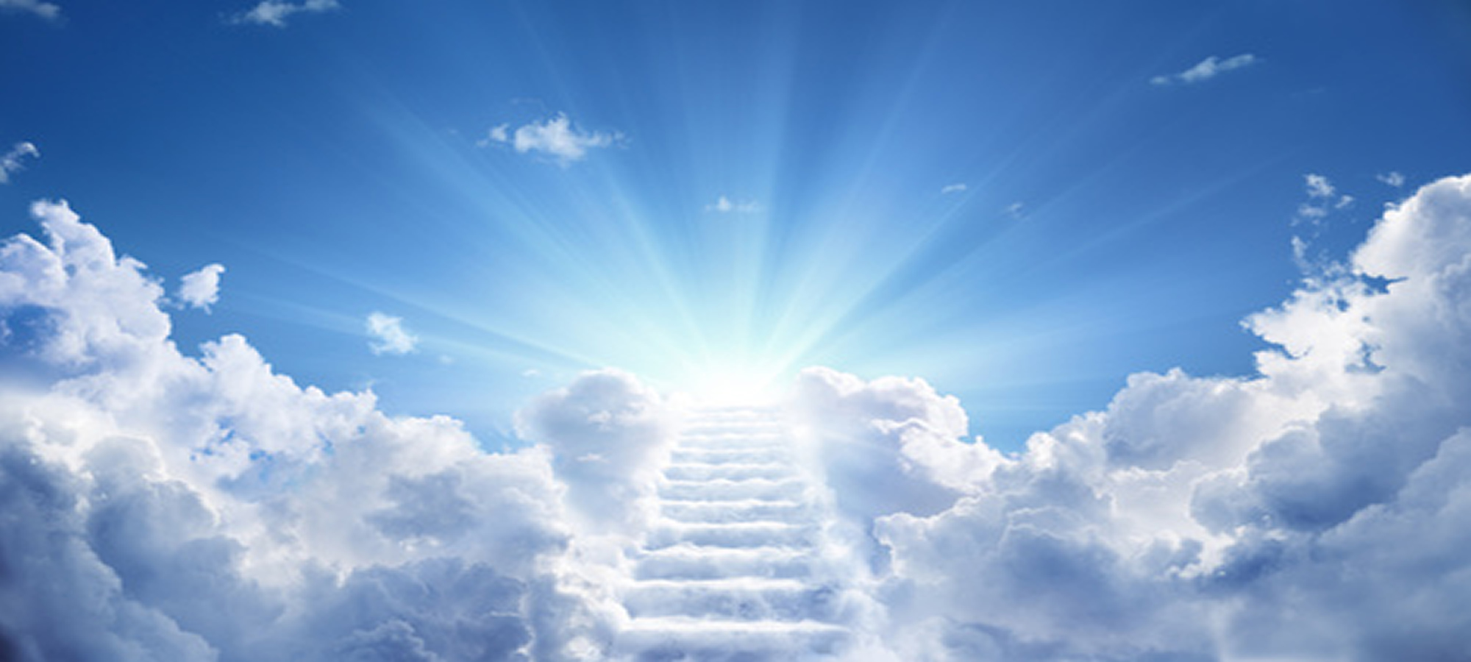
Set Your Mind on Things Above
by Pastor Fee Soliven
Colossians 3:1-8
Wednesday Evening
May 12, 2021

Slide 3
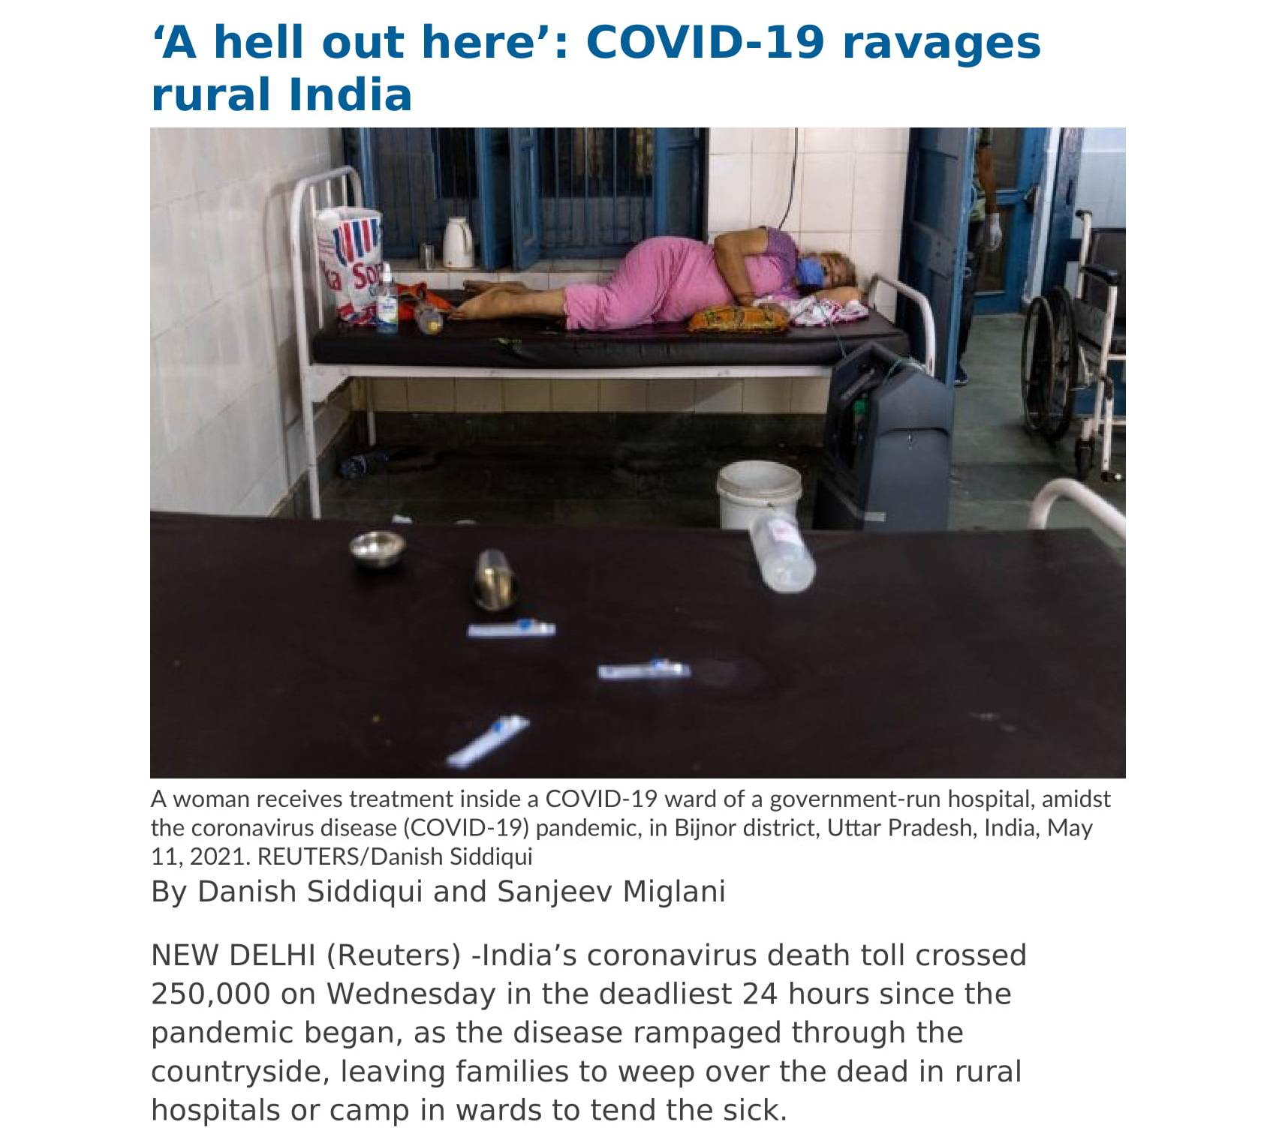

Slide 5
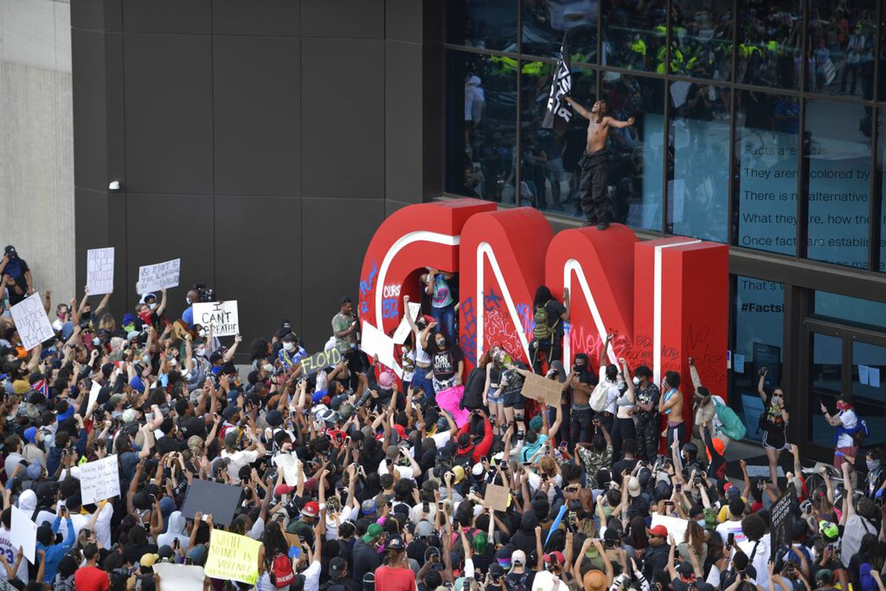
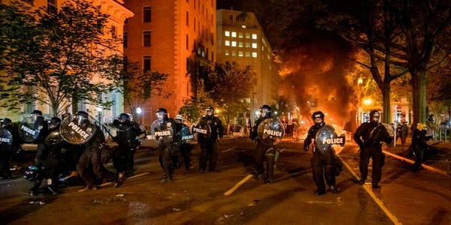
Riots in the Streets of America

Slide 6
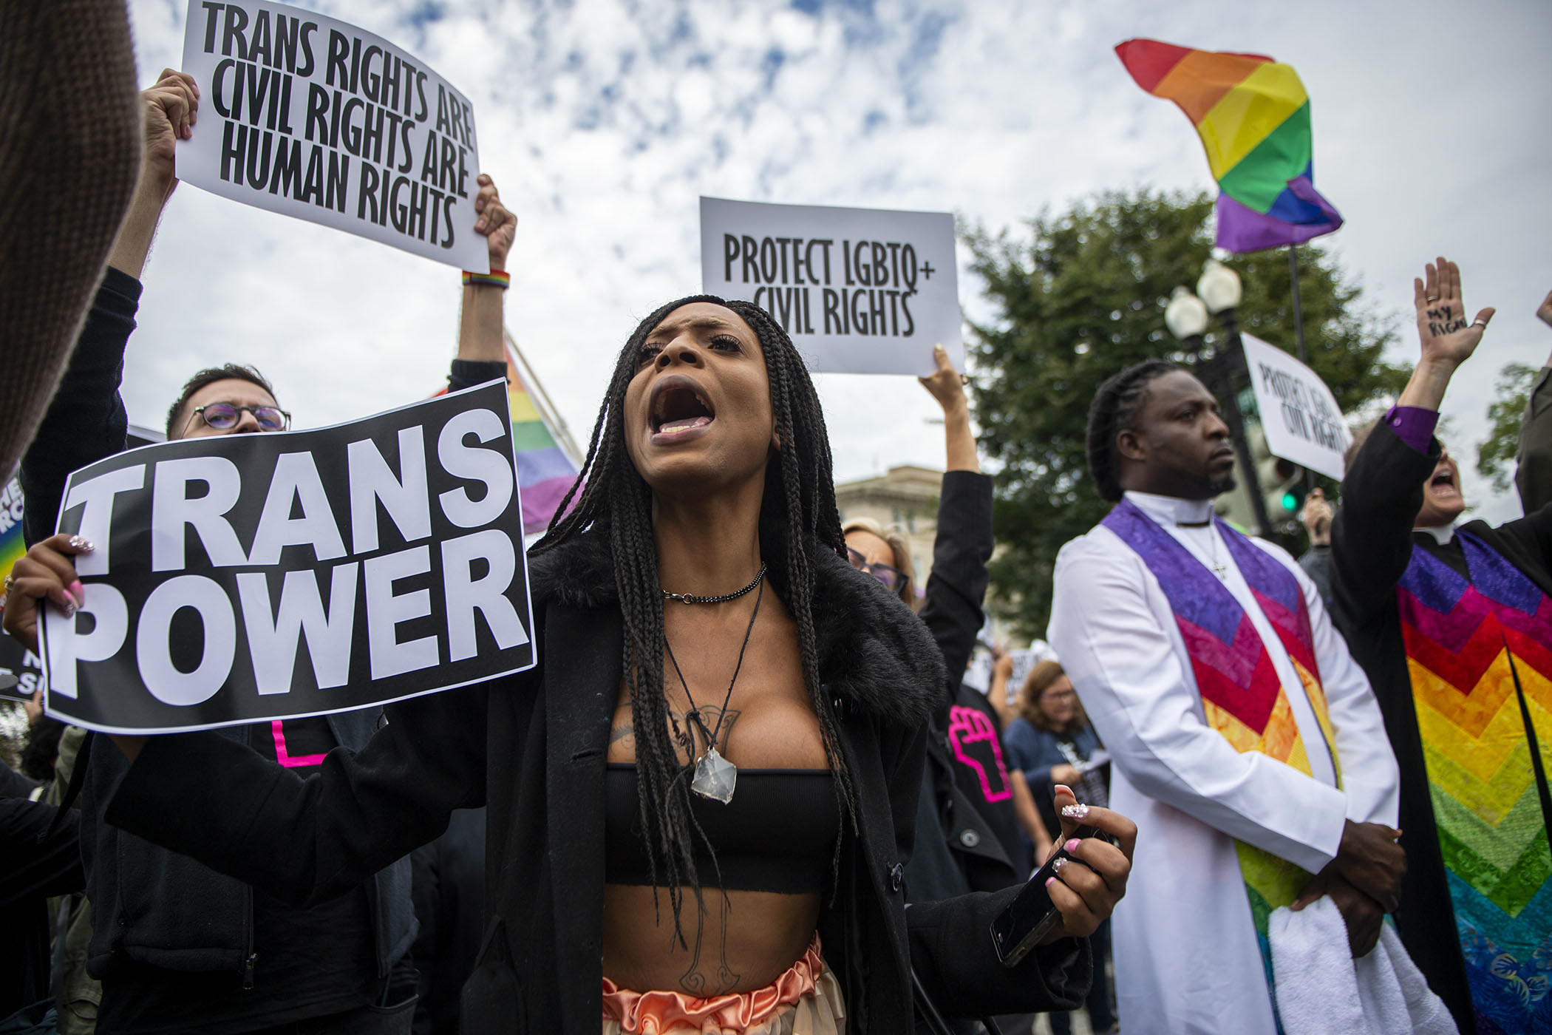
The Transgender & Homosexual
Transformation of America

Slide 7
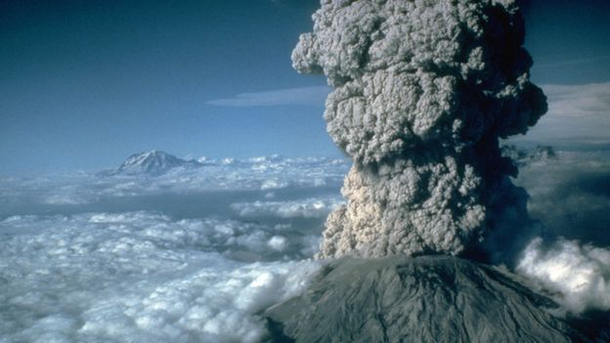
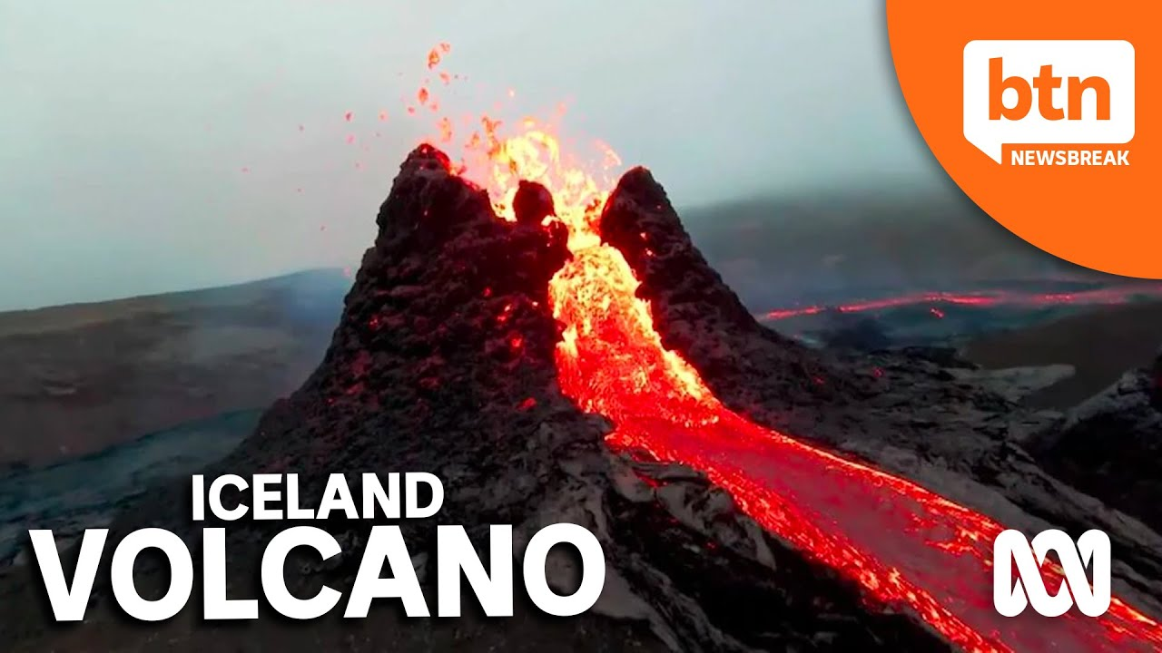
Volcanos Erupting Worldwide
Like Never Before

Slide 8
Colossians 3:1-11
1 If then you were raised with Christ, seek those things which are above, where Christ is, sitting at the right hand of God. 2 Set your mind on things above, not on things on the earth. 3 For you died, and your life is hidden with Christ in God. 4 When Christ who is our life appears, then you also will appear with Him in glory.

Slide 9
5 Therefore put to death your members which are on the earth: fornication, uncleanness, passion, evil desire, and covetousness, which is idolatry. 6 Because of these things the wrath of God is coming upon the sons of disobedience, 7 in which you yourselves once walked when you lived in them. 8 But now you yourselves are to put off all these: anger, wrath, malice, blasphemy, filthy language out of your mouth.

Slide 10
1 If then you were raised with Christ, seek those things which are above, where Christ is, sitting at the right hand of God.

Slide 11
John 3:3-7
3 Jesus answered and said to him, "Most assuredly, I say to you, unless one is born again, he cannot see the kingdom of God." 4 Nicodemus said to Him, "How can a man be born when he is old? Can he enter a second time into his mother's womb and be born?"

Slide 12
5 Jesus answered, "Most assuredly, I say to you, unless one is born of water and the Spirit, he cannot enter the kingdom of God. 6 That which is born of the flesh is flesh, and that which is born of the Spirit is spirit. 7 Do not marvel that I said to you, 'You must be born again.'

Slide 13
2 Set your mind on things above, not on things on the earth.

Slide 14
Philippians 4:8-9
8 Finally, brethren, whatever things are true, whatever things are noble, whatever things are just, whatever things are pure, whatever things are lovely, whatever things are of good report, if there is any virtue and if there is anything praiseworthy--meditate on these things. 9 The things which you learned and received and heard and saw in me, these do, and the God of peace will be with you.

Slide 15
Colossians 3:12-13
12 Therefore, as the elect of God, holy and beloved, put on tender mercies, kindness, humility, meekness, longsuffering; 13 bearing with one another, and forgiving one another, if anyone has a complaint against another; even as Christ forgave you, so you also must do.

Slide 16
3 For you died, and your life is hidden with Christ in God. 4 When Christ who is our life appears, then you also will appear with Him in glory.

Slide 17
1 John 3:2-3
2 Beloved, now we are children of God; and it has not yet been revealed what we shall be, but we know that when He is revealed, we shall be like Him, for we shall see Him as He is. 3 And everyone who has this hope in Him purifies himself, just as He is pure.

Slide 18
1 John 3:2-3
2 Beloved, now we are children of God; and it has not yet been revealed what we shall be, but we know that when He is revealed, we shall be like Him, for we shall see Him as He is. 3 And everyone who has this hope in Him purifies himself, just as He is pure.

Slide 19
Revelation 21:1-8
1 Now I saw a new heaven and a new earth, for the first heaven and the first earth had passed away. Also there was no more sea. 2 Then I, John, saw the holy city, New Jerusalem, coming down out of heaven from God, prepared as a bride adorned for her husband.

Slide 20
3 And I heard a loud voice from heaven saying, "Behold, the tabernacle of God is with men, and He will dwell with them, and they shall be His people. God Himself will be with them and be their God. 4 And God will wipe away every tear from their eyes; there shall be no more death, nor sorrow, nor crying. There shall be no more pain, for the former things have passed away."

Slide 21
5 Then He who sat on the throne said, "Behold, I make all things new." And He said to me, "Write, for these words are true and faithful." 6 And He said to me, "It is done! I am the Alpha and the Omega, the Beginning and the End. I will give of the fountain of the water of life freely to him who thirsts.

Slide 22
7 He who overcomes shall inherit all things, and I will be his God and he shall be My son. 8 But the cowardly, unbelieving, abominable, murderers, sexually immoral, sorcerers, idolaters, and all liars shall have their part in the lake which burns with fire and brimstone, which is the second death."

Slide 23
5 Therefore put to death your members which are on the earth: fornication, uncleanness, passion, evil desire, and covetousness, which is idolatry.

Slide 24
1 John 3:2-3
2 Beloved, now we are children of God; and it has not yet been revealed what we shall be, but we know that when He is revealed, we shall be like Him, for we shall see Him as He is. 3 And everyone who has this hope in Him purifies himself, just as He is pure.

Slide 25
1. Sexual Sin
Any form of illicit sexual relationship. The term serves to spotlight forbidden sexual behavior between people or indirect participation as an audience. We derive our term “pornography” from this Greek word. In contrast to the loose morals of the ancient Greek world, believers ought to show self-discipline and obedience to God in this area.

Slide 26
2. Impurity
Moral uncleanness. Perhaps no sexual act has taken place, but the person exhibits a crudeness or insensitivity in sexual matters.

Slide 27
3. Lust
Evil sexual passion that leads to excessive sexual immorality and perversion

Slide 28
Romans 1:26-27
26 For this reason God gave them up to vile passions. For even their women exchanged the natural use for what is against nature. 27 Likewise also the men, leaving the natural use of the woman, burned in their lust for one another, men with men committing what is shameful, and receiving in themselves the penalty of their error which was due.

Slide 29
4. Shameful Desires
Wanting something that is sinister and vile in order to satisfy one’s desires

Slide 30
Galatians 5:16
“I say then: Walk in the Spirit, and you shall not fulfill the lust of the flesh”

Slide 31
5. Greed for the good things of this life, for that is Idolatry
Relentless urge to get more for oneself. In this context, Paul may have been focusing on greed for satisfying evil desires and for sexual immorality. The greed is described as idolatry because its focus is on filling desires rather than on God.

Slide 32
6 Because of these things the wrath of God is coming upon the sons of disobedience,

Slide 33
7 in which you yourselves once walked when you lived in them. 8 But now you yourselves are to put off all these: anger, wrath, malice, blasphemy, filthy language out of your mouth.

Slide 34
1. Anger
A continuous attitude of hatred that remains bottled up within. This could refer to what is under the surface, while “rage” (below) refers to what bursts out. Anger would destroy the harmony and unity Paul called for among the believers.

Slide 35
2. Rage
Outbursts of anger or quick temper for selfish reasons. This could mean continual and uncontrolled behavior.

Slide 36
3. Malicious Behavior
Doing evil despite the good that has been received. This word is a general term referring to an evil force that destroys relationships. It can mean anything from trouble to wickedness. It is a deliberate attempt to harm another person.

Slide 37
4. Slander
Destroying another person’s good reputation by lies, gossip, spreading rumors, etc. Malice often manifests itself through slander.

Slide 38
5. Dirty Language
Crude talk, abrasive language, expletives. Paul admonished the believers that such language must be caught and stopped before it escapes their mouths.

Slide 39
1 Thessalonians 4:13-18
13 But I do not want you to be ignorant, brethren, concerning those who have fallen asleep, lest you sorrow as others who have no hope. 14 For if we believe that Jesus died and rose again, even so God will bring with Him those who sleep in Jesus.

Slide 40
15 For this we say to you by the word of the Lord, that we who are alive and remain until the coming of the Lord will by no means precede those who are asleep. 16 For the Lord Himself will descend from heaven with a shout, with the voice of an archangel, and with the trumpet of God. And the dead in Christ will rise first.

Slide 41
17 Then we who are alive and remain shall be caught up together with them in the clouds to meet the Lord in the air. And thus we shall always be with the Lord. 18 Therefore comfort one another with these words.

Slide 42
1 Corinthians 15:50-54
50 Now this I say, brethren, that flesh and blood cannot inherit the kingdom of God; nor does corruption inherit incorruption. 51 Behold, I tell you a mystery: We shall not all sleep, but we shall all be changed-- 52 in a moment, in the twinkling of an eye, at the last trumpet. For the trumpet will sound, and the dead will be raised incorruptible, and we shall be changed.

Slide 43
53 For this corruptible must put on incorruption, and this mortal must put on immortality. 54 So when this corruptible has put on incorruption, and this mortal has put on immortality, then shall be brought to pass the saying that is written: "Death is swallowed up in victory."

Slide 44
20 Again, when a righteous man turns from his righteousness and commits iniquity, and I lay a stumbling block before him, he shall die; because you did not give him warning, he shall die in his sin, and his righteousness which he has done shall not be remembered; but his blood I will require at your hand.

Slide 45
Acts 2:38-39
38 Then Peter said to them, "Repent, and let every one of you be baptized in the name of Jesus Christ for the remission of sins; and you shall receive the gift of the Holy Spirit. 39 For the promise is to you and to your children, and to all who are afar off, as many as the Lord our God will call."

