Slide 1
Ephesians 6:18-24
18 praying always with all prayer and supplication in the Spirit, being watchful to this end with all perseverance and supplication for all the saints-- 19 and for me, that utterance may be given to me, that I may open my mouth boldly to make known the mystery of the gospel, 20 for which I am an ambassador in chains; that in it I may speak boldly, as I ought to speak.

Slide 2
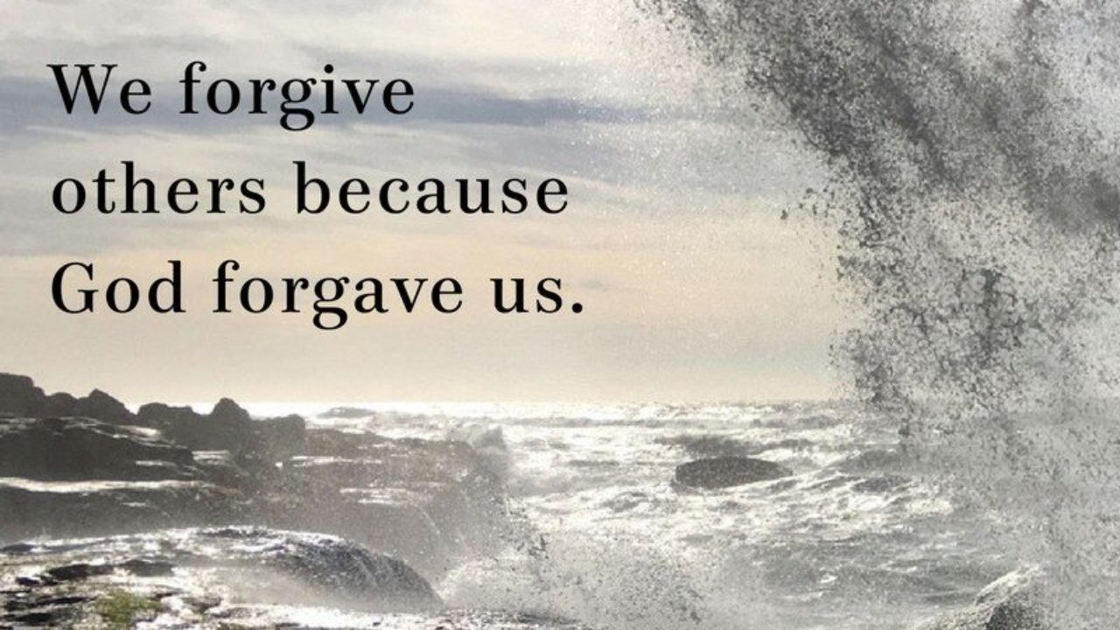
Thank God Has Forgiven Us
by Pastor Fee Soliven
Matthew 18:10-16
Wednesday Evening
May 26, 2021

Slide 3
Matthew 18:10-16
10 "Take heed that you do not despise one of these little ones, for I say to you that in heaven their angels always see the face of My Father who is in heaven. 11 For the Son of Man has come to save that which was lost.

Slide 4
12 What do you think? If a man has a hundred sheep, and one of them goes astray, does he not leave the ninety-nine and go to the mountains to seek the one that is straying? 13 And if he should find it, assuredly, I say to you, he rejoices more over that sheep than over the ninety-nine that did not go astray. 14 Even so it is not the will of your Father who is in heaven that one of these little ones should perish.

Slide 5
15 "Moreover if your brother sins against you, go and tell him his fault between you and him alone. If he hears you, you have gained your brother. 16 But if he will not hear, take with you one or two more, that 'by the mouth of two or three witnesses every word may be established.'

Slide 6
10 "Take heed that you do not despise one of these little ones, for I say to you that in heaven their angels always see the face of My Father who is in heaven. 11 For the Son of Man has come to save that which was lost.

Slide 7
Luke 18:9-14
9 Also He spoke this parable to some who trusted in themselves that they were righteous, and despised others: 10 Two men went up to the temple to pray, one a Pharisee and the other a tax collector. 11 The Pharisee stood and prayed thus with himself, 'God, I thank You that I am not like other men--extortioners, unjust, adulterers, or even as this tax collector. 12 I fast twice a week; I give tithes of all that I possess.'

Slide 8
13 And the tax collector, standing afar off, would not so much as raise his eyes to heaven, but beat his breast, saying, 'God, be merciful to me a sinner!' 14 I tell you, this man went down to his house justified rather than the other; for everyone who exalts himself will be humbled, and he who humbles himself will be exalted."

Slide 9
Hebrews 1:14
“Are they not all ministering spirits sent forth to minister for those who will inherit salvation?”

Slide 10
Psalm 91:9-11
9 Because you have made the LORD, who is my refuge, Even the Most High, your dwelling place, 10 No evil shall befall you, Nor shall any plague come near your dwelling; 11 For He shall give His angels charge over you, To keep you in all your ways…

Slide 11
Daniel 10:10-14
10 Suddenly, a hand touched me, which made me tremble on my knees and on the palms of my hands. 11 And he said to me, "O Daniel, man greatly beloved, understand the words that I speak to you, and stand upright, for I have now been sent to you." While he was speaking this word to me, I stood trembling.

Slide 12
12 Then he said to me, "Do not fear, Daniel, for from the first day that you set your heart to understand, and to humble yourself before your God, your words were heard; and I have come because of your words.

Slide 13
13 But the prince of the kingdom of Persia withstood me twenty-one days; and behold, Michael, one of the chief princes, came to help me, for I had been left alone there with the kings of Persia. 14 Now I have come to make you understand what will happen to your people in the latter days, for the vision refers to many days yet to come."

Slide 14
12 What do you think? If a man has a hundred sheep, and one of them goes astray, does he not leave the ninety-nine and go to the mountains to seek the one that is straying?

Slide 15
Psalm 119:169-176
169 Let my cry come before You, O LORD; Give me understanding according to Your word. 170 Let my supplication come before You; Deliver me according to Your word. 171 My lips shall utter praise, For You teach me Your statutes. 172 My tongue shall speak of Your word, For all Your commandments are righteousness.

Slide 16
173 Let Your hand become my help, For I have chosen Your precepts. 174 I long for Your salvation, O LORD, And Your law is my delight. 175 Let my soul live, and it shall praise You; And let Your judgments help me. 176 I have gone astray like a lost sheep; Seek Your servant, For I do not forget Your commandments.

Slide 17
13 And if he should find it, assuredly, I say to you, he rejoices more over that sheep than over the ninety-nine that did not go astray. 14 Even so it is not the will of your Father who is in heaven that one of these little ones should perish.

Slide 18
Prodigal: Webster’s Dictionary Definition
1. wastefully or recklessly extravagant: prodigal expenditure.

Slide 19
2. giving or yielding profusely; lavish (usually followed by of or with): prodigal of smiles; prodigal with money.

Slide 20
3. lavishly abundant; profuse: nature's prodigal resources.

Slide 21
4. a person who spends, or has spent, his or her money or substance with wasteful extravagance; spendthrift.

Slide 22
Luke 15:11-32
11 Then He said: "A certain man had two sons. 12 And the younger of them said to his father, 'Father, give me the portion of goods that falls to me.' So he divided to them his livelihood. 13 And not many days after, the younger son gathered all together, journeyed to a far country, and there wasted his possessions with prodigal living.

Slide 23
14 But when he had spent all, there arose a severe famine in that land, and he began to be in want. 15 Then he went and joined himself to a citizen of that country, and he sent him into his fields to feed swine. 16 And he would gladly have filled his stomach with the pods that the swine ate, and no one gave him anything.

Slide 24
17 But when he came to himself, he said, 'How many of my father's hired servants have bread enough and to spare, and I perish with hunger! 18 I will arise and go to my father, and will say to him, "Father, I have sinned against heaven and before you,

Slide 25
19 and I am no longer worthy to be called your son. Make me like one of your hired servants." ' 20 And he arose and came to his father. But when he was still a great way off, his father saw him and had compassion, and ran and fell on his neck and kissed him. 21 And the son said to him, 'Father, I have sinned against heaven and in your sight, and am no longer worthy to be called your son.'

Slide 26
22 But the father said to his servants, 'Bring out the best robe and put it on him, and put a ring on his hand and sandals on his feet. 23 And bring the fatted calf here and kill it, and let us eat and be merry; 24 for this my son was dead and is alive again; he was lost and is found.' And they began to be merry. 25 Now his older son was in the field. And as he came and drew near to the house, he heard music and dancing.

Slide 27
26 So he called one of the servants and asked what these things meant. 27 And he said to him, 'Your brother has come, and because he has received him safe and sound, your father has killed the fatted calf.' 28 But he was angry and would not go in. Therefore his father came out and pleaded with him.

Slide 28
29 So he answered and said to his father, 'Lo, these many years I have been serving you; I never transgressed your commandment at any time; and yet you never gave me a young goat, that I might make merry with my friends.

Slide 29
30 But as soon as this son of yours came, who has devoured your livelihood with harlots, you killed the fatted calf for him.' 31 And he said to him, 'Son, you are always with me, and all that I have is yours. 32 It was right that we should make merry and be glad, for your brother was dead and is alive again, and was lost and is found.' "

Slide 30
2 Peter 3:9
“The Lord is not slack concerning His promise, as some count slackness, but is longsuffering toward us, not willing that any should perish but that all should come to repentance.”

Slide 31
Matthew 22:36-40
36 “Teacher, which is the great commandment in the law?” 37 Jesus said to him, “‘You shall love the Lord your God with all your heart, with all your soul, and with all your mind.’ 38 This is the first and great commandment. 39 And the second is like it: ‘You shall love your neighbor as yourself.’ 40 On these two commandments hang all the Law and the Prophets.”

Slide 32
Galatians 6:1-4
1 Brethren, if a man is overtaken in any trespass, you who are spiritual restore such a one in a spirit of gentleness, considering yourself lest you also be tempted. 2 Bear one another's burdens, and so fulfill the law of Christ.

Slide 33
3 For if anyone thinks himself to be something, when he is nothing, he deceives himself. 4 But let each one examine his own work, and then he will have rejoicing in himself alone, and not in another.

Slide 34
1 Thessalonians 4:13-18
13 But I do not want you to be ignorant, brethren, concerning those who have fallen asleep, lest you sorrow as others who have no hope. 14 For if we believe that Jesus died and rose again, even so God will bring with Him those who sleep in Jesus.

Slide 35
15 For this we say to you by the word of the Lord, that we who are alive and remain until the coming of the Lord will by no means precede those who are asleep. 16 For the Lord Himself will descend from heaven with a shout, with the voice of an archangel, and with the trumpet of God. And the dead in Christ will rise first.

Slide 36
17 Then we who are alive and remain shall be caught up together with them in the clouds to meet the Lord in the air. And thus we shall always be with the Lord. 18 Therefore comfort one another with these words.

Slide 37
1 Corinthians 15:50-54
50 Now this I say, brethren, that flesh and blood cannot inherit the kingdom of God; nor does corruption inherit incorruption. 51 Behold, I tell you a mystery: We shall not all sleep, but we shall all be changed-- 52 in a moment, in the twinkling of an eye, at the last trumpet. For the trumpet will sound, and the dead will be raised incorruptible, and we shall be changed.

Slide 38
53 For this corruptible must put on incorruption, and this mortal must put on immortality. 54 So when this corruptible has put on incorruption, and this mortal has put on immortality, then shall be brought to pass the saying that is written: "Death is swallowed up in victory."

Slide 39
20 Again, when a righteous man turns from his righteousness and commits iniquity, and I lay a stumbling block before him, he shall die; because you did not give him warning, he shall die in his sin, and his righteousness which he has done shall not be remembered; but his blood I will require at your hand.

Slide 40
Acts 2:38-39
38 Then Peter said to them, "Repent, and let every one of you be baptized in the name of Jesus Christ for the remission of sins; and you shall receive the gift of the Holy Spirit. 39 For the promise is to you and to your children, and to all who are afar off, as many as the Lord our God will call."

