Slide 1


Slide 2
“Awake My Soul”
(Hillsong Auf Deutsch)

Slide 3
There is a sound. I love to hear. It’s the sound of the Saviors robe. As you walk into the room where

Slide 4
Pray. Where we hear praises he hears faith. There is a sound I love to hear. It’s the sound of the Saviors

Slide 5
Robe as he walks into the room. Where people pray. Where we hear worship he hears Faith.

Slide 6
Awake my soul and sing. Sing His Praise Aloud. Sing his Praise Aloud. Awake my soul and sing. Sing his

Slide 7
Praise Aloud. Sing his praise Aloud. There is a sound that changes things. The sound of His people on

Slide 8
Their knees. It’s time to worship Him. Awake my soul and Sing. Sing his Praise Aloud. Sing his Praise

Slide 9
Aloud. Awake My soul and Sing. Sing his praise Aloud. Sing his Praise Aloud.

Slide 10
And when he moves. And when we Pray. Where stood a wall now stands a way. Where every promise

Slide 11
Is Amen. And when he moves. Make no mistake. The bowels of hell begin to shake. All hail the Lord. All

Slide 12
Hail the King. Oh oh oh oh. Oh let the King of Glory enter in. Oh oh oh oh. Fall down on your knees and

Slide 13
Worship Him. Oh Oh oh oh. Let his praise rise up don’t hold it in. Awake my soul and sing. Sing his

Slide 14
Praise Aloud. Sing his Praise Aloud. Awake my soul and sing. Sing his praise Aloud. Sing his Praise

Slide 15
Aloud.

Slide 16
“ Raise A Hallelujah”

Slide 17
I raise a hallelujah, In the presence of my enemies. I raise a hallelujah, louder than the unbelief. I raise a

Slide 18
Hallelujah, my weapon is a melody. I raise a hallelujah, heaven comes to fight for me.

Slide 19
I’m gonna sing in the middle of the storm. Louder and louder, you’re gonna hear my praises roar.

Slide 20
Up from the ashes, hope will arise. Death is defeated the king is alive. I raise a hallelujah, with

Slide 21
Everything inside of me. I raise a hallelujah, I will watch the darkness flee. I raise a hallelujah, In the

Slide 22
middle of the mystery. I raise a hallelujah, fear you lost your hold on me. I’m gonna sing in the middle

Slide 23
storm. Louder and louder. You’re gonna hear my praises roar. Up from the ashes. Hope will arise

Slide 24
death is defeated the king is alive. Sing a little louder(in the presence of my enemies. Sing a little

Slide 25
louder. (louder than the unbelief). Sing a little louder(my weapon is a melody. Sing a little louder.

Slide 26
(heaven comes to fight for me) Sing a little louder(in the presence of my enemies). Sing a little louder

Slide 27
(louder than the unbelief) Sing a little louder(my weapon is a melody).Sing a little louder( Heaven

Slide 28
comes o fight for me. Sing a little louder. Cause im gonna sing . In the middle of this storm louder and

Slide 29
louder your gonna hear my praises roar. Up from the ashes. Hope will arise. Death is defeated. The

Slide 30
king is alive. Cause im gonna sing . In the middle of this storm louder and louder. You’re gonna hear my

Slide 31
praises roar. Up from the ashes hope will arise. Death is defeated , The king is alive.

Slide 32
“Good Good Father”
Chris Tomlin

Slide 33
I’ve heard a thousand stories of what they think your like but I’ve heard the tender whispers of love in the

Slide 34
dead of night. You tell me that you are pleased and that I’m never alone. You’re a good good Father. It’s

Slide 35
who you are. It’s who you are, and I’m loved by you. It’s who I am. It’s who I am. It’s who I am. I’ve seen

Slide 36
many searching for answers far and wide. But I know were all searching for answers only you

Slide 37
Provide. Because you know just what we need before we say a word. You’re a good good father

Slide 38
It’s who you are. It’s who you are. It’s who you are and I’m loved by you. It’s who I am. It’s who I am. It’s

Slide 39
who I am. You’re a good good Father. It’s who you are. It’s who you are. It’s who you are and I’m loved

Slide 40
by you. It’s who I am. It’s who I am. It’s who I am.. You are perfect in all of your ways. You are perfect in

Slide 41
all of your ways. You are perfect in all of your ways to us. Lord you are. You are perfect in all of your

Slide 42
ways. You are perfect in all of your ways. You are perfect in all of your ways to us. You’re a good

Slide 43
good father. It’s who you are. It’s who you are. It’s who you are and I’m loved by you. It’s who I am, It’s

Slide 44
Who I am. It’s who I am. It’s who I am. Love so undeniable I can hardly speak. Peace so

Slide 45
unexplainable I can hardly think. As you call me deeper still. As you call me deeper still. As you call

Slide 46
Me deeper still into love love love. You’re a good good Father. It’s who you are. It’s who you are. It’s

Slide 47
who you are and I’m loved by you. It’s who I am. It’s who I am. It’s who I am. You’re a good good father

Slide 48
It’s who you are. It’s who you ar. It’s who you are and I’m loved by you. Its who I am. It’s who I am. It’s

Slide 49
Who I am.

Slide 50
You are here moving in our midst. I worship you, I worship You. You are here working in this place.

Slide 51
I worship you. I worship you. (You are) Way Maker, Miracle worker, Promise keeper, light in the darkness

Slide 52
My God, that is who you are. You are here, Touching every heart. I worship you, I worship you. You are

Slide 53
Here healing every life. I worship you. I worship you.
You are here, turning lives around. I worship you.

Slide 54
I worship you. You are here mending every heart. I worship you. I worship you. You are way maker,

Slide 55
Miracle worker, Promise keeper, light in the darkness my God that is who you are. You are way

Slide 56
maker, Miracle worker promise keeper, light in the darkness. My God that is who you are.

Slide 57
Even when I don’t see it your working. Even when I don’t feel it your working. You never stop. Never

Slide 58
Stop working. You never stop never stop working. Even When I don’t see it your working. Even when

Slide 59
I don’t feel it your working. You never stop. Never stop working. You never stop never stop working.

Slide 60
You are waymaker , Miracle Worker, Promise keeper, light in the darkness. My God that is who you

Slide 61
are. You are Waymaker, Miracle Worker, Promise keeper. Light in the darkness. My God that is who

Slide 62
you are. That is who you are.

Slide 63
“Forever Reign”
Hillsong United

Slide 64
You are good. You are good. When there’s nothing good in me. You ar love. You are love. On display

Slide 65
You are good. You are good. When there’s nothing good in me. You are love. You are love. On display

Slide 66
For all to see. You are light. You are light when the darkness closes in. You are hope, You are hope. You

Slide 67
have covered all my sin. You are peace. You ae peace when my fear is crippling. You are true. You

Slide 68
are true. Even in my wondering. You are joy. You are Joy you’re the reason that I sin. You are life, You are

Slide 69
life. In you death has lost it’s sting. Oh I’m running to your arms. I’m running to your arms. The riches of

Slide 70
your love will always be enough. Nothing compares to your embrace. Light of the world. Forever Reign.

Slide 71
You are more. You are more. Than my words ould ever say. You are Lord. You are Lord. All creation will

Slide 72
Proclaim. You are here. You are here. In your presence im made whole. You are God. You are God

Slide 73
Of all else I’m letting go . Oh I’m running to your arms. I’m running to your arms. The

Slide 74
riches of your love. Will always be enough. Nothing compares to your embrace. Light of the world.

Slide 75
Forever Reign. My heart will sing. No other name. Jesus, Jesus. My heart will sing no other name

Slide 76
Jesus , Jesus. My heart will sing. No other name Jesus, Jesus. My heart will sing no other name.

Slide 77
Jesus, Jesus. Oh I’m running to your arms. I’m running to your arms. The riches of your love. Will

Slide 78
Always be enough nothing compares to your embrace. Light of the world forever reign

Slide 80
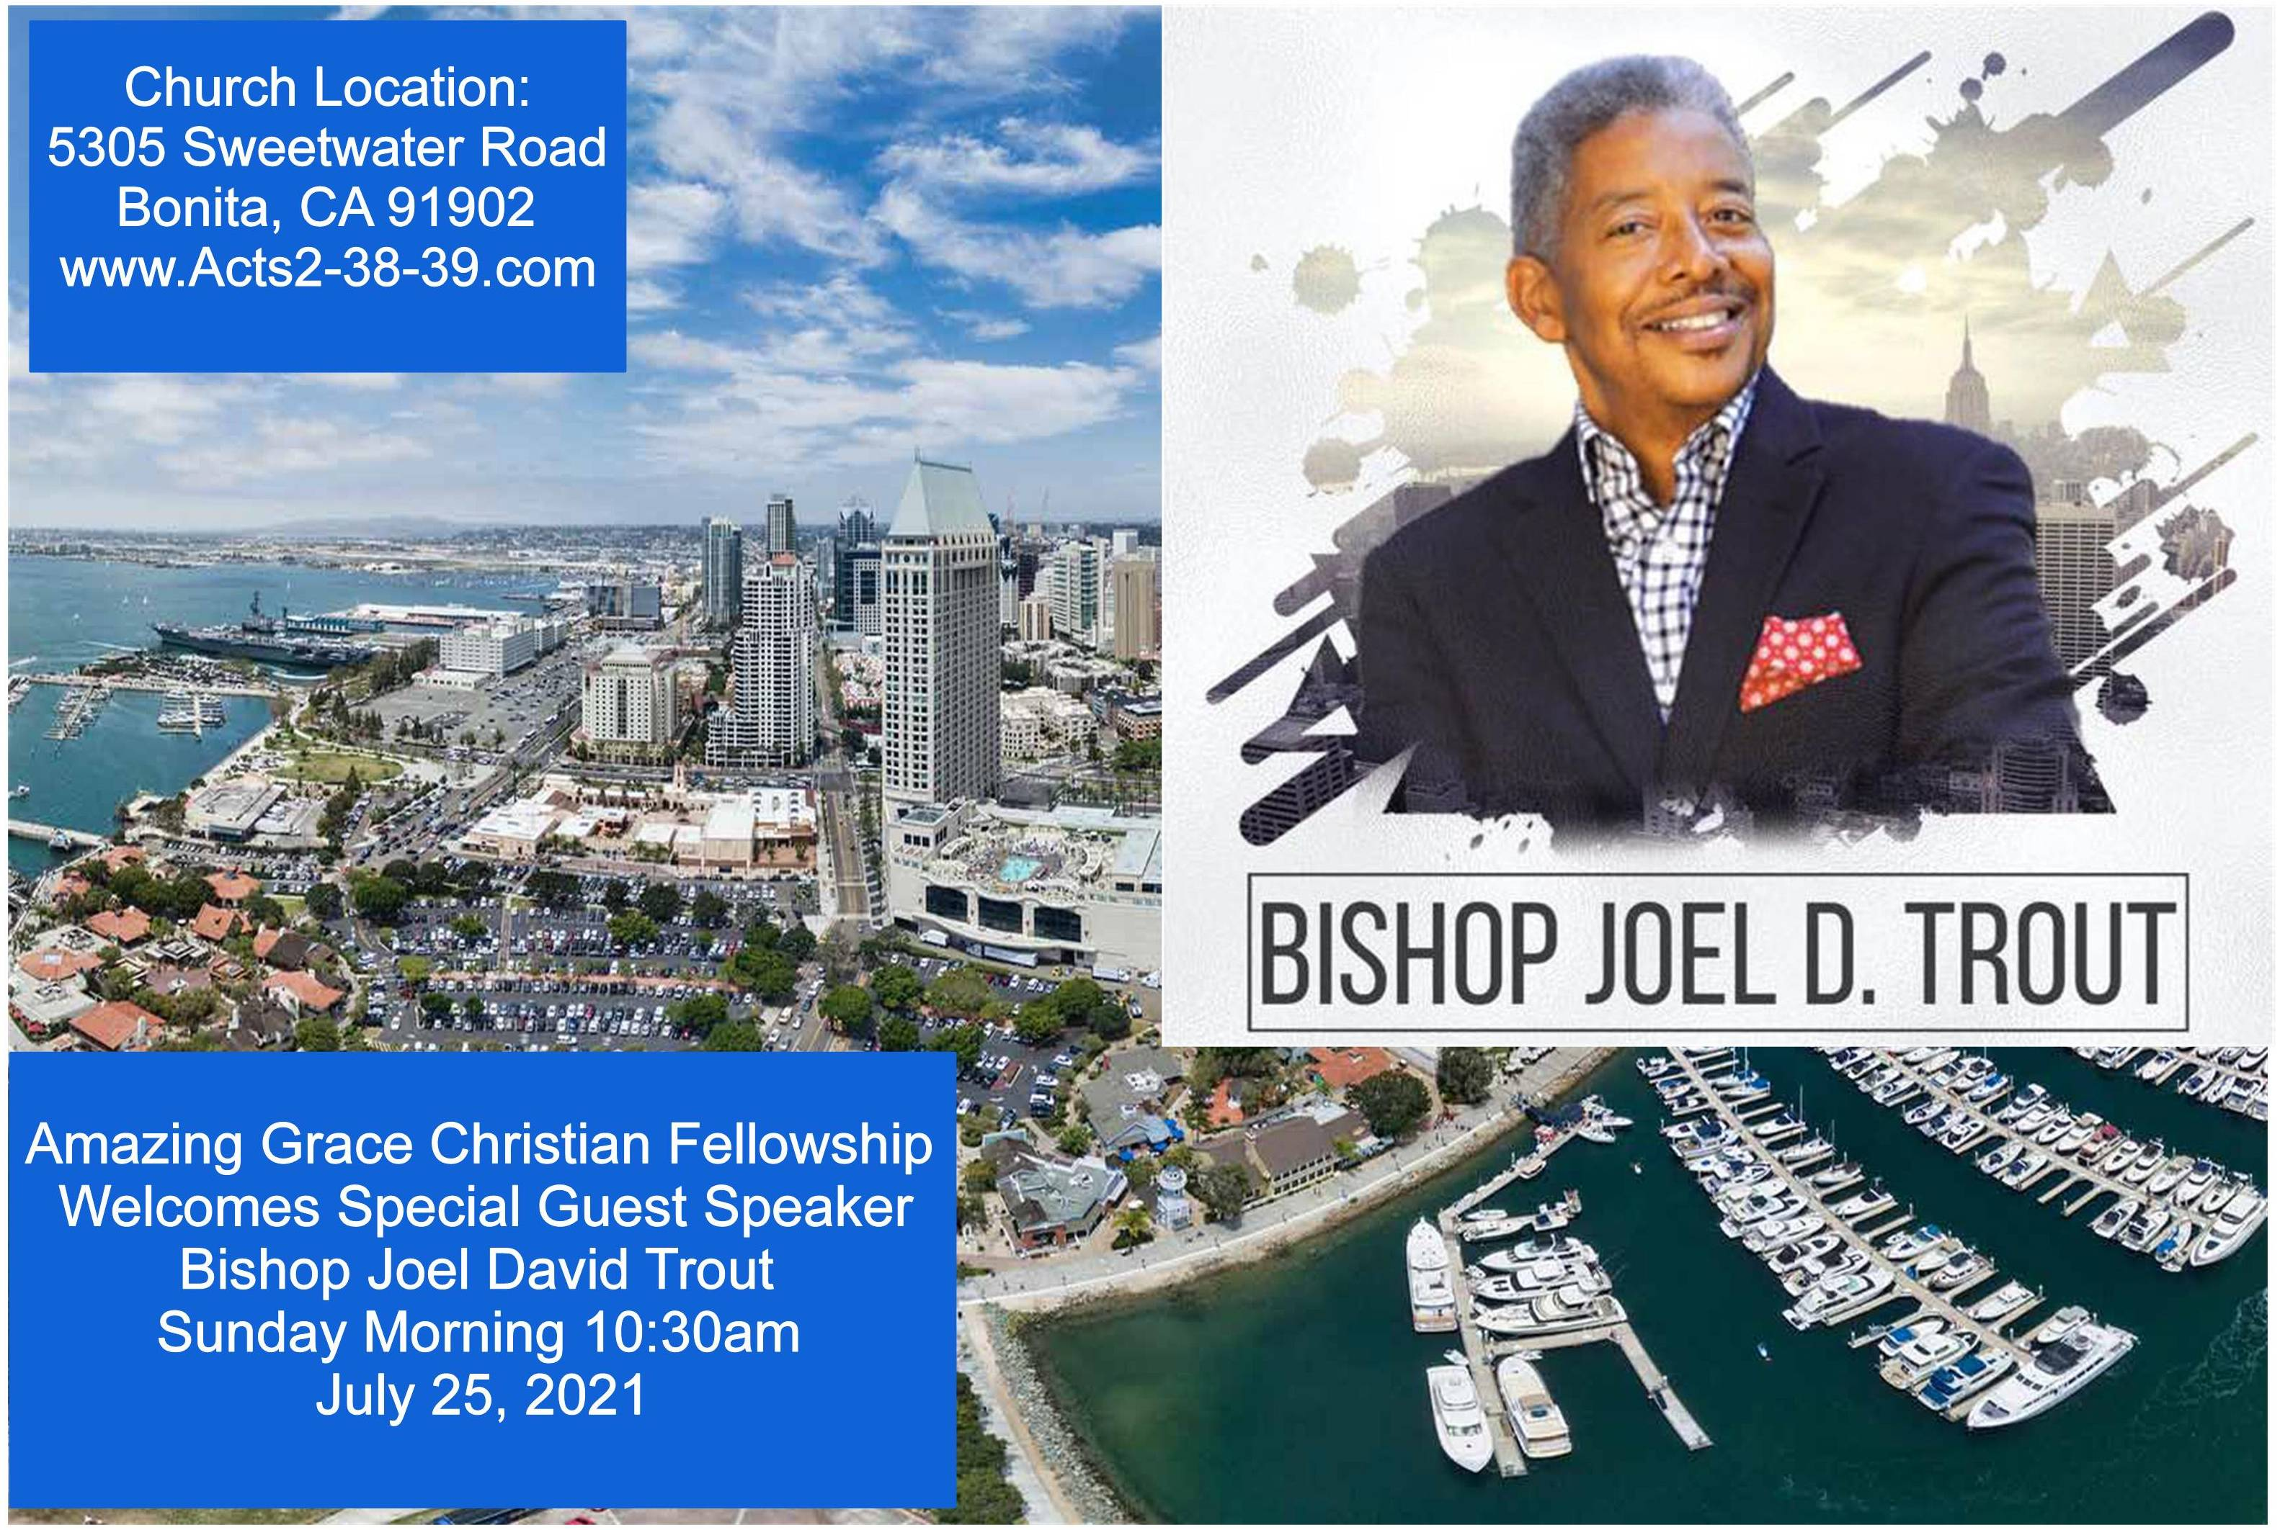

Slide 81
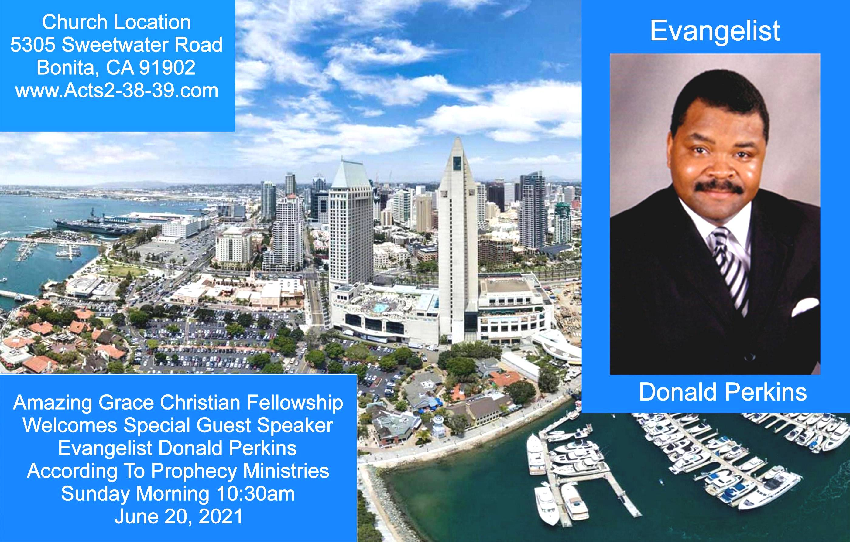

Exodus 23:14-16
14 "Three times you shall keep a feast to Me in the year: 15 You shall keep the Feast of Unleavened Bread (you shall eat unleavened bread seven days, as I commanded you, at the time appointed in the month of Abib, for in it you came out of Egypt; none shall appear before Me empty);

Slide 82


Slide 83


It is Time to Wake Up Church
by Pastor Fee Soliven
Psalm 11:1-3
Sunday Morning
July 4, 2021

Slide 84
Psalm 11:1-3
1 In the LORD I put my trust; How can you say to my soul, "Flee as a bird to your mountain"? 2 For look! The wicked bend their bow, They make ready their arrow on the string, That they may shoot secretly at the upright in heart. 3 If the foundations are destroyed, What can the righteous do?

Slide 85
What is Our Foundation?

Slide 86
Ephesians 2:19-22
19 Now, therefore, you are no longer strangers and foreigners, but fellow citizens with the saints and members of the household of God, 20 having been built on the foundation of the apostles and prophets, Jesus Christ Himself being the chief cornerstone,

Slide 87
21 in whom the whole building, being joined together, grows into a holy temple in the Lord, 22 in whom you also are being built together for a dwelling place of God in the Spirit.

Slide 88
God’s Word is a stabilizer in our lives

Slide 89
King David was familiar with difficult situations, and through them all, he learned to trust the Lord

Slide 90
1 Samuel 17:40-47
40 Then he took his staff in his hand; and he chose for himself five smooth stones from the brook, and put them in a shepherd's bag, in a pouch which he had, and his sling was in his hand. And he drew near to the Philistine.

Slide 91
41 So the Philistine came, and began drawing near to David, and the man who bore the shield went before him. 42 And when the Philistine looked about and saw David, he disdained him; for he was only a youth, ruddy and good-looking. 43 So the Philistine said to David, "Am I a dog, that you come to me with sticks?" And the Philistine cursed David by his gods.

Slide 92
44 And the Philistine said to David, "Come to me, and I will give your flesh to the birds of the air and the beasts of the field!" 45 Then David said to the Philistine, "You come to me with a sword, with a spear, and with a javelin. But I come to you in the name of the LORD of hosts, the God of the armies of Israel, whom you have defied.

Slide 93
46 This day the LORD will deliver you into my hand, and I will strike you and take your head from you. And this day I will give the carcasses of the camp of the Philistines to the birds of the air and the wild beasts of the earth, that all the earth may know that there is a God in Israel.

Slide 94
47 Then all this assembly shall know that the LORD does not save with sword and spear; for the battle is the LORD's, and He will give you into our hands."

Slide 95
“If the foundations are destroyed, what can the righteous do?”

Slide 96
John 16:32-33
32 Indeed the hour is coming, yes, has now come, that you will be scattered, each to his own, and will leave Me alone. And yet I am not alone, because the Father is with Me. 33 These things I have spoken to you, that in Me you may have peace. In the world you will have tribulation; but be of good cheer, I have overcome the world."

Slide 97
How should we respond if the foundations are destroyed?

Slide 98
1. Turn to God

Slide 99
“In the LORD I put my trust”

Slide 100
2. Don’t Run

Slide 101
“How can you say to my soul, ‘Flee as a bird to your mountain’?”

Slide 102
Matthew 11:28-30
28 Come to Me, all you who labor and are heavy laden, and I will give you rest. 29 Take My yoke upon you and learn from Me, for I am gentle and lowly in heart, and you will find rest for your souls. 30 For My yoke is easy and My burden is light."

Slide 103
How does God respond when we turn to Him?

Slide 104
1. The Lord places us under His Divine Protection

Slide 105
2 Corinthians 5:8
We are confident, yes, well pleased rather to be absent from the body and to be present with the Lord.

Slide 106
2. God is Available

Slide 107
Psalm 11:4
“The Lord is in His holy temple; the Lord’s throne is in heaven”

Slide 108
Acts 3:19-21
19 Repent therefore and be converted, that your sins may be blotted out, so that times of refreshing may come from the presence of the Lord, 20 and that He may send Jesus Christ, who was preached to you before, 21 whom heaven must receive until the times of restoration of all things, which God has spoken by the mouth of all His holy prophets since the world began.

Slide 109
3. God Sees

Slide 110
Psalm 11:4
“The LORD is in His holy temple, The LORD's throne is in heaven; His eyes behold, His eyelids test the sons of men”

Slide 111
What attitude should God’s people have?

Slide 112
1. We must Trust the Lord

Slide 113
Proverbs 3:5-6
5 Trust in the LORD with all your heart, And lean not on your own understanding; 6 In all your ways acknowledge Him, And He shall direct your paths.

Slide 114
2. We must ask God for Cleansing

Slide 115
Ephesians 5:26-27
26 that He might sanctify and cleanse her with the washing of water by the word, 27 that He might present her to Himself a glorious church, not having spot or wrinkle or any such thing, but that she should be holy and without blemish.

Slide 116
3. We must be willing to
Encourage Others

Slide 117
1 Thessalonians 5:9-11
9 For God did not appoint us to wrath, but to obtain salvation through our Lord Jesus Christ, 10 who died for us, that whether we wake or sleep, we should live together with Him. 11 Therefore comfort each other and edify one another, just as you also are doing.

Slide 118
4. We must Pray for Revival

Slide 119
Psalm 143:11-12
11 Revive me, O LORD, for Your name's sake! For Your righteousness' sake bring my soul out of trouble. 12 In Your mercy cut off my enemies, And destroy all those who afflict my soul; For I am Your servant.

Slide 120
Jesus is Coming Back Real Soon

Slide 121
Luke 17:28-33
28 Likewise as it was also in the days of Lot: They ate, they drank, they bought, they sold, they planted, they built; 29 but on the day that Lot went out of Sodom it rained fire and brimstone from heaven and destroyed them all. 30 Even so will it be in the day when the Son of Man is revealed.

Slide 122
31 In that day, he who is on the housetop, and his goods are in the house, let him not come down to take them away. And likewise the one who is in the field, let him not turn back. 32 Remember Lot's wife. 33 Whoever seeks to save his life will lose it, and whoever loses his life will preserve it.

Slide 123
1. When the foundations begin to crumble, whether personally or nationally, do you turn to God and His Word?

Slide 124
2. What effect would it have on your emotions, thoughts, and reactions if this became your first choice?

Slide 125
3. As our society abandons its former foundation, will you commit to interceding for our nation and asking God to revive His church?

Slide 126
1 Thessalonians 4:13-18
13 But I do not want you to be ignorant, brethren, concerning those who have fallen asleep, lest you sorrow as others who have no hope. 14 For if we believe that Jesus died and rose again, even so God will bring with Him those who sleep in Jesus.

Slide 127
15 For this we say to you by the word of the Lord, that we who are alive and remain until the coming of the Lord will by no means precede those who are asleep. 16 For the Lord Himself will descend from heaven with a shout, with the voice of an archangel, and with the trumpet of God. And the dead in Christ will rise first.

Slide 128
17 Then we who are alive and remain shall be caught up together with them in the clouds to meet the Lord in the air. And thus we shall always be with the Lord. 18 Therefore comfort one another with these words.

Slide 129
1 Corinthians 15:50-54
50 Now this I say, brethren, that flesh and blood cannot inherit the kingdom of God; nor does corruption inherit incorruption. 51 Behold, I tell you a mystery: We shall not all sleep, but we shall all be changed-- 52 in a moment, in the twinkling of an eye, at the last trumpet. For the trumpet will sound, and the dead will be raised incorruptible, and we shall be changed.

Slide 130
53 For this corruptible must put on incorruption, and this mortal must put on immortality. 54 So when this corruptible has put on incorruption, and this mortal has put on immortality, then shall be brought to pass the saying that is written: "Death is swallowed up in victory."

Slide 131

20 Again, when a righteous man turns from his righteousness and commits iniquity, and I lay a stumbling block before him, he shall die; because you did not give him warning, he shall die in his sin, and his righteousness which he has done shall not be remembered; but his blood I will require at your hand.

Slide 132
Acts 2:38-39
38 Then Peter said to them, "Repent, and let every one of you be baptized in the name of Jesus Christ for the remission of sins; and you shall receive the gift of the Holy Spirit. 39 For the promise is to you and to your children, and to all who are afar off, as many as the Lord our God will call."

