Slide 1


Slide 2
“Lion and the Lamb”
(Bethel)

Slide 3
He’s coming on the clouds. Kings and Kingdoms will bow down. And every chain will break. As broken

Slide 4
Hearts declare his praise. For who can stop the Lord all mighty. And Our God is the lion. The Lion of Judah

Slide 5
He’s roaring with power.. And fightingour battles.. And every knee will bow before him. Our God is

Slide 6
The Lamb. The Lamb that was slain. For the sins of the world. His blood breaks the chains. And every

Slide 7
Knee will bow before the Lion and the Lamb. Yes Every knee will bow before him. So open up the

Slide 8
Gates. Make way before the King of Kings. The God who comes to save. Is here to set the captives free.

Slide 9
For who can stop the Lord Almighty. Our God is the Lion the Lion of Judah. He’s roaring with power and

Slide 10
Fighting our battles. And every knee will bow before him. Our god is the Lamb. The Lamb that was slain.

Slide 11
For the sin of the world. His blood breaks the chains. And every knee will bow before the Lion and the

Slide 12
Lamb. Every knee will bow before him. For who can stop the Lord Almighty Who can stop the Lord

Slide 13
Almighty. Who can stop the Lord Almighty. No one. Who can stop. Sing it over the battle. Who can

Slide 14
Stop the Lord Almighty. There is no one. Who can stop the Lord Almighty. Who Can Stop the Lord (yeah

Slide 15
And our God is the Lion. The Lion of Judah. He’s roaring with power. And fighting our battles. And

Slide 16
Every knee will bow before him. Our god is the Lamb. The Lamb that was slain. For the sins of the

Slide 17
World. His blood breaks the chains. And every knee will bow before the Lion and the Lamb. Every knee

Slide 18
Will bow before him.

Slide 19
Every knee will bow before him. Our god is the Lamb. The Lamb that was slain. For the sins of the

Slide 20
“Our God”
(Chris Tomlin)

Slide 21
Water, You turned into wine. Opened the eyes of the blind. There’s no one like you. None like you.

Slide 22
Into the darkness you shine. Out of the ashes we rise. There’s no one like you. None like you.

Slide 23
Our God is greater. Our God is stronger. God you are higher than any other . Our God is healer. Awesome

Slide 24
In power our God. Our God. Into the Darkness , you shine. Out of the ashes, we rise. There’s no one like

Slide 25
You none like you. Our God is Greater. Our God is stronger. God, you are higher than any other. Our

Slide 26
God Is healer. Awesome in Power. Our God, our God. Our God is greater. Our God is stronger.

Slide 27
God, You are higher than any other. Our God is healer. Awesome in Power. Our God, Our God.

Slide 28
Our God is greater. Our God is stronger. God, you are higher than any other. Our God is healer.

Slide 29
Awesome in Power. Our God, Our God. And if our God is for us. Then who could ever stop us?

Slide 30
And if our God is with us. Then what can stand against? And if our God is for us. Then who could

Slide 31
Ever stop us? And if our God is with us. Then what could stand against? Then what could stand against?

Slide 32
Our God is Greater. Our God is stronger. God you are higher then any other. Our God is healer.

Slide 33
Awesome in Power. Our God, Our God. Our god is greater Our God is greater. Our God is stronger.

Slide 34
God you are higher than any other. Our God is healer. Awesome in Power. Our God, Our God.

Slide 35
“ What a beautiful Name”

Slide 36
You were the word at the beginning. One with God the Lord most high. Your hidden glory in creation.

Slide 37
Now revealed in you are Christ. What a beautiful name it is. What a beautiful name it is. The name of

Slide 38
Jesus Christ my king. What a beautiful name it is. Nothing compares to this. What a beautiful name it

Slide 39
is the name of Jesus. You didn’t want heaven without us. So Jesus, You brought heaven down.

Slide 40
My sin was great your love was greater. What could separate us now? What a wonderful name it is

Slide 41
what a wonderful name it is. The name of Jesus Christ my King. What a wonderful name it is

Slide 42
Nothing compares to this. What a wonderful name it is. The name of Jesus. Death could not hold you.

Slide 43
The veil tore before you, you silenced the boast of sin and grave. The heavens are roaring the praise

Slide 44
of your glory. For you are raised to life again. You have no rival. You have no equal. Now and forever

Slide 45
god you reign. Yours is the kingdom. Yours is the glory. Yours is the name above all names. What a

Slide 46
powerful name it is. What a powerful name it is. The name of Jesus Christ my king. What a powerful

Slide 47
name it is nothing cn stand against. What a powerful name it is. The name of Jesus. What a powerful

Slide 48
name it is. The name of Jesus.

Slide 49
“Shout to the Lord”

Slide 50
My Jesus my Savior. Lord there is none like you. All of my days I want to praise the wonders of your

Slide 51
Mighty Love. My comfort, my shelter. Tower of refuge and strength. Let every breath, all that I am

Slide 52
never cease to worship you. Shout to Lord all the earth let us sing. Power and Majesty praise to the

Slide 53
King. Mountains bow down and the seas will roar at the sound of your name. I sing for joy at the work

Slide 54
of your hands. Forever I love you forever I’ll stand. Nothing compares to the promise I have in you

Slide 55
My Jesus , My Savior. Lord there is none like you. All of my days. I want to praise. The wonders of your

Slide 56
mighty love. My comfort, My shelter. Tower of refuge and strength. Let every breath, all that I am. Never

Slide 57
cease to worship you. Shout to the Lord all the earth let us sing. Power and Majesty praise to the King.

Slide 58
Mountains bow down and the seas will roar at the sound of your name. I sing for joy at the work of your

Slide 59
Hands. Forever I’ll love you forever I’ll stand. Nothing compares to the promise I have in you.

Slide 60
Oh nothing compares to the promise I have. Nothing compares to the promise I have in you.

Slide 61
“Great are you Lord”

Slide 62
You give life. You are love. You bring light darkness.
You give hope you restore every heart that is broken.

Slide 63
And great are you Lord. It’s your breath in our lungs. So we pour out our praise pour out our praise. It’s

Slide 64
Your breath in our lungs. So we pour out our praise to you only. You give life. You are love. You bring

Slide 65
Light to the darkness. You give hope you restore. Every heart that is broken. Great are you Lord.

Slide 66
It’s your breath in our lungs. So we pour out our praise. We pour out our praise. It’s your breath in our

Slide 67
Lungs so we pour out our praise to you only. It’s your breath in our lungs. So we pour out our praise to you

Slide 68
Only. And all the earth will shout your praise. Our hearts will cry these bones will sing. Great are

Slide 69
You Lord. And all the earth with shout your praise. Our hearts will cry these bones will sing. Great are

Slide 70
You Lord. And all the earth with shout your praise. Our hearts will cry these bones will sing. Great are

Slide 71
You Lord. Its your breath in our lungs so we pour out our praise. We pour out our praise. It’s your breath

Slide 72
In our lungs so we pour out our praise to you only .It’s your breath in our lungs so we pour out our

Slide 73
Praise to you only.

Slide 74
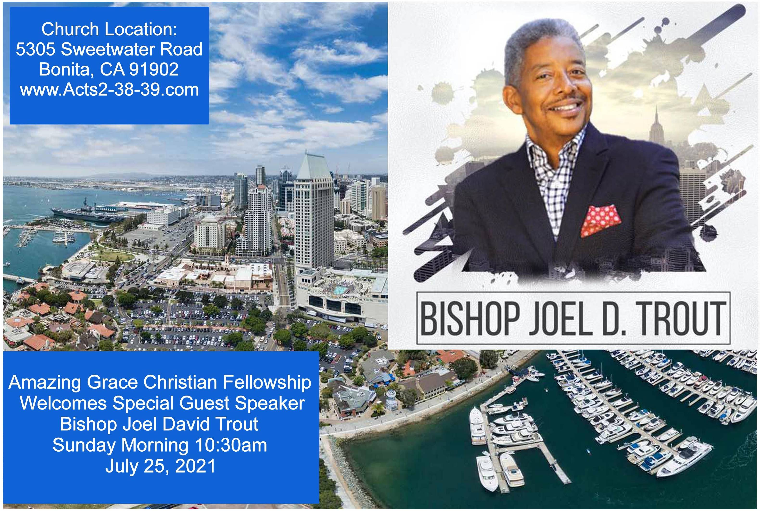

Slide 75


Slide 76


Jesus Lives Inside of Us
by Pastor Fee Soliven
Luke 24:44-49
Sunday Morning
July 18, 2021

Slide 77
Luke 24:44-49
44 Then He said to them, "These are the words which I spoke to you while I was still with you, that all things must be fulfilled which were written in the Law of Moses and the Prophets and the Psalms concerning Me." 45 And He opened their understanding, that they might comprehend the Scriptures.

Slide 78
46 Then He said to them, "Thus it is written, and thus it was necessary for the Christ to suffer and to rise from the dead the third day, 47 and that repentance and remission of sins should be preached in His name to all nations, beginning at Jerusalem. 48 And you are witnesses of these things. 49 Behold, I send the Promise of My Father upon you; but tarry in the city of Jerusalem until you are endued with power from on high."

Slide 79
Even as Christians, it’s possible for us to be unaware of one of God’s most awesome blessings!

Slide 80
Ezekiel 36:24-27
24 For I will take you from among the nations, gather you out of all countries, and bring you into your own land. 25 Then I will sprinkle clean water on you, and you shall be clean; I will cleanse you from all your filthiness and from all your idols.

Slide 81
26 I will give you a new heart and put a new spirit within you; I will take the heart of stone out of your flesh and give you a heart of flesh. 27 I will put My Spirit within you and cause you to walk in My statutes, and you will keep My judgments and do them.

Slide 82
Who is the Holy Spirit?

Slide 83
Romans 1:20
“For since the creation of the world His invisible attributes are clearly seen, being understood by the things that are made, even His eternal power and Godhead, so that they are without excuse…

Slide 84
John 14:16-18
16 And I will pray the Father, and He will give you another Helper, that He may abide with you forever-- 17 the Spirit of truth, whom the world cannot receive, because it neither sees Him nor knows Him; but you know Him, for He dwells with you and will be in you. 18 I will not leave you orphans; I will come to you.

Slide 85
Why did the Father send the Holy Spirit?

Slide 86
Matthew 4:16-17
16 The people who sat in darkness have seen a great light, And upon those who sat in the region and shadow of death Light has dawned." 17 From that time Jesus began to preach and to say, "Repent, for the kingdom of heaven is at hand."

Slide 87
Acts 2:1-6
1 Now when the Day of Pentecost had fully come, they were all with one accord in one place. 2 And suddenly there came a sound from heaven, as of a rushing mighty wind, and it filled the whole house where they were sitting. 3 Then there appeared to them divided tongues, as of fire, and one sat upon each of them.

Slide 88
4 And they were all filled with the Holy Spirit and began to speak with other tongues, as the Spirit gave them utterance. 5 And there were dwelling in Jerusalem Jews, devout men, from every nation under heaven. 6 And when this sound occurred, the multitude came together, and were confused, because everyone heard them speak in his own language.

Slide 89
Ecclesia the Birth of the Born-Again Church!

Slide 90
When does the Holy Spirit come?

Slide 91
Ephesians 1:13-14
13 In Him you also trusted, after you heard the word of truth, the gospel of your salvation; in whom also, having believed, you were sealed with the Holy Spirit of promise, 14 who is the guarantee of our inheritance until the redemption of the purchased possession, to the praise of His glory.

Slide 92
Galatians 5:22-23
22 But the fruit of the Spirit is love, joy, peace, longsuffering, kindness, goodness, faithfulness, 23 gentleness, self-control. Against such there is no law.

Slide 93
What does the Holy Spirit do?

Slide 94
1. He Convicts Us of Sin
John 16:8-9
8 And when He has come, He will convict the world of sin, and of righteousness, and of judgment: 9 of sin, because they do not believe in Me;

Slide 95
2. He Permanently Indwells Us
John 14:16-17
16 And I will pray the Father, and He will give you another Helper, that He may abide with you forever-- 17 the Spirit of truth, whom the world cannot receive, because it neither sees Him nor knows Him; but you know Him, for He dwells with you and will be in you.

Slide 96
3. He Seals Us
Ephesians 1:13
“In Him you also trusted, after you heard the word of truth, the gospel of your salvation; in whom also, having believed, you were sealed with the Holy Spirit of promise”

Slide 97
4. He Teaches Us
John 14:26
“But the Helper, the Holy Spirit, whom the Father will send in My name, He will teach you all things, and bring to your remembrance all things that I said to you”

Slide 98
5. He Guides Us into All Truth
John 16:13
“However, when He, the Spirit of truth, has come, He will guide you into all truth; for He will not speak on His own authority, but whatever He hears He will speak; and He will tell you things to come”

Slide 99
6. He Reminds Us
John 14:26
“But the Helper, the Holy Spirit, whom the Father will send in My name, He will teach you all things, and bring to your remembrance all things that I said to you”

Slide 100
7. He Bears Fruit Through Us
Galatians 5:22-23
22 But the fruit of the Spirit is love, joy, peace, longsuffering, kindness, goodness, faithfulness, 23 gentleness, self-control. Against such there is no law.

Slide 101
8. He Comforts Us
2 Corinthians 1:3-4
3 Blessed be the God and Father of our Lord Jesus Christ, the Father of mercies and God of all comfort, 4 who comforts us in all our tribulation, that we may be able to comfort those who are in any trouble, with the comfort with which we ourselves are comforted by God.

Slide 102
9. He Equips Us with Spiritual Gifts
1 Corinthians 12:4-11
4 There are diversities of gifts, but the same Spirit. 5 There are differences of ministries, but the same Lord. 6 And there are diversities of activities, but it is the same God who works all in all.

Slide 103
7 But the manifestation of the Spirit is given to each one for the profit of all: 8 for to one is given the word of wisdom through the Spirit, to another the word of knowledge through the same Spirit, 9 to another faith by the same Spirit, to another gifts of healings by the same Spirit,

Slide 104
10 to another the working of miracles, to another prophecy, to another discerning of spirits, to another different kinds of tongues, to another the interpretation of tongues. 11 But one and the same Spirit works all these things, distributing to each one individually as He wills.

Slide 105
10. He Fills Us
Ephesians 5:18
“And do not be drunk with wine, in which is dissipation; but be filled with the Spirit…”

Slide 106
11. He Empowers Us
Acts 1:8
“But you shall receive power when the Holy Spirit has come upon you; and you shall be witnesses to Me in Jerusalem, and in all Judea and Samaria, and to the end of the earth."

Slide 107
1 John 1:9-10
9 If we confess our sins, He is faithful and just to forgive us our sins and to cleanse us from all unrighteousness. 10 If we say that we have not sinned, we make Him a liar, and His word is not in us.

Slide 108
The Holy Spirit is our Source of Power

Slide 109
Luke 24:49
“Behold, I send the Promise of My Father upon you; but tarry in the city of Jerusalem until you are endued with power from on high."

Slide 110
1. We may get tired, but we won’t burn out.

Slide 111
2. We won’t get discouraged by obstacles, knowing the Holy Spirit within us will enable us to do whatever He’s called us to accomplish.

Slide 112
3. We’ll trust God rather than trying to manipulate our circumstances.

Slide 113
4. We may experience distress, but we won’t become desperate

Slide 114
What does it mean to be filled with the Spirit?

Slide 115
1. What role does the Holy Spirit play in your life?

Slide 116
2. Are you yielding to Him?

Slide 117
3. What do you think a fully surrendered life would require of you?

Slide 118
4. What would you have to relinquish or change?

Slide 119
5. Have you ever tried to live the Christian life in your own power?

Slide 120
6. What was the outcome?

Slide 121
7. As you examine your life, is the fruit of the Spirit displayed in all you do?

Slide 122
8. How can you remind yourself to respond to others based on the Spirit’s promptings, rather than your own emotions?

Slide 123
1 Thessalonians 4:13-18
13 But I do not want you to be ignorant, brethren, concerning those who have fallen asleep, lest you sorrow as others who have no hope. 14 For if we believe that Jesus died and rose again, even so God will bring with Him those who sleep in Jesus.

Slide 124
15 For this we say to you by the word of the Lord, that we who are alive and remain until the coming of the Lord will by no means precede those who are asleep. 16 For the Lord Himself will descend from heaven with a shout, with the voice of an archangel, and with the trumpet of God. And the dead in Christ will rise first.

Slide 125
17 Then we who are alive and remain shall be caught up together with them in the clouds to meet the Lord in the air. And thus we shall always be with the Lord. 18 Therefore comfort one another with these words.

Slide 126
1 Corinthians 15:50-54
50 Now this I say, brethren, that flesh and blood cannot inherit the kingdom of God; nor does corruption inherit incorruption. 51 Behold, I tell you a mystery: We shall not all sleep, but we shall all be changed-- 52 in a moment, in the twinkling of an eye, at the last trumpet. For the trumpet will sound, and the dead will be raised incorruptible, and we shall be changed.

Slide 127
53 For this corruptible must put on incorruption, and this mortal must put on immortality. 54 So when this corruptible has put on incorruption, and this mortal has put on immortality, then shall be brought to pass the saying that is written: "Death is swallowed up in victory."

Slide 128

20 Again, when a righteous man turns from his righteousness and commits iniquity, and I lay a stumbling block before him, he shall die; because you did not give him warning, he shall die in his sin, and his righteousness which he has done shall not be remembered; but his blood I will require at your hand.

Slide 129
Acts 2:38-39
38 Then Peter said to them, "Repent, and let every one of you be baptized in the name of Jesus Christ for the remission of sins; and you shall receive the gift of the Holy Spirit. 39 For the promise is to you and to your children, and to all who are afar off, as many as the Lord our God will call."

