Slide 2
“House of The Lord”
(Phil Wickham)

Slide 3
We worship the God who was. We worship the god who is. We worship the God who evermore will be.

Slide 4
He opened the prison doors. He parted the raging sea. My God he holds the Victory. There’s Joy in the

Slide 5
House of the lord. There’s Joy in the house of the Lord today. And we wont be quiet. We shout out your

Slide 6
Praise. There’s Joy in the house of the Lord. Our God is surely in this place. And we wont be quiet. We

Slide 7
Shout out your praise. Oh oh oh We shout out your praise. We sing to the God who heals. We sing to

Slide 8
The God who saves. We sing to the God who always makes a way. He hung upon that cross. Then He

Slide 9
Rose up from the grave. My god’s still rolling stones away. There’s Joy in the house of the Lord. There’s

Slide 10
Joy in the house of the Lord today. And we wont be quiet. We shout out your praise. There’s joy in the

Slide 11
House of the Lord. Our God is surely in this place. And we wont be quiet. We shout out your Praise.

Slide 12
We were the beggars. Now we’re royalty. We were the prisoners. Now we’re running free. We are

Slide 13
Forgiven, accepted. Redeemed by his grace. Let the house of the Lord sing praise . Cause we were the

Slide 14
Beggars . Now we’re royalty. We were the prisoners. Now we’re running free. We are forgiven, accepted

Slide 15
Redeemed by his grace. Let the house of the Lord sing praise. There’s joy in the house of the Lord.

Slide 16
There’s joy in the house of the Lord today. And we wont be quiet. We shout out your praise. There’s Joy

Slide 17
In the house of the Lord. Our God is surely in this place. And we wont be quiet. We shout out your

Slide 18
Praise . There’s joy in the house of the Lord. There’s joy in the house of the Lord today. And we wont be

Slide 19
Quiet. We shout out your praise. There’s joy in the house of the Lord . Our God is surely in this place.

Slide 20
And we won’t be quiet. We shout out your praise. We shout out your praise. There’s Joy in the house

Slide 21
There’s joy in the in the house today. We shout out your praise. We shout out your praise.

Slide 22
“This is Amazing Grace”
(Phil Wickham)

Slide 23
Who breaks the power of sin and darkness. Who’s love is mighty and so much stronger. The King of

Slide 24
glory ,the king above all kings. Who shakes the whole earth with holy thunder. And leaves us

Slide 25
in awe and wonder? The King of Glory, the King above all Kings. This is amazing grace. This is

Slide 26
unfailing love. That you would would take my place. That you would bear my cross. You laid down your

Slide 27
life. That I would be set free. Oh, Jesus I sing for all that you’ve done for me. Who brings our chaos back

Slide 28
into order. Who makes the orphans a son and daughter. The King of Glory, The King of Glory

Slide 29
into order. Who makes the orphans a son and daughter. The King of Glory, The King of Glory

Slide 30
Who rules the nation. With truth and justice . Shines like the sun in all of his brilliance. The King of Glory

Slide 31
The King above all Kings. This is Amazing Grace. This is unfailing love. That you would take my place.

Slide 32
That you would bear my cross. You laid down your life. That I would be set free. Oh, Jesus, I sing for

Slide 33
All that you've done for me. Worthy is the Lamb who was slain. Worthy is the King who conquered the

Slide 34
grave. Worthy is the Lamb who was slain. Worthy is the King who conquered the grave. Worthy is the

Slide 35
Lamb who was slain. Worthy, Worthy , Worthy. This is Amazing Grace. This is unfailing love. That you

Slide 36
would take my place. That you would bear my cross. You laid down your life. That I would be set free

Slide 37
Oh, Jesus I sing for. All that you’ve done for me.

Slide 38
”No Longer Slaves”
(Bethel)

Slide 39
You unravel me. With a melody. You surround me with song of deliverance. From my enemies. Til’ all

Slide 40
My fears are gone.. I’m no longer a slave to fear. I am a child of God. I’m no longer a slave to fear.

Slide 41
I am a child of God. From my mother’s womb you have chosen me. Love has called my name.

Slide 42
I’ve been born again. Into your family. Your blood flows through my veins. I’m no longer slave to fear

Slide 43
I am a child of god. I’m no longer a slave to fear. I am a child of God. Ooh, oooh . Ooh , oooh. Ooh, oooh.

Slide 44
Ooh, oooh . You split the sea so I could walk right through it. My fears are drowned in perfect Love.

Slide 45
You rescue me. So I could stand and say. I am a child of God. You split the sea so I could walk right

Slide 46
Through it. My fears are drowned in perfect love. You rescued me. So I could stand and say. I am a child

Slide 47
Of god. I am a child of God. Yes I am a child of God.

Slide 48
"Something has to break”
(Essential Worship and Red Rocks Worship)

Slide 49
I feel it in this room. Holy spirit move. Cause when you have your way. Something has to break. Tear

Slide 50
Down every lie. Set the wrong thing right. Cause when you have your way. Something has to break.

Slide 51
Something has to break. I feel it in this room. Holy spirit move. Cause when you have your way

Slide 52
Something has to break. Tear down every lie. Set the wrong thing right. Cause when you have your way

Slide 53
Something has to break. Something has to break.
Right now in you name. Something has to break.

Slide 54
Something has to break. Something has to break.
Right now in your name. Something has to break.

Slide 55
I believe you’ll get me to it. I believe you’ll get me through it. I believe that you will do it right now.

Slide 56
Something has to break. I believe you’ll get me to it. I believe you’ll get me through it. I believe that you will

Slide 57
do it right now. Something has to break. I believe you’ll get me to it. I believe you’ll get me through it. I

Slide 58
believe that you will do it right now. Something has to break. Something has to break. Right now in your

Slide 59
name. Something has to break. Something has to break. Something has to break. Right now in your

Slide 60
Name. Something has to break.

Slide 61
Cornerstone

Slide 62
My hope is built on nothing less. Than Jesus blood and righteousness. I dare not trust the sweetest

Slide 63
frame. But wholly trust in Jesus name. My hope is built on nothing less. Than Jesus blood and

Slide 64
righteousness. I dare not trust the sweetest frame Burt wholly trust in Jesus name. Christ alone,

Slide 65
Cornerstone weak made strong in the Savior’s love. Through the storm, He is Lord. Lord of all. When

Slide 66
Darkness seems to hide his face. I rest on his unchanging grace. In every high and stormy gale my

Slide 67
anchor holds within the Veil. My anchor holds within the veil. Christ alone Cornerstone.Weak made strong

Slide 68
in the Savior’s love. Through the storm, He is Lord. Lord of all. He is Lord, Lord of all. Christ alone

Slide 69
Cornerstone, weak made strong in the Savior’s love. Through the storm, He is Lord. Lord of all. When he

Slide 70
Shall come with trumpet sound. Oh may I then in him be found. Dressed in His righteousness alone.

Slide 71
Faultless stand before the throne. Christ alone, Cornerstone. Weak made stong in the Savior’s love.

Slide 72
Through the storm, He is Lord lord of all.

Slide 75
Exodus 23:14-16
14 "Three times you shall keep a feast to Me in the year: 15 You shall keep the Feast of Unleavened Bread (you shall eat unleavened bread seven days, as I commanded you, at the time appointed in the month of Abib, for in it you came out of Egypt; none shall appear before Me empty);

Slide 77
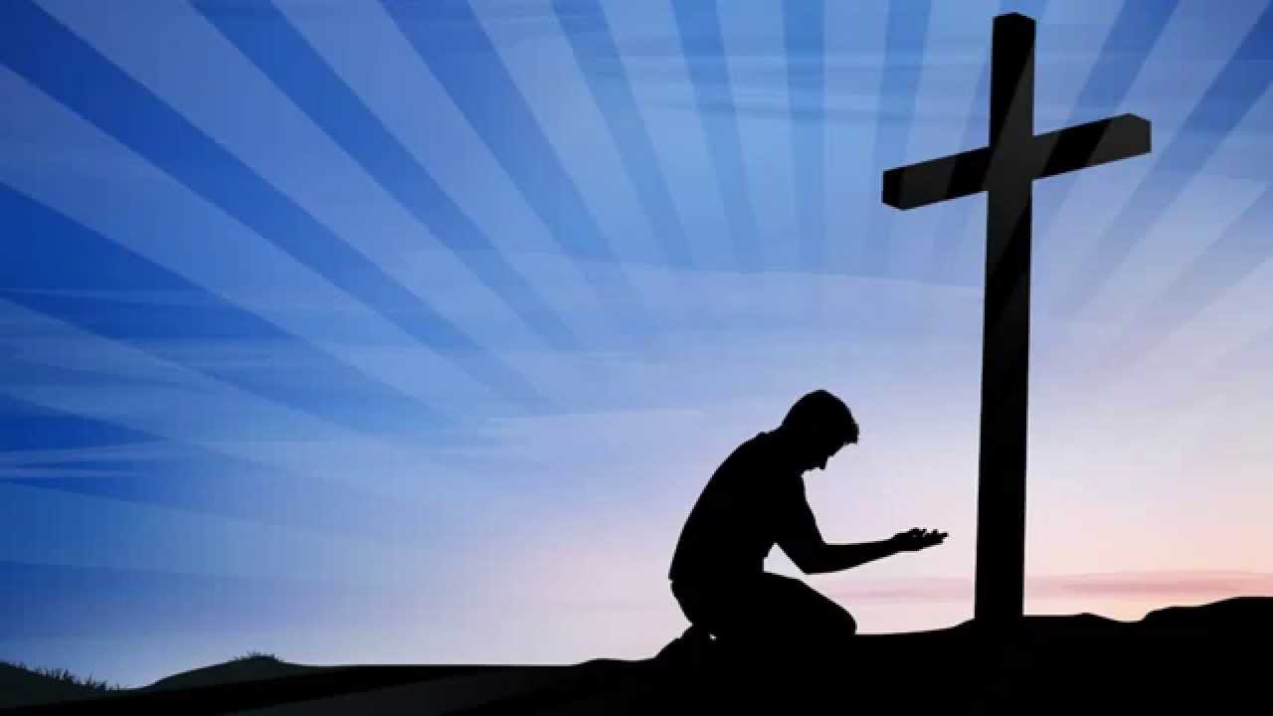
Jesus Our Only Hope
by Pastor Fee Soliven
Proverbs 14:31-35
Sunday Morning
July 11, 2021

Slide 78
Proverbs 14:31-35
31 He who oppresses the poor reproaches his Maker, But he who honors Him has mercy on the needy. 32 The wicked is banished in his wickedness, But the righteous has a refuge in his death. 33 Wisdom rests in the heart of him who has understanding, But what is in the heart of fools is made known.

Slide 79
34 Righteousness exalts a nation, But sin is a reproach to any people. 35 The king's favor is toward a wise servant, But his wrath is against him who causes shame.

Slide 80
2 Kings 21:1-16
1 Manasseh was twelve years old when he became king, and he reigned fifty-five years in Jerusalem. His mother's name was Hephzibah. 2 And he did evil in the sight of the LORD, according to the abominations of the nations whom the LORD had cast out before the children of Israel.

Slide 81
3 For he rebuilt the high places which Hezekiah his father had destroyed; he raised up altars for Baal, and made a wooden image, as Ahab king of Israel had done; and he worshiped all the host of heaven and served them. 4 He also built altars in the house of the LORD, of which the LORD had said, "In Jerusalem I will put My name."

Slide 82
5 And he built altars for all the host of heaven in the two courts of the house of the LORD. 6 Also he made his son pass through the fire, practiced soothsaying, used witchcraft, and consulted spiritists and mediums. He did much evil in the sight of the LORD, to provoke Him to anger.

Slide 83
7 He even set a carved image of Asherah that he had made, in the house of which the LORD had said to David and to Solomon his son, "In this house and in Jerusalem, which I have chosen out of all the tribes of Israel, I will put My name forever; 8 and I will not make the feet of Israel wander anymore from the land which I gave their fathers--only if they are careful to do according to all that I have commanded them, and according to all the law that My servant Moses commanded them."

Slide 84
9 But they paid no attention, and Manasseh seduced them to do more evil than the nations whom the LORD had destroyed before the children of Israel. 10 And the LORD spoke by His servants the prophets, saying, 11 "Because Manasseh king of Judah has done these abominations (he has acted more wickedly than all the Amorites who were before him, and has also made Judah sin with his idols),

Slide 85
12 therefore thus says the LORD God of Israel: 'Behold, I am bringing such calamity upon Jerusalem and Judah, that whoever hears of it, both his ears will tingle. 13 And I will stretch over Jerusalem the measuring line of Samaria and the plummet of the house of Ahab; I will wipe Jerusalem as one wipes a dish, wiping it and turning it upside down.

Slide 86
14 So I will forsake the remnant of My inheritance and deliver them into the hand of their enemies; and they shall become victims of plunder to all their enemies, 15 because they have done evil in My sight, and have provoked Me to anger since the day their fathers came out of Egypt, even to this day.' " 16 Moreover Manasseh shed very much innocent blood, till he had filled Jerusalem from one end to another, besides his sin by which he made Judah sin, in doing evil in the sight of the LORD.

Slide 87
46 This day the LORD will deliver you into my hand, and I will strike you and take your head from you. And this day I will give the carcasses of the camp of the Philistines to the birds of the air and the wild beasts of the earth, that all the earth may know that there is a God in Israel.

Slide 88
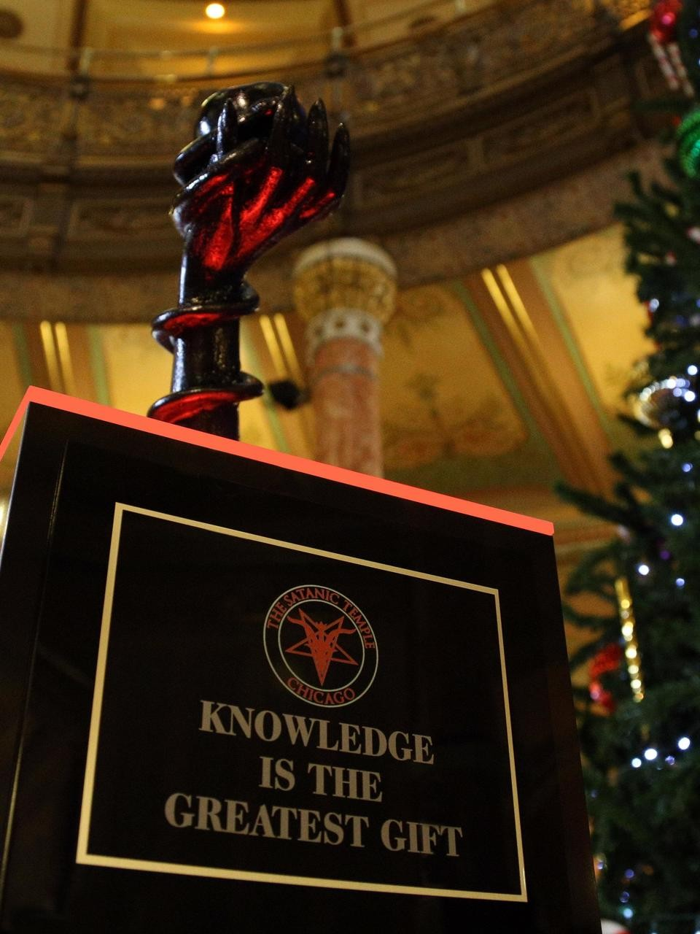

Slide 89
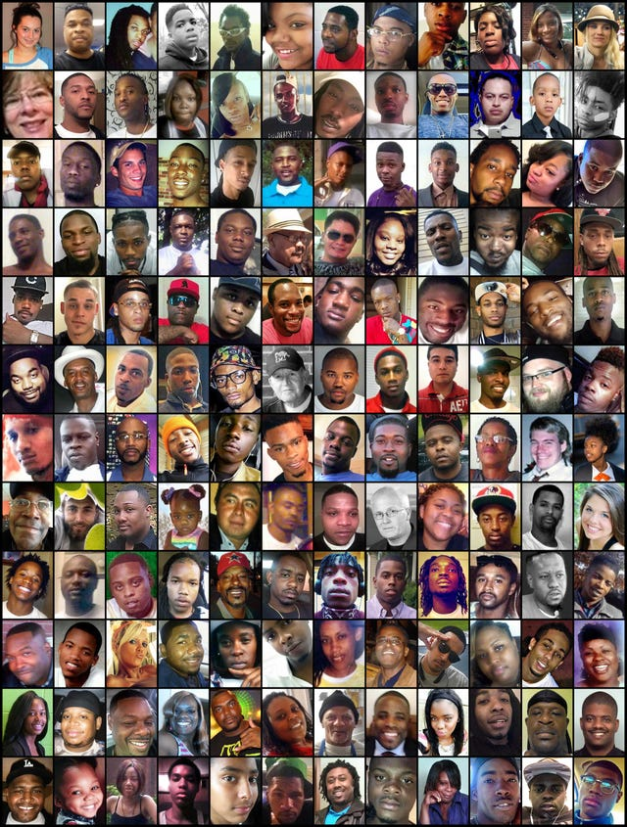

Slide 90
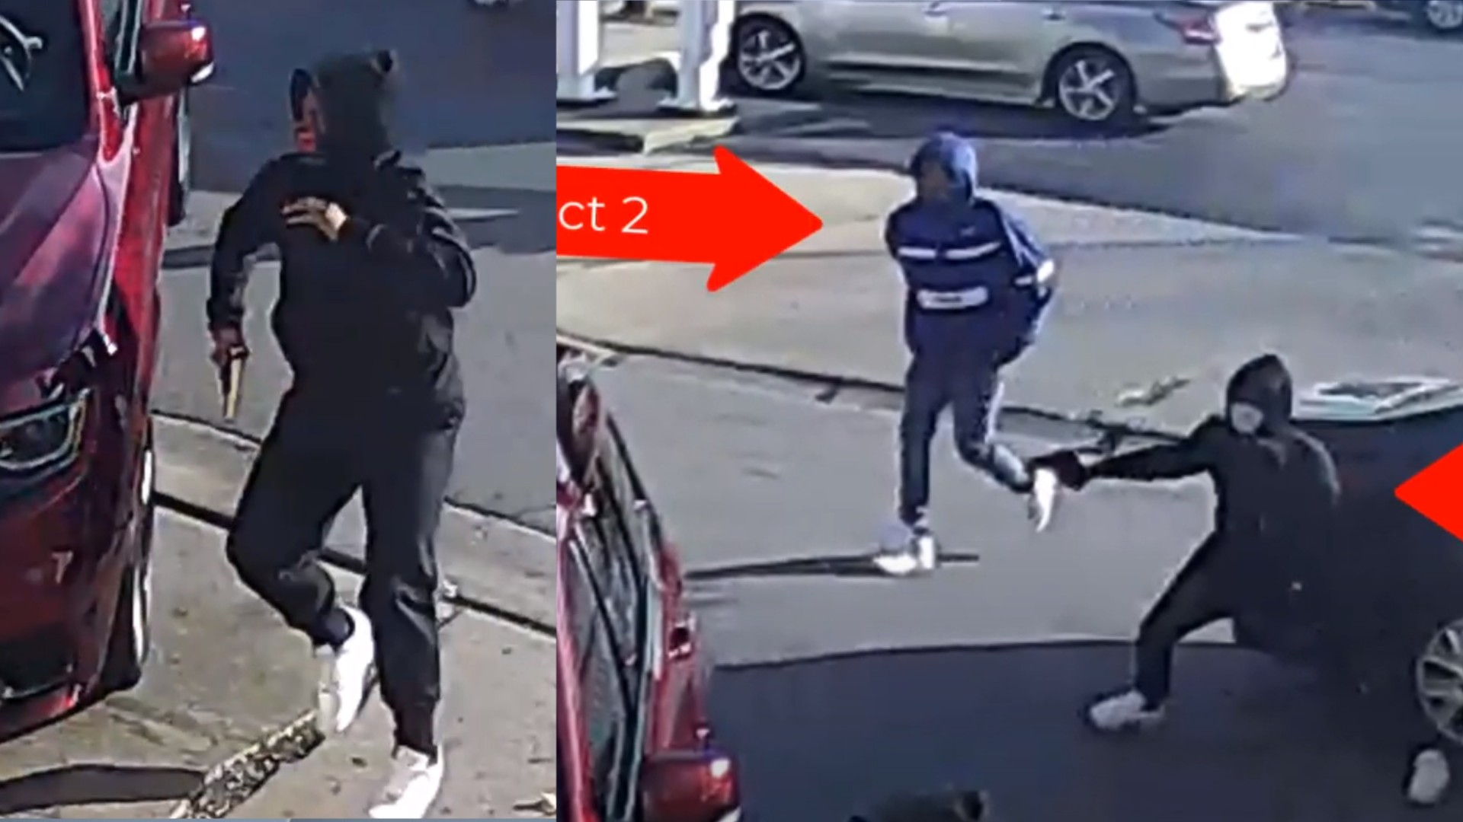
Matthew 11:28-30
28 Come to Me, all you who labor and are heavy laden, and I will give you rest. 29 Take My yoke upon you and learn from Me, for I am gentle and lowly in heart, and you will find rest for your souls. 30 For My yoke is easy and My burden is light."

Slide 91
John 16:32-33
32 Indeed the hour is coming, yes, has now come, that you will be scattered, each to his own, and will leave Me alone. And yet I am not alone, because the Father is with Me. 33 These things I have spoken to you, that in Me you may have peace. In the world you will have tribulation; but be of good cheer, I have overcome the world."

Slide 92
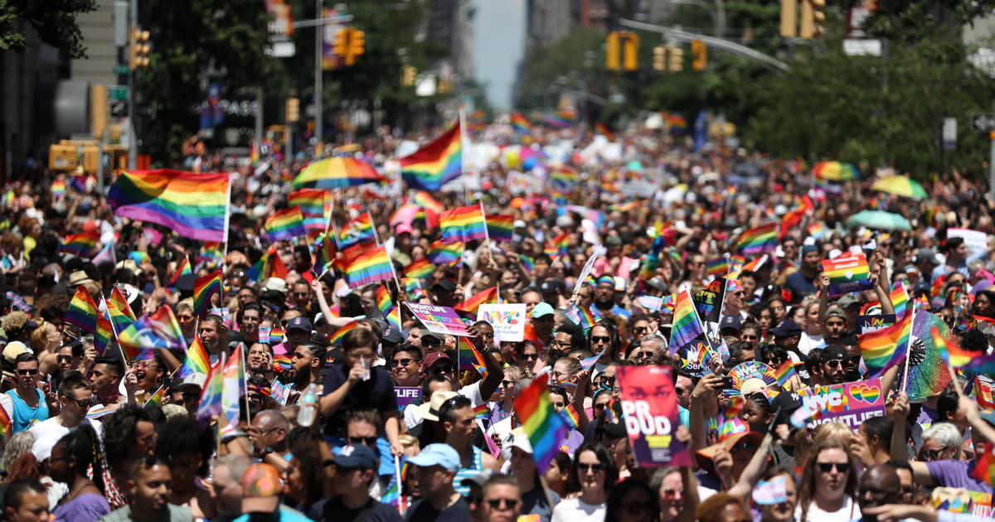
How should we respond if the foundations are destroyed?

Slide 93
1. Turn to God

Slide 94
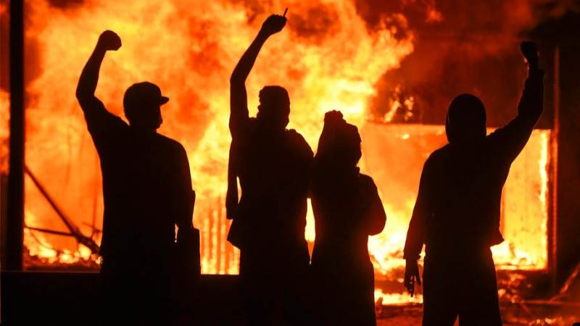
“In the LORD I put my trust”

Slide 95
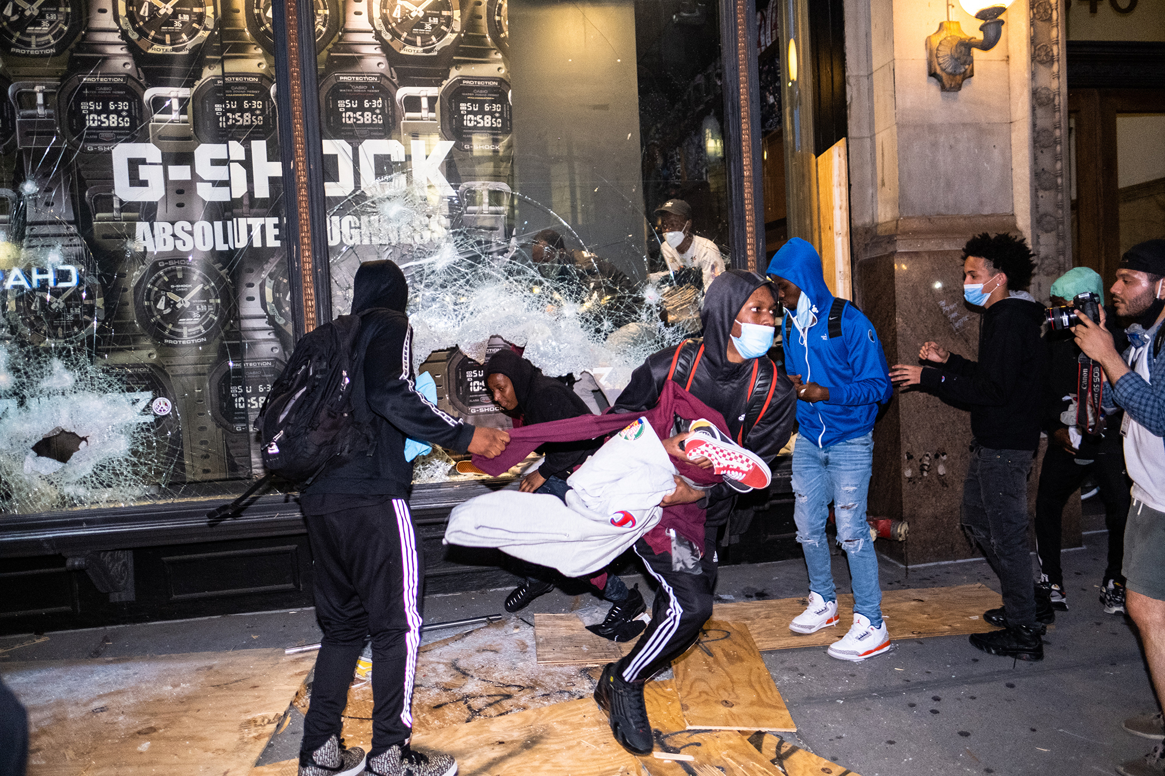
2. Don’t Run

Slide 96
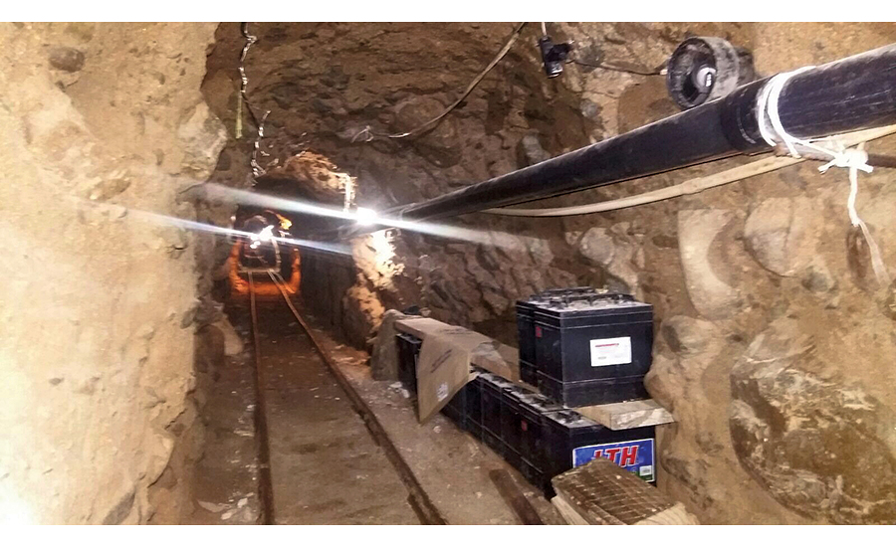
“How can you say to my soul, ‘Flee as a bird to your mountain’?”

Slide 97
Proverbs 14:34
“Righteousness exalts a nation, But sin is a reproach to any people.”

Slide 98
Psalm 9:15-17
15 The nations have sunk down in the pit which they made; In the net which they hid, their own foot is caught. 16 The LORD is known by the judgment He executes; The wicked is snared in the work of his own hands. Meditation. Selah 17 The wicked shall be turned into hell, And all the nations that forget God.

Slide 99
America needs a Josiah!

Slide 100
Josiah and The Road to
Reform and Revival

Slide 101
2 Kings 22:1-23
1 Josiah was eight years old when he became king, and he reigned thirty-one years in Jerusalem. His mother's name was Jedidah the daughter of Adaiah of Bozkath. 2 And he did what was right in the sight of the LORD, and walked in all the ways of his father David; he did not turn aside to the right hand or to the left.

Slide 102
3 Now it came to pass, in the eighteenth year of King Josiah, that the king sent Shaphan the scribe, the son of Azaliah, the son of Meshullam, to the house of the LORD, saying: 4 "Go up to Hilkiah the high priest, that he may count the money which has been brought into the house of the LORD, which the doorkeepers have gathered from the people.

Slide 103
5 And let them deliver it into the hand of those doing the work, who are the overseers in the house of the LORD; let them give it to those who are in the house of the LORD doing the work, to repair the damages of the house—6 to carpenters and builders and masons--and to buy timber and hewn stone to repair the house. 7 However there need be no accounting made with them of the money delivered into their hand, because they deal faithfully."

Slide 104
8 Then Hilkiah the high priest said to Shaphan the scribe, "I have found the Book of the Law in the house of the LORD." And Hilkiah gave the book to Shaphan, and he read it. 9 So Shaphan the scribe went to the king, bringing the king word, saying, "Your servants have gathered the money that was found in the house, and have delivered it into the hand of those who do the work, who oversee the house of the LORD."

Slide 105
10 Then Shaphan the scribe showed the king, saying, "Hilkiah the priest has given me a book." And Shaphan read it before the king.
11 Now it happened, when the king heard the words of the Book of the Law, that he tore his clothes. 12 Then the king commanded Hilkiah the priest, Ahikam the son of Shaphan, Achbor the son of Michaiah, Shaphan the scribe, and Asaiah a servant of the king, saying,

Slide 106
13 "Go, inquire of the LORD for me, for the people and for all Judah, concerning the words of this book that has been found; for great is the wrath of the LORD that is aroused against us, because our fathers have not obeyed the words of this book, to do according to all that is written concerning us."

Slide 107
14 So Hilkiah the priest, Ahikam, Achbor, Shaphan, and Asaiah went to Huldah the prophetess, the wife of Shallum the son of Tikvah, the son of Harhas, keeper of the wardrobe. (She dwelt in Jerusalem in the Second Quarter.) And they spoke with her. 15 Then she said to them, "Thus says the LORD God of Israel, 'Tell the man who sent you to Me,

Slide 108
16 Thus says the LORD: 'Behold, I will bring calamity on this place and on its inhabitants--all the words of the book which the king of Judah has read—17 because they have forsaken Me and burned incense to other gods, that they might provoke Me to anger with all the works of their hands. Therefore My wrath shall be aroused against this place and shall not be quenched.' " '

Slide 109
18 "But to the king of Judah, who sent you to inquire of the LORD, in this manner you shall speak to him, 'Thus says the LORD God of Israel: "Concerning the words which you have heard—19 because your heart was tender, and you humbled yourself before the LORD when you heard what I spoke against this place and against its inhabitants, that they would become a desolation and a curse, and you tore your clothes and wept before Me, I also have heard you," says the LORD.

Slide 110
20 Surely, therefore, I will gather you to your fathers, and you shall be gathered to your grave in peace; and your eyes shall not see all the calamity which I will bring on this place." ' " So they brought word to the king.

Slide 111
What was the message that the Lord sent to Josiah?

Slide 112
2 Kings 22:16
“Behold, I bring evil on this place and on its inhabitants, even all the words of the book which the king of Judah has read.”

Slide 113
2 Kings 22:17
“Because they have forsaken Me and have burned incense to other gods that they might provoke Me to anger with all the work of their hands, therefore My wrath burns against this place, and it shall not be quenched.”

Slide 114
2 Kings 22:18-19
“But to the king of Judah who sent you to inquire of the Lord thus you shall say to him….‘Because your heart was tender and you humbled yourself before the Lord when you heard what I spoke against this place and against its inhabitants that they should become a desolation and a curse, and you have torn your clothes and wept before Me, I truly have heard you,’ declares the Lord.”

Slide 115
2 Kings 22:20
“Therefore, behold, I will gather you to your fathers, and you will be gathered to your grave in peace, and your eyes will not see all the evil which I will bring on this place.”

Slide 116
Ecclesiastes 1:9-11
9 What has been, will be again, what has been done will be done again; there is nothing new under the sun. 10 Is there anything of which one can say, "Look! This is something new"? It was here already, long ago; it was here before our time. 11 There is no remembrance of men of old, and even those who are yet to come
will not be remembered by those who follow.

Slide 117
Amos 3:3-7
3 Can two walk together, unless they are agreed? 4 Will a lion roar in the forest, when he has no prey? Will a young lion cry out of his den, if he has caught nothing? 5 Will a bird fall into a snare on the earth, where there is no trap for it? Will a snare spring up from the earth, if it has caught nothing at all?

Slide 118
6 If a trumpet is blown in a city, will not the people be afraid? If there is calamity in a city, will not the LORD have done it? 7 Surely the Lord GOD does nothing, Unless He reveals His secret to His servants the prophets.

Slide 119
1 Thessalonians 4:13-18
13 But I do not want you to be ignorant, brethren, concerning those who have fallen asleep, lest you sorrow as others who have no hope. 14 For if we believe that Jesus died and rose again, even so God will bring with Him those who sleep in Jesus.

Slide 120
15 For this we say to you by the word of the Lord, that we who are alive and remain until the coming of the Lord will by no means precede those who are asleep. 16 For the Lord Himself will descend from heaven with a shout, with the voice of an archangel, and with the trumpet of God. And the dead in Christ will rise first.

Slide 121
17 Then we who are alive and remain shall be caught up together with them in the clouds to meet the Lord in the air. And thus we shall always be with the Lord. 18 Therefore comfort one another with these words.

Slide 122
1 Corinthians 15:50-54
50 Now this I say, brethren, that flesh and blood cannot inherit the kingdom of God; nor does corruption inherit incorruption. 51 Behold, I tell you a mystery: We shall not all sleep, but we shall all be changed-- 52 in a moment, in the twinkling of an eye, at the last trumpet. For the trumpet will sound, and the dead will be raised incorruptible, and we shall be changed.

Slide 123
53 For this corruptible must put on incorruption, and this mortal must put on immortality. 54 So when this corruptible has put on incorruption, and this mortal has put on immortality, then shall be brought to pass the saying that is written: "Death is swallowed up in victory."

Slide 124
20 Again, when a righteous man turns from his righteousness and commits iniquity, and I lay a stumbling block before him, he shall die; because you did not give him warning, he shall die in his sin, and his righteousness which he has done shall not be remembered; but his blood I will require at your hand.

Slide 125
Acts 2:38-39
38 Then Peter said to them, "Repent, and let every one of you be baptized in the name of Jesus Christ for the remission of sins; and you shall receive the gift of the Holy Spirit. 39 For the promise is to you and to your children, and to all who are afar off, as many as the Lord our God will call."

