Slide 1


Slide 2
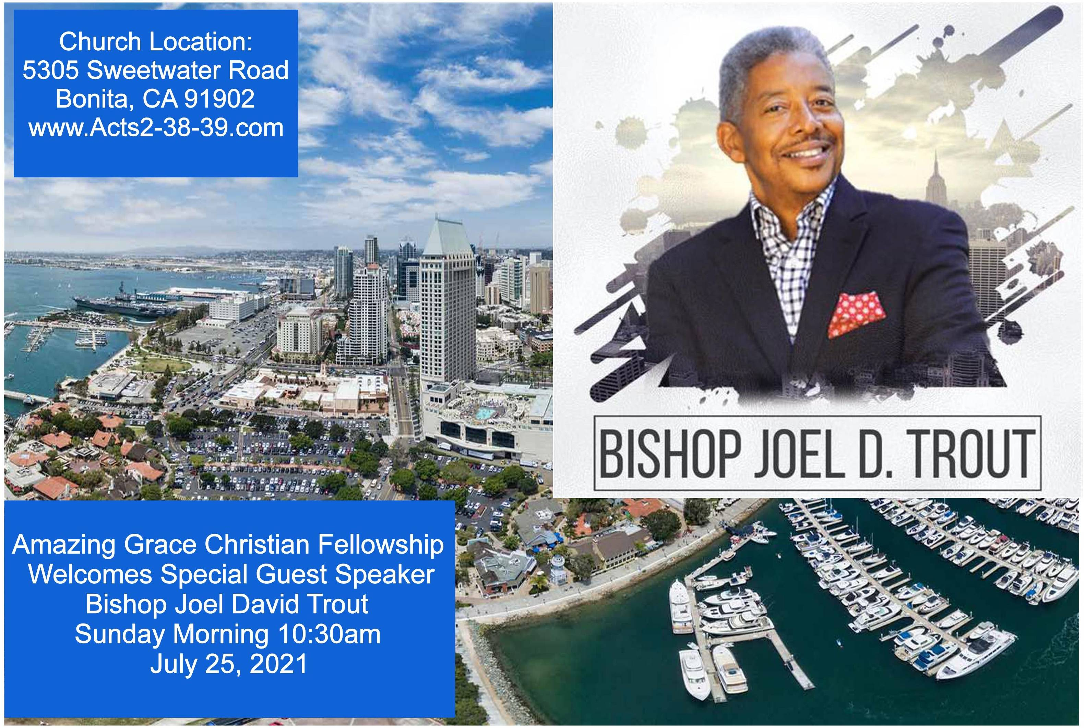

Slide 3
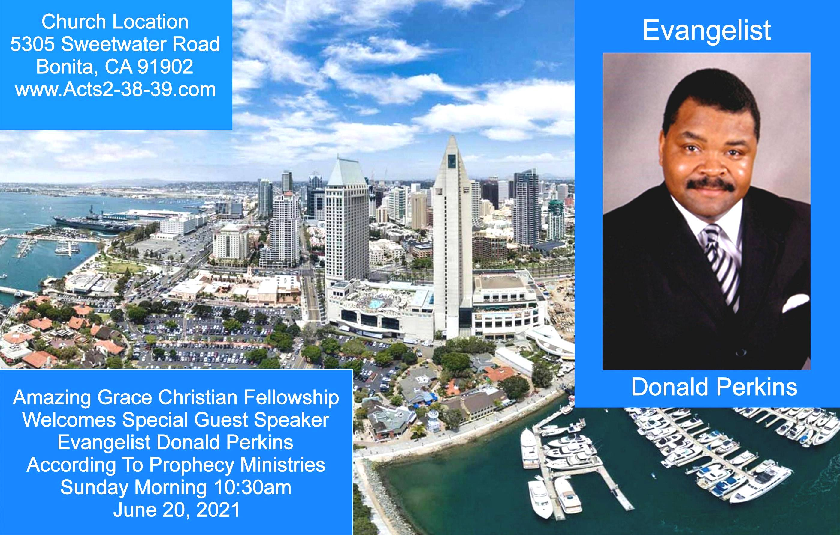

Exodus 23:14-16
14 "Three times you shall keep a feast to Me in the year: 15 You shall keep the Feast of Unleavened Bread (you shall eat unleavened bread seven days, as I commanded you, at the time appointed in the month of Abib, for in it you came out of Egypt; none shall appear before Me empty);

Slide 4


Our Treasure in Heaven
by Pastor Fee Soliven
Colossians 1:1-8
Wednesday Evening
July 7, 2021

Slide 5
Purpose:
To combat errors in the Church and to show that believers have everything they need in Christ.

Slide 6
Author:
Paul

Slide 7
Audience:
The Church at Colosse, a city in Asia Minor, and all believers everywhere.

Slide 8
Date Written:
Approximately A.D. 60 during Paul's imprisonment in Rome.

Slide 9
Setting:
Paul had never visited Colosse, Evidently the Church had been founded by Epaphras and other converts from Paul's missionary travels. The Church however was infiltrated by religious relativism, with some believers attempting to combine elements of paganism and secular philosophy and Christian doctrine. Paul confronts these false teachings and affirms sufficiency of Christ!

Slide 10
Colossians 1:1-5
1 Paul, an apostle of Jesus Christ by the will of God, and Timothy our brother, 2 To the saints and faithful brethren in Christ who are in Colosse: Grace to you and peace from God our Father and the Lord Jesus Christ.

Slide 11
3 We give thanks to the God and Father of our Lord Jesus Christ, praying always for you, 4 since we heard of your faith in Christ Jesus and of your love for all the saints; 5 because of the hope which is laid up for you in heaven, of which you heard before in the word of the truth of the gospel,

Slide 12
6 which has come to you, as it has also in all the world, and is bringing forth fruit, as it is also among you since the day you heard and knew the grace of God in truth; 7 as you also learned from Epaphras, our dear fellow servant, who is a faithful minister of Christ on your behalf, 8 who also declared to us your love in the Spirit.

Slide 13
1 Paul, an apostle of Jesus Christ by the will of God, and Timothy our brother,

Slide 14
Acts 9:1-6
1 Then Saul, still breathing threats and murder against the disciples of the Lord, went to the high priest 2 and asked letters from him to the synagogues of Damascus, so that if he found any who were of the Way, whether men or women, he might bring them bound to Jerusalem.

Slide 15
3 And as he journeyed he came near Damascus, and suddenly a light shone around him from heaven. 4 Then he fell to the ground, and heard a voice saying to him, "Saul, Saul, why are you persecuting Me?" 5 And he said, "Who are You, Lord?" And the Lord said, "I am Jesus, whom you are persecuting. It is hard for you to kick against the goads."

Slide 16
6 So he, trembling and astonished, said, "Lord, what do You want me to do?" And the Lord said to him, "Arise and go into the city, and you will be told what you must do."

Slide 17
2 To the Saints and faithful brethren in Christ who are in Colosse: Grace to you and peace from God our Father and the Lord Jesus Christ.

Slide 18
2 Corinthians 12:7-10
7 And lest I should be exalted above measure by the abundance of the revelations, a thorn in the flesh was given to me, a messenger of Satan to buffet me, lest I be exalted above measure. 8 Concerning this thing I pleaded with the Lord three times that it might depart from me.

Slide 19
9 And He said to me, "My grace is sufficient for you, for My strength is made perfect in weakness." Therefore most gladly I will rather boast in my infirmities, that the power of Christ may rest upon me. 10 Therefore I take pleasure in infirmities, in reproaches, in needs, in persecutions, in distresses, for Christ's sake. For when I am weak, then I am strong.

Slide 20
3 We give thanks to the God and Father of our Lord Jesus Christ, praying always for you,

Slide 21
Philippians 4:5-7
5 Let your gentleness be known to all men. The Lord is at hand. 6 Be anxious for nothing, but in everything by prayer and supplication, with thanksgiving, let your requests be made known to God; 7 and the peace of God, which surpasses all understanding, will guard your hearts and minds through Christ Jesus.

Slide 22
Ephesians 6:18
"praying always with all prayer and supplication in the Spirit, being watchful to this end with all perseverance and supplication for all the saints..."

Slide 23
1 Timothy 2:1-5
1 Therefore I exhort first of all that supplications, prayers, intercessions, and giving of thanks be made for all men, 2 for kings and all who are in authority, that we may lead a quiet and peaceable life in all godliness and reverence. 3 For this is good and acceptable in the sight of God our Savior, 4 who desires all men to be saved and to come to the knowledge of the truth.

Slide 24
4 since we heard of your faith in Christ Jesus and of your love for all the saints;

Slide 25
Philippians 3:12-14
12 Not that I have already attained, or am already perfected; but I press on, that I may lay hold of that for which Christ Jesus has also laid hold of me. 13 Brethren, I do not count myself to have apprehended; but one thing I do, forgetting those things which are behind and reaching forward to those things which are ahead, 14 I press toward the goal for the prize of the upward call of God in Christ Jesus.

Slide 26
5 because of the hope which is laid up for you in heaven, of which you heard before in the word of the truth of the gospel,

Slide 27
Ephesians 1:12-14
13 In Him you also trusted, after you heard the word of truth, the gospel of your salvation; in whom also, having believed, you were sealed with the Holy Spirit of promise, 14 who is the guarantee of our inheritance until the redemption of the purchased possession, to the praise of His glory.

Slide 28
2 Timothy 4:6-8
6 For I am already being poured out as a drink offering, and the time of my departure is at hand. 7 I have fought the good fight, I have finished the race, I have kept the faith. 8 Finally, there is laid up for me the crown of righteousness, which the Lord, the righteous Judge, will give to me on that Day, and not to me only but also to all who have loved His appearing.

Slide 29
We have a lively hope in Christ Jesus!

Slide 30
Titus 1:1-4
1 Paul, a bondservant of God and an apostle of Jesus Christ, according to the faith of God's elect and the acknowledgment of the truth which accords with godliness, 2 in hope of eternal life which God, who cannot lie, promised before time began, 3 but has in due time manifested His word through preaching, which was committed to me according to the commandment of God our Savior;

Slide 31
6 which has come to you, as it has also in all the world, and is bringing forth fruit, as it is also among you since the day you heard and knew the grace of God in truth;

Slide 32
Colossians 4:12-13
12 Epaphras, who is one of you, a bondservant of Christ, greets you, always laboring fervently for you in prayers, that you may stand perfect and complete in all the will of God. 13 For I bear him witness that he has a great zeal for you, and those who are in Laodicea, and those in Hierapolis.

Slide 33
7 as you also learned from Epaphras, our dear fellow servant, who is a faithful minister of Christ on your behalf,

Slide 34
8 who also declared to us your love in the Spirit.

Slide 35
1 Thessalonians 4:13-18
13 But I do not want you to be ignorant, brethren, concerning those who have fallen asleep, lest you sorrow as others who have no hope. 14 For if we believe that Jesus died and rose again, even so God will bring with Him those who sleep in Jesus.

Slide 36
15 For this we say to you by the word of the Lord, that we who are alive and remain until the coming of the Lord will by no means precede those who are asleep. 16 For the Lord Himself will descend from heaven with a shout, with the voice of an archangel, and with the trumpet of God. And the dead in Christ will rise first.

Slide 37
17 Then we who are alive and remain shall be caught up together with them in the clouds to meet the Lord in the air. And thus we shall always be with the Lord. 18 Therefore comfort one another with these words.

Slide 38
1 Corinthians 15:50-54
50 Now this I say, brethren, that flesh and blood cannot inherit the kingdom of God; nor does corruption inherit incorruption. 51 Behold, I tell you a mystery: We shall not all sleep, but we shall all be changed-- 52 in a moment, in the twinkling of an eye, at the last trumpet. For the trumpet will sound, and the dead will be raised incorruptible, and we shall be changed.

Slide 39
53 For this corruptible must put on incorruption, and this mortal must put on immortality. 54 So when this corruptible has put on incorruption, and this mortal has put on immortality, then shall be brought to pass the saying that is written: "Death is swallowed up in victory."

Slide 40

20 Again, when a righteous man turns from his righteousness and commits iniquity, and I lay a stumbling block before him, he shall die; because you did not give him warning, he shall die in his sin, and his righteousness which he has done shall not be remembered; but his blood I will require at your hand.

Slide 41
Acts 2:38-39
38 Then Peter said to them, "Repent, and let every one of you be baptized in the name of Jesus Christ for the remission of sins; and you shall receive the gift of the Holy Spirit. 39 For the promise is to you and to your children, and to all who are afar off, as many as the Lord our God will call."

