Slide 1


Slide 2
My Testimony
(Elevation Worship)

Slide 3
I saw satan fall like lightning. I saw darkness run for cover. But still the miracle that I just can’t get over

Slide 4
My name is registered in heaven. I believe in signs and wonders. I have resurrection power. Still the

Slide 5
Miracles that I just cant get over. My name is registered in heaven. My praise belongs to you

Slide 6
forever. This is my testimony from dead to life. Cause grace rewrote my story, I’ll testify By Jesus

Slide 7
Christ the righteous I’m Justified. This is my Testimony. This is my Testimony. Come together

Slide 8
sons and daughters. Bought with blood and washed in water.Sing the praises of the Spirit Son and Father

Slide 9
Our god will finish what he started. Our God will finish what he started. This is my testimony from

Slide 10
dead to life. Cause grace rewrote my story, I’ll testify
By Jesus Christ the righteous I’m Justified . This is

Slide 11
My Testimony. This is my Testimony. This is my testimony from from dead to life. Cause grace

Slide 12
rewrote my story, I’ll testify By Jesus righteous I’m Justified. This is my testimony. This is my testimony.

Slide 13
If I’m not dead your not done. Greater things are still to come Oh I believe. If I’m not dead your not done.

Slide 14
Greater things are still to come Oh I believe. If I’m not dead your not done. Greater things are still to

Slide 15
come Oh I believe. If I’m not dead your not done your not done. Greater things are still to come. Oh I

Slide 16
Believe. This is My testimony from death to life. Cause Grace rewrote my story, I’ll testify. By Jesus

Slide 17
Christ the righteous im Justified. This is my testimony. This is My Testimony. This is My

Slide 18
Testimony from death to life. Cause grace rewrote my story, I’ll testify. By Jesus Christ the righteous I’m

Slide 19
Justified. This is my Testimony. This is My Testimony.

Slide 20
“ Raise A Hallelujah”

Slide 21
I raise a hallelujah, In the presence of my enemies. I raise a hallelujah, louder than the unbelief. I raise a

Slide 22
Hallelujah, my weapon is a melody. I raise a hallelujah, heaven comes to fight for me.

Slide 23
I’m gonna sing in the middle of the storm. Louder and louder, you’re gonna hear my praises roar.

Slide 24
Up from the ashes, hope will arise. Death is defeated the king is alive. I raise a hallelujah, with

Slide 25
Everything inside of me. I raise a hallelujah, I will watch the darkness flee. I raise a hallelujah, In the

Slide 26
middle of the mystery. I raise a hallelujah, fear you lost your hold on me. I’m gonna sing in the middle

Slide 27
storm. Louder and louder. You’re gonna hear my praises roar. Up from the ashes. Hope will arise

Slide 28
death is defeated the king is alive. Sing a little louder(in the presence of my enemies. Sing a little

Slide 29
louder. (louder than the unbelief). Sing a little louder(my weapon is a melody. Sing a little louder.

Slide 30
(heaven comes to fight for me) Sing a little louder(in the presence of my enemies). Sing a little louder

Slide 31
(louder than the unbelief) Sing a little louder(my weapon is a melody).Sing a little louder( Heaven

Slide 32
comes o fight for me. Sing a little louder. Cause im gonna sing . In the middle of this storm louder and

Slide 33
louder your gonna hear my praises roar. Up from the ashes. Hope will arise. Death is defeated. The

Slide 34
king is alive. Cause im gonna sing . In the middle of this storm louder and louder. You’re gonna hear my

Slide 35
praises roar. Up from the ashes hope will arise. Death is defeated , The king is alive.

Slide 36
“Glorious Day”
(Passion)

Slide 37
I was buried beneath my shame. Who could carry that kind of weight. It was my tomb till I met you.

Slide 38
I was breathing but not alive. All my failures I try to hide. It was my tomb, Yeah Till I met you.

Slide 39
You Called My Name And I ran out out of that Grave. Out of the darkness Into your Glorious Day.

Slide 40
You Called My Name And I ran out out of that Grave. Out of the darkness Into your Glorious Day.

Slide 41
Now your Mercy has saved my soul. Now your freedom is all that I know. The old made New. Jesus

Slide 42
When I met you. When you called my Name and I ran out of that grave. Out of the darkness into your

Slide 43
Glorious Day. You called my name and I ran out of that Grave. Out of the darkness into your Glorious

Slide 44
Day. I needed Rescue My sin was heavy. But chains break at the weight of your Glory. I needed shelter

Slide 45
I was an orphan. Now you call me a citizen of Heaven. When I was broken you were my healing

Slide 46
now your love is the air that I’m breathing. I have a future my eyes are open. Cause when you call my

Slide 47
Name

Slide 48
And I ran out of that Grave. Out of the darkness. Into your Glorious Day. You Called my Name and I ran

Slide 49
Out of that Grave. Out of the darkness. Into your Glorious Day.

Slide 50
“Holy Spirit”

Slide 51
There’s nothing worth more. That could ever come close. No thing can compare. You’re our living hope.

Slide 52
Your presence Lord. I’ve tasted and seen of the sweetest of loves. Where my heart becomes free

Slide 53
And my shame is undone. Your presence, Lord.
Holy spirit you are welcome here. Come flood this

Slide 54
place and fill the atmosphere. Your glory God is what our hearts long for. To be overcomed. By your

Slide 55
presence Lord. There’s nothing worth more. That could ever come close. No thing can compare.

Slide 56
you’re living hope. Your presence, Lord. I’ve tasted and seen of the sweetest of loves. Where my heart

Slide 57
becomes free and my shame is undone. Your presence, Lord. Holy spirit you are welcome here

Slide 58
Come flood this place and fill the atmosphere. Your glory God is what our hearts long for. To be

Slide 59
overcome by your presence Lord. Your presence Lord. Let us become more aware of your presence

Slide 60
Let us experience the Glory of your goodness. Let us become. More aware of your presence. Let us

Slide 61
experience the Glory of your goodness. Let us become more aware of your presence. Let us

Slide 62
the atmosphere/ Your glory God is what our heart longs for to be overcome. By your presence Lord.

Slide 63
“Great are you Lord”
(All Sons and Daughters)

Slide 64
You give life, You are love. You bring light in the darkness. You give hope, You restore

Slide 65
Every heart that is broken. And great are you Lord. It’s your breath in our lungs so we

Slide 66
Pour out our praise. We pour out our praise.
It’s your breath in our lungs. So we pour out

Slide 67
Our praise to you only. You give life, you are love. You bring light to the darkness. You

Slide 68
Give hope, You restore. Every heart that is broken. Great are you Lord. It’s your breath

Slide 69
In our lungs. So we pour out our praise we pour out our praise. It’s your breath in our

Slide 70
Lungs so we pour out our praise to you only. It’s your breath in our lungs. So we

Slide 71
Pour out our praise we pour out our praise. It’s your breath in our lungs. So we pour out

Slide 72
Our praise to you only. And all the earth will shout your praise. Our hearts will cry, these

Slide 73
Bones will sing. Great are You, Lord. And all the earth will shout your praise. Our hearts

Slide 74
Will cry these bones will sing. Great are you,Lord. And all the earth will shout your

Slide 75
Praise Our hearts will cry these bones will sing. Great are you, Lord. It’s your breath in

Slide 76
Our Lungs. So we pour out our praise. We pour out our praise. It’s your breath in our

Slide 77
Lungs so we pour out our praise to you only. Great are you, Lord. It’s your breath in

Slide 78
Our lungs so we pour out our praise. Pour out our praise. It’s your breath in our lungs

Slide 79
So we pour out our praise to you only. Great are you , Lord.

Slide 81
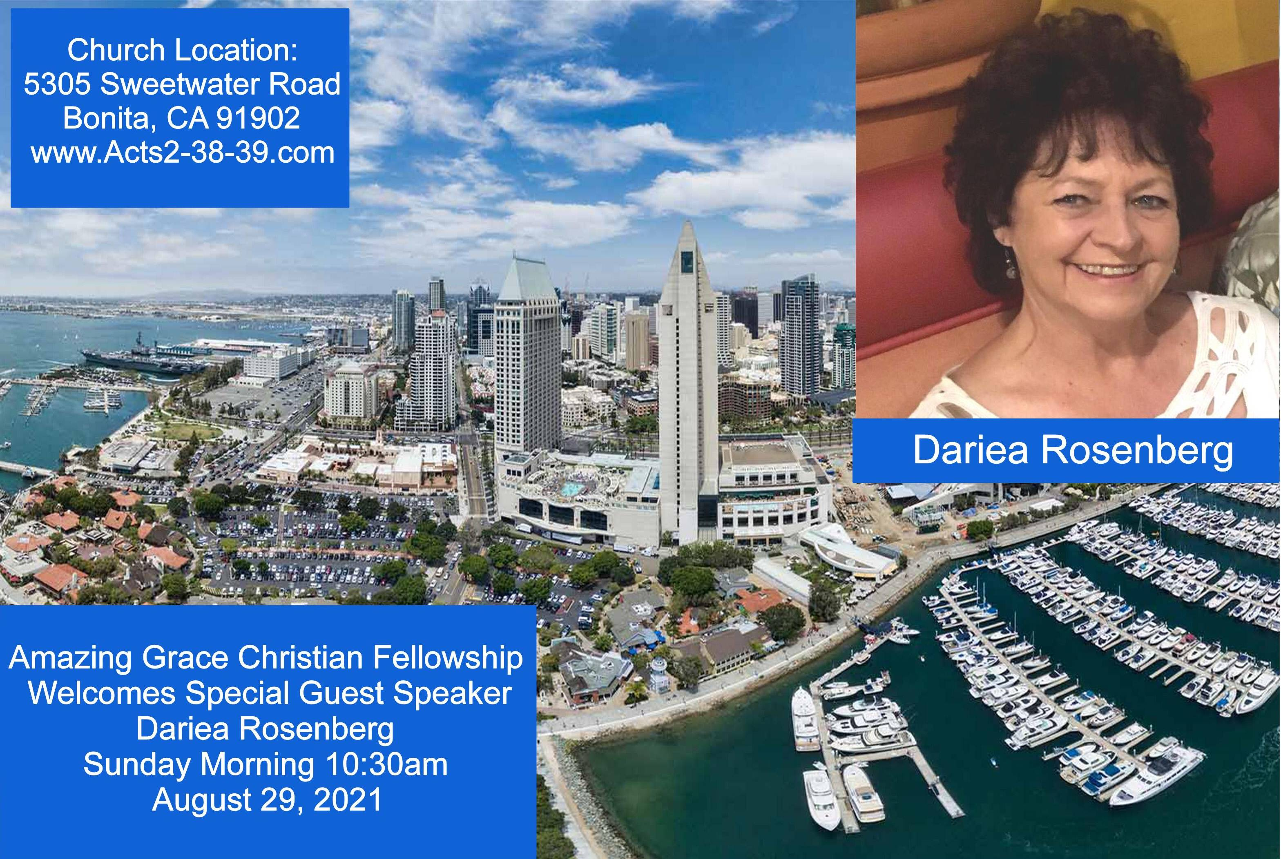

Slide 82


Slide 83
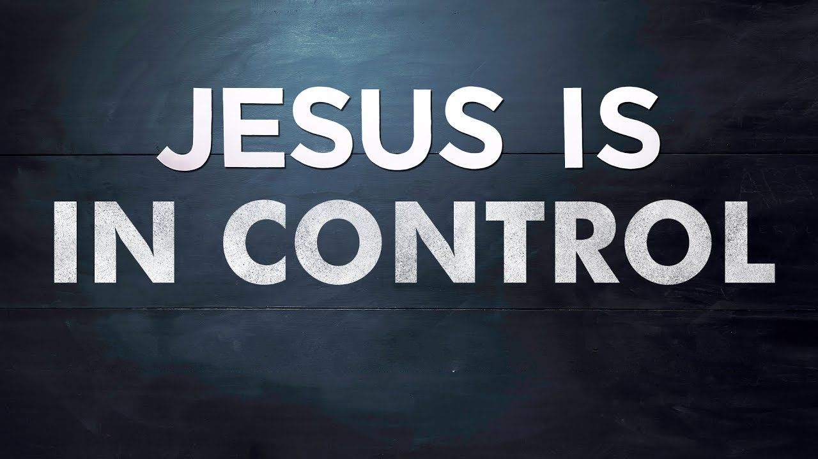

Slow Your Roll Jesus is in Control
by Pastor Fee Soliven
Joshua 1:5-9
Sunday Morning
August 8, 2021

Slide 84
Joshua 1:5-9
5 No man shall be able to stand before you all the days of your life; as I was with Moses, so I will be with you. I will not leave you nor forsake you. 6 Be strong and of good courage, for to this people you shall divide as an inheritance the land which I swore to their fathers to give them.

Slide 85
7 Only be strong and very courageous, that you may observe to do according to all the law which Moses My servant commanded you; do not turn from it to the right hand or to the left, that you may prosper wherever you go. 8 This Book of the Law shall not depart from your mouth, but you shall meditate in it day and night, that you may observe to do according to all that is written in it. For then you will make your way prosperous, and then you will have good success.

Slide 86
9 Have I not commanded you? Be strong and of good courage; do not be afraid, nor be dismayed, for the LORD your God is with you wherever you go."

Slide 87
Knowing biblical principles is essential for living the Christian life as God desires

Slide 88
Proverbs 3:5-8
5 Trust in the LORD with all your heart, And lean not on your own understanding; 6 In all your ways acknowledge Him, And He shall direct your paths. 7 Do not be wise in your own eyes; Fear the LORD and depart from evil. 8 It will be health to your flesh, And strength to your bones.

Slide 89
To keep in step with God’s perfect will, we must guard against jumping ahead of Him

Slide 90
Psalm 27:14
“Wait on the LORD; Be of good courage, And He shall strengthen your heart; Wait, I say, on the LORD!

Slide 91
God’s timing isn’t just good;
It’s Perfect

Slide 92
Psalm 139:4
“For there is not a word on my tongue, But behold, O LORD, You know it altogether”

Slide 93
Hebrews 4:13
“And there is no creature hidden from His sight, but all things are naked and open to the eyes of Him to whom we must give account”

Slide 94
Philippians 4:19-20
“And my God shall supply all your need according to His riches in glory by Christ Jesus”

Slide 95
Matthew 6:33
“But seek first the kingdom of God and His righteousness, and all these things shall be added to you”

Slide 96
2 Corinthians 9:8
“And God is able to make all grace abound toward you, that you, always having all sufficiency in all things, may have an abundance for every good work”

Slide 97
When God says “Wait,” that’s exactly what He means for us to do

Slide 98
John 10:27-30
27 My sheep hear My voice, and I know them, and they follow Me. 28 And I give them eternal life, and they shall never perish; neither shall anyone snatch them out of My hand. 29 My Father, who has given them to Me, is greater than all; and no one is able to snatch them out of My Father's hand. 30 I and My Father are one."

Slide 99
What are the requirements for waiting upon God?

Slide 100
Trust

Slide 101
Matthew 7:7-8
7 "Ask, and it will be given to you; seek, and you will find; knock, and it will be opened to you. 8 For everyone who asks receives, and he who seeks finds, and to him who knocks it will be opened.

Slide 102
Psalm 145:9
“The Lord is good to all, and his mercy is over all that he has made”

Slide 103
Psalm 34:8
“Oh, taste and see that the Lord is good! Blessed is the man who takes refuge in him!”

Slide 104
Patience

Slide 105
Psalm 37:7
“Rest in the LORD, and wait patiently for Him; Do not fret because of him who prospers in his way, Because of the man who brings wicked schemes to pass”

Slide 106
Courage

Slide 107
Joshua 1:9
“Have I not commanded you? Be strong and of good courage; do not be afraid, nor be dismayed, for the LORD your God is with you wherever you go."

Slide 108
Determination

Slide 109
Jeremiah 29:11
“For I know the plans I have for you, declares the Lord, plans for welfare and not for evil, to give you a future and a hope”

Slide 110
Strength

Slide 111
Philippians 4:13
“I can do all things through Christ who strengthens me”

Slide 112
Endurance

Slide 113
Romans 5:3-4
3 More than that, we rejoice in our sufferings, knowing that suffering produces endurance, 4 and endurance produces character, and character produces hope…

Slide 114
James 1:12
“Blessed is the man who remains steadfast under trial, for when he has stood the test he will receive the crown of life, which God has promised to those who love him”

Slide 115
Hebrews 10:36
“For you have need of endurance, so that when you have done the will of God you may receive what is promised”

Slide 116
2 Timothy 3:16-17
16 All Scripture is breathed out by God and profitable for teaching, for reproof, for correction, and for training in righteousness, 17 that the man of God may be competent, equipped for every good work.

Slide 117
1. What requests are you still waiting for God to answer?

Slide 118
2. Which of His attributes assure you that He is working on your behalf?

Slide 119
3. Do you want the Lord’s will above all else, even if He doesn’t give you what you want when you desire? If not, what is keeping you from trusting Him?

Slide 120
1 Thessalonians 4:13-18
13 But I do not want you to be ignorant, brethren, concerning those who have fallen asleep, lest you sorrow as others who have no hope. 14 For if we believe that Jesus died and rose again, even so God will bring with Him those who sleep in Jesus.

Slide 121
15 For this we say to you by the word of the Lord, that we who are alive and remain until the coming of the Lord will by no means precede those who are asleep. 16 For the Lord Himself will descend from heaven with a shout, with the voice of an archangel, and with the trumpet of God. And the dead in Christ will rise first.

Slide 122
17 Then we who are alive and remain shall be caught up together with them in the clouds to meet the Lord in the air. And thus we shall always be with the Lord. 18 Therefore comfort one another with these words.

Slide 123
1 Corinthians 15:50-54
50 Now this I say, brethren, that flesh and blood cannot inherit the kingdom of God; nor does corruption inherit incorruption. 51 Behold, I tell you a mystery: We shall not all sleep, but we shall all be changed-- 52 in a moment, in the twinkling of an eye, at the last trumpet. For the trumpet will sound, and the dead will be raised incorruptible, and we shall be changed.

Slide 124
53 For this corruptible must put on incorruption, and this mortal must put on immortality. 54 So when this corruptible has put on incorruption, and this mortal has put on immortality, then shall be brought to pass the saying that is written: "Death is swallowed up in victory."

Slide 125

20 Again, when a righteous man turns from his righteousness and commits iniquity, and I lay a stumbling block before him, he shall die; because you did not give him warning, he shall die in his sin, and his righteousness which he has done shall not be remembered; but his blood I will require at your hand.

Slide 126
Acts 2:38-39
38 Then Peter said to them, "Repent, and let every one of you be baptized in the name of Jesus Christ for the remission of sins; and you shall receive the gift of the Holy Spirit. 39 For the promise is to you and to your children, and to all who are afar off, as many as the Lord our God will call."

