Slide 2
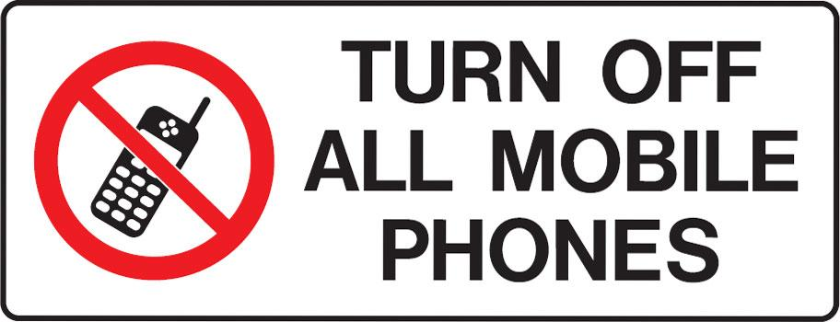

Slide 3
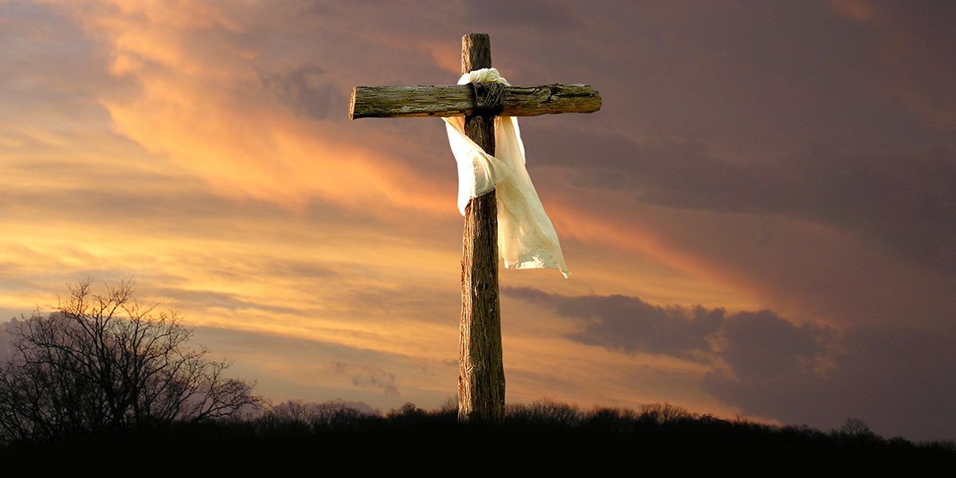
The Cross of Christ
by Pastor Fee Soliven
Colossians 1:19-23
Sunday Morning
August 1, 2021

Slide 4
Colossians 1:19-23
19 For it pleased the Father that in Him all the fullness should dwell, 20 and by Him to reconcile all things to Himself, by Him, whether things on earth or things in heaven, having made peace through the blood of His cross. 21 And you, who once were alienated and enemies in your mind by wicked works, yet now He has reconciled

Slide 5
22 in the body of His flesh through death, to present you holy, and blameless, and above reproach in His sight-- 23 if indeed you continue in the faith, grounded and steadfast, and are not moved away from the hope of the gospel which you heard, which was preached to every creature under heaven, of which I, Paul, became a minister.

Slide 6
The cross has become a symbol of Christianity, but it’s so much more than a mere piece of jewelry hanging around someone’s neck

Slide 7
Colossians 1:22-23
21 And you, who once were alienated and enemies in your mind by wicked works, yet now He has reconciled 22 in the body of His flesh through death, to present you holy, and blameless, and above reproach in His sight…

Slide 8
Corinth was one of the most corrupt cities of its time, and its belief system was a mixture of various philosophies

Slide 9
1 Corinthians 2:2
“For I determined not to know anything among you except Jesus Christ and Him crucified”

Slide 10
1 Corinthians 1:23-25
23 but we preach Christ crucified, to the Jews a stumbling block and to the Greeks foolishness, 24 but to those who are called, both Jews and Greeks, Christ the power of God and the wisdom of God. 25 Because the foolishness of God is wiser than men, and the weakness of God is stronger than men.

Slide 11
The Crucifixion was God’s Plan

Slide 12
1 Peter 1:19-21
19 but with the precious blood of Christ, as of a lamb without blemish and without spot. 20 He indeed was foreordained before the foundation of the world, but was manifest in these last times for you 21 who through Him believe in God, who raised Him from the dead and gave Him glory, so that your faith and hope are in God.

Slide 13
Ephesians 1:4-5
4 just as He chose us in Him before the foundation of the world, that we should be holy and without blame before Him in love, 5 having predestined us to adoption as sons by Jesus Christ to Himself, according to the good pleasure of His will…

Slide 14
God’s Plan for the Crucifixion of His Son was Motivated by Three Things

Slide 15
1. The Sinfulness of Mankind

Slide 16
Romans 3:23
“For all have sinned and fall short of the glory of God”

Slide 17
2. God’s love

Slide 18
Romans 5:8
“While we were yet sinners, Christ died for us”

Slide 19
3. God’s Justice

Slide 20
Ezekiel 18:4
“The soul who sins will die.”

Slide 21
Romans 6:23
“The wages of sin is death”

Slide 22
The crucifixion was where our sin and God’s Love and Justice Met

Slide 23
Hebrews 10:8-13
8 Previously saying, "Sacrifice and offering, burnt offerings, and offerings for sin You did not desire, nor had pleasure in them" (which are offered according to the law), 9 then He said, "Behold, I have come to do Your will, O God." He takes away the first that He may establish the second. 10 By that will we have been sanctified through the offering of the body of Jesus Christ once for all.

Slide 24
11 And every priest stands ministering daily and offering repeatedly the same sacrifices, which can never take away sins. 12 But this Man, after He had offered one sacrifice for sins forever, sat down at the right hand of God, 13 from that time waiting till His enemies are made His footstool.

Slide 25
Hebrews 9:24-26
24 For Christ has not entered the holy places made with hands, which are copies of the true, but into heaven itself, now to appear in the presence of God for us; 25 not that He should offer Himself often, as the high priest enters the Most Holy Place every year with blood of another—

Slide 26
26 He then would have had to suffer often since the foundation of the world; but now, once at the end of the ages, He has appeared to put away sin by the sacrifice of Himself.

Slide 27
Hebrews 9:26
“…but now, once at the end of the ages, He has appeared to put away sin by the sacrifice of Himself…”

Slide 28
Matthew 27:46
“My God, My God, why have You forsaken Me?”

Slide 29
The crucifixion was an event that can never be Duplicated and will Never Need to be Repeated

Slide 30
Romans 6:8-14
8 Now if we died with Christ, we believe that we shall also live with Him, 9 knowing that Christ, having been raised from the dead, dies no more. Death no longer has dominion over Him.

Slide 31
10 For the death that He died, He died to sin once for all; but the life that He lives, He lives to God. 11 Likewise you also, reckon yourselves to be dead indeed to sin, but alive to God in Christ Jesus our Lord. 12 Therefore do not let sin reign in your mortal body, that you should obey it in its lusts.

Slide 32
13 And do not present your members as instruments of unrighteousness to sin but present yourselves to God as being alive from the dead, and your members as instruments of righteousness to God. 14 For sin shall not have dominion over you, for you are not under law but under grace.

Slide 33
The Death of Christ Covered Everything

Slide 34
Luke 10:17-20
17 Then the seventy returned with joy, saying, "Lord, even the demons are subject to us in Your name." 18 And He said to them, "I saw Satan fall like lightning from heaven. 19 Behold, I give you the authority to trample on serpents and scorpions, and over all the power of the enemy, and nothing shall by any means hurt you. 20 Nevertheless do not rejoice in this, that the spirits are subject to you, but rather rejoice because your names are written in heaven."

Slide 35
Luke 23:42
“Jesus, remember me when You come in Your kingdom!”

Slide 36
Luke 23:43
“Today you shall be with Me in Paradise”

Slide 37
1 Thessalonians 4:13-18
13 But I do not want you to be ignorant, brethren, concerning those who have fallen asleep, lest you sorrow as others who have no hope. 14 For if we believe that Jesus died and rose again, even so God will bring with Him those who sleep in Jesus.

Slide 38
15 For this we say to you by the word of the Lord, that we who are alive and remain until the coming of the Lord will by no means precede those who are asleep. 16 For the Lord Himself will descend from heaven with a shout, with the voice of an archangel, and with the trumpet of God. And the dead in Christ will rise first.

Slide 39
17 Then we who are alive and remain shall be caught up together with them in the clouds to meet the Lord in the air. And thus we shall always be with the Lord. 18 Therefore comfort one another with these words.

Slide 40
1 Corinthians 15:50-54
50 Now this I say, brethren, that flesh and blood cannot inherit the kingdom of God; nor does corruption inherit incorruption. 51 Behold, I tell you a mystery: We shall not all sleep, but we shall all be changed-- 52 in a moment, in the twinkling of an eye, at the last trumpet. For the trumpet will sound, and the dead will be raised incorruptible, and we shall be changed.

Slide 41
53 For this corruptible must put on incorruption, and this mortal must put on immortality. 54 So when this corruptible has put on incorruption, and this mortal has put on immortality, then shall be brought to pass the saying that is written: "Death is swallowed up in victory."

Slide 42
20 Again, when a righteous man turns from his righteousness and commits iniquity, and I lay a stumbling block before him, he shall die; because you did not give him warning, he shall die in his sin, and his righteousness which he has done shall not be remembered; but his blood I will require at your hand.

Slide 43
Acts 2:38-39
38 Then Peter said to them, "Repent, and let every one of you be baptized in the name of Jesus Christ for the remission of sins; and you shall receive the gift of the Holy Spirit. 39 For the promise is to you and to your children, and to all who are afar off, as many as the Lord our God will call."

