Slide 2
“Alpha and Omega”

Slide 3
You are Alpha and Omega. We worship you are Lord. You are worthy to be praised.

Slide 4
You are Alpha and Omega. We worship you are Lord. You are worthy to be praised.

Slide 5
You are Alpha and Omega. We worship you are Lord. You are worthy to be praised.

Slide 6
You are Alpha and Omega. We worship you are Lord. You are worthy to be praised.

Slide 7
We give you all the glory. We worship you our Lord you are worthy to be praised.

Slide 8
We give you all the glory. We worship you our Lord you are worthy to be praised.

Slide 9
You are Alpha and Omega. We worship you our Lord. You are worthy to be praised.

Slide 10
You are Alpha and Omega. We worship you our Lord. You are worthy to be praised.

Slide 11
You are Alpha and Omega. We worship you our Lord. You are worthy to be praised.

Slide 12
Rattle
(Elevation Worship)

Slide 13
Saturday was silent. Surely it was through. Since when has impossible. Ever stopped you. Friday’s

Slide 14
Disappointment. Is Sunday’s empty tomb. Since when has impossible ever stopped you.

Slide 15
This is the sound of dry bones rattling. This is the praise make a dead man walk again. Open the

Slide 16
Grave I’m coming out I’m gonna live, gonna live again. This is the sound of dry bones rattling.

Slide 17
Pentecostal fire stirring something new. You’re not gonna run out of miracles anytime soon. Yeah,

Slide 18
Resurrection power runs in my veins too. I believe there’s another miracle here in this room.

Slide 19
This is the sound of dry bones rattling. This is the praise make a dead man walk again. Open the

Slide 20
Grave im coming out I’m gonna live, gonna live again. This is the sound of dry bones rattling.

Slide 21
My God is able to save and deliver and heal

Slide 22
And restore anything that he wants to. Just ask the man who was thrown on the bones of Elisha. If

Slide 23
There’s anything that He can’t do. Just ask the stone that was rolled at the tomb in the garden. What

Slide 24
Happens when God says to move. I feel him moving it now. I feel him doing it now. I feel him doing it now.

Slide 25
Do it now, Do it now. This is the sound of dry bones rattling. This is the praise make a dead man walk

Slide 26
Again. Open the grave I’m coming out. I’m gonna live gonna live again. Open the grave I’m coming out

Slide 27
I’m gonna live gonna live again. Open the grave I’m coming out I’m gonna live gonna live again. This is

Slide 28
The sound of dry bones rattling.

Slide 29
Open Up The Heavens

Slide 30
We waited for this day. Were gathered in your name Calling out to you. With Glory like a fire.

Slide 31
awakening desire Will burn our hearts with truth
You're the reason we're here You're the reason we're

Slide 32
Singing Open up the heavens, we wanna see You
Open up the floodgates, a mighty river Flowing from

Slide 33
Your heart, filling every part of our praise Your presence in this place Your glory on our face

Slide 34
We're looking to the sky. Descending like a cloud
You're standing with us now. Lord unveil our eyes

Slide 35
You're the reason we're here You're the reason we're singing So open up the heavens, we wanna

Slide 36
See You Open up the floodgates, a mighty river
Flowing from Your heart, filling every part of our

Slide 37
Praise. Open up the heavens, we wanna see You
Open up the floodgates, a mighty river Flowing from

Slide 38
Your heart, filling every part of our praise Show us, show us Your glory Show us, show us Your power

Slide 39
Show us,show us your glory, Lord. We want to see you, Lord. Show us,show us your glory. Show

Slide 40
Us, show us your power. Show us,show us your glory, Lord. We want to see you, Lord. Open up

Slide 41
The heavens we want to see you. Open up the floodgates a mighty river flowing from our hearts and

Slide 42
Filling every part of our praise. Yes open up the heavens we want to see you open up the floodgates

Slide 43
A mighty river flowing from our hearts and filling every part of our praise.

Slide 44
“No Longer Slaves”
(Bethel)

Slide 45
You unravel me with a melody. You surround me with a song. Of deliverance from my enemies. Til

Slide 46
All my fears are gone. I’m no longer a slave to fear. I am a child of God. I’m no longer a slave to fear.

Slide 47
I am a child of God . From my mother’s womb. You have chosen me. Love has called my name. I’ve

Slide 48
been born again into your family. Your blood has flows through my veins. I’m no longer a slave to fear.

Slide 49
I am a child of God. I’m no longer a slave to fear. I am a child of God.I’m no longer a slave to fear. I am

Slide 50
A child of God. I’m no longer a slave to fear. I am a child of God. Ooh, Ooh ,Ooh, ooh. Ooh, Ooh, Ooh,

Slide 51
Oooh. You split the sea so I could walk right through it. My fears are drowned in perfect love. You rescued

Slide 52
Me so I could stand and sing. I am a child of God. You split the sea so I can walk right through it. My

Slide 53
fears are drowned in perfect love. You rescued me so I could stand and sing. I am a child of God.

Slide 54
Yes I am a child of God. Oh I am A child of God.

Slide 55
“Here I am to Worship”
(Auf Deutsch)

Slide 56
Light of the world. You stepped down into darkness. Opened my eyes, let me see. Beauty that

Slide 57
this heart adore you. Hope of a life spent with you. And here I am to worship. Here I am to bow down.

Slide 58
YesHere I am to say that You’re my God. You’re all together lovely. Altogether worthy.

Slide 59
Yes Altogether wonderful to me. King of all days. Oh so highly exhalted. Glorious in heaven above.

Slide 60
Humbly you came to this earth you created. All for love’s sake became poor. And here I am to worship

Slide 61
YesHere I am to bow down. Here I am to say that you’re my God. You’re altogether lovely. altogether

Slide 62
Worthy all together wonderful to me. And here I am to worship. Here I am to bow down. Here I am to say

Slide 63
that you’re my God . You’re altogether lovely. Altogether worthy. Altogether wonderful to me.

Slide 64
Oh I’ll never know how much it cost. To see my sin upon that cross. I’ll never know how much it cost. To

Slide 65
See my sin upon that cross .I’ll never know how much it cost. To see my sin upon that cross. No

Slide 66
I’ll never know how much it cost to see my sin upon that cross. Here I am to worship. Here I am to bow

Slide 67
down. Here I am to say that your my God. You’re altogether lovely. Altogether worthy. Altogether

Slide 68
wonderful to me.

Slide 69
I’ll never know how much it cost to see my sin upon that cross. Here I am to worship. Here I am to bow

Slide 70
Down here I am to say that you’re my God. You’re altogether lovely. Altogether worthy, Altogether

Slide 71
Wonderful to me.

Slide 73
1 Corinthians 15:51-54
51 Behold, I shew you a mystery; We shall not all sleep, but we shall all be changed, 52 In a moment, in the twinkling of an eye, at the last trump: for the trumpet shall sound, and the dead shall be raised incorruptible, and we shall be changed.

Slide 74
1 Corinthians 15:51-54
51 Behold, I shew you a mystery; We shall not all sleep, but we shall all be changed, 52 In a moment, in the twinkling of an eye, at the last trump: for the trumpet shall sound, and the dead shall be raised incorruptible, and we shall be changed.

Slide 76
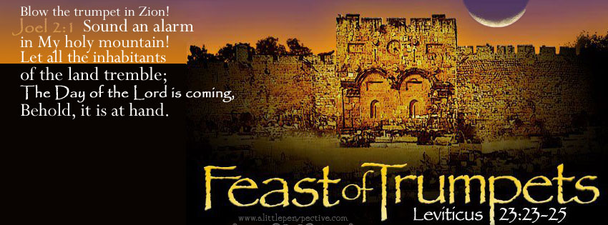
The Feast of Trumpets
By Pastor Fee Soliven
1 Corinthians 15:51-54
Sunday Morning
August 15, 2021

Slide 77
1 Corinthians 15:51-54
51 Behold, I shew you a mystery; We shall not all sleep, but we shall all be changed, 52 In a moment, in the twinkling of an eye, at the last trump: for the trumpet shall sound, and the dead shall be raised incorruptible, and we shall be changed.

Slide 78
53 For this corruptible must put on incorruption, and this mortal must put on immortality.54 So when this corruptible shall have put on incorruption, and this mortal shall have put on immortality, then shall be brought to pass the saying that is written, Death is swallowed up in victory.

Slide 79
Leviticus 23:2
And the LORD spoke to Moses, saying, Speak to the children of Israel, and say to them, Concerning the Feasts of the LORD, which you shall proclaim to be holy convocations, even these are my feasts.

Slide 80
The Hebrew word for Feasts is also MOED meaning appointed times. The Hebrew word for convocation is MIQRA meaning a dress rehearsal.

Slide 81
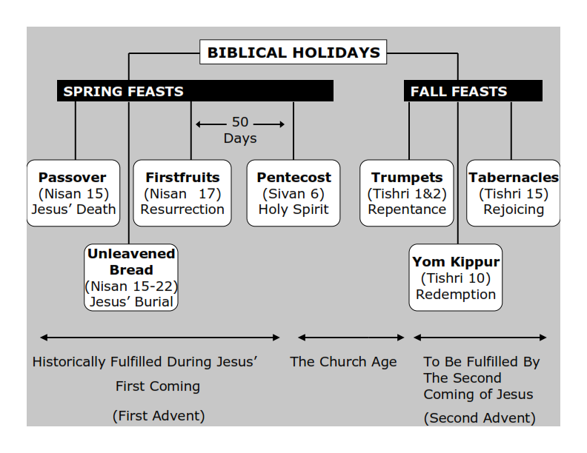
Philippians 3:20-21
20 For our citizenship is in heaven, from which we also eagerly wait for the Savior, the Lord Jesus Christ, 21 who will transform our lowly body that it may be conformed to His glorious body, according to the working by which He is able even to subdue all things to Himself.

Slide 82
Feast of Trumpets : REPENTANCE
Feast of Yom Kippur: REDEMPTION
Feast of Tabernacles: REJOICING

Slide 83
Idioms for the Feast of Yom Teruah:
(The Feast of Trumpets)

Slide 84
(Idioms: Webster Definition)
A construction or expression of one language whose parts correspond to elements in another language but whose total structure is matched in an indirect way.

Slide 85
1. The Time of Jacobs trouble
The 7 Year Tribulation. It will be the beginning of a new 7 year Shemitah cycle.

Slide 86
2. The Day of the Awakening Blast. The Rapture of the Church!

Slide 87
3. Yom HaDin: Day of Judgment, The Opening of the Books, Opening of the Gates

Slide 88
4. Yom HaKeseh: The Hidden Day

Slide 89
5. Ha Kiddushin Nesuin:
Wedding of the Messiah

Slide 90
6. Ha Melech: Coronation of the Messiah

Slide 91
1. The Time of Jacobs trouble

Slide 92
The 7 Year Tribulation. It will be the beginning of a new 7 year Shemitah cycle.

Slide 93
Jeremiah 30:6-7
6 Ask now, and see, Whether a man is ever in labor with child? So why do I see every man with his hands on his loins Like a woman in labor, And all faces turned pale? 7 Alas! For that day is great, So that none is like it; And it is the time of Jacob's trouble, But he shall be saved out of it.

Slide 94
Daniel 12:1-3
1 "At that time Michael shall stand up, The great prince who stands watch over the sons of your people; And there shall be a time of trouble, Such as never was since there was a nation, Even to that time. And at that time your people shall be delivered, Every one who is found written in the book.

Slide 95
2 And many of those who sleep in the dust of the earth shall awake, Some to everlasting life, Some to shame and everlasting contempt. 3 Those who are wise shall shine Like the brightness of the firmament, And those who turn many to righteousness Like the stars forever and ever.

Slide 96
Matthew 24:21-22
21 For then there will be great tribulation, such as has not been since the beginning of the world until this time, no, nor ever shall be. 22 And unless those days were shortened, no flesh would be saved; but for the elect's sake those days will be shortened.

Slide 97
2. The Day of the Awakening Blast
The Rapture of the Church!

Slide 98
On the Feast of Trumpets the Shofar is blown 100 times. There are three sounds made with the shofar:

Slide 99
Tekiah - One long straight blast.
Shevarim - Three shorter blasts.
Teruah – 9 quick blasts in short succession
This series is blown 11 times for a total of 99 blasts and the final blast is known as
“The Last Trump” !

Slide 100
1 Corinthians 15:51-54
51 Behold, I shew you a mystery; We shall not all sleep, but we shall all be changed, 52 In a moment, in the twinkling of an eye, at the last trump: for the trumpet shall sound, and the dead shall be raised incorruptible, and we shall be changed.

Slide 101
53 For this corruptible must put on incorruption, and this mortal must put on immortality. 54 So when this corruptible shall have put on incorruption, and this mortal shall have put on immortality, then shall be brought to pass the saying that is written, Death is swallowed up in victory.

Slide 102
1 Thessalonians 4:16-17
16 For the Lord himself shall descend from heaven with a shout, with the voice of the archangel, and with the trump of God: and the dead in Christ shall rise first: 17 Then we which are alive and remain shall be caught up together with them in the clouds, to meet the Lord in the air: and so shall we ever be with the Lord.

Slide 103
3. Yom HaDin/Day of Judgment/The Opening of the Books/
Opening of the Gates

Slide 104
1 Corinthians 3:13-15
13 each one's work will become clear; for the Day will declare it, because it will be revealed by fire; and the fire will test each one's work, of what sort it is. 14 If anyone's work which he has built on it endures, he will receive a reward. 15 If anyone's work is burned, he will suffer loss; but he himself will be saved, yet so as through fire.

Slide 105
2 Corinthians 5:10-11
10 For we must all appear before the judgment seat of Christ, that each one may receive the things done in the body, according to what he has done, whether good or bad. 11 Knowing, therefore, the terror of the Lord, we persuade men; but we are well known to God, and I also trust are well known in your consciences.

Slide 106
Revelation 20:11-15
11 Then I saw a great white throne and Him who sat on it, from whose face the earth and the heaven fled away. And there was found no place for them. 12 And I saw the dead, small and great, standing before God, and books were opened. And another book was opened, which is the Book of Life. And the dead were judged according to their works, by the things which were written in the books.

Slide 107
13 The sea gave up the dead who were in it, and Death and Hades delivered up the dead who were in them. And they were judged, each one according to his works. 14 Then Death and Hades were cast into the lake of fire. This is the second death. 15 And anyone not found written in the Book of Life was cast into the lake of fire.

Slide 108
Psalm 24:7-10
7 Lift up your heads, O you gates! And be lifted up, you everlasting doors! And the King of glory shall come in. 8 Who is this King of glory? The LORD strong and mighty, The LORD mighty in battle. 9 Lift up your heads, O you gates! Lift up, you everlasting doors! And the King of glory shall come in. 10 Who is this King of glory? The LORD of hosts, He is the King of glory.

Slide 109
Psalm 118:19-21
19 Open to me the gates of righteousness; I will go through them, And I will praise the LORD. 20 This is the gate of the LORD, Through which the righteous shall enter. 21 I will praise You, For You have answered me, And have become my salvation.

Slide 110
4. Yom HaKeseh (The Hidden Day)

Slide 111
Zephaniah 2:1-3
1 Gather yourselves together, yes, gather together, O undesirable nation, 2 Before the decree is issued, Or the day passes like chaff, Before the LORD's fierce anger comes upon you, Before the day of the LORD's anger comes upon you!

Slide 112
3 Seek the LORD, all you meek of the earth, Who have upheld His justice. Seek righteousness, seek humility. It may be that you will be hidden In the day of the LORD's anger.

Slide 113
1 Thessalonians 5:9-11
9 For God did not appoint us to wrath, but to obtain salvation through our Lord Jesus Christ, 10 who died for us, that whether we wake or sleep, we should live together with Him. 11 Therefore comfort each other and edify one another, just as you also are doing.

Slide 114
Psalm 27:5
5 For in the time of trouble He shall hide me in His pavilion; In the secret place of His tabernacle He shall hide me; He shall set me high upon a rock.

Slide 115
Isaiah 26:20-21
20 Come, my people, enter your chambers, And shut your doors behind you; Hide yourself, as it were, for a little moment, Until the indignation is past. 21 For behold, the LORD comes out of His place To punish the inhabitants of the earth for their iniquity; The earth will also disclose her blood, And will no more cover her slain.

Slide 116
Matthew 24:36
"But of that day and hour no one knows, not even the angels of heaven, but My Father only.

Slide 117
So here is the big clue for us:

Slide 118
1 Thessalonians 5:1-9
1 But concerning the times and the seasons, brethren, you have no need that I should write to you. 2 For you yourselves know perfectly that the day of the Lord so comes as a thief in the night. 3 For when they say, "Peace and safety!" then sudden destruction comes upon them, as labor pains upon a pregnant woman. And they shall not escape.

Slide 119
4 But you, brethren, are not in darkness, so that this Day should overtake you as a thief. 5 You are all sons of light and sons of the day. We are not of the night nor of darkness. 6 Therefore let us not sleep, as others do, but let us watch and be sober. 7 For those who sleep, sleep at night, and those who get drunk are drunk at night.

Slide 120
8 But let us who are of the day be sober, putting on the breastplate of faith and love, and as a helmet the hope of salvation. 9 For God did not appoint us to wrath, but to obtain salvation through our Lord Jesus Christ

Slide 121
The Feast of Trumpets is on Tishri 1&2 it's a 2 day feast and no one knew when the sighting of the new moon would be. So when they saw the new moon the feast began!

Slide 122
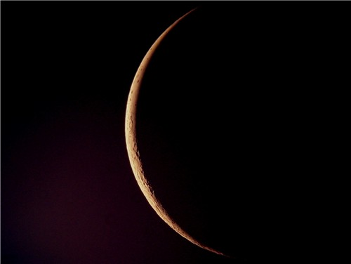
The Great tribulation is going to be a time of horrific trouble this world has never seen nor will it ever see it like that again!

Slide 123
5. Ha Kiddushin/Nesuin
(Wedding of the Messiah)

Slide 124
1. Marriages were arranged by the parents (Abraham for Isaac)
Typically the young man would go to the house of the “bride to be” carrying 3 items A. Large sum of Money B. Betrothal Contract C. Skin of wine. Anyone arriving at a house with these 3 items was definitely considered a prospect.

Slide 125
If the bridal price was approved a glass of wine was poured. If she approved, the betrothal contract became a legal document between the two. Their status was betrothed rather than fully married even though they would be called husband and wife.

Slide 126
Ezekiel 16:8-10
8 When I passed by you again and looked upon you, indeed your time was the time of love; so I spread My wing over you and covered your nakedness. Yes, I swore an oath to you and entered into a covenant with you, and you became Mine," says the Lord GOD. 9 Then I washed you in water; yes, I thoroughly washed off your blood, and I anointed you with oil.

Slide 127
In Jewish tradition The Bridegroom would make the statement “He would go to his Father’s house and prepare a place for her”. This place was known as the chamber.

Slide 128
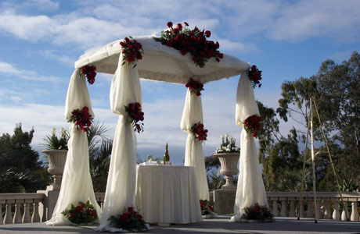
creation." 5 For this they willfully forget: that by the word of God the heavens were of old, and the earth standing out of water and in the water, 6 by which the world that then existed perished, being flooded with water. 7 But the heavens and the earth which are

Slide 129
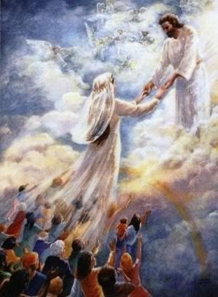

Slide 130
John 14:1-4
1 "Let not your heart be troubled; you believe in God, believe also in Me. 2 In My Father's house are many mansions; if it were not so, I would have told you. I go to prepare a place for you. 3 And if I go and prepare a place for you, I will come again and receive you to Myself; that where I am, there you may be also. 4 And where I go you know, and the way you know."

Slide 131
The Bride has been bought with a price and is to spend her time preparing to live as a wife and mother in Israel. Spending her days learning how to please her husband and waiting for his return.

Slide 132
2. The Bridal price was established for the Bride

Slide 133
1 Peter 1:18-19
18 knowing that you were not redeemed with corruptible things, like silver or gold, from your aimless conduct received by tradition from your fathers, 19 but with the precious blood of Christ, as of a lamb without blemish and without spot.

Slide 134
1 Corinthians 6:19-20
19 Or do you not know that your body is the temple of the Holy Spirit who is in you, whom you have from God, and you are not your own? 20 For you were bought at a price; therefore glorify God in your body and in your spirit, which are God's.

Slide 135
3. Bride and Groom are Betrothed

Slide 136
This legally binds the two together but they don’t live together.

Slide 137
Hosea 2:19-23
9 "I will betroth you to Me forever; Yes, I will betroth you to Me In righteousness and justice, In lovingkindness and mercy; 20 I will betroth you to Me in faithfulness, And you shall know the LORD. 21 "It shall come to pass in that day That I will answer," says the LORD; "I will answer the heavens, And they shall answer the earth.

Slide 138
22 The earth shall answer With grain, With new wine, And with oil; They shall answer Jezreel. 23 Then I will sow her for Myself in the earth, And I will have mercy on her who had not obtained mercy; Then I will say to those who were not My people, 'You are My people!' And they shall say, 'You are my God!' "

Slide 139
4. Written document drawn up called the Ketubah which states the bride price, promises of the groom, and the rights of the bride. The Bible is our Ketubah!

Slide 140
2 Corinthians 1:20-22
20 For all the promises of God in Him are Yes, and in Him Amen, to the glory of God through us. 21 Now He who establishes us with you in Christ and has anointed us is God, 22 who also has sealed us and given us the Spirit in our hearts as a guarantee.

Slide 141
5. The Bride must give her consent
“I do”

Slide 142
Romans 10:9-13
9 that if you confess with your mouth the Lord Jesus and believe in your heart that God has raised Him from the dead, you will be saved. 10 For with the heart one believes unto righteousness, and with the mouth confession is made unto salvation.

Slide 143
11 For the Scripture says, "Whoever believes on Him will not be put to shame." 12 For there is no distinction between Jew and Greek, for the same Lord over all is rich to all who call upon Him. 13 For "whoever calls on the name of the LORD shall be saved."

Slide 144
4. The marriage Supper of the Lamb

Slide 145
Revelation 19:7-9
7 Let us be glad and rejoice and give Him glory, for the marriage of the Lamb has come, and His wife has made herself ready." 8 And to her it was granted to be arrayed in fine linen, clean and bright, for the fine linen is the righteous acts of the saints. 9 Then he said to me, "Write: 'Blessed are those who are called to the marriage supper of the Lamb!' " And he said to me, "These are the true sayings of God."

Slide 146
6. Ha Melech (Coronation of the Messiah)

Slide 147
Psalms 98:6-9
6 With trumpets and the sound of a horn; Shout joyfully before the LORD, the King. 7 Let the sea roar, and all its fullness, The world and those who dwell in it; 8 Let the rivers clap their hands; Let the hills be joyful together before the LORD, 9 For He is coming to judge the earth. With righteousness He shall judge the world, And the peoples with equity.

Slide 148
Hebrews 1:8
8 But to the Son He says: "Your throne, O God, is forever and ever; A scepter of righteousness is the scepter of Your Kingdom.

Slide 149
Psalm 47:1-4
1 Oh, clap your hands, all you peoples! Shout to God with the voice of triumph! 2 For the LORD Most High is awesome; He is a great King over all the earth. 3 He will subdue the peoples under us, And the nations under our feet. 4 He will choose our inheritance for us, The excellence of Jacob whom He loves.

Slide 150
Titus 2:12-15
13 looking for the blessed hope and glorious appearing of our great God and Savior Jesus Christ, 14 who gave Himself for us, that He might redeem us from every lawless deed and purify for Himself His own special people, zealous for good works. 15 Speak these things, exhort, and rebuke with all authority. Let no one despise you.

Slide 151
2 Peter:12-17
¹² looking for and hastening the coming of the day of God, because of which the heavens will be dissolved, being on fire, and the elements will melt with fervent heat? ¹³ Nevertheless we, according to His promise, look for new heavens and a new earth in which righteousness dwells.

Slide 152
¹⁴ Therefore, beloved, looking forward to these things, be diligent to be found by Him in peace, without spot and blameless; ¹⁵ and consider that the longsuffering of our Lord is salvation—as also our beloved brother Paul, according to the wisdom given to him, has written to you,

Slide 153
¹⁶ as also in all his epistles, speaking in them of these things, in which are some things hard to understand, which untaught and unstable people twist to their own destruction, as they do also the rest of the Scriptures.

Slide 154
¹⁷ You therefore, beloved, since you know this beforehand, beware lest you also fall from your own steadfastness, being led away with the error of the wicked; ¹⁸ but grow in the grace and knowledge of our Lord and Savior Jesus Christ. To Him be the glory both now and forever. Amen

Slide 155
1 Thessalonians 4:13-18
13 But I do not want you to be ignorant, brethren, concerning those who have fallen asleep, lest you sorrow as others who have no hope. 14 For if we believe that Jesus died and rose again, even so God will bring with Him those who sleep in Jesus.

Slide 156
15 For this we say to you by the word of the Lord, that we who are alive and remain until the coming of the Lord will by no means precede those who are asleep. 16 For the Lord Himself will descend from heaven with a shout, with the voice of an archangel, and with the trumpet of God. And the dead in Christ will rise first.

Slide 157
17 Then we who are alive and remain shall be caught up together with them in the clouds to meet the Lord in the air. And thus we shall always be with the Lord. 18 Therefore comfort one another with these words.

Slide 158
1 Corinthians 15:50-54
50 Now this I say, brethren, that flesh and blood cannot inherit the kingdom of God; nor does corruption inherit incorruption. 51 Behold, I tell you a mystery: We shall not all sleep, but we shall all be changed-- 52 in a moment, in the twinkling of an eye, at the last trumpet. For the trumpet will sound, and the dead will be raised incorruptible, and we shall be changed.

Slide 159
53 For this corruptible must put on incorruption, and this mortal must put on immortality. 54 So when this corruptible has put on incorruption, and this mortal has put on immortality, then shall be brought to pass the saying that is written: "Death is swallowed up in victory."

Slide 160
20 Again, when a righteous man turns from his righteousness and commits iniquity, and I lay a stumbling block before him, he shall die; because you did not give him warning, he shall die in his sin, and his righteousness which he has done shall not be remembered; but his blood I will require at your hand.

Slide 161
Acts 2:38-39
38 Then Peter said to them, "Repent, and let every one of you be baptized in the name of Jesus Christ for the remission of sins; and you shall receive the gift of the Holy Spirit. 39 For the promise is to you and to your children, and to all who are afar off, as many as the Lord our God will call."

Slide 162
“For the Joy of the Lord is your Strength”
Nehemiah 8:10

