Slide 1


Slide 2
“Everlasting God”
(Jeremy Camp)

Slide 3
Strength will rise as we wait upon the Lord we will wait upon the Lord. We will wait upon the Lord.

Slide 4
Strength will rise as we wait upon the Lord. We will wait upon the Lord. We will wait upon the Lord.

Slide 5
Our god you reign forever. Our hope our strong deliverer. You are the everlasting God. The

Slide 6
Ever;asting god. You do not faint you wont grow weary. You’re the defender of the weak. You comfort

Slide 7
Those in need. You lift us up on wings like eagles.
Strength will rise as we wait upon the Lord. We will

Slide 8
Wait upon the Lord. We will wait upon the Lord. Strength will rise as we wait upon the Lord. Wait

Slide 9
Upon the Lord. We will wait upon the Lord. Our God you reign forever. Our hope our strong deliverer.

Slide 10
You are the everlasting God. The everlasting God. You do not faint you wont grow weary. You’re the

Slide 11
Defender of the weak. You comfort those in need. You lift us up on wings like eagles.

Slide 12
You are the everlasting God. The everlasting God. You do not faint you wont grow weary. You’re the

Slide 13
Defender of the weak. You comfort those in need you lift us up on wings like eagles.

Slide 14
“Look to Jesus”
(Phil Wickham)

Slide 15
Death is like an empty grave. Fear looks like a giant slain. Trails look like gifts of grace. When I look to

Slide 16
Failures bow to victory. Sin has lost it’s hold on me. Endless love is all I see. When I look to Jesus.

Slide 17
How my heart leaps. How my soul sings. For I know where my help comes from. Jesus Sought me. Jesus

Slide 18
Saved me. Hallelujah for all he’s done, yeah. Every wall comes crashing down. Chains are broken on the

Slide 19
Ground. What can stand against us now When we look to Jesus? How my heart leaps. How my soul

Slide 20
Sings. For I know where my help comes from. Jesus sought me. Jesus saved me . Hallelujah for all he’s

Slide 21
Done. How my heart leaps how my soul sings. For I know where my help comes from. Jesus sought me.

Slide 22
Jesus saved me. Hallelujah for all he’s done. I will keep my eyes on you. We’ll dance upon the

Slide 23
Crashing waves. I will keep my eyes on you. For only you can make a way. I will keep my eyes on you.

Slide 24
We’ll dance upon the crashing waves. I will keep my eyes on you. For only you can make a way.

Slide 25
How my heart leaps. How my soul sings. For I know where my help comes from. Jesus sought me. Jesus

Slide 26
Saved me. Hallelujah for all he’s done. How my heart leaps. How my soul sings. For I know where my help

Slide 27
Comes from. Jesus sought me. Jesus saved me. Hallelujah for all he’s done. For all he’s done. Sing

Slide 28
Hallelujah for all he’s done. We sing hallelujah. Hallelujah for all he’s done.

Slide 29
“Glory to Glory”
(Bethel)

Slide 30
Created from dust. You came and you lived among us. You took on our frame. You walked in our pain

Slide 31
And now you’re taking us higher. You stepped into time. You laid down your life to save us. You took all

Slide 32
Our shame. On the cross it was laid and now your taking us higher. We go from glory to glory to glory.

Slide 33
We’ll never be the same never be the same. We go from glory to glory to glory. We’re forever changed

Slide 34
Forever changed. You call me your friend. Brought into your endless kingdom. By the blood I was made.

Slide 35
No longer a slave and now you’re taking us higher. Until we reach that day, love conquers everything.

Slide 36
We’ll cry an anthem singing, Holy, Holy. And when we see that day, we’re standing face to face. We’ll

Slide 37
Shout n anthem singing, Holy, Holy. You took on the grave. So, not even death can shake us. The victor

Slide 38
Has won and heaven has come. And now you’re taking us higher.And now you’re taking us higher.

Slide 39
We go from glory to glory to glory. We’ll never be the same. Never be the same. You take us higher and

Slide 40
Higher and higher. We’re forever changed. Were forever changed. We go from glory to glory to glory.

Slide 41
We go from glory to glory to glory. You take us higher and higher and higher. We’re forever changed. We’re

Slide 42
”How he loves”

Slide 43
He is jealous for me. Loves like a hurricane, I am a tree. Bending beneath the weight of his wind and

Slide 44
Mercy. When all of a sudden. I am unware of these afflictions eclipsed by glory. And I realize just how

Slide 45
Beautiful you are ande how great your affections are for me. And oh, How he loves us. Oh how he loves

Slide 46
Us. How he loves us all. And he is jealous for me. Love’s like a hurricane, I am a tree. Bending

Slide 47
Beneath the weight of his wind and mercy. When all of a sudden I am unware of these afflictions eclipsed

Slide 48
By glory. And I realize just how beautiful you are and how great your affections are for me. And oh how he

Slide 49
Loves us, oh. Oh how he loves us. How he loves us all. Yeah, He loves us. Oh, How he love us. Oh, How

Slide 50
He loves us. Oh, how he loves us. And we are his portion and he is is our prize. Drawn to redemption

Slide 51
By the grace in his his. If grace is an ocean, we’re all sinking. And heaven meets earth like an unforeseen

Slide 52
Kiss and my heart turns violently inside of my chest. I don’t have time to maintain these regrets. When I

Slide 53
Think about the way. That he loves us. Oh how he loves us. Oh’ how he loves us. Oh how he loves.

Slide 54
Yeah he love us. Oh, How he loves us. Oh, how he love us, Oh how he loves..

Slide 55
Forever changed.

Slide 56
“I have decided to follow Jesus”

Slide 57
I have decided to follow Jesus. I have decided to follow Jesus. I have decided to follow Jesus.

Slide 58
No turning back, no turning back. Tho’ none go with me, I still will follow. Tho’ none go with me I still will

Slide 59
Follow. Tho’ none go with me I still will follow. No turning back, no turning back.

Slide 60
My cross I’ll carry, till I see Jesus. My cross I’ll carry till I see Jesus. My cross I’ll carry till I see Jesus.

Slide 61
No turning Back, No turning Back.

Slide 63
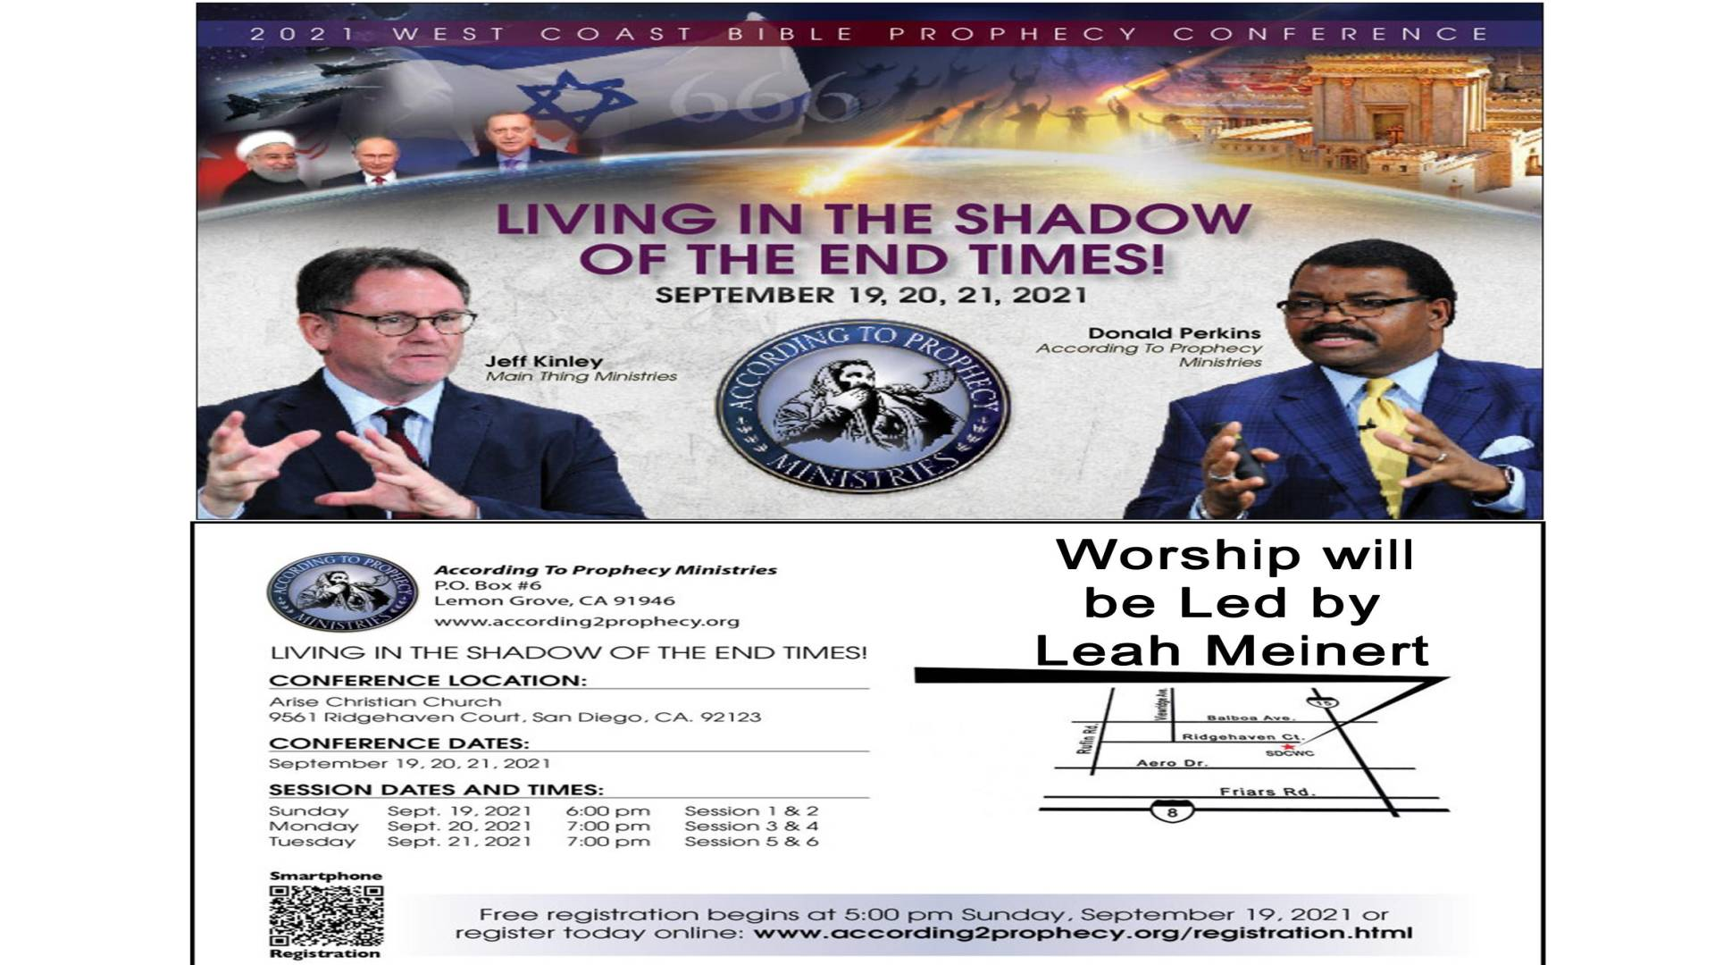

Slide 64
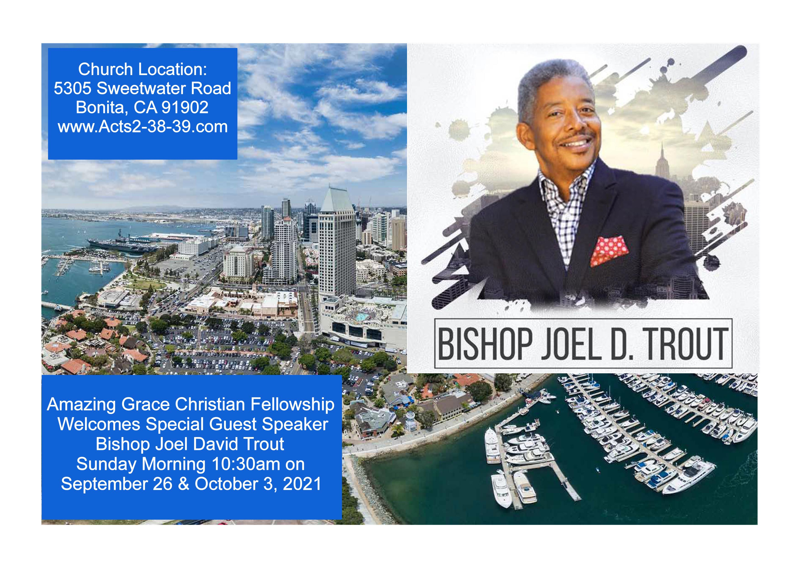

Slide 65
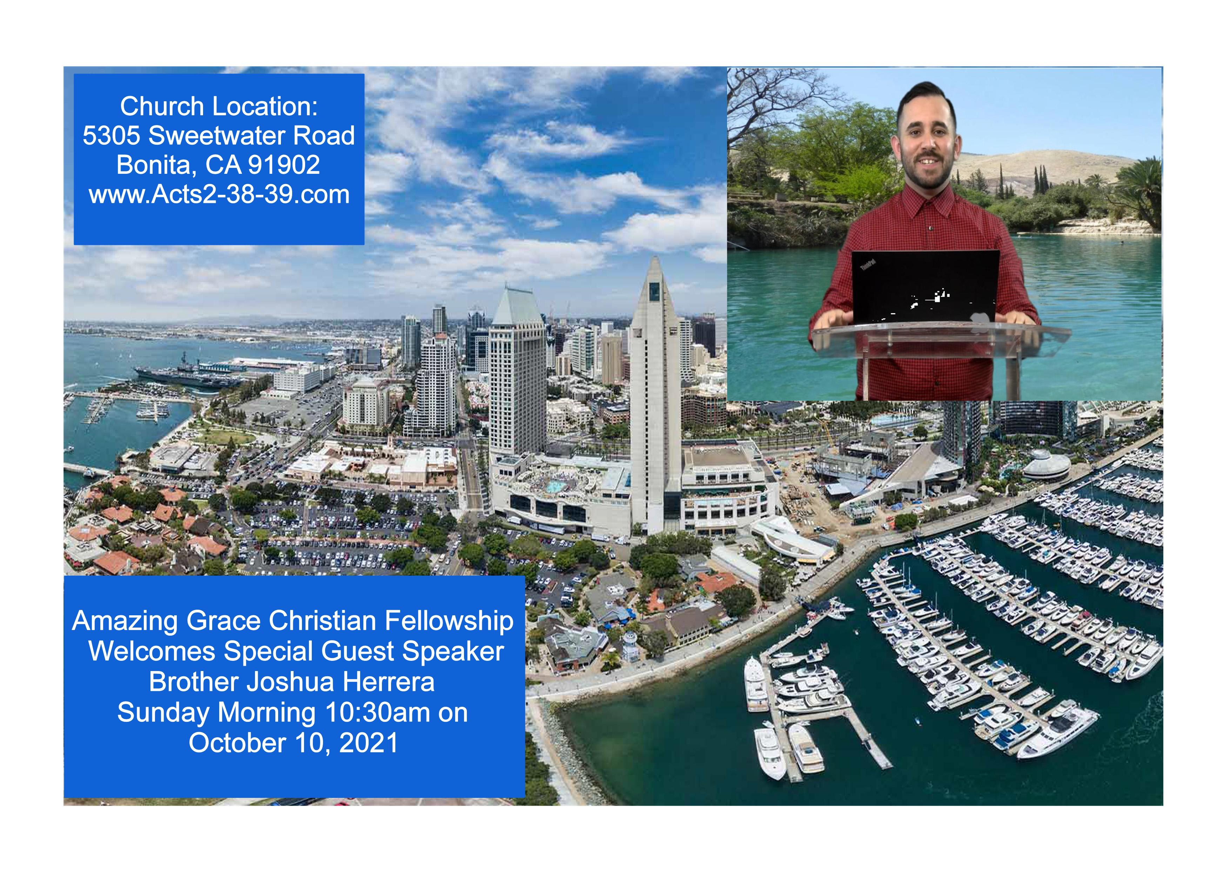

Slide 66


Slide 67
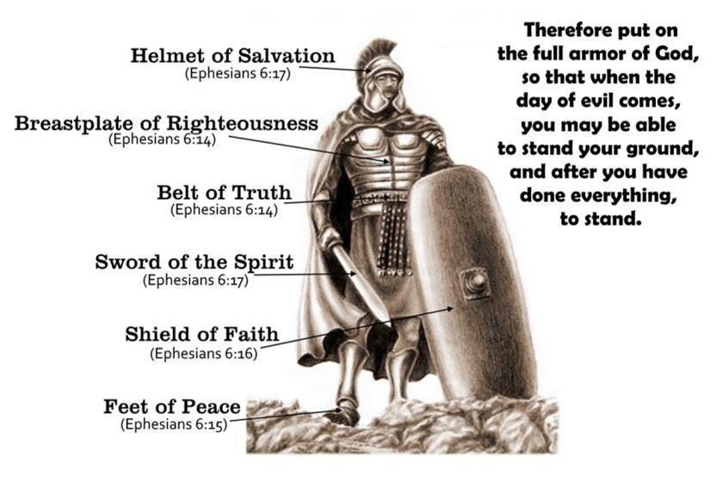

Be Strong in The Power of His Might
by Pastor Fee Soliven
Joshua 1:5-9
Sunday Morning
September 19, 2021

Slide 68
Joshua 1:5-9
5 No man shall be able to stand before you all the days of your life; as I was with Moses, so I will be with you. I will not leave you nor forsake you. 6 Be strong and of good courage, for to this people you shall divide as an inheritance the land which I swore to their fathers to give them.

Slide 69
7 Only be strong and very courageous, that you may observe to do according to all the law which Moses My servant commanded you; do not turn from it to the right hand or to the left, that you may prosper wherever you go. 8 This Book of the Law shall not depart from your mouth, but you shall meditate in it day and night, that you may observe to do according to all that is written in it. For then you will make your way prosperous, and then you will have good success.

Slide 70
9 Have I not commanded you? Be strong and of good courage; do not be afraid, nor be dismayed, for the LORD your God is with you wherever you go."

Slide 71
The most important activity in a Believer’s Life is Personal, Private Meditation on God and His Word

Slide 72
Joshua 1:9
Have I not commanded you? Be strong and of good courage; do not be afraid, nor be dismayed, for the LORD your God is with you wherever you go."

Slide 73
Numbers 14:1-31
14:1 So all the congregation lifted up their voices and cried, and the people wept that night. 2 And all the children of Israel complained against Moses and Aaron, and the whole congregation said to them, "If only we had died in the land of Egypt! Or if only we had died in this wilderness!

Slide 74
3 Why has the LORD brought us to this land to fall by the sword, that our wives and children should become victims? Would it not be better for us to return to Egypt?"

Slide 75
4 So they said to one another, "Let us select a leader and return to Egypt." 5 Then Moses and Aaron fell on their faces before all the assembly of the congregation of the children of Israel. 6 But Joshua the son of Nun and Caleb the son of Jephunneh, who were among those who had spied out the land, tore their clothes; 7 and they spoke to all the congregation of the children of Israel, saying: "The land we passed through to spy out is an exceedingly good land.

Slide 76
8 If the LORD delights in us, then He will bring us into this land and give it to us, 'a land which flows with milk and honey.' 9 "Only do not rebel against the LORD, nor fear the people of the land, for they are our bread; their protection has departed from them, and the LORD is with us. Do not fear them." 10 And all the congregation said to stone them with stones. Now the glory of the LORD appeared in the tabernacle of meeting before all the children of Israel.

Slide 77
11 Then the LORD said to Moses: "How long will these people reject Me? And how long will they not believe Me, with all the signs which I have performed among them? 12 I will strike them with the pestilence and disinherit them, and I will make of you a nation greater and mightier than they."

Slide 78
13 And Moses said to the LORD: "Then the Egyptians will hear it, for by Your might You brought these people up from among them, 14 and they will tell it to the inhabitants of this land. They have heard that You, LORD, are among these people; that You, LORD, are seen face to face and that Your cloud stands above them; and You go before them in a pillar of cloud by day and in a pillar of fire by night.

Slide 79
15 Now if You kill these people as one man, then the nations which have heard of Your fame will speak, saying, 16'Because the LORD was not able to bring this people to the land which He swore to give them, therefore He killed them in the wilderness.' 17 "And now, I pray, let the power of my LORD be great, just as You have spoken, saying,

Slide 80
18'The LORD is longsuffering and abundant in mercy, forgiving iniquity and transgression; but He by no means clears the guilty, visiting the iniquity of the fathers on the children to the third and fourth generation.'

Slide 81
19 "Pardon the iniquity of this people, I pray, according to the greatness of Your mercy, just as You have forgiven this people, from Egypt even until now." 20 Then the LORD said: "I have pardoned, according to your word; 21 but truly, as I live, all the earth shall be filled with the glory of the LORD—

Slide 82
22 because all these men who have seen My glory and the signs which I did in Egypt and in the wilderness, and have put Me to the test now these ten times, and have not heeded My voice, 23 they certainly shall not see the land of which I swore to their fathers, nor shall any of those who rejected Me see it. 24 But My servant Caleb, because he has a different spirit in him and has followed Me fully, I will bring into the land where he went, and his descendants shall inherit it.

Slide 83
25 Now the Amalekites and the Canaanites dwell in the valley; tomorrow turn and move out into the wilderness by the Way of the Red Sea." 26 Then the LORD spoke to Moses and Aaron, saying, 27 "How long shall I bear with this evil congregation who murmur against Me? I have heard the complaints which the children of Israel murmur against Me.

Slide 84
28 Say to them, 'As I live,' says the LORD, 'just as you have spoken in My hearing, so I will do to you: 29 The carcasses of you who have complained against Me shall fall in this wilderness, all of you who were numbered, according to your entire number, from twenty years old and above. 30 Except for Caleb the son of Jephunneh and Joshua the son of Nun, you shall by no means enter the land which I swore I would make you dwell in.

Slide 85
The Lord’s Promises

Slide 86
Joshua 1:2-3
“Arise, cross this Jordan, you and all this people, to the land which I am giving to them, to the sons of Israel. Every place on which the sole of your foot treads, I have given it to you”

Slide 87
Joshua 1:5
No man shall be able to stand before you all the days of your life; as I was with Moses, so I will be with you. I will not leave you nor forsake you.

Slide 88
God’s Command

Slide 89
Joshua 1:6
Be strong and of good courage, for to this people you shall divide as an inheritance the land which I swore to their fathers to give them.

Slide 90
Definition of Meditation

Slide 91
Meditation includes reading Scripture, believing what it says, absorbing it into our hearts, and obeying what God says.

Slide 92
Definition of Courage

Slide 93
Courage is the quality of mind and spirit enabling one to meet danger, opposition, or the challenges of life with fearlessness, calmness, and firmness by trusting and obeying God.

Slide 94
The Command

Slide 95
Joshua 1:9
“Be Strong and Courageous…”

Slide 96
The Basis

Slide 97
Joshua 1:5
“I will be with you; I will not fail you or forsake you”

Slide 98
The Caution

Slide 99
Joshua 1:9
“Do not tremble or be dismayed, for the Lord your God is with you wherever you go...”

Slide 100
The Issue

Slide 101
Joshua 1:8
“This book of the law shall not depart from your mouth, but you shall meditate on it day and night, so that you may be careful to do according to all that is written in it; for then you will make your way prosperous, and then you will have success”

Slide 102
The Consequences

Slide 103
Joshua 1:7
“Be careful to do according to all the law which Moses My servant commanded you; do not turn from it to the right or to the left, so that you may have success wherever you go....”

Slide 104
1. Do you trust God in challenging times?

Slide 105
2. According to today’s passage, what is the evidence of genuine trust in a person’s life?

Slide 106
3. How is it displayed in your emotions, your habits, and your willingness to obey whatever God asks of you?

Slide 107
4. How ready are you to obey the Lord when you don’t know the details of how the situation will work out?

Slide 108
5. How could meditation each morning on God’s command, “Be strong and courageous,” influence your attitude, thinking, and obedience to Him throughout the day?

Slide 109
1 Thessalonians 4:13-18
13 But I do not want you to be ignorant, brethren, concerning those who have fallen asleep, lest you sorrow as others who have no hope. 14 For if we believe that Jesus died and rose again, even so God will bring with Him those who sleep in Jesus.

Slide 110
15 For this we say to you by the word of the Lord, that we who are alive and remain until the coming of the Lord will by no means precede those who are asleep. 16 For the Lord Himself will descend from heaven with a shout, with the voice of an archangel, and with the trumpet of God. And the dead in Christ will rise first.

Slide 111
17 Then we who are alive and remain shall be caught up together with them in the clouds to meet the Lord in the air. And thus we shall always be with the Lord. 18 Therefore comfort one another with these words.

Slide 112
1 Corinthians 15:50-54
50 Now this I say, brethren, that flesh and blood cannot inherit the kingdom of God; nor does corruption inherit incorruption. 51 Behold, I tell you a mystery: We shall not all sleep, but we shall all be changed-- 52 in a moment, in the twinkling of an eye, at the last trumpet. For the trumpet will sound, and the dead will be raised incorruptible, and we shall be changed.

Slide 113
53 For this corruptible must put on incorruption, and this mortal must put on immortality. 54 So when this corruptible has put on incorruption, and this mortal has put on immortality, then shall be brought to pass the saying that is written: "Death is swallowed up in victory."

Slide 114

20 Again, when a righteous man turns from his righteousness and commits iniquity, and I lay a stumbling block before him, he shall die; because you did not give him warning, he shall die in his sin, and his righteousness which he has done shall not be remembered; but his blood I will require at your hand.

Slide 115
Acts 2:38-39
38 Then Peter said to them, "Repent, and let every one of you be baptized in the name of Jesus Christ for the remission of sins; and you shall receive the gift of the Holy Spirit. 39 For the promise is to you and to your children, and to all who are afar off, as many as the Lord our God will call."

Slide 116
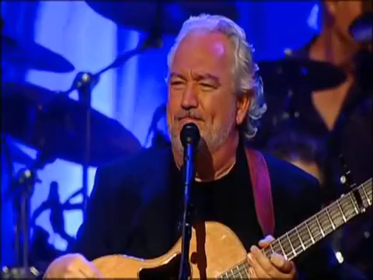
“For the Joy of the Lord is your Strength”
Nehemiah 8:10

