Slide 2
1 Corinthians 15:51-54
51 Behold, I shew you a mystery; We shall not all sleep, but we shall all be changed, 52 In a moment, in the twinkling of an eye, at the last trump: for the trumpet shall sound, and the dead shall be raised incorruptible, and we shall be changed.

Slide 3
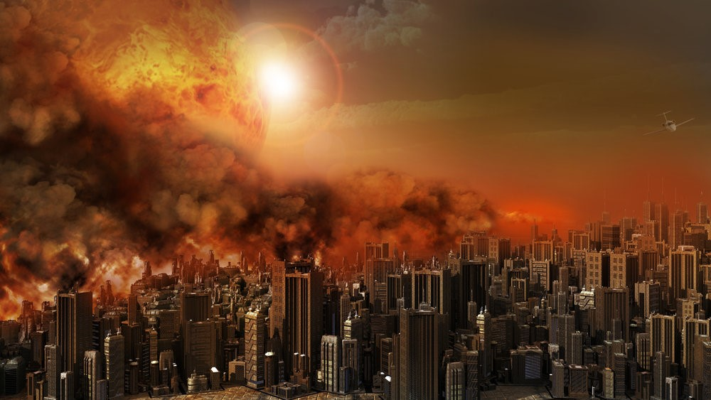
Delivered from the Wrath to Come
by Pastor Fee Soliven
1 Thessalonians 1:5-10
Wednesday Night
September 1, 2021

Slide 4
1 Thessalonians 1:5-10
5 For our gospel did not come to you in word only, but also in power, and in the Holy Spirit and in much assurance, as you know what kind of men we were among you for your sake. 6 And you became followers of us and of the Lord, having received the word in much affliction, with joy of the Holy Spirit,

Slide 5
7 so that you became examples to all in Macedonia and Achaia who believe. 8 For from you the word of the Lord has sounded forth, not only in Macedonia and Achaia, but also in every place. Your faith toward God has gone out, so that we do not need to say anything.

Slide 6
9 For they themselves declare concerning us what manner of entry we had to you, and how you turned to God from idols to serve the living and true God, 10 and to wait for His Son from heaven, whom He raised from the dead, even Jesus who delivers us from the wrath to come.

Slide 7
1 Corinthians 2:1-5
1 And I, brethren, when I came to you, did not come with excellence of speech or of wisdom declaring to you the testimony of God. 2 For I determined not to know anything among you except Jesus Christ and Him crucified. 3 I was with you in weakness, in fear, and in much trembling.

Slide 8
4 And my speech and my preaching were not with persuasive words of human wisdom, but in demonstration of the Spirit and of power, 5 that your faith should not be in the wisdom of men but in the power of God.

Slide 9
Philippians 3:8-11
8 Yet indeed I also count all things loss for the excellence of the knowledge of Christ Jesus my Lord, for whom I have suffered the loss of all things, and count them as rubbish, that I may gain Christ 9 and be found in Him, not having my own righteousness, which is from the law, but that which is through faith in Christ, the righteousness which is from God by faith;

Slide 10
10 that I may know Him and the power of His resurrection, and the fellowship of His sufferings, being conformed to His death, 11 if, by any means, I may attain to the resurrection from the dead.

Slide 11
6 And you became followers of us and of the Lord, having received the word in much affliction, with joy of the Holy Spirit,

Slide 12
Acts 17:1-6
1 Now when they had passed through Amphipolis and Apollonia, they came to Thessalonica, where there was a synagogue of the Jews. 2 Then Paul, as his custom was, went into them, and for three Sabbaths reasoned with them from the Scriptures,

Slide 13
3 explaining and demonstrating that the Christ had to suffer and rise again from the dead, and saying, "This Jesus whom I preach to you is the Christ." 4 And some of them were persuaded; and a great multitude of the devout Greeks, and not a few of the leading women, joined Paul and Silas.

Slide 14
5 But the Jews who were not persuaded, becoming envious, took some of the evil men from the marketplace, and gathering a mob, set all the city in an uproar and attacked the house of Jason, and sought to bring them out to the people.

Slide 15
6 But when they did not find them, they dragged Jason and some brethren to the rulers of the city, crying out, "These who have turned the world upside down have come here too.

Slide 16
Galatians 5:22-25
22 But the fruit of the Spirit is love, joy, peace, longsuffering, kindness, goodness, faithfulness, 23 gentleness, self-control. Against such there is no law. 24 And those who are Christ's have crucified the flesh with its passions and desires. 25 If we live in the Spirit, let us also walk in the Spirit.

Slide 17
7 so that you became examples to all in Macedonia and Achaia who believe.

Slide 18
1 Timothy 4:11-12
11 These things command and teach. 12 Let no one despise your youth, but be an example to the believers in word, in conduct, in love, in spirit, in faith, in purity.

Slide 19
Hebrews 13:7
7 Remember those who rule over you, who have spoken the word of God to you, whose faith follow, considering the outcome of their conduct.

Slide 20
1 Corinthians 11:1-2
1 Imitate me, just as I also imitate Christ. 2 Now I praise you, brethren, that you remember me in all things and keep the traditions just as I delivered them to you.

Slide 21
8 For from you the word of the Lord has sounded forth, not only in Macedonia and Achaia, but also in every place. Your faith toward God has gone out, so that we do not need to say anything.

Slide 22
Psalm 92:1-2
1 It is good to give thanks to the LORD, and to sing praises to Your name, O Most High; 2 To declare Your lovingkindness in the morning, And Your faithfulness every night...

Slide 23
Hebrews 10:22-25
22 let us draw near with a true heart in full assurance of faith, having our hearts sprinkled from an evil conscience and our bodies washed with pure water. 23 Let us hold fast the confession of our hope without wavering, for He who promised is faithful.

Slide 24
24 And let us consider one another in order to stir up love and good works, 25 not forsaking the assembling of ourselves together, as is the manner of some, but exhorting one another, and so much the more as you see the Day approaching.

Slide 25
9 For they themselves declare concerning us what manner of entry we had to you, and how you turned to God from idols to serve the living and true God,

Slide 26
2 Corinthians 6:17-18
17 Therefore "Come out from among them and be separate, says the Lord. Do not touch what is unclean, And I will receive you." 18 "I will be a Father to you, and you shall be My sons and daughters, Says the LORD Almighty."

Slide 27
Matthew 10:32-39
32 "Therefore whoever confesses Me before men, him I will also confess before My Father who is in heaven. 33 But whoever denies Me before men, him I will also deny before My Father who is in heaven. 34 "Do not think that I came to bring peace on earth. I did not come to bring peace but a sword.

Slide 28
35 For I have come to 'set a man against his father, a daughter against her mother, and a daughter-in-law against her mother-in-law'; 36 and 'a man's enemies will be those of his own household.' 37 He who loves father or mother more than Me is not worthy of Me. And he who loves son or daughter more than Me is not worthy of Me.

Slide 29
38 And he who does not take his cross and follow after Me is not worthy of Me. 39 He who finds his life will lose it, and he who loses his life for My sake will find it.

Slide 30
10 and to wait for His Son from heaven, whom He raised from the dead, even Jesus who delivers us from the wrath to come.

Slide 31
Romans 1:18-19
18 For the wrath of God is revealed from heaven against all ungodliness and unrighteousness of men, who suppress the truth in unrighteousness, 19 because what may be known of God is manifest in them, for God has shown it to them.

Slide 32
Ephesians 5:3-7
3 But fornication and all uncleanness or covetousness, let it not even be named among you, as is fitting for saints; 4 neither filthiness, nor foolish talking, nor coarse jesting, which are not fitting, but rather giving of thanks. 5 For this you know that no fornicator, unclean person, nor covetous man, who is an idolater, has any inheritance in the kingdom of Christ and God.

Slide 33
6 Let no one deceive you with empty words, for because of these things the wrath of God comes upon the sons of disobedience. 7 Therefore do not be partakers with them.

Slide 34
Titus 2:11-13
11 For the grace of God that brings salvation has appeared to all men, 12 teaching us that, denying ungodliness and worldly lusts, we should live soberly, righteously, and godly in the present age, 13 looking for the blessed hope and glorious appearing of our great God and Savior Jesus Christ...

Slide 35
Acts 1:9-11
9 Now when He had spoken these things, while they watched, He was taken up, and a cloud received Him out of their sight. 10 And while they looked steadfastly toward heaven as He went up, behold, two men stood by them in white apparel,

Slide 36
11 who also said, "Men of Galilee, why do you stand gazing up into heaven? This same Jesus, who was taken up from you into heaven, will so come in like manner as you saw Him go into heaven."

Slide 37
1 Thessalonians 4:13-18
13 But I do not want you to be ignorant, brethren, concerning those who have fallen asleep, lest you sorrow as others who have no hope. 14 For if we believe that Jesus died and rose again, even so God will bring with Him those who sleep in Jesus.

Slide 38
15 For this we say to you by the word of the Lord, that we who are alive and remain until the coming of the Lord will by no means precede those who are asleep. 16 For the Lord Himself will descend from heaven with a shout, with the voice of an archangel, and with the trumpet of God. And the dead in Christ will rise first.

Slide 39
17 Then we who are alive and remain shall be caught up together with them in the clouds to meet the Lord in the air. And thus we shall always be with the Lord. 18 Therefore comfort one another with these words.

Slide 40
1 Corinthians 15:50-54
50 Now this I say, brethren, that flesh and blood cannot inherit the kingdom of God; nor does corruption inherit incorruption. 51 Behold, I tell you a mystery: We shall not all sleep, but we shall all be changed-- 52 in a moment, in the twinkling of an eye, at the last trumpet. For the trumpet will sound, and the dead will be raised incorruptible, and we shall be changed.

Slide 41
53 For this corruptible must put on incorruption, and this mortal must put on immortality. 54 So when this corruptible has put on incorruption, and this mortal has put on immortality, then shall be brought to pass the saying that is written: "Death is swallowed up in victory."

Slide 42
20 Again, when a righteous man turns from his righteousness and commits iniquity, and I lay a stumbling block before him, he shall die; because you did not give him warning, he shall die in his sin, and his righteousness which he has done shall not be remembered; but his blood I will require at your hand.

Slide 43
Acts 2:38-39
38 Then Peter said to them, "Repent, and let every one of you be baptized in the name of Jesus Christ for the remission of sins; and you shall receive the gift of the Holy Spirit. 39 For the promise is to you and to your children, and to all who are afar off, as many as the Lord our God will call."

