Slide 1


Slide 2
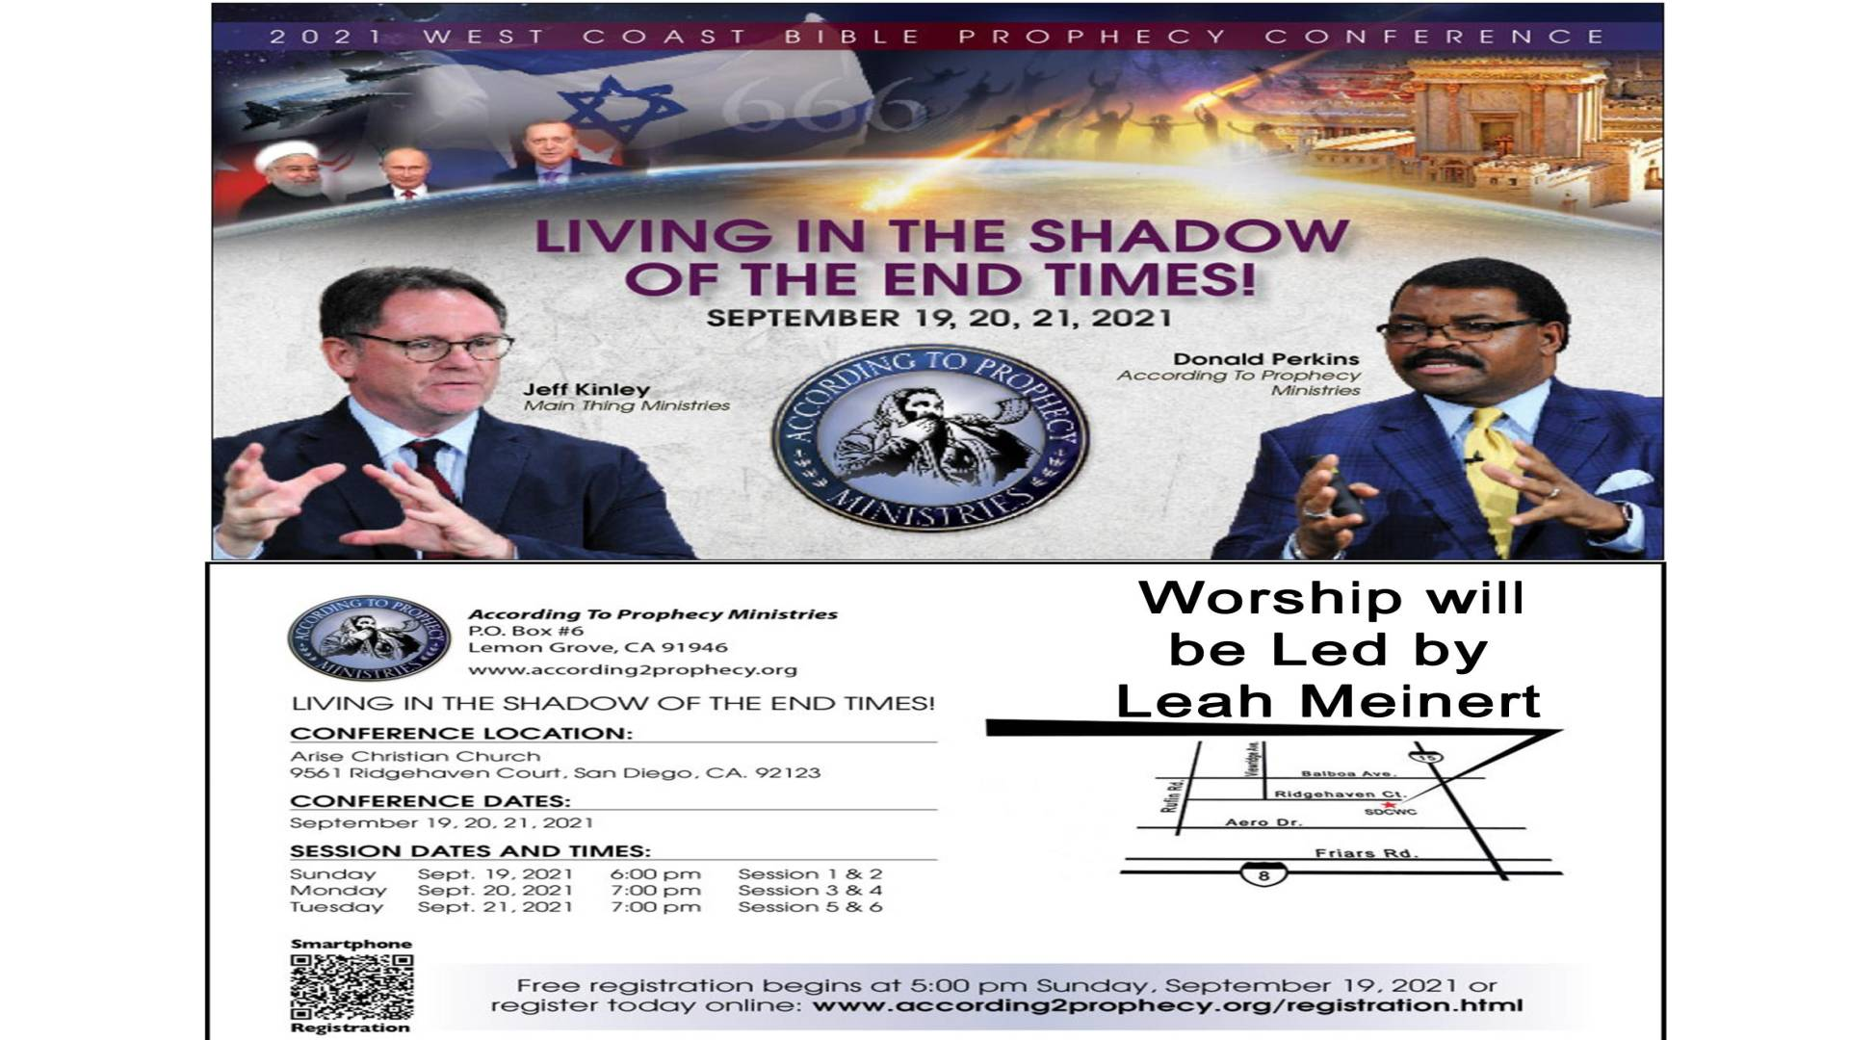

Slide 3
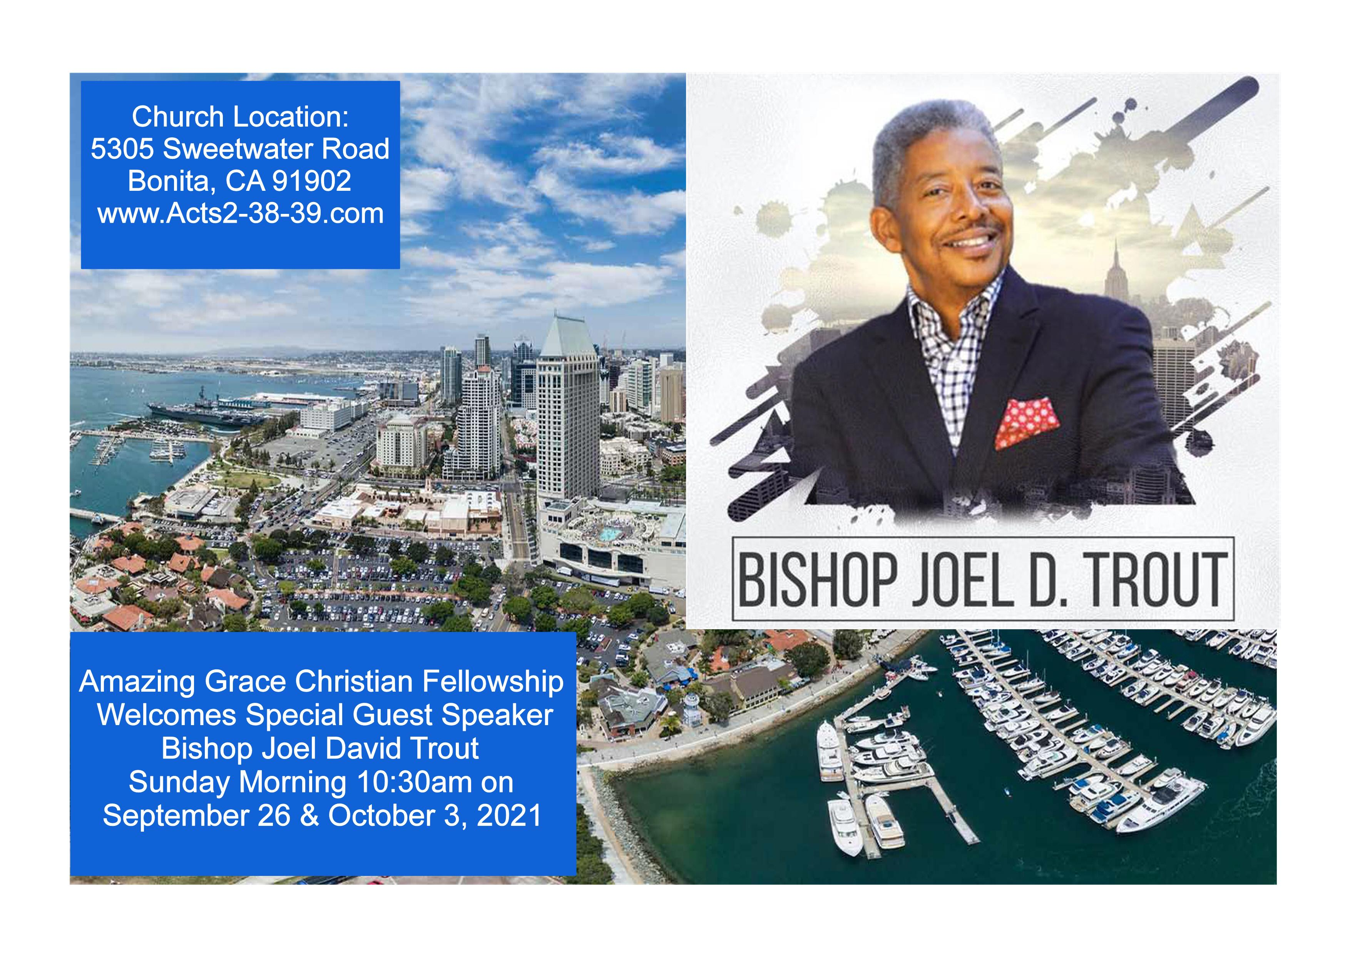

Slide 4
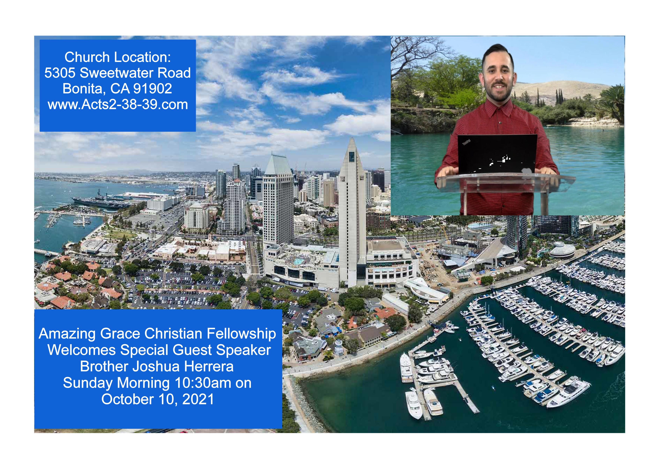

Slide 5
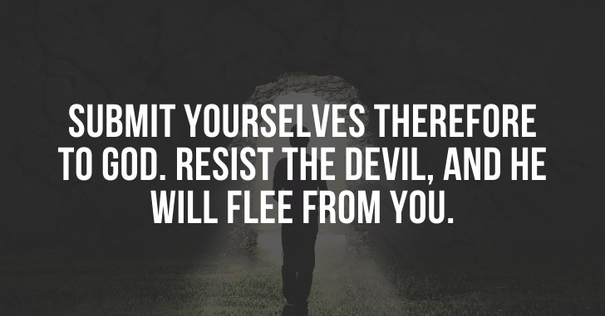

The Enemy Will Hinder You
by Pastor Fee Soliven
1 Thessalonians 2:16-20
Wednesday Evening
September 15, 2021

Slide 6
1 Thessalonians 2:16-20
16 forbidding us to speak to the Gentiles that they may be saved, so as always to fill up the measure of their sins; but wrath has come upon them to the uttermost. 17 But we, brethren, having been taken away from you for a short time in presence, not in heart, endeavored more eagerly to see your face with great desire.

Slide 7
18 Therefore we wanted to come to you--even I, Paul, time and again--but Satan hindered us. 19 For what is our hope, or joy, or crown of rejoicing? Is it not even you in the presence of our Lord Jesus Christ at His coming? 20 For you are our glory and joy.

Slide 8
16 forbidding us to speak to the Gentiles that they may be saved, so as always to fill up the measure of their sins; but wrath has come upon them to the uttermost.

Slide 9
Hebrews 3:1-15
1 Therefore, holy brethren, partakers of the heavenly calling, consider the Apostle and High Priest of our confession, Christ Jesus, 2 who was faithful to Him who appointed Him, as Moses also was faithful in all His house.

Slide 10
3 For this One has been counted worthy of more glory than Moses, inasmuch as He who built the house has more honor than the house. 4 For every house is built by someone, but He who built all things is God. 5 And Moses indeed was faithful in all His house as a servant, for a testimony of those things which would be spoken afterward,

Slide 11
6 but Christ as a Son over His own house, whose house we are if we hold fast the confidence and the rejoicing of the hope firm to the end. 7 Therefore, as the Holy Spirit says: "Today, if you will hear His voice, 8 Do not harden your hearts as in the rebellion, In the day of trial in the wilderness,

Slide 12
9 Where your fathers tested Me, tried Me, And saw My works forty years. 10 Therefore I was angry with that generation, And said, 'They always go astray in their heart, And they have not known My ways.' 11 So I swore in My wrath, 'They shall not enter My rest.' "

Slide 13
12 Beware, brethren, lest there be in any of you an evil heart of unbelief in departing from the living God; 13 but exhort one another daily, while it is called "Today," lest any of you be hardened through the deceitfulness of sin.

Slide 14
14 For we have become partakers of Christ if we hold the beginning of our confidence steadfast to the end, 15 while it is said: "Today, if you will hear His voice, Do not harden your hearts as in the rebellion."

Slide 15
Romans 10:1
"Brethren, my heart's desire and prayer to God for Israel is that they may be saved"

Slide 16
17 But we, brethren, having been taken away from you for a short time in presence, not in heart, endeavored more eagerly to see your face with great desire.

Slide 17
Hebrews 10:24-25
24 And let us consider one another in order to stir up love and good works, 25 not forsaking the assembling of ourselves together, as is the manner of some, but exhorting one another, and so much the more as you see the Day approaching.

Slide 18
Psalm 133:1-3
1 Behold, how good and how pleasant it is For brethren to dwell together in unity! 2 It is like the precious oil upon the head, Running down on the beard, The beard of Aaron, Running down on the edge of his garments. 3 It is like the dew of Hermon, Descending upon the mountains of Zion; For there the LORD commanded the blessing--Life forevermore.

Slide 19
18 Therefore we wanted to come to you--even I, Paul, time and again--but Satan hindered us.

Slide 20
Ephesians 6:12
"For we do not wrestle against flesh and blood, but against principalities, against powers, against the rulers of the darkness of this age, against spiritual hosts of wickedness in the heavenly places"

Slide 21
Our prayers can be hindered by Satan!

Slide 22
Daniel 10:10-14
(New Living Translation)
10 Just then a hand touched me and lifted me, still trembling, to my hands and knees. 11 And the man said to me, “Daniel, you are very precious to God, so listen carefully to what I have to say to you. Stand up, for I have been sent to you.” When he said this to me, I stood up, still trembling.

Slide 23
12 Then he said, “Don’t be afraid, Daniel. Since the first day you began to pray for understanding and to humble yourself before your God, your request has been heard in heaven. I have come in answer to your prayer.

Slide 24
13 But for twenty-one days the spirit prince of the kingdom of Persia blocked my way. Then Michael, one of the archangels, came to help me, and I left him there with the spirit prince of the kingdom of Persia. 14 Now I am here to explain what will happen to your people in the future, for this vision concerns a time yet to come.”

Slide 25
Satan will bring sexual temptation on those who lack self-control.

Slide 26
1 Corinthians 7:5
Do not deprive one another except with consent for a time, that you may give yourselves to fasting and prayer; and come together again so that Satan does not tempt you because of your lack of self-control.

Slide 27
The enemy will attempt to cause division among believers!

Slide 28
2 Corinthians 2:10-11
10 Now whom you forgive anything, I also forgive. For if indeed I have forgiven anything, I have forgiven that one for your sakes in the presence of Christ, 11 lest Satan should take advantage of us; for we are not ignorant of his devices.

Slide 29
Satan will bring in false teaching to lead believers astray!

Slide 30
2 Corinthians 11:3-4
3 But I fear, lest somehow, as the serpent deceived Eve by his craftiness, so your minds may be corrupted from the simplicity that is in Christ. 4 For if he who comes preaches another Jesus whom we have not preached, or if you receive a different spirit which you have not received, or a different gospel which you have not accepted--you may well put up with it!

Slide 31
Satan can even disguise himself as an angel of light

Slide 32
2 Corinthians 11:13-15
13 For such are false apostles, deceitful workers, transforming themselves into apostles of Christ. 14 And no wonder! For Satan himself transforms himself into an angel of light. 15 Therefore it
is no great thing if his ministers also transform themselves into ministers of righteousness, whose end will be according to their works.

Slide 33
19 For what is our hope, or joy, or crown of rejoicing? Is it not even you in the presence of our Lord Jesus Christ at His coming?

Slide 34
1 Corinthians 9:25-27
25 And everyone who competes for the prize is temperate in all things. Now they do it to obtain a perishable crown, but we for an imperishable crown. 26 Therefore I run thus: not with uncertainty. Thus I fight: not as one who beats the air. 27 But I discipline my body and bring it into subjection, lest, when I have preached to others, I myself should become disqualified.

Slide 35
Philippians 4:1
"Therefore, my beloved and longed-for brethren, my joy and crown, so stand fast in the Lord, beloved"

Slide 36
20 For you are our glory and joy.

Slide 37
1 Thessalonians 4:13-18
13 But I do not want you to be ignorant, brethren, concerning those who have fallen asleep, lest you sorrow as others who have no hope. 14 For if we believe that Jesus died and rose again, even so God will bring with Him those who sleep in Jesus.

Slide 38
15 For this we say to you by the word of the Lord, that we who are alive and remain until the coming of the Lord will by no means precede those who are asleep. 16 For the Lord Himself will descend from heaven with a shout, with the voice of an archangel, and with the trumpet of God. And the dead in Christ will rise first.

Slide 39
17 Then we who are alive and remain shall be caught up together with them in the clouds to meet the Lord in the air. And thus we shall always be with the Lord. 18 Therefore comfort one another with these words.

Slide 40
1 Corinthians 15:50-54
50 Now this I say, brethren, that flesh and blood cannot inherit the kingdom of God; nor does corruption inherit incorruption. 51 Behold, I tell you a mystery: We shall not all sleep, but we shall all be changed-- 52 in a moment, in the twinkling of an eye, at the last trumpet. For the trumpet will sound, and the dead will be raised incorruptible, and we shall be changed.

Slide 41
53 For this corruptible must put on incorruption, and this mortal must put on immortality. 54 So when this corruptible has put on incorruption, and this mortal has put on immortality, then shall be brought to pass the saying that is written: "Death is swallowed up in victory."

Slide 42

20 Again, when a righteous man turns from his righteousness and commits iniquity, and I lay a stumbling block before him, he shall die; because you did not give him warning, he shall die in his sin, and his righteousness which he has done shall not be remembered; but his blood I will require at your hand.

Slide 43
Acts 2:38-39
38 Then Peter said to them, "Repent, and let every one of you be baptized in the name of Jesus Christ for the remission of sins; and you shall receive the gift of the Holy Spirit. 39 For the promise is to you and to your children, and to all who are afar off, as many as the Lord our God will call."

