Slide 2
Rattle
(Elevation Worship)

Slide 3
Saturday was silent. Surely it was through. Since when has impossible. Ever stopped you. Friday’s

Slide 4
Disappointment. Is Sunday’s empty tomb. Since when has impossible ever stopped you.

Slide 5
This is the sound of dry bones rattling. This is the praise make a dead man walk again. Open the

Slide 6
Grave I’m coming out I’m gonna live, gonna live again. This is the sound of dry bones rattling.

Slide 7
Pentecostal fire stirring something new. You’re not gonna run out of miracles anytime soon. Yeah,

Slide 8
Resurrection power runs in my veins too. I believe there’s another miracle here in this room.

Slide 9
This is the sound of dry bones rattling. This is the praise make a dead man walk again. Open the

Slide 10
Grave im coming out I’m gonna live, gonna live again. This is the sound of dry bones rattling.

Slide 11
My God is able to save and deliver and heal

Slide 12
And restore anything that he wants to. Just ask the man who was thrown on the bones of Elisha. If

Slide 13
There’s anything that He can’t do. Just ask the stone that was rolled at the tomb in the garden. What

Slide 14
Happens when God says to move. I feel him moving it now. I feel him doing it now. I feel him doing it now.

Slide 15
Do it now, Do it now. This is the sound of dry bones rattling. This is the praise make a dead man walk

Slide 16
Again. Open the grave I’m coming out. I’m gonna live gonna live again. Open the grave I’m coming out

Slide 17
I’m gonna live gonna live again. Open the grave I’m coming out I’m gonna live gonna live again. This is

Slide 18
The sound of dry bones rattling.

Slide 19
“ Raise A Hallelujah”

Slide 20
I raise a hallelujah, In the presence of my enemies. I raise a hallelujah, louder than the unbelief. I raise a

Slide 21
Hallelujah, my weapon is a melody. I raise a hallelujah, heaven comes to fight for me.

Slide 22
I’m gonna sing in the middle of the storm. Louder and louder, you’re gonna hear my praises roar.

Slide 23
Up from the ashes, hope will arise. Death is defeated the king is alive. I raise a hallelujah, with

Slide 24
Everything inside of me. I raise a hallelujah, I will watch the darkness flee. I raise a hallelujah, In the

Slide 25
middle of the mystery. I raise a hallelujah, fear you lost your hold on me. I’m gonna sing in the middle

Slide 26
storm. Louder and louder. You’re gonna hear my praises roar. Up from the ashes. Hope will arise

Slide 27
death is defeated the king is alive. Sing a little louder(in the presence of my enemies. Sing a little

Slide 28
louder. (louder than the unbelief). Sing a little louder(my weapon is a melody. Sing a little louder.

Slide 29
(heaven comes to fight for me) Sing a little louder(in the presence of my enemies). Sing a little louder

Slide 30
(louder than the unbelief) Sing a little louder(my weapon is a melody).Sing a little louder( Heaven

Slide 31
comes o fight for me. Sing a little louder. Cause im gonna sing . In the middle of this storm louder and

Slide 32
louder your gonna hear my praises roar. Up from the ashes. Hope will arise. Death is defeated. The

Slide 33
king is alive. Cause im gonna sing . In the middle of this storm louder and louder. You’re gonna hear my

Slide 34
praises roar. Up from the ashes hope will arise. Death is defeate, The king is alive.

Slide 35
“Better Is One Day”
“Matt Redman”

Slide 36
Better is one day in your courts. Better is one day in your house. Better is one day in your courts. Than

Slide 37
Thousands else where. Better is one day in your courts. Better is one day in your house. Better is one

Slide 38
Day in your courts. Than thousands elsewhere. How lovely is your dwelling place. Oh, Lord oh mighty. For

Slide 39
My soul longs and even faints for you. For here my heart is satisfied. Within your presence. I sing

Slide 40
Beneath The shadow of your wings. Better is one day in your courts. Better is one day in your house.

Slide 41
Better is one Day in your courts than thousand elsewhere. Better is one day in your courts. Better is

Slide 42
one day in your House better is one day in your courts than thousands elsewhere. One thing I ask

Slide 43
and I would Seek. To see your beauty. To find you in the place your glory dwells. One thing I ask and I

Slide 44
would Seek To see your beauty. To find you in the place your glory dwells. Better is one day in your

Slide 45
Courts better Is one day in your house. Better is one day in your courts. Than thousands elsewhere.

Slide 46
Better is one day In your courts. Better is one day in your house. Better is one day in your courts than

Slide 47
thousands Elsewhere. Than thousands elsewhere. My heart and flesh cry out. To you the living God.

Slide 48
Your spirits Water to my soul. I’ve tasted and I’ve seen. Come once again to me. I will draw near to

Slide 49
you. I will draw Near to you. Better is one day in your courts better is one day in your house better is one

Slide 50
day in your Courts than thousands elsewhere. Better is One day. Better is one day. Better is one day. Than

Slide 51
thousands Elsewhere. Than thousands elsewhere.

Slide 52
The Great I Am

Slide 53
I wanna be close. Close to your side. So heaven is real and death is a lie. I wanna hear voices. Of

Slide 54
Angels above singing as one. Hallelujah, Holy, Holy. God almighty. The great I am. Who is worthy. None

Slide 55
Beside thee. God almighty. The great I am. I wanna be near. Near to your heart. Loving the world. Hating

Slide 56
The dark. I wanna see dry bones. Living again. Singing as one. Hallelujah, Holy, Holy. God Almighty

Slide 57
The Great I am. Who is worthy. None beside thee. God almighty. The great I am. The great I am.

Slide 58
The mountains shake before you. The demons run and flee. At the mention of the name King of

Slide 59
Majesty. There is no power in hell. Or any who could stand. Before the power and the presence. Of the

Slide 60
Great I am. The great I am Hallelujah Holy, holy. God almighty. The great I am. Who is worthy. None

Slide 61
Beside thee. God Almighty. The Great I am. Hallelujah, Holy, Holy. God almighty. The great I am.

Slide 62
Who is worthy. None beside thee. God almighty. The great I am. The great I am. He is the Great I am.

Slide 63
Cornerstone

Slide 64
My hope is built on nothing less. Than Jesus blood and righteousness. I dare not trust the sweetest

Slide 65
frame. But wholly trust in Jesus name. My hope is built on nothing less. Than Jesus blood and

Slide 66
righteousness. I dare not trust the sweetest frame Burt wholly trust in Jesus name. Christ alone,

Slide 67
Cornerstone weak made strong in the Savior’s love. Through the storm, He is Lord. Lord of all. When

Slide 68
Darkness seems to hide his face. I rest on his unchanging grace. In every high and stormy gale my

Slide 69
anchor holds within the Veil. My anchor holds within the veil. Christ alone Cornerstone.Weak made strong

Slide 70
in the Savior’s love. Through the storm, He is Lord. Lord of all. He is Lord, Lord of all. Christ alone

Slide 71
Cornerstone, weak made strong in the Savior’s love. Through the storm, He is Lord. Lord of all. When he

Slide 72
Shall come with trumpet sound. Oh may I then in him be found. Dressed in His righteousness alone.

Slide 73
Faultless stand before the throne. Christ alone, Cornerstone. Weak made stong in the Savior’s love.

Slide 74
Through the storm, He is Lord lord of all.

Slide 76
1 Corinthians 15:51-54
51 Behold, I shew you a mystery; We shall not all sleep, but we shall all be changed, 52 In a moment, in the twinkling of an eye, at the last trump: for the trumpet shall sound, and the dead shall be raised incorruptible, and we shall be changed.

Slide 77
The Great Deception
by Pastor Fee Soliven
Genesis 3:1-8
Sunday Morning
September 5, 2021

Slide 78
Genesis 3:1-8
1 Now the serpent was more cunning than any beast of the field which the LORD God had made. And he said to the woman, "Has God indeed said, 'You shall not eat of every tree of the garden'?" 2 And the woman said to the serpent, "We may eat the fruit of the trees of the garden;

Slide 79
3 but of the fruit of the tree which is in the midst of the garden, God has said, 'You shall not eat it, nor shall you touch it, lest you die.' " 4 Then the serpent said to the woman, "You will not surely die. 5 For God knows that in the day you eat of it your eyes will be opened, and you will be like God, knowing good and evil."

Slide 80
6 So when the woman saw that the tree was good for food, that it was pleasant to the eyes, and a tree desirable to make one wise, she took of its fruit and ate. She also gave to her husband with her, and he ate. 7 Then the eyes of both of them were opened, and they knew that they were naked; and they sewed fig leaves together and made themselves coverings.

Slide 81
8 And they heard the sound of the LORD God walking in the garden in the cool of the day, and Adam and his wife hid themselves from the presence of the LORD God among the trees of the garden.

Slide 82
The Alien Deception

Slide 83
Ezekiel 28:12-17
12 "Son of man, take up a lamentation for the king of Tyre, and say to him, 'Thus says the Lord GOD: "You were the seal of perfection, Full of wisdom and perfect in beauty. 13 You were in Eden, the garden of God; Every precious stone was your covering: The sardius, topaz, and diamond, Beryl, onyx, and jasper, Sapphire, turquoise, and emerald with gold. The workmanship of your timbrels and pipes Was prepared for you on the day you were created.

Slide 84
14 "You were the anointed cherub who covers; I established you; You were on the holy mountain of God; You walked back and forth in the midst of fiery stones. 15 You were perfect in your ways from the day you were created, Till iniquity was found in you.

Slide 85
16 "By the abundance of your trading You became filled with violence within, And you sinned; Therefore I cast you as a profane thing Out of the mountain of God; And I destroyed you, O covering cherub, From the midst of the fiery stones.

Slide 86
17 "Your heart was lifted up because of your beauty; You corrupted your wisdom for the sake of your splendor; I cast you to the ground, I laid you before kings, That they might gaze at you.

Slide 87
Interloper:
a person who becomes involved in a place or situation where they are not wanted or are considered not to belong.

Slide 88
Genesis 6:1-13
1 Now it came to pass, when men began to multiply on the face of the earth, and daughters were born to them, 2 that the sons of God saw the daughters of men, that they were beautiful; and they took wives for themselves of all whom they chose. 3 And the LORD said, "My Spirit shall not strive with man forever, for he is indeed flesh; yet his days shall be one hundred and twenty years."

Slide 89
4 There were giants on the earth in those days, and also afterward, when the sons of God came into the daughters of men, and they bore children to them. Those were the mighty men who were of old, men of renown. 5 Then the LORD saw that the wickedness of man was great in the earth, and that every intent of the thoughts of his heart was only evil continually.

Slide 90
6 And the LORD was sorry that He had made man on the earth, and He was grieved in His heart. 7 So the LORD said, "I will destroy man whom I have created from the face of the earth, both man and beast, creeping thing and birds of the air, for I am sorry that I have made them." 8 But Noah found grace in the eyes of the LORD.

Slide 91
9 This is the genealogy of Noah. Noah was a just man, perfect in his generations. Noah walked with God. 10 And Noah begot three sons: Shem, Ham, and Japheth. 11 The earth also was corrupt before God, and the earth was filled with violence. 12 So God looked upon the earth, and indeed it was corrupt; for all flesh had corrupted their way on the earth.

Slide 92
13 And God said to Noah, "The end of all flesh has come before Me, for the earth is filled with violence through them; and behold, I will destroy them with the earth.

Slide 93
Luke 17:20-30
20 Now when He was asked by the Pharisees when the kingdom of God would come, He answered them and said, "The kingdom of God does not come with observation; 21 nor will they say, 'See here!' or 'See there!' For indeed, the kingdom of God is within you."

Slide 94
22 Then He said to the disciples, "The days will come when you will desire to see one of the days of the Son of Man, and you will not see it. 23 And they will say to you, 'Look here!' or 'Look there!' Do not go after them or follow them. 24 For as the lightning that flashes out of one part under heaven shines to the other part under heaven, so also the Son of Man will be in His day.

Slide 95
25 But first He must suffer many things and be rejected by this generation. 26 And as it was in the days of Noah, so it will be also in the days of the Son of Man: 27 They ate, they drank, they married wives, they were given in marriage, until the day that Noah entered the ark, and the flood came and destroyed them all.

Slide 96
28 Likewise as it was also in the days of Lot: They ate, they drank, they bought, they sold, they planted, they built; 29 but on the day that Lot went out of Sodom it rained fire and brimstone from heaven and destroyed them all. 30 Even so will it be in the day when the Son of Man is revealed.

Slide 97
Why does history on earth repeats it’s self and why does Jesus have to come back and judge this earth?

Slide 98
SIN

Slide 99
S - Satan’s
I - Inspired
N - Nature

Slide 100
Ezekiel 18:20
The soul who sins shall die…

Slide 101
Romans 6:23
“For the wages of sin is death, but the gift of God is eternal life in Christ Jesus our Lord”

Slide 102
Jesus had to come and
Rescue us from our SIN

Slide 103
1 Corinthians 15:45-49
45 And so it is written, "The first man Adam became a living being." The last Adam became a life-giving spirit. 46 However, the spiritual is not first, but the natural, and afterward the spiritual. 47 The first man was of the earth, made of dust; the second Man is the Lord from heaven.

Slide 104
48 As was the man of dust, so also are those who are made of dust; and as is the heavenly Man, so also are those who are heavenly. 49 And as we have borne the image of the man of dust, we shall also bear the image of the heavenly Man.

Slide 105
This is Mankind’s current Nature and Condition of the Heart

Slide 106
Proverbs 6:16-19
16 These six things the LORD hates, Yes, seven are an abomination to Him: 17 A proud look, A lying tongue, Hands that shed innocent blood, 18 A heart that devises wicked plans, Feet that are swift in running to evil, 19 A false witness who speaks lies, And one who sows discord among brethren.

Slide 107
Jesus had to come in this dispensation to do His Father’s will!

Slide 108
John 3:16-21
16 For God so loved the world that He gave His only begotten Son, that whoever believes in Him should not perish but have everlasting life. 17 For God did not send His Son into the world to condemn the world, but that the world through Him might be saved.

Slide 109
18 He who believes in Him is not condemned; but he who does not believe is condemned already, because he has not believed in the name of the only begotten Son of God. 19 And this is the condemnation, that the light has come into the world, and men loved darkness rather than light, because their deeds were evil.

Slide 110
20 For everyone practicing evil hates the light and does not come to the light, lest his deeds should be exposed. 21 But he who does the truth comes to the light, that his deeds may be clearly seen, that they have been done in God."

Slide 111
John 6:37-40
37 All that the Father gives Me will come to Me, and the one who comes to Me I will by no means cast out. 38 For I have come down from heaven, not to do My own will, but the will of Him who sent Me.

Slide 112
39 This is the will of the Father who sent Me, that of all He has given Me I should lose nothing, but should raise it up at the last day. 40 And this is the will of Him who sent Me, that everyone who sees the Son and believes in Him may have everlasting life; and I will raise him up at the last day."

Slide 113
We need to know the Sign-Line and not the Timeline

Slide 114
Matthew 24:3-14
3 Now as He sat on the Mount of Olives, the disciples came to Him privately, saying, "Tell us, when will these things be? And what will be the sign of Your coming, and of the end of the age?"

Slide 115
4 And Jesus answered and said to them: "Take heed that no one deceives you. 5 For many will come in My name, saying, 'I am the Christ,' and will deceive many. 6 And you will hear of wars and rumors of wars. See that you are not troubled; for all these things must come to pass, but the end is not yet.

Slide 116
Boer War, 1899–1902
First World War, 1914–1918
Russian Civil War, 1917–1922
Third Afghan War, 1919
Irish War of Independence, 1919–1921
Irish Civil War, 1922–1923
Spanish Civil War, 1936–1939
Arab Revolt in Palestine, 1936-1939
Second World War, 1939–1945
Jewish insurgency in Mandatory
Palestine, 1944-1948
Partition of India, 1947
Israeli-Palestinian Conflict, 1948 onwards
Malayan Emergency, 1948–1960
Yangtze Incident, 1949
Korean War, 1950–1953
Kenya Emergency, 1952–1960
Cyprus Emergency, 1955–1959
Vietnam War, 1955–1975
Suez Crisis, 1956
Brunei Revolt, 1962–1963
Indonesian Confrontation, 1963–1966
Aden Emergency, 1963–1967
The Troubles, 1968–1998
Falklands War, 1982
Gulf War, 1990–1991
Sierra Leone Civil War, 1991–2002
Bosnian War, 1992–1995
Kosovo War, 1998–1999
War in Afghanistan, 2001–2021
Iraq War, 2003–2011
Libya Conflict, 2011–present
Syria Conflict, 2011–present
Yemen Conflict, 2014–present
Global Coalition to Defeat ISIS, 2021–present

Slide 117
7 For nation will rise against nation, and kingdom against kingdom. And there will be famines, pestilences, and earthquakes in various places. 8 All these are the beginning of sorrows. 9 Then they will deliver you up to tribulation and kill you, and you will be hated by all nations for My name's sake.

Slide 118
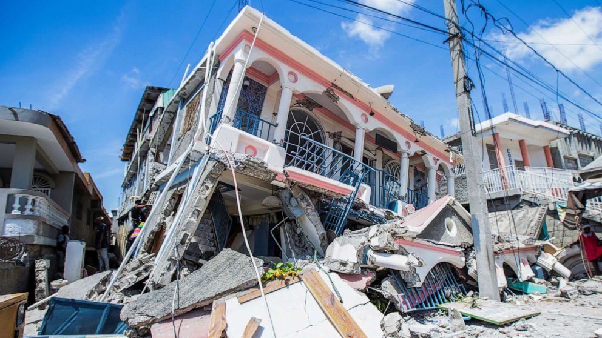
Jesus had to come in this dispensation to do His Father’s will!
Haiti 2021 Earthquake Killing 2,000 people

Slide 119
Jesus had to come in this dispensation to do His Father’s will!

Slide 120
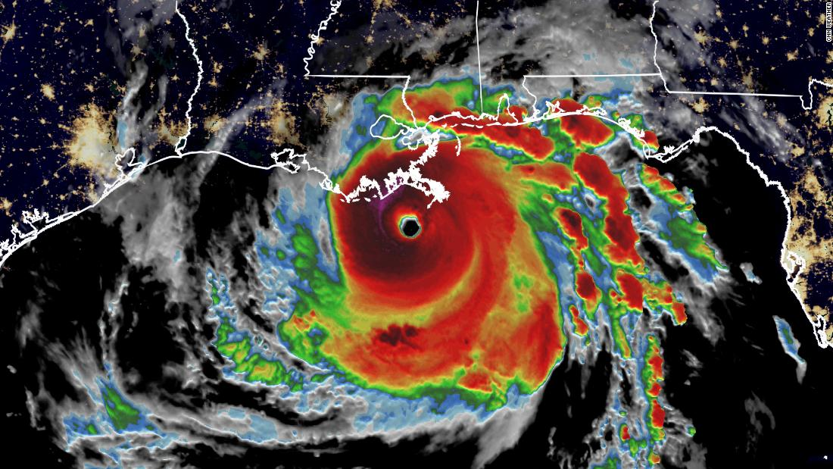
Jesus had to come in this dispensation to do His Father’s will!
Hurricane Ida 2021

Slide 121
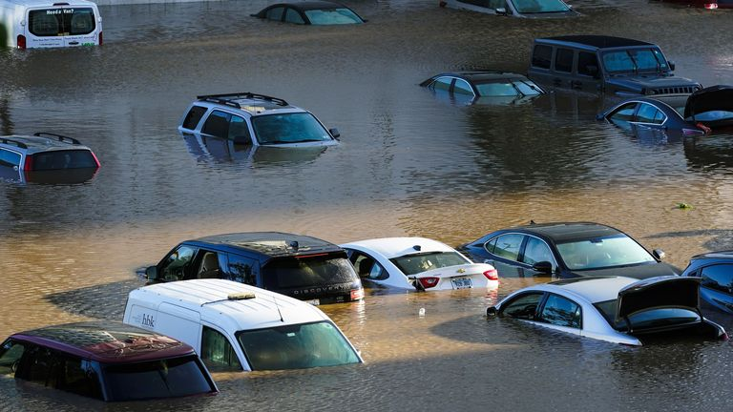
Jesus had to come in this dispensation to do His Father’s will!
Hurricane Ida 2021

Slide 122
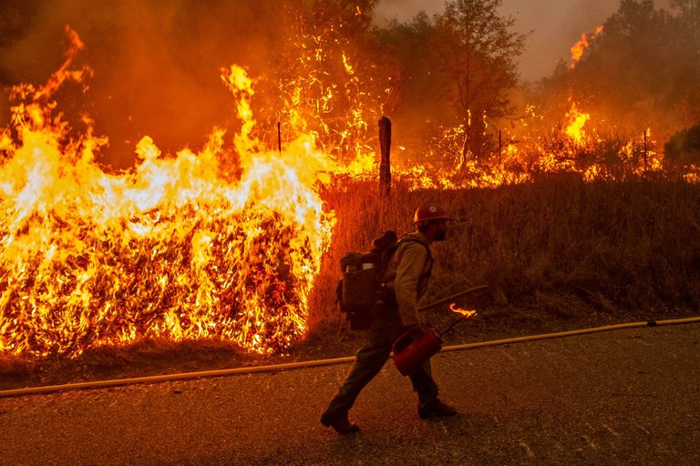
Jesus had to come in this dispensation to do His Father’s will!
Hurricane Ida 2021

Slide 123
Jesus had to come in this dispensation to do His Father’s will!
Hurricane Ida 2021

Slide 124
10 And then many will be offended, will betray one another, and will hate one another. 11 Then many false prophets will rise up and deceive many. 12 And because lawlessness will abound, the love of many will grow cold.

Slide 125
13 But he who endures to the end shall be saved. 14 And this gospel of the kingdom will be preached in all the world as a witness to all the nations, and then the end will come.

Slide 126
Matthew 24:15-51
15 "Therefore when you see the 'abomination of desolation,' spoken of by Daniel the prophet, standing in the holy place" (whoever reads, let him understand), 16 then let those who are in Judea flee to the mountains. 17 Let him who is on the housetop not go down to take anything out of his house.

Slide 127
18 And let him who is in the field not go back to get his clothes. 19 But woe to those who are pregnant and to those who are nursing babies in those days! 20 And pray that your flight may not be in winter or on the Sabbath.

Slide 128
21 For then there will be great tribulation, such as has not been since the beginning of the world until this time, no, nor ever shall be. 22 And unless those days were shortened, no flesh would be saved; but for the elect's sake those days will be shortened. 23 Then if anyone says to you, 'Look, here is the Christ!' or 'There!' do not believe it.

Slide 129
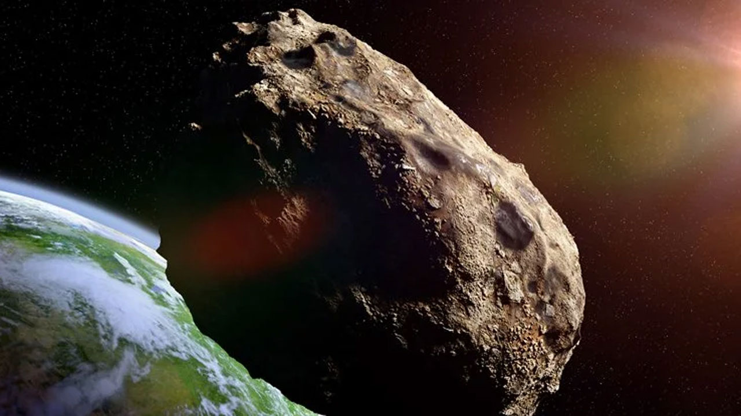
Jesus had to come in this dispensation to do His Father’s will!
Apophis is on course to strike the earth on the West Coast on
April 13, 2029

Slide 130
24 For false christs and false prophets will rise and show great signs and wonders to deceive, if possible, even the elect. 25 See, I have told you beforehand. 26 Therefore if they say to you, 'Look, He is in the desert!' do not go out; or 'Look, He is in the inner rooms!' do not believe it.

Slide 131
27 For as the lightning comes from the east and flashes to the west, so also will the coming of the Son of Man be. 28 For wherever the carcass is, there the eagles will be gathered together. 29 "Immediately after the tribulation of those days the sun will be darkened, and the moon will not give its light; the stars will fall from heaven, and the powers of the heavens will be shaken.

Slide 132
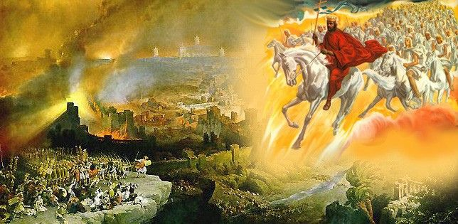
27 For as the lightning comes from the east and flashes to the west, so also will the coming of the Son of Man be. 28 For wherever the carcass is, there the eagles will be gathered together. 29 "Immediately after the tribulation of those days the sun will be darkened, and the moon will not give its light; the stars will fall from heaven, and the powers of the heavens will be shaken.

Slide 133
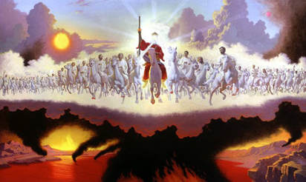

Slide 134
30 Then the sign of the Son of Man will appear in heaven, and then all the tribes of the earth will mourn, and they will see the Son of Man coming on the clouds of heaven with power and great glory. 31 And He will send His angels with a great sound of a trumpet, and they will gather together His elect from the four winds, from one end of heaven to the other.

Slide 135
32 "Now learn this parable from the fig tree: When its branch has already become tender and puts forth leaves, you know that summer is near. 33 So you also, when you see all these things, know that it is near--at the doors! 34 Assuredly, I say to you, this generation will by no means pass away till all these things take place. 35 Heaven and earth will pass away, but My words will by no means pass away.

Slide 136
36 "But of that day and hour no one knows, not even the angels of heaven, but My Father only. 37 But as the days of Noah were, so also will the coming of the Son of Man be. 38 For as in the days before the flood, they were eating and drinking, marrying and giving in marriage, until the day that Noah entered the ark,

Slide 137
39 and did not know until the flood came and took them all away, so also will the coming of the Son of Man be. 40 Then two men will be in the field: one will be taken and the other left. 41 Two women will be grinding at the mill: one will be taken and the other left.

Slide 138
42 Watch therefore, for you do not know what hour your Lord is coming. 43 But know this, that if the master of the house had known what hour the thief would come, he would have watched and not allowed his house to be broken into. 44 Therefore you also be ready, for the Son of Man is coming at an hour you do not expect.

Slide 139
45 "Who then is a faithful and wise servant, whom his master made ruler over his household, to give them food in due season? 46 Blessed is that servant whom his master, when he comes, will find so doing. 47 Assuredly, I say to you that he will make him ruler over all his goods.

Slide 140
48 But if that evil servant says in his heart, 'My master is delaying his coming,' 49 "and begins to beat his fellow servants, and to eat and drink with the drunkards, 50 the master of that servant will come on a day when he is not looking for him and at an hour that he is not aware of, 51 and will cut him in two and appoint him his portion with the hypocrites. There shall be weeping and gnashing of teeth.

Slide 141
1 Thessalonians 4:13-18
13 But I do not want you to be ignorant, brethren, concerning those who have fallen asleep, lest you sorrow as others who have no hope. 14 For if we believe that Jesus died and rose again, even so God will bring with Him those who sleep in Jesus.

Slide 142
15 For this we say to you by the word of the Lord, that we who are alive and remain until the coming of the Lord will by no means precede those who are asleep. 16 For the Lord Himself will descend from heaven with a shout, with the voice of an archangel, and with the trumpet of God. And the dead in Christ will rise first.

Slide 143
17 Then we who are alive and remain shall be caught up together with them in the clouds to meet the Lord in the air. And thus we shall always be with the Lord. 18 Therefore comfort one another with these words.

Slide 144
1 Corinthians 15:50-54
50 Now this I say, brethren, that flesh and blood cannot inherit the kingdom of God; nor does corruption inherit incorruption. 51 Behold, I tell you a mystery: We shall not all sleep, but we shall all be changed-- 52 in a moment, in the twinkling of an eye, at the last trumpet. For the trumpet will sound, and the dead will be raised incorruptible, and we shall be changed.

Slide 145
53 For this corruptible must put on incorruption, and this mortal must put on immortality. 54 So when this corruptible has put on incorruption, and this mortal has put on immortality, then shall be brought to pass the saying that is written: "Death is swallowed up in victory."

Slide 146
20 Again, when a righteous man turns from his righteousness and commits iniquity, and I lay a stumbling block before him, he shall die; because you did not give him warning, he shall die in his sin, and his righteousness which he has done shall not be remembered; but his blood I will require at your hand.

Slide 147
Acts 2:38-39
38 Then Peter said to them, "Repent, and let every one of you be baptized in the name of Jesus Christ for the remission of sins; and you shall receive the gift of the Holy Spirit. 39 For the promise is to you and to your children, and to all who are afar off, as many as the Lord our God will call."

