Slide 1


Slide 2
“Look to Jesus”
(Phil Wickham)

Slide 3
Death is like an empty grave. Fear looks like a giant slain. Trails look like gifts of grace. When I look to

Slide 4
Failures bow to victory. Sin has lost it’s hold on me. Endless love is all I see. When I look to Jesus.

Slide 5
How my heart leaps. How my soul sings. For I know where my help comes from. Jesus Sought me. Jesus

Slide 6
Saved me. Hallelujah for all he’s done, yeah. Every wall comes crashing down. Chains are broken on the

Slide 7
Ground. What can stand against us now When we look to Jesus? How my heart leaps. How my soul

Slide 8
Sings. For I know where my help comes from. Jesus sought me. Jesus saved me . Hallelujah for all he’s

Slide 9
Done. How my heart leaps how my soul sings. For I know where my help comes from. Jesus sought me.

Slide 10
Jesus saved me. Hallelujah for all he’s done. I will keep my eyes on you. We’ll dance upon the

Slide 11
Crashing waves. I will keep my eyes on you. For only you can make a way. I will keep my eyes on you.

Slide 12
We’ll dance upon the crashing waves. I will keep my eyes on you. For only you can make a way.

Slide 13
How my heart leaps. How my soul sings. For I know where my help comes from. Jesus sought me. Jesus

Slide 14
Saved me. Hallelujah for all he’s done. How my heart leaps. How my soul sings. For I know where my help

Slide 15
Comes from. Jesus sought me. Jesus saved me. Hallelujah for all he’s done. For all he’s done. Sing

Slide 16
Hallelujah for all he’s done. We sing hallelujah. Hallelujah for all he’s done.

Slide 17
“Inhabit”

Slide 18
Our Praise becomes your house. Your Place.
Our Praise becomes your house. Your Place.

Slide 19
Our praise becomes your house. Your Place
Our praise becomes your house. Your place.

Slide 20
Our praise becomes your house. Your place.
Our praise becomes your house. Your Place.

Slide 21
Our Praise becomes your house your place. We sing a song and you come in. Make a dance and you

Slide 22
come in. Shout your name and you come in. Give you praise and you come in. Sing a song and you

Slide 23
come in.Make a dance and you come in. Sshout your name and you come in. Give you praise.

Slide 24
You inhabit the praises of your people. You inhabit the praises of your people. Our praise becomes your

Slide 25
your house your place . Our praise becomes your house. Your Place. Our praise becomes your

Slide 26
your house your place. We sing a song and you come in. Make a dance and you come in. You

Slide 27
inhabit the praises of your people. You inhabit the praises of your people. You in habit the praises of

Slide 28
your people.

Slide 29
"Something has to break”
(Essential Worship and Red Rocks Worship)

Slide 30
I feel it in this room. Holy spirit move. Cause when you have your way. Something has to break. Tear

Slide 31
Down every lie. Set the wrong thing right. Cause when you have your way. Something has to break.

Slide 32
Something has to break. I feel it in this room. Holy spirit move. Cause when you have your way

Slide 33
Something has to break. Tear down every lie. Set the wrong thing right. Cause when you have your way

Slide 34
Something has to break. Something has to break.
Right now in you name. Something has to break.

Slide 35
Something has to break. Something has to break.
Right now in your name. Something has to break.

Slide 36
I believe you’ll get me to it. I believe you’ll get me through it. I believe that you will do it right now.

Slide 37
Something has to break. I believe you’ll get me to it. I believe you’ll get me through it. I believe that you will

Slide 38
do it right now. Something has to break. I believe you’ll get me to it. I believe you’ll get me through it. I

Slide 39
believe that you will do it right now. Something has to break. Something has to break. Right now in your

Slide 40
name. Something has to break. Something has to break. Something has to break. Right now in your

Slide 41
Name. Something has to break.

Slide 42
“ Canvas and the Clay”
(Pat Barret)

Slide 43
In my mother’s womb. You formed me with your hands. Known and loved by you. Before I took a

Slide 44
Breath. When I doubt it, Lord, remind me. I’m wonderfully made. You’re an artist and a potter.

Slide 45
I’m the canvas and the clay. You make all things work together. For my future and for my good. You make

Slide 46
All things work together for your glory and for your name. There’s a healing light. Just beyond the clouds

Slide 47
Though I’ve walked through fire. I see it clearly now.I know nothing has been wasted. No failure or mistake

Slide 48
You’re an artist and a potter I’m the canvas and the clay. You make all things work together. For my

Slide 49
Future and for my good. You make all things work together for your glory and for your name.

Slide 50
For my good. For my good. And when I doubt it, Lord, remind me. I’m wonderfully made . You’re an

Slide 51
Artist and a potter I’m the canvas and the clay. And I know nothing has been wasted. No failure or

Slide 52
Mistake. You’re an artist and a potter. I’m the canvas and the clay. You make all things. Work together for

Slide 53
My future and for my good. You make all things. Work together for your glory. And for your name.

Slide 54
When I doubt it, Lord, remind me I’m wonderfully made. You’re and artist and a potter. I’m the canvas

Slide 55
And the clay. I know nothing has been wasted. No failure or mistake. You’re an artist and a potter. I’m

Slide 56
The canvas and clay. You’re an artist and a potter. I’m the canvas and the clay. You’re an artist and a

Slide 57
Potter I’m the canvas and the clay.

Slide 58
“I’ve decided o follow Jesus”
(Phil Wickham)

Slide 59
I have decided to follow Jesus. I have decided to follow Jesus. I have decided to follow Jesus. No

Slide 60
Turning back. No turning back. Tho’ none go with me. I still will follow. Tho’ none go with me. I still will

Slide 61
Follow. Tho’ none go with me I still will follow. No turning back. No turning Back. My cross I’ll carry. Till

Slide 62
I see Jesus. My cross I’ll carry till I see Jesus. My cross I’ll carry. Till I see Jesus. No turning Back.

Slide 63
No turning back.

Slide 65
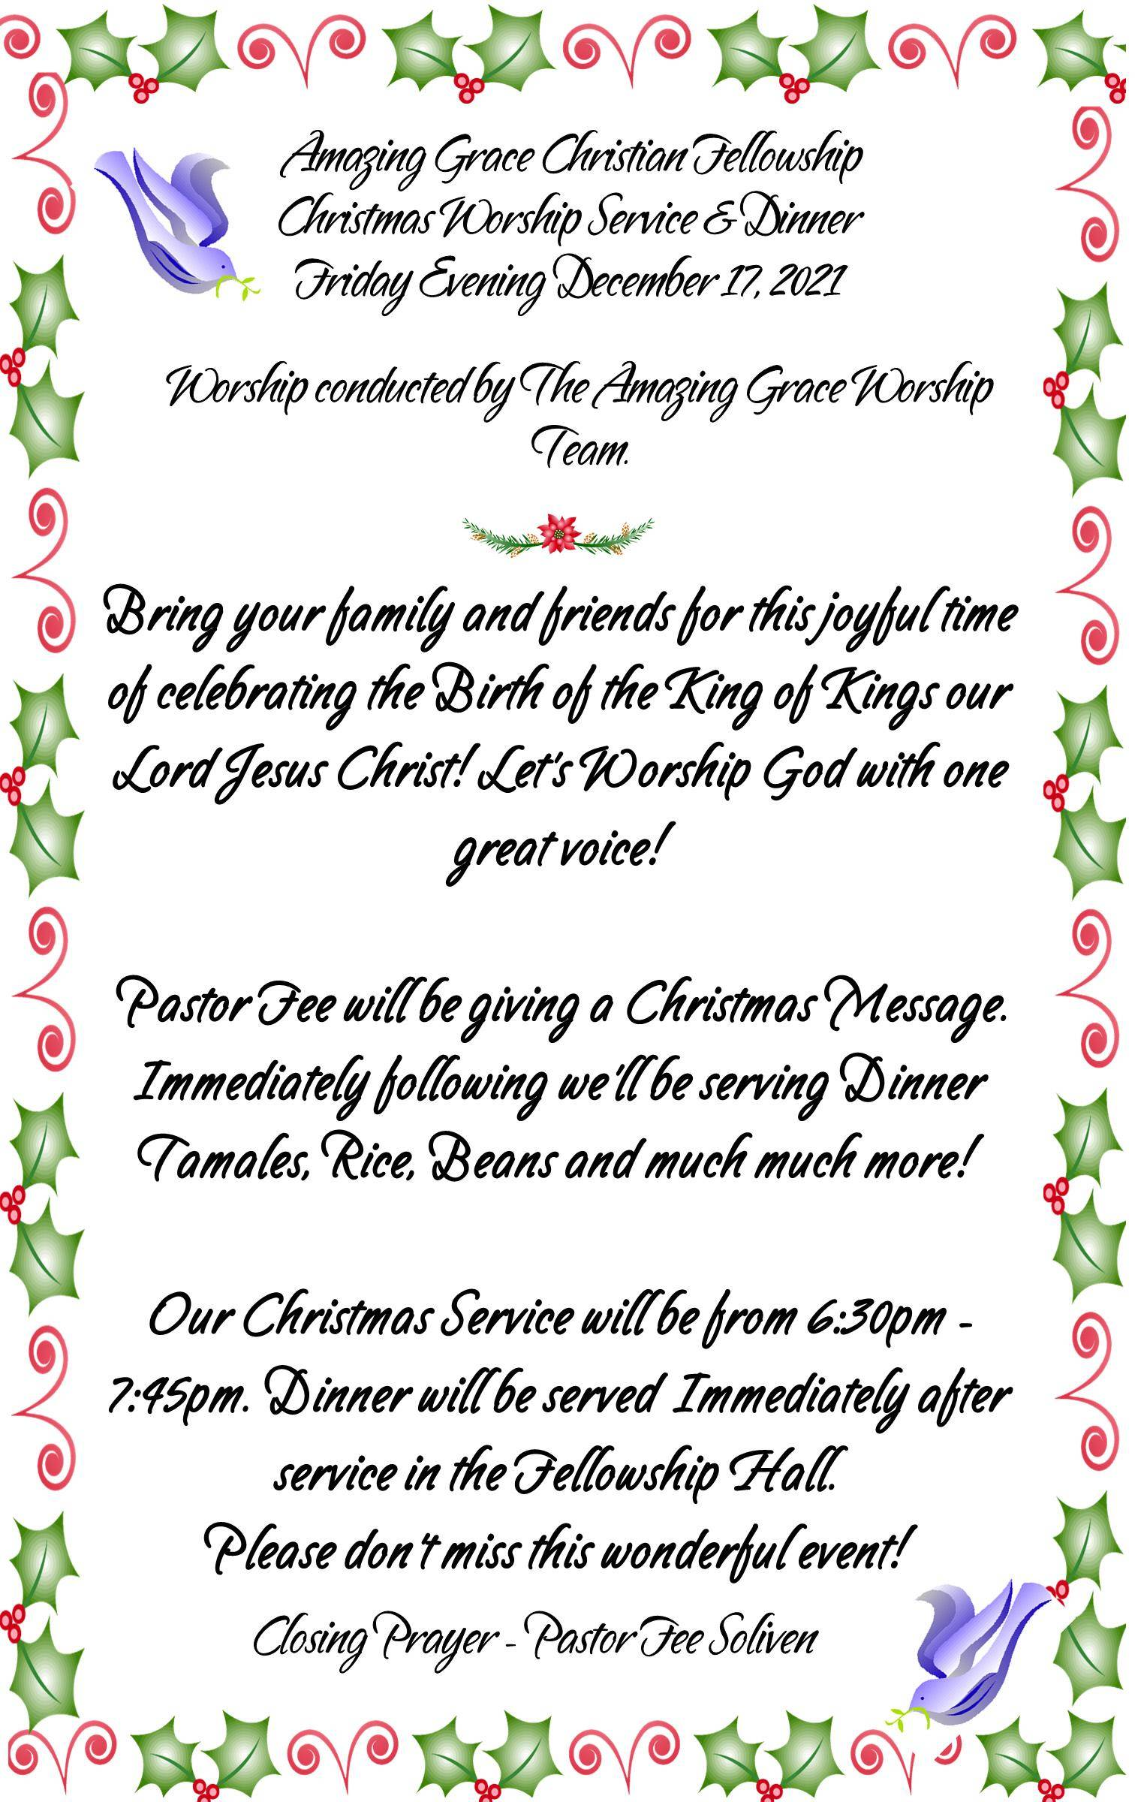

Slide 66
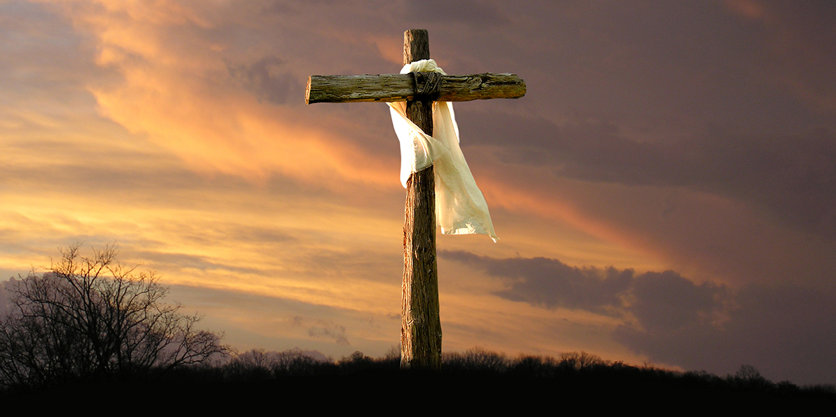

Walk in the Ways of Jesus
by Pastor Fee Soliven
John 12:20-26
Sunday Morning
November 14, 2021

Slide 67
John 12:20-26
20 Now there were certain Greeks among those who came up to worship at the feast. 21 Then they came to Philip, who was from Bethsaida of Galilee, and asked him, saying, "Sir, we wish to see Jesus." 22 Philip came and told Andrew, and in turn Andrew and Philip told Jesus.

Slide 68
23 But Jesus answered them, saying, "The hour has come that the Son of Man should be glorified. 24 Most assuredly, I say to you, unless a grain of wheat falls into the ground and dies, it remains alone; but if it dies, it produces much grain.

Slide 69
25 He who loves his life will lose it, and he who hates his life in this world will keep it for eternal life. 26 If anyone serves Me, let him follow Me; and where I am, there My servant will be also. If anyone serves Me, him My Father will honor.

Slide 70
The cross has become a symbol of Christianity, but it’s so much more than a mere piece of jewelry hanging around someone’s neck.

Slide 71
1 Corinthians 2:1-5
1 And I, brethren, when I came to you, did not come with excellence of speech or of wisdom declaring to you the testimony of God. 2 For I determined not to know anything among you except Jesus Christ and Him crucified.

Slide 72
3 I was with you in weakness, in fear, and in much trembling. 4 And my speech and my preaching were not with persuasive words of human wisdom, but in demonstration of the Spirit and of power, 5 that your faith should not be in the wisdom of men but in the power of God.

Slide 73
Corinth was one of the most corrupt cities of its time, and its belief system was a mixture of various philosophies.

Slide 74
1 Corinthians 2:2
“For I determined not to know anything among you except Jesus Christ and Him crucified”

Slide 75
1 Corinthians 1:23-24
23 but we preach Christ crucified, to the Jews a stumbling block and to the Greeks foolishness, 24 but to those who are called, both Jews and Greeks, Christ the power of God and the wisdom of God.

Slide 76
The crucifixion was God’s Plan

Slide 77
1 Peter 1:19-21
19 but with the precious blood of Christ, as of a lamb without blemish and without spot. 20 He indeed was foreordained before the foundation of the world, but was manifest in these last times for you 21 who through Him believe in God, who raised Him from the dead and gave Him glory, so that your faith and hope are in God.

Slide 78
Ephesians 1:4-5
4 just as He chose us in Him before the foundation of the world, that we should be holy and without blame before Him in love, 5 having predestined us to adoption as sons by Jesus Christ to Himself, according to the good pleasure of His will,

Slide 79
God’s plan for the crucifixion of His Son was motivated by three things

Slide 80
1. The sinfulness of mankind

Slide 81
Romans 3:23
“For all have sinned and fall short of the glory of God”

Slide 82
2. God’s Love

Slide 83
Romans 5:8
“While we were yet sinners, Christ died for us”

Slide 84
3. God’s Justice

Slide 85
Ezekiel 18:4
“The soul who sins will die.”

Slide 86
Romans 6:23
“The wages of sin is death,”

Slide 87
The crucifixion was where our sin and God’s love and justice met

Slide 88
Hebrews 10:8-10
8 Previously saying, "Sacrifice and offering, burnt offerings, and offerings for sin You did not desire, nor had pleasure in them" (which are offered according to the law),

Slide 89
9 then He said, "Behold, I have come to do Your will, O God." He takes away the first that He may establish the second. 10 By that will we have been sanctified through the offering of the body of Jesus Christ once for all.

Slide 90
The cross is the heart of the Christian Life

Slide 91
Hebrews 9:24-26
24 For Christ has not entered the holy places made with hands, which are copies of the true, but into heaven itself, now to appear in the presence of God for us; 25 not that He should offer Himself often, as the high priest enters the Most Holy Place every year with blood of another—

Slide 92
26 He then would have had to suffer often since the foundation of the world; but now, once at the end of the ages, He has appeared to put away sin by the sacrifice of Himself.

Slide 93
“put away sin by the sacrifice of Himself”

Slide 94
The crucifixion was the only moment in eternity when the Godhead was separated

Slide 95
Matthew 27:46
“My God, My God, why have You forsaken Me?”

Slide 96
Romans 8:1-5
1 There is therefore now no condemnation to those who are in Christ Jesus, who do not walk according to the flesh, but according to the Spirit.

Slide 97
2 For the law of the Spirit of life in Christ Jesus has made me free from the law of sin and death. 3 For what the law could not do in that it was weak through the flesh, God did by sending His own Son in the likeness of sinful flesh, on account of sin: He condemned sin in the flesh,

Slide 98
4 that the righteous requirement of the law might be fulfilled in us who do not walk according to the flesh but according to the Spirit.

Slide 99
Luke 23:42
“Jesus, remember me when You come in Your kingdom!”

Slide 100
1. How does a deeper understanding of what transpired on the cross affect your appreciation of salvation?

Slide 101
2. How could it change your lifestyle and priorities?

Slide 102
3. How does this affect your perception and tolerance of sin in your life?

Slide 103
1 Thessalonians 4:13-18
13 But I do not want you to be ignorant, brethren, concerning those who have fallen asleep, lest you sorrow as others who have no hope. 14 For if we believe that Jesus died and rose again, even so God will bring with Him those who sleep in Jesus.

Slide 104
15 For this we say to you by the word of the Lord, that we who are alive and remain until the coming of the Lord will by no means precede those who are asleep. 16 For the Lord Himself will descend from heaven with a shout, with the voice of an archangel, and with the trumpet of God. And the dead in Christ will rise first.

Slide 105
17 Then we who are alive and remain shall be caught up together with them in the clouds to meet the Lord in the air. And thus we shall always be with the Lord. 18 Therefore comfort one another with these words.

Slide 106
1 Corinthians 15:50-54
50 Now this I say, brethren, that flesh and blood cannot inherit the kingdom of God; nor does corruption inherit incorruption. 51 Behold, I tell you a mystery: We shall not all sleep, but we shall all be changed-- 52 in a moment, in the twinkling of an eye, at the last trumpet. For the trumpet will sound, and the dead will be raised incorruptible, and we shall be changed.

Slide 107
53 For this corruptible must put on incorruption, and this mortal must put on immortality. 54 So when this corruptible has put on incorruption, and this mortal has put on immortality, then shall be brought to pass the saying that is written: "Death is swallowed up in victory."

Slide 108

20 Again, when a righteous man turns from his righteousness and commits iniquity, and I lay a stumbling block before him, he shall die; because you did not give him warning, he shall die in his sin, and his righteousness which he has done shall not be remembered; but his blood I will require at your hand.

Slide 109
Acts 2:38-39
38 Then Peter said to them, "Repent, and let every one of you be baptized in the name of Jesus Christ for the remission of sins; and you shall receive the gift of the Holy Spirit. 39 For the promise is to you and to your children, and to all who are afar off, as many as the Lord our God will call."

