Slide 1


Slide 2
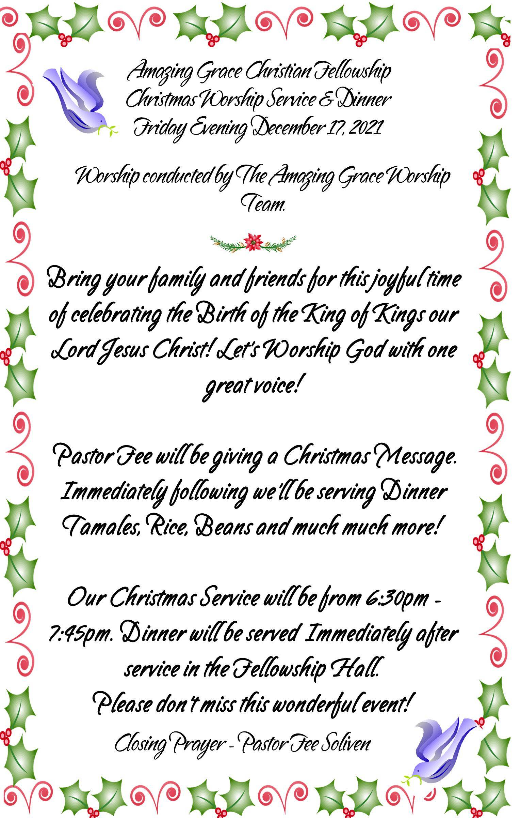

Slide 3
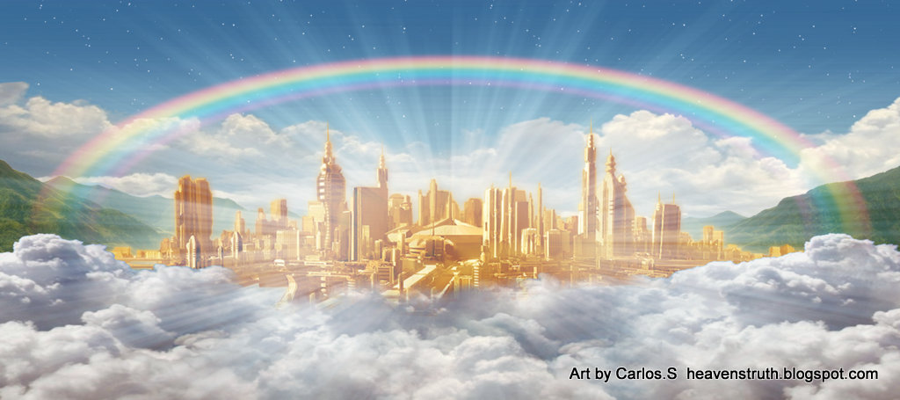

Worthy of the Kingdom of God
by Pastor Fee Soliven
2 Thessalonians 1:1-10
Wednesday Evening
November 10, 2021

Slide 4
2 Thessalonians 1:1-10
1 Paul, Silvanus, and Timothy, To the church of the Thessalonians in God our Father and the Lord Jesus Christ: 2 Grace to you and peace from God our Father and the Lord Jesus Christ. 3 We are bound to thank God always for you, brethren, as it is fitting, because your faith grows exceedingly, and the love of every one of you all abounds toward each other,

Slide 5
4 so that we ourselves boast of you among the churches of God for your patience and faith in all your persecutions and tribulations that you endure, 5 which is manifest evidence of the righteous judgment of God, that you may be counted worthy of the kingdom of God, for which you also suffer; 6 since it is a righteous thing with God to repay with tribulation those who trouble you,

Slide 6
7 and to give you who are troubled rest with us when the Lord Jesus is revealed from heaven with His mighty angels, 8 in flaming fire taking vengeance on those who do not know God, and on those who do not obey the gospel of our Lord Jesus Christ. 9 These shall be punished with everlasting destruction from the presence of the Lord and from the glory of His power,

Slide 7
10 when He comes, in that Day, to be glorified in His saints and to be admired among all those who believe, because our testimony among you was believed.

Slide 8
1 Paul, Silvanus, and Timothy, To the church of the Thessalonians in God our Father and the Lord Jesus Christ:

Slide 9
Acts 15:32
“Now Judas and Silas, themselves being prophets also, exhorted and strengthened the brethren with many words”

Slide 10
Acts 15:40
“but Paul chose Silas and departed, being commended by the brethren to the grace of God”

Slide 11
Acts 18:5
“When Silas and Timothy had come from Macedonia, Paul was compelled by the Spirit, and testified to the Jews that Jesus is the Christ”

Slide 12
2 Corinthians 1:19
“For the Son of God, Jesus Christ, who was preached among you by us--by me, Silvanus, and Timothy--was not Yes and No, but in Him was Yes”

Slide 13
2 Grace to you and peace from God our Father and the Lord Jesus Christ.

Slide 14
3 We are bound to thank God always for you, brethren, as it is fitting, because your faith grows exceedingly, and the love of every one of you all abounds toward each other,

Slide 15
1 Thessalonians 3:10
…night and day praying exceedingly that we may see your face and perfect what is lacking in your faith?

Slide 16
1 Thessalonians 3:12
“And may the Lord make you increase and abound in love to one another and to all, just as we do to you”

Slide 17
4 so that we ourselves boast of you among the churches of God for your patience and faith in all your persecutions and tribulations that you endure,

Slide 18
1 Thessalonians 1:7-10
7 so that you became examples to all in Macedonia and Achaia who believe. 8 For from you the word of the Lord has sounded forth, not only in Macedonia and Achaia, but also in every place. Your faith toward God has gone out, so that we do not need to say anything.

Slide 19
9 For they themselves declare concerning us what manner of entry we had to you, and how you turned to God from idols to serve the living and true God, 10 and to wait for His Son from heaven, whom He raised from the dead, even Jesus who delivers us from the wrath to come.

Slide 20
Hupomone

Slide 21
1 Thessalonians 1:3
“remembering without ceasing your work of faith, labor of love, and patience of hope in our Lord Jesus Christ in the sight of our God and Father”

Slide 22
Acts 17:5-6
“But the Jews who were not persuaded, becoming envious, took some of the evil men from the marketplace, and gathering a mob, set all the city in an uproar and attacked the house of Jason, and sought to bring them out to the people. 6 But when they did not find them, they dragged Jason and some brethren to the rulers of the city, crying out, "These who have turned the world upside down have come here too.

Slide 23
5 which is manifest evidence of the righteous judgment of God, that you may be counted worthy of the kingdom of God, for which you also suffer; 6 since it is a righteous thing with God to repay with tribulation those who trouble you,

Slide 24
John 15:20-21
20 Remember the word that I said to you, 'A servant is not greater than his master.' If they persecuted Me, they will also persecute you. If they kept My word, they will keep yours also. 21 But all these things they will do to you for My name's sake, because they do not know Him who sent Me.

Slide 25
7 and to give you who are troubled rest with us when the Lord Jesus is revealed from heaven with His mighty angels, 8 in flaming fire taking vengeance on those who do not know God, and on those who do not obey the gospel of our Lord Jesus Christ.

Slide 26
Exodus 13:21
“And the LORD went before them by day in a pillar of cloud to lead the way, and by night in a pillar of fire to give them light, so as to go by day and night”

Slide 27
Deuteronomy 4:12
“And the LORD spoke to you out of the midst of the fire. You heard the sound of the words, but saw no form; you only heard a voice”

Slide 28
Isaiah 66:15
“For behold, the LORD will come with fire And with His chariots, like a whirlwind, To render His anger with fury, And His rebuke with flames of fire”

Slide 29
Revelation 1:13-14
13 and in the midst of the seven lampstands One like the Son of Man, clothed with a garment down to the feet and girded about the chest with a golden band. 14 His head and hair were white like wool, as white as snow, and His eyes like a flame of fire;

Slide 30
Matthew 25:31
“When the Son of Man comes in His glory, and all the holy angels with Him, then He will sit on the throne of His glory”

Slide 31
9 These shall be punished with everlasting destruction from the presence of the Lord and from the glory of His power, 10 when He comes, in that Day, to be glorified in His saints and to be admired among all those who believe, because our testimony among you was believed.

Slide 32
Matthew 25:31-46
31 "When the Son of Man comes in His glory, and all the holy angels with Him, then He will sit on the throne of His glory. 32 All the nations will be gathered before Him, and He will separate them one from another, as a shepherd divides his sheep from the goats.

Slide 33
33 And He will set the sheep on His right hand, but the goats on the left. 34 Then the King will say to those on His right hand, 'Come, you blessed of My Father, inherit the kingdom prepared for you from the foundation of the world: 35 for I was hungry and you gave Me food; I was thirsty and you gave Me drink; I was a stranger and you took Me in;

Slide 34
36 I was naked and you clothed Me; I was sick and you visited Me; I was in prison and you came to Me.' 37 "Then the righteous will answer Him, saying, 'Lord, when did we see You hungry and feed You, or thirsty and give You drink?

Slide 35
38 When did we see You a stranger and take You in, or naked and clothe You? 39 Or when did we see You sick, or in prison, and come to You?' 40 "And the King will answer and say to them, 'Assuredly, I say to you, inasmuch as you did it to one of the least of these My brethren, you did it to Me.'

Slide 36
41 "Then He will also say to those on the left hand, 'Depart from Me, you cursed, into the everlasting fire prepared for the devil and his angels: 42 for I was hungry and you gave Me no food; I was thirsty and you gave Me no drink;

Slide 37
43 I was a stranger and you did not take Me in, naked and you did not clothe Me, sick and in prison and you did not visit Me.' 44 "Then they also will answer Him, saying, 'Lord, when did we see You hungry or thirsty or a stranger or naked or sick or in prison, and did not minister to You?'

Slide 38
45 "Then He will answer them, saying, 'Assuredly, I say to you, inasmuch as you did not do it to one of the least of these, you did not do it to Me.' 46 "And these will go away into everlasting punishment, but the righteous into eternal life."

Slide 39
1 Thessalonians 4:13-18
13 But I do not want you to be ignorant, brethren, concerning those who have fallen asleep, lest you sorrow as others who have no hope. 14 For if we believe that Jesus died and rose again, even so God will bring with Him those who sleep in Jesus.

Slide 40
15 For this we say to you by the word of the Lord, that we who are alive and remain until the coming of the Lord will by no means precede those who are asleep. 16 For the Lord Himself will descend from heaven with a shout, with the voice of an archangel, and with the trumpet of God. And the dead in Christ will rise first.

Slide 41
17 Then we who are alive and remain shall be caught up together with them in the clouds to meet the Lord in the air. And thus we shall always be with the Lord. 18 Therefore comfort one another with these words.

Slide 42
1 Corinthians 15:50-54
50 Now this I say, brethren, that flesh and blood cannot inherit the kingdom of God; nor does corruption inherit incorruption. 51 Behold, I tell you a mystery: We shall not all sleep, but we shall all be changed-- 52 in a moment, in the twinkling of an eye, at the last trumpet. For the trumpet will sound, and the dead will be raised incorruptible, and we shall be changed.

Slide 43
53 For this corruptible must put on incorruption, and this mortal must put on immortality. 54 So when this corruptible has put on incorruption, and this mortal has put on immortality, then shall be brought to pass the saying that is written: "Death is swallowed up in victory."

Slide 44

20 Again, when a righteous man turns from his righteousness and commits iniquity, and I lay a stumbling block before him, he shall die; because you did not give him warning, he shall die in his sin, and his righteousness which he has done shall not be remembered; but his blood I will require at your hand.

Slide 45
Acts 2:38-39
38 Then Peter said to them, "Repent, and let every one of you be baptized in the name of Jesus Christ for the remission of sins; and you shall receive the gift of the Holy Spirit. 39 For the promise is to you and to your children, and to all who are afar off, as many as the Lord our God will call."

