Slide 1


Slide 2
“Lion and The Lamb”
(Big Daddy Weave)

Slide 3
He's coming on the clouds Kings and kingdoms will bow down And every chain will break As broken

Slide 4
hearts declare His praise For who can stop the Lord Almighty And our God is the lion The Lion of Judah

Slide 5
He's roaring with power And fighting our battles And every knee will bow before Him Our God is the lamb

Slide 6
The lamb that was slain For the sins of the world His blood breaks the chains And every knee will bow

Slide 7
before the lion and the lamb Every knee will bow before Him (yeah) So, open up the gates So, open

Slide 8
up the gates Make way before the King of Kings The God who comes to save Is here to set the captives

Slide 9
Free For who can stop the Lord Almighty Our God is the lion The Lion of Judah He's roaring with power

Slide 10
And fighting our battles And every knee will bow before Him Our God is the lamb The lamb that was

Slide 11
Slain For the sin of the world His blood breaks the chains And every knee will bow before the lion and

Slide 12
the lamb Every knee will bow before Him "How many here believe Every knee will bow Every tongue will

Slide 13
Confess And then“ For who can stop the Lord Almighty Who can stop the Lord Almighty Who can

Slide 14
stop the Lord Almighty No one Who can stop sing it over the battle "Yeah, that's it“ Who can

Slide 15
stop the Lord Almighty There is no one Who can stop the Lord Almighty Who can stop the Lord (yeah) And

Slide 16
our God is the lion The Lion of Judah He's roaring with power And fighting our battles And every knee

Slide 17
will bow before Him Our God is the lamb The lamb that was slain For the sins of the world His blood

Slide 18
breaks the chains And every knee will bow before the lion and the lamb Every knee will bow before Him

Slide 19
(yeah) Every knee will bow Tongue confess

Slide 20
Our God
(By Chris Tomlin)

Slide 21
Water, You turned into wine Opened the eyes of the blind There's no one like You None like You Into the

Slide 22
darkness, You shine Out of the ashes we rise There's no one like You None like You Our God is

Slide 23
Greater Our God is stronger God, You are higher than any other Our God is healer Awesome in power

Slide 24
Our God, our God Into the darkness, You shine Out of the ashes, we rise There's no one like You None

Slide 25
like You Our God is greater Our God is stronger God, You are higher than any other Our God is

Slide 26
Healer Awesome in power Our God, our God Our God is greater Our God is stronger God, You are

Slide 27
higher than any other Our God is healer Awesome in power Our God, our God And if our God is for us

Slide 28
Then who could ever stop us? And if our God is with us Then what could stand against? And if our God is

Slide 29
for us Then who could ever stop us? And if our God is with us Then what could stand against? Then what

Slide 30
could stand against? Our God is greater Our God is stronger God, You are higher than any other Our

Slide 31
God is healer Awesome in power Our God, our God
Our God is greater Our God is stronger God, You are

Slide 32
higher than any other Our God is healer
Awesome in power Our God, our God And if our

Slide 33
God is for us Then who could ever stop us? And if our God is with us Then what could stand against?

Slide 34
And if our God is for us Then who could ever stop us? And if our God is with us Then what could stand

Slide 35
against? What could stand against? What could stand against? (What could stand)

Slide 36
What A Beautiful Name
(by Ben Fielding)

Slide 37
You were the Word at the beginning One With God the Lord Most High Your hidden glory in creation

Slide 38
Now revealed in You our Christ What a beautiful Name it is What a beautiful Name it is The Name of

Slide 39
Jesus Christ my King What a beautiful Name it is
Nothing compares to this What a beautiful Name it is

Slide 40
The Name of Jesus You didn’t want heaven without us So Jesus, You brought heaven down My sin was

Slide 41
great, Your love was greater What could separate us now What a wonderful Name it is What a wonderful

Slide 42
Name it is The Name of Jesus Christ my King What a wonderful Name it is Nothing compares to this What

Slide 43
a wonderful Name it is The Name of Jesus What a wonderful Name it is The Name of Jesus How sweet

Slide 44
is your name, Lord, how good You are Love to sing in the name of the Lord, love to sing for you all? Death

Slide 45
could not hold You, the veil tore before You You silenced the boast, of sin and grave The heavens are

Slide 46
roaring, the praise of Your glory For You are raised to life again You have no rival, You have no equal Now

Slide 47
and forever, Our God reigns Yours is the Kingdom, Yours is the glory Yours is the Name, above all

Slide 48
Names What a powerful Name it is What a powerful Name it is The Name of Jesus Christ my King What a

Slide 49
powerful Name it is Nothing can stand against What a powerful Name it is The Name of Jesus You have

Slide 50
no rival, You have no equal Now and forever, Our God reigns Yours is the Kingdom, Yours is the glory

Slide 51
Yours is the Name, above all names What a powerful Name it is What a powerful Name it is The Name of

Slide 52
Jesus Christ my King What a powerful Name it is
Nothing can stand against What a powerful Name it

Slide 53
Is The Name of Jesus What a powerful Name it is
The Name of Jesus What a powerful Name it is

Slide 54
The Name of Jesus

Slide 55
Way Maker
(by Michael W. Smith)

Slide 56
You are here, moving in our midst I worship You, I worship You You are here, working in this place I

Slide 57
worship You, I worship You You are here, moving in our midst I worship You, I worship You You are here,

Slide 58
working in this place I worship You, I worship You
Waymaker, miracle worker Promise keeper, light in

Slide 59
the darkness My God, that is who You are Waymaker, miracle worker Promise keeper, light in

Slide 60
the darkness My God, that is who You are You are here, touching every heart I worship You, hold my

Slide 61
hands, I worship You You are here, healing every heart I worship You, I worship You You are here,

Slide 62
turning lives around I worship You, I worship You
You are here, turning lives around I worship You, I

Slide 63
worship You Waymaker, miracle worker Promise keeper, light in the darkness My God, that is who

Slide 64
You are Waymaker, miracle worker Promise keeper, light in the darkness My God, that is who You are

Slide 65
I said that is who You are (that is who You are) That is who You are (that is who You are) That is who You

Slide 66
are (that is who You are) That is who You are (that is who You are) Waymaker, miracle worker Waymaker,

Slide 67
miracle worker Waymaker, miracle worker Waymaker, miracle worker (everybody say)

Slide 68
Waymaker, miracle worker (anybody know He's a waymaker tonight) Waymaker, miracle worker (He's

Slide 69
a miracle worker) Waymaker, miracle worker
Waymaker, miracle worker Even when I don't see it,

Slide 70
You're working Even when I can't feel it, You’re working You never stop, You never stop working You

Slide 71
never stop, You never stop working Even when Ican't see it, You're working Even when I can't feel it,

Slide 72
You're working You never stop, You never stop working You never stop, You never stop working

Slide 73
Even when I don't see it, You're working Even when I can't feel it, You're working You never stop, You

Slide 74
never stop working You never stop, You never stop working Even when I don't see it, You're working

Slide 75
Even when I don't feel it, You're working You never stop, You never stop working You never stop, You

Slide 76
never stop working He never stops working Our God is at work with us here Our God is a healer, He's a

Slide 77
comforter Waymaker, miracle worker Promise Keeper, Light in the darkness My God, that is who

Slide 78
You are (we know, we know, we know who you are)
Waymaker, miracle worker Promise keeper, light in

Slide 79
the darkness My God, that is who You are (ooh)
Waymaker, miracle worker Promise keeper, light in

Slide 80
the darkness My God, that is who You are (everybody lift it up again and say) Waymaker,

Slide 81
miracle worker Promise keeper, light in the darkness
My God, that is who You are Waymaker, miracle

Slide 82
worker Promise keeper, light in the darkness My God, that is who You are Waymaker, miracle worker

Slide 83
Promise keeper, light in the darkness My God, that is who You are

Slide 84
Revelation Song
(by Kari Jobe)

Slide 85
Worthy is the Lamb who was slain Holy, holy is He
Sing a new song to Him who sits on Heaven's mercy

Slide 86
Seat Worthy is the Lamb who was slain Holy, holy is He Sing a new song to Him who sits on Heaven's

Slide 87
mercy seat Holy, holy, holy is the Lord God Almighty
Who was and is and is to come With all creation I

Slide 88
sing praise to the King of kings You are my everything and I will adore You Clothed in rainbows

Slide 89
of living color Flashes of lightning rolls of thunder
Blessing and honor strength and glory and power be

Slide 90
To You the only one who's King Holy, holy, holy is the Lord God Almighty Who was and is and is to come

Slide 91
With all creation I sing praise to the King of kings
You are my everything and I will adore You Filled with

Slide 92
wonder awestruck wonder At the mention of Your name Jesus Your name is power, breath and living

Slide 93
Water Such a marvelous mystery Oh Oh, You're worthy, mystery You are worthy Holy, holy, holy is the

Slide 94
Lord God Almighty Who was and is and is to come
With all creation I sing praise to the King of kings

Slide 95
You are my everything and I will adore You I will adore You

Slide 97


Slide 98
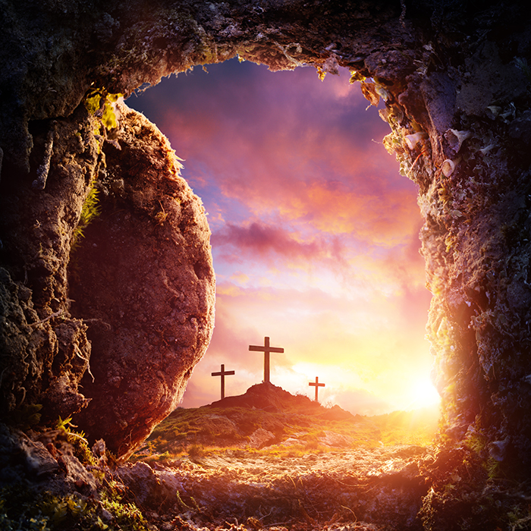

The Promise of The Resurrection
by Pastor Fee Soliven
John 2:19-21
Sunday Morning
December 26, 2021

Slide 99
John 2:19–21
19 Jesus answered and said unto them, Destroy this temple, and in three days I will raise it up. 20 Then said the Jews, Forty and six years was this temple in building, and wilt thou rear it up in three days? 21 But he spoke of the temple of his body.

Slide 100
1. The First Resurrection

Slide 101
Jesus Promised His Resurrection

Slide 102
Matthew 20:18-19
18 Behold, we are going up to Jerusalem, and the Son of Man will be betrayed to the chief priests and to the scribes; and they will condemn Him to death, 19 and deliver Him to the Gentiles to mock and to scourge and to crucify. And the third day He will rise again."

Slide 103
Jesus 1st Came as the Suffering Messiah

Slide 104
Matthew 16:21-23
21 From that time Jesus began to show to His disciples that He must go to Jerusalem, and suffer many things from the elders and chief priests and scribes, and be killed, and be raised the third day.

Slide 105
22 Then Peter took Him aside and began to rebuke Him, saying, "Far be it from You, Lord; this shall not happen to You!" 23 But He turned and said to Peter, "Get behind Me, Satan! You are an offense to Me, for you are not mindful of the things of God, but the things of men."

Slide 106
2. Jesus Willingly Laid Down His Life

Slide 107
John 10:17-18
17 Therefore My Father loves Me, because I lay down My life that I may take it again. 18 No one takes it from Me, but I lay it down of Myself. I have power to lay it down, and I have power to take it again. This command I have received from My Father."

Slide 108
Isaiah 53:7
“He was oppressed and He was afflicted, Yet He opened not His mouth; He was led as a lamb to the slaughter, And as a sheep before its shearers is silent, So He opened not His mouth”

Slide 109
Romans 5:18-21
18 Therefore, as through one man's offense judgment came to all men, resulting in condemnation, even so through one Man's righteous act the free gift came to all men, resulting in justification of life. 19 For as by one man's disobedience many were made sinners, so also by one Man's obedience many will be made righteous.

Slide 110
20 Moreover the law entered that the offense might abound. But where sin abounded, grace abounded much more, 21 so that as sin reigned in death, even so grace might reign through righteousness to eternal life through Jesus Christ our Lord.

Slide 111
Hebrews 12:2
“For the joy set before him he endured the cross”

Slide 112
3. Jesus Was Buried in a Borrowed Tomb

Slide 113
Matthew 27:57-61
57 Now when evening had come, there came a rich man from Arimathea, named Joseph, who himself had also become a disciple of Jesus. 58 This man went to Pilate and asked for the body of Jesus. Then Pilate commanded the body to be given to him.

Slide 114
59 When Joseph had taken the body, he wrapped it in a clean linen cloth, 60 and laid it in his new tomb which he had hewn out of the rock; and he rolled a large stone against the door of the tomb, and departed. 61 And Mary Magdalene was there, and the other Mary, sitting opposite the tomb.

Slide 115
Isaiah 53:9
“And he made his grave with the wicked, and with the rich in his death; because he had done no violence, neither was any deceit
in his mouth.

Slide 116
4. Jesus Rose from the Dead on the Third Day

Slide 117
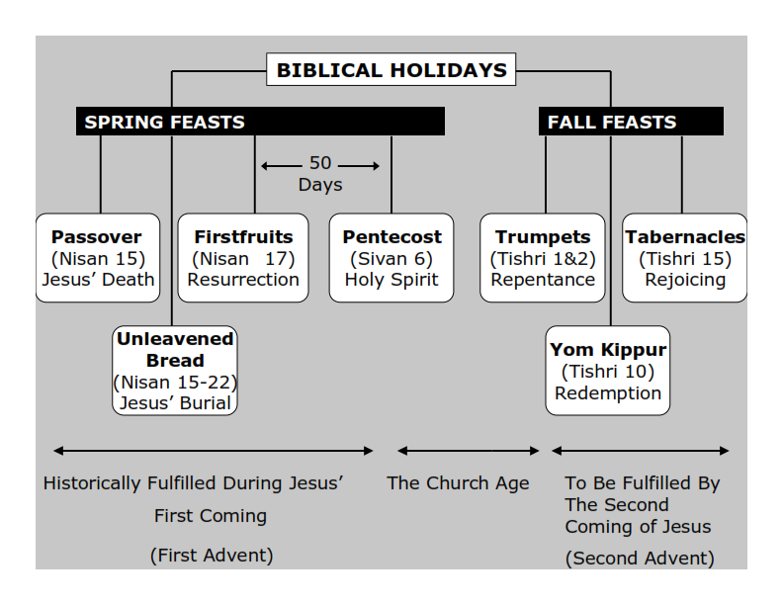
Philippians 3:20-21
20 For our citizenship is in heaven, from which we also eagerly wait for the Savior, the Lord Jesus Christ, 21 who will transform our lowly body that it may be conformed to His glorious body, according to the working by which He is able even to subdue all things to Himself.

Slide 118
Matthew 28:5-6
5 But the angel answered and said to the women, "Do not be afraid, for I know that you seek Jesus who was crucified. 6 He is not here; for He is risen, as He said. Come, see the place where the Lord lay.

Slide 119
Philippians 2:9-11
9 Therefore God also has highly exalted Him and given Him the name which is above every name, 10 that at the name of Jesus every knee should bow, of those in heaven, and of those on earth, and of those under the earth, 11 and that every tongue should confess that Jesus Christ is Lord, to the glory of God the Father.

Slide 120
5. Jesus’ Resurrection Gives Us Hope

Slide 121
Bill Gaither wrote,
“Because He lives, I can face tomorrow.”

Slide 122
John 11:25-27
25 Jesus said to her, "I am the resurrection and the life. He who believes in Me, though he may die, he shall live. 26 And whoever lives and believes in Me shall never die. Do you believe this?" 27 She said to Him, "Yes, Lord, I believe that You are the Christ, the Son of God, who is to come into the world."

Slide 123
6. Resurrection Through the Holy Ghost

Slide 124
Acts 2:38-39
38 Then Peter said to them, "Repent, and let every one of you be baptized in the name of Jesus Christ for the remission of sins; and you shall receive the gift of the Holy Spirit. 39 For the promise is to you and to your children, and to all who are afar off, as many as the Lord our God will call."

Slide 125
7. From Death to Life by the Holy Ghost

Slide 126
Romans 3:23
“for all have sinned and fall short of the glory of God”

Slide 127
Romans 3:24-26
24 being justified freely by His grace through the redemption that is in Christ Jesus, 25 whom God set forth as a propitiation by His blood, through faith, to demonstrate His righteousness, because in His forbearance God had passed over the sins that were previously committed, 26 to demonstrate at the present time His righteousness, that He might be just and the justifier of the one who has faith in Jesus.

Slide 128
8. We Can All Experience Resurrection in Our Lives through the Holy Ghost

Slide 129
Romans 8:9-11
9 But you are not in the flesh but in the Spirit, if indeed the Spirit of God dwells in you. Now if anyone does not have the Spirit of Christ, he is not His. 10 And if Christ is in you, the body is dead because of sin, but the Spirit is life because of righteousness.

Slide 130
11 But if the Spirit of Him who raised Jesus from the dead dwells in you, He who raised Christ from the dead will also give life to your mortal bodies through His Spirit who dwells in you.

Slide 131
Ephesians 1:13-14
13 In Him you also trusted, after you heard the word of truth, the gospel of your salvation; in whom also, having believed, you were sealed with the Holy Spirit of promise, 14 who is the guarantee of our inheritance until the redemption of the purchased possession, to the praise of His glory.

Slide 132
9. The Final Resurrection

Slide 133
The Same Spirit That Raised Jesus Will Also Raise Us

Slide 134
1 Corinthians 15:50-54
50 Now this I say, brethren, that flesh and blood cannot inherit the kingdom of God; nor does corruption inherit incorruption. 51 Behold, I tell you a mystery: We shall not all sleep, but we shall all be changed-- 52 in a moment, in the twinkling of an eye, at the last trumpet. For the trumpet will sound, and the dead will be raised incorruptible, and we shall be changed.

Slide 135
53 For this corruptible must put on incorruption, and this mortal must put on immortality. 54 So when this corruptible has put on incorruption, and this mortal has put on immortality, then shall be brought to pass the saying that is written: "Death is swallowed up in victory."

Slide 136
Because Jesus Rose from the Dead, We Have Hope of Rising to Be with Him in the Final Resurrection

Slide 137
1 Thessalonians 4:13-18
13 But I do not want you to be ignorant, brethren, concerning those who have fallen asleep, lest you sorrow as others who have no hope. 14 For if we believe that Jesus died and rose again, even so God will bring with Him those who sleep in Jesus.

Slide 138
15 For this we say to you by the word of the Lord, that we who are alive and remain until the coming of the Lord will by no means precede those who are asleep. 16 For the Lord Himself will descend from heaven with a shout, with the voice of an archangel, and with the trumpet of God. And the dead in Christ will rise first.

Slide 139
17 Then we who are alive and remain shall be caught up together with them in the clouds to meet the Lord in the air. And thus we shall always be with the Lord. 18 Therefore comfort one another with these words.

