Slide 1


Slide 2
“Awake My Soul”
(Hillsong)

Slide 3
There is a sound I love to hear It's the sound of the Savior's robe As He walks into the room where

Slide 4
people pray Where we hear praises He hears faith
There is a sound I love to hear It's the sound of the

Slide 5
Savior's robe As He walks into the room where people pray Where we hear worship He hears faith

Slide 6
Awake my soul and sing Sing His praise aloud Sing His praise aloud Awake my soul and sing Sing His

Slide 7
praise aloud Sing His praise aloud There is a sound that changes things The sound of His people on their

Slide 8
knees Oh wake up you slumbering It's time to worship Him Awake my soul and sing Sing His praise

Slide 9
aloud Sing His praise aloud Awake my soul and sing
Sing His praise aloud Sing His praise aloud And

Slide 10
when He moves And when we pray Where stood a wall now stands a way Where every promise is amen

Slide 11
And when He moves Make no mistake The bowels of hell begin to shake All hail the Lord all hail the King

Slide 12
Hey oh Oh let the King of glory enter in Hey oh Fall down on your knees and worship Him Hey oh Let His

Slide 13
praise rise up don't hold it in Awake my soul and sing
Sing His praise aloud Sing His praise aloud Awake

Slide 14
my soul and sing Sing His praise aloud Sing His praise aloud

Slide 15
House of The Lord
(by Phil Wickham)

Slide 16
We worship the God who was We worship the God who is We worship the God who evermore will be He

Slide 17
opened the prison doors He parted the raging sea My God, He holds the victory There's joy in the

Slide 18
house of the Lord There's joy in the house of the Lord today And we won't be quiet We shout out Your

Slide 19
praise There's joy in the house of the Lord Our God is surely in this place And we won't be quiet We

Slide 20
shout out Your praise (Oh-oh, oh) we shout out Your praise (Oh-oh, oh) We sing to the God who heals We

Slide 21
sing to the God who saves We sing to the God who always makes a way 'Cause He hung up on that

Slide 22
cross Then He rose up from that grave My God's still rolling stones away There's joy in the house of the

Slide 23
Lord There's joy in the house of the Lord today And we won't be quiet We shout out Your praise There's

Slide 24
joy in the house of the Lord Our God is surely in this place And we won't be quiet We shout out Your

Slide 25
praise We were the beggars Now we're royalty We were the prisoners Now we're running free We are

Slide 26
forgiven, accepted Redeemed by His grace Let the house of the Lord sing praise 'Cause we were the

Slide 27
beggars Now we're royalty We were the prisoners
Now we're running free We are forgiven, accepted

Slide 28
Redeemed by His grace Let the house of the Lord sing praise There's joy in the house of the Lord

Slide 29
(there is joy in the house) There's joy in the house of the Lord today And we won't be quiet (oh yeah)

Slide 30
We shout out Your praise (I wanna shout out Your praise) There's joy in the house of the Lord (there is

Slide 31
joy) Our God is surely in this place (there is joy) And we won't be quiet We shout out Your praise (we

Slide 32
gonna shout out Your praise) There's joy in the house of the Lord There's joy in the house of the

Slide 33
Lord today And we won't be quiet We shout out Your praise (we gonna shout out Your praise) There's joy

Slide 34
in the house of the Lord (there is joy, there is joy)
Our God is surely in this place (joy in this place)

Slide 35
And we won't be quiet (we won't be quiet) We shout out Your praise We shout out Your praise There is

Slide 36
joy in the house, there is joy in the house today We shout out Your praise We shout out Your praise

Slide 37
Look to Jesus
(by Phil Wickham)

Slide 38
Death is like an empty grave Fear looks like a giant slain Trials look like gifts of grace When I look to

Slide 39
Jesus Failures bow to victory Sin has lost its hold on me Endless love is all I see When I look to Jesus

Slide 40
How my heart leaps How my soul sings For I know where my help comes from Jesus sought me Jesus

Slide 41
saved me Hallelujah for all He's done, yeah Every wall comes crashing down Chains are broken on the

Slide 42
ground What can stand against us now When we look to Jesus? Yeah How my heart leaps How my

Slide 43
soul sings For I know where my help comes from
Jesus sought me Jesus saved me Hallelujah for all

Slide 44
He's done How my heart leaps How my soul sings For I know where my help comes from Jesus sought

Slide 45
me Jesus saved me Hallelujah for all He's done I will keep my eyes on You We'll dance upon the crashing

Slide 46
waves I will keep my eyes on You For only You can make a way I will keep my eyes on You We'll dance

Slide 47
upon the crashing waves I will keep my eyes on You
For only You can make a way How my heart leaps

Slide 48
How my soul sings For I know where my help comes from Jesus sought me Jesus saved me Hallelujah for

Slide 49
all He's done How my heart leaps How my soul sings
For I know where my help comes from Jesus sought

Slide 50
me Jesus saved me Hallelujah for all He's done For all He's done Sing hallelujah for all He's done We

Slide 51
sing hallelujah Hallelujah for all He's done

Slide 52
Goodness of God
(by Bethal)

Slide 53
I love You, Lord For Your mercy never fails me All my days, I've been held in Your hands From the moment

Slide 54
that I wake up Until I lay my head Oh, I will sing of the goodness of God And all my life You have been

Slide 55
faithful And all my life You have been so, so good With every breath that I am able Oh, I will sing of the

Slide 56
goodness of God I love Your voice You have led me through the fire In the darkest night You are close

Slide 57
God (yeah) And all my life You have been faithful (oh) And all my life You have been so, so good With

Slide 58
every breath that I am able Oh, I will sing of the goodness of God (yeah) 'Cause Your goodness is

Slide 59
running after It's running after me Your goodness is running after It's running after me With my life laid

Slide 60
down I'm surrendered now I give You everything
'Cause Your goodness is running after It's running

Slide 61
after me (oh-oh) 'Cause Your goodness is running after It's running after me Your goodness is running

Slide 62
after It's running after me With my life laid down I'm surrendered now I give You everything 'Cause Your

Slide 63
goodness is running after It keeps running after me
And all my life You have been faithful And all my life

Slide 64
You have been so, so good With every breath that I am able Oh, I'm gonna sing of the goodness of God

Slide 65
(I'm gonna sing, I'm gonna sing) 'Cause all my life You have been faithful And all my life You have been

Slide 66
so, so good With every breath that I am able Oh, I'm gonna sing of the goodness of God Oh, I'm gonna

Slide 67
sing of the goodness of God

Slide 68
Forever Reign
(by Hillsong)

Slide 69
You are good You are good When there's nothing good in me You are love You are love On display for

Slide 70
all to see You are light You are light When the darkness closes in You are hope You are hope You

Slide 71
have covered all my sins You are peace You are peace When my fear is crippling You are truth You

Slide 72
are truth Even in my wondering You are joy You are joy You're the reason that I sing You are life You are

Slide 73
life And you death has lost its sting Oh, I run into your arms I run into your arms The riches of your love Will

Slide 74
always be enough Nothing compares to your embrace Light of the world Forever reigns You are

Slide 75
more You are more Than my words will ever say You are Lord You are Lord All creation will proclaim You

Slide 76
are here You are here In your presence I'm made whole You are God You are God Of all else I'm letting

Slide 77
go Oh, I run into your arms I run into your arms The riches of your love Will always be enough

Slide 78
Nothing compares to your embrace Light of the world Forever reigns My heart will sing No other

Slide 79
name, Jesus, Jesus My heart will sing No other name, Jesus, Jesus Oh, I run into your arms I'm

Slide 80
running to your arms The riches of your love Will always be enough Nothing compares to your

Slide 81
embrace Light of the world Forever reigns Oh, I run into your arms I'm running to your arms The riches of

Slide 82
your love Will always be enough Nothing compares to your embrace Light of the world Forever reigns

Slide 83


Slide 84
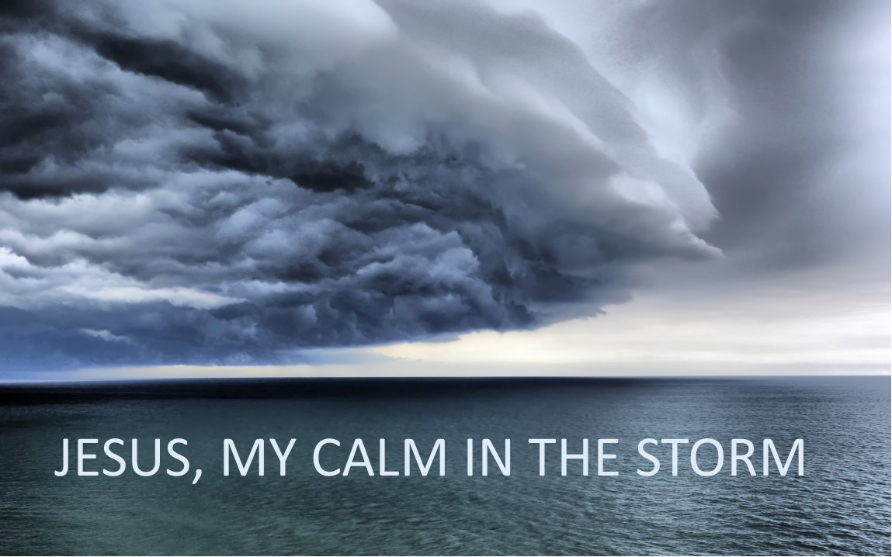

Jesus Will Quiet Your Storms
by Pastor Fee Soliven
John 14:25-27
Sunday Morning
January 30, 2022

Slide 85
John 14:25-27
25 "These things I have spoken to you while being present with you. 26 But the Helper, the Holy Spirit, whom the Father will send in My name, He will teach you all things, and bring to your remembrance all things that I said to you. 27 Peace I leave with you, My peace I give to you; not as the world gives do I give to you. Let not your heart be troubled, neither let it be afraid.

Slide 86
Christians have two opposing options for life—one leads to peace, the other to stress.

Slide 87
Proverbs 3:1-12
1 My son, do not forget my law, But let your heart keep my commands; 2 For length of days and long life And peace they will add to you. 3 Let not mercy and truth forsake you; Bind them around your neck, Write them on the tablet of your heart,

Slide 88
4 And so find favor and high esteem In the sight of God and man. 5 Trust in the LORD with all your heart, And lean not on your own understanding; 6 In all your ways acknowledge Him, And He shall direct your paths. 7 Do not be wise in your own eyes; Fear the LORD and depart from evil.

Slide 89
8 It will be health to your flesh, And strength to your bones. 9 Honor the LORD with your possessions, And with the firstfruits of all your increase; 10 So your barns will be filled with plenty, And your vats will overflow with new wine.

Slide 90
11 My son, do not despise the chastening of the LORD, Nor detest His correction; 12 For whom the LORD loves He corrects, Just as a father the son in whom he delights.

Slide 91
1.Obey God and leave all the consequences to Him

Slide 92
John 14:15
"If you love Me, keep My commandments”

Slide 93
1 John 2:3-5
3 Now by this we know that we know Him, if we keep His commandments. 4 He who says, "I know Him," and does not keep His commandments, is a liar, and the truth is not in him. 5 But whoever keeps His word, truly the love of God is perfected in him. By this we know that we are in Him.

Slide 94
2. Trust the Lord for every need in your life

Slide 95
Proverbs 3:5-6
5 Trust in the LORD with all your heart, And lean not on your own understanding; 6 In all your ways acknowledge Him, And He shall direct your paths

Slide 96
3. Wait upon God for His direction and timing

Slide 97
Isaiah 64:4
“For since the beginning of the world Men have not heard nor perceived by the ear, Nor has the eye seen any God besides You, Who acts for the one who waits for Him”

Slide 98
4. Give generously to the Lord’s work

Slide 99
2 Corinthians 9:8-11
8 And God is able to make all grace abound toward you, that you, always having all sufficiency in all things, may have an abundance for every good work. 9 As it is written: "He has dispersed abroad, He has given to the poor; His righteousness endures forever."

Slide 100
10 Now may He who supplies seed to the sower, and bread for food, supply and multiply the seed you have sown and increase the fruits of your righteousness, 11 while you are enriched in everything for all liberality, which causes thanksgiving through us to God.

Slide 101
5. Admit that you can’t live the Christian life because Christ is the one who lives it through you

Slide 102
Galatians 2:20
“I have been crucified with Christ; it is no longer I who live, but Christ lives in me; and the life which I now live in the flesh I live by faith in the Son of God, who loved me and gave Himself for me”

Slide 103
6. Accept that God loves you unconditionally

Slide 104
John 17:23
“I in them, and You in Me; that they may be made perfect in one, and that the world may know that You have sent Me, and have loved them as You have loved Me”

Slide 105
7. Know that God is in absolute control of every circumstance of life

Slide 106
Romans 8:28-30
28 And we know that all things work together for good to those who love God, to those who are the called according to His purpose. 29 For whom He foreknew, He also predestined to be conformed to the image of His Son, that He might be the firstborn among many brethren. 30 Moreover whom He predestined, these He also called; whom He called, these He also justified; and whom He justified, these He also glorified.

Slide 107
8. Depend upon the Holy Spirit for everything

Slide 108
John 14:26
“But the Helper, the Holy Spirit, whom the Father will send in My name, He will teach you all things, and bring to your remembrance all things that I said to you”

Slide 109
Romans 8:26
“Likewise the Spirit also helps in our weaknesses. For we do not know what we should pray for as we ought, but the Spirit Himself makes intercession for us with groanings which cannot be uttered”

Slide 110
9. Make your personal time of meditation with God the priority of your life

Slide 111
Philippians 4:6
“Be anxious for nothing, but in everything by prayer and supplication, with thanksgiving, let your requests be made known to God”

Slide 112
Matthew 6:6
“But you, when you pray, go into your room, and when you have shut your door, pray to your Father who is in the secret place; and your Father who sees in secret will reward you openly”

Slide 113
10. Recognize that the gospel of Jesus Christ, when clearly presented in the power of the Holy Spirit, can penetrate the most hardened heart, transform that life, and change his or her eternal destiny

Slide 114
Romans 1:16-17
16 For I am not ashamed of the gospel of Christ, for it is the power of God to salvation for everyone who believes, for the Jew first and also for the Greek. 17 For in it the righteousness of God is revealed from faith to faith; as it is written, "The just shall live by faith."

Slide 115
1. Is your life guided by biblical principles, or are you letting circumstances, feelings, and pressures dictate the course of your life?

Slide 116
2. How would living by God’s principles free you from worry, burdens, and fears?

Slide 117
3. Does God’s sovereignty over every event in your life comfort or disquiet you? Why?

Slide 118
4. How does knowing you’re dependent on the Lord in every way make you feel?

Slide 119
5. Read over these 10 principles again. Notice how many of them require trust in God instead of self-reliance.

Slide 120
6. What fears or desires tend to hinder your trust in the Lord?

Slide 121
1 Thessalonians 4:13-18
13 But I do not want you to be ignorant, brethren, concerning those who have fallen asleep, lest you sorrow as others who have no hope. 14 For if we believe that Jesus died and rose again, even so God will bring with Him those who sleep in Jesus.

Slide 122
15 For this we say to you by the word of the Lord, that we who are alive and remain until the coming of the Lord will by no means precede those who are asleep. 16 For the Lord Himself will descend from heaven with a shout, with the voice of an archangel, and with the trumpet of God. And the dead in Christ will rise first.

Slide 123
17 Then we who are alive and remain shall be caught up together with them in the clouds to meet the Lord in the air. And thus we shall always be with the Lord. 18 Therefore comfort one another with these words.

Slide 124
1 Corinthians 15:50-54
50 Now this I say, brethren, that flesh and blood cannot inherit the kingdom of God; nor does corruption inherit incorruption. 51 Behold, I tell you a mystery: We shall not all sleep, but we shall all be changed-- 52 in a moment, in the twinkling of an eye, at the last trumpet. For the trumpet will sound, and the dead will be raised incorruptible, and we shall be changed.

Slide 125
53 For this corruptible must put on incorruption, and this mortal must put on immortality. 54 So when this corruptible has put on incorruption, and this mortal has put on immortality, then shall be brought to pass the saying that is written: "Death is swallowed up in victory."

Slide 126

20 Again, when a righteous man turns from his righteousness and commits iniquity, and I lay a stumbling block before him, he shall die; because you did not give him warning, he shall die in his sin, and his righteousness which he has done shall not be remembered; but his blood I will require at your hand.

Slide 127
Acts 2:38-39
38 Then Peter said to them, "Repent, and let every one of you be baptized in the name of Jesus Christ for the remission of sins; and you shall receive the gift of the Holy Spirit. 39 For the promise is to you and to your children, and to all who are afar off, as many as the Lord our God will call."

