Slide 1


Slide 2
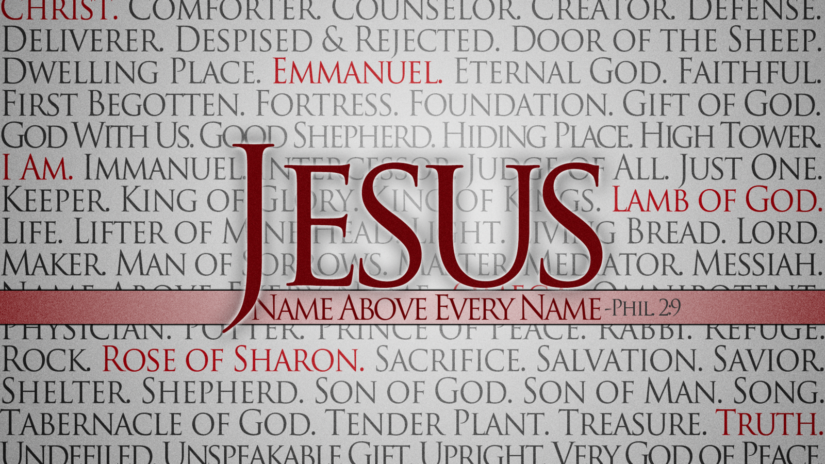

Jesus Above Every Name
by Pastor Fee Soliven
Philippians 2:9-18
Wednesday Evening
February 23, 2022

Slide 3
Philippians 2:9-18
9 Therefore God also has highly exalted Him and given Him the name which is above every name, 10 that at the name of Jesus every knee should bow, of those in heaven, and of those on earth, and of those under the earth,

Slide 4
11 and that every tongue should confess that Jesus Christ is Lord, to the glory of God the Father. 12 Therefore, my beloved, as you have always obeyed, not as in my presence only, but now much more in my absence, work out your own salvation with fear and trembling;

Slide 5
13 for it is God who works in you both to will and to do for His good pleasure. 14 Do all things without complaining and disputing, 15 that you may become blameless and harmless, children of God without fault in the midst of a crooked and perverse generation, among whom you shine as lights in the world,

Slide 6
16 holding fast the word of life, so that I may rejoice in the day of Christ that I have not run in vain or labored in vain.

Slide 7
9 Therefore God also has highly exalted Him and given Him the name which is above every name,

Slide 8
Acts 2:33
“Therefore being exalted to the right hand of God, and having received from the Father the promise of the Holy Spirit, He poured out this which you now see and hear”

Slide 9
Ephesians 1:20-23
20 which He worked in Christ when He raised Him from the dead and seated Him at His right hand in the heavenly places, 21 far above all principality and power and might and dominion, and every name that is named, not only in this age but also in that which is to come. 22 And He put all things under His feet, and gave Him to be head over all things to the church, 23 which is His body, the fullness of Him who fills all in all.

Slide 10
Hebrews 1:3
“who being the brightness of His glory and the express image of His person, and upholding all things by the word of His power, when He had by Himself purged our sins, sat down at the right hand of the Majesty on high”

Slide 11
Matthew 28:18
And Jesus came and spoke to them, saying, "All authority has been given to Me in heaven and on earth.

Slide 12
John 5:27
“and has given Him authority to execute judgment also, because He is the Son of Man”

Slide 13
Romans 14:9
“For to this end Christ died and rose and lived again, that He might be Lord of both the dead and the living”

Slide 14
10 that at the name of Jesus every knee should bow, of those in heaven, and of those on earth, and of those under the earth,

Slide 15
Ephesians 4:9-10
9(Now this, "He ascended"--what does it mean but that He also first descended into the lower parts of the earth? 10 He who descended is also the One who ascended far above all the heavens, that He might fill all things.)

Slide 16
Revelations 5:13
And every creature which is in heaven and on the earth and under the earth and such as are in the sea, and all that are in them, I heard saying: "Blessing and honor and glory and power Be to Him who sits on the throne, And to the Lamb, forever and ever!"

Slide 17
Revelation 19:20
“Then the beast was captured, and with him the false prophet who worked signs in his presence, by which he deceived those who received the mark of the beast and those who worshiped his image. These two were cast alive into the lake of fire burning with brimstone”

Slide 18
Revelation 21:1
“Now I saw a new heaven and a new earth, for the first heaven and the first earth had passed away. Also there was no more sea”

Slide 19
11 and that every tongue should confess that Jesus Christ is Lord, to the glory of God the Father.

Slide 20
12 Therefore, my beloved, as you have always obeyed, not as in my presence only, but now much more in my absence, work out your own salvation with fear and trembling; 13 for it is God who works in you both to will and to do for His good pleasure.

Slide 21
1 Corinthians 12:4-7
4 There are diversities of gifts, but the same Spirit. 5 There are differences of ministries, but the same Lord. 6 And there are diversities of activities, but it is the same God who works all in all. 7 But the manifestation of the Spirit is given to each one for the profit of all:

Slide 22
14 Do all things without complaining and disputing, 15 that you may become blameless and harmless, children of God without fault in the midst of a crooked and perverse generation, among whom you shine as lights in the world,

Slide 23
1 Corinthians 6:1-11
1 Dare any of you, having a matter against another, go to law before the unrighteous, and not before the saints? 2 Do you not know that the saints will judge the world? And if the world will be judged by you, are you unworthy to judge the smallest matters?

Slide 24
3 Do you not know that we shall judge angels? How much more, things that pertain to this life? 4 If then you have judgments concerning things pertaining to this life, do you appoint those who are least esteemed by the church to judge? 5 I say this to your shame. Is it so, that there is not a wise man among you, not even one, who will be able to judge between his brethren?

Slide 25
6 But brother goes to law against brother, and that before unbelievers! 7 Now therefore, it is already an utter failure for you that you go to law against one another. Why do you not rather accept wrong? Why do you not rather let yourselves be cheated? 8 No, you yourselves do wrong and cheat, and you do these things to your brethren!

Slide 26
9 Do you not know that the unrighteous will not inherit the kingdom of God? Do not be deceived. Neither fornicators, nor idolaters, nor adulterers, nor homosexuals, nor sodomites, 10 nor thieves, nor covetous, nor drunkards, nor revilers, nor extortioners will inherit the kingdom of God.

Slide 27
11 And such were some of you. But you were washed, but you were sanctified, but you were justified in the name of the Lord Jesus and by the Spirit of our God.

Slide 28
16 holding fast the word of life, so that I may rejoice in the day of Christ that I have not run in vain or labored in vain.

Slide 29
1 Thessalonians 4:13-18
13 But I do not want you to be ignorant, brethren, concerning those who have fallen asleep, lest you sorrow as others who have no hope. 14 For if we believe that Jesus died and rose again, even so God will bring with Him those who sleep in Jesus.

Slide 30
15 For this we say to you by the word of the Lord, that we who are alive and remain until the coming of the Lord will by no means precede those who are asleep. 16 For the Lord Himself will descend from heaven with a shout, with the voice of an archangel, and with the trumpet of God. And the dead in Christ will rise first.

Slide 31
17 Then we who are alive and remain shall be caught up together with them in the clouds to meet the Lord in the air. And thus we shall always be with the Lord. 18 Therefore comfort one another with these words.

Slide 32
1 Corinthians 15:50-54
50 Now this I say, brethren, that flesh and blood cannot inherit the kingdom of God; nor does corruption inherit incorruption. 51 Behold, I tell you a mystery: We shall not all sleep, but we shall all be changed-- 52 in a moment, in the twinkling of an eye, at the last trumpet. For the trumpet will sound, and the dead will be raised incorruptible, and we shall be changed.

Slide 33
53 For this corruptible must put on incorruption, and this mortal must put on immortality. 54 So when this corruptible has put on incorruption, and this mortal has put on immortality, then shall be brought to pass the saying that is written: "Death is swallowed up in victory."

Slide 34

20 Again, when a righteous man turns from his righteousness and commits iniquity, and I lay a stumbling block before him, he shall die; because you did not give him warning, he shall die in his sin, and his righteousness which he has done shall not be remembered; but his blood I will require at your hand.

Slide 35
Acts 2:38-39
38 Then Peter said to them, "Repent, and let every one of you be baptized in the name of Jesus Christ for the remission of sins; and you shall receive the gift of the Holy Spirit. 39 For the promise is to you and to your children, and to all who are afar off, as many as the Lord our God will call."

