Slide 1


Slide 2
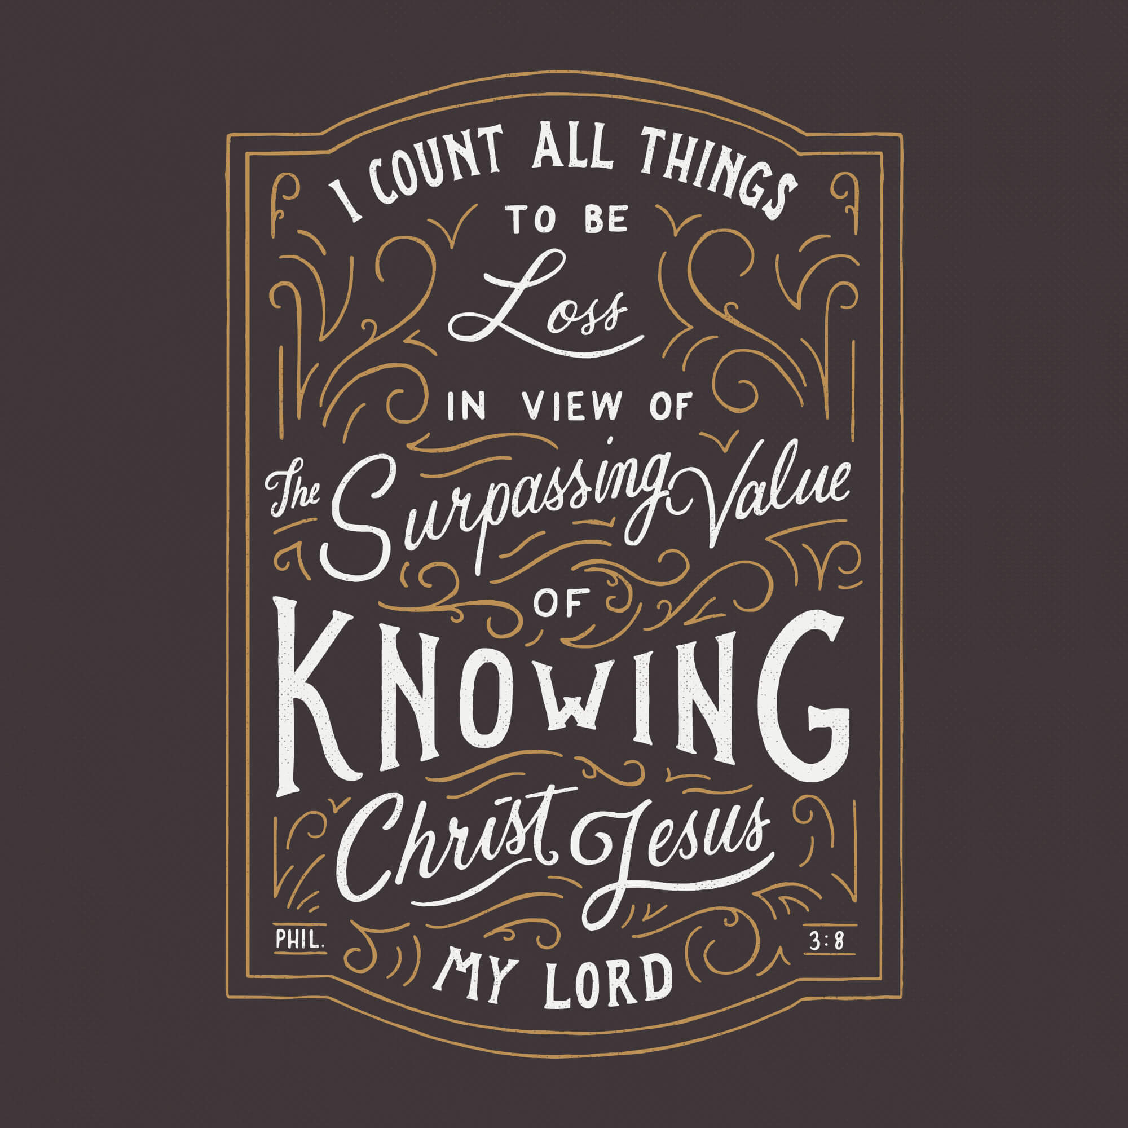

Count All Things Lost for Christ
by Pastor Fee Soliven
Philippians 3:1-9
Wednesday Evening
March 9, 2022

Slide 3
Philippians 3:1-11
1 Finally, my brethren, rejoice in the Lord. For me to write the same things to you is not tedious, but for you it is safe. 2 Beware of dogs, beware of evil workers, beware of the mutilation! 3 For we are the circumcision, who worship God in the Spirit, rejoice in Christ Jesus, and have no confidence in the flesh,

Slide 4
4 though I also might have confidence in the flesh. If anyone else thinks he may have confidence in the flesh, I more so: 5 circumcised the eighth day, of the stock of Israel, of the tribe of Benjamin, a Hebrew of the Hebrews; concerning the law, a Pharisee; 6 concerning zeal, persecuting the church; concerning the righteousness which is in the law, blameless.

Slide 5
7 But what things were gain to me, these I have counted loss for Christ. 8 Yet indeed I also count all things loss for the excellence of the knowledge of Christ Jesus my Lord, for whom I have suffered the loss of all things, and count them as rubbish, that I may gain Christ

Slide 6
9 and be found in Him, not having my own righteousness, which is from the law, but that which is through faith in Christ, the righteousness which is from God by faith;

Slide 7
1 Finally, my brethren, rejoice in the Lord. For me to write the same things to you is not tedious, but for you it is safe.

Slide 8
What is true joy?

Slide 9
Often happiness is mistaken for joy, but the two are very different. Inward joy comes from knowing and trusting God; happiness comes as a result of pleasant circumstances. Inward joy is lasting; we can feel joy in spite of our deepest troubles; happiness is temporary because it is based on external circumstances.

Slide 10
1 Peter 1:7-9
7 that the genuineness of your faith, being much more precious than gold that perishes, though it is tested by fire, may be found to praise, honor, and glory at the revelation of Jesus Christ, 8 whom having not seen you love. Though now you do not see Him, yet believing, you rejoice with joy inexpressible and full of glory, 9 receiving the end of your faith--the salvation of your souls.
.

Slide 11
2 Beware of dogs, beware of evil workers, beware of the mutilation!

Slide 12
1. Dogs were regarded by Jews as despised and unclean creatures; it was common for orthodox Jews to refer to Gentiles as “dogs”; however, here Paul switched the designation to refer not to Gentiles but to an extreme faction of Jews.

Slide 13
2. He also called them wicked men or evil workers. The Jews regarded themselves as holy, not evil, because they kept the law. But their reliance on the law lessened their reliance on God.

Slide 14
3. Finally is this passage, he called them mutilators. Some Jewish Christians wrongly believed that it was essential for Gentiles to follow all the Old Testament Jewish laws, saying that the Gentile believers had to be circumcised to be saved. Those who taught this wrong doctrine were called Judaizers; they were a severe problem for Paul.

Slide 15
Genesis 17:9-11
9 And God said to Abraham: "As for you, you shall keep My covenant, you and your descendants after you throughout their generations. 10 This is My covenant which you shall keep, between Me and you and your descendants after you: Every male child among you shall be circumcised; 11 and you shall be circumcised in the flesh of your foreskins, and it shall be a sign of the covenant between Me and you.

Slide 16
3 For we are the circumcision, who worship God in the Spirit, rejoice in Christ Jesus, and have no confidence in the flesh,

Slide 17
Deuteronomy 30:6
“And the LORD your God will circumcise your heart and the heart of your descendants, to love the LORD your God with all your heart and with all your soul, that you may live”

Slide 18
1. For we are the circumcision

Slide 19
Deuteronomy 30:6
“And the LORD your God will circumcise your heart and the heart of your descendants, to love the LORD your God with all your heart and with all your soul, that you may live”

Slide 20
Romans 2:28-29
28 For he is not a Jew who is one outwardly, nor is circumcision that which is outward in the flesh; 29 but he is a Jew who is one inwardly; and circumcision is that of the heart, in the Spirit, not in the letter; whose praise is not from men but from God.

Slide 21
2. Believers worship God in the Spirit.

Slide 22
3. Put no confidence in Human Effort.

Slide 23
4 though I also might have confidence in the flesh. If anyone else thinks he may have confidence in the flesh, I more so:

Slide 24
Ephesians 2:7-10
7 that in the ages to come He might show the exceeding riches of His grace in His kindness toward us in Christ Jesus. 8 For by grace you have been saved through faith, and that not of yourselves; it is the gift of God, 9 not of works, lest anyone should boast. 10 For we are His workmanship, created in Christ Jesus for good works, which God prepared beforehand that we should walk in them.

Slide 25
5 circumcised the eighth day, of the stock of Israel, of the tribe of Benjamin, a Hebrew of the Hebrews; concerning the law, a Pharisee;

Slide 26
Romans 11:1
“I say then, has God cast away His people? Certainly not! For I also am an Israelite, of the seed of Abraham, of the tribe of Benjamin”

Slide 27
2 Corinthians 11:22
Are they Hebrews? So am I. Are they Israelites? So am I. Are they the seed of Abraham? So am I.

Slide 28
6 concerning zeal, persecuting the church; concerning the righteousness which is in the law, blameless.

Slide 29
Acts 9:1-2
1 Then Saul, still breathing threats and murder against the disciples of the Lord, went to the high priest 2 and asked letters from him to the synagogues of Damascus, so that if he found any who were of the Way, whether men or women, he might bring them bound to Jerusalem.

Slide 30
Acts 22:3-5
3 "I am indeed a Jew, born in Tarsus of Cilicia, but brought up in this city at the feet of Gamaliel, taught according to the strictness of our fathers' law, and was zealous toward God as you all are today. 4 I persecuted this Way to the death, binding and delivering into prisons both men and women,

Slide 31
5 as also the high priest bears me witness, and all the council of the elders, from whom I also received letters to the brethren, and went to Damascus to bring in chains even those who were there to Jerusalem to be punished.

Slide 32
Acts 26:9-11
9 Indeed, I myself thought I must do many things contrary to the name of Jesus of Nazareth. 10 This I also did in Jerusalem, and many of the saints I shut up in prison, having received authority from the chief priests; and when they were put to death, I cast my vote against them.

Slide 33
11 And I punished them often in every synagogue and compelled them to blaspheme; and being exceedingly enraged against them, I persecuted them even to foreign cities.

Slide 34
7 But what things were gain to me, these I have counted loss for Christ. 8 Yet indeed I also count all things loss for the excellence of the knowledge of Christ Jesus my Lord, for whom I have suffered the loss of all things, and count them as rubbish, that I may gain Christ 9 and be found in Him, not having my own righteousness, which is from the law, but that which is through faith in Christ, the righteousness which is from God by faith;

Slide 35
Colossians 2:2-3
2 that their hearts may be encouraged, being knit together in love, and attaining to all riches of the full assurance of understanding, to the knowledge of the mystery of God, both of the Father and of Christ, 3 in whom are hidden all the treasures of wisdom and knowledge.

Slide 36
Ephesians 2:7-10
7 that in the ages to come He might show the exceeding riches of His grace in His kindness toward us in Christ Jesus. 8 For by grace you have been saved through faith, and that not of yourselves; it is the gift of God, 9 not of works, lest anyone should boast. 10 For we are His workmanship, created in Christ Jesus for good works, which God prepared beforehand that we should walk in them.

Slide 37
1 Thessalonians 4:13-18
13 But I do not want you to be ignorant, brethren, concerning those who have fallen asleep, lest you sorrow as others who have no hope. 14 For if we believe that Jesus died and rose again, even so God will bring with Him those who sleep in Jesus.

Slide 38
15 For this we say to you by the word of the Lord, that we who are alive and remain until the coming of the Lord will by no means precede those who are asleep. 16 For the Lord Himself will descend from heaven with a shout, with the voice of an archangel, and with the trumpet of God. And the dead in Christ will rise first.

Slide 39
17 Then we who are alive and remain shall be caught up together with them in the clouds to meet the Lord in the air. And thus we shall always be with the Lord. 18 Therefore comfort one another with these words.

Slide 40
1 Corinthians 15:50-54
50 Now this I say, brethren, that flesh and blood cannot inherit the kingdom of God; nor does corruption inherit incorruption. 51 Behold, I tell you a mystery: We shall not all sleep, but we shall all be changed-- 52 in a moment, in the twinkling of an eye, at the last trumpet. For the trumpet will sound, and the dead will be raised incorruptible, and we shall be changed.

Slide 41
53 For this corruptible must put on incorruption, and this mortal must put on immortality. 54 So when this corruptible has put on incorruption, and this mortal has put on immortality, then shall be brought to pass the saying that is written: "Death is swallowed up in victory."

Slide 42

20 Again, when a righteous man turns from his righteousness and commits iniquity, and I lay a stumbling block before him, he shall die; because you did not give him warning, he shall die in his sin, and his righteousness which he has done shall not be remembered; but his blood I will require at your hand.

Slide 43
Acts 2:38-39
38 Then Peter said to them, "Repent, and let every one of you be baptized in the name of Jesus Christ for the remission of sins; and you shall receive the gift of the Holy Spirit. 39 For the promise is to you and to your children, and to all who are afar off, as many as the Lord our God will call."

