Slide 1


Slide 2
All My Fountain
(Chris Tomlin)

Slide 3
This dry and desert land I tell myself keep walking on
Hear something up ahead Water falling like a song

Slide 4
An everlasting stream You're river carries me home
Let it flow, let it flow All my fountains A flood for my

Slide 5
Soul A well that never will run dry I've rambled on my own Never believing I would find An everlasting

Slide 6
Stream You're river carries me home Let it flow, let it flow Open the Heavens Come living water All my

Slide 7
fountains are in you You're strong like a river Your love is running through All my fountains are in you

Slide 8
Come on and rain down on us, rain down on us, Lord
Come on and rain down on us, rain down on us, Lord

Slide 9
Come on and rain down on us, rain down on us, Lord (we pray) Come on and rain down on us, rain down

Slide 10
on us, Lord Open the Heavens Come living water
All my fountains are in you You're strong like a river

Slide 11
Your love is running through All my fountains are in you Open the Heavens Come living water All my

Slide 12
fountains are in you You're strong like a river Your love is running through All my fountains are in you

Slide 13
All my fountains are in you

Slide 14
“This is Amazing Grace”
(Phil Wickham)

Slide 15
Who breaks the power of sin and darkness. Who’s love is mighty and so much stronger. The King of

Slide 16
glory ,the king above all kings. Who shakes the whole earth with holy thunder. And leaves us

Slide 17
in awe and wonder? The King of Glory, the King above all Kings. This is amazing grace. This is

Slide 18
unfailing love. That you would would take my place. That you would bear my cross. You laid down your

Slide 19
life. That I would be set free. Oh, Jesus I sing for all that you’ve done for me. Who brings our chaos back

Slide 20
into order. Who makes the orphans a son and daughter. The King of Glory, The King of Glory

Slide 21
into order. Who makes the orphans a son and daughter. The King of Glory, The King of Glory

Slide 22
Who rules the nation. With truth and justice.Shines like the sun in all of his brilliance. The King of Glory

Slide 23
The King above all Kings. This is Amazing Grace. This is unfailing love. That you would take my place.

Slide 24
That you would bear my cross. You laid down your life. That I would be set free. Oh, Jesus, I sing for

Slide 25
All that you,ve done for me. Worthy is the Lamb who was slain. Worthy is the King who conquered the

Slide 26
grave. Worthy is the Lamb who was slain. Worthy is the King who conquered the grave. Worthy is the

Slide 27
Lamb who was slain. Worthy, Worthy,Worthy. This is Amazing Grace. This is unfailing love. That you

Slide 28
would take my place. That you would bear my cross. You laid down your life. That I would be set free

Slide 29
Oh, Jesus I sing for. All that you’ve done for me.

Slide 30
“ Canvas and the Clay”
(Pat Barret)

Slide 31
In my mother’s womb. You formed me with your hands. Known and loved by you. Before I took a

Slide 32
Breath. When I doubt it, Lord, remind me. I’m wonderfully made. You’re an artist and a potter.

Slide 33
I’m the canvas and the clay. You make all things work together. For my future and for my good. You make

Slide 34
All things work together for your glory and for your name. There’s a healing light. Just beyond the clouds

Slide 35
Though I’ve walked through fire. I see it clearly now.I know nothing has been wasted. No failure or mistake

Slide 36
You’re an artist and a potter I’m the canvas and the clay. You make all things work together. For my

Slide 37
Future and for my good. You make all things work together for your glory and for your name.

Slide 38
For my good. For my good. And when I doubt it, Lord, remind me. I’m wonderfully made . You’re an

Slide 39
Artist and a potter I’m the canvas and the clay. And I know nothing has been wasted. No failure or

Slide 40
Mistake. You’re an artist and a potter. I’m the canvas and the clay. You make all things. Work together for

Slide 41
My future and for my good. You make all things. Work together for your glory. And for your name.

Slide 42
When I doubt it, Lord, remind me I’m wonderfully made. You’re and artist and a potter. I’m the canvas

Slide 43
And the clay. I know nothing has been wasted. No failure or mistake. You’re an artist and a potter. I’m

Slide 44
The canvas and clay. You’re an artist and a potter. I’m the canvas and the clay. You’re an artist and a

Slide 45
Potter I’m the canvas and the clay.

Slide 46
Living Hope
(Phil Whickam)

Slide 47
How great the chasm that lay between us How high the mountain I could not climb In desperation, I

Slide 48
turned to heaven And spoke your name into the night
Then through the darkness Your loving kindness

Slide 49
Tore through the shadows of my soul The work is ﬁnished, the end is written Jesus Christ, my living

Slide 50
Hope Who could imagine so great a mercy? What heart could fathom such boundless grace? The God

Slide 51
of ages stepped down from glory To wear my sin and bear my shame The cross has spoken, I am forgiven

Slide 52
The king of kings calls me His own Beautiful savior, I'm yours forever Jesus Christ, my living hope

Slide 53
Hallelujah, praise the one who set me free Hallelujah, death has lost its grip on me You have broken every

Slide 54
Chain There's salvation in your name Jesus Christ, my living hope Hallelujah, praise the one who set me

Slide 55
Free Hallelujah, death has lost its grip on me You have broken every chain There's salvation in your

Slide 56
Name Jesus Christ, my living hope Then came the morning that sealed the promise Your buried body

Slide 57
began to breathe Out of the silence, the roaring lion
Declared the grave has no claim on me Then came

Slide 58
the morning that sealed the promise Your buried body began to breathe Out of the silence, the roaring

Slide 59
Lion Declared the grave has no claim on me Jesus, yours is the victory, whoa! Hallelujah, praise the one

Slide 60
who set me free Hallelujah, death has lost its grip on me You have broken every chain There's salvation in

Slide 61
your name Jesus Christ, my living hope Hallelujah, praise the one who set me free Hallelujah, death has

Slide 62
lost its grip on me You have broken every chain
There's salvation in your name Jesus Christ, my

Slide 63
living hope Jesus Christ, my living hope
Oh God, you are my living hope

Slide 64
I Have Decided to Follow Jesus

Slide 65
I have decided to follow Jesus; I have decided to follow Jesus; I have decided to follow Jesus; No

Slide 66
turning back, no turning back. 2. Tho' none go with me, I still will follow, Tho' none go with me I still will

Slide 67
follow, Tho' none go with me, I still will follow; No turning back, no turning back. 3. My cross I'll carry,

Slide 68
till I see Jesus; My cross I'll carry till I see Jesus, My cross I'll carry till I see Jesus; No turning back, No

Slide 69
turning back. 4. The world behind me, the cross before me, The world behind me, the cross before

Slide 70
me; The world behind me, the cross before me;
No turning back, no turning back.

Slide 71


Slide 72


Israel The Prophetic Time Clock
by Pastor Fee Soliven
Daniel 12:1-4
Sunday Morning
March 6, 2022

Slide 73
Daniel 12:1-4
1 "At that time Michael shall stand up, The great prince who stands watch over the sons of your people; And there shall be a time of trouble, Such as never was since there was a nation, Even to that time. And at that time your people shall be delivered, Every one who is found written in the book.

Slide 74
2 And many of those who sleep in the dust of the earth shall awake, Some to everlasting life, Some to shame and everlasting contempt. 3 Those who are wise shall shine Like the brightness of the firmament, And those who turn many to righteousness Like the stars forever and ever. 4 "But you, Daniel, shut up the words, and seal the book until the time of the end; many shall run to and fro, and knowledge shall increase."

Slide 75
The Scattering of the Jews

Slide 76
The Warning

Slide 77
Deuteronomy 4:22-27
23 Take heed to yourselves, lest you forget the covenant of the LORD your God which He made with you, and make for yourselves a carved image in the form of anything which the LORD your God has forbidden you. 24 For the LORD your God is a consuming fire, a jealous God.

Slide 78
25 "When you beget children and grandchildren and have grown old in the land, act corruptly and make a carved image in the form of anything, and do evil in the sight of the LORD your God to provoke Him to anger,

Slide 79
26 I call heaven and earth to witness against you this day, that you will soon utterly perish from the land which you cross over the Jordan to possess; you will not prolong your days in it, but will be utterly destroyed. 27 And the LORD will scatter you among the peoples, and you will be left few in number among the nations where the LORD will drive you.

Slide 80
The First Judgment &
Destruction of the Temple

Slide 81
2 Kings 25:1-3
1 Now it came to pass in the ninth year of his reign, in the tenth month, on the tenth day of the month, that Nebuchadnezzar king of Babylon and all his army came against Jerusalem and encamped against it; and they built a siege wall against it all around.

Slide 82
2 So the city was besieged until the eleventh year of King Zedekiah. 3 By the ninth day of the fourth month the famine had become so severe in the city that there was no food for the people of the land.

Slide 83
The First Scattering

Slide 84
Ezekiel 36:16-20
16 Moreover the word of the LORD came to me, saying: 17 "Son of man, when the house of Israel dwelt in their own land, they defiled it by their own ways and deeds; to Me their way was like the uncleanness of a woman in her customary impurity. 18 Therefore I poured out My fury on them for the blood they had shed on the land, and for their idols with which they had defiled it.

Slide 85
19 So I scattered them among the nations, and they were dispersed throughout the countries; I judged them according to their ways and their deeds. 20 When they came to the nations, wherever they went, they profaned My holy name--when they said of them, 'These are the people of the LORD, and yet they have gone out of His land.'

Slide 86
The Second Judgment & Destruction of the Temple

Slide 87
Luke 19:41-44
41 Now as He drew near, He saw the city and wept over it, 42 saying, "If you had known, even you, especially in this your day, the things that make for your peace! But now they are hidden from your eyes. 43 For days will come upon you when your enemies will build an embankment around you, surround you and close you in on every side,

Slide 88
44 and level you, and your children within you, to the ground; and they will not leave in you one stone upon another, because you did not know the time of your visitation."

Slide 89
The Second Scattering

Slide 90
Luke 21:20-24
20 "But when you see Jerusalem surrounded by armies, then know that its desolation is near. 21 Then let those in Judea flee to the mountains, let those who are in the midst of her depart, and let not those who are in the country enter her. 22 For these are the days of vengeance, that all things which are written may be fulfilled.

Slide 91
23 But woe to those who are pregnant and to those who are nursing babies in those days! For there will be great distress in the land and wrath upon this people. 24 And they will fall by the edge of the sword, and be led away captive into all nations. And Jerusalem will be trampled by Gentiles until the times of the Gentiles are fulfilled.

Slide 92
The Jews are Regathered to Israel

Slide 93
Ezekiel 20:41-43
41 I will accept you as a sweet aroma when I bring you out from the peoples and gather you out of the countries where you have been scattered; and I will be hallowed in you before the Gentiles. 42 Then you shall know that I am the LORD, when I bring you into the land of Israel, into the country for which I lifted My hand in an oath to give to your fathers.

Slide 94
43 And there you shall remember your ways and all your doings with which you were defiled; and you shall loathe yourselves in your own sight because of all the evils that you have committed.

Slide 95
Jeremiah 16:14-17
14 "Therefore behold, the days are coming," says the LORD, "that it shall no more be said, 'The LORD lives who brought up the children of Israel from the land of Egypt,' 15 "but, 'The LORD lives who brought up the children of Israel from the land of the north and from all the lands where He had driven them.' For I will bring them back into their land which I gave to their fathers.

Slide 96
16 "Behold, I will send for many fishermen," says the LORD, "and they shall fish them; and afterward I will send for many hunters, and they shall hunt them from every mountain and every hill, and out of the holes of the rocks. 17 For My eyes are on all their ways; they are not hidden from My face, nor is their iniquity hidden from My eyes.

Slide 97
Israel Becomes a Nation in 1948 in
One Day

Slide 98
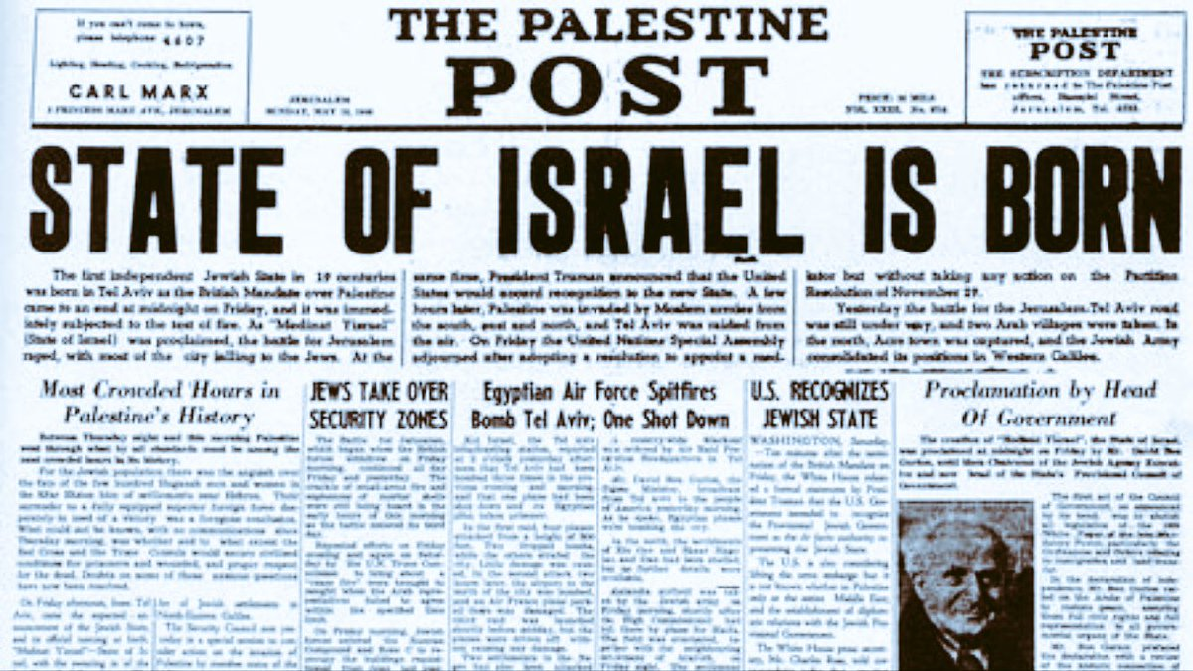
Photo 1948 >

Slide 99
Isaiah 66:8
“Who has heard such a thing? Who has seen such things? Shall the earth be made to give birth in one day? Or shall a nation be born at once? For as soon as Zion was in labor, She gave birth to her children”

Slide 100
“The Olivet Discourse”
The Prophecy of Jesus

Slide 101
Matthew 24:1-44
1 Then Jesus went out and departed from the temple, and His disciples came up to show Him the buildings of the temple. 2 And Jesus said to them, "Do you not see all these things? Assuredly, I say to you, not one stone shall be left here upon another, that shall not be thrown down."

Slide 102
3 Now as He sat on the Mount of Olives, the disciples came to Him privately, saying, "Tell us, when will these things be? And what will be the sign of Your coming, and of the end of the age?" 4 And Jesus answered and said to them: "Take heed that no one deceives you.

Slide 103
5 For many will come in My name, saying, 'I am the Christ,' and will deceive many. 6 And you will hear of wars and rumors of wars. See that you are not troubled; for all these things must come to pass, but the end is not yet. 7 For nation will rise against nation, and kingdom against kingdom. And there will be famines, pestilences, and earthquakes in various places.

Slide 104
8 All these are the beginning of sorrows. 9 Then they will deliver you up to tribulation and kill you, and you will be hated by all nations for My name's sake. 10 And then many will be offended, will betray one another, and will hate one another. 11 Then many false prophets will rise up and deceive many. 12 And because lawlessness will abound, the love of many will grow cold. 13 But he who endures to the end shall be saved.

Slide 105
14 And this gospel of the kingdom will be preached in all the world as a witness to all the nations, and then the end will come. 15 "Therefore when you see the 'abomination of desolation,' spoken of by Daniel the prophet, standing in the holy place" (whoever reads, let him understand), 16 then let those who are in Judea flee to the mountains.

Slide 106
17 Let him who is on the housetop not go down to take anything out of his house. 18 And let him who is in the field not go back to get his clothes. 19 But woe to those who are pregnant and to those who are nursing babies in those days! 20 And pray that your flight may not be in winter or on the Sabbath.

Slide 107
21 For then there will be great tribulation, such as has not been since the beginning of the world until this time, no, nor ever shall be. 22 And unless those days were shortened, no flesh would be saved; but for the elect's sake those days will be shortened. 23 Then if anyone says to you, 'Look, here is the Christ!' or 'There!' do not believe it.

Slide 108
24 For false christs and false prophets will rise and show great signs and wonders to deceive, if possible, even the elect. 25 See, I have told you beforehand. 26 Therefore if they say to you, 'Look, He is in the desert!' do not go out; or 'Look, He is in the inner rooms!' do not believe it. 27 For as the lightning comes from the east and flashes to the west, so also will the coming of the Son of Man be.

Slide 109
28 For wherever the carcass is, there the eagles will be gathered together. 29 "Immediately after the tribulation of those days the sun will be darkened, and the moon will not give its light; the stars will fall from heaven, and the powers of the heavens will be shaken.

Slide 110
30 Then the sign of the Son of Man will appear in heaven, and then all the tribes of the earth will mourn, and they will see the Son of Man coming on the clouds of heaven with power and great glory.

Slide 111
31 And He will send His angels with a great sound of a trumpet, and they will gather together His elect from the four winds, from one end of heaven to the other. 32 "Now learn this parable from the fig tree: When its branch has already become tender and puts forth leaves, you know that summer is near.

Slide 112
33 So you also, when you see all these things, know that it is near--at the doors! 34 Assuredly, I say to you, this generation will by no means pass away till all these things take place. 35 Heaven and earth will pass away, but My words will by no means pass away.

Slide 113
36 "But of that day and hour no one knows, not even the angels of heaven, but My Father only. 37 But as the days of Noah were, so also will the coming of the Son of Man be. 38 For as in the days before the flood, they were eating and drinking, marrying and giving in marriage, until the day that Noah entered the ark,

Slide 114
39 and did not know until the flood came and took them all away, so also will the coming of the Son of Man be. 40 Then two men will be in the field: one will be taken and the other left. 41 Two women will be grinding at the mill: one will be taken and the other left. 42 Watch therefore, for you do not know what hour your Lord is coming.

Slide 115
43 But know this, that if the master of the house had known what hour the thief would come, he would have watched and not allowed his house to be broken into. 44 Therefore you also be ready, for the Son of Man is coming at an hour you do not expect.

Slide 116
What is a Shemitah

Slide 117
Deuteronomy 15:1-2
1 "At the end of every seven years you shall grant a release of debts. 2 And this is the form of the release: Every creditor who has lent anything to his neighbor shall release it; he shall not require it of his neighbor or his brother, because it is called the LORD's release.

Slide 118
Historical Dates & Events on a New Shemitah Cycle

Slide 119
586 B.C. The Babylonian Army destroyed the First Temple

Slide 120
70 AC The Romans destroyed Jerusalem

Slide 121
July 28, 1914, World War 1

Slide 122
1948 The Holocaust

Slide 123
1967 The Vietnam War

Slide 124
2001 The First Intifada in Israel

Slide 125
2008 The Great Worldwide Market Crash

Slide 126
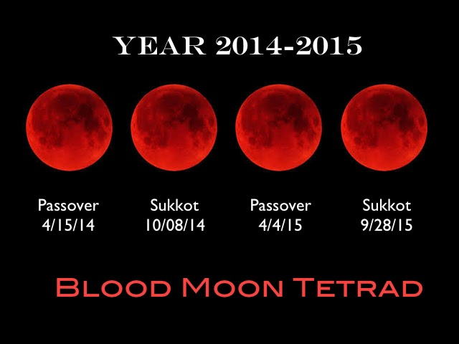
2014-2015 The Blood Moons
Announcing the Tribulation

Slide 127
2022 The Feast of Trumpets / Rosh Shoshana. The possible start of the Tribulation and a Rapture Alert/Watch

Slide 128
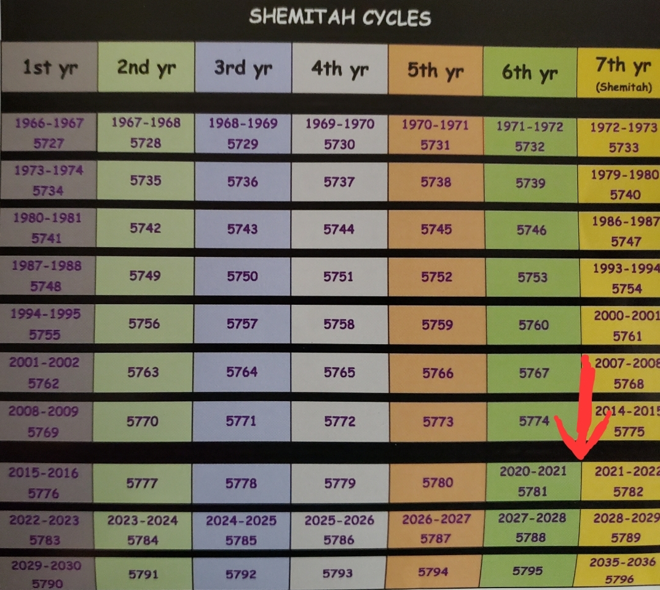
Shemitah Cycle Chart>

Slide 129
Psalm 102:12-16
2 But You, O LORD, shall endure forever, And the remembrance of Your name to all generations. 13 You will arise and have mercy on Zion; For the time to favor her, Yes, the set time, has come. 14 For Your servants take pleasure in her stones, And show favor to her dust. 15 So the nations shall fear the name of the LORD, And all the kings of the earth Your glory. 16 For the LORD shall build up Zion; He shall appear in His glory.

Slide 130
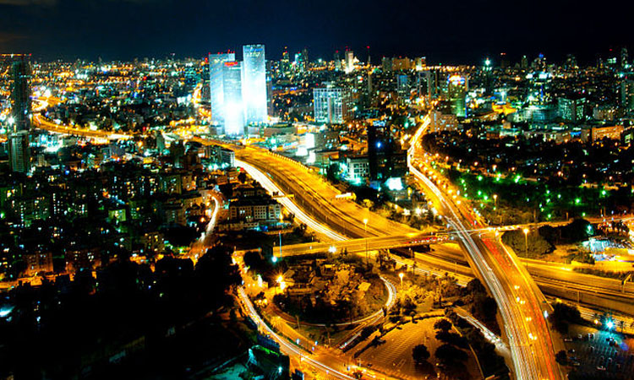
What is repentance?

Slide 131
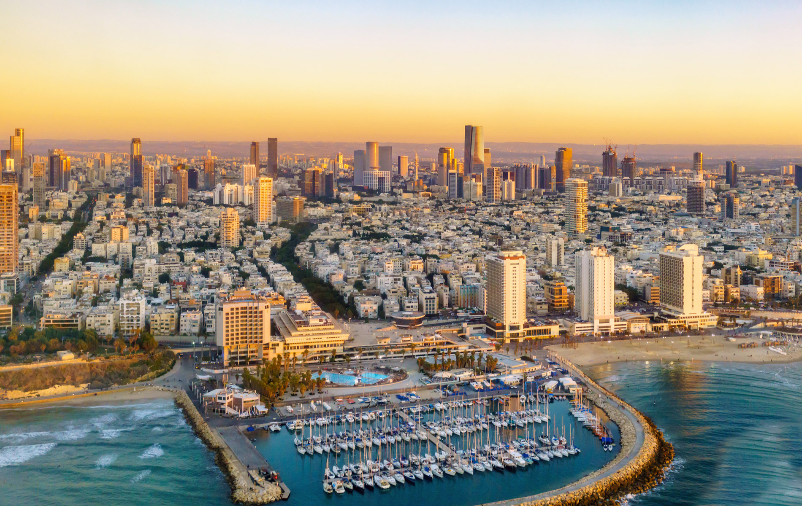
The Definition

Slide 132
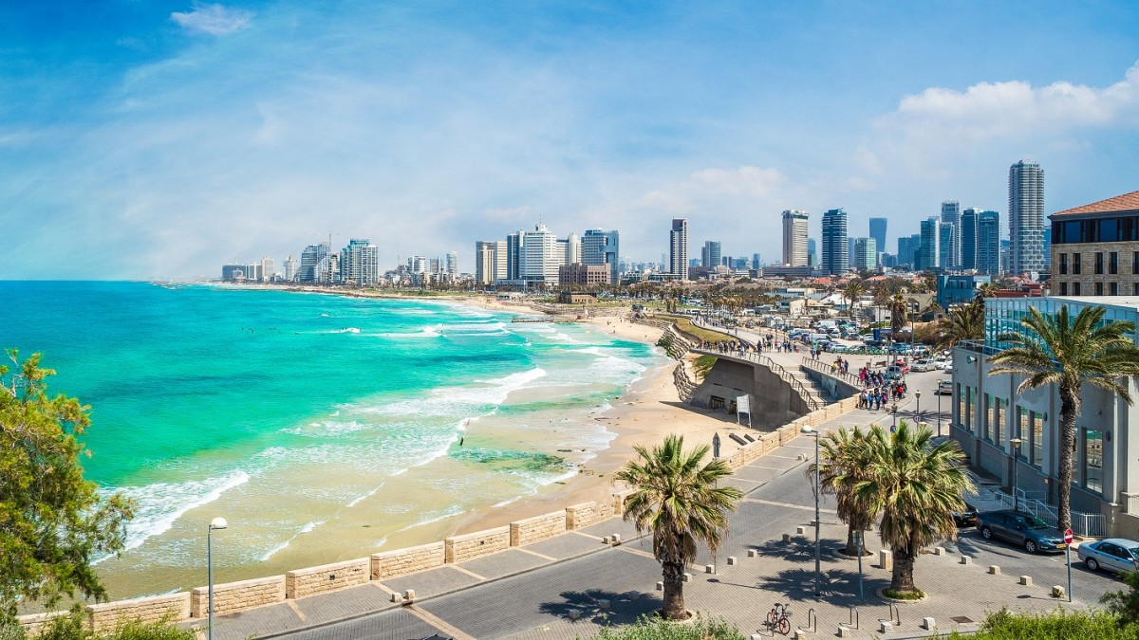
In the New Testament, repentance includes recognition of sin, godly sorrow for that sin, and a commitment to change direction. Regret, grief, and remorse accompany repentance but are not evidence of it if there is no change in behavior

Slide 133
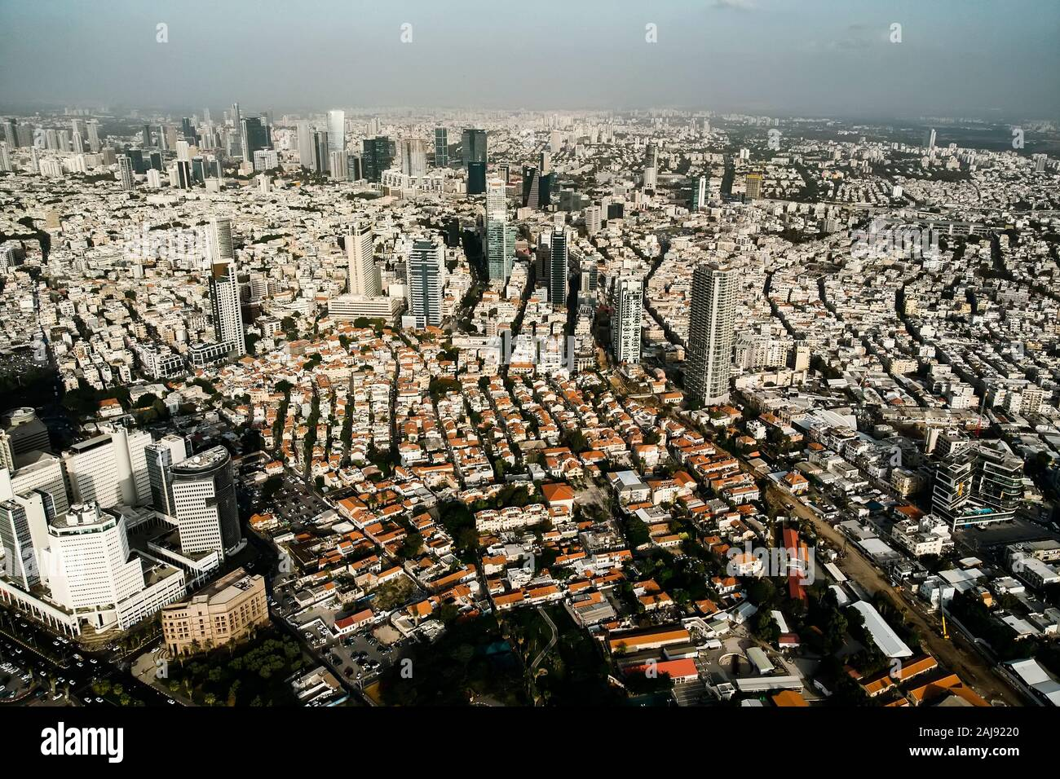
In the Old Testament, the Hebrew word for repentance is “turn.”

Slide 134
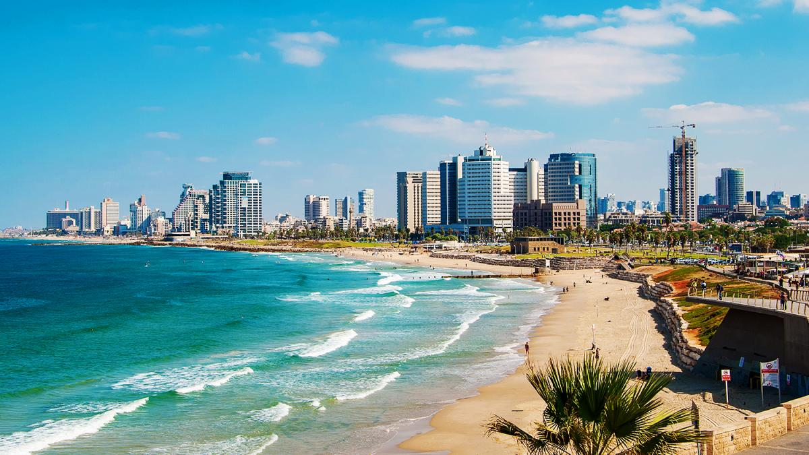
John 20:31
but these are written that you may believe that Jesus is the Christ, the Son of God, and that believing you may have life in His name.

Slide 135
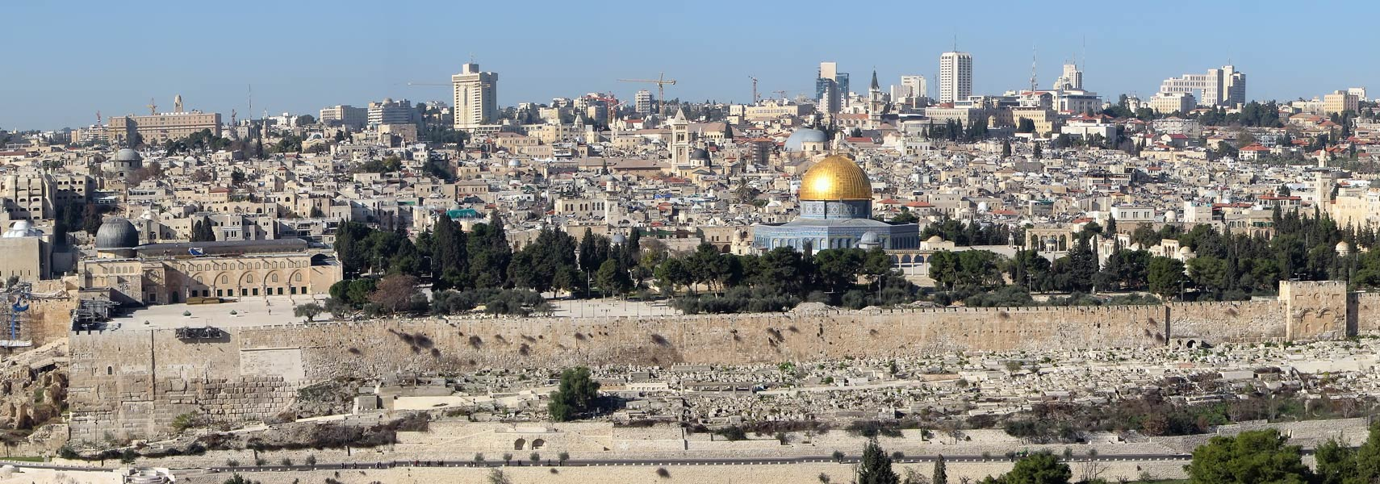
Romans 6:4
Therefore we were buried with Him through baptism into death, that just as Christ was raised from the dead by the glory of the Father, even so we also should walk in newness of life.

Slide 136
1 Thessalonians 4:13-18
13 But I do not want you to be ignorant, brethren, concerning those who have fallen asleep, lest you sorrow as others who have no hope. 14 For if we believe that Jesus died and rose again, even so God will bring with Him those who sleep in Jesus.

Slide 137
15 For this we say to you by the word of the Lord, that we who are alive and remain until the coming of the Lord will by no means precede those who are asleep. 16 For the Lord Himself will descend from heaven with a shout, with the voice of an archangel, and with the trumpet of God. And the dead in Christ will rise first.

Slide 138
17 Then we who are alive and remain shall be caught up together with them in the clouds to meet the Lord in the air. And thus we shall always be with the Lord. 18 Therefore comfort one another with these words.

Slide 139
1 Corinthians 15:50-54
50 Now this I say, brethren, that flesh and blood cannot inherit the kingdom of God; nor does corruption inherit incorruption. 51 Behold, I tell you a mystery: We shall not all sleep, but we shall all be changed-- 52 in a moment, in the twinkling of an eye, at the last trumpet. For the trumpet will sound, and the dead will be raised incorruptible, and we shall be changed.

Slide 140
53 For this corruptible must put on incorruption, and this mortal must put on immortality. 54 So when this corruptible has put on incorruption, and this mortal has put on immortality, then shall be brought to pass the saying that is written: "Death is swallowed up in victory."

Slide 141

20 Again, when a righteous man turns from his righteousness and commits iniquity, and I lay a stumbling block before him, he shall die; because you did not give him warning, he shall die in his sin, and his righteousness which he has done shall not be remembered; but his blood I will require at your hand.

Slide 142
Acts 2:38-39
38 Then Peter said to them, "Repent, and let every one of you be baptized in the name of Jesus Christ for the remission of sins; and you shall receive the gift of the Holy Spirit. 39 For the promise is to you and to your children, and to all who are afar off, as many as the Lord our God will call."

