Slide 1


Slide 2
My Testimony
(Elevation Worship)

Slide 3
I saw satan fall like lightning. I saw darkness run for cover. But still the miracle that I just can’t get over

Slide 4
My name is registered in heaven. I believe in signs and wonders. I have resurrection power. Still the

Slide 5
Miracles that I just cant get over. My name is registered in heaven. My praise belongs to you

Slide 6
forever. This is my testimony from dead to life. Cause grace rewrote my story, I’ll testify By Jesus

Slide 7
Christ the righteous I’m Justified. This is my Testimony. This is my Testimony. Come together

Slide 8
sons and daughters. Bought with blood and washed in water.Sing the praises of the Spirit Son and Father

Slide 9
Our god will finish what he started. Our God will finish what he started. This is my testimony from

Slide 10
dead to life. Cause grace rewrote my story, I’ll testify
By Jesus Christ the righteous I’m Justified . This is

Slide 11
My Testimony. This is my Testimony. This is my testimony from from dead to life. Cause grace

Slide 12
rewrote my story, I’ll testify By Jesus righteous I’m Justified. This is my testimony. This is my testimony.

Slide 13
If I’m not dead your not done. Greater things are still to come Oh I believe. If I’m not dead your not done.

Slide 14
Greater things are still to come Oh I believe. If I’m not dead your not done. Greater things are still to

Slide 15
come Oh I believe. If I’m not dead your not done your not done. Greater things are still to come. Oh I

Slide 16
Believe. This is My testimony from death to life. Cause Grace rewrote my story, I’ll testify. By Jesus

Slide 17
Christ the righteous im Justified. This is my testimony. This is My Testimony. This is My

Slide 18
Testimony from death to life. Cause grace rewrote my story, I’ll testify. By Jesus Christ the righteous I’m

Slide 19
Justified. This is my Testimony. This is My Testimony.

Slide 20
All My Fountain
(Chris Tomlin)

Slide 21
This dry and desert land I tell myself keep walking on
Hear something up ahead Water falling like a song

Slide 22
An everlasting stream You're river carries me home
Let it flow, let it flow All my fountains A flood for my

Slide 23
Soul A well that never will run dry I've rambled on my own Never believing I would find An everlasting

Slide 24
Stream You're river carries me home Let it flow, let it flow Open the Heavens Come living water All my

Slide 25
fountains are in you You're strong like a river Your love is running through All my fountains are in you

Slide 26
Come on and rain down on us, rain down on us, Lord
Come on and rain down on us, rain down on us, Lord

Slide 27
Come on and rain down on us, rain down on us, Lord (we pray) Come on and rain down on us, rain down

Slide 28
on us, Lord Open the Heavens Come living water
All my fountains are in you You're strong like a river

Slide 29
Your love is running through All my fountains are in you Open the Heavens Come living water All my

Slide 30
fountains are in you You're strong like a river Your love is running through All my fountains are in you

Slide 31
All my fountains are in you

Slide 32
“ See A Victory”
(Elevation Worship)

Slide 33
The weapon may be formed, but it wont prosper. When the darkness falls, it won’t prevail. Cause the

Slide 34
God I serve knows only how to triumph. My God will never fail. Oh, my God will never fail. I’m gonna see

Slide 35
a victory. I’m gonna see a victory. For the battle belongs to you Lord. I’m gonna see a victory. I’m

Slide 36
gonna see a victory. For the battle belongs to you Lord. There’s power in the mighty name of Jesus.

Slide 37
Every war He wages He will win. I’m not backing down from any giant. Cause I know how this story

Slide 38
ends. Yes I know how this story ends. I’m gonna see a victory. I’m gonna see a victory. For the battle

Slide 39
belongs to you Lord. I’m gonna see a victory. I’m gonna see a victory. For the battle belongs to you

Slide 40
Lord. I’m gonna see a victory. I’m gonna see a victory. For the battle belongs to you Lord.I’m gonna

Slide 41
see a victory. I’m gonna see a victory. For the battle belongs to you Lord. You take what the enemy

Slide 42
meant for evil. And you turn it for good. You turn it for good. You take what the enemy meant for evil.

Slide 43
You turn it for good. You turn it for good. You take what the enemy meant for evil. You turn it for good

Slide 44
you turn it for good. You take what the enemy meant for evil and you turn it for good. You turn it for good.

Slide 45
I’m gonna see a victory. I’m gonna see a victory. For the battle belongs to you Lord. I’m gonna see a

Slide 46
Victory. I’m gonna see a victory. For the battle belongs to you Lord. I’m gonna see a victory. I’m

Slide 47
gonna see a victory. For the battle belongs to you Lord.

Slide 48
goodness is running after It keeps running after me
And all my life You have been faithful And all my life

Slide 49
You have been so, so good With every breath that I am able Oh, I'm gonna sing of the goodness of God

Slide 50
(I'm gonna sing, I'm gonna sing) 'Cause all my life You have been faithful And all my life You have been

Slide 51
so, so good With every breath that I am able Oh, I'm gonna sing of the goodness of God Oh, I'm gonna

Slide 52
sing of the goodness of God

Slide 53
”The Anthem”
(Planet Shakers)

Slide 54
By His stripes, we are healed By His nail-pierced hands, we're free By His blood, we're washed clean

Slide 55
Now we have the victory The power of sin is broken
Jesus overcame it all He has won our freedom

Slide 56
Jesus has won it all Hallelujah, You have won the victory Hallelujah, You have won it all for me

Slide 57
Death could not hold You down, You are the risen King Seated in majesty, You are the risen King By

Slide 58
His stripes, we are healed By His nail-pierced hands, we're free By His blood, we're washed clean Now we

Slide 59
have the victory The power of sin is broken Jesus overcame it all He has won our freedom Jesus has

Slide 60
won it all Hallelujah, You have won the victory
Hallelujah, You have won it all for me Death could not

Slide 61
hold You down, You are the risen King Seated in majesty, You are the risen King Our God is risen, He

Slide 62
is alive He won the victory, He reigns on high Our God is risen, He is alive He won the victory, He

Slide 63
reigns on high Our God is risen, He is alive He won the victory, He reigns on high Our God is risen, He is

Slide 64
Alive He won the victory, He reigns on high Hallelujah, You have won the victory Hallelujah, You

Slide 65
have won it all for me Death could not hold You down, You are the risen King Seated in majesty, You

Slide 66
are the risen King Hallelujah, You have won the victory Hallelujah, You have won it all for me

Slide 67
Death could not hold You down, You are the risen King Seated in majesty, You are the risen King

Slide 68
I Have Decided to
Follow Jesus

Slide 69
I have decided to follow Jesus; I have decided to follow Jesus; I have decided to follow Jesus; No

Slide 70
turning back, no turning back. 2. Tho' none go with me, I still will follow, Tho' none go with me I still will

Slide 71
follow, Tho' none go with me, I still will follow; No turning back, no turning back. 3. My cross I'll carry,

Slide 72
till I see Jesus; My cross I'll carry till I see Jesus, My cross I'll carry till I see Jesus; No turning back, No

Slide 73
turning back. 4. The world behind me, the cross before me, The world behind me, the cross before

Slide 74
me; The world behind me, the cross before me;
No turning back, no turning back.

Slide 75


Slide 76
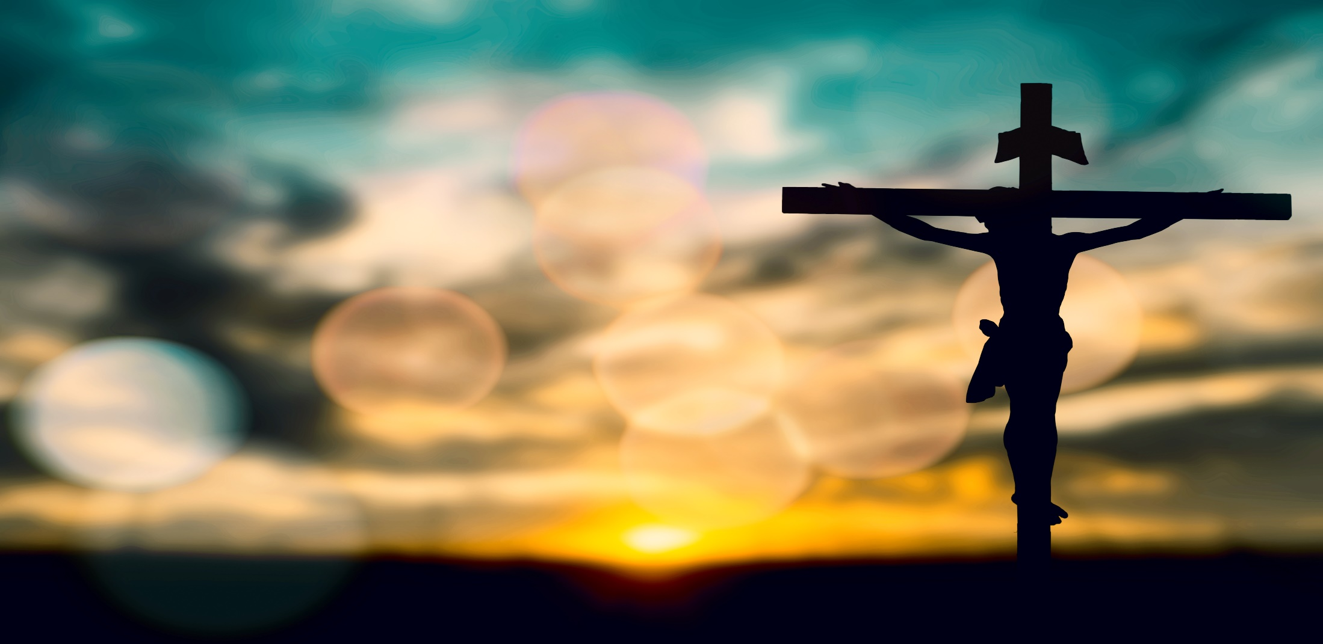

Stages of The Cross Part 1
By Pastor Fee Soliven
Luke 22:39-43
Sunday Morning
April 3, 2022

Slide 77
Luke 22:39-43
39 Coming out, He went to the Mount of Olives, as He was accustomed, and His disciples also followed Him. 40 When He came to the place, He said to them, "Pray that you may not enter into temptation." 41 And He was withdrawn from them about a stone's throw, and He knelt down and prayed, 42 saying, "Father, if it is Your will, take this cup away from Me; nevertheless not My will, but Yours, be done."

Slide 78
Via Dolorosa

Slide 79
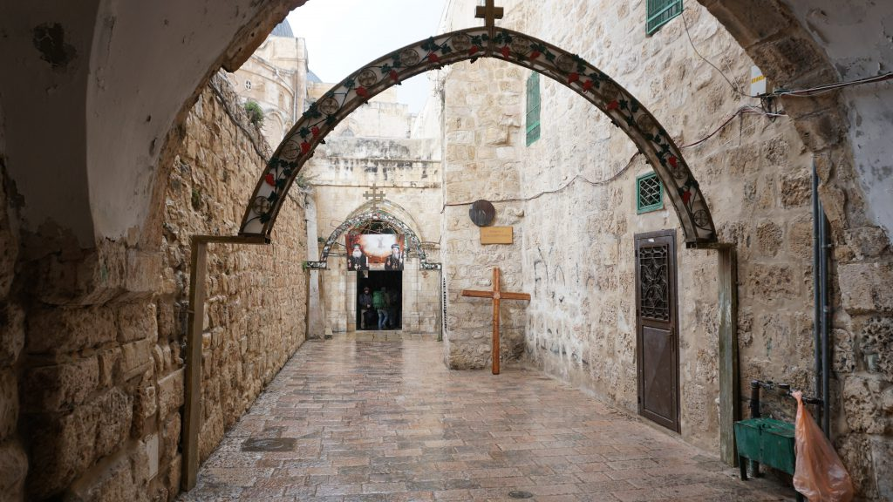
1. Do you remember the last time you felt down or discouraged?

Slide 80
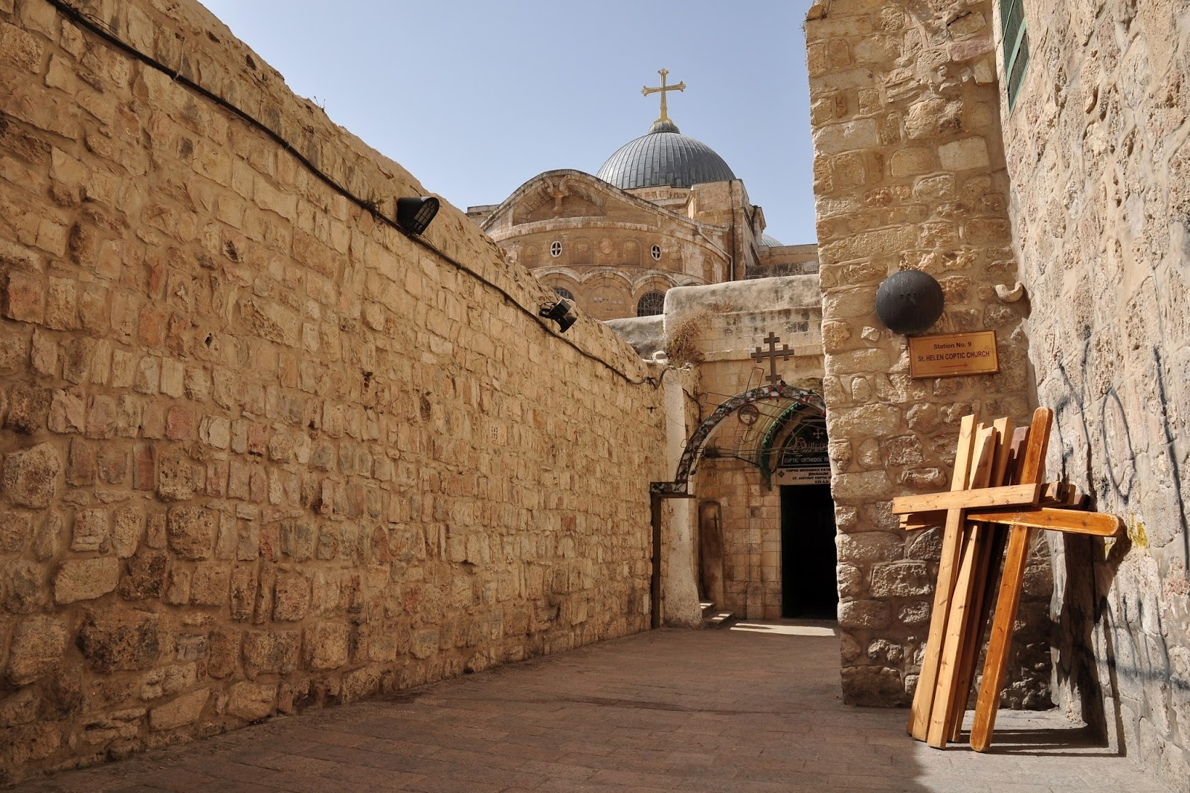
2. What caused you to feel this way?

Slide 81
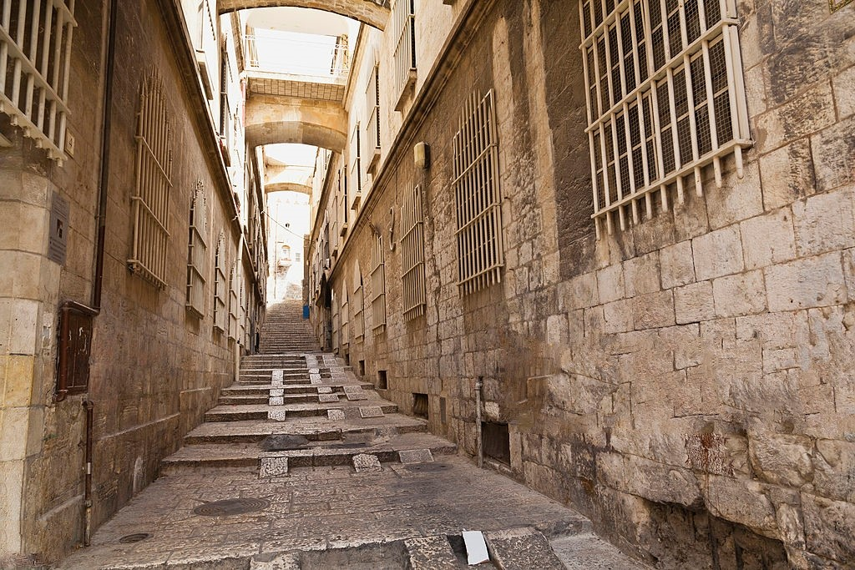
The apostle Paul is an inspiring example of someone who was down but not out.

Slide 82
1st Station of the Cross
Jesus on the Mount of Olives

Slide 83
Luke 22:39-46
39 Coming out, He went to the Mount of Olives, as He was accustomed, and His disciples also followed Him. 40 When He came to the place, He said to them, "Pray that you may not enter into temptation." 41 And He was withdrawn from them about a stone's throw, and He knelt down and prayed, 42 saying, "Father, if it is Your will, take this cup away from Me; nevertheless not My will, but Yours, be done."

Slide 84
43 Then an angel appeared to Him from heaven, strengthening Him. 44 And being in agony, He prayed more earnestly. Then His sweat became like great drops of blood falling down to the ground. 45 When He rose up from prayer, and had come to His disciples, He found them sleeping from sorrow. 46 Then He said to them, "Why do you sleep? Rise and pray, lest you enter into temptation."

Slide 85
2nd Station of the Cross
Jesus is betrayed by
Judas and Arrested

Slide 86
Luke 22:47-48
47 And while He was still speaking, behold, a multitude; and he who was called Judas, one of the twelve, went before them and drew near to Jesus to kiss Him. 48 But Jesus said to him, "Judas, are you betraying the Son of Man with a kiss?"

Slide 87
2 Corinthians 13:5
“Examine yourselves as to whether you are in the faith. Test yourselves. Do you not know yourselves, that Jesus Christ is in you?--unless indeed you are disqualified.”

Slide 88
3rd Station of the Cross
Jesus is condemned
by the Sanhedrin

Slide 89
Luke 22:66-71
66 As soon as it was day, the elders of the people, both chief priests and scribes, came together and led Him into their council, saying, 67 "If You are the Christ, tell us." But He said to them, "If I tell you, you will by no means believe. 68 And if I also ask you, you will by no means answer Me or let Me go.

Slide 90
69 Hereafter the Son of Man will sit on the right hand of the power of God." 70 Then they all said, "Are You then the Son of God?" So He said to them, "You rightly say that I am." 71 And they said, "What further testimony do we need? For we have heard it ourselves from His own mouth."

Slide 91
Luke 6:37-38
37 "Judge not, and you shall not be judged. Condemn not, and you shall not be condemned. Forgive, and you will be forgiven. 38 Give, and it will be given to you: good measure, pressed down, shaken together, and running over will be put into your bosom. For with the same measure that you use, it will be measured back to you."

Slide 92
4th Station of the Cross
Peter denies Jesus

Slide 93
Luke 22:54-62
54 Having arrested Him, they led Him and brought Him into the high priest's house. And Peter followed at a distance. 55 Now when they had kindled a fire in the midst of the courtyard and sat down together, Peter sat among them. 56 And a certain servant girl, seeing him as he sat by the fire, looked intently at him and said, "This man was also with Him."

Slide 94
57 But he denied Him, saying, "Woman, I do not know Him." 58 And after a little while another saw him and said, "You also are of them." But Peter said, "Man, I am not!" 59 Then after about an hour had passed, another confidently affirmed, saying, "Surely this fellow also was with Him, for he is a Galilean."

Slide 95
60 But Peter said, "Man, I do not know what you are saying!" Immediately, while he was still speaking, the rooster crowed. 61 And the Lord turned and looked at Peter. And Peter remembered the word of the Lord, how He had said to him, "Before the rooster crows, you will deny Me three times." 62 So Peter went out and wept bitterly.

Slide 96
Matthew 14:29-33
29 So He said, "Come." And when Peter had come down out of the boat, he walked on the water to go to Jesus. 30 But when he saw that the wind was boisterous, he was afraid; and beginning to sink he cried out, saying, "Lord, save me!"

Slide 97
31 And immediately Jesus stretched out His hand and caught him, and said to him, "O you of little faith, why did you doubt?" 32 And when they got into the boat, the wind ceased. 33 Then those who were in the boat came and worshiped Him, saying, "Truly You are the Son of God."

Slide 98
5th Station of the Cross
Jesus is judged by Pontius Pilate

Slide 99
Luke 23:13-25
13 Then Pilate, when he had called together the chief priests, the rulers, and the people, 14 said to them, "You have brought this Man to me, as one who misleads the people. And indeed, having examined Him in your presence, I have found no fault in this Man concerning those things of which you accuse Him;

Slide 100
15 no, neither did Herod, for I sent you back to him; and indeed nothing deserving of death has been done by Him. 16 I will therefore chastise Him and release Him" 17(for it was necessary for him to release one to them at the feast). 18 And they all cried out at once, saying, "Away with this Man, and release to us Barabbas"—

Slide 101
19 who had been thrown into prison for a certain rebellion made in the city, and for murder. 20 Pilate, therefore, wishing to release Jesus, again called out to them. 21 But they shouted, saying, "Crucify Him, crucify Him!" 22 Then he said to them the third time, "Why, what evil has He done? I have found no reason for death in Him. I will therefore chastise Him and let Him go."

Slide 102
23 But they were insistent, demanding with loud voices that He be crucified. And the voices of these men and of the chief priests prevailed. 24 So Pilate gave sentence that it should be as they requested. 25 And he released to them the one they requested, who for rebellion and murder had been thrown into prison; but he delivered Jesus to their will.

Slide 103
Isaiah 42:8
“I am the LORD, that is My name; And My glory I will not give to another, Nor My praise to graven images. 9 Behold, the former things have come to pass, And new things I declare; Before they spring forth I tell you of them."

Slide 104
6th Station of the Cross
Jesus is Scourged
and Crowned with Thorns

Slide 105
Luke 22:63-65
63 Now the men who held Jesus mocked Him and beat Him. 64 And having blindfolded Him, they struck Him on the face and asked Him, saying, "Prophesy! Who is the one who struck You?" 65 And many other things they blasphemously spoke against Him.

Slide 106
Isaiah 53:3-6
3 He is despised and rejected by men, A Man of sorrows and acquainted with grief. And we hid, as it were, our faces from Him; He was despised, and we did not esteem Him. 4 Surely He has borne our griefs And carried our sorrows; Yet we esteemed Him stricken, Smitten by God, and afflicted.

Slide 107
5 But He was wounded for our transgressions, He was bruised for our iniquities; The chastisement for our peace was upon Him, And by His stripes we are healed. 6 All we like sheep have gone astray; We have turned, every one, to his own way; And the LORD has laid on Him the iniquity of us all.

Slide 108
7th Station of the Cross
Jesus Takes up His Cross

Slide 109
John 19:17
“And He, bearing His cross, went out to a place called the Place of a Skull, which is called in Hebrew, Golgotha…”

Slide 110
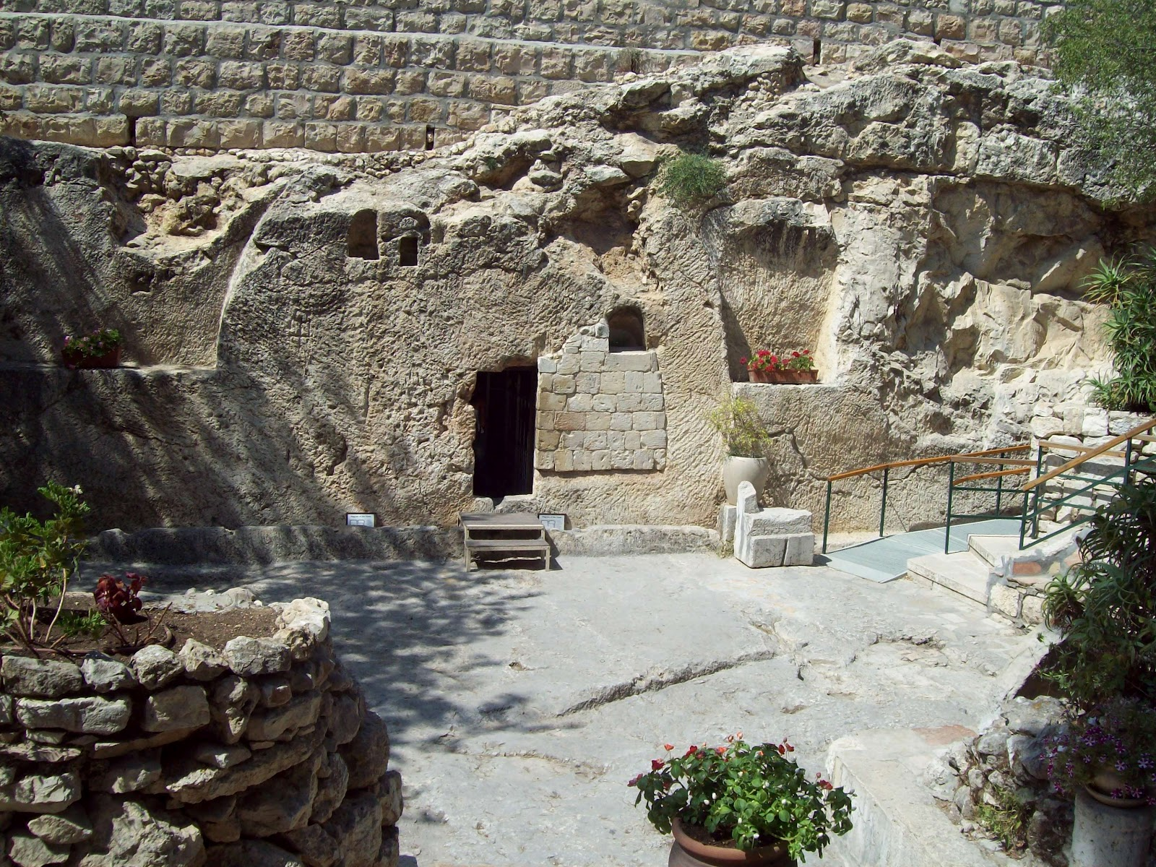
3. When you’re feeling down, where is your focus?

Slide 111
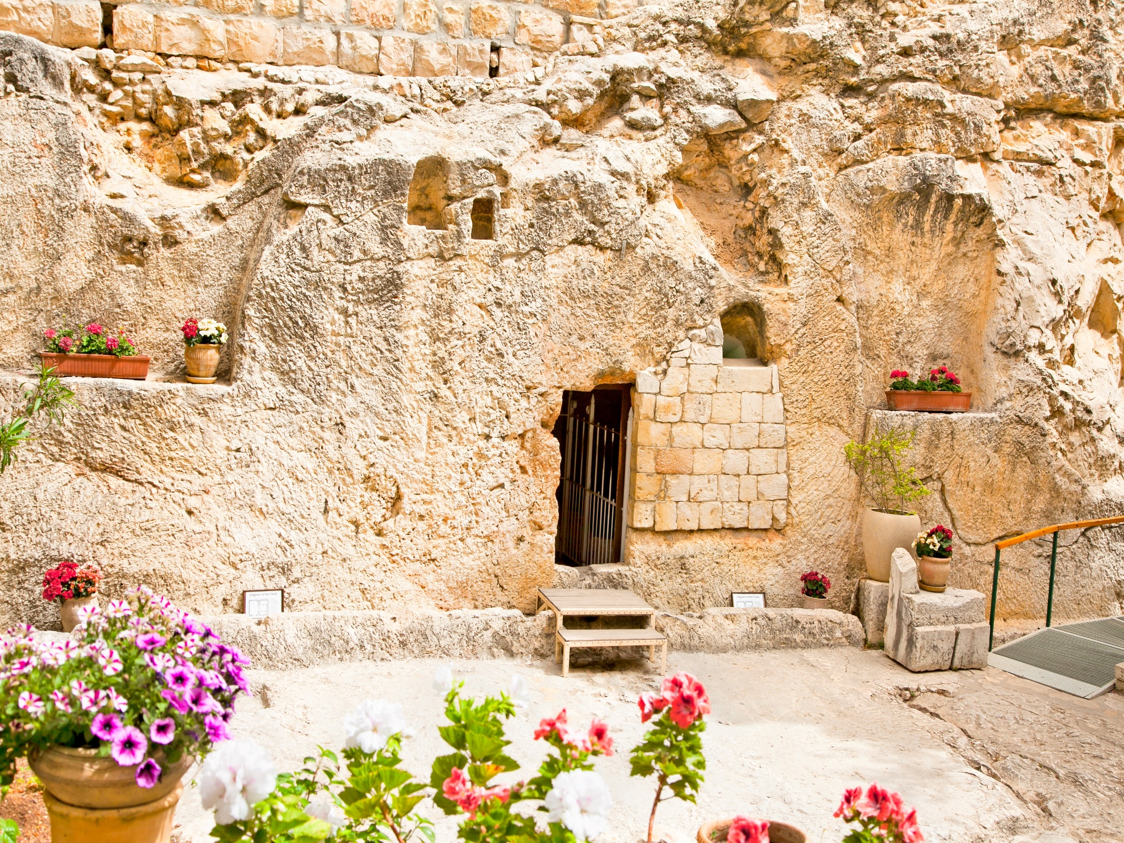
4. How would focusing on the Lord change your response to discouragement?

Slide 112
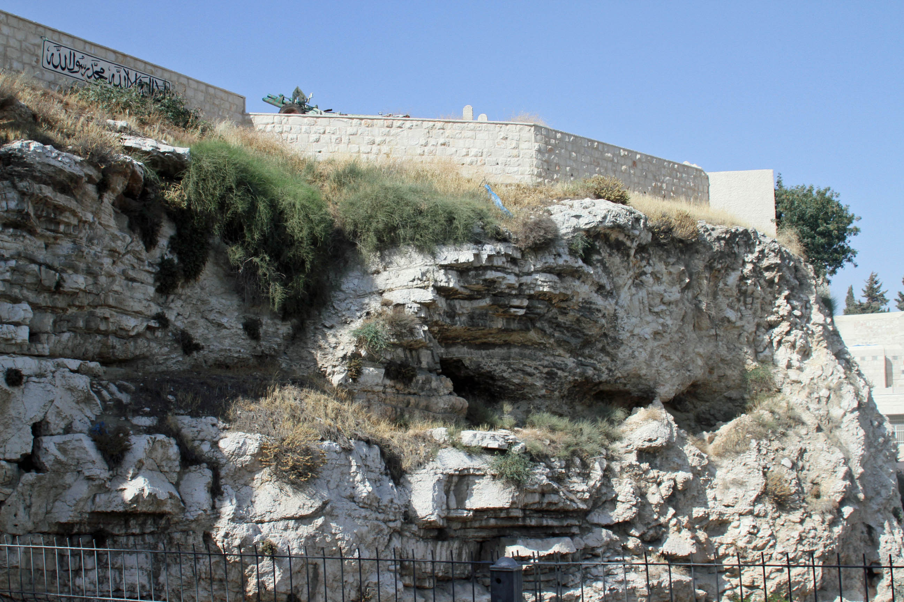
5. Who in your life has been an example of perseverance through hardship? For whom are you setting an example?

Slide 113
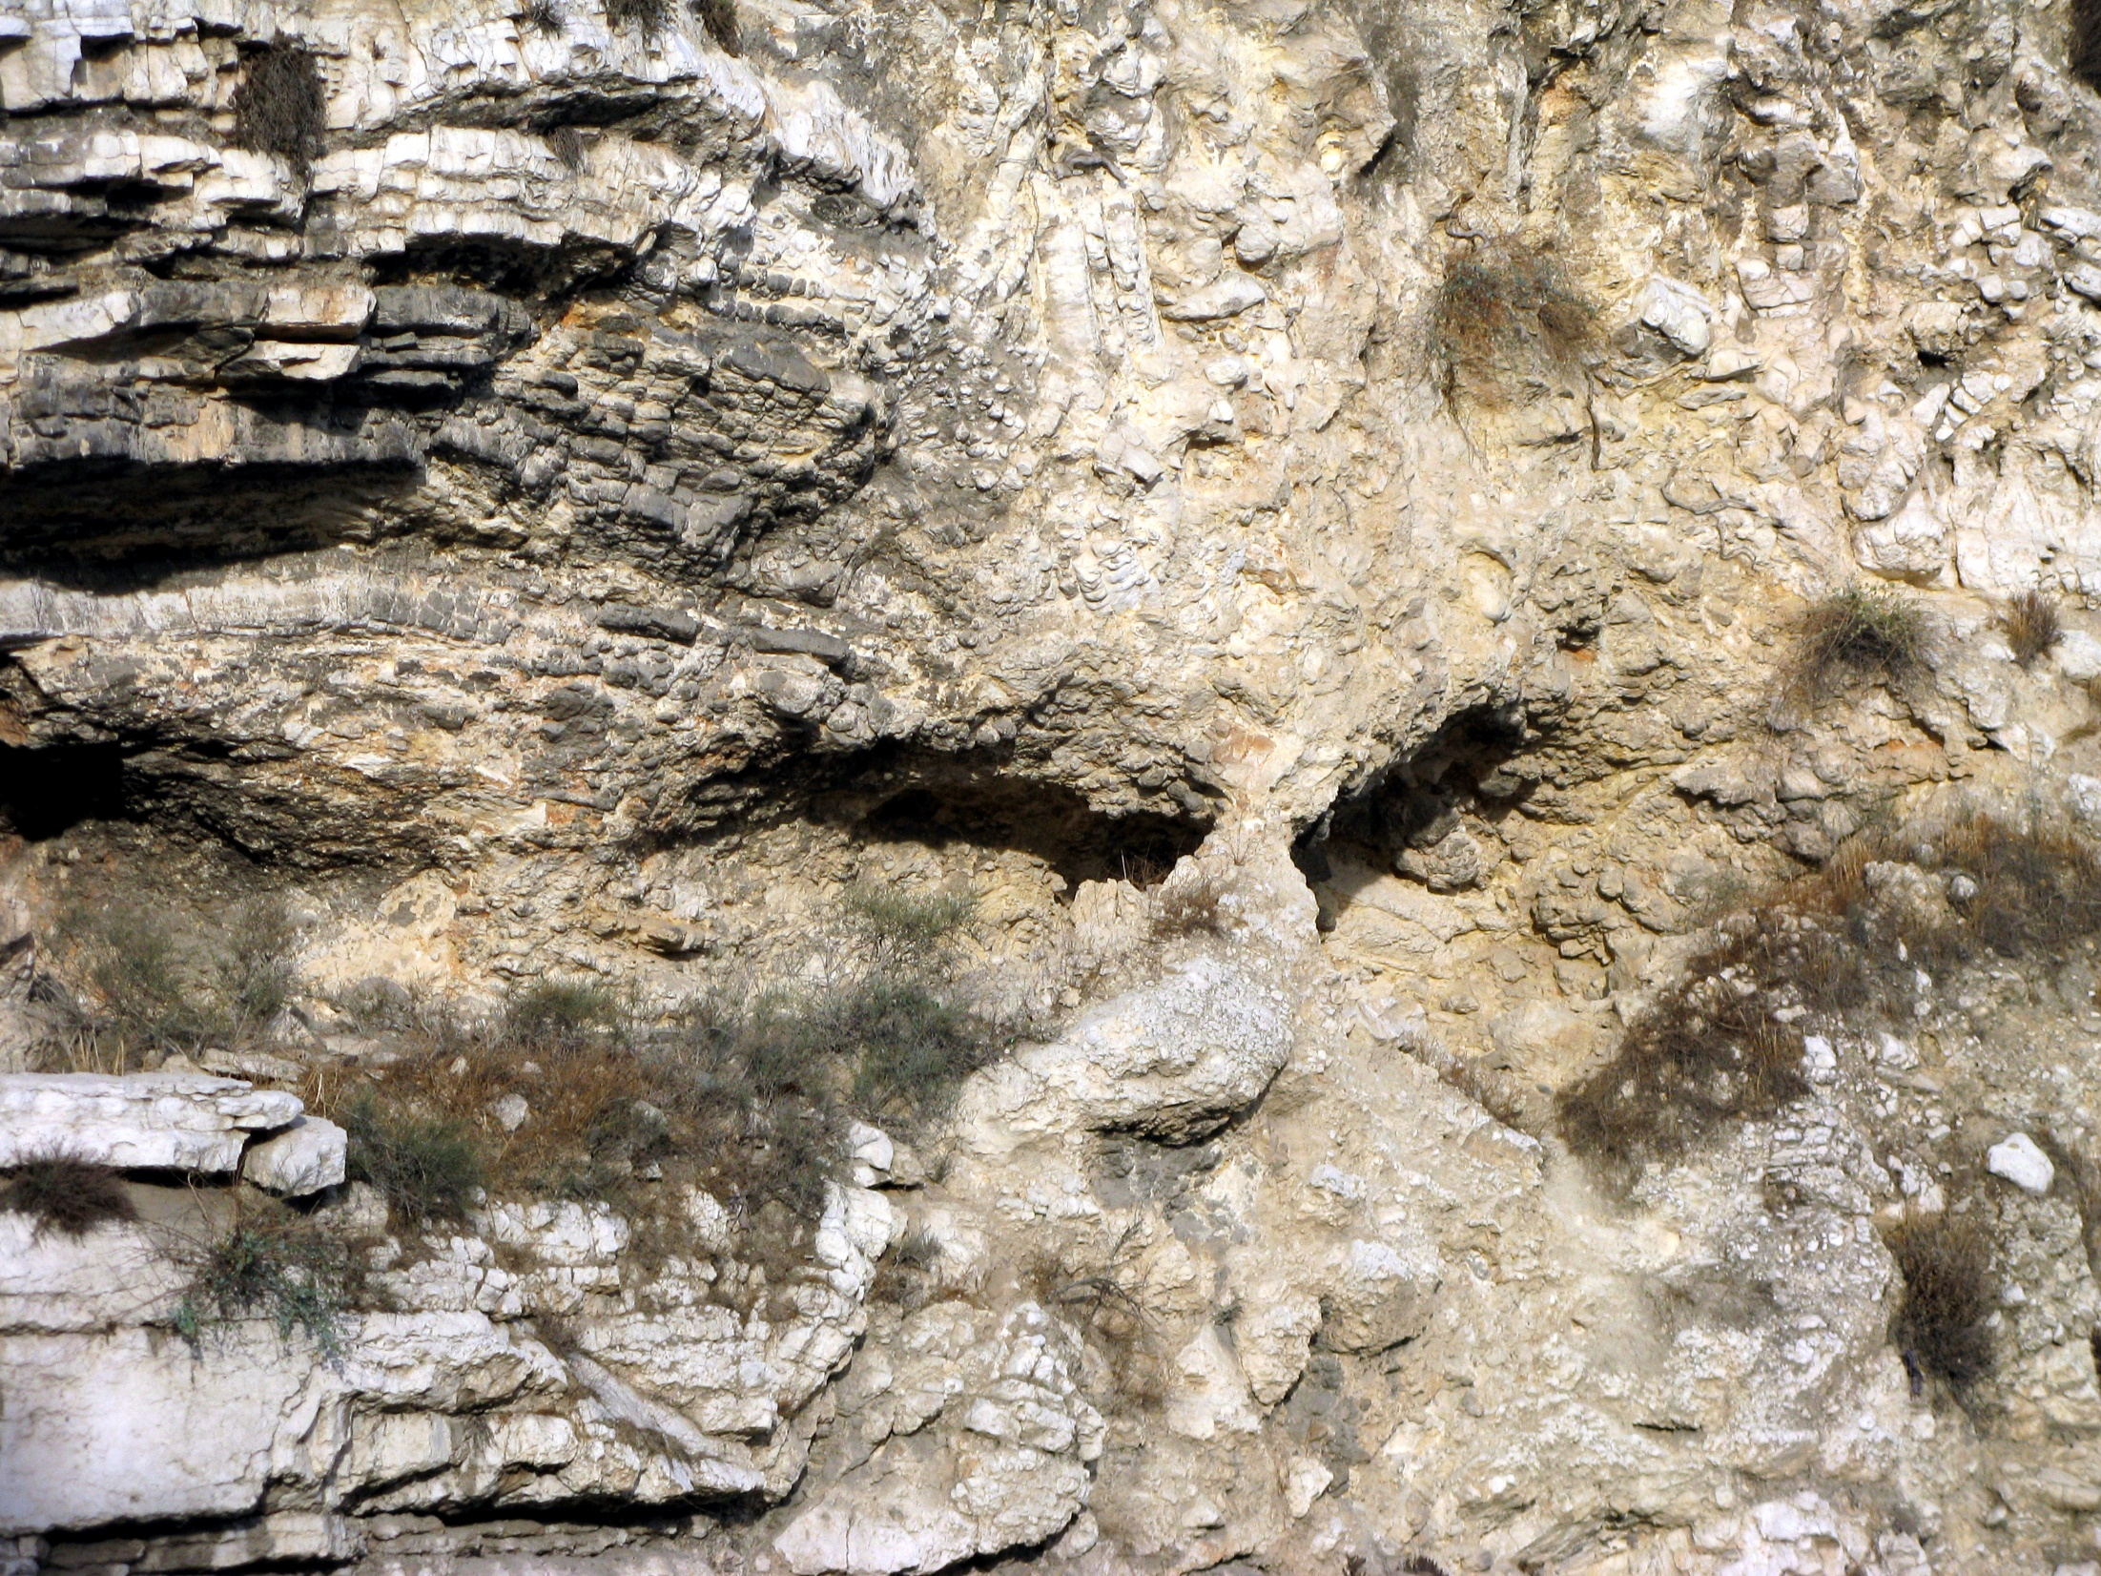
5. Who in your life has been an example of perseverance through hardship? For whom are you setting an example?

Slide 114
Matthew 16:24
"If anyone would come after me, he must deny himself and take up his cross and follow me.”

Slide 115
Matthew 10:38
“…and anyone who does not take his cross and follow me is not worthy of me

Slide 116
2 Corinthians 5:17
“Therefore, if anyone is in Christ, he is a new creation; old things have passed away; behold, all things have become new.”

Slide 117
1 Thessalonians 4:13-18
13 But I do not want you to be ignorant, brethren, concerning those who have fallen asleep, lest you sorrow as others who have no hope. 14 For if we believe that Jesus died and rose again, even so God will bring with Him those who sleep in Jesus.

Slide 118
15 For this we say to you by the word of the Lord, that we who are alive and remain until the coming of the Lord will by no means precede those who are asleep. 16 For the Lord Himself will descend from heaven with a shout, with the voice of an archangel, and with the trumpet of God. And the dead in Christ will rise first.

Slide 119
17 Then we who are alive and remain shall be caught up together with them in the clouds to meet the Lord in the air. And thus we shall always be with the Lord. 18 Therefore comfort one another with these words.

Slide 120
1 Corinthians 15:50-54
50 Now this I say, brethren, that flesh and blood cannot inherit the kingdom of God; nor does corruption inherit incorruption. 51 Behold, I tell you a mystery: We shall not all sleep, but we shall all be changed-- 52 in a moment, in the twinkling of an eye, at the last trumpet. For the trumpet will sound, and the dead will be raised incorruptible, and we shall be changed.

Slide 121
53 For this corruptible must put on incorruption, and this mortal must put on immortality. 54 So when this corruptible has put on incorruption, and this mortal has put on immortality, then shall be brought to pass the saying that is written: "Death is swallowed up in victory."

Slide 122

20 Again, when a righteous man turns from his righteousness and commits iniquity, and I lay a stumbling block before him, he shall die; because you did not give him warning, he shall die in his sin, and his righteousness which he has done shall not be remembered; but his blood I will require at your hand.

Slide 123
Acts 2:38-39
38 Then Peter said to them, "Repent, and let every one of you be baptized in the name of Jesus Christ for the remission of sins; and you shall receive the gift of the Holy Spirit. 39 For the promise is to you and to your children, and to all who are afar off, as many as the Lord our God will call."

