Slide 1
Rattle
(Elevation Worship)

Slide 2
Saturday was silent. Surely it was through. Since when has impossible. Ever stopped you. Friday’s

Slide 3
Disappointment. Is Sunday’s empty tomb. Since when has impossible ever stopped you.

Slide 4
This is the sound of dry bones rattling. This is the praise make a dead man walk again. Open the

Slide 5
Grave I’m coming out I’m gonna live, gonna live again. This is the sound of dry bones rattling.

Slide 6
Pentecostal fire stirring something new. You’re not gonna run out of miracles anytime soon. Yeah,

Slide 7
Resurrection power runs in my veins too. I believe there’s another miracle here in this room.

Slide 8
This is the sound of dry bones rattling. This is the praise make a dead man walk again. Open the

Slide 9
Grave im coming out I’m gonna live, gonna live again. This is the sound of dry bones rattling.

Slide 10
My God is able to save and deliver and heal

Slide 11
And restore anything that he wants to. Just ask the man who was thrown on the bones of Elisha. If

Slide 12
There’s anything that He can’t do. Just ask the stone that was rolled at the tomb in the garden. What

Slide 13
Happens when God says to move. I feel him moving it now. I feel him doing it now. I feel him doing it now.

Slide 14
Do it now, Do it now. This is the sound of dry bones rattling. This is the praise make a dead man walk

Slide 15
Again. Open the grave I’m coming out. I’m gonna live gonna live again. Open the grave I’m coming out

Slide 16
I’m gonna live gonna live again. Open the grave I’m coming out I’m gonna live gonna live again. This is

Slide 17
The sound of dry bones rattling.

Slide 18
Look to Jesus
(by Phil Wickham)

Slide 19
Death is like an empty grave Fear looks like a giant slain Trials look like gifts of grace When I look to

Slide 20
Jesus Failures bow to victory Sin has lost its hold on me Endless love is all I see When I look to Jesus

Slide 21
How my heart leaps How my soul sings For I know where my help comes from Jesus sought me Jesus

Slide 22
saved me Hallelujah for all He's done, yeah Every wall comes crashing down Chains are broken on the

Slide 23
ground What can stand against us now When we look to Jesus? Yeah How my heart leaps How my

Slide 24
soul sings For I know where my help comes from
Jesus sought me Jesus saved me Hallelujah for all

Slide 25
He's done How my heart leaps How my soul sings For I know where my help comes from Jesus sought

Slide 26
me Jesus saved me Hallelujah for all He's done I will keep my eyes on You We'll dance upon the crashing

Slide 27
waves I will keep my eyes on You For only You can make a way I will keep my eyes on You We'll dance

Slide 28
upon the crashing waves I will keep my eyes on You
For only You can make a way How my heart leaps

Slide 29
How my soul sings For I know where my help comes from Jesus sought me Jesus saved me Hallelujah for

Slide 30
all He's done How my heart leaps How my soul sings
For I know where my help comes from Jesus sought

Slide 31
me Jesus saved me Hallelujah for all He's done For all He's done Sing hallelujah for all He's done We

Slide 32
sing hallelujah Hallelujah for all He's done

Slide 33
“No Longer Slaves”
(Bethel)

Slide 34
You unravel me with a melody. You surround me with a song. Of deliverance from my enemies. Til

Slide 35
All my fears are gone. I’m no longer a slave to fear. I am a child of God. I’m no longer a slave to fear.

Slide 36
I am a child of God . From my mother’s womb. You have chosen me. Love has called my name. I’ve

Slide 37
been born again into your family. Your blood has flows through my veins. I’m no longer a slave to fear.

Slide 38
I am a child of God. I’m no longer a slave to fear. I am a child of God.I’m no longer a slave to fear. I am

Slide 39
A child of God. I’m no longer a slave to fear. I am a child of God. Ooh, Ooh ,Ooh, ooh. Ooh, Ooh, Ooh,

Slide 40
Oooh. You split the sea so I could walk right through it. My fears are drowned in perfect love. You rescued

Slide 41
Me so I could stand and sing. I am a child of God. You split the sea so I can walk right through it. My

Slide 42
fears are drowned in perfect love. You rescued me so I could stand and sing. I am a child of God.

Slide 43
Yes I am a child of God. Oh I am A child of God.

Slide 44
Goodness of God
(by Bethel)

Slide 45
I love You, Lord For Your mercy never fails me All my days, I've been held in Your hands From the moment

Slide 46
that I wake up Until I lay my head Oh, I will sing of the goodness of God And all my life You have been

Slide 47
faithful And all my life You have been so, so good With every breath that I am able Oh, I will sing of the

Slide 48
goodness of God I love Your voice You have led me through the fire In the darkest night You are close

Slide 49
God (yeah) And all my life You have been faithful (oh) And all my life You have been so, so good With

Slide 50
every breath that I am able Oh, I will sing of the goodness of God (yeah) 'Cause Your goodness is

Slide 51
running after It's running after me Your goodness is running after It's running after me With my life laid

Slide 52
down I'm surrendered now I give You everything
'Cause Your goodness is running after It's running

Slide 53
after me (oh-oh) 'Cause Your goodness is running after It's running after me Your goodness is running

Slide 54
after It's running after me With my life laid down I'm surrendered now I give You everything 'Cause Your

Slide 55
goodness is running after It keeps running after me
And all my life You have been faithful And all my life

Slide 56
You have been so, so good With every breath that I am able Oh, I'm gonna sing of the goodness of God

Slide 57
(I'm gonna sing, I'm gonna sing) 'Cause all my life You have been faithful And all my life You have been

Slide 58
so, so good With every breath that I am able Oh, I'm gonna sing of the goodness of God Oh, I'm gonna

Slide 59
sing of the goodness of God

Slide 60
Open Up The Heavens
(Vertical Worship)

Slide 61
We waited for this day were gathered in your name
calling out to you. Your glory like a fire

Slide 62
awakening desire Will burn our hearts with truth
You're the reason we're here You're the reason we're

Slide 63
Singing Open up the heavens, we wanna see You
Open up the floodgates, a mighty river Flowing from

Slide 64
Your heart, filling every part of our praise. Your presence in this place Your glory on our face

Slide 65
We're looking to the sky Descending like a cloud
You're standing with us now Lord unveil our eyes

Slide 66
You're the reason we're here You're the reason we're singing So open up the heaven we wanna

Slide 67
see You Open up the floodgates, a mighty river
Flowing from Your heart, filling every part of our

Slide 68
Praise Open up the heavens, we wanna see You
Open up the floodgates, a mighty river Flowing from

Slide 69
Your heart and filling every part of our praise.Show us, show us your glory. Show us, show us your

Slide 70
Power. Show us,show us your glory, Lord. We want to see you, Lord. Show us,show us your glory. Show

Slide 71
Us, show us your power. Show us,show us your glory, Lord. We want to see you, Lord. Open up

Slide 72
The heavens we want to see you. Open up the floodgates a mighty river flowing from our hearts and

Slide 73
Filling every part of our praise. Yes open up the heavens we want to see you open up the floodgates

Slide 74
A mighty river flowing from our hearts and filling every part of our praise.

Slide 75


Slide 76


Slide 77
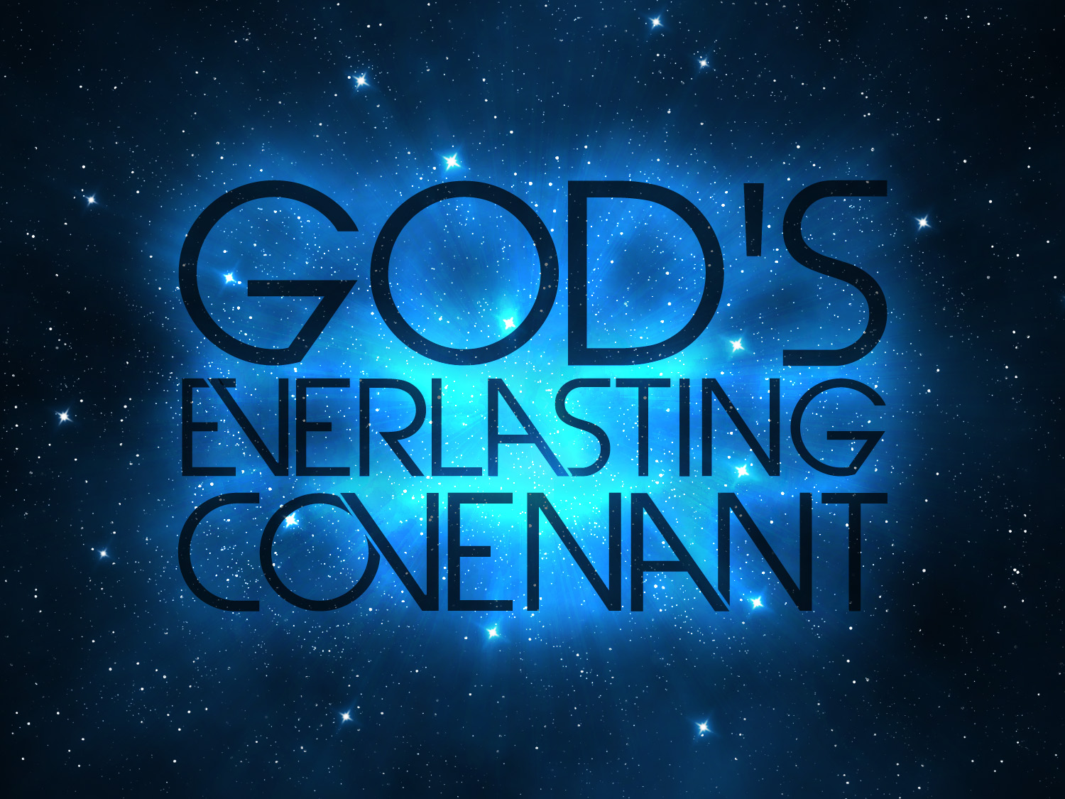

The Covenant People of God
By Pastor Fee Soliven
Hebrews 10:11-18
Sunday Morning
May 22, 2022

Slide 78
Hebrews 10:11-18
11 And every priest stands ministering daily and offering repeatedly the same sacrifices, which can never take away sins. 12 But this Man, after He had offered one sacrifice for sins forever, sat down at the right hand of God, 13 from that time waiting till His enemies are made His footstool. 14 For by one offering He has perfected forever those who are being sanctified.

Slide 79
15 But the Holy Spirit also witnesses to us; for after He had said before, 16 "This is the covenant that I will make with them after those days, says the LORD: I will put My laws into their hearts, and in their minds I will write them," 17 then He adds, "Their sins and their lawless deeds I will remember no more."

Slide 80
What does “Covenant” mean?

Slide 81
1. Supernatural Increase and Promotion

Slide 82
Genesis 39:21-23
21 But the LORD was with Joseph and showed him mercy, and He gave him favor in the sight of the keeper of the prison. 22 And the keeper of the prison committed to Joseph's hand all the prisoners who were in the prison; whatever they did there, it was his doing.

Slide 83
23 The keeper of the prison did not look into anything that was under Joseph's authority, because the LORD was with him; and whatever he did, the LORD made it prosper.

Slide 84
2. Restoration of all the Enemy has Stolen

Slide 85
Exodus 3:20-22
20 So I will stretch out My hand and strike Egypt with all My wonders which I will do in its midst; and after that he will let you go. 21 And I will give this people favor in the sight of the Egyptians; and it shall be, when you go, that you shall not go empty-handed.

Slide 86
22 But every woman shall ask of her neighbor, namely, of her who dwells near her house, articles of silver, articles of gold, and clothing; and you shall put them on your sons and on your daughters. So you shall plunder the Egyptians."

Slide 87
3. Honor in the Midst of Adversaries

Slide 88
Exodus 11:1-5
1 And the LORD said to Moses, "I will bring yet one more plague on Pharaoh and on Egypt. Afterward he will let you go from here. When he lets you go, he will surely drive you out of here altogether. 2 Speak now in the hearing of the people, and let every man ask from his neighbor and every woman from her neighbor, articles of silver and articles of gold."

Slide 89
3 And the LORD gave the people favor in the sight of the Egyptians. Moreover the man Moses was very great in the land of Egypt, in the sight of Pharaoh's servants and in the sight of the people. 4 Then Moses said, "Thus says the LORD: 'About midnight I will go out into the midst of Egypt;

Slide 90
5 and all the firstborn in the land of Egypt shall die, from the firstborn of Pharaoh who sits on his throne, even to the firstborn of the female servant who is behind the handmill, and all the firstborn of the animals.

Slide 91
4. Increased Assets, especially Real Estates

Slide 92
Deuteronomy 33:1-2, 23
1 Now this is the blessing with which Moses the man of God blessed the children of Israel before his death. 2 And he said: 23 And of Naphtali he said:"O Naphtali, satisfied with favor, And full of the blessing of the LORD, Possess the west and the south."

Slide 93
5. Greater Victories in the midst of Greater Odds or Impossibilities

Slide 94
Joshua 11:20-23
20 For it was of the LORD to harden their hearts, that they should come against Israel in battle, that He might utterly destroy them, and that they might receive no mercy, but that He might destroy them, as the LORD had commanded Moses.

Slide 95
21 And at that time Joshua came and cut off the Anakim from the mountains: from Hebron, from Debir, from Anab, from all the mountains of Judah, and from all the mountains of Israel; Joshua utterly destroyed them with their cities. 22 None of the Anakim were left in the land of the children of Israel; they remained only in Gaza, in Gath, and in Ashdod.

Slide 96
23 So Joshua took the whole land, according to all that the LORD had said to Moses; and Joshua gave it as an inheritance to Israel according to their divisions by their tribes. Then the land rested from war.

Slide 97
6. Recognition Even when it seems to be the Least likely to Receive It

Slide 98
1 Samuel 16:19-23
19 Therefore Saul sent messengers to Jesse, and said, "Send me your son David, who is with the sheep." 20 And Jesse took a donkey loaded with bread, a skin of wine, and a young goat, and sent them by his son David to Saul.

Slide 99
21 So David came to Saul and stood before him. And he loved him greatly, and he became his armorbearer. 22 Then Saul sent to Jesse, saying, "Please let David stand before me, for he has found favor in my sight."

Slide 100
23 And so it was, whenever the spirit from God was upon Saul, that David would take a harp and play it with his hand. Then Saul would become refreshed and well, and the distressing spirit would depart from him.

Slide 101
7. Battles Won that we won’t have to Fight because God Fights for Us

Slide 102
Psalm 44:1-3
1 We have heard with our ears, O God, Our fathers have told us, The deeds You did in their days, In days of old: 2 You drove out the nations with Your hand, But them You planted; You afflicted the peoples, and cast them out. 3 For they did not gain possession of the land by their own sword, Nor did their own arm save them; But it was Your right hand, Your arm, and the light of Your countenance, Because You favored them.

Slide 103
1. Our Sins are Removed from us Forever!

Slide 104
Jeremiah 31:31-34
31 "Behold, the days are coming, says the LORD, when I will make a new covenant with the house of Israel and with the house of Judah—

Slide 105
32 not according to the covenant that I made with their fathers in the day that I took them by the hand to lead them out of the land of Egypt, My covenant which they broke, though I was a husband to them, says the LORD.

Slide 106
33 But this is the covenant that I will make with the house of Israel after those days, says the LORD: I will put My law in their minds, and write it on their hearts; and I will be their God, and they shall be My people.

Slide 107
34 No more shall every man teach his neighbor, and every man his brother, saying, 'Know the LORD,' for they all shall know Me, from the least of them to the greatest of them, says the LORD. For I will forgive their iniquity, and their sin I will remember no more."

Slide 108
2. Jesus' Blood Washed Away Our Sins

Slide 109
Mark 14:24-26
24 And He said to them, "This is My blood of the new covenant, which is shed for many. 25 Assuredly, I say to you, I will no longer drink of the fruit of the vine until that day when I drink it new in the kingdom of God." 26 And when they had sung a hymn, they went out to the Mount of Olives.

Slide 110
2. A Covenant Promise is Salvation Through Repentance

Slide 111
Acts 2:38-39
38 Then Peter said to them, "Repent, and let every one of you be baptized in the name of Jesus Christ for the remission of sins; and you shall receive the gift of the Holy Spirit. 39 For the promise is to you and to your children, and to all who are afar off, as many as the Lord our God will call."

Slide 112
3. The Born-Again Believer is
Eternally Secured!

Slide 113
Ephesians 1:3-14
3 Blessed be the God and Father of our Lord Jesus Christ, who has blessed us with every spiritual blessing in the heavenly places in Christ, 4 just as He chose us in Him before the foundation of the world, that we should be holy and without blame before Him in love,

Slide 114
5 having predestined us to adoption as sons by Jesus Christ to Himself, according to the good pleasure of His will, 6 to the praise of the glory of His grace, by which He has made us accepted in the Beloved. 7 In Him we have redemption through His blood, the forgiveness of sins, according to the riches of His grace 8 which He made to abound toward us in all wisdom and prudence,

Slide 115
9 having made known to us the mystery of His will, according to His good pleasure which He purposed in Himself, 10 that in the dispensation of the fullness of the times He might gather together in one all things in Christ, both which are in heaven and which are on earth--in Him. 11 In Him also we have obtained an inheritance, being predestined according to the purpose of Him who works all things according to the counsel of His will,

Slide 116
12 that we who first trusted in Christ should be to the praise of His glory. 13 In Him you also trusted, after you heard the word of truth, the gospel of your salvation; in whom also, having believed, you were sealed with the Holy Spirit of promise, 14 who is the guarantee of our inheritance until the redemption of the purchased possession, to the praise of His glory.

Slide 117
5. We Will Live with God Forever!

Slide 118
Revelation 21:1-8
1 Now I saw a new heaven and a new earth, for the first heaven and the first earth had passed away. Also there was no more sea. 2 Then I, John, saw the holy city, New Jerusalem, coming down out of heaven from God, prepared as a bride adorned for her husband.

Slide 119
3 And I heard a loud voice from heaven saying, "Behold, the tabernacle of God is with men, and He will dwell with them, and they shall be His people. God Himself will be with them and be their God. 4 And God will wipe away every tear from their eyes; there shall be no more death, nor sorrow, nor crying. There shall be no more pain, for the former things have passed away."

Slide 120
5 Then He who sat on the throne said, "Behold, I make all things new." And He said to me, "Write, for these words are true and faithful." 6 And He said to me, "It is done! I am the Alpha and the Omega, the Beginning and the End. I will give of the fountain of the water of life freely to him who thirsts.

Slide 121
7 He who overcomes shall inherit all things, and I will be his God and he shall be My son. 8 But the cowardly, unbelieving, abominable, murderers, sexually immoral, sorcerers, idolaters, and all liars shall have their part in the lake which burns with fire and brimstone, which is the second death."

Slide 122
1 Thessalonians 4:13-18
13 But I do not want you to be ignorant, brethren, concerning those who have fallen asleep, lest you sorrow as others who have no hope. 14 For if we believe that Jesus died and rose again, even so God will bring with Him those who sleep in Jesus.

Slide 123
15 For this we say to you by the word of the Lord, that we who are alive and remain until the coming of the Lord will by no means precede those who are asleep. 16 For the Lord Himself will descend from heaven with a shout, with the voice of an archangel, and with the trumpet of God. And the dead in Christ will rise first.

Slide 124
17 Then we who are alive and remain shall be caught up together with them in the clouds to meet the Lord in the air. And thus we shall always be with the Lord. 18 Therefore comfort one another with these words.

Slide 125
1 Corinthians 15:50-54
50 Now this I say, brethren, that flesh and blood cannot inherit the kingdom of God; nor does corruption inherit incorruption. 51 Behold, I tell you a mystery: We shall not all sleep, but we shall all be changed-- 52 in a moment, in the twinkling of an eye, at the last trumpet. For the trumpet will sound, and the dead will be raised incorruptible, and we shall be changed.

Slide 126
53 For this corruptible must put on incorruption, and this mortal must put on immortality. 54 So when this corruptible has put on incorruption, and this mortal has put on immortality, then shall be brought to pass the saying that is written: "Death is swallowed up in victory."

Slide 127

20 Again, when a righteous man turns from his righteousness and commits iniquity, and I lay a stumbling block before him, he shall die; because you did not give him warning, he shall die in his sin, and his righteousness which he has done shall not be remembered; but his blood I will require at your hand.

Slide 128
Acts 2:38-39
38 Then Peter said to them, "Repent, and let every one of you be baptized in the name of Jesus Christ for the remission of sins; and you shall receive the gift of the Holy Spirit. 39 For the promise is to you and to your children, and to all who are afar off, as many as the Lord our God will call."

