Slide 1


Slide 2
“Everlasting God”
(Jeremy Camp)

Slide 3
Strength will rise as we wait upon the Lord we will wait upon the Lord. We will wait upon the Lord.

Slide 4
Strength will rise as we wait upon the Lord. We will wait upon the Lord. We will wait upon the Lord.

Slide 5
Everlasting god. You do not faint you wont grow weary. You’re the defender of the weak. You comfort

Slide 6
Those in need. You lift us up on wings like eagles.
Strength will rise as we wait upon the Lord. We will

Slide 7
Wait upon the Lord. We will wait upon the Lord. Strength will rise as we wait upon the Lord. Wait

Slide 8
Upon the Lord. We will wait upon the Lord. Our God you reign forever. Our hope our strong deliverer.

Slide 9
You are the everlasting God. The everlasting God. You do not faint you wont grow weary. You’re the

Slide 10
Defender of the weak. You comfort those in need. You lift us up on wings like eagles.

Slide 11
You are the everlasting God. The everlasting God. You do not faint you wont grow weary. You’re the

Slide 12
Defender of the weak. You comfort those in need you lift us up on wings like eagles.

Slide 13
“Battle Belongs”
(Phil Wickham)CCLI #7148126

Slide 14
When all I see is battle, you see my victory.When all I see is mountain, You see a mountain move. And as

Slide 15
I walk through the shadow, Your love surrounds me. There’s nothing to fear now for I am safe with you.

Slide 16
So when I fight, I’ll fight on my knees. With my hands lifted high. Oh God, the battle belongs to you. And

Slide 17
Every fear I lay at your feet. I’ll sing through the night. Oh God, the battle belongs to you. And if you

Slide 18
Are for me, who can stand against me, who can be against me? Yeah for Jesus, there’s nothing

Slide 19
Impossible for you. When all I see are the ashes., You see the beauty. Thank you God. When all I see

Slide 20
Is the cross, God, You see the empty tomb. So when I fight, I’ll fight on my knees. With my hands lifted

Slide 21
High. Oh God, the battle belongs to you. And every fear I lay at your feet. I’ll sing through the night.

Slide 22
Oh, God, the battle belongs to you. Almighty fortress, You go before us. Nothing can stand against the

Slide 23
power of our God. You shine in the shadow, You win every battle. Nothing can stand against the power

Slide 24
Of our God. All mighty fortress, you go before us. Nothing can stand against the power of our God. You

Slide 25
Shine in the shadows. You win every battle. Nothing can stand against the power of our God. So when I

Slide 26
Fight, I’ll fight on my knees. With my hands lifted high. Oh’ god, the battle belongs to you. And every

Slide 27
Fear I lay at your feet. I’ll sing through the night. Oh God, the battle belongs to you.

Slide 28
“ Canvas and the Clay”
(Pat Barret)

Slide 29
In my mother’s womb. You formed me with your hands. Known and loved by you. Before I took a

Slide 30
Breath. When I doubt it, Lord, remind me. I’m wonderfully made. You’re an artist and a potter.

Slide 31
I’m the canvas and the clay. You make all things work together. For my future and for my good. You make

Slide 32
All things work together for your glory and for your name. There’s a healing light. Just beyond the clouds

Slide 33
Though I’ve walked through fire. I see it clearly now.I know nothing has been wasted. No failure or mistake

Slide 34
You’re an artist and a potter I’m the canvas and the clay. You make all things work together. For my

Slide 35
Future and for my good. You make all things work together for your glory and for your name.

Slide 36
For my good. For my good. And when I doubt it, Lord, remind me. I’m wonderfully made . You’re an

Slide 37
Artist and a potter I’m the canvas and the clay. And I know nothing has been wasted. No failure or

Slide 38
Mistake. You’re an artist and a potter. I’m the canvas and the clay. You make all things. Work together for

Slide 39
My future and for my good. You make all things. Work together for your glory. And for your name.

Slide 40
When I doubt it, Lord, remind me I’m wonderfully made. You’re and artist and a potter. I’m the canvas

Slide 41
And the clay. I know nothing has been wasted. No failure or mistake. You’re an artist and a potter. I’m

Slide 42
The canvas and clay. You’re an artist and a potter. I’m the canvas and the clay. You’re an artist and a

Slide 43
Potter I’m the canvas and the clay.

Slide 44
When I Lock Eyes With You
(Maverick City Music)

Slide 45
So when I lock eyes with You, I see my reflection
When I lock eyes with You, I feel Your affection I love

Slide 46
to get lost in You, 'cause You're my obsession When I lock eyes with You And, all I want is You And, all I

Slide 47
need is You And, all I see is You, just You Hmm And when I lock eyes with You, I see my reflection When I

Slide 48
lock eyes with You, I feel Your affection I love to get lost in You, 'cause You're my obsession When I lock

Slide 49
eyes with You, ooh 'Cause, all I want is You And, all I need is You All I see is You, just You, just You, Jesus

Slide 50
Oh, all I want is You All I need is You, my breath, my life All I see is You, just You, just You Sing it again, all

Slide 51
I, all Oh, oh, all I want is You Jesus (just You, just You) And all I need is You All I see is You, just You,

Slide 52
just You So come in like a fire Come in like a flood I don't care what it looks like I'm so in love Oh, just

Slide 53
come in like a fire Come in like a flood I don't care what it looks like I'm so in love Come in like a fire

Slide 54
Come in like a flood I don't care what it looks like
I'm so in love, come in, come in Come in like a fire

Slide 55
Come in like a flood I don't care what it looks like
I'm so in love, come in, come in Come in like a fire

Slide 56
(come in like a fire) Come in like a flood (come in like a flood) I don't care what it looks like (oohh) I'm so in

Slide 57
love Sing it again Come in like a fire (come in like a fire) Come in like a flood I don't care what it looks like

Slide 58
I'm so in love 'Cause, all I want is You And, all I need is You Ohh all I see is You, just You, just You Just

Slide 59
You Jesus, all I want All I want is You (I'm coming after your heart) All I need is You (You're all I need)

Slide 60
And, all I see is You, just You, just You, just You
Just You (Just You) Just You (It's just You) My one

Slide 61
and only My one and only (my one and only) Just You, Jesus (just You, Jesus) Just you Jesus Hmm

Slide 62
So come in like a fire You can come in like a flood
I don't care what it looks like ('cause I'm falling), I'm

Slide 63
so in love I fell so hard So come in like a fire (Burn me up, burn me up) Come in like a flood (Let it go, let

Slide 64
it go higher) I don't care what it looks like I'm so in love (I don't care) You can come in like a fire (I give

Slide 65
You permission, to come in like...) Come in like a flood (take me over) I don't care what it looks like

Slide 66
(take me over) I'm so in love (all of me, all of me) So come in like a fire (so wash, it's a flame) Come in like

Slide 67
a flood (wave after wave) I don't care what it looks like ('cause I'm so in love) I'm so in love (I'm so in

Slide 68
love) So come in like a fire (you can come in like)
Come in like a flood (wash me over) I don't care what

Slide 69
it looks like I'm so in love So come in like a fire, (oh)
Come in like a flood, (oh) I don't care what it looks

Slide 70
like, (oh) I'm so in love Search me, oh God Search my heart (yes God) If you find any desire It's not You,

Slide 71
it's not You Take it all away, take it all away Till all that's left is you (yes, yes) Send the searchlight down

Slide 72
from heaven (yes, Lord yes) Search me, search me
I'm open, I'm open (yes) Search me, search me

Slide 73
Search me, search me You're the only one qualified
You're the only one qualified 'Cause You made me,

Slide 74
You made me 'Cause You made me, You made me
You know what's supposed to be there You know

Slide 75
what's supposed to be there (search me) So take it all away, take it all away Till all that's left is You Take

Slide 76
it all away (take it all), take it all away (take it all), take it all away Till all that's left is You Take it all

Slide 77
away, take it all away (right now, right now), take it all away Till all that's left is You Take it all away (oh

Slide 78
yeah, oh yeah) Take it all away (oh yeah, oh yeah), take it all away Till all that's left is You

Slide 79
Take it all away (oh yeah, oh yeah) Take it all away (yeah), take it all away Till all that's left is You take it

Slide 80
all away (Take it all) take it all away Till all that's left is You Till all that's left is Your love You that all that's left

Slide 81
is You Those who hunger and thirst, after righteousness You promises, we will be filled Till all

Slide 82
that's left is You You give us the desires of our hearts You give us what to want You give is what to crave

Slide 83
Till all that's left is You You revive my heat Create in me a clean heart Create in me a clean heart Till all

Slide 84
that's left is You Revel the right spirit Revel the right motives Revel the right pursuit Revel heaven oh

Slide 85
yeah Till all that's left is You, oh, oh Till all that's left is You Take it all Take it all away Till all that's left is You

Slide 86
Take it all away Till all that's left is You Holy fire burn, holy fire burn Empty everything inside of me Till all

Slide 87
that's left is You Burn it all away, right now in Your presence Oh, till all that's left is You There's a

Slide 88
cleansing happening now Lift your hands, there's a cleansing happening now The Devine Surgeon, He's

Slide 89
in the room Even the things you don't know that are there He's taking it out But His gentle, He's taking it

Slide 90
out With His fire, He's taking it out With His love, His love, His love He's a gentle Surgeon, He won't hurt

Slide 91
you, whoa His taking it out, yeah Take whatever You desire

Slide 92
”King of My Heart”
(Bethel)

Slide 93
Let the King of my heart Be the mountain where I run
The fountain I drink from Oh, He is my song Let the

Slide 94
King of my heart Be the shadow where I hide The ransom for my life Oh, He is my song 'Cause You are

Slide 95
good You are good, oh oh You are good You are good, oh oh You are good You are good, oh oh You

Slide 96
are good You are good, oh oh And let the King of my heart Be the wind inside my sails The anchor in the

Slide 97
waves Oh oh, He is my song Let the King of my heart
Be the fire inside my veins The echo of my days Oh

Slide 98
oh, He is my song Let the King of my heart Be the wind inside my sails The anchor in the waves Oh oh,

Slide 99
He is my song Let the King of my heart Be the fire inside my veins The echo of my days Oh, He is my

Slide 100
song 'Cause You are good You are good, oh oh You are good You are good, oh oh You are good You are

Slide 101
good, oh oh You are good You are good, oh oh You're never gonna let You're never gonna let me

Slide 102
down And You're never gonna let You're never gonna let me down You're never gonna let You're never

Slide 103
gonna let me down You're never gonna let You're never gonna let me down You're never gonna let

Slide 104
You're never gonna let You're never gonna let me down You're never gonna let You're never gonna let

Slide 105
me down You're never gonna let You're never gonna let me down Oh 'cause You are good You are good,

Slide 106
oh oh 'Cause You are good You are good, oh oh 'Cause You are good You are good, oh oh You are

Slide 107
good You are good, oh oh You're never gonna let
You're never gonna let me down You're never gonna

Slide 108
let You're never gonna let me down You're never gonna let You're never gonna let me down You're

Slide 109
never gonna let You're never gonna let me down
'Cause You are good You are good, oh oh You are

Slide 110
good You are good, oh oh

Slide 112


Slide 113
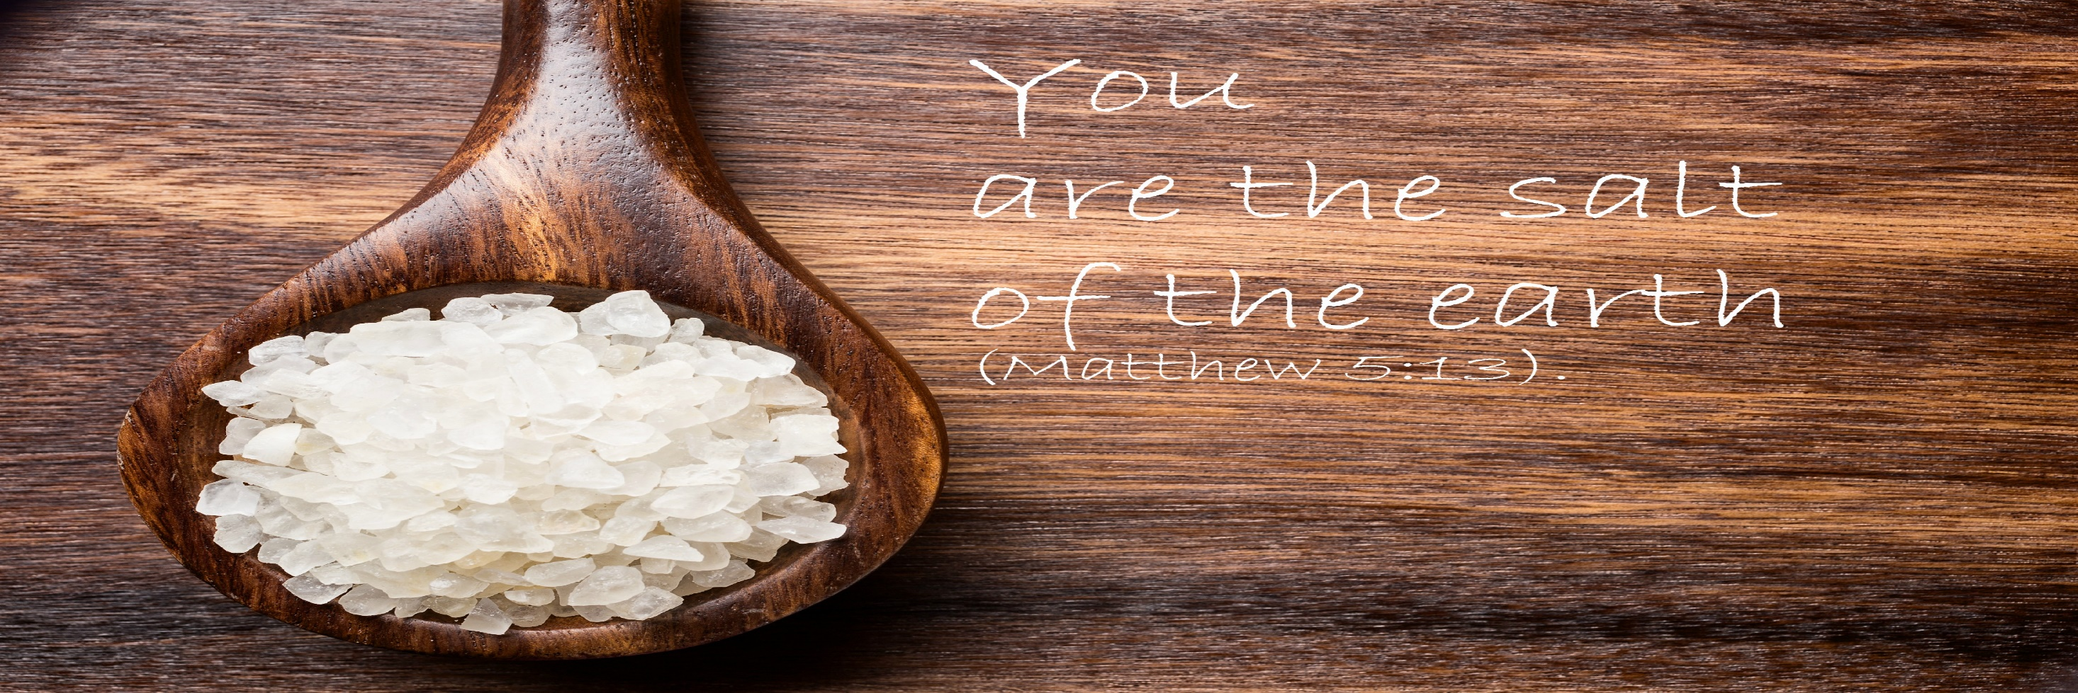

The Salt of The Earth
by Pastor Fee Soliven
Matthew 5:11-16
Sunday Morning
May 15, 2022

Slide 114
Matthew 5:11-16
11 "Blessed are you when they revile and persecute you, and say all kinds of evil against you falsely for My sake. 12 Rejoice and be exceedingly glad, for great is your reward in heaven, for so they persecuted the prophets who were before you.

Slide 115
13 "You are the salt of the earth; but if the salt loses its flavor, how shall it be seasoned? It is then good for nothing but to be thrown out and trampled underfoot by men. 14 You are the light of the world. A city that is set on a hill cannot be hidden.

Slide 116
15 Nor do they light a lamp and put it under a basket, but on a lampstand, and it gives light to all who are in the house. 16 Let your light so shine before men, that they may see your good works and glorify your Father in heaven.

Slide 117
11 "Blessed are you when they revile and persecute you, and say all kinds of evil against you falsely for My sake.

Slide 118
John 15:18-21
18 "If the world hates you, you know that it hated Me before it hated you. 19 If you were of the world, the world would love its own. Yet because you are not of the world, but I chose you out of the world, therefore the world hates you.

Slide 119
20 Remember the word that I said to you, 'A servant is not greater than his master.' If they persecuted Me, they will also persecute you. If they kept My word, they will keep yours also. 21 But all these things they will do to you for My name's sake, because they do not know Him who sent Me.

Slide 120
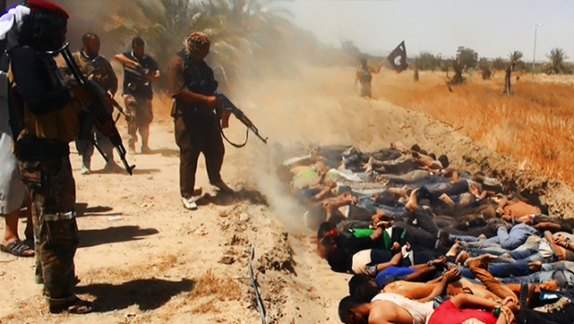
Remember Her Gratefully

Slide 121
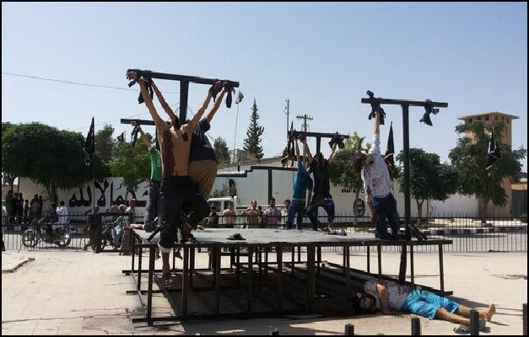
Hebrews 12:28
Wherefore we receive a kingdom which cannot be moved, let us have grace, whereby we may serve God acceptably with reverence and godly fear”

Slide 122

1 John 4:7
“Beloved, let us love one another: for love is of God; and everyone that loves is born of God, and knows God”

Slide 123
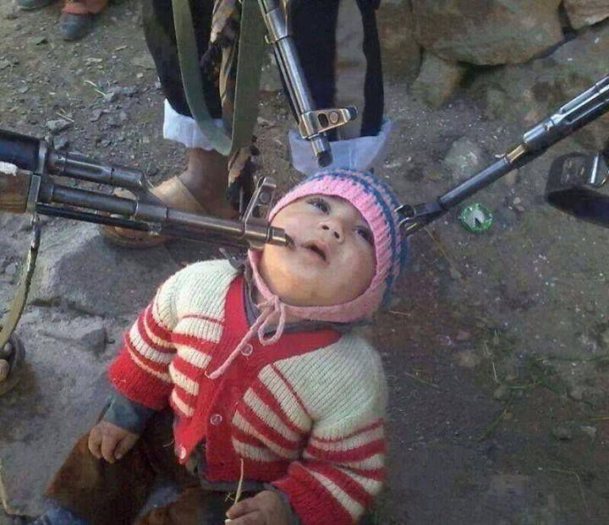
1 Peter 4:7-10
7 But the end of all things is at hand; therefore be serious and watchful in your prayers. 8 And above all things have fervent love for one another, for "love will cover a multitude of sins." 9 Be hospitable to one another without grumbling. 10 As each one has received a gift, minister it to one another, as good stewards of the manifold grace of God.

Slide 124
12 Rejoice and be exceedingly glad, for great is your reward in heaven, for so they persecuted the prophets who were before you.

Slide 125
James 1:12
"Blessed is the man who endures temptation; for when he has been approved, he will receive the crown of life which the Lord has promised to those who love Him."

Slide 126
Jeremiah 20:11
"But the LORD is with me as a mighty, awesome One. Therefore my persecutors will stumble, and will not prevail. They will be greatly ashamed, for they will not prosper. Their everlasting confusion will never be forgotten."

Slide 127
Revelation 22:12
"And behold, I am coming quickly, and My reward is with Me, to give to everyone according to his work."

Slide 128
13 "You are the salt of the earth; but if the salt loses its flavor, how shall it be seasoned? It is then good for nothing but to be thrown out and trampled underfoot by men.

Slide 129
2 Corinthians 6:17-18
17 Therefore "Come out from among them And be separate, says the Lord. Do not touch what is unclean, And I will receive you." 18 "I will be a Father to you, And you shall be My sons and daughters, Says the LORD Almighty."

Slide 130
Romans 12:1-2
1 I beseech you therefore, brethren, by the mercies of God, that you present your bodies a living sacrifice, holy, acceptable to God, which is your reasonable service. 2 And do not be conformed to this world, but be transformed by the renewing of your mind, that you may prove what is that good and acceptable and perfect will of God.

Slide 131
1 John 2:15-17
15 Do not love the world or the things in the world. If anyone loves the world, the love of the Father is not in him. 16 For all that is in the world--the lust of the flesh, the lust of the eyes, and the pride of life--is not of the Father but is of the world. 17 And the world is passing away, and the lust of it; but he who does the will of God abides forever.

Slide 132
14 You are the light of the world. A city that is set on a hill cannot be hidden.

Slide 133
John 8:12
"Then Jesus spoke to them again, saying, "I am the light of the world. He who follows Me shall not walk in darkness, but have the light of life."

Slide 134
John 3:19-21
19 And this is the condemnation, that the light has come into the world, and men loved darkness rather than light, because their deeds were evil. 20 For everyone practicing evil hates the light and does not come to the light, lest his deeds should be exposed. 21 But he who does the truth comes to the light, that his deeds may be clearly seen, that they have been done in God."

Slide 135
15 Nor do they light a lamp and put it under a basket, but on a lampstand, and it gives light to all who are in the house.

Slide 136
Luke 9:23-26
23 Then He said to them all, "If anyone desires to come after Me, let him deny himself, and take up his cross daily, and follow Me. 24 For whoever desires to save his life will lose it, but whoever loses his life for My sake will save it.

Slide 137
25 For what profit is it to a man if he gains the whole world, and is himself destroyed or lost? 26 For whoever is ashamed of Me and My words, of him the Son of Man will be ashamed when He comes in His own glory, and in His Father's, and of the holy angels.

Slide 138
Romans 1:16-17
16 For I am not ashamed of the gospel of Christ, for it is the power of God to salvation for everyone who believes, for the Jew first and also for the Greek. 17 For in it the righteousness of God is revealed from faith to faith; as it is written, "The just shall live by faith."

Slide 139
1 Peter 4:16-19
16 Yet if anyone suffers as a Christian, let him not be ashamed, but let him glorify God in this matter. 17 For the time has come for judgment to begin at the house of God; and if it begins with us first, what will be the end of those who do not obey the gospel of God?

Slide 140
18 Now "If the righteous one is scarcely saved, Where will the ungodly and the sinner appear?" 19 Therefore let those who suffer according to the will of God commit their souls to Him in doing good, as to a faithful Creator.

Slide 141
16 Let your light so shine before men, that they may see your good works and glorify your Father in heaven.

Slide 142
1 Peter 1:13-16
13 Therefore gird up the loins of your mind, be sober, and rest your hope fully upon the grace that is to be brought to you at the revelation of Jesus Christ; 14 as obedient children, not conforming yourselves to the former lusts, as in your ignorance; 15 but as He who called you is holy, you also be holy in all your conduct, 16 because it is written, "Be holy, for I am holy."

Slide 143
Ephesians 4:17-32
17 This I say, therefore, and testify in the Lord, that you should no longer walk as the rest of the Gentiles walk, in the futility of their mind, 18 having their understanding darkened, being alienated from the life of God, because of the ignorance that is in them, because of the hardening of their heart;

Slide 144
19 who, being past feeling, have given themselves over to lewdness, to work all uncleanness with greediness. 20 But you have not so learned Christ, 21 if indeed you have heard Him and have been taught by Him, as the truth is in Jesus: 22 that you put off, concerning your former conduct, the old man which grows corrupt according to the deceitful lusts,

Slide 145
23 and be renewed in the spirit of your mind, 24 and that you put on the new man which was created according to God, in true righteousness and holiness. 25 Therefore, putting away lying, "Let each one of you speak truth with his neighbor," for we are members of one another. 26 Be angry, and do not sin": do not let the sun go down on your wrath, 27 nor give place to the devil.

Slide 146
28 Let him who stole steal no longer, but rather let him labor, working with his hands what is good, that he may have something to give him who has need. 29 Let no corrupt word proceed out of your mouth, but what is good for necessary edification, that it may impart grace to the hearers.

Slide 147
30 And do not grieve the Holy Spirit of God, by whom you were sealed for the day of redemption. 31 Let all bitterness, wrath, anger, clamor, and evil speaking be put away from you, with all malice. 32 And be kind to one another, tenderhearted, forgiving one another, just as God in Christ forgave you.

Slide 148
1 Thessalonians 4:13-18
13 But I do not want you to be ignorant, brethren, concerning those who have fallen asleep, lest you sorrow as others who have no hope. 14 For if we believe that Jesus died and rose again, even so God will bring with Him those who sleep in Jesus.

Slide 149
15 For this we say to you by the word of the Lord, that we who are alive and remain until the coming of the Lord will by no means precede those who are asleep. 16 For the Lord Himself will descend from heaven with a shout, with the voice of an archangel, and with the trumpet of God. And the dead in Christ will rise first.

Slide 150
17 Then we who are alive and remain shall be caught up together with them in the clouds to meet the Lord in the air. And thus we shall always be with the Lord. 18 Therefore comfort one another with these words.

Slide 151
1 Corinthians 15:50-54
50 Now this I say, brethren, that flesh and blood cannot inherit the kingdom of God; nor does corruption inherit incorruption. 51 Behold, I tell you a mystery: We shall not all sleep, but we shall all be changed-- 52 in a moment, in the twinkling of an eye, at the last trumpet. For the trumpet will sound, and the dead will be raised incorruptible, and we shall be changed.

Slide 152
53 For this corruptible must put on incorruption, and this mortal must put on immortality. 54 So when this corruptible has put on incorruption, and this mortal has put on immortality, then shall be brought to pass the saying that is written: "Death is swallowed up in victory."

Slide 153

20 Again, when a righteous man turns from his righteousness and commits iniquity, and I lay a stumbling block before him, he shall die; because you did not give him warning, he shall die in his sin, and his righteousness which he has done shall not be remembered; but his blood I will require at your hand.

Slide 154
Acts 2:38-39
38 Then Peter said to them, "Repent, and let every one of you be baptized in the name of Jesus Christ for the remission of sins; and you shall receive the gift of the Holy Spirit. 39 For the promise is to you and to your children, and to all who are afar off, as many as the Lord our God will call."

