Slide 1
Rattle
(Elevation Worship)

Slide 2
Saturday was silent. Surely it was through. Since when has impossible. Ever stopped you. Friday’s

Slide 3
Disappointment. Is Sunday’s empty tomb. Since when has impossible ever stopped you.

Slide 4
This is the sound of dry bones rattling. This is the praise make a dead man walk again. Open the

Slide 5
Grave I’m coming out I’m gonna live, gonna live again. This is the sound of dry bones rattling.

Slide 6
Pentecostal fire stirring something new. You’re not gonna run out of miracles anytime soon. Yeah,

Slide 7
Resurrection power runs in my veins too. I believe there’s another miracle here in this room.

Slide 8
This is the sound of dry bones rattling. This is the praise make a dead man walk again. Open the

Slide 9
Grave im coming out I’m gonna live, gonna live again. This is the sound of dry bones rattling.

Slide 10
My God is able to save and deliver and heal

Slide 11
And restore anything that he wants to. Just ask the man who was thrown on the bones of Elisha. If

Slide 12
There’s anything that He can’t do. Just ask the stone that was rolled at the tomb in the garden. What

Slide 13
Happens when God says to move. I feel him moving it now. I feel him doing it now. I feel him doing it now.

Slide 14
Do it now, Do it now. This is the sound of dry bones rattling. This is the praise make a dead man walk

Slide 15
Again. Open the grave I’m coming out. I’m gonna live gonna live again. Open the grave I’m coming out

Slide 16
I’m gonna live gonna live again. Open the grave I’m coming out I’m gonna live gonna live again. This is

Slide 17
The sound of dry bones rattling.

Slide 18
“We Believe”
(NewsBoys)

Slide 19
In this time of desperation When all we know is doubt and fear There is only one foundation We

Slide 20
believe We believe We believe in God the Father
We believe in Jesus Christ We believe in the Holy

Slide 21
Spirit And He's given us new life We believe in the crucifixion We believe that He conquered death We

Slide 22
believe in the resurrection And He's comin' back again We believe So, let our faith be more than

Slide 23
anthems Greater than the songs we sing And in our weakness and temptations We believe We believe

Slide 24
We believe in God the Father We believe in Jesus Christ We believe in the Holy Spirit And He's given

Slide 25
us new life We believe in the crucifixion We believe that He conquered death We believe in the

Slide 26
resurrection And He's comin' back again Let the lost be found and the dead be raised In the here and

Slide 27
now, let love invade Let the church live loud, our God we'll say We believe, we believe And the gates

Slide 28
of hell will not prevail For the power of God, has torn the veil Now we know Your love will never fail We

Slide 29
believe, we believe We believe in God the Father
We believe in Jesus Christ We believe in the Holy

Slide 30
Spirit And He's given us new life We believe in the crucifixion We believe that He conquered death

Slide 31
We believe in the resurrection And He's comin' back
He's comin' back again He's comin' back again We

Slide 32
believe We believe

Slide 33
Make Room The Church Will Sing
(Elyssa Smith, Community Music)

Slide 34
Here is where I lay it down Every burden, every crown This is my surrender This is my surrender

Slide 35
Here is where I lay it down Every lie and every doubt
This is my surrender And I will make room for You

Slide 36
To do whatever You want to To do whatever You want to I will make room for You To do whatever You

Slide 37
want to To do whatever You want to Here is where I lay it down Every burden, every crown This is my

Slide 38
surrender This is my surrender Here is where I lay it down Every lie and every doubt This is my surrender

Slide 39
And I will make room for You To do whatever You want to To do whatever You want to And I will make

Slide 40
room for You To do whatever You want to To do whatever You want to And I will make room for You

Slide 41
To do whatever You want to To do whatever You want to And I will make room for You To do

Slide 42
whatever You want to To do whatever You want to (Jesus) Have Your way, have Your way Jesus Have

Slide 43
Your way with us Have Your way with us, ooh We surrender We surrender Jesus Have Your way Jesus

Slide 44
Shake up the ground of all my tradition Break down the walls of all my religion Your way is better Your

Slide 45
way is better Shake up the ground of all my tradition Break down the walls of all my religion Your way is

Slide 46
better Your way is better Shake up the ground of all my tradition Break down the walls of all my religion

Slide 47
Your way is better Your way is better Shake up the ground of all my tradition Break down the walls of all

Slide 48
my religion Your way is better Your way is better And I will make room for You To do whatever You want to

Slide 49
To do whatever You want to I will make room for You To do whatever You want to To do whatever You

Slide 50
want to Here is where I lay it down You are all I'm chasing now This is my surrender This is my

Slide 51
surrender Here is where I lay it down You are all I'm chasing now This is my surrender This is my

Slide 52
surrender.

Slide 53
“Holy Spirit”
(Kim Walker)

Slide 54
There’s nothing worth more. That could ever come close. No thing can compare. You’re our living hope.

Slide 55
Your presence Lord. I’ve tasted and seen of the sweetest of loves. Where my heart becomes free

Slide 56
And my shame is undone. Your presence, Lord.
Holy spirit you are welcome here. Come flood this

Slide 57
place and fill the atmosphere. Your glory God is what our hearts long for. To be overcomed, By your

Slide 58
presence Lord. There’s nothing worth more. That could ever come close. No thing can compare.

Slide 59
you’re living hope. Your presence, Lord. I’ve tasted and seen of the sweetest of loves. Where my heart

Slide 60
becomes free and my shame is undone. Your presence, Lord. Holy Spirit you are welcome here

Slide 61
Come flood this place and fill the atmosphere. Your glory God is what our hearts long for. To be

Slide 62
overcome by your presence Lord. Your presence Lord. Let us become more aware of your presence

Slide 63
Let us experience the Glory of your goodness. Let us become. More aware of your presence. Let us

Slide 64
experience the Glory of your goodness. Let us become more aware of your presence. Let us

Slide 65
the atmosphere, Your glory God is what our heart longs for to be overcome. By your presence Lord.

Slide 66
“This is Amazing Grace”
(Phil Wickham)

Slide 67
Who breaks the power of sin and darkness. Who’s love is mighty and so much stronger. The King of

Slide 68
glory ,the king above all kings. Who shakes the whole earth with holy thunder. And leaves us

Slide 69
in awe and wonder? The King of Glory, the King above all Kings. This is amazing grace. This is

Slide 70
unfailing love. That you would would take my place. That you would bear my cross. You laid down your

Slide 71
life. That I would be set free. Oh, Jesus I sing for all that you’ve done for me. Who brings our chaos back

Slide 72
into order. Who makes the orphans a son and daughter. The King of Glory, The King of Glory

Slide 73
into order. Who makes the orphans a son and daughter. The King of Glory, The King of Glory

Slide 74
Who rules the nation. With truth and justice.Shines like the sun in all of his brilliance. The King of Glory

Slide 75
The King above all Kings. This is Amazing Grace. This is unfailing love. That you would take my place.

Slide 76
That you would bear my cross. You laid down your life. That I would be set free. Oh, Jesus, I sing for

Slide 77
All that you,ve done for me. Worthy is the Lamb who was slain. Worthy is the King who conquered the

Slide 78
grave. Worthy is the Lamb who was slain. Worthy is the King who conquered the grave. Worthy is the

Slide 79
Lamb who was slain. Worthy, Worthy,Worthy. This is Amazing Grace. This is unfailing love. That you

Slide 80
would take my place. That you would bear my cross. You laid down your life. That I would be set free

Slide 81
Oh, Jesus I sing for. All that you’ve done for me.

Slide 82


Slide 83


Slide 84
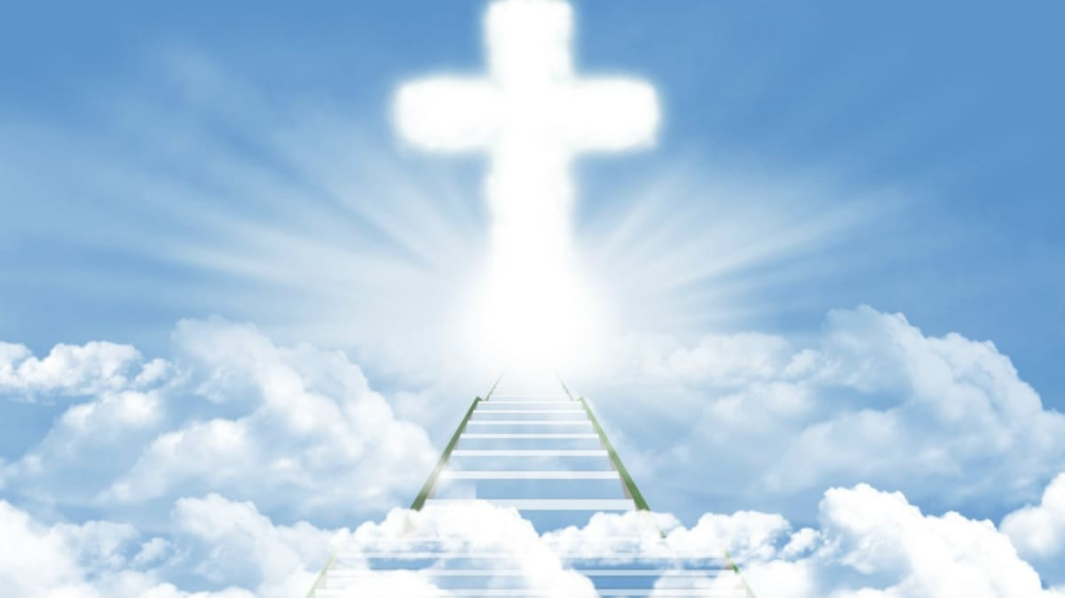

Beyond Mere Mortals
by Pastor Fee Soliven
2 Corinthians 5:16-21
Sunday Morning
June 12, 2022

Slide 85
2 Corinthians 5:16-21
16 Therefore, from now on, we regard no one according to the flesh. Even though we have known Christ according to the flesh, yet now we know Him thus no longer. 17 Therefore, if anyone is in Christ, he is a new creation; old things have passed away; behold, all things have become new.

Slide 86
18 Now all things are of God, who has reconciled us to Himself through Jesus Christ, and has given us the ministry of reconciliation, 19 that is, that God was in Christ reconciling the world to Himself, not imputing their trespasses to them, and has committed to us the word of reconciliation.

Slide 87
20 Now then, we are ambassadors for Christ, as though God were pleading through us: we implore you on Christ's behalf, be reconciled to God. 21 For He made Him who knew no sin to be sin for us, that we might become the righteousness of God in Him.

Slide 88
1. It’s Already Done

Slide 89
2 Corinthians 5:17
“Therefore, if anyone is in Christ, he is a new creation; old things have passed away; behold, all things have become new”

Slide 90
2. You Are Not an Old Sinner
Saved by Grace

Slide 91
Ephesians 2:4–5 (NLT)
4 But God is so rich in mercy, and he loved us so much, that even though we were dead because of our sins, he gave us life when he raised Christ from the dead. 5 (It is only by God’s grace that you have been saved!)

Slide 92
3. You Are the Righteousness of God in Christ Jesus

Slide 93
2 Corinthians 5:21
“For He made Him who knew no sin to be sin for us, that we might become the righteousness of God in Him”

Slide 94
4. You Are Forgiven

Slide 95
Revelation 1:5
“And from Jesus Christ, the faithful witness, the firstborn from the dead, and the ruler over the kings of the earth. To Him who loved us and washed us from our sins in His own blood”

Slide 96
Colossians 2:13 (NLT)
“You were dead because of your sins and because your sinful nature was not yet cut away. Then God made you alive with Christ, for he forgave all our sins”

Slide 97
What should believers do if they sin?

Slide 98
1 John 1:9
“If we confess our sins, He is faithful and just to forgive us our sins and to cleanse us from all unrighteousness.”

Slide 99
5. You Have Divine Access

Slide 100
Hebrews 10:19–20 (NLT)
19 And so, dear brothers and sisters, we can boldly enter heaven’s Most Holy Place because of the blood of Jesus. 20 By his death, Jesus opened a new and life-giving way through the curtain into the Most Holy Place

Slide 101
6. You Are Redeemed

Slide 102
Galatians 3:13
Christ has redeemed us from the curse of the law, having become a curse for us (for it is written, “Cursed is everyone who hangs on a tree”

Slide 103
1 Peter 1:18–19
18 knowing that you were not redeemed with corruptible things, like silver or gold, from your aimless conduct received by tradition from your fathers, 19 but with the precious blood of Christ, as of a lamb without blemish and without spot

Slide 104
7. You Have the Advantage

Slide 105
Galatians 6:15
“For in Christ Jesus neither circumcision nor uncircumcision avails anything, but a new creation”

Slide 106
8. You Are an Overcomer

Slide 107
1 John 5:4–5
4 For whatsoever is born of God overcomes the world. And this is the victory that has overcome the world—our faith. 5 Who is he who overcomes the world, but he who believes that Jesus is the Son of God?

Slide 108
Romans 8:37
“Yet in all these things we are more than conquerors through Him who loved us”

Slide 109
2 Corinthians 2:14
“Now thanks be to God who always leads us in triumph in Christ, and through us diffuses the fragrance of His knowledge in every place”

Slide 110
9. You Have a New Nature

Slide 111
2 Peter 1:3-4
3 As His divine power has given to us all things that pertain to life and godliness, godliness, through the knowledge of Him who called us by glory and virtue,

Slide 112
4 by which have been given to us exceedingly great and precious promises, that through these you may be partakers of the divine nature, having escaped the corruption that is in the world through lust

Slide 113
Galatians 5:22-24
22 But the fruit of the Spirit is love, joy, peace, longsuffering, kindness, goodness, faithfulness, 23 gentleness, self-control. Against such there is no law.

Slide 114
10. Your Limits Have Been Removed

Slide 115
Romans 8:26
“Likewise the Spirit also helps in our weaknesses. For we do not know what we should pray for as we ought, but the Spirit Himself makes intercession for us with groanings which cannot be uttered”

Slide 116
11. You Are an Ambassador

Slide 117
2 Corinthians 5:20
“Now then, we are ambassadors for Christ, as though God were pleading through us: we implore you on Christ’s behalf, be reconciled to God”

Slide 118
12. You Are Royalty

Slide 119
Romans 5:17
“For if by the one man’s offense death reigned through the one, much more those who receive abundance of grace and of the gift of righteousness will reign in life through the One, Jesus Christ”

Slide 120
Revelation 1:6
And has made us kings and priests to His God and Father, to Him be glory and dominion forever and ever. Amen

Slide 121
13. You Are the Temple of God

Slide 122
1 Corinthians 6:19–20
19 Or do you not know that your body is the temple of the Holy Spirit who is in you, whom you have from God, and you are not your own? 20 For you were bought at a price; therefore glorify God in your body and in your spirit, which are God’s

Slide 123
14. You Have a Purpose

Slide 124
Ephesians 2:10 (NLT)
“For we are God’s masterpiece. He has created us anew in Christ Jesus, so we can do the good things he planned for us long ago”

Slide 125
15. You Are Anointed

Slide 126
1 Corinthians 12:27
“Now you are the body of Christ and members individually”

Slide 127
16. You Are a Spirit

Slide 128
1 Thessalonians 5:23 (NLT)
“Now may the God of peace make you holy in every way, and may your whole spirit and soul and body be kept blameless until our Lord Jesus Christ comes again”

Slide 129
2 Peter 1:13-14
13 Yes, I think it is right, as long as I am in this tent, to stir you up by reminding you, 14 knowing that shortly I must put off my tent, just as our Lord Jesus Christ showed me.

Slide 130
1 Thessalonians 4:13-18
13 But I do not want you to be ignorant, brethren, concerning those who have fallen asleep, lest you sorrow as others who have no hope. 14 For if we believe that Jesus died and rose again, even so God will bring with Him those who sleep in Jesus.

Slide 131
15 For this we say to you by the word of the Lord, that we who are alive and remain until the coming of the Lord will by no means precede those who are asleep. 16 For the Lord Himself will descend from heaven with a shout, with the voice of an archangel, and with the trumpet of God. And the dead in Christ will rise first.

Slide 132
17 Then we who are alive and remain shall be caught up together with them in the clouds to meet the Lord in the air. And thus we shall always be with the Lord. 18 Therefore comfort one another with these words.

Slide 133
1 Corinthians 15:50-54
50 Now this I say, brethren, that flesh and blood cannot inherit the kingdom of God; nor does corruption inherit incorruption. 51 Behold, I tell you a mystery: We shall not all sleep, but we shall all be changed-- 52 in a moment, in the twinkling of an eye, at the last trumpet. For the trumpet will sound, and the dead will be raised incorruptible, and we shall be changed.

Slide 134
53 For this corruptible must put on incorruption, and this mortal must put on immortality. 54 So when this corruptible has put on incorruption, and this mortal has put on immortality, then shall be brought to pass the saying that is written: "Death is swallowed up in victory."

Slide 135

20 Again, when a righteous man turns from his righteousness and commits iniquity, and I lay a stumbling block before him, he shall die; because you did not give him warning, he shall die in his sin, and his righteousness which he has done shall not be remembered; but his blood I will require at your hand.

Slide 136
Acts 2:38-39
38 Then Peter said to them, "Repent, and let every one of you be baptized in the name of Jesus Christ for the remission of sins; and you shall receive the gift of the Holy Spirit. 39 For the promise is to you and to your children, and to all who are afar off, as many as the Lord our God will call."

