Slide 1


Slide 2
All My Fountain
(Chris Tomlin)

Slide 3
This dry and desert land I tell myself keep walking on
Hear something up ahead Water falling like a song

Slide 4
An everlasting stream You're river carries me home
Let it flow, let it flow All my fountains A flood for my

Slide 5
Soul A well that never will run dry I've rambled on my own Never believing I would find An everlasting

Slide 6
Stream You're river carries me home Let it flow, let it flow Open the Heavens Come living water All my

Slide 7
fountains are in you You're strong like a river Your love is running through All my fountains are in you

Slide 8
Come on and rain down on us, rain down on us, Lord
Come on and rain down on us, rain down on us, Lord

Slide 9
Come on and rain down on us, rain down on us, Lord (we pray) Come on and rain down on us, rain down

Slide 10
on us, Lord Open the Heavens Come living water
All my fountains are in you You're strong like a river

Slide 11
Your love is running through All my fountains are in you Open the Heavens Come living water All my

Slide 12
fountains are in you You're strong like a river Your love is running through All my fountains are in you

Slide 13
All my fountains are in you

Slide 14
“Battle Belongs”
(Phil Wickham)CCLI #7148126

Slide 15
When all I see is battle, you see my victory.When all I see is mountain, You see a mountain move. And as

Slide 16
I walk through the shadow, Your love surrounds me. There’s nothing to fear now for I am safe with you.

Slide 17
So when I fight, I’ll fight on my knees. With my hands lifted high. Oh God, the battle belongs to you. And

Slide 18
Every fear I lay at your feet. I’ll sing through the night. Oh God, the battle belongs to you. And if you

Slide 19
Are for me, who can stand against me, who can be against me? Yeah for Jesus, there’s nothing

Slide 20
Impossible for you. When all I see are the ashes., You see the beauty. Thank you God. When all I see

Slide 21
Is the cross, God, You see the empty tomb. So when I fight, I’ll fight on my knees. With my hands lifted

Slide 22
High. Oh God, the battle belongs to you. And every fear I lay at your feet. I’ll sing through the night.

Slide 23
Oh, God, the battle belongs to you. Almighty fortress, You go before us. Nothing can stand against the

Slide 24
power of our God. You shine in the shadow, You win every battle. Nothing can stand against the power

Slide 25
Of our God. All mighty fortress, you go before us. Nothing can stand against the power of our God. You

Slide 26
Shine in the shadows. You win every battle. Nothing can stand against the power of our God. So when I

Slide 27
Fight, I’ll fight on my knees. With my hands lifted high. Oh’ god, the battle belongs to you. And every

Slide 28
Fear I lay at your feet. I’ll sing through the night. Oh God, the battle belongs to you.

Slide 29
Goodness of God
(by Bethel)

Slide 30
I love You, Lord For Your mercy never fails me All my days, I've been held in Your hands From the moment

Slide 31
that I wake up Until I lay my head Oh, I will sing of the goodness of God And all my life You have been

Slide 32
faithful And all my life You have been so, so good With every breath that I am able Oh, I will sing of the

Slide 33
goodness of God I love Your voice You have led me through the fire In the darkest night You are close

Slide 34
God (yeah) And all my life You have been faithful (oh) And all my life You have been so, so good With

Slide 35
every breath that I am able Oh, I will sing of the goodness of God (yeah) 'Cause Your goodness is

Slide 36
running after It's running after me Your goodness is running after It's running after me With my life laid

Slide 37
down I'm surrendered now I give You everything
'Cause Your goodness is running after It's running

Slide 38
after me (oh-oh) 'Cause Your goodness is running after It's running after me Your goodness is running

Slide 39
after It's running after me With my life laid down I'm surrendered now I give You everything 'Cause Your

Slide 40
goodness is running after It keeps running after me
And all my life You have been faithful And all my life

Slide 41
You have been so, so good With every breath that I am able Oh, I'm gonna sing of the goodness of God

Slide 42
(I'm gonna sing, I'm gonna sing) 'Cause all my life You have been faithful And all my life You have been

Slide 43
so, so good With every breath that I am able Oh, I'm gonna sing of the goodness of God Oh, I'm gonna

Slide 44
sing of the goodness of God

Slide 45
“God Turned It Around”
(Church of The City)

Slide 46
I'm praying, God come And turn this thing around God, turn it around God, turn it around God, turn it

Slide 47
Around I'm calling on the name That changes everything, yes God, turn it around God, turn it

Slide 48
Around God, turn it around All of my hope Is in the name The name of Jesus Breakthrough will come

Slide 49
Come in the name The name of Jesus I'm praying, God come And turn this thing around Oh, yes God,

Slide 50
turn it around God, turn it around God, turn it around
I'm calling on the name That changes everything Oh,

Slide 51
yeah yeah God, turn it around God, turn it around God, turn it around 'Cause all of my hope Is in the

Slide 52
name The name of Jesus Breakthrough will come
Come in the name The name of Jesus God, turn it

Slide 53
around God, turn it around God, turn it around Oh oh
God, turn it around God, turn it around God, turn it

Slide 54
around He is up to something He is up to something
God is doing something right now He is up to

Slide 55
something He is up to something God is doing something right now He is healing someone He is

Slide 56
saving someone God is doing something, oh, right now He is healing someone He is saving someone

Slide 57
God is doing something right now (right now) He is moving mountains Making a way for someone God is

Slide 58
doing something right now, right now He is moving mountains Making a way for someone (yeah) God is

Slide 59
doing something right now, right now He is moving mountains Making a way for someone God is doing

Slide 60
something right now All of my hope (yeah) Is in the name (the name) The name of Jesus (of Jesus) Said,

Slide 61
breakthrough will come in the name Come in the name The name of Jesus All of my hope (is in the

Slide 62
name) Is in the name (said) The name of Jesus Said, breakthrough will come Come in the name The name

Slide 63
of Jesus God, turn it around Turn it around Oh, oh
God, turn it around Turn it around Turn it around

Slide 64
The Blessing
(Kari Jobe)

Slide 65
The Lord bless you and keep you. Make his face shine upon you. And be gracious to you. The Lord

Slide 66
turn his face towards and give you peace. Amen, Amen, Amen, Amen, Amen, Amen. The Lord bless

Slide 67
You and keep you. Make his face shine upon you. And be gracious to you. The Lord turn his. Face

Slide 68
towards you. And give you peace. Amen, Amen, Amen, Amen, Amen, Amen. May his favor be

Slide 69
upon you and a thousand generations. And your family and your children, and their children, and their

Slide 70
children. May his favor be upon you. And a thousand generations. And your family and your

Slide 71
children. And their children, and their children. May his presence. Go before you. And behind you

Slide 72
and beside you. All around you, and within you. He is with you. He is with you. In the morning, In the

Slide 73
evening. In your coming, and your going. In your weeping, and rejoicing. He is for you, He is for you.

Slide 74
He is for you, He is for you, He is for you, He is for you, He is for you, he is for you. Amen, Amen, Amen

Slide 75
Amen, Amen, Amen. May his presence go before you. And behind you, and beside you. All around

Slide 76
you, and with you, he is with you, he is with you. In the morning, In the evening, In your coming, and

Slide 77
your going. In your weeping, and rejoicing. He is for you.

Slide 79


Slide 80
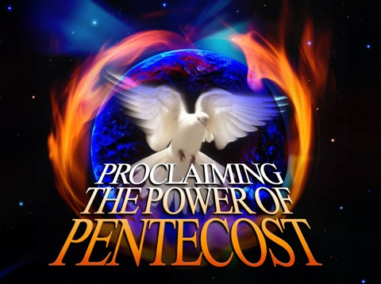

The Feast of Pentecost
by Pastor Fee Soliven
Exodus 23:14-16
Sunday Morning
June 5,2022 – Sivan 6, 5782

Slide 81
Exodus 23:14-16
14 "Three times you shall keep a feast to Me in the year: 15 You shall keep the Feast of Unleavened Bread (you shall eat unleavened bread seven days, as I commanded you, at the time appointed in the month of Abib, for in it you came out of Egypt; none shall appear before Me empty);

Slide 82
16 and the Feast of Harvest, the firstfruits of your labors which you have sown in the field; and the Feast of Ingathering at the end of the year, when you have gathered in the fruit of your labors from the field.

Slide 83
Feast of Weeks,
The Feast of Harvest,
The Latter Firstfruits
The Feast of Pentecost
and
The Feast of Shavuot

Slide 84
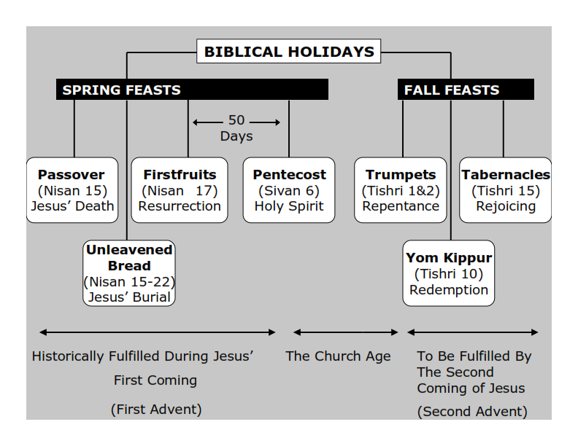
Philippians 3:20-21
20 For our citizenship is in heaven, from which we also eagerly wait for the Savior, the Lord Jesus Christ, 21 who will transform our lowly body that it may be conformed to His glorious body, according to the working by which He is able even to subdue all things to Himself.

Slide 85
Feast of Weeks

Slide 86
Leviticus 23:15-16
15'And you shall count for yourselves from the day after the Sabbath, from the day that you brought the sheaf of the wave offering: seven Sabbaths shall be completed. 16 Count fifty days to the day after the seventh Sabbath; then you shall offer a new grain offering to the LORD.

Slide 87
Latter Firstfruits

Slide 88
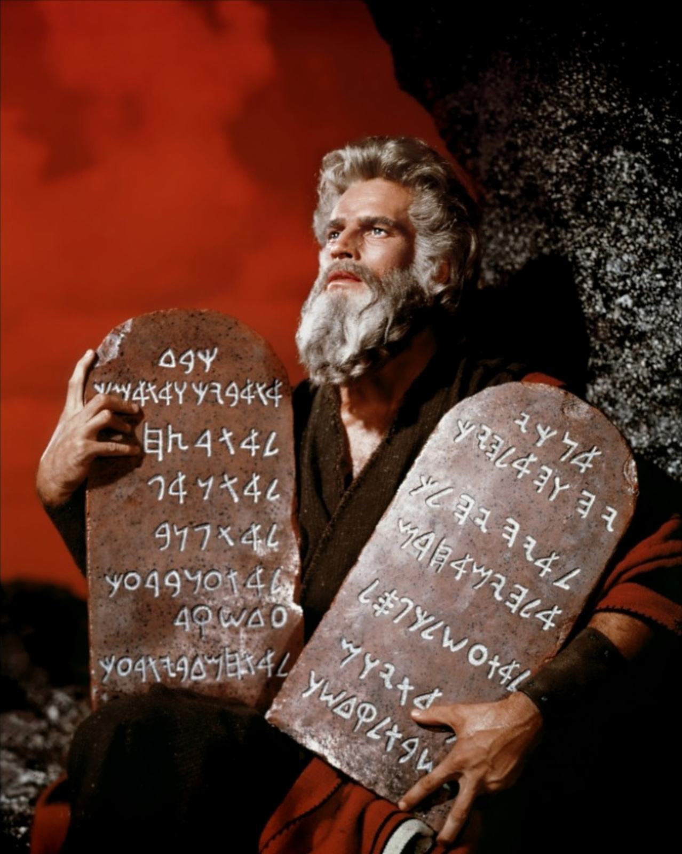

Slide 89
Acts 2:14-21
14 But Peter, standing up with the eleven, raised his voice and said to them, "Men of Judea and all who dwell in Jerusalem, let this be known to you, and heed my words. 15 For these are not drunk, as you suppose, since it is only the third hour of the day. 16 But this is what was spoken by the prophet Joel:

Slide 90
17'And it shall come to pass in the last days, says God, That I will pour out of My Spirit on all flesh; Your sons and your daughters shall prophesy, Your young men shall see visions, Your old men shall dream dreams. 18 And on My menservants and on My maidservants I will pour out My Spirit in those days; And they shall prophesy.

Slide 91
19 I will show wonders in heaven above And signs in the earth beneath: Blood and fire and vapor of smoke. 20 The sun shall be turned into darkness, And the moon into blood, Before the coming of the great and awesome day of the LORD. 21 And it shall come to pass That whoever calls on the name of the LORD Shall be saved.'

Slide 92
1. Pentecost serves as a reminder that God grants His Holy Spirit to the FirstFruits of His Spiritual Harvest.

Slide 93
Philippians 3:20-21
20 For our citizenship is in heaven, from which we also eagerly wait for the Savior, the Lord Jesus Christ, 21 who will transform our lowly body that it may be conformed to His glorious body, according to the working by which He is able even to subdue all things to Himself.

Slide 94
Exodus 23:16
16 and the Feast of Harvest, the firstfruits of your labors which you have sown in the field; and the Feast of Ingathering at the end of the year, when you have gathered in the fruit of your labors from the field.

Slide 95
Numbers 28:26
26'Also on the day of the firstfruits, when you bring a new grain offering to the LORD at your Feast of Weeks, you shall have a holy Convocation.

Slide 96
The Hebrew word for Feasts is also MOED meaning appointed times.
The Hebrew word for convocation is MIQRA meaning a dress rehearsal.

Slide 97
Pentecost
( Pentekostos in the original), which means "fiftieth"

Slide 98
2. The Gift of Pentecost: the Holy Spirit

Slide 99
Acts 1:12-15
12 Then they returned to Jerusalem from the mount called Olivet, which is near Jerusalem, a Sabbath day's journey. 13 And when they had entered, they went up into the upper room where they were staying: Peter, James, John, and Andrew; Philip and Thomas; Bartholomew and Matthew; James the son of Alphaeus and Simon the Zealot; and Judas the son of James.

Slide 100
14 These all continued with one accord in prayer and supplication, with the women and Mary the mother of Jesus, and with His brothers. 15 And in those days Peter stood up in the midst of the disciples (altogether the number of names was about a hundred and twenty)...

Slide 101
Acts 2:1-4
1 "Now when the Day of Pentecost had fully come, they were all with one accord in one place. 2 And suddenly there came a sound from heaven, as of a rushing mighty wind, and it filled the whole house where they were sitting.

Slide 102
3 Then there appeared to them divided tongues, as of fire, and one sat upon each of them. 4 And they were all filled with the Holy Spirit and began to speak with other tongues, as the Spirit gave them utterance"

Slide 103
Acts 2:17, Joel 2:28
"And it shall come to pass in the last days, says God, that I will pour out of My Spirit on all flesh".

Slide 104
Acts 2:38-39
38 "Repent, and let every one of you be baptized in the name of Jesus Christ for the remission of sins; and you shall receive the gift of the Holy Spirit. 39 For the promise is to you and to your children, and to all who are afar off, as many as the Lord our God will call".

Slide 105
The Law and God’s Grace!

Slide 106
Exodus 32:25-29
25 Now when Moses saw that the people were unrestrained (for Aaron had not restrained them, to their shame among their enemies), 26 then Moses stood in the entrance of the camp, and said, "Whoever is on the LORD's side, come to me." And all the sons of Levi gathered themselves together to him.

Slide 107
27 And he said to them, "Thus says the LORD God of Israel: 'Let every man put his sword on his side, and go in and out from entrance to entrance throughout the camp, and let every man kill his brother, every man his companion, and every man his neighbor.' "

Slide 108
28 So the sons of Levi did according to the word of Moses. And about three thousand men of the people fell that day. 29 Then Moses said, "Consecrate yourselves today to the LORD, that He may bestow on you a blessing this day, for every man has opposed his son and his brother."

Slide 109
Acts 2:40-42
40 And with many other words he testified and exhorted them, saying, "Be saved from this perverse generation." 41 Then those who gladly received his word were baptized; and that day about three thousand souls were added to them. 42 And they continued steadfastly in the apostles' doctrine and fellowship, in the breaking of bread, and in prayers.

Slide 110
3. Why we Need God's Spirit

Slide 111
1 Kings 8:46
"When they sin against You
(for there is no one who does not sin)...

Slide 112
John 16:8-9
8 And when He has come, He will convict the world of sin, and of righteousness, and of judgment: 9 of sin, because they do not believe in Me;

Slide 113
Romans 3:23
"for all have sinned and fall short of the glory of God"...

Slide 114
Deuteronomy 5:29
"Oh, that they had such a heart in them that they would fear Me and always keep all My commandments that it might be well with them and with their children forever!"

Slide 115
Jeremiah 17:9-10
9 "The heart is deceitful above all things, And desperately wicked; Who can know it? 10 I, the LORD, search the heart, I test the mind, Even to give every man according to his ways, According to the fruit of his doings.

Slide 116
Luke 10:27
"You shall love the LORD your God with all your heart, with all your soul, with all your strength, and with all your mind" and "[love] your neighbor as yourself."

Slide 117
The Holy Ghost is The Power To Raise Us From The Dead!

Slide 118
Romans 8:10-11
10 And if Christ is in you, the body is dead because of sin, but the Spirit is life because of righteousness. 11 But if the Spirit of Him who raised Jesus from the dead dwells in you, He who raised Christ from the dead will also give life to your mortal bodies through His Spirit who dwells in you.

Slide 119
4. The Holy Spirit at work in Our Lives

Slide 120
Acts 1:8
"But you shall receive power when the Holy Spirit has come upon you; and you shall be witnesses to Me in Jerusalem, and in all Judea and Samaria, and to the end of the earth."

Slide 121
Acts 17:6
"turning the world upside down"

Slide 122
Romans 15:13
"Now may the God of hope fill you with all joy and peace in believing, that you may abound in hope by the power of the Holy Spirit"

Slide 123
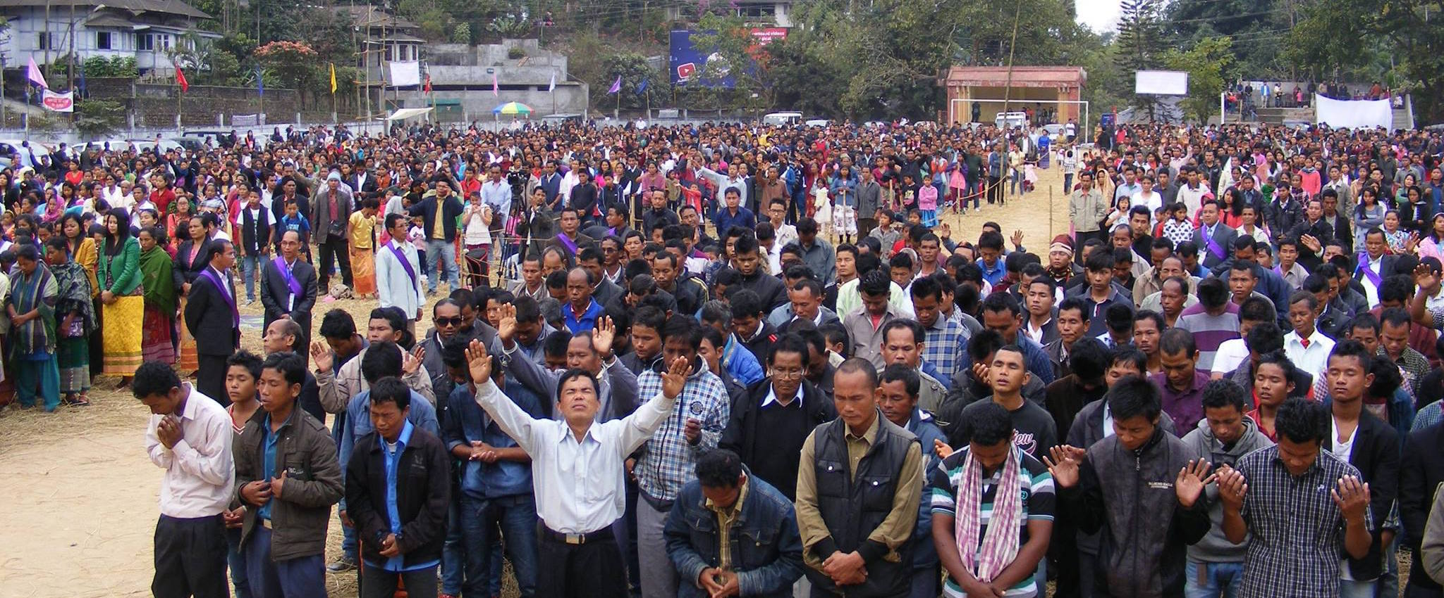
Acts 1:8
"But you shall receive power when the Holy Spirit has come upon you; and you shall be witnesses to Me in Jerusalem, and in all Judea and Samaria, and to the end of the earth."

Slide 124
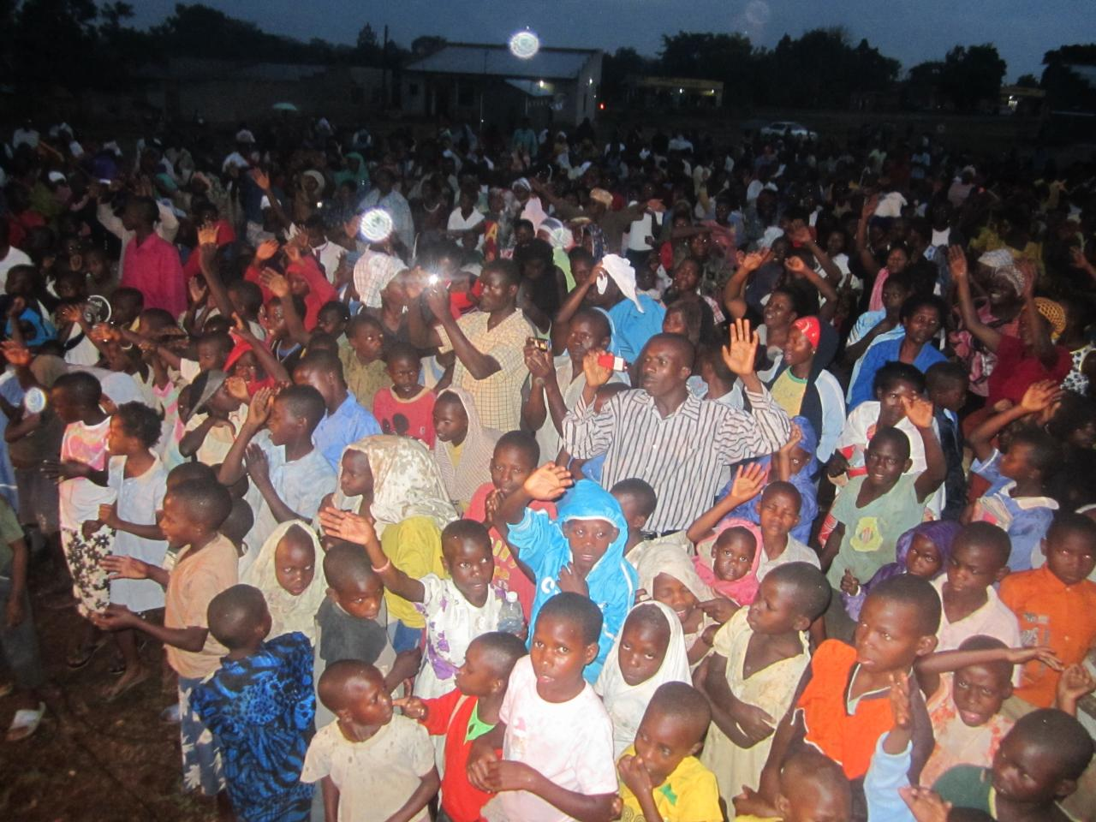
Acts 17:6
"turning the world upside down"

Slide 125
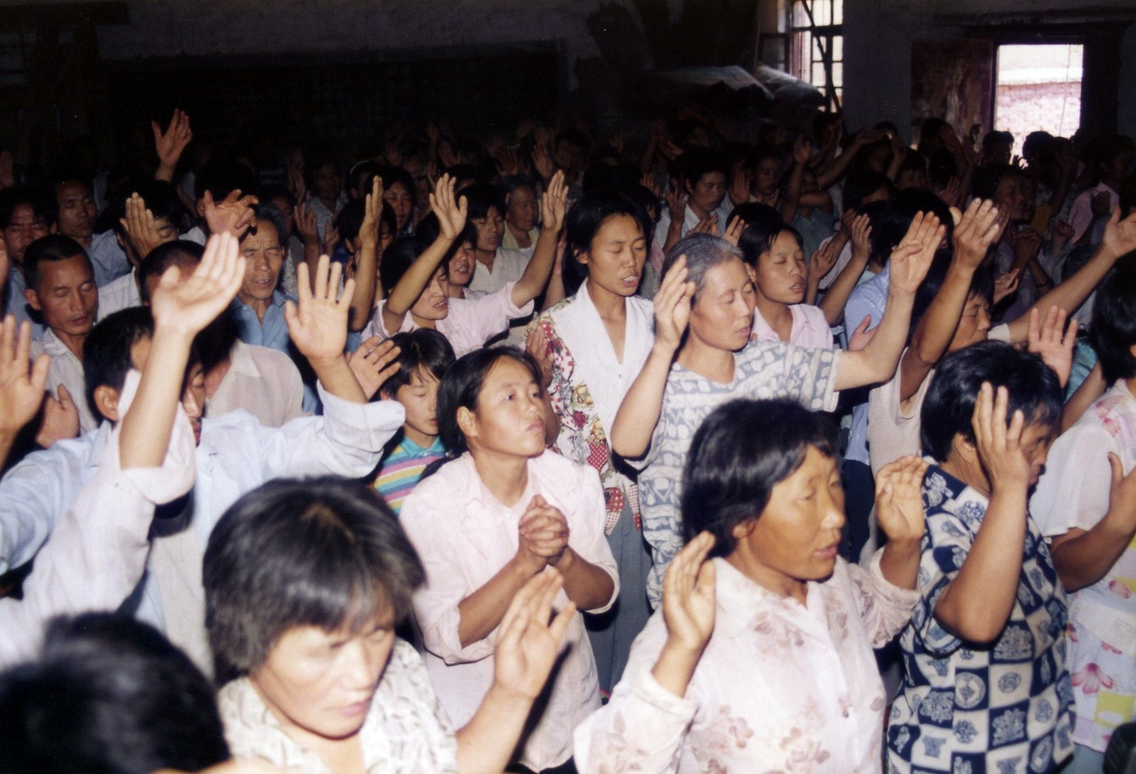
Romans 15:13
"Now may the God of hope fill you with all joy and peace in believing, that you may abound in hope by the power of the Holy Spirit"

Slide 126
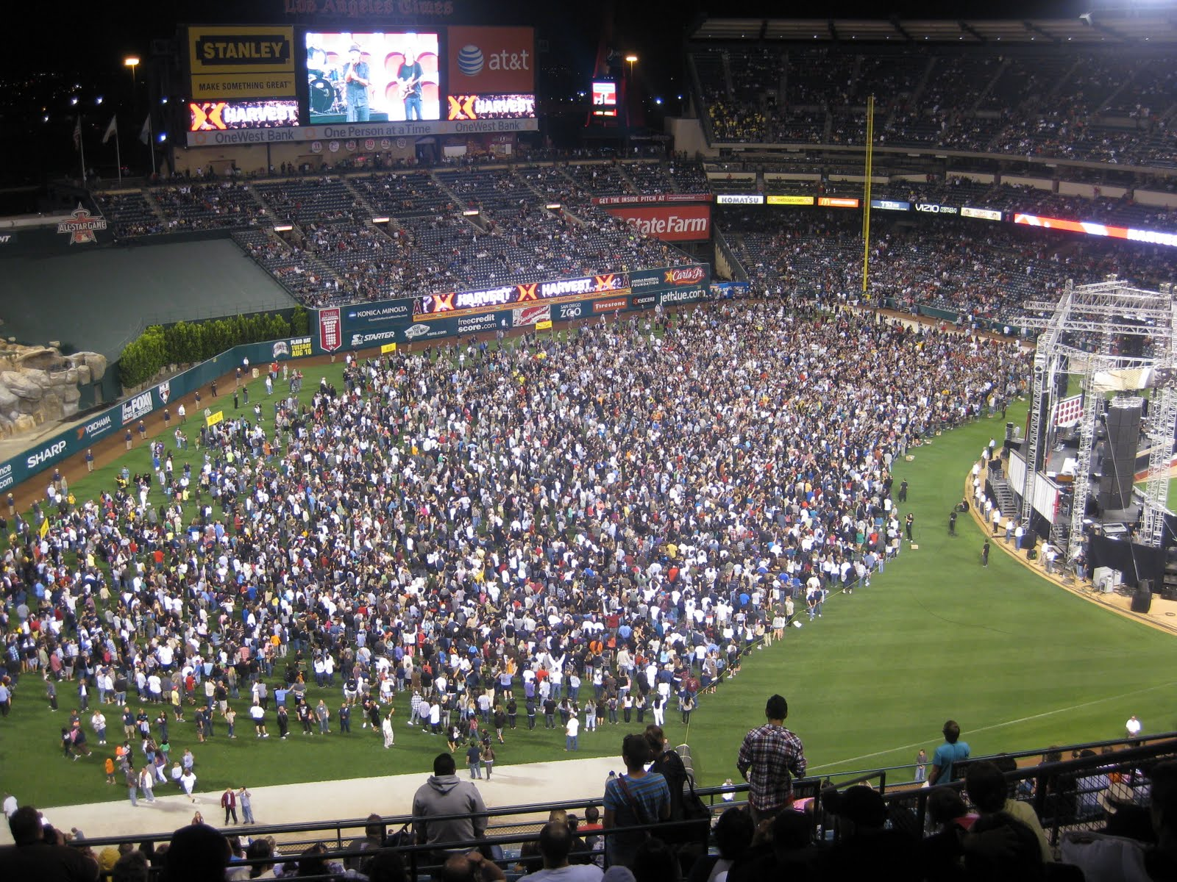

Slide 127
1 Thessalonians 4:13-18
13 But I do not want you to be ignorant, brethren, concerning those who have fallen asleep, lest you sorrow as others who have no hope. 14 For if we believe that Jesus died and rose again, even so God will bring with Him those who sleep in Jesus.

Slide 128
15 For this we say to you by the word of the Lord, that we who are alive and remain until the coming of the Lord will by no means precede those who are asleep. 16 For the Lord Himself will descend from heaven with a shout, with the voice of an archangel, and with the trumpet of God. And the dead in Christ will rise first.

Slide 129
17 Then we who are alive and remain shall be caught up together with them in the clouds to meet the Lord in the air. And thus we shall always be with the Lord. 18 Therefore comfort one another with these words.

Slide 130
Acts 2:38-39
38 Then Peter said to them, "Repent, and let every one of you be baptized in the name of Jesus Christ for the remission of sins; and you shall receive the gift of the Holy Spirit. 39 For the promise is to you and to your children, and to all who are afar off, as many as the Lord our God will call."

