Slide 2
Only King Forever
(Elevation Worship)

Slide 3
Our God, a firm foundation Our rock, the only solid ground As nations rise and fall Kingdoms once strong

Slide 4
now shaken But we trust forever in Your name The name of Jesus We trust the name of Jesus You are

Slide 5
the only King forever Almighty God we lift You higher
You are the only King forever Forevermore, You are

Slide 6
victorious You are the only King forever Almighty God we lift You higher You are the only King forever

Slide 7
Forevermore, You are victorious Unmatched in all Your wisdom In love and justice You will reign And

Slide 8
every knee will bow We bring our expectations Our hope is anchored in Your name The name of Jesus

Slide 9
Oh-oh, we trust the name of Jesus You are the only King forever Almighty God we lift You higher You are

Slide 10
the only King forever Forevermore, You are victorious
You are the only King forever Almighty God we lift

Slide 11
You higher You are the only King forever Forevermore, You are victorious We lift our banner

Slide 12
high We lift the name of Jesus From age to age You reign Your kingdom has no end We lift our banner

Slide 13
high We lift the name of Jesus From age to age You reign Your kingdom has no end You are the only King

Slide 14
forever Almighty God we lift You higher You are the only King forever Forevermore, You are

Slide 15
victorious You are the only King forever Almighty God we lift You higher You are the only King forever

Slide 16
Forevermore, You are victorious

Slide 17
Agnus Dei
(by Michael W. Smith)

Slide 18
Alleluia Alleluia For our Lord God Almighty reigns
Alleluia Alleluia For our Load God Almighty reigns

Slide 19
Alleluia Holy Holy Are You Lord God Almighty Worthy is the Lamb Worthy is the Lamb You are Holy Holy

Slide 20
Are You Lord God Almighty Worthy is the Lamb Worthy is the Lamb Amen Holy Holy Are You Lord

Slide 21
God Almighty Worthy is the Lamb Worthy is the Lamb You are Holy Holy Are You Lord God Almighty

Slide 22
Worthy is the Lamb Worthy is the Lamb Amen

Slide 23
“Worthy of it all”
(CeCe Winans)

Slide 24
All the saints and angels. They bow before the throne. All the elders cast their crowns before the

Slide 25
Lamb of God and sing. All the saints and angels. They bow before your throne. All the elders cast their

Slide 26
Crowns before the lamb of God and sing. You are worthy of it all. You are worthy of it all. For from you

Slide 27
All. For from you are all things and to you are all things. You deserve the glory. Day and night, night

Slide 28
Night and day. Let incense arise. Day and night, night and day. Let incense arise. Day and night, night

Slide 29
And day let incense arise. Day and night night and day. You are worthy of it all. You are worthy of it all

Slide 30
For from you are al things. And to you are all things. You deserve the glory. You are worthy of it all. You

Slide 31
Are worthy of it all. For from you are all things and to you are all things. You deserve the glory. We exalt

Slide 32
Thee. We exalt thee. We exalt thee, Oh, Lord.
We exalt thee. We exalt thee, We exalt thee, Oh

Slide 33
“Build My Life”
(Pat Barret)

Slide 34
Worthy of every song we could ever sing Worthy of all the praise we could ever bring Worthy of every

Slide 35
breath we could ever breathe We live for you Oh, we live for you Jesus, the Name above every other

Slide 36
name Jesus, the only One who could ever save (worthy...) Worthy of every breath we could ever

Slide 37
breathe We live for you Holy, there is no one like You There is none beside You Open up my eyes in

Slide 38
wonder Show me who You are and fill me With Your heart and lead me In your love to those around me

Slide 39
Jesus, the Name above every other name Jesus, the only One who could ever save Worthy of every

Slide 40
breathe we could ever breathe We live for You, Oh! We live for for You Holy, there is no one like You

Slide 41
There is none beside You Open up my eyes I wonder Show me who You are and fill me With Your

Slide 42
heart and lead me In your love to those around me I will build my life upon Your love It is a firm foundation

Slide 43
I will put my trust in You alone And I will not be shaken I will build my life upon Your love It is a firm

Slide 44
foundation I will put my trust in You alone And I will not be shaken Holy, there is no one like You There is

Slide 45
none beside You Open up my eyes in wonder Show me who You are and fill me With Your heart and lead

Slide 46
me In your love to those around me I will build my life upon Your love It is a firm foundation I will put my

Slide 47
trust in You alone And I will not be shaken I will build my life upon Your love It is a firm foundation I will put

Slide 48
my trust in You alone And I will not be shaken Lord

Slide 49
The Blessing
(Kari Jobe)

Slide 50
The Lord bless you and keep you. Make his face shine upon you. And be gracious to you. The Lord

Slide 51
turn his face towards and give you peace. Amen, Amen, Amen, Amen, Amen, Amen. The Lord bless

Slide 52
You and keep you. Make his face shine upon you. And be gracious to you. The Lord turn his. Face

Slide 53
towards you. And give you peace. Amen, Amen, Amen, Amen, Amen, Amen. May his favor be

Slide 54
upon you and a thousand generations. And your family and your children, and their children, and their

Slide 55
children. May his favor be upon you. And a thousand generations. And your family and your

Slide 56
children. And their children, and their children. May his presence. Go before you. And behind you

Slide 57
and beside you. All around you, and within you. He is with you. He is with you. In the morning, In the

Slide 58
evening. In your coming, and your going. In your weeping, and rejoicing. He is for you, He is for you.

Slide 59
He is for you, He is for you, He is for you, He is for you, He is for you, he is for you. Amen, Amen, Amen

Slide 60
Amen, Amen, Amen. May his presence go before you. And behind you, and beside you. All around

Slide 61
you, and with you, he is with you, he is with you. In the morning, In the evening, In your coming, and

Slide 62
your going. In your weeping, and rejoicing. He is for you.

Slide 64
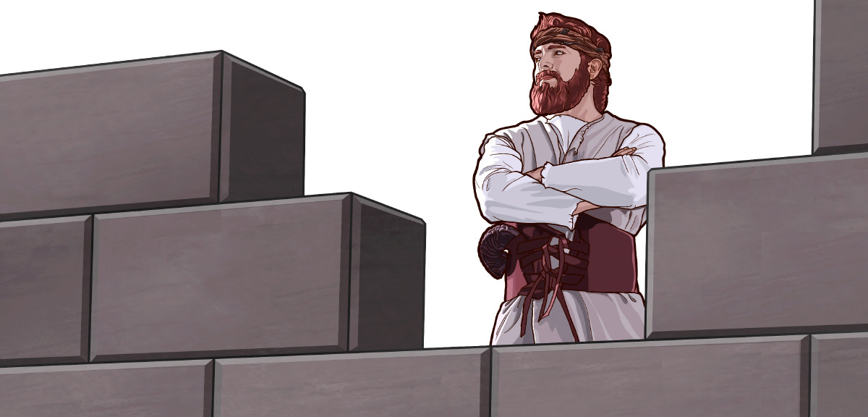
It’s Time to Be a Watchman
by Pastor Fee Soliven
Matthew 24:40-42
Wednesday Evening
November 6, 2022

Slide 66
Matthew 24:40-42
40 Then two men will be in the field: one will be taken and the other left. 41 Two women will be grinding at the mill: one will be taken and the other left. 42 Watch therefore, for you do not know what hour your Lord is coming.

Slide 67
1 Corinthians 15:50-58
50 Now this I say, brethren, that flesh and blood cannot inherit the kingdom of God; nor does corruption inherit incorruption. 51 Behold, I tell you a mystery: We shall not all sleep, but we shall all be changed-- 52 in a moment, in the twinkling of an eye, at the last trumpet. For the trumpet will sound, and the dead will be raised incorruptible, and we shall be changed.

Slide 68
53 For this corruptible must put on incorruption, and this mortal must put on immortality. 54 So when this corruptible has put on incorruption, and this mortal has put on immortality, then shall be brought to pass the saying that is written: "Death is swallowed up in victory."

Slide 69
55 "O Death, where is your sting? O Hades, where is your victory?" 56 The sting of death is sin, and the strength of sin is the law. 57 But thanks be to God, who gives us the victory through our Lord Jesus Christ. 58 Therefore, my beloved brethren, be steadfast, immovable, always abounding in the work of the Lord, knowing that your labor is not in vain in the Lord.

Slide 70
Matthew 25:1-13
1 "Then the kingdom of heaven shall be likened to ten virgins who took their lamps and went out to meet the bridegroom. 2 Now five of them were wise, and five were foolish. 3 Those who were foolish took their lamps and took no oil with them,

Slide 71
4 but the wise took oil in their vessels with their lamps. 5 But while the bridegroom was delayed, they all slumbered and slept. 6 And at midnight a cry was heard: 'Behold, the bridegroom is coming; go out to meet him!' 7 "Then all those virgins arose and trimmed their lamps. 8 And the foolish said to the wise, 'Give us some of your oil, for our lamps are going out.'

Slide 72
9 "But the wise answered, saying, 'No, lest there should not be enough for us and you; but go rather to those who sell, and buy for yourselves.' 10 "And while they went to buy, the bridegroom came, and those who were ready went in with him to the wedding; and the door was shut.

Slide 73
11 Afterward the other virgins came also, saying, 'Lord, Lord, open to us!' 12 "But he answered and said, 'Assuredly, I say to you, I do not know you.' 13 "Watch therefore, for you know neither the day nor the hour in which the Son of Man is coming.

Slide 74
Matthew 24:43-44
43 But know this, that if the master of the house had known what hour the thief would come, he would have watched and not allowed his house to be broken into. 44 Therefore you also be ready, for the Son of Man is coming at an hour you do not expect.

Slide 75
Ezekiel 33:1-9
1 Again the word of the LORD came to me, saying, 2 "Son of man, speak to the children of your people, and say to them: 'When I bring the sword upon a land, and the people of the land take a man from their territory and make him their watchman, 3 when he sees the sword coming upon the land, if he blows the trumpet and warns the people,

Slide 76
4 then whoever hears the sound of the trumpet and does not take warning, if the sword comes and takes him away, his blood shall be on his own head. 5 He heard the sound of the trumpet, but did not take warning; his blood shall be upon himself. But he who takes warning will save his life.

Slide 77
6 But if the watchman sees the sword coming and does not blow the trumpet, and the people are not warned, and the sword comes and takes any person from among them, he is taken away in his iniquity; but his blood I will require at the watchman's hand.' 7 "So you, son of man: I have made you a watchman for the house of Israel; therefore you shall hear a word from My mouth and warn them for Me.

Slide 78
8 When I say to the wicked, 'O wicked man, you shall surely die!' and you do not speak to warn the wicked from his way, that wicked man shall die in his iniquity; but his blood I will require at your hand. 9 Nevertheless if you warn the wicked to turn from his way, and he does not turn from his way, he shall die in his iniquity; but you have delivered your soul.

Slide 79
Matthew 24:45-47
45 "Who then is a faithful and wise servant, whom his master made ruler over his household, to give them food in due season? 46 Blessed is that servant whom his master, when he comes, will find so doing. 47 Assuredly, I say to you that he will make him ruler over all his goods.

Slide 80
Proverbs 14:35
"The king's favor is toward a wise servant, But his wrath is against him who causes shame"

Slide 81
Proverbs 28:20
“A faithful man will abound with blessings, But he who hastens to be rich will not go unpunished”

Slide 82
Luke 16:10
“He who is faithful in what is least is faithful also in much; and he who is unjust in what is least is unjust also in much”

Slide 83
Matthew 24:48-51
48 But if that evil servant says in his heart, 'My master is delaying his coming,' 49 "and begins to beat his fellow servants, and to eat and drink with the drunkards, 50 the master of that servant will come on a day when he is not looking for him and at an hour that he is not aware of, 51 and will cut him in two and appoint him his portion with the hypocrites. There shall be weeping and gnashing of teeth.

Slide 84
2 Peter 3:2-13
3 knowing this first: that scoffers will come in the last days, walking according to their own lusts, 4 and saying, "Where is the promise of His coming? For since the fathers fell asleep, all things continue as they were from the beginning of creation." 5 For this they willfully forget: that by the word of God the heavens were of old, and the earth standing out of water and in the water,

Slide 85
6 by which the world that then existed perished, being flooded with water. 7 But the heavens and the earth which are now preserved by the same word, are reserved for fire until the day of judgment and perdition of ungodly men. 8 But, beloved, do not forget this one thing, that with the Lord one day is as a thousand years, and a thousand years as one day.

Slide 86
9 The Lord is not slack concerning His promise, as some count slackness, but is longsuffering toward us, not willing that any should perish but that all should come to repentance. 10 But the day of the Lord will come as a thief in the night, in which the heavens will pass away with a great noise, and the elements will melt with fervent heat; both the earth and the works that are in it will be burned up.

Slide 87
11 Therefore, since all these things will be dissolved, what manner of persons ought you to be in holy conduct and godliness, 12 looking for and hastening the coming of the day of God, because of which the heavens will be dissolved, being on fire, and the elements will melt with fervent heat? 13 Nevertheless we, according to His promise, look for new heavens and a new earth in which righteousness dwells.

Slide 88
1. Walk Submissively

Slide 89
2. Worship Triumphantly

Slide 90
3. Witness Urgently

Slide 91
4. Work Fervently

Slide 92
2 Corinthians 5:10
“we must all appear before the judgment seat of Christ, that each one may receive the things done in the body, according to what he has done, whether good or bad”

Slide 93
5. Watch Expectantly

Slide 94
1 Thessalonians 4:13-18
13 But I do not want you to be ignorant, brethren, concerning those who have fallen asleep, lest you sorrow as others who have no hope. 14 For if we believe that Jesus died and rose again, even so God will bring with Him those who sleep in Jesus.

Slide 95
15 For this we say to you by the word of the Lord, that we who are alive and remain until the coming of the Lord will by no means precede those who are asleep. 16 For the Lord Himself will descend from heaven with a shout, with the voice of an archangel, and with the trumpet of God. And the dead in Christ will rise first.

Slide 96
17 Then we who are alive and remain shall be caught up together with them in the clouds to meet the Lord in the air. And thus we shall always be with the Lord. 18 Therefore comfort one another with these words.

Slide 97
1 Corinthians 15:50-54
50 Now this I say, brethren, that flesh and blood cannot inherit the kingdom of God; nor does corruption inherit incorruption. 51 Behold, I tell you a mystery: We shall not all sleep, but we shall all be changed-- 52 in a moment, in the twinkling of an eye, at the last trumpet. For the trumpet will sound, and the dead will be raised incorruptible, and we shall be changed.

Slide 98
53 For this corruptible must put on incorruption, and this mortal must put on immortality. 54 So when this corruptible has put on incorruption, and this mortal has put on immortality, then shall be brought to pass the saying that is written: "Death is swallowed up in victory."

Slide 99
20 Again, when a righteous man turns from his righteousness and commits iniquity, and I lay a stumbling block before him, he shall die; because you did not give him warning, he shall die in his sin, and his righteousness which he has done shall not be remembered; but his blood I will require at your hand.

Slide 100
Acts 2:38-39
38 Then Peter said to them, "Repent, and let every one of you be baptized in the name of Jesus Christ for the remission of sins; and you shall receive the gift of the Holy Spirit. 39 For the promise is to you and to your children, and to all who are afar off, as many as the Lord our God will call."

