Slide 1


Slide 2
“Amazing Grace My Chains Are Gone”
(Chris Tomlin)

Slide 3
Amazing Grace! How sweet the sound that saved a wretch like me. I once was lost but now I’m found

Slide 4
blind but now I see. Twas grace that taught my heart to fear and grace my fears relieved. How precious

Slide 5
did that grace appear the hour I first believed. My chains are gone i’ve been set free. My God, My

Slide 6
Savior has ransomed me. And like a flood his mercy reigns, Unending love. Amazing Grace.

Slide 7
My chains are gone i’ve been set free. My God, MySavior has ransomed me. And like a flood his

Slide 8
Mercy reigns, Unending love. Amazing Grace.
Amazing Grace how sweet the sound. That saved a

Slide 9
wretch like me. I once was lost but now I’m found. Was blind but now I see.

Slide 10
“Jesus We Love You”
(Bethel Music)

Slide 11
Old things have passed away.Your love has stayed the same. Your constant grace remains the

Slide 12
Cornerstone. Things that we thought were dead. Are breathing in life again.. You cause your son to shine

Slide 13
On darkest nights. For all that you’ve done we will pour out our love. This will be our anthem song.

Slide 14
Jesus we love you. Oh how we love you. You are the one our hearts adore. The hopeless have found their

Slide 15
Hope. The orphans now have a home. All that was lost has found it’s place in you. You lift our weary

Slide 16
Head. You make us strong instead. You took these rags and made us beautiful. For all that you’ve done

Slide 17
We will pour out our love. This will be our anthem song Jesus we love you. Oh how we love you. You

Slide 18
Are the one our hearts adore. Jesus we love you oh we love you. You are the one our hearts adore.

Slide 19
Our affection, our devotion poured out on the feet of Jesus. Our affection our devotion poured out on the

Slide 20
Feet of Jesus. Our affection our devotion poured out on the feet of Jesus. Our affection our devotion

Slide 21
Poured out on the feet of Jesus we love you. Oh how we love you. You are the one our hearts adore.

Slide 22
Jesus we love you. Oh how we love you. You are the one our hearts Adore. You are the one our hearts

Slide 23
When You Walk Into The Room
(Bryan & Katie Torwalt)

Slide 24
When You walk into the room Everything changes
Darkness starts to tremble At the light that You bring

Slide 25
And when You walk into the room Every heart starts burning And nothing matters more Than just to sit

Slide 26
here at Your feet And worship You We worship You (Oh) We love You We'll never stop We can't live

Slide 27
without You, Jesus We love You And we can't get enough All this is for You, Jesus When You walk into

Slide 28
the room Sickness starts to vanish Every hopeless situation ceases to exist And when You walk into the

Slide 29
room The dead begin to rise 'Cause there is resurrection life In all You do We love You We'll

Slide 30
never stop Can't live without You, Jesus We love You And we can't get enough All this is for You,

Slide 31
Jesus Oh Jesus Come and consume, God All we are We give You permission Our hearts are Yours

Slide 32
We want You We want You Come and consume, God All we are We give You permission Our hearts

Slide 33
are Yours We want You We want You Come and consume, God All we are We give You permission

Slide 34
Our hearts are Yours We want You We want You Come and consume, God All we are We give You

Slide 35
permission Our hearts are Yours We want You We want You We love You We'll never stop Can't live

Slide 36
without You, Jesus We love You And we can't get enough All this is for You, Jesus Oh how we love You

Slide 37
Oh how we love You

Slide 38
Set A Fire
(Jesus Culture)

Slide 39
Set a fire down in my soul That I can't contain and I can't control Cause I want more of you God I want

Slide 40
more of you God Set a fire down in my soul That I can't contain and I can't control Cause I want more of

Slide 41
you God I want more of you God Set a fire down in my soul That I can't contain and I can't control

Slide 42
Cause I want more of you God I want more of you God Set a fire down in my soul That I can't contain

Slide 43
and I can't control Cause I want more of you God I want more of you God Set a fire down in my soul

Slide 44
That I can't contain and I can't control Cause I want more of you God I want more of you God Set a fire

Slide 45
down in my soul That I can't contain and I can't control Cause I want more of you God I want more of

Slide 46
you God Set a fire down in my soul That I can't contain and I can't control Cause I want more of you

Slide 47
God I want more of you God Set a fire down in my soul That I can’t contain and I can't control Cause I

Slide 48
want more of you God I want more of you God Set a fire down in my soul That I can't contain and I can't

Slide 49
control Cause I want more of you God I want more of you God Set a fire down in my soul That I can't

Slide 50
contain and I can't control Cause I want more of you God I want more of you God

Slide 51
“Miracles”
(Colton Dixon)

Slide 52
Ninety miles on the highway Every day moving so fast Taking all the wrong ways out Never saw you

Slide 53
coming Stopping me in my tracks Keeping me from the long way down Doesn't matter just how many

Slide 54
times I tried There could only be a single reason why
So tell me How do miracles just happen like that?

Slide 55
Happen like that, happen like that You can say the stars align but know that it's more than timing How

Slide 56
do miracles just happen like that? Happen like that, happen like that Right before I hit the ground some

Slide 57
How You came along and found me, ooh, ooh Right before I hit the ground some How You came along

Slide 58
and found me Some will say it's magic But I know that You did all that You're the reason, there's no

Slide 59
doubt Doesn't matter just how many times I tried There could only be a single reason why So tell me

Slide 60
How do miracles just happen like that? Happen like that, happen like that You can say the stars align but

Slide 61
I know that it's more than timing How do miracles just happen like that? Happen like that, happen like that

Slide 62
Right before I hit the ground some How You came along and found me, ooh, ooh Right before I hit the

Slide 63
ground some How You came along and found me There's no doubt when I feel Your love Call me crazy

Slide 64
and out of touch But I know that it's from above Tell me How do miracles just happen like that Happen

Slide 65
like that, happen like that You can say the stars align but I know that it's more than timing How do miracles

Slide 66
just happen like that Happen like that, happen like that Right before I hit the ground some How You

Slide 67
came along and found me, ooh, ooh You can say the stars align but I know that it's more than

Slide 68
timing, ooh, ooh Right before I hit the ground some How You came along and found me

Slide 69
So Will I (100 Billion X)
(Hillsong Worship)

Slide 70
God of creation There at the start Before the beginning of time With no point of reference You

Slide 71
spoke to the dark And fleshed out the wonder of light
And as You speak A hundred billion galaxies are

Slide 72
born In the vapour of Your breath the planets form If the stars were made to worship so will I I can see

Slide 73
Your heart in everything You've made Every burning star A signal fire of grace If creation sings Your

Slide 74
praises so will I God of Your promise You don't speak in vain No syllable empty or void For once You

Slide 75
have spoken All nature and science Follow the sound of Your voice And as You speak A hundred

Slide 76
billion creatures catch Your breath Evolving in pursuit of what You said If it all reveals Your nature

Slide 77
so will I I can see Your heart in everything You say Every painted sky A canvas of Your grace If creation

Slide 78
still obeys You so will I If the stars were made to worship so will I If the mountains bow in reverence

Slide 79
so will I If the oceans roar Your greatness so will I For if everything exists to lift You high so will I If the

Slide 80
wind goes where You send it so will I If the rocks cry out in silence so will I If the sum of all our praises still

Slide 81
falls shy Then we'll sing again a hundred billion times God of salvation You chased down my heart

Slide 82
Through all of my failure and pride On a hill You created The light of the world Abandoned in

Slide 83
darkness to die And as You speak A hundred billion failures disappear Where You lost Your life so I could

Slide 84
find it here If You left the grave behind You so will I I can see Your heart in everything You've done Every

Slide 85
part designed in a work of art called love If You gladly chose surrender so will I I can see Your heart

Slide 86
Eight billion different ways Every precious one A child You died to save If You gave Your life to love

Slide 87
them so will I Like You would again a hundred billion times But what measure could amount to Your desire

Slide 88
You're the One who never leaves the one behind

Slide 90


Slide 91
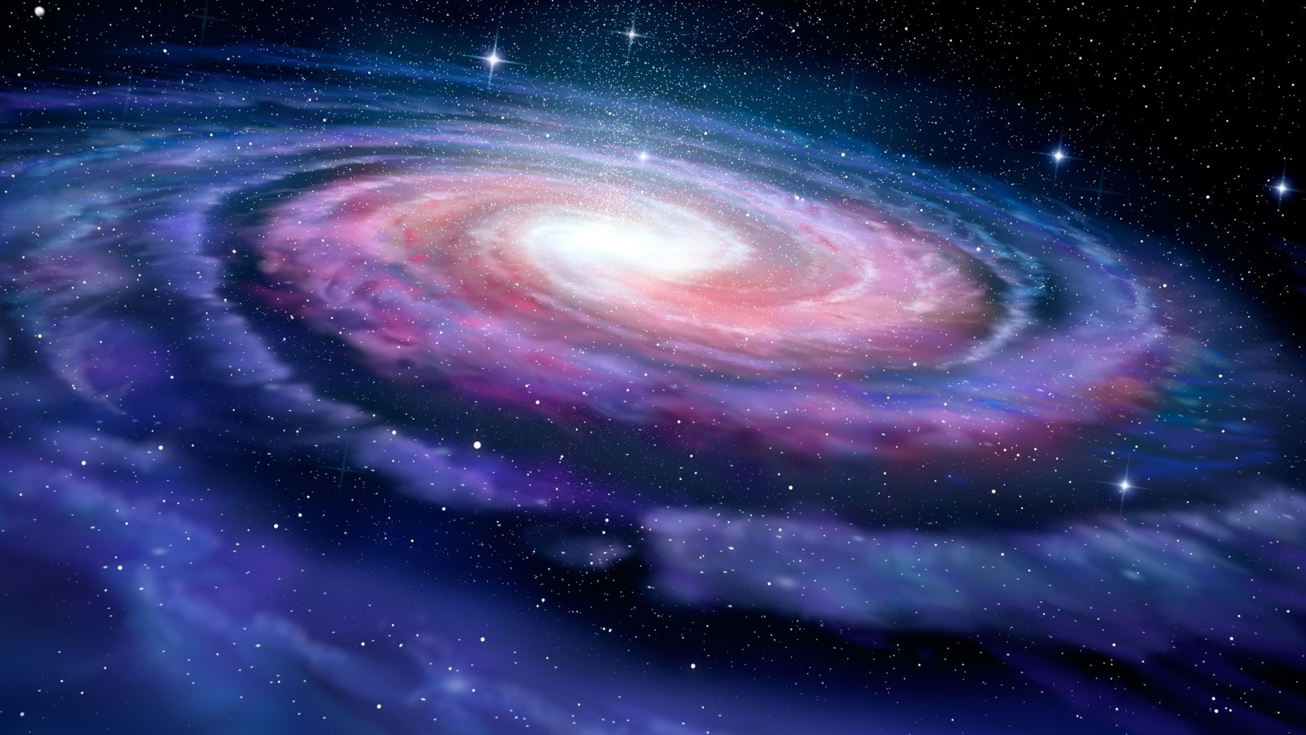

Knowing The God of All Creation
by Pastor Fee Soliven
Romans 1:18-25
Sunday Morning
January 15, 2023

Slide 92
Romans 1:18-25
18 For the wrath of God is revealed from heaven against all ungodliness and unrighteousness of men, who suppress the truth in unrighteousness, 19 because what may be known of God is manifest in them, for God has shown it to them.

Slide 93
20 For since the creation of the world His invisible attributes are clearly seen, being understood by the things that are made, even His eternal power and Godhead, so that they are without excuse,

Slide 94
21 because, although they knew God, they did not glorify Him as God, nor were thankful, but became futile in their thoughts, and their foolish hearts were darkened. 22 Professing to be wise, they became fools, 23 and changed the glory of the incorruptible God into an image made like corruptible man--and birds and four-footed animals and creeping things.

Slide 95
24 Therefore God also gave them up to uncleanness, in the lusts of their hearts, to dishonor their bodies among themselves, 25 who exchanged the truth of God for the lie, and worshiped and served the creature rather than the Creator, who is blessed forever. Amen.

Slide 96
We’ve all had the privilege of knowing someone who stands out above everyone else in our minds

Slide 97
Philippians 3:7-11
7 But what things were gain to me, these I have counted loss for Christ. 8 Yet indeed I also count all things loss for the excellence of the knowledge of Christ Jesus my Lord, for whom I have suffered the loss of all things, and count them as rubbish, that I may gain Christ

Slide 98
9 and be found in Him, not having my own righteousness, which is from the law, but that which is through faith in Christ, the righteousness which is from God by faith; 10 that I may know Him and the power of His resurrection, and the fellowship of His sufferings, being conformed to His death, 11 if, by any means, I may attain to the resurrection from the dead.

Slide 99
Philippians 3:8
Yet indeed I also count all things loss for the excellence of the knowledge of Christ Jesus my Lord, for whom I have suffered the loss of all things, and count them as rubbish, that I may gain Christ

Slide 100
Why do so many people not know God?

Slide 101
Unredeemed society lives in
spiritual darkness

Slide 102
Mark 16:15-18
15 And He said to them, "Go into all the world and preach the gospel to every creature. 16 He who believes and is baptized will be saved; but he who does not believe will be condemned. 17 And these signs will follow those who believe: In My name they will cast out demons; they will speak with new tongues;

Slide 103
18 they will take up serpents; and if they drink anything deadly, it will by no means hurt them; they will lay hands on the sick, and they will recover."

Slide 104
Many people have no interest in knowing God

Slide 105
Romans 3:10-18
10 As it is written: "There is none righteous, no, not one; 11 There is none who understands; There is none who seeks after God. 12 They have all turned aside; They have together become unprofitable; There is none who does good, no, not one."

Slide 106
13 "Their throat is an open tomb; With their tongues they have practiced deceit"; "The poison of asps is under their lips"; 14 "Whose mouth is full of cursing and bitterness." 15 "Their feet are swift to shed blood; 16 Destruction and misery are in their ways; 17 And the way of peace they have not known." 18 "There is no fear of God before their eyes."

Slide 107
Some people are unwilling to pay the price required to know God more deeply

Slide 108
Knowing God is Progressive

Slide 109
2 Peter 3:17-18
17 You therefore, beloved, since you know this beforehand, beware lest you also fall from your own steadfastness, being led away with the error of the wicked; 18 but grow in the grace and knowledge of our Lord and Savior Jesus Christ. To Him be the glory both now and forever. Amen.

Slide 110
God Desires that we know Him

Slide 111
Jeremiah 9:23-24
23 Thus says the LORD: "Let not the wise man glory in his wisdom, Let not the mighty man glory in his might, Nor let the rich man glory in his riches; 24 But let him who glories glory in this, That he understands and knows Me, That I am the LORD, exercising lovingkindness, judgment, and righteousness in the earth. For in these I delight," says the LORD.

Slide 112
Hosea 6:6
For I desire mercy and not sacrifice, And the knowledge of God more than burnt offerings

Slide 113
John 14:9
Jesus said to him, "Have I been with you so long, and yet you have not known Me, Philip? He who has seen Me has seen the Father; so how can you say, 'Show us the Father'?

Slide 114
What does it mean to know God?

Slide 115
Philippians 3:7-11
7 But what things were gain to me, these I have counted loss for Christ. 8 Yet indeed I also count all things loss for the excellence of the knowledge of Christ Jesus my Lord, for whom I have suffered the loss of all things, and count them as rubbish, that I may gain Christ

Slide 116
9 and be found in Him, not having my own righteousness, which is from the law, but that which is through faith in Christ, the righteousness which is from God by faith; 10 that I may know Him and the power of His resurrection, and the fellowship of His sufferings, being conformed to His death, 11 if, by any means, I may attain to the resurrection from the dead.

Slide 117
James 4:8
Draw near to God and He will draw near to you. Cleanse your hands, you sinners; and purify your hearts, you double-minded

Slide 118
Who is responsible for whether or not we’re known?

Slide 119
John 10:26-30
26 But you do not believe, because you are not of My sheep, as I said to you. 27 My sheep hear My voice, and I know them, and they follow Me. 28 And I give them eternal life, and they shall never perish; neither shall anyone snatch them out of My hand. 29 My Father, who has given them to Me, is greater than all; and no one is able to snatch them out of My Father's hand. 30 I and My Father are one."

Slide 120
To know God, we have to open up

Slide 121
Matthew 22:37
And he said to him, “You shall love the Lord your God with all your heart and with all your soul and with all your mind.

Slide 122
It’s in brokenness that we discover truths about God that we wouldn’t know in any other way

Slide 123
Psalm 51:17
The sacrifices of God are a broken spirit; a broken and contrite heart, O God, you will not despise

Slide 124
What’s involved in knowing God other than reading the Bible?

Slide 125
1. Receive Jesus Christ as Savior

Slide 126
2. Be interested in God’s interests

Slide 127
How can we know God?

Slide 128
Ephesians 2:1-2
“And you hath he quickened, who were dead in trespasses and sins; 2 Wherein in time past ye walked according to the course of this world, according to the prince of the power of the air, the spirit that now worketh in the children of disobedience:

Slide 129
We must read and listen to God’s Word and allow the Holy Spirit to interpret and apply it to our lives

Slide 130
Observe the character and ways of God

Slide 131
Be willing to accept His invitation and follow His commands

Slide 132
Acts 2:38-39
38 Then Peter said to them, "Repent, and let every one of you be baptized in the name of Jesus Christ for the remission of sins; and you shall receive the gift of the Holy Spirit. 39 For the promise is to you and to your children, and to all who are afar off, as many as the Lord our God will call."

Slide 133
Recognize God’s love for you and rejoice

Slide 134
1 Thessalonians 4:13-18
13 But I do not want you to be ignorant, brethren, concerning those who have fallen asleep, lest you sorrow as others who have no hope. 14 For if we believe that Jesus died and rose again, even so God will bring with Him those who sleep in Jesus.

Slide 135
15 For this we say to you by the word of the Lord, that we who are alive and remain until the coming of the Lord will by no means precede those who are asleep. 16 For the Lord Himself will descend from heaven with a shout, with the voice of an archangel, and with the trumpet of God. And the dead in Christ will rise first.

Slide 136
17 Then we who are alive and remain shall be caught up together with them in the clouds to meet the Lord in the air. And thus we shall always be with the Lord. 18 Therefore comfort one another with these words.

Slide 137
1 Corinthians 15:50-54
50 Now this I say, brethren, that flesh and blood cannot inherit the kingdom of God; nor does corruption inherit incorruption. 51 Behold, I tell you a mystery: We shall not all sleep, but we shall all be changed-- 52 in a moment, in the twinkling of an eye, at the last trumpet. For the trumpet will sound, and the dead will be raised incorruptible, and we shall be changed.

Slide 138
53 For this corruptible must put on incorruption, and this mortal must put on immortality. 54 So when this corruptible has put on incorruption, and this mortal has put on immortality, then shall be brought to pass the saying that is written: "Death is swallowed up in victory."

Slide 139

20 Again, when a righteous man turns from his righteousness and commits iniquity, and I lay a stumbling block before him, he shall die; because you did not give him warning, he shall die in his sin, and his righteousness which he has done shall not be remembered; but his blood I will require at your hand.

Slide 140
Acts 2:38-39
38 Then Peter said to them, "Repent, and let every one of you be baptized in the name of Jesus Christ for the remission of sins; and you shall receive the gift of the Holy Spirit. 39 For the promise is to you and to your children, and to all who are afar off, as many as the Lord our God will call."

