Slide 1


Slide 2
Child of Love
(We The Kingdom)

Slide 3
I was walking the wayside Lost on a lonely road I was chasing the high life Tryna satisfy my soul All the

Slide 4
lies I believed in Left me crying like the rain Then I saw lightning from Heaven And I've never been the

Slide 5
same I'm gonna climb a mountain I'm gonna shout about it I am a child of love I found a world of

Slide 6
freedom I found a friend in Jesus I am a child of love
I've felt the sting of the fire But I saw You in the

Slide 7
flames Just when I thought it was over You broke me out of the grave I'm gonna climb a mountain I'm

Slide 8
gonna shout about it I am a child of love I found a world of freedom I found a friend in Jesus I am a

Slide 9
child of love I am a child of love, yeah, oh I am a child of love Nothing can change the way You love

Slide 10
me Nothing can change the way I belong to You
Yes I do Nothing can separate Nothing can change

Slide 11
the way You love me Nothing can change the way
I belong to You Yes I do Nothing can separate I'm

Slide 12
gonna climb a mountain I am a child of love I found a world of freedom I am a child of love I'm gonna climb

Slide 13
a mountain I'm gonna shout about it I am a child of love I found a world of freedom I found a friend in

Slide 14
Jesus I am a child of love, oh yeah Yeah, I am a child of love I am a child of love

Slide 15
Been the same. I’m gonna climb the mountain. I’m gonna shout about it. I am a child of love. I found a

Slide 16
World of freedom. I found a friend in Jesus. I am a child of love. I’ve felt the sting of the fire. But I saw

Slide 17
You in the flames. Just when I thought it was over. You broke me out of the grave. I’m gonna climb A

Slide 18
Mountain. I’m gonna shout about it. I am a child of love. I found a world of freedom. I found a friend in

Slide 19
Jesus. I am a child of love. I’m gona climb a mountain, I’m gonna shout about it. I am a child of

Slide 20
Love. I found a world of freedom, I found a friend in Jesus. I am a child of love. Yeah Oh I am a child of

Slide 21
Love. Yeah oh I am a child of love. Nothing can change the way you love me. Nothing can change

Slide 22
The way. I belong to you. Yes’ I do, nothing can separate. Nothing can change the way you love me.

Slide 23
Nothing can change the way. I belong to you. Yes, I do. Nothing can separate. I’m gonna climb a

Slide 24
Mountain, I am a child of love. I found a world of Freedom. I am a child of Love. I’m gonna climb a

Slide 25
Mountain, I’m gonna shout about it. I am a child of love. I found a world of freedom. I found a friend in

Slide 26
Jesus. I am a child of Love. I’m gonna climb a mountain. I’m gonna shout about it. I am a child of

Slide 27
Love. I found a world of freedom. I found a friend in Jesus. I am a child of love. Oh Yeah, oh I am a child

Slide 28
Of love. Oh yeah, oh I am a child of love. Oh yeah ,I am a child of love.

Slide 29
Stand In Your Love
(Bethel)

Slide 30
When darkness tries to roll over my bones When sorrow comes to steal the joy I own When

Slide 31
brokenness and pain is all I know I won't be shaken, no, I won't be shaken 'Cause my fear doesn't stand a

Slide 32
chance When I stand in Your love My fear doesn't stand a chance When I stand in Your love My fear

Slide 33
doesn't stand a chance When I stand in Your love
Shame no longer has a place to hide And I am not a

Slide 34
captive to the lies I'm not afraid to leave my past behind Oh, I won't be shaken, no, I won't be shaken

Slide 35
My fear doesn't stand a chance When I stand in Your love My fear doesn't stand a chance When I stand in

Slide 36
Your love My fear doesn't stand a chance When I stand in Your love Oh, I'm standing There's power

Slide 37
that can break off every chain There's power that can empty out a grave There's resurrection power that

Slide 38
can save There's power in Your name, power in Your name My fear doesn't stand a chance When I stand

Slide 39
in Your love My fear doesn't stand a chance When I stand in Your love My fear doesn't stand a chance

Slide 40
When I stand in Your love Oh, when, when I'm standing in Your love Oh, my fear doesn't stand a

Slide 41
chance When I stand in Your love My fear doesn't stand a chance When I stand in Your love My fear

Slide 42
chance When I stand in Your love My fear doesn't stand a chance When I stand in Your love My fear

Slide 43
doesn't stand a chance When I stand in Your love
Oh, I standing in Your love Oh, standing on the rock

Slide 44
Oh, I am standing, standing in Your love

Slide 45
Make Room The Church Will Sing
(Elyssa Smith, Community Music)

Slide 46
Here is where I lay it down Every burden, every crown This is my surrender This is my surrender

Slide 47
Here is where I lay it down Every lie and every doubt
This is my surrender And I will make room for You

Slide 48
To do whatever You want to To do whatever You want to I will make room for You To do whatever You

Slide 49
want to To do whatever You want to Here is where I lay it down Every burden, every crown This is my

Slide 50
surrender This is my surrender Here is where I lay it down Every lie and every doubt This is my surrender

Slide 51
And I will make room for You To do whatever You want to To do whatever You want to And I will make

Slide 52
room for You To do whatever You want to To do whatever You want to And I will make room for You

Slide 53
To do whatever You want to To do whatever You want to And I will make room for You To do

Slide 54
whatever You want to To do whatever You want to (Jesus) Have Your way, have Your way Jesus Have

Slide 55
Your way with us Have Your way with us, ooh We surrender We surrender Jesus Have Your way Jesus

Slide 56
Shake up the ground of all my tradition Break down the walls of all my religion Your way is better Your

Slide 57
way is better Shake up the ground of all my tradition Break down the walls of all my religion Your way is

Slide 58
better Your way is better Shake up the ground of all my tradition Break down the walls of all my religion

Slide 59
Your way is better Your way is better Shake up the ground of all my tradition Break down the walls of all

Slide 60
my religion Your way is better Your way is better And I will make room for You To do whatever You want to

Slide 61
To do whatever You want to I will make room for You To do whatever You want to To do whatever You

Slide 62
want to Here is where I lay it down You are all I'm chasing now This is my surrender This is my

Slide 63
surrender Here is where I lay it down You are all I'm chasing now This is my surrender This is my

Slide 64
surrender.

Slide 65
“ Ever Be”
(Bethel)

Slide 66
I have watched how You drove back the sea That swallowed up my every fear I have walked from the

Slide 67
shore to the deep And through it all, You were there
Mighty Redeemer, strong to deliver You are the great

Slide 68
I am We crown You with every crown For the way You saved us Crown You with every crown For the

Slide 69
way You love us High King of Heaven We crown You the Lord of all I have watched how You led

Slide 70
through the wild A cloud by day and fire by night Guiding me to Your promised land Every step, by my

Slide 71
side Mighty Redeemer, strong to deliver You are the great I am We crown You with every crown For the

Slide 72
way You saved us Crown You with every crown For the way You love us High King of Heaven We crown

Slide 73
You the Lord of all We crown You with every crown For the way You saved us Crown You with every

Slide 74
crown For the way You love us High King of Heaven We crown You the Lord of all All hail Redeemer hail

Slide 75
For You have died for me And Your praise will never, never fail Through all eternity All hail Redeemer hail

Slide 76
For You have died for me And Your praise will never, never fail Through all eternity We crown You with

Slide 77
every crown For the way You saved us Crown You with every crown For the way You love us High King

Slide 78
of Heaven We crown You the Lord of all We crown You with every crown For the way You saved us

Slide 79
Crown You with every crown For the way You love us High King of Heaven We crown You the Lord of all

Slide 80
“Worthy of it all”
(CeCe Winans)

Slide 81
All the saints and angels. They bow before the throne. All the elders cast their crowns before the

Slide 82
Lamb of God and sing. All the saints and angels. They bow before your throne. All the elders cast their

Slide 83
Crowns before the lamb of God and sing. You are worthy of it all. You are worthy of it all. For from you

Slide 84
All. For from you are all things and to you are all things. You deserve the glory. Day and night, night

Slide 85
Night and day. Let incense arise. Day and night, night and day. Let incense arise. Day and night, night

Slide 86
And day let incense arise. Day and night night and day. You are worthy of it all. You are worthy of it all

Slide 87
For from you are al things. And to you are all things. You deserve the glory. You are worthy of it all. You

Slide 88
Are worthy of it all. For from you are all things and to you are all things. You deserve the glory. We exalt

Slide 89
Thee. We exalt thee. We exalt thee, Oh, Lord.
We exalt thee. We exalt thee, We exalt thee, Oh

Slide 91


Slide 92
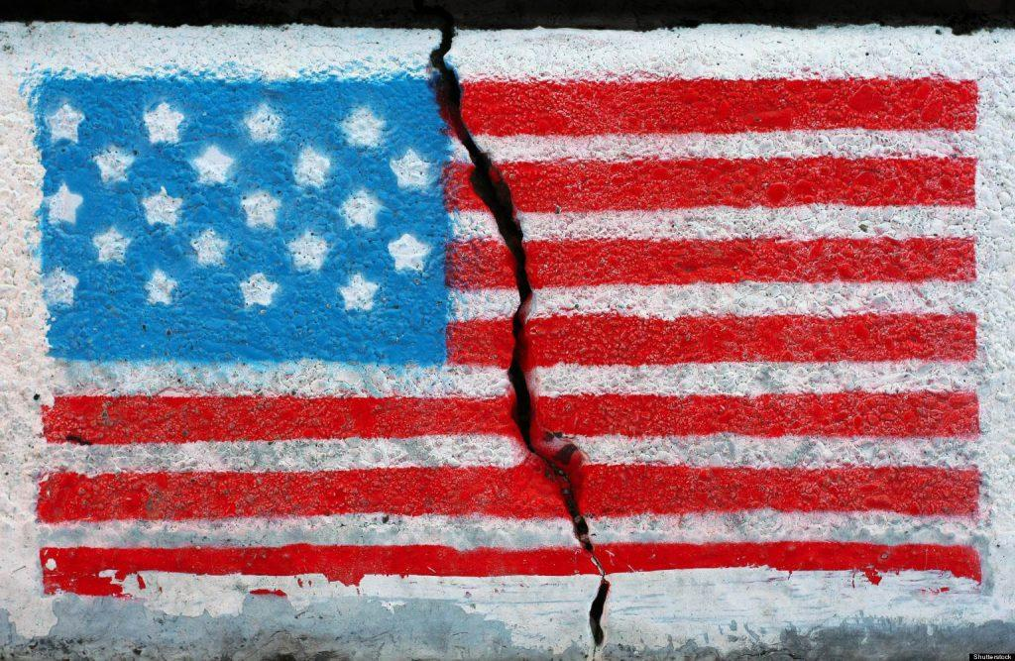

The State of Our Nation
by Pastor Fee Soliven
Psalms 9:1-19
Sunday Morning
January 22, 2023

Slide 93
Psalms 9:1-19
1 I will praise You, O LORD, with my whole heart; I will tell of all Your marvelous works. 2 I will be glad and rejoice in You; I will sing praise to Your name, O Most High. 3 When my enemies turn back, They shall fall and perish at Your presence.

Slide 94
4 For You have maintained my right and my cause; You sat on the throne judging in righteousness. 5 You have rebuked the nations, You have destroyed the wicked; You have blotted out their name forever and ever. 6 O enemy, destructions are finished forever! And you have destroyed cities; Even their memory has perished.

Slide 95
7 But the LORD shall endure forever; He has prepared His throne for judgment. 8 He shall judge the world in righteousness, And He shall administer judgment for the peoples in uprightness. 9 The LORD also will be a refuge for the oppressed, A refuge in times of trouble. 10 And those who know Your name will put their trust in You; For You, LORD, have not forsaken those who seek You.

Slide 96
11 Sing praises to the LORD, who dwells in Zion! Declare His deeds among the people. 12 When He avenges blood, He remembers them; He does not forget the cry of the humble. 13 Have mercy on me, O LORD! Consider my trouble from those who hate me, You who lift me up from the gates of death, 14 That I may tell of all Your praise In the gates of the daughter of Zion. I will rejoice in Your salvation.

Slide 97
15 The nations have sunk down in the pit which they made; In the net which they hid, their own foot is caught. 16 The LORD is known by the judgment He executes; The wicked is snared in the work of his own hands. Meditation. Selah

Slide 98
17 The wicked shall be turned into hell, And all the nations that forget God. 18 For the needy shall not always be forgotten; The expectation of the poor shall not perish forever. 19 Arise, O LORD, Do not let man prevail; Let the nations be judged in Your sight. 20 Put them in fear, O LORD, That the nations may know themselves to be but men.

Slide 99
The greatest privilege in life is to know God, The Lord Jesus Christ

Slide 100
Jeremiah 9:23-24
23 Thus says the LORD: "Let not the wise man glory in his wisdom, Let not the mighty man glory in his might, Nor let the rich man glory in his riches; 24 But let him who glories glory in this, That he understands and knows Me, That I am the LORD, exercising lovingkindness, judgment, and righteousness in the earth. For in these I delight," says the LORD.

Slide 101
Romans 1:20-21
20 For since the creation of the world His invisible attributes are clearly seen, being understood by the things that are made, even His eternal power and Godhead, so that they are without excuse, 21 because, although they knew God, they did not glorify Him as God, nor were thankful, but became futile in their thoughts, and their foolish hearts were darkened.

Slide 102
Our Heavenly Father has given us knowledge of Himself

Slide 103
1. Natural Revelation

Slide 104
Hebrews 11:3
By faith we understand that the worlds were framed by the word of God, so that the things which are seen were not made of things which are visible.

Slide 105
Psalm 19:1
“The heavens declare the glory of God; And the firmament shows His handiwork”

Slide 106
Acts 14:15
and saying, "Men, why are you doing these things? We also are men with the same nature as you, and preach to you that you should turn from these useless things to the living God, who made the heaven, the earth, the sea, and all things that are in them…”

Slide 107
2. Our Conscience

Slide 108
Romans 1:19
“because what may be known of God is manifest in them, for God has shown it to them”

Slide 109
Romans 2:14-15
14 for when Gentiles, who do not have the law, by nature do the things in the law, these, although not having the law, are a law to themselves, 15 who show the work of the law written in their hearts, their conscience also bearing witness, and between themselves their thoughts accusing or else excusing them…

Slide 110
3. The Lord Jesus Christ

Slide 111
John 14:7-10
7 "If you had known Me, you would have known My Father also; and from now on you know Him and have seen Him." 8 Philip said to Him, "Lord, show us the Father, and it is sufficient for us." 9 Jesus said to him, "Have I been with you so long, and yet you have not known Me, Philip? He who has seen Me has seen the Father; so how can you say, 'Show us the Father'?

Slide 112
10 Do you not believe that I am in the Father, and the Father in Me? The words that I speak to you I do not speak on My own authority; but the Father who dwells in Me does the works.

Slide 113
Hebrews 8:12-13
12 For I will be merciful to their unrighteousness, and their sins and their lawless deeds I will remember no more." 13 In that He says, "A new covenant," He has made the first obsolete. Now what is becoming obsolete and growing old is ready to vanish away.

Slide 114
Isaiah 43:25
"I, even I, am He who blots out your transgressions for My own sake; And I will not remember your sins.

Slide 115
Psalm 103:8-14
8 The LORD is merciful and gracious, Slow to anger, and abounding in mercy. 9 He will not always strive with us, Nor will He keep His anger forever. 10 He has not dealt with us according to our sins, Nor punished us according to our iniquities. 11 For as the heavens are high above the earth, So great is His mercy toward those who fear Him;

Slide 116
12 As far as the east is from the west, So far has He removed our transgressions from us. 13 As a father pities his children, So the LORD pities those who fear Him. 14 For He knows our frame; He remembers that we are dust.

Slide 117
4. The Word of God Our Bible

Slide 118
Hebrews 4:12
“For the word of God is living and powerful, and sharper than any two-edged sword, piercing even to the division of soul and spirit, and of joints and marrow, and is a discerner of the thoughts and intents of the heart”

Slide 119
2 Timothy 3:16-17
16 All Scripture is given by inspiration of God, and is profitable for doctrine, for reproof, for correction, for instruction in righteousness, 17 that the man of God may be complete, thoroughly equipped for every good work.

Slide 120
Matthew 4:1-4
1 Then Jesus was led up by the Spirit into the wilderness to be tempted by the devil. 2 And when He had fasted forty days and forty nights, afterward He was hungry. 3 Now when the tempter came to Him, he said, "If You are the Son of God, command that these stones become bread." 4 But He answered and said, "It is written, 'Man shall not live by bread alone, but by every word that proceeds from the mouth of God.'

Slide 121
John 17:17
Sanctify them by Your truth. Your word is truth…

Slide 122
Man has turned away from the Knowledge of God

Slide 123
Romans 1:20
“For since the creation of the world His invisible attributes are clearly seen, being understood by the things that are made, even His eternal power and Godhead, so that they are without excuse”

Slide 124
1. Intelligence

Slide 125
2 Corinthians 4:3-4
3 But even if our gospel is veiled, it is veiled to those who are perishing, 4 whose minds the god of this age has blinded, who do not believe, lest the light of the gospel of the glory of Christ, who is the image of God, should shine on them.

Slide 126
2. Ignorance

Slide 127
Romans 1:21-22
21 because, although they knew God, they did not glorify Him as God, nor were thankful, but became futile in their thoughts, and their foolish hearts were darkened. 22 Professing to be wise, they became fools…

Slide 128
John 3:19
“And this is the condemnation, that the light has come into the world, and men loved darkness rather than light, because their deeds were evil”

Slide 129
3. Indulgence

Slide 130
Romans 1:23-24
23 and changed the glory of the incorruptible God into an image made like corruptible man--and birds and four-footed animals and creeping things. 24 Therefore God also gave them up to uncleanness, in the lusts of their hearts, to dishonor their bodies among themselves…

Slide 131
4. An Impenitent Heart

Slide 132
Romans 1:26-32
26 For this reason God gave them up to vile passions. For even their women exchanged the natural use for what is against nature. 27 Likewise also the men, leaving the natural use of the woman, burned in their lust for one another, men with men committing what is shameful, and receiving in themselves the penalty of their error which was due.

Slide 133
28 And even as they did not like to retain God in their knowledge, God gave them over to a debased mind, to do those things which are not fitting; 29 being filled with all unrighteousness, sexual immorality, wickedness, covetousness, maliciousness; full of envy, murder, strife, deceit, evil-mindedness; they are whisperers,

Slide 134
30 backbiters, haters of God, violent, proud, boasters, inventors of evil things, disobedient to parents, 31 undiscerning, untrustworthy, unloving, unforgiving, unmerciful…

Slide 135
Romans 1:32
“who, knowing the righteous judgment of God, that those who practice such things are worthy of death, not only do the same but also approve of those who practice them”

Slide 136
1. We can easily put other priorities and goals above our devotion to God. Ask the Lord, “Father, is there anything in my life that I am allowing to take Your place of honor in my life?

Slide 137
2. Is there anything I am devoting myself, my time, and my resources to, more than to You?”

Slide 138
3. How can we intercede for individuals or groups who are living in spiritual darkness?

Slide 139
4. Ask God to break through their ignorance and reveal His love and goodness to them.

Slide 140
1 Thessalonians 4:13-18
13 But I do not want you to be ignorant, brethren, concerning those who have fallen asleep, lest you sorrow as others who have no hope. 14 For if we believe that Jesus died and rose again, even so God will bring with Him those who sleep in Jesus.

Slide 141
15 For this we say to you by the word of the Lord, that we who are alive and remain until the coming of the Lord will by no means precede those who are asleep. 16 For the Lord Himself will descend from heaven with a shout, with the voice of an archangel, and with the trumpet of God. And the dead in Christ will rise first.

Slide 142
17 Then we who are alive and remain shall be caught up together with them in the clouds to meet the Lord in the air. And thus we shall always be with the Lord. 18 Therefore comfort one another with these words.

Slide 143
1 Corinthians 15:50-54
50 Now this I say, brethren, that flesh and blood cannot inherit the kingdom of God; nor does corruption inherit incorruption. 51 Behold, I tell you a mystery: We shall not all sleep, but we shall all be changed-- 52 in a moment, in the twinkling of an eye, at the last trumpet. For the trumpet will sound, and the dead will be raised incorruptible, and we shall be changed.

Slide 144
53 For this corruptible must put on incorruption, and this mortal must put on immortality. 54 So when this corruptible has put on incorruption, and this mortal has put on immortality, then shall be brought to pass the saying that is written: "Death is swallowed up in victory."

Slide 145

20 Again, when a righteous man turns from his righteousness and commits iniquity, and I lay a stumbling block before him, he shall die; because you did not give him warning, he shall die in his sin, and his righteousness which he has done shall not be remembered; but his blood I will require at your hand.

Slide 146
Acts 2:38-39
38 Then Peter said to them, "Repent, and let every one of you be baptized in the name of Jesus Christ for the remission of sins; and you shall receive the gift of the Holy Spirit. 39 For the promise is to you and to your children, and to all who are afar off, as many as the Lord our God will call."

