Slide 1


Slide 2
Who You Say I Am
(Hillsong)

Slide 3
Who am I that the highest King would welcome me?
I was lost, but He brought me in Oh His love for me

Slide 4
Oh His love for me Who the Son sets free Oh, is free indeed I'm a child of God, yes, I am Free at last, He

Slide 5
has ransomed me His grace runs deep While I was a slave to sin, Jesus died for me Yes, He died for me

Slide 6
Who the Son sets free Oh is free indeed I'm a child of God, yes, I am In my Father's house There's a

Slide 7
place for me I'm a child of God, yes, I am I am chosen, not forsaken I am who You say I am You are

Slide 8
for me, not against me I am who You say I am I am chosen, not forsaken I am who You say I am You are

Slide 9
for me, not against me I am who You say I am I am who You say I am Who the Son sets free Oh is free

Slide 10
indeed I'm a child of God, yes, I am In my Father's house There's a place for me I'm a child of God, yes,

Slide 11
I am In my Father's house There's a place for me I'm a child of God, yes, I am I am chosen, not forsaken I

Slide 12
am who You say I am You are for me, not against me
I am who You say I am I am chosen, not forsaken I

Slide 13
am who You say I am You are for me, not against me
I am who You say I am I am chosen, not forsaken I

Slide 14
am who You say I am You are for me, not against me I am who You say I am Oh I am who

Slide 15
You say I am Yes, I am who you say I am Who the Son sets free Oh is free indeed I'm a child of God,

Slide 16
yes, I am In my Father's house There's a place for me I'm a child of God, yes, I am

Slide 17
I Believe It
(Jon Reddick)

Slide 18
It's not just a story It's a living breathing walking testimony Of a God so good He'd leave His home in

Slide 19
glory For the world He loved For the world that he so loved It's not just a story I believe in the life of Jesus

Slide 20
I believe that He conquered death I believe in the resurrection I believe that He's coming back again I

Slide 21
believe that His spirits with us I believe that He gives us power I believe that He is the son of God I believe

Slide 22
it I believe it I believe it I believe it I believe in the life of Jesus I believe in I believe in I can't deny it If I said

Slide 23
I got here on my own I'd be lyin 'Cause my eyes have seen the goodness Of the father We're the ones he

Slide 24
loves We're the ones that he so loved I can't deny it I believe in the life of Jesus I believe that He

Slide 25
conquered death I believe in the resurrection I believe that He's coming back again I believe that

Slide 26
His spirits with us I believe that He gives us power I believe that He is the son of God I believe it I believe

Slide 27
it I believe it I believe it I believe in the life of Jesus I believe it I believe it I believe it We cry Holy, holy Let

Slide 28
the earth rejoice He is worthy of all praise We cry Holy, holy Let the earth rejoice He is worthy of all

Slide 29
praise I believe in the life of Jesus I believe that he conquered death I believe in the resurrection

Slide 30
I believe I believe sing I believe that His spirits with us I believe that He gives us power I

Slide 31
believe that He is the son of God I believe it I believe it I believe I believe I believe in the life of

Slide 32
Jesus I believe I believe

Slide 33
“ Canvas and the Clay”
(Pat Barret)

Slide 34
In my mother’s womb. You formed me with your hands. Known and loved by you. Before I took a

Slide 35
Breath. When I doubt it, Lord, remind me. I’m wonderfully made. You’re an artist and a potter.

Slide 36
I’m the canvas and the clay. You make all things work together. For my future and for my good. You make

Slide 37
All things work together for your glory and for your name. There’s a healing light. Just beyond the clouds

Slide 38
Though I’ve walked through fire. I see it clearly now.I know nothing has been wasted. No failure or mistake

Slide 39
You’re an artist and a potter I’m the canvas and the clay. You make all things work together. For my

Slide 40
Future and for my good. You make all things work together for your glory and for your name.

Slide 41
For my good. For my good. And when I doubt it, Lord, remind me. I’m wonderfully made . You’re an

Slide 42
Artist and a potter I’m the canvas and the clay. And I know nothing has been wasted. No failure or

Slide 43
Mistake. You’re an artist and a potter. I’m the canvas and the clay. You make all things. Work together for

Slide 44
My future and for my good. You make all things. Work together for your glory. And for your name.

Slide 45
When I doubt it, Lord, remind me I’m wonderfully made. You’re and artist and a potter. I’m the canvas

Slide 46
And the clay. I know nothing has been wasted. No failure or mistake. You’re an artist and a potter. I’m

Slide 47
The canvas and clay. You’re an artist and a potter. I’m the canvas and the clay. You’re an artist and a

Slide 48
Potter I’m the canvas and the clay.

Slide 49
“Build My Life”
(Pat Barret / Housefires)

Slide 50
Worthy of every song we could ever sing Worthy of all the praise we could ever bring Worthy of every

Slide 51
breath we could ever breathe We live for you Oh, we live for you Jesus, the Name above every other

Slide 52
name Jesus, the only One who could ever save (worthy...) Worthy of every breath we could ever

Slide 53
breathe We live for you Holy, there is no one like You There is none beside You Open up my eyes in

Slide 54
Jesus, the Name above every other name Jesus, the only One who could ever save Worthy of every

Slide 55
breathe we could ever breathe We live for You, Oh! We live for for You Holy, there is no one like You

Slide 56
There is none beside You Open up my eyes I wonder Show me who You are and fill me With Your

Slide 57
heart and lead me In your love to those around me I will build my life upon Your love It is a firm foundation

Slide 58
I will put my trust in You alone And I will not be shaken I will build my life upon Your love It is a firm

Slide 59
foundation I will put my trust in You alone And I will not be shaken Holy, there is no one like You There is

Slide 60
none beside You Open up my eyes in wonder Show me who You are and fill me With Your heart and lead

Slide 61
me In your love to those around me I will build my life upon Your love It is a firm foundation I will put my

Slide 62
trust in You alone And I will not be shaken I will build my life upon Your love It is a firm foundation I will put

Slide 63
my trust in You alone And I will not be shaken Lord

Slide 64
The Blessing
(Kari Jobe)

Slide 65
The Lord bless you and keep you. Make his face shine upon you. And be gracious to you. The Lord

Slide 66
turn his face towards and give you peace. Amen, Amen, Amen, Amen, Amen, Amen. The Lord bless

Slide 67
You and keep you. Make his face shine upon you. And be gracious to you. The Lord turn his. Face

Slide 68
towards you. And give you peace. Amen, Amen, Amen, Amen, Amen, Amen. May his favor be

Slide 69
upon you and a thousand generations. And your family and your children, and their children, and their

Slide 70
children. May his favor be upon you. And a thousand generations. And your family and your

Slide 71
children. And their children, and their children. May his presence. Go before you. And behind you

Slide 72
and beside you. All around you, and within you. He is with you. He is with you. In the morning, In the

Slide 73
evening. In your coming, and your going. In your weeping, and rejoicing. He is for you, He is for you.

Slide 74
He is for you, He is for you, He is for you, He is for you, He is for you, he is for you. Amen, Amen, Amen

Slide 75
Amen, Amen, Amen. May his presence go before you. And behind you, and beside you. All around

Slide 76
you, and with you, he is with you, he is with you. In the morning, In the evening, In your coming, and

Slide 77
your going. In your weeping, and rejoicing. He is for you.

Slide 79


Slide 80
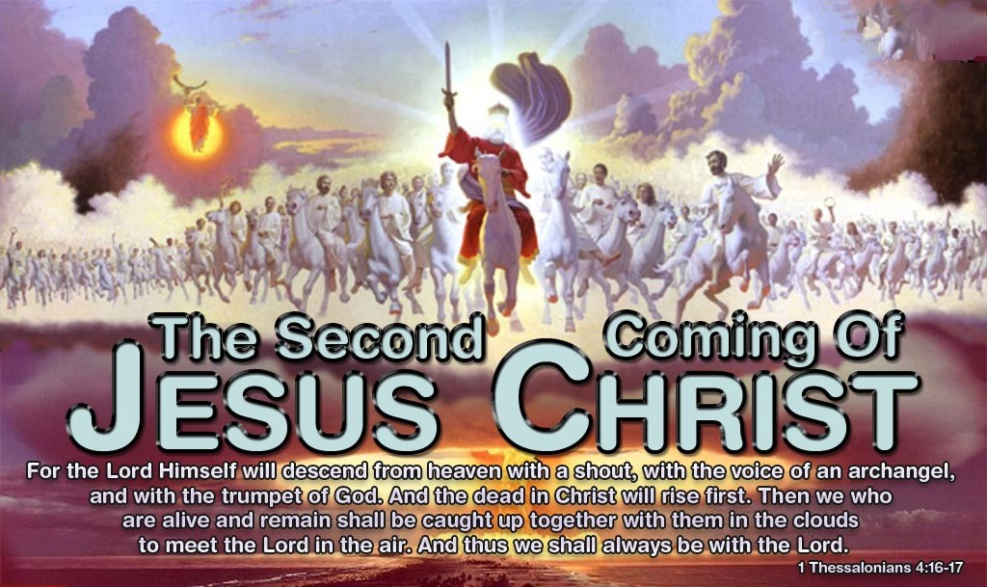

I Hear the Footsteps of the Messiah
By Pastor Fee Soliven
Psalm 102:12-17
Sunday Morning
April 16, 2023

Slide 81
Asusa Street Revival
April 9, 1906
World War 1
July 28, 1914
Balfour Declaration
December 2, 1917

Slide 82
Jesus Revolution
1960-1970
The Vietnam War
1964
Jerusalem Recaptured
1960
During the 3 Day War

Slide 83
Ashbury Revival
2023
World War 3?
Israel the Ezekiel War?

Slide 84
Psalm 102:12-17
12 But You, O LORD, shall endure forever, And the remembrance of Your name to all generations. 13 You will arise and have mercy on Zion; For the time to favor her, Yes, the set time, has come. 14 For Your servants take pleasure in her stones, And show favor to her dust.

Slide 85
15 So the nations shall fear the name of the LORD, And all the kings of the earth Your glory. 16 For the LORD shall build up Zion; He shall appear in His glory. 17 He shall regard the prayer of the destitute, And shall not despise their prayer.

Slide 86
1. Israel Would Face Near Extinction Before Christ Returns

Slide 87
Ezekiel 37:1-6
1 The hand of the LORD came upon me and brought me out in the Spirit of the LORD, and set me down in the midst of the valley; and it was full of bones. 2 Then He caused me to pass by them all around, and behold, there were very many in the open valley; and indeed they were very dry.

Slide 88
3 And He said to me, "Son of man, can these bones live?" So I answered, "O Lord GOD, You know." 4 Again He said to me, "Prophesy to these bones, and say to them, 'O dry bones, hear the word of the LORD! 5 Thus says the Lord GOD to these bones: "Surely I will cause breath to enter into you, and you shall live.

Slide 89
6 I will put sinews on you and bring flesh upon you, cover you with skin and put breath in you; and you shall live. Then you shall know that I am the LORD." ' "

Slide 90
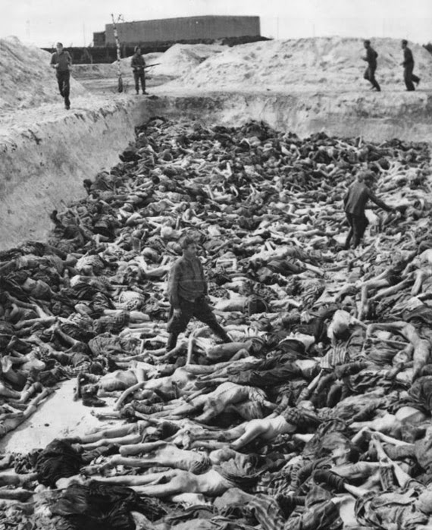
Redeemed From
The Curse Of The Law

Slide 91
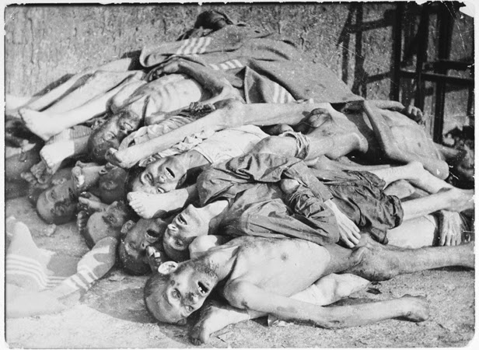
Galatians 3:24-25
24 Therefore the law was our tutor to bring us to Christ, that we might be justified by faith. 25 But after faith has come, we are no longer under a tutor.

Slide 92
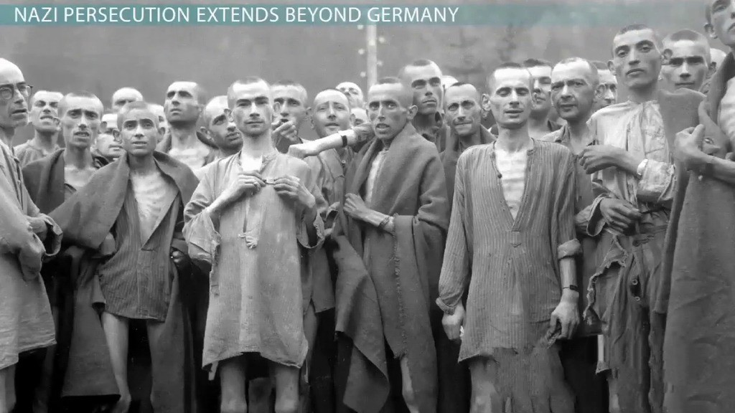
2 Corinthians 5:19-21
19 that is, that God was in Christ reconciling the world to Himself, not imputing their trespasses to them, and has committed to us the word of reconciliation. 20 Now then, we are ambassadors for Christ, as though God were pleading through us: we implore you on Christ's behalf, be reconciled to God. 21 For He made Him who knew no sin to be sin for us, that we might become the righteousness of God in Him.

Slide 93
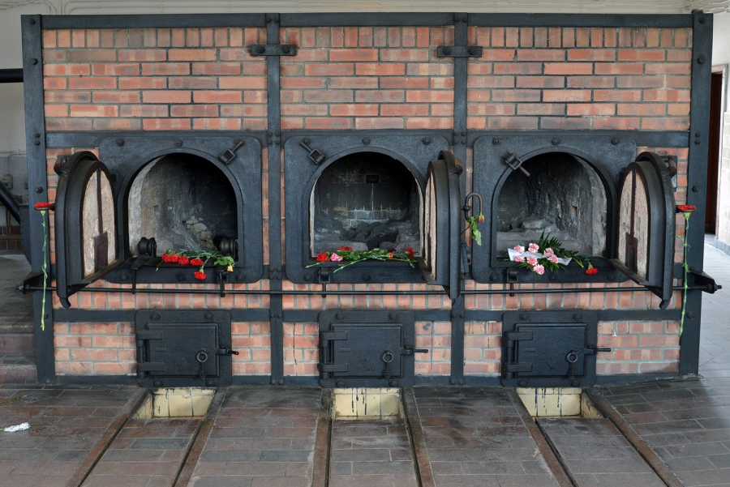
I John 3:16
“Hereby perceive we the love of God, because he laid down his life for us”

Slide 94
2. Israel Would Be Reborn
In One Day

Slide 95
Isaiah 66:8-11
8 Who has heard such a thing? Who has seen such things? Shall the earth be made to give birth in one day? Or shall a nation be born at once? For as soon as Zion was in labor, She gave birth to her children.

Slide 96
9 Shall I bring to the time of birth, and not cause delivery?" says the LORD. "Shall I who cause delivery shut up the womb?" says your God. 10 "Rejoice with Jerusalem, And be glad with her, all you who love her; Rejoice for joy with her, all you who mourn for her;

Slide 97
11 That you may feed and be satisfied With the consolation of her bosom, That you may drink deeply and be delighted With the abundance of her glory."

Slide 98
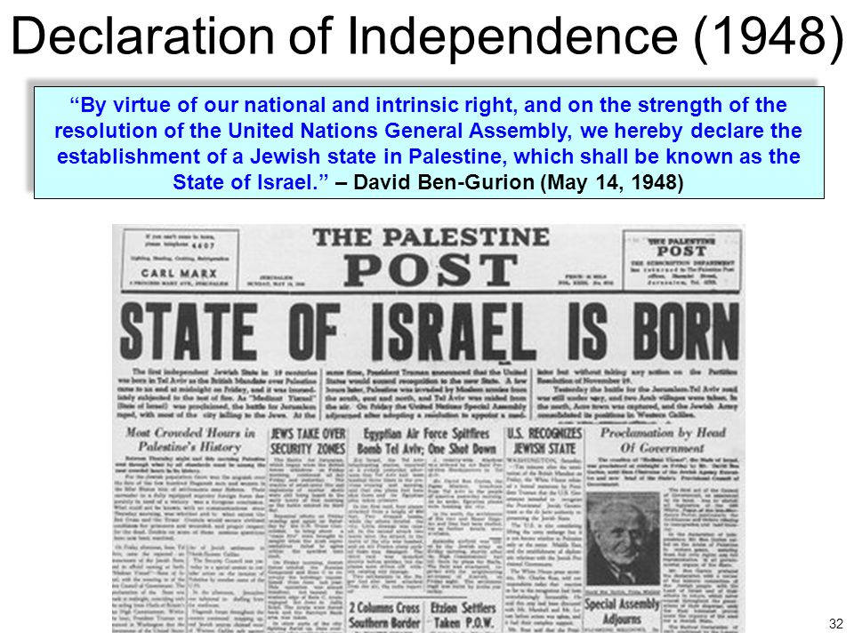
Joseph Alleine wrote,
“Oh, better were it for you to die in a jail, in a ditch, in a dungeon, than to die in your sins.”

Slide 99
3. Israel Will Be One Nation Not Two

Slide 100
Ezekiel 37:22
“and I will make them one nation in the land, on the mountains of Israel; and one king shall be king over them all; they shall no longer be two nations, nor shall they ever be divided into two kingdoms again.”

Slide 101
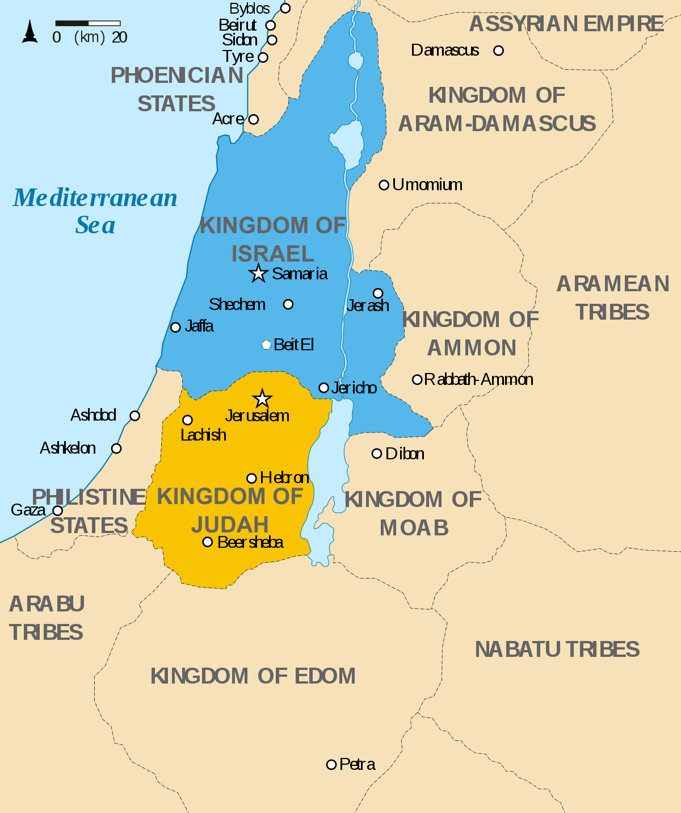
44 You are of your father the devil, and the desires of your father you want to do. He was a murderer from the beginning, and does not stand in the truth, because there is no truth in him. When he speaks a lie, he speaks from his own resources, for he is a liar and the father of it.

Slide 102
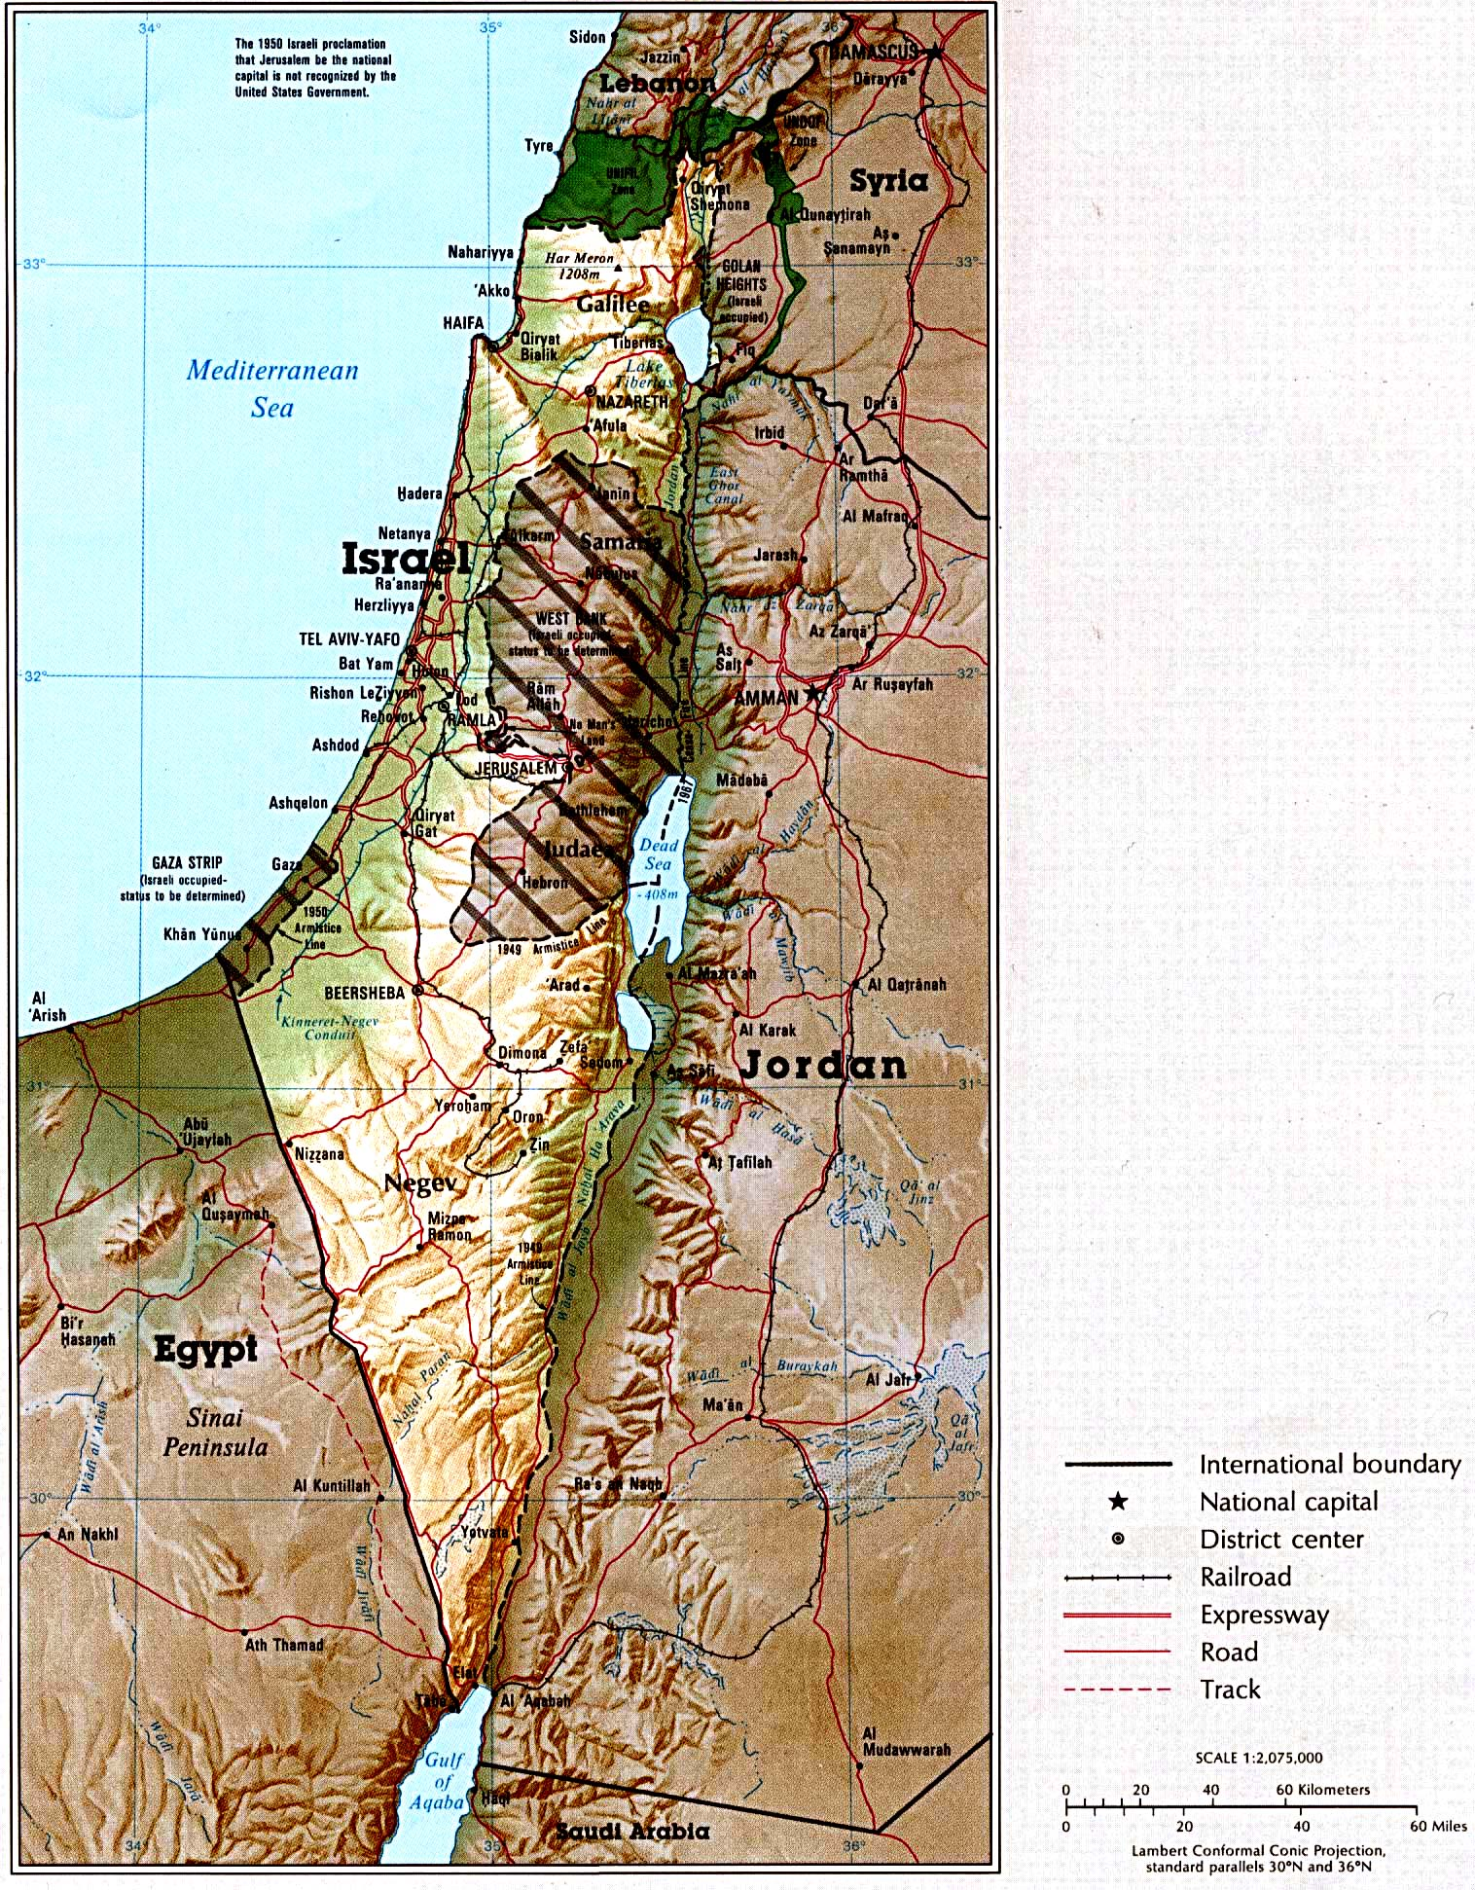
Romans 7:25
“So then with the mind I myself serve the law of God; but with the flesh the law of sin”

Slide 103
4. Israel’s Return Would Be Greater Than The Exodus

Slide 104
Jeremiah 16:14-15
14 "Therefore behold, the days are coming," says the LORD, "that it shall no more be said, 'The LORD lives who brought up the children of Israel from the land of Egypt,' 15 "but, 'The LORD lives who brought up the children of Israel from the land of the north and from all the lands where He had driven them.' For I will bring them back into their land which I gave to their fathers.

Slide 105
Jeremiah 32:37-41
37 Behold, I will gather them out of all countries where I have driven them in My anger, in My fury, and in great wrath; I will bring them back to this place, and I will cause them to dwell safely. 38 They shall be My people, and I will be their God;

Slide 106
39 then I will give them one heart and one way, that they may fear Me forever, for the good of them and their children after them. 40 And I will make an everlasting covenant with them, that I will not turn away from doing them good; but I will put My fear in their hearts so that they will not depart from Me.

Slide 107
41 Yes, I will rejoice over them to do them good, and I will assuredly plant them in this land, with all My heart and with all My soul.'

Slide 108
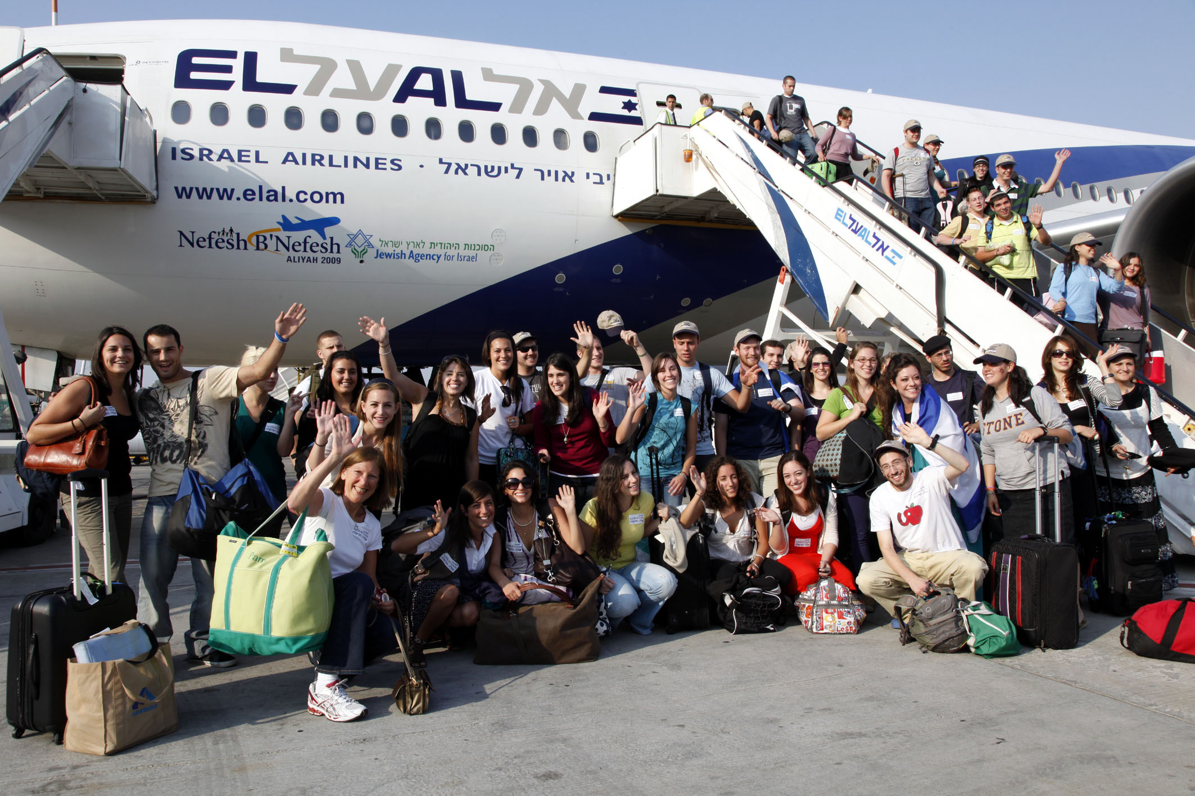
Hebrews 2:17
“Wherefore in all things it behoved him to be made like unto his brethren, that he might be a merciful and faithful high priest in things pertaining to God, to make reconciliation for the sins of the people”

Slide 109
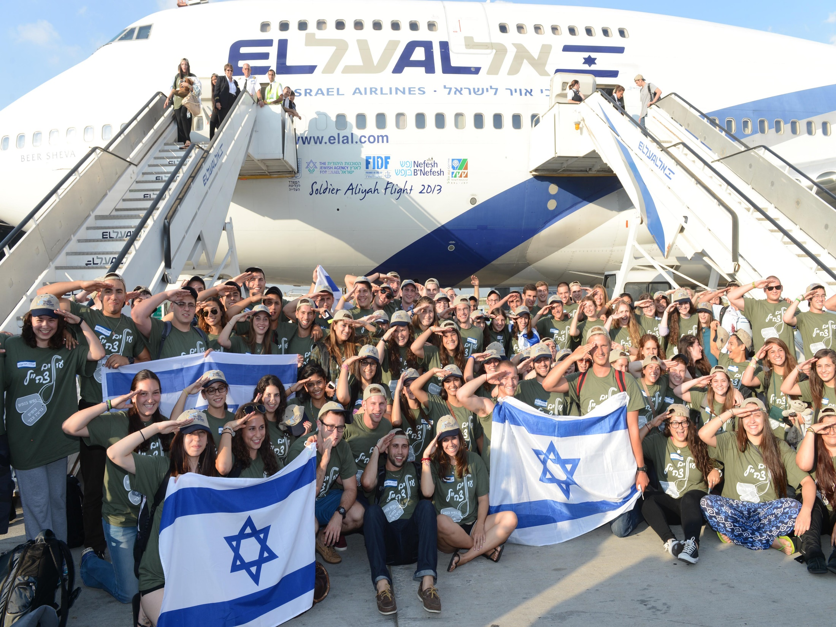
2. Jesus was the only one able to Redeem Us

Slide 110
5. Israel Will Rebuild
Old Cities and Prosper

Slide 111
Amos 9:13-15
13 "Behold, the days are coming," says the LORD, "When the plowman shall overtake the reaper, And the treader of grapes him who sows seed; The mountains shall drip with sweet wine, And all the hills shall flow with it.

Slide 112
14 I will bring back the captives of My people Israel; They shall build the waste cities and inhabit them; They shall plant vineyards and drink wine from them; They shall also make gardens and eat fruit from them. 15 I will plant them in their land, And no longer shall they be pulled up From the land I have given them," Says the LORD your God.

Slide 113
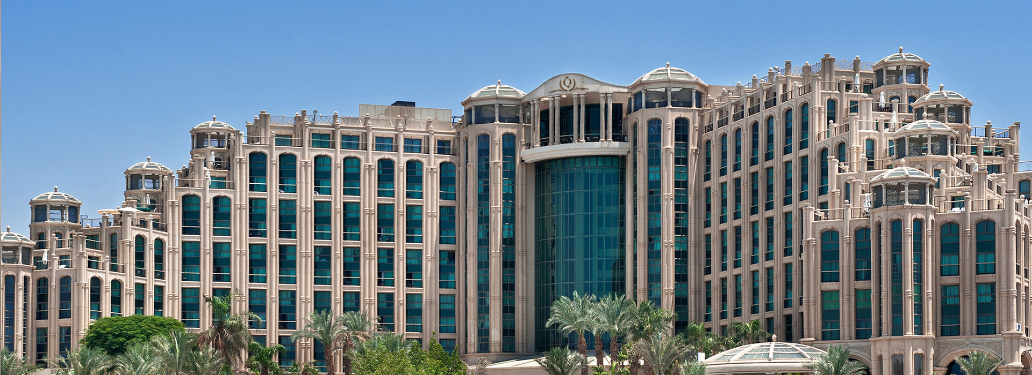
3. Jesus was willing to Redeem Us

Slide 114
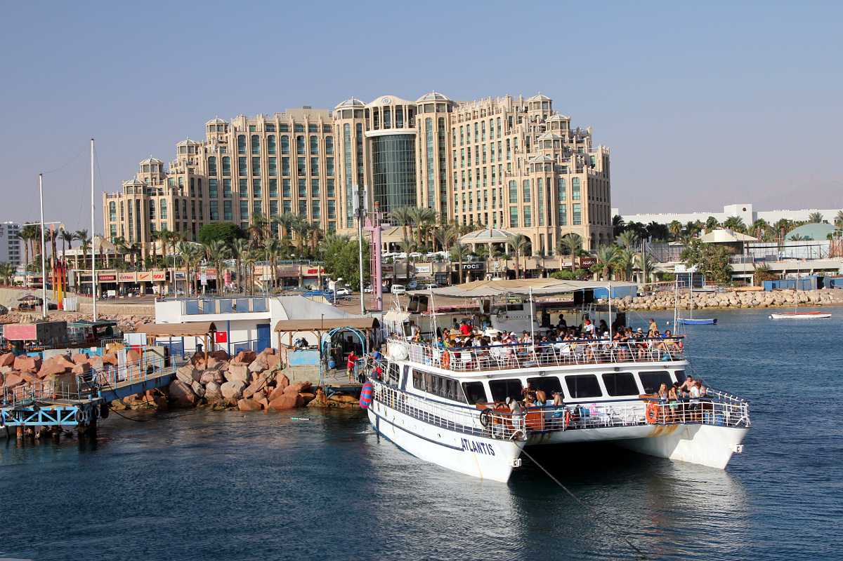
Hebrews 10:7
“Then said I, Lo, I come in the volume of the book it is written of me, to do your will, O God. . . .

Slide 115
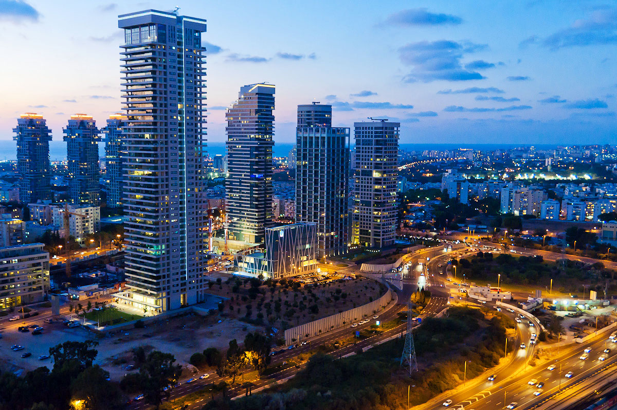
Hebrews 10:10
“By the which will we are sanctified through the offering of the body of Jesus Christ once for all”

Slide 116
6. Israel Would Return And Rebuild A Great Army

Slide 117
Ezekiel 37:10
“So I prophesied as He commanded me, and breath came into them, and they lived, and stood upon their feet, an exceedingly great army.”

Slide 118
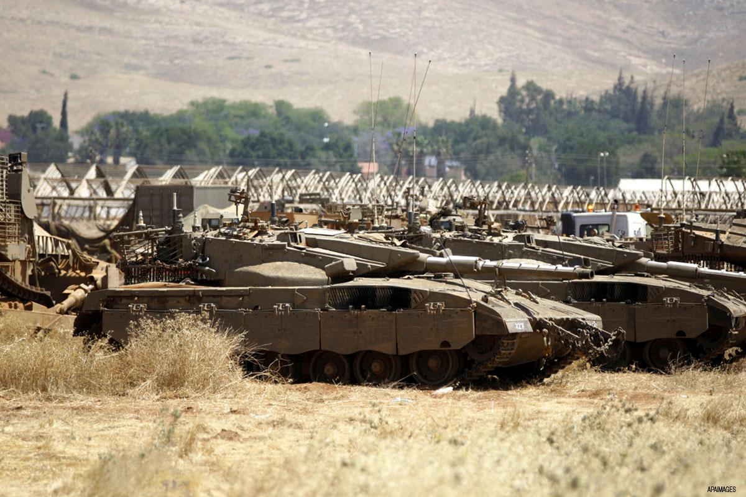
“Cares all past, home at last, ever to rejoice!” All because He redeemed us by His blood!

Slide 119
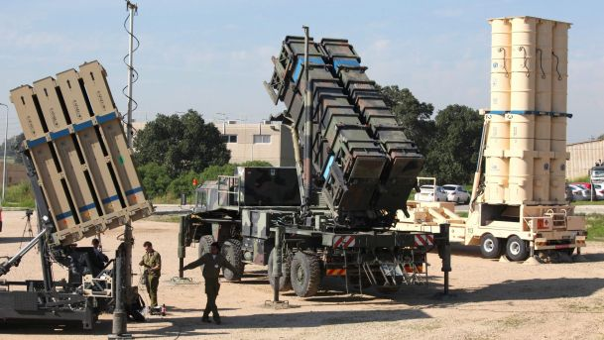
6. Israel Would Return And Rebuild A Great Army

Slide 120
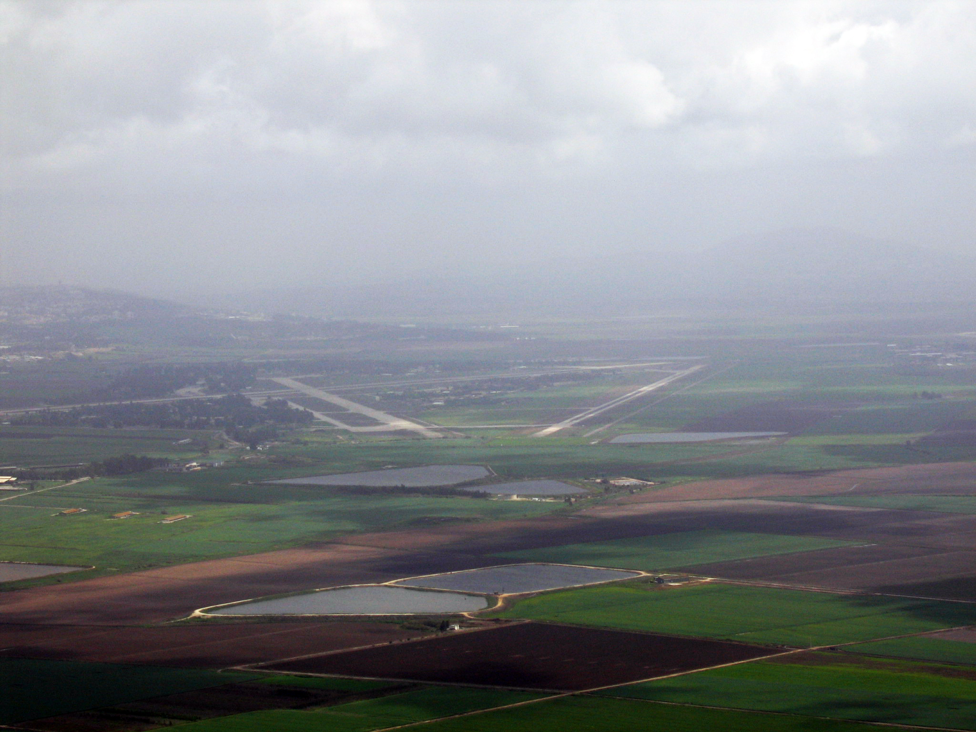
Ezekiel 37:10
“So I prophesied as He commanded me, and breath came into them, and they lived, and stood upon their feet, an exceedingly great army.”

Slide 121
7. Israel Will Fill The Earth With Fruit Grown In Israel

Slide 122
Isaiah 27:6
“Those who come He shall cause to take root in Jacob; Israel shall blossom and bud, And fill the face of the world with fruit.”

Slide 123
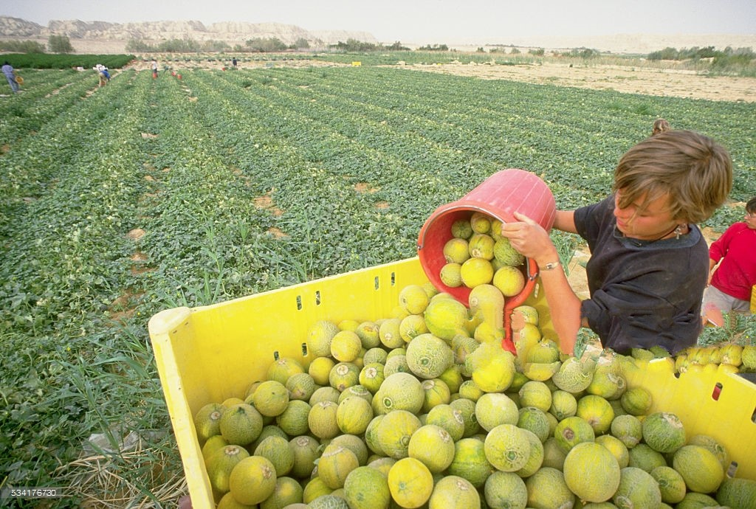
Ezekiel 37:10
“So I prophesied as He commanded me, and breath came into them, and they lived, and stood upon their feet, an exceedingly great army.”

Slide 124
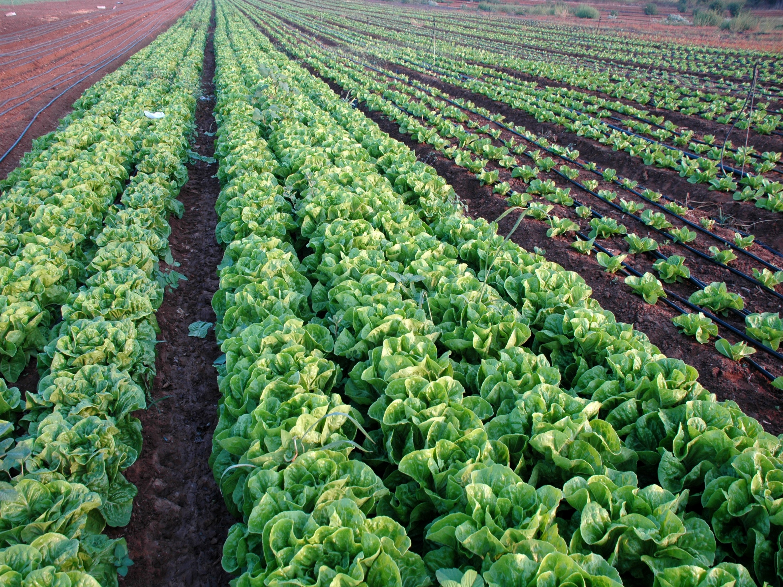
“Cares all past, home at last, ever to rejoice!” All because He redeemed us by His blood!

Slide 125
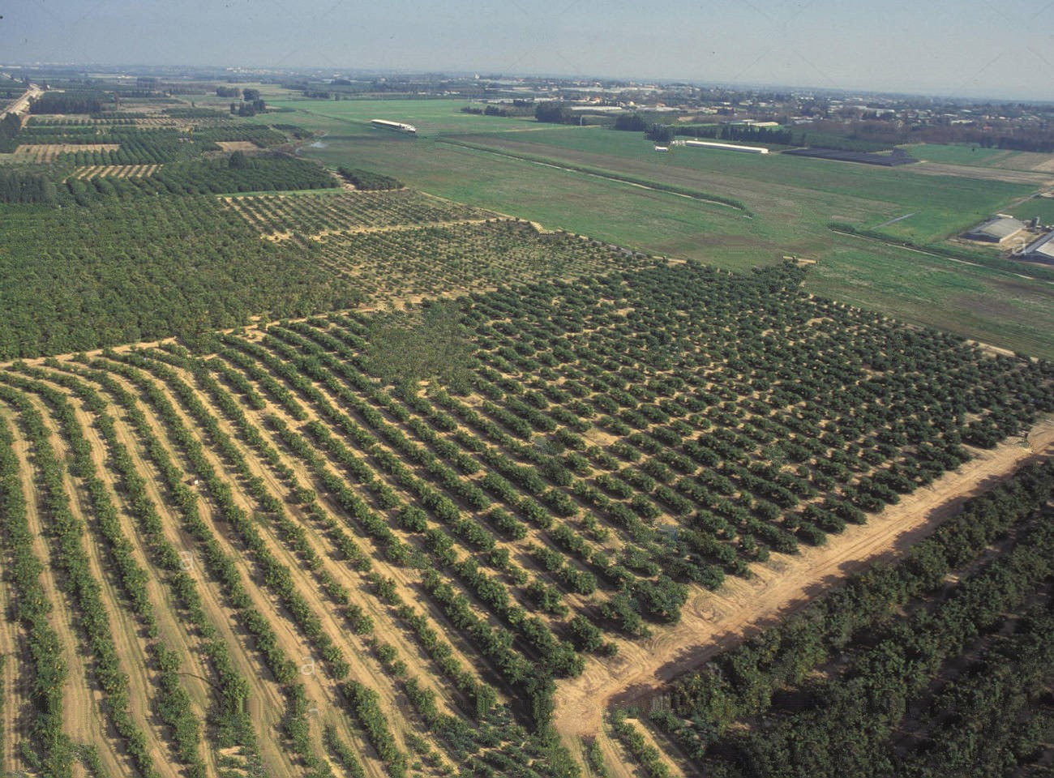
6. Israel Would Return And Rebuild A Great Army

Slide 126
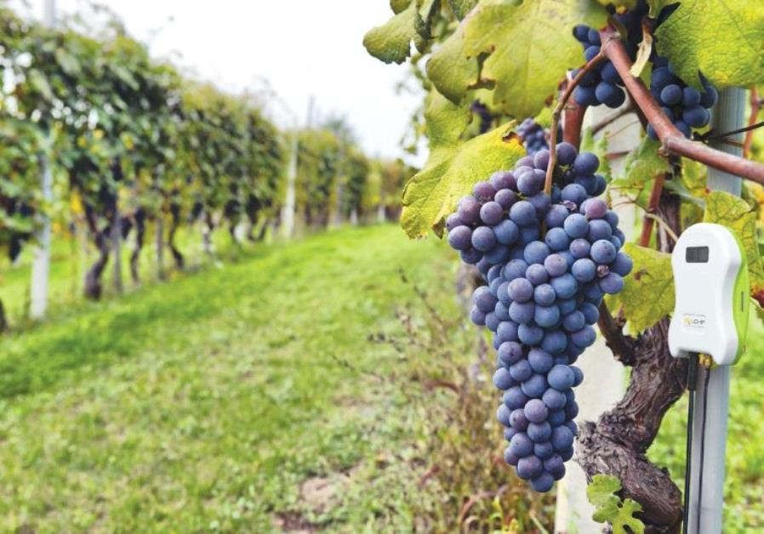
Ezekiel 37:10
“So I prophesied as He commanded me, and breath came into them, and they lived, and stood upon their feet, an exceedingly great army.”

Slide 127
Isaiah 35:1-2
1 The wilderness and the wasteland shall be glad for them, And the desert shall rejoice and blossom as the rose; 2 It shall blossom abundantly and rejoice, Even with joy and singing. The glory of Lebanon shall be given to it, The excellence of Carmel and Sharon. They shall see the glory of the LORD, The excellency of our God.

Slide 128
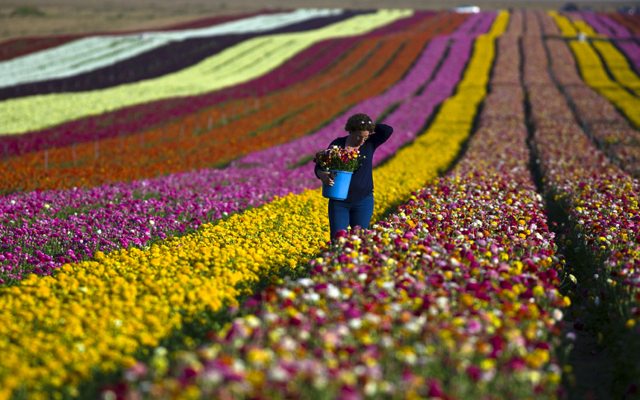
6. Israel Would Return And Rebuild A Great Army

Slide 129
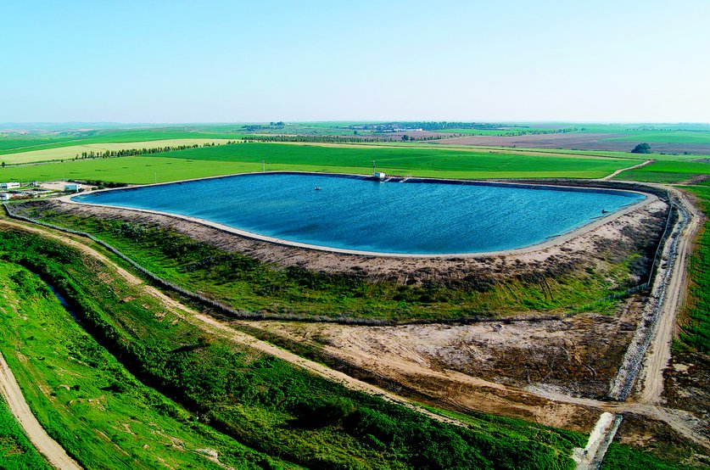
Ezekiel 37:10
“So I prophesied as He commanded me, and breath came into them, and they lived, and stood upon their feet, an exceedingly great army.”

Slide 130
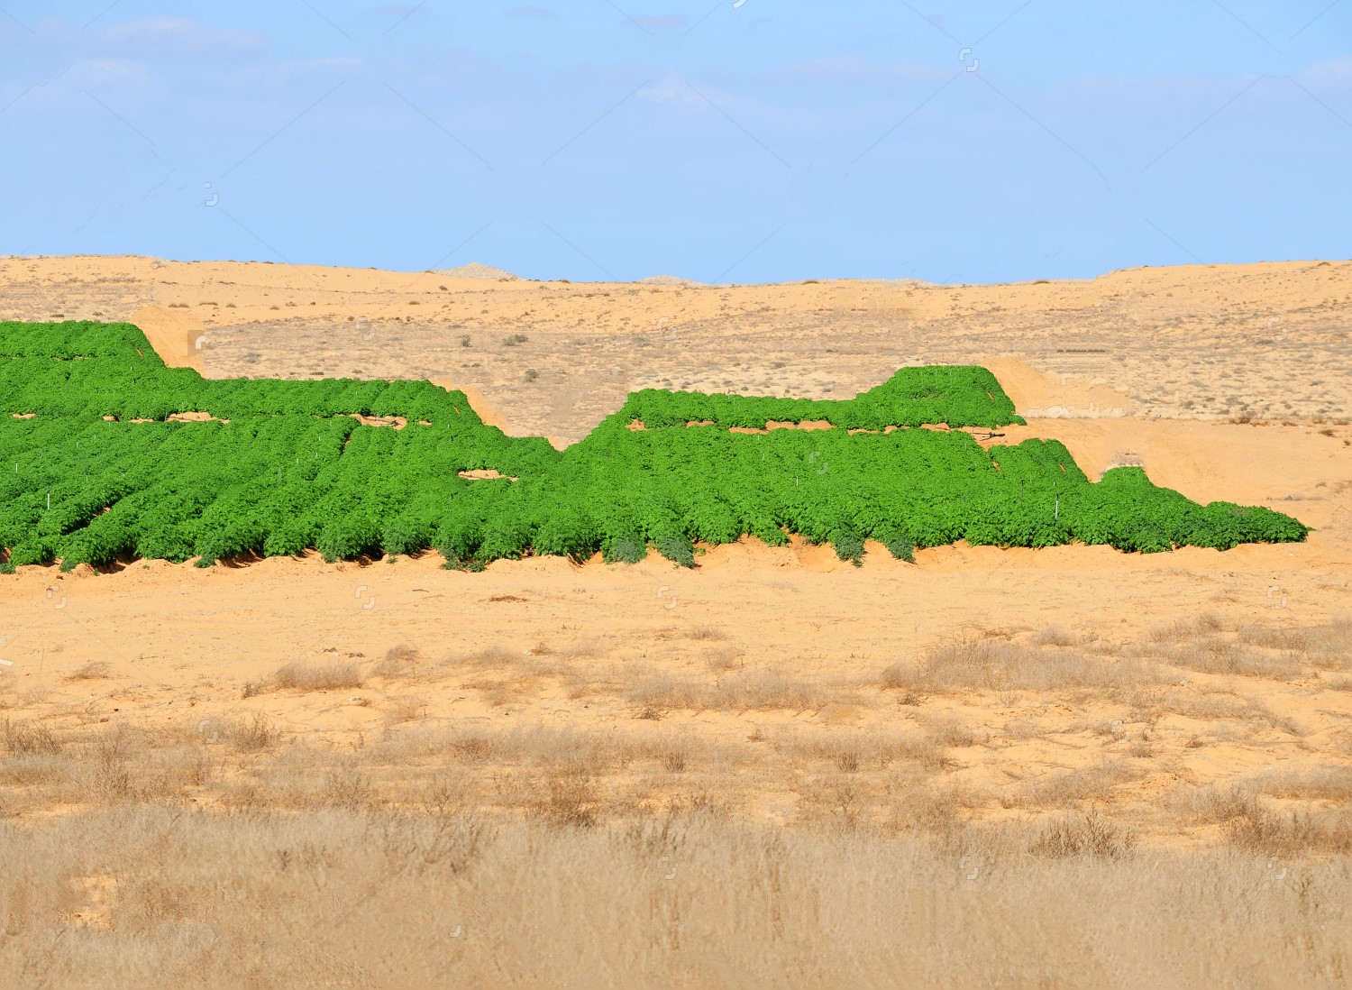
“Cares all past, home at last, ever to rejoice!” All because He redeemed us by His blood!

Slide 131
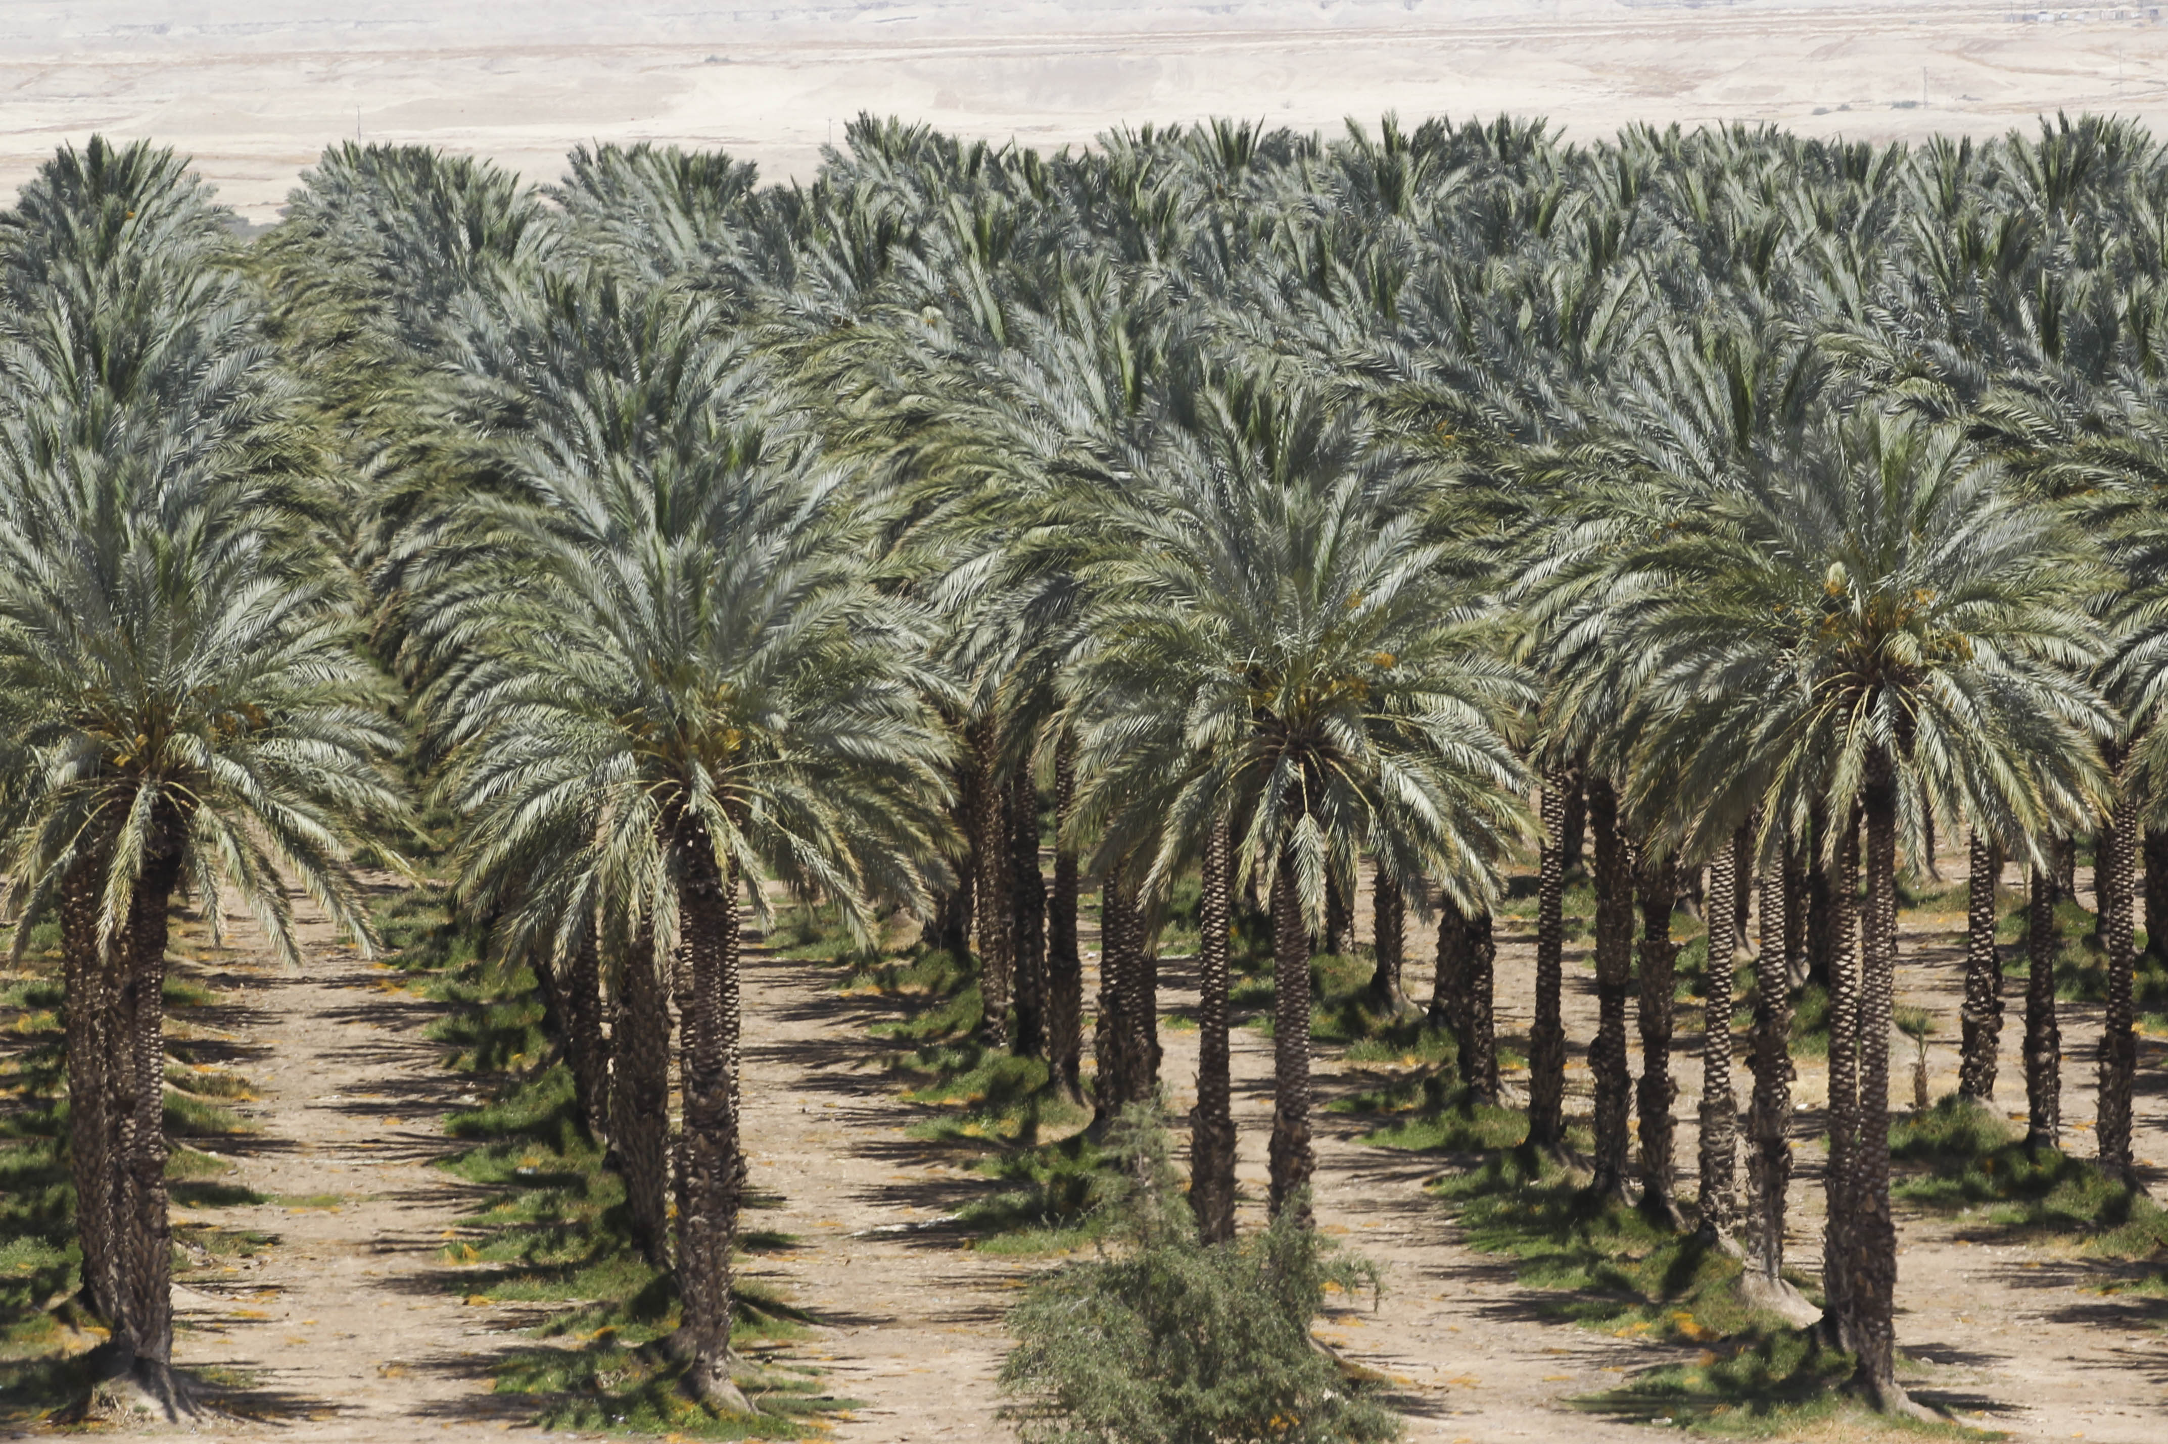
6. Israel Would Return And Rebuild A Great Army

Slide 132
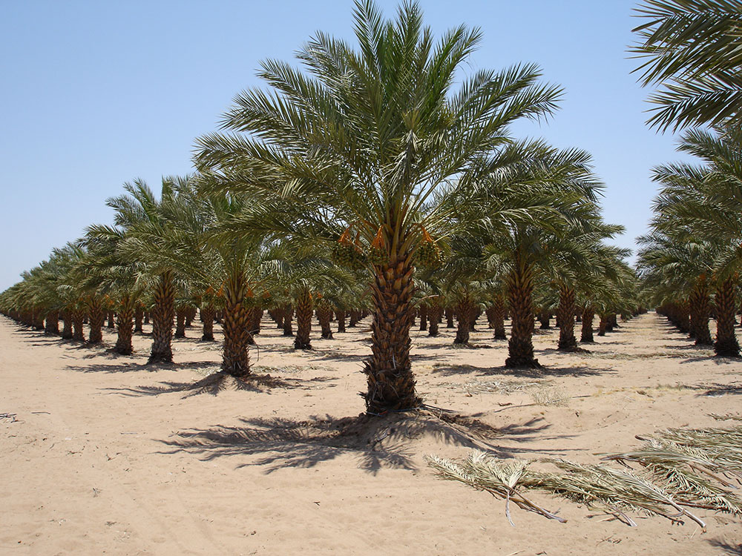
Ezekiel 37:10
“So I prophesied as He commanded me, and breath came into them, and they lived, and stood upon their feet, an exceedingly great army.”

Slide 133
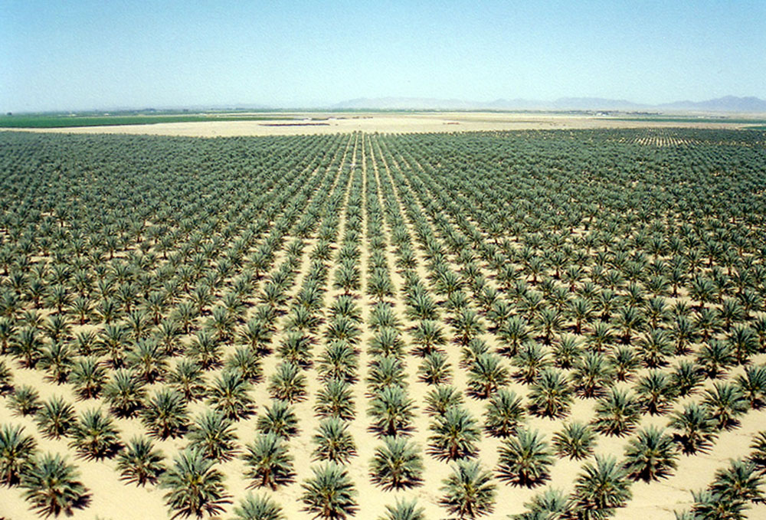
“Cares all past, home at last, ever to rejoice!” All because He redeemed us by His blood!

Slide 134
Deuteronomy 11:8-12
8 "Therefore you shall keep every commandment which I command you today, that you may be strong, and go in and possess the land which you cross over to possess, 9 and that you may prolong your days in the land which the LORD swore to give your fathers, to them and their descendants, 'a land flowing with milk and honey.'

Slide 135
10 "For the land which you go to possess is not like the land of Egypt from which you have come, where you sowed your seed and watered it by foot, as a vegetable garden; 11 but the land which you cross over to possess is a land of hills and valleys, which drinks water from the rain of heaven,

Slide 136
12 a land for which the LORD your God cares; the eyes of the LORD your God are always on it, from the beginning of the year to the very end of the year.

Slide 137
8. Israel Would Gain Control of Jerusalem And Build It Up

Slide 138
Psalm 102:15-16
15 So the nations shall fear the name of the LORD, And all the kings of the earth Your glory. 16 For the LORD shall build up Zion; He shall appear in His glory.

Slide 139
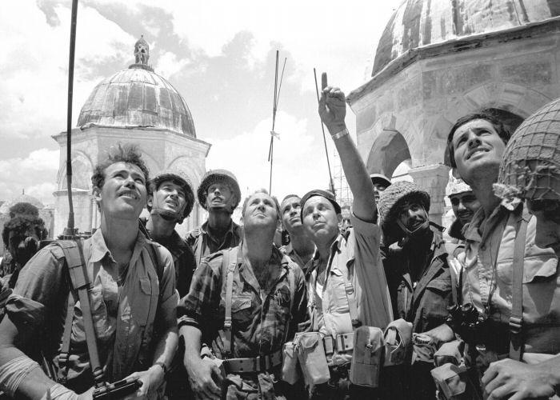
“Cares all past, home at last, ever to rejoice!” All because He redeemed us by His blood!

Slide 140
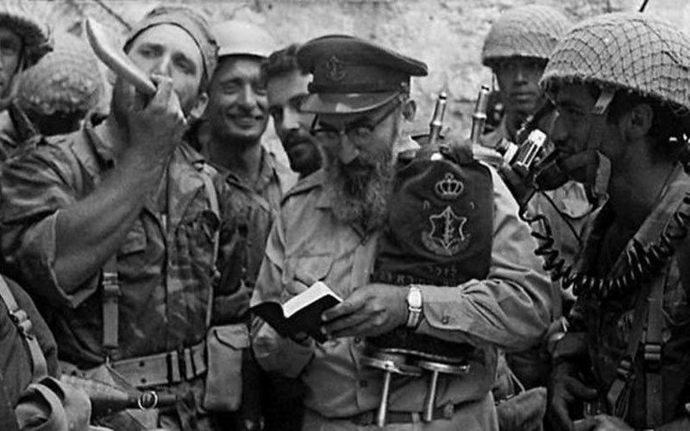
“Cares all past, home at last, ever to rejoice!” All because He redeemed us by His blood!

Slide 141
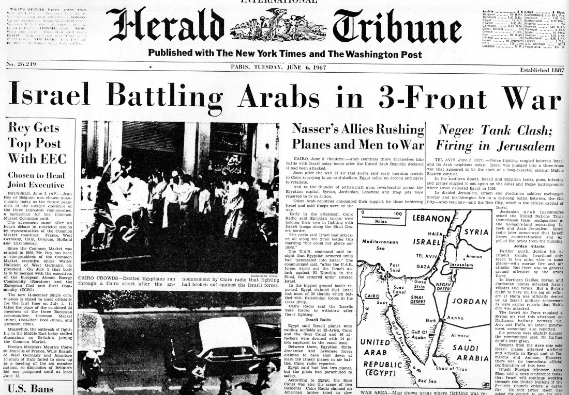
“Cares all past, home at last, ever to rejoice!” All because He redeemed us by His blood!

Slide 142
Genesis 12:2-3
2 I will make you a great nation; I will bless you and make your name great; And you shall be a blessing. 3 I will bless those who bless you, And I will curse him who curses you; And in you all the families of the earth shall be blessed."

Slide 143
9. Israel Would Be More Prosperous At The End
Than Ever Before

Slide 144
Deuteronomy 30:4-6
4 If any of you are driven out to the farthest parts under heaven, from there the LORD your God will gather you, and from there He will bring you. 5 Then the LORD your God will bring you to the land which your fathers possessed, and you shall possess it. He will prosper you and multiply you more than your fathers.

Slide 145
6 And the LORD your God will circumcise your heart and the heart of your descendants, to love the LORD your God with all your heart and with all your soul, that you may live.

Slide 146
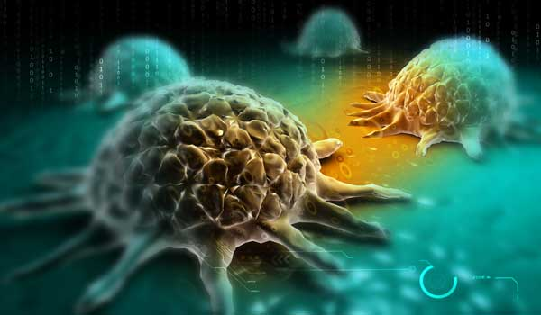
“Cares all past, home at last, ever to rejoice!” All because He redeemed us by His blood!

Slide 147
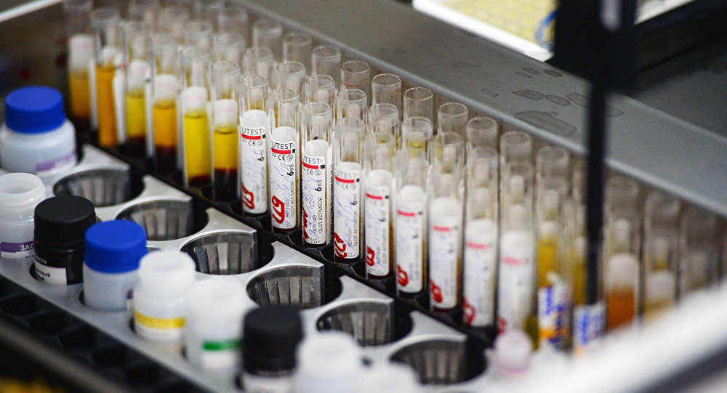
“Cares all past, home at last, ever to rejoice!” All because He redeemed us by His blood!

Slide 148
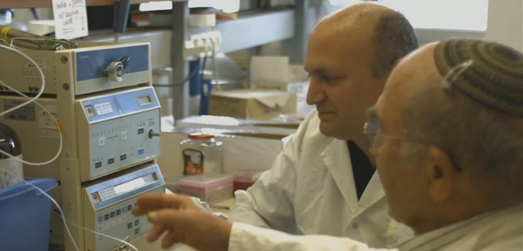
“Cares all past, home at last, ever to rejoice!” All because He redeemed us by His blood!

Slide 149
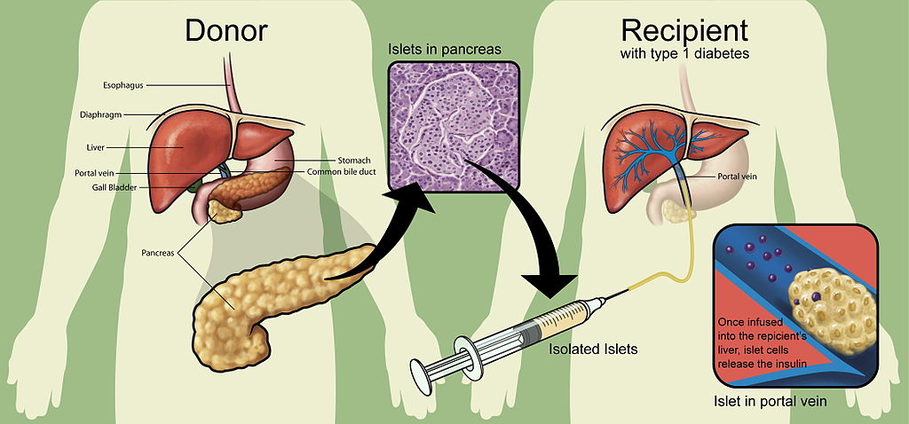
“Cares all past, home at last, ever to rejoice!” All because He redeemed us by His blood!

Slide 150
10. Israel Will Defeat All Of Her Enemies

Slide 151
Ezekiel 38:1-23
1 Now the word of the LORD came to me, saying, 2 "Son of man, set your face against Gog, of the land of Magog, the prince of Rosh, Meshech, and Tubal, and prophesy against him, 3 and say, 'Thus says the Lord GOD: "Behold, I am against you, O Gog, the prince of Rosh, Meshech, and Tubal.

Slide 152
4 I will turn you around, put hooks into your jaws, and lead you out, with all your army, horses, and horsemen, all splendidly clothed, a great company with bucklers and shields, all of them handling swords. 5 Persia, Ethiopia, and Libya are with them, all of them with shield and helmet; 6 Gomer and all its troops; the house of Togarmah from the far north and all its troops--many people are with you.

Slide 153
7 "Prepare yourself and be ready, you and all your companies that are gathered about you; and be a guard for them. 8 After many days you will be visited. In the latter years you will come into the land of those brought back from the sword and gathered from many people on the mountains of Israel, which had long been desolate; they were brought out of the nations, and now all of them dwell safely.

Slide 154
9 You will ascend, coming like a storm, covering the land like a cloud, you and all your troops and many peoples with you." 10'Thus says the Lord GOD: "On that day it shall come to pass that thoughts will arise in your mind, and you will make an evil plan: 11 You will say, 'I will go up against a land of unwalled villages; I will go to a peaceful people, who dwell safely, all of them dwelling without walls, and having neither bars nor gates'—

Slide 155
12 to take plunder and to take booty, to stretch out your hand against the waste places that are again inhabited, and against a people gathered from the nations, who have acquired livestock and goods, who dwell in the midst of the land. 13 Sheba, Dedan, the merchants of Tarshish, and all their young lions will say to you, 'Have you come to take plunder? Have you gathered your army to take booty, to carry away silver and gold, to take away livestock and goods, to take great plunder?' " '

Slide 156
14 "Therefore, son of man, prophesy and say to Gog, 'Thus says the Lord GOD: "On that day when My people Israel dwell safely, will you not know it? 15 Then you will come from your place out of the far north, you and many peoples with you, all of them riding on horses, a great company and a mighty army.

Slide 157
16 You will come up against My people Israel like a cloud, to cover the land. It will be in the latter days that I will bring you against My land, so that the nations may know Me, when I am hallowed in you, O Gog, before their eyes." 17'Thus says the Lord GOD: "Are you he of whom I have spoken in former days by My servants the prophets of Israel, who prophesied for years in those days that I would bring you against them?

Slide 158
18 "And it will come to pass at the same time, when Gog comes against the land of Israel," says the Lord GOD, "that My fury will show in My face. 19 For in My jealousy and in the fire of My wrath I have spoken: 'Surely in that day there shall be a great earthquake in the land of Israel,

Slide 159
20 so that the fish of the sea, the birds of the heavens, the beasts of the field, all creeping things that creep on the earth, and all men who are on the face of the earth shall shake at My presence. The mountains shall be thrown down, the steep places shall fall, and every wall shall fall to the ground.'

Slide 160
21 "I will call for a sword against Gog throughout all My mountains," says the Lord GOD. "Every man's sword will be against his brother. 22 And I will bring him to judgment with pestilence and bloodshed; I will rain down on him, on his troops, and on the many peoples who are with him, flooding rain, great hailstones, fire, and brimstone. 23 Thus I will magnify Myself and sanctify Myself, and I will be known in the eyes of many nations. Then they shall know that I am the LORD." '

Slide 161
Matthew 24:32-51
32 "Now learn this parable from the fig tree: When its branch has already become tender and puts forth leaves, you know that summer is near. 33 So you also, when you see all these things, know that it is near--at the doors!

Slide 162
34 Assuredly, I say to you, this generation will by no means pass away till all these things take place. 35 Heaven and earth will pass away, but My words will by no means pass away. 36 "But of that day and hour no one knows, not even the angels of heaven, but My Father only. 37 But as the days of Noah were, so also will the coming of the Son of Man be.

Slide 163
38 For as in the days before the flood, they were eating and drinking, marrying and giving in marriage, until the day that Noah entered the ark, 39 and did not know until the flood came and took them all away, so also will the coming of the Son of Man be. 40 Then two men will be in the field: one will be taken and the other left. 41 Two women will be grinding at the mill: one will be taken and the other left.
+

Slide 164
42 Watch therefore, for you do not know what hour your Lord is coming. 43 But know this, that if the master of the house had known what hour the thief would come, he would have watched and not allowed his house to be broken into. 44 Therefore you also be ready, for the Son of Man is coming at an hour you do not expect.

Slide 165
45 "Who then is a faithful and wise servant, whom his master made ruler over his household, to give them food in due season? 46 Blessed is that servant whom his master, when he comes, will find so doing. 47 Assuredly, I say to you that he will make him ruler over all his goods.

Slide 166
48 But if that evil servant says in his heart, 'My master is delaying his coming,' 49 "and begins to beat his fellow servants, and to eat and drink with the drunkards, 50 the master of that servant will come on a day when he is not looking for him and at an hour that he is not aware of, 51 and will cut him in two and appoint him his portion with the hypocrites. There shall be weeping and gnashing of teeth.

Slide 167
1 Thessalonians 4:13-18
13 But I do not want you to be ignorant, brethren, concerning those who have fallen asleep, lest you sorrow as others who have no hope. 14 For if we believe that Jesus died and rose again, even so God will bring with Him those who sleep in Jesus.

Slide 168
15 For this we say to you by the word of the Lord, that we who are alive and remain until the coming of the Lord will by no means precede those who are asleep. 16 For the Lord Himself will descend from heaven with a shout, with the voice of an archangel, and with the trumpet of God. And the dead in Christ will rise first.

Slide 169
17 Then we who are alive and remain shall be caught up together with them in the clouds to meet the Lord in the air. And thus we shall always be with the Lord. 18 Therefore comfort one another with these words.

Slide 170
1 Corinthians 15:50-54
50 Now this I say, brethren, that flesh and blood cannot inherit the kingdom of God; nor does corruption inherit incorruption. 51 Behold, I tell you a mystery: We shall not all sleep, but we shall all be changed-- 52 in a moment, in the twinkling of an eye, at the last trumpet. For the trumpet will sound, and the dead will be raised incorruptible, and we shall be changed.

Slide 171
53 For this corruptible must put on incorruption, and this mortal must put on immortality. 54 So when this corruptible has put on incorruption, and this mortal has put on immortality, then shall be brought to pass the saying that is written: "Death is swallowed up in victory."

Slide 172

20 Again, when a righteous man turns from his righteousness and commits iniquity, and I lay a stumbling block before him, he shall die; because you did not give him warning, he shall die in his sin, and his righteousness which he has done shall not be remembered; but his blood I will require at your hand.

Slide 173
Acts 2:38-39
38 Then Peter said to them, "Repent, and let every one of you be baptized in the name of Jesus Christ for the remission of sins; and you shall receive the gift of the Holy Spirit. 39 For the promise is to you and to your children, and to all who are afar off, as many as the Lord our God will call."

