Slide 1


Slide 2
Make Room The Church Will Sing
(Elyssa Smith, Community Music)

Slide 3
Here is where I lay it down Every burden, every crown This is my surrender This is my surrender

Slide 4
Here is where I lay it down Every lie and every doubt
This is my surrender And I will make room for You

Slide 5
To do whatever You want to To do whatever You want to I will make room for You To do whatever You

Slide 6
want to To do whatever You want to Here is where I lay it down Every burden, every crown This is my

Slide 7
surrender This is my surrender Here is where I lay it down Every lie and every doubt This is my surrender

Slide 8
And I will make room for You To do whatever You want to To do whatever You want to And I will make

Slide 9
room for You To do whatever You want to To do whatever You want to And I will make room for You

Slide 10
To do whatever You want to To do whatever You want to And I will make room for You To do

Slide 11
whatever You want to To do whatever You want to (Jesus) Have Your way, have Your way Jesus Have

Slide 12
Your way with us Have Your way with us, ooh We surrender We surrender Jesus Have Your way Jesus

Slide 13
Shake up the ground of all my tradition Break down the walls of all my religion Your way is better Your

Slide 14
way is better Shake up the ground of all my tradition Break down the walls of all my religion Your way is

Slide 15
better Your way is better Shake up the ground of all my tradition Break down the walls of all my religion

Slide 16
Your way is better Your way is better Shake up the ground of all my tradition Break down the walls of all

Slide 17
my religion Your way is better Your way is better And I will make room for You To do whatever You want to

Slide 18
To do whatever You want to I will make room for You To do whatever You want to To do whatever You

Slide 19
want to Here is where I lay it down You are all I'm chasing now This is my surrender This is my

Slide 20
surrender Here is where I lay it down You are all I'm chasing now This is my surrender This is my

Slide 21
surrender.

Slide 22
”Waymaker”
(Tasha Cobbs )

Slide 23
[Verse 1] You are here, moving in our midst I worship You, I worship You You are here,

Slide 24
working in this place I worship You, I worship You
You are here, moving in our midst I worship You, I

Slide 25
worship You You are here, working in this place
I worship You, I worship You [Chorus] You are

Slide 26
Waymaker, miracle worker Promise keeper, light in the darkness My God, that is who You are You are

Slide 27
Waymaker, miracle worker Promise keeper, light in the darkness My God, that is who You are [Verse 2]

Slide 28
You are here, touching every heart I worship You, I worship You You are here, healing every heart I

Slide 29
worship You, I worship You [Verse 3] You are here, turning lives around I worship You, I worship You You

Slide 30
are here, mending every heart I worship You, yeah, I worship You, Lord [Chorus] And You are Waymaker,

Slide 31
miracle worker Promise keeper, light in the darkness
My God, that is who You are Yeah, You are the

Slide 32
waymaker Waymaker, miracle worker Promise keeper, light in the darkness My God, that is who

Slide 33
You are Yeah, sing it again You are, yeah Waymaker, miracle worker Promise keeper, light in the darkness

Slide 34
My God, that is who You are Oh, it's who You are, Jesus, yeah Waymaker, miracle worker Promise

Slide 35
keeper, light in the darkness My God, that is who You are You might also like Way Maker [Refrain]

Slide 36
Sing that is who You are Oh, that is who You are

Slide 37
(That is who You are) Oh, and that is who You are (That is who You are) My Jesus, that is who You are

Slide 38
(That is who You are) Oh, we lift You up, that is who You are (That is who You are) My Jesus [Chorus]

Slide 39
Waymaker, miracle worker Promise keeper, light in the darkness My God, that is who You are Yes it is,

Slide 40
that is who You are Waymaker, miracle worker Promise keeper, light in the darkness My God, that is

Slide 41
who You are [Bridge] Let's sing this together, even when I don't see it Come on, even when Even when

Slide 42
I don't see it, You're working Even when I don't feel it, You're working You never stop, You never stop

Slide 43
working You never stop, You never stop working Come on And even when I don't see it, You’re

Slide 44
working Even when I don't feel it, You're working You never stop, You never stop working You never stop,

Slide 45
You never stop working Oh-oh Even when I don't see it, You're working Even when I don't feel it, You’re

Slide 46
working You never stop, You never stop working You never stop, You never stop working Even when I

Slide 47
don't see it, You're working Even when I don't feel it, You're working You never stop, You never stop

Slide 48
working You never stop, You never stop working
[Chorus] You are the way maker, yeah Waymaker,

Slide 49
miracle worker Promise keeper, light in the darkness
My God, that is who You are Waymaker, miracle

Slide 50
worker Promise keeper, light in the darkness My God, that is who You are

Slide 51
“Good Good Father”
(Chris Tomlin)

Slide 52
I’ve heard a thousand stories of what they think you’re like. But I’ve heard the tender whispers of love

Slide 53
In the dead of night. And you tell me that you’re pleased and that I’m never alone. You’re a good

Slide 54
Good Father. It’s who you are, it’s who you are, it’s who you are and I am loved by you. It’s who I am

Slide 55
It’s who I am. It’s who I am. I’ve seen many searching for answers far and wide. But I know we’re

Slide 56
All searching for answers only you provide. Cause you know just what we need before we say a word.

Slide 57
You’re a good good Father. It’s who you are, It’s who you are. It’s who you are. And I’m loved by you. It’s

Slide 58
Who I am, It’s who I am, It’s who I am. You are perfect in all of your ways. You are perfect in all of

Slide 59
Your ways. You are perfect in all of your ways to us. You are perfect in all of your ways. You are perfect in

Slide 60
All of your ways. You are perfect in all of your ways to us. You’re a good good Father. It’s who you are, It’s

Slide 61
who you are, It’s who you are. And I’m loved by you. It’s who I am, it’s who I am, It’s who I am.

Slide 62
Love so undeniable I, I , can hardly speak. Peace so unexplainable I , I , can hardly think. As you call me

Slide 63
Deeper still. As you call me deeper still. As you call me deeper still into Love love love. You’re a good

Slide 64
Good father. It’s who you are, It’s who you are, it’s who you are. And I’m loved by you. It’s who I am,

Slide 65
It’s who I am, It’s who I am.

Slide 66
“Holy Spirit”
(Kim Walker)

Slide 67
There’s nothing worth more. That could ever come close. No thing can compare. You’re our living hope.

Slide 68
Your presence Lord. I’ve tasted and seen of the sweetest of loves. Where my heart becomes free

Slide 69
And my shame is undone. Your presence, Lord.
Holy spirit you are welcome here. Come flood this

Slide 70
place and fill the atmosphere. Your glory God is what our hearts long for. To be overcomed, By your

Slide 71
presence Lord. There’s nothing worth more. That could ever come close. No thing can compare.

Slide 72
you’re living hope. Your presence, Lord. I’ve tasted and seen of the sweetest of loves. Where my heart

Slide 73
becomes free and my shame is undone. Your presence, Lord. Holy Spirit you are welcome here

Slide 74
Come flood this place and fill the atmosphere. Your glory God is what our hearts long for. To be

Slide 75
overcome by your presence Lord. Your presence Lord. Let us become more aware of your presence

Slide 76
Let us experience the Glory of your goodness. Let us become. More aware of your presence. Let us

Slide 77
experience the Glory of your goodness. Let us become more aware of your presence. Let us

Slide 78
the atmosphere, Your glory God is what our heart longs for to be overcome. By your presence Lord.

Slide 79
Open The Eyes of My Heart
(Michael W. Smith)

Slide 80
Open the eyes of my heart, Lord Open the eyes of my heart I want to see You I want to see You Open

Slide 81
the eyes of my heart, Lord Open the eyes of my heart I want to see You I want to see You To see You

Slide 82
high and lifted up Shinin' in the light of Your glory Pour out Your power and love As we sing holy, holy,

Slide 83
holy Open the eyes of my heart, Lord Open the eyes of my heart I want to see You I want to see You Open

Slide 84
the eyes of my heart, Lord Open the eyes of my heart I want to see You I want to see You To see You

Slide 85
high and lifted up Shinin' in the light of Your glory Pour out Your power and love As we sing holy, holy,

Slide 86
holy To see You high and lifted up Shinin' in the light of Your glory Pour out Your power and love As we

Slide 87
sing holy, holy, holy To see You high and lifted up Shinin' in the light of Your glory Pour out Your power

Slide 88
and love As we sing holy, holy, holy Holy, holy, holy We cry holy, holy, holy You are holy, holy, holy I want

Slide 89
to see you Holy, holy, holy Holy, holy, holy You are holy, holy, holy I want to see you Holy, holy, holy

Slide 90
Holy, holy, holy Holy, holy, holy, I want to see you Holy, holy, holy Holy, holy, holy Holy, holy, holy, I

Slide 91
want to see you Holy, holy, holy Holy, holy, holy Holy, holy, holy, I want to see you Holy, holy, holy

Slide 92
Holy, holy, holy Holy, holy, holy, I want to see you Holy, holy, holy Holy, holy, holy Holy, holy, holy, I

Slide 93
want to see you Holy, holy, holy Holy, holy, holy Holy, holy, holy, I want to see you.

Slide 94


Slide 95
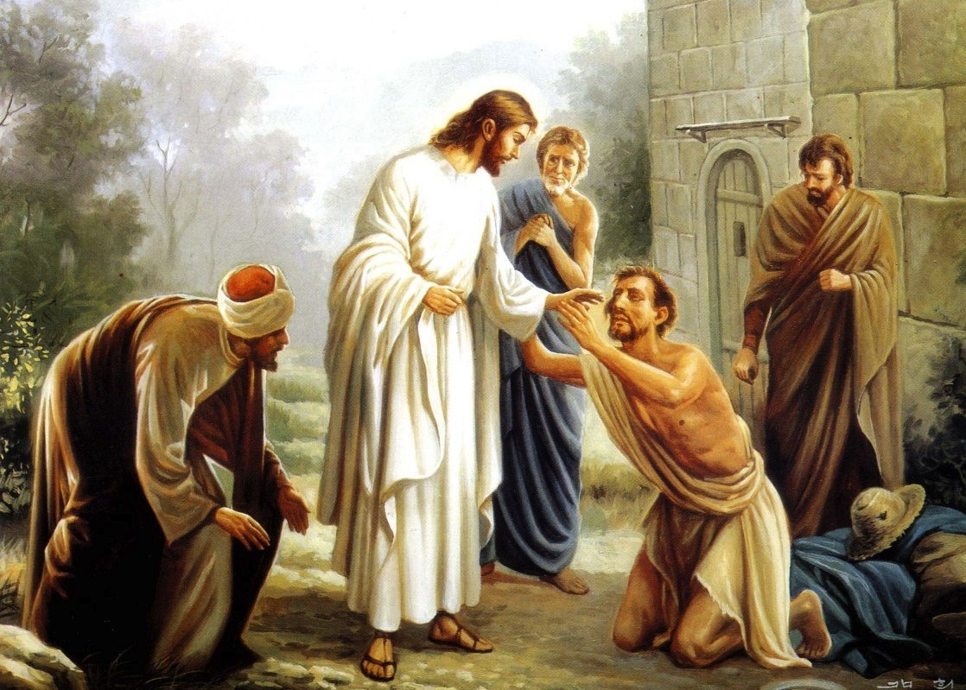

Jesus Did It All for Me
by Pastor Fee Soliven
Luke 24:1-9
Sunday Morning
May 21, 2023

Slide 96
Luke 24:1-9
1 Now on the first day of the week, very early in the morning, they, and certain other women with them, came to the tomb bringing the spices which they had prepared. 2 But they found the stone rolled away from the tomb.

Slide 97
3 Then they went in and did not find the body of the Lord Jesus. 4 And it happened, as they were greatly perplexed about this, that behold, two men stood by them in shining garments. 5 Then, as they were afraid and bowed their faces to the earth, they said to them, "Why do you seek the living among the dead?

Slide 98
6 He is not here, but is risen! Remember how He spoke to you when He was still in Galilee, 7 saying, 'The Son of Man must be delivered into the hands of sinful men, and be crucified, and the third day rise again.' " 8 And they remembered His words. 9 Then they returned from the tomb and told all these things to the eleven and to all the rest.

Slide 99
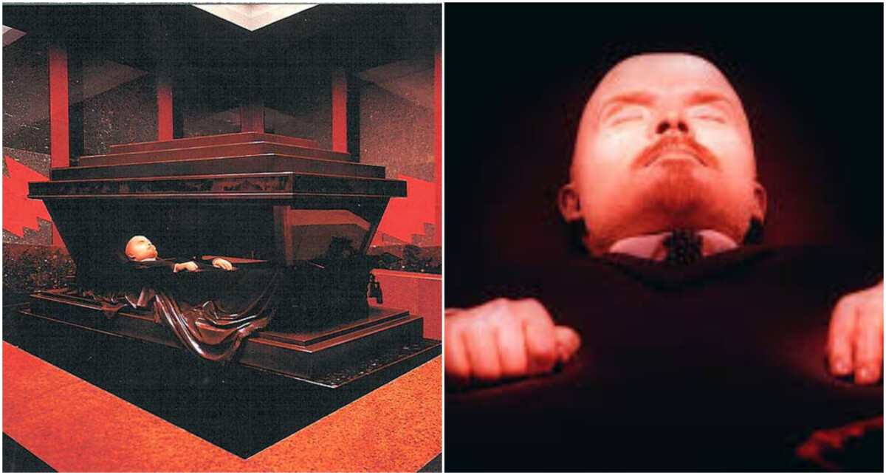
1 Corinthians 15:1-4
1 Moreover, brethren, I declare to you the gospel which I preached to you, which also you received and in which you stand, 2 by which also you are saved, if you hold fast that word which I preached to you--unless you believed in vain.

Slide 100
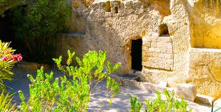
3 For I delivered to you first of all that which I also received: that Christ died for our sins according to the Scriptures, 4 and that He was buried, and that He rose again the third day according to the Scriptures

Slide 101
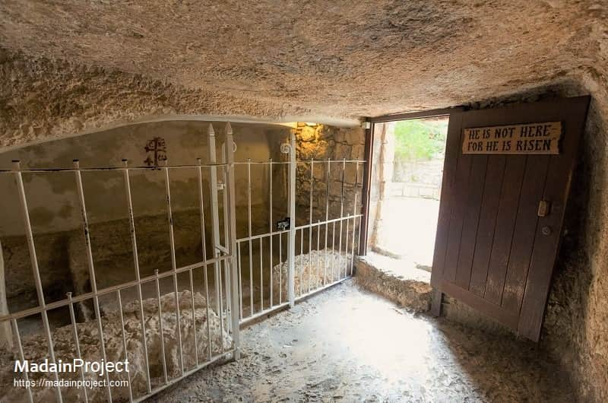
1 Peter 2:21-25
21 For to this you were called, because Christ also suffered for us, leaving us an example, that you should follow His steps: 22 "Who committed no sin, Nor was deceit found in His mouth"; 23 who, when He was reviled, did not revile in return; when He suffered, He did not threaten, but committed Himself to Him who judges righteously;

Slide 102
Matthew 16:21
From that time Jesus began to show to His disciples that He must go to Jerusalem, and suffer many things from the elders and chief priests and scribes, and be killed, and be raised the third day.

Slide 103
The first message is that Christ is Alive

Slide 104
Hebrews 10:12
But this Man, after He had offered one sacrifice for sins forever, sat down at the right hand of God…

Slide 105
But what is He doing in heaven?

Slide 106
1. He’s interceding for Us

Slide 107
Hebrews 7:25
Therefore He is also able to save to the uttermost those who come to God through Him, since He always lives to make intercession for them.

Slide 108
2. He’s our Advocate

Slide 109
1 John 2:1
“My little children, these things I write to you, so that you may not sin. And if anyone sins, we have an Advocate with the Father, Jesus Christ the righteous”

Slide 110
3. He’s preparing a place for us in His Father’s House

Slide 111
John 14:2-3
2 In My Father's house are many mansions; if it were not so, I would have told you. I go to prepare a place for you. 3 And if I go and prepare a place for you, I will come again and receive you to Myself; that where I am, there you may be also.

Slide 112
4. He’s living within every child of God through the presence of the Holy Spirit.

Slide 113
John 15:5
“I am the vine, you are the branches. He who abides in Me, and I in him, bears much fruit; for without Me you can do nothing”

Slide 114
The second message of the resurrection is that our sins have been forgiven, and we’re eternally secure in Christ

Slide 115
Ephesians 1:7-14
7 In Him we have redemption through His blood, the forgiveness of sins, according to the riches of His grace 8 which He made to abound toward us in all wisdom and prudence, 9 having made known to us the mystery of His will, according to His good pleasure which He purposed in Himself,

Slide 116
10 that in the dispensation of the fullness of the times He might gather together in one all things in Christ, both which are in heaven and which are on earth--in Him. 11 In Him also we have obtained an inheritance, being predestined according to the purpose of Him who works all things according to the counsel of His will, 12 that we who first trusted in Christ should be to the praise of His glory.

Slide 117
13 In Him you also trusted, after you heard the word of truth, the gospel of your salvation; in whom also, having believed, you were sealed with the Holy Spirit of promise, 14 who is the guarantee of our inheritance until the redemption of the purchased possession, to the praise of His glory.

Slide 118
Hebrews 9:12
Not with the blood of goats and calves, but with His own blood He entered the Most Holy Place once for all, having obtained eternal redemption.

Slide 119
John 6:37-38
37 All that the Father gives Me will come to Me, and the one who comes to Me I will by no means cast out. 38 For I have come down from heaven, not to do My own will, but the will of Him who sent Me.

Slide 120
John 6:39-40
39 This is the will of the Father who sent Me, that of all He has given Me I should lose nothing, but should raise it up at the last day. 40 And this is the will of Him who sent Me, that everyone who sees the Son and believes in Him may have everlasting life; and I will raise him up at the last day."

Slide 121
The third message of the resurrection is that believers will live forever

Slide 122
John 11:25-27
25 Jesus said to her, "I am the resurrection and the life. He who believes in Me, though he may die, he shall live. 26 And whoever lives and believes in Me shall never die. Do you believe this?" 27 She said to Him, "Yes, Lord, I believe that You are the Christ, the Son of God, who is to come into the world."

Slide 123
2 Corinthians5:6-7
6 So we are always confident, knowing that while we are at home in the body we are absent from the Lord. 7 For we walk by faith, not by sight.

Slide 124
1 Thessalonians 4:13-17
13 But I do not want you to be ignorant, brethren, concerning those who have fallen asleep, lest you sorrow as others who have no hope. 14 For if we believe that Jesus died and rose again, even so God will bring with Him those who sleep in Jesus.

Slide 125
15 For this we say to you by the word of the Lord, that we who are alive and remain until the coming of the Lord will by no means precede those who are asleep.

Slide 126
16 For the Lord Himself will descend from heaven with a shout, with the voice of an archangel, and with the trumpet of God. And the dead in Christ will rise first.17 Then we who are alive and remain shall be caught up together with them in the clouds to meet the Lord in the air. And thus we shall always be with the Lord. 18 Therefore comfort one another with these words.

Slide 127
The fourth message is our Bodily Resurrection

Slide 128
1 Corinthians 15:23-26
23 But each one in his own order: Christ the firstfruits, afterward those who are Christ's at His coming. 24 Then comes the end, when He delivers the kingdom to God the Father, when He puts an end to all rule and all authority and power. 25 For He must reign till He has put all enemies under His feet. 26 The last enemy that will be destroyed is death.

Slide 129
1 Corinthians 15:50
ow this I say, brethren, that flesh and blood cannot inherit the kingdom of God; nor does corruption inherit incorruption.

Slide 130
1 John 3:2
Beloved, now we are children of God; and it has not yet been revealed what we shall be, but we know that when He is revealed, we shall be like Him, for we shall see Him as He is

Slide 131
The fifth message of the Resurrection is that Heaven is going to be Our Eternal Home

Slide 132
Revelation 21:27
But there shall by no means enter it anything that defiles, or causes an abomination or a lie, but only those who are written in the Lamb's Book of Life.

Slide 133
Revelation 22:4-5
4 They shall see His face, and His name shall be on their foreheads. 5 There shall be no night there: They need no lamp nor light of the sun, for the Lord God gives them light. And they shall reign forever and ever.

Slide 134
The sixth message of the Resurrection is that because Christ Rose from the Dead, we can face each tomorrow with Assurance and Perfect Peace

Slide 135
Psalm 23
1 The LORD is my shepherd; I shall not want. 2 He makes me to lie down in green pastures; He leads me beside the still waters. 3 He restores my soul; He leads me in the paths of righteousness For His name's sake.

Slide 136
4 Yea, though I walk through the valley of the shadow of death, I will fear no evil; For You are with me; Your rod and Your staff, they comfort me.

Slide 137
5 You prepare a table before me in the presence of my enemies; You anoint my head with oil; My cup runs over. 6 Surely goodness and mercy shall follow me All the days of my life; And I will dwell in the house of the LORD Forever.

Slide 138
1 Thessalonians 4:13-18
13 But I do not want you to be ignorant, brethren, concerning those who have fallen asleep, lest you sorrow as others who have no hope. 14 For if we believe that Jesus died and rose again, even so God will bring with Him those who sleep in Jesus.

Slide 139
15 For this we say to you by the word of the Lord, that we who are alive and remain until the coming of the Lord will by no means precede those who are asleep. 16 For the Lord Himself will descend from heaven with a shout, with the voice of an archangel, and with the trumpet of God. And the dead in Christ will rise first.

Slide 140
17 Then we who are alive and remain shall be caught up together with them in the clouds to meet the Lord in the air. And thus we shall always be with the Lord. 18 Therefore comfort one another with these words.

Slide 141
1 Corinthians 15:50-54
50 Now this I say, brethren, that flesh and blood cannot inherit the kingdom of God; nor does corruption inherit incorruption. 51 Behold, I tell you a mystery: We shall not all sleep, but we shall all be changed-- 52 in a moment, in the twinkling of an eye, at the last trumpet. For the trumpet will sound, and the dead will be raised incorruptible, and we shall be changed.

Slide 142
53 For this corruptible must put on incorruption, and this mortal must put on immortality. 54 So when this corruptible has put on incorruption, and this mortal has put on immortality, then shall be brought to pass the saying that is written: "Death is swallowed up in victory."

Slide 143

20 Again, when a righteous man turns from his righteousness and commits iniquity, and I lay a stumbling block before him, he shall die; because you did not give him warning, he shall die in his sin, and his righteousness which he has done shall not be remembered; but his blood I will require at your hand.

Slide 144
Acts 2:38-39
38 Then Peter said to them, "Repent, and let every one of you be baptized in the name of Jesus Christ for the remission of sins; and you shall receive the gift of the Holy Spirit. 39 For the promise is to you and to your children, and to all who are afar off, as many as the Lord our God will call."

