Slide 1


Slide 2
Whe You Walk Into the Room
(Katie Torwait)

Slide 3
When You walk into the room Everything changes
Darkness starts to tremble At the light that You bring

Slide 4
And when You walk into the room Every heart starts burning And nothing matters more Than just to sit

Slide 5
here at Your feet And worship You We worship You, oh We love You We'll never stop We can't live

Slide 6
without You, Jesus We love You And we can't get enough All this is for You, Jesus When You walk into

Slide 7
the room Sickness starts to vanish Every hopeless situation ceases to exist And when You walk into the

Slide 8
room The dead begin to rise 'Cause there is resurrection life in all You do We love You We'll never

Slide 9
stop Can't live without You, Jesus We love You And we can't get enough All this is for You, Jesus Oh,

Slide 10
Jesus Come and consume, God All we are We give You permission Our hearts are Yours We want You,

Slide 11
we want You Come and consume, God All we are We give You permission Our hearts are Yours We

Slide 12
want You, we want You Come and consume, God All we are We give You permission Our hearts are Yours

Slide 13
We want You, we want You Come and consume, God All we are We give You permission Our hearts

Slide 14
are Yours We want You, we want You We love You We'll never stop Can't live without You, Jesus We

Slide 15
love You And we can't get enough All this is for You, Jesus Oh, how we love You Oh, how we love You

Slide 16
Graves into Gardens
(Elevation Worship)

Slide 17
I searched the World but it couldn’t fill me. Man’s empty praise and treasures that fade Are never

Slide 18
Enough. Then you came along and put me back together And every desire Is now satisfied here in

Slide 19
Your love. Oh’ there’s nothing better than you. There’s nothing better than you. Lord there’s nothing

Slide 20
Nothing is better than you. Im not afraid to show you my weakness. My failures and flaws Lord you’ve

Slide 21
Seen them all and you still call me friend.Cause the God of the mountain. Is the God of the Valley.

Slide 22
There’s not a place. Your mercy and grace. Wont find me again. Oh there’s nothing better than you. There’s

Slide 23
Nothing better than you. Lord there’s nothing. Nothing is better than you. Oh there’s nothing better

Slide 24
Better than you. There’s nothing better than you. Lord’ there’s nothing. Nothing is better than you.

Slide 25
You turn mourning to dancing. You give beauty for ashes. You turn shame into glory. You’re the only one

Slide 26
Who can. You turn mourning to dancing. You give beauty for ashes. You turn shame into glory. You’re

Slide 27
The only one who can. You turn graves into gardens. You turn bones into armies. You turn seas into

Slide 28
Highways. You’re the only one who can you’re the only one who can. Oh there’s nothing better than you

Slide 29
There’s nothing better than you. Lord there’s nothing. Nothing is better than you. Oh there’s nothing better

Slide 30
Than you. There’s nothing better than you. Lord, there’s nothing. Nothing is better than you. You turn

Slide 31
Graves into gardens. You turn bones into armies. You turn seas into highways. You’re the only one who

Slide 32
Can. You turn graves into gardens. You turn bones into armies. You turn seas into highways you’re the

Slide 33
Only one who can. You’re the only one who. You’re the only one who can.

Slide 34
above all names Be exalted now in the heavens As Your glory fills this place You alone deserve our

Slide 35
praise You’re the name above all names Worthy is Your name, Jesus You deserve the praise Worthy is

Slide 36
Your name Worthy is Your name, Jesus You deserve the praise Worthy is Your name Worthy is Your

Slide 37
name, Jesus You deserve the praise Worthy is Your name Worthy is Your name, Jesus You deserve the

Slide 38
praise Worthy is Your name Oh, oh

Slide 39
“Great Are You Lord”
(All Sons & Daughters)

Slide 40
You give life, You are love You bring light to the darkness You give hope, You restore Every heart

Slide 41
that is broken And great are You, Lord It's Your breath in our lungs So we pour out our praise

Slide 42
We pour out our praise It's Your breath in our lungs So we pour out our praise to You only You give life,

Slide 43
You are love You bring light to the darkness You give hope, You restore (You restore) Every heart that

Slide 44
is broken And great are You, Lord It's Your breath in our lungs So we pour out our praise We pour out our

Slide 45
praise It's Your breath in our lungs So we pour out our praise to You only It's Your breath in our lungs

Slide 46
So we pour out our praise We pour out our praise It's Your breath in our lungs So we pour out our praise to

Slide 47
You only And all the earth will shout Your praise Our hearts will cry, these bones will sing Great are You,

Slide 48
Lord And all the earth will shout Your praise Our hearts will cry, these bones will sing Great are You,

Slide 49
Lord And all the earth will shout Your praise Our hearts will cry, these bones will say Great are You,

Slide 50
Lord It's Your breath in our lungs So we pour out our praise We pour out our praise It's Your breath in our

Slide 51
lungs So we pour out our praise to You only It's Your breath in our lungs So we pour out our praise We

Slide 52
pour out our praise It's Your breath in our lungs So we pour out our praise to You only

Slide 53
“I Saw The Lord You Are Holy”
(Dallas Holm)

Slide 54
The place was white as snow and pure as finest gold. It had the look of new, yet had the look of old.

Slide 55
I felt like I was home, but felt so far away, In fear I thought to leave, but felt the urge to stay. And

Slide 56
then a silence fell like none I'd ever known. I stood among the millions, I stood there all alone. His face

Slide 57
was like the sun, His eyes were like the sea, His voice was like the thunder rolling through eternity.

Slide 58
And... I saw the Lord He was high and lifted up and rightfully adored And...I saw the Lord and He saw me

Slide 59
And then from sleep awakened I looked into the night. The darkness overtaken By a bright and

Slide 60
shining light. I couldn't understand it I couldn't reason how, And then my eyes beheld Him I wasn't

Slide 61
dreaming now And...I saw the Lord He was high and lifted up And rightfully adored, And...I saw the Lord

Slide 62
And He saw me.

Slide 63
“ What a beautiful Name”
(Hillsong)

Slide 64
You were the word at the beginning. One with God the Lord most high. Your hidden glory in creation.

Slide 65
Now revealed in you are Christ. What a beautiful name it is. What a beautiful name it is. The name of

Slide 66
Jesus Christ my king. What a beautiful name it is. Nothing compares to this. What a beautiful name it

Slide 67
is the name of Jesus. You didn’t want heaven without us. So Jesus, You brought heaven down.

Slide 68
My sin was great your love was greater. What could separate us now? What a wonderful name it is

Slide 69
what a wonderful name it is. The name of Jesus Christ my King. What a wonderful name it is

Slide 70
Nothing compares to this. What a wonderful name it is. The name of Jesus. Death could not hold you.

Slide 71
The veil tore before you, you silenced the boast of sin and grave. The heavens are roaring the praise

Slide 72
of your glory. For you are raised to life again. You have no rival. You have no equal. Now and forever

Slide 73
god you reign. Yours is the kingdom. Yours is the glory. Yours is the name above all names. What a

Slide 74
powerful name it is. What a powerful name it is. The name of Jesus Christ my king. What a powerful

Slide 75
name it is nothing cn stand against. What a powerful name it is. The name of Jesus. What a powerful

Slide 76
name it is. The name of Jesus.

Slide 77


Slide 78
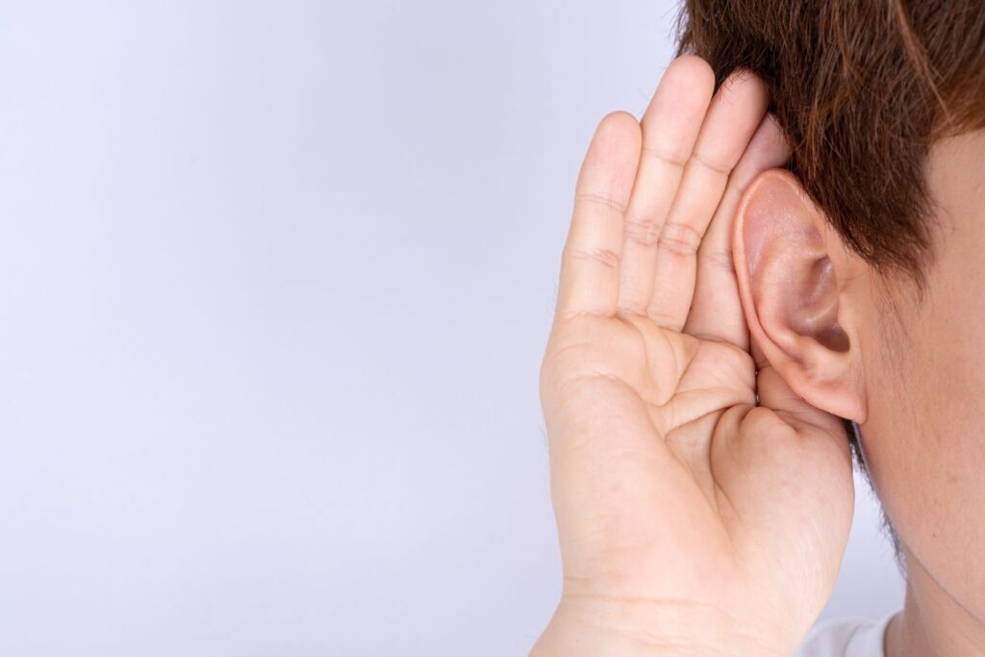

I Can Hear Clearly Now
by Pastor Fee Soliven
John 14:26-28
Sunday Morning
July 9, 2023

Slide 79
John 14:26-28
26 But the Helper, the Holy Spirit, whom the Father will send in My name, He will teach you all things, and bring to your remembrance all things that I said to you. 27 Peace I leave with you, My peace I give to you; not as the world gives do I give to you. Let not your heart be troubled, neither let it be afraid.

Slide 80
28 You have heard Me say to you, 'I am going away and coming back to you.' If you loved Me, you would rejoice because I said, 'I am going to the Father,' for My Father is greater than I.

Slide 81
Hebrews 1:1-2
1 God, who at various times and in various ways spoke in time past to the fathers by the prophets, 2 has in these last days spoken to us by His Son, whom He has appointed heir of all things, through whom also He made the worlds...

Slide 82
John 16:13
"However, when He, the Spirit of truth, has come, He will guide you into all truth; for He will not speak on His own authority, but whatever He hears He will speak; and He will tell you things to come"

Slide 83
Our Ears are tuned to whatever Holds our Hearts and Minds

Slide 84
What are the Primary reasons People Don’t Listen to God?

Slide 85
1. They don’t have a Relationship with Him

Slide 86
Romans 3:10-12
10 As it is written: "There is none righteous, no, not one; 11 There is none who understands; There is none who seeks after God. 12 They have all turned aside; They have together become unprofitable; There is none who does good, no, not one."

Slide 87
2. Many People don’t Expect the
Lord to Speak to Them

Slide 88
1 John 4:10
"In this is love, not that we loved God, but that He loved us and sent His Son to be the propitiation for our sins"

Slide 89
3. The Messages of the World Drown out God’s Voice

Slide 90
1 Corinthians 2:16
"For "who has known the mind of the LORD that he may instruct Him?" But we have the mind of Christ"

Slide 91
4. They Don’t Think He has ever
Spoken to Them

Slide 92
John 10:27-28
27 My sheep hear My voice, and I know them, and they follow Me. 28 And I give them eternal life, and they shall never perish; neither shall anyone snatch them out of My hand.

Slide 93
5. Their Minds are Closed to His Voice

Slide 94
Acts 28:25-27
25 So when they did not agree among themselves, they departed after Paul had said one word: "The Holy Spirit spoke rightly through Isaiah the prophet to our fathers, 26 saying, 'Go to this people and say: "Hearing you will hear, and shall not understand; And seeing you will see, and not perceive;

Slide 95
27 For the hearts of this people have grown dull. Their ears are hard of hearing, And their eyes they have closed, Lest they should see with their eyes and hear with their ears, Lest they should understand with their hearts and turn, So that I should heal them."

Slide 96
6. People are Too Busy

Slide 97
Luke 21:34-36
34 "But take heed to yourselves, lest your hearts be weighed down with carousing, drunkenness, and cares of this life, and that Day come on you unexpectedly. 35 For it will come as a snare on all those who dwell on the face of the whole earth.

Slide 98
36 Watch therefore, and pray always that you may be counted worthy to escape all these things that will come to pass, and to stand before the Son of Man."

Slide 99
7. They May Fear the Message

Slide 100
2 Corinthians 6:14-18
14 Do not be unequally yoked together with unbelievers. For what fellowship has righteousness with lawlessness? And what communion has light with darkness? 15 And what accord has Christ with Belial? Or what part has a believer with an unbeliever?

Slide 101
16 And what agreement has the temple of God with idols? For you are the temple of the living God. As God has said: "I will dwell in them And walk among them. I will be their God, And they shall be My people."

Slide 102
17 Therefore "Come out from among them And be separate, says the Lord. Do not touch what is unclean, And I will receive you." 18 "I will be a Father to you, And you shall be My sons and daughters, Says the LORD Almighty."

Slide 103
8. Sometimes People are
Angry with the Lord

Slide 104
Ephesians 4:26-27
26 Be angry, and do not sin": do not let the sun go down on your wrath, 27 nor give place to the devil.

Slide 105
9. They have Neglected Reading and Meditating on the Bible

Slide 106
Romans 12:1-2
1 I beseech you therefore, brethren, by the mercies of God, that you present your bodies a living sacrifice, holy, acceptable to God, which is your reasonable service. 2 And do not be conformed to this world, but be transformed by the renewing of your mind, that you may prove what is that good and acceptable and perfect will of God.

Slide 107
10. Some People have a Rebellious Spirit

Slide 108
1 Samuel 15:22-23
(New Living Translation)
22 But Samuel replied, “What is more pleasing to the Lord: your burnt offerings and sacrifices or your obedience to his voice? Listen! Obedience is better than sacrifice, and submission is better than offering the fat of rams.

Slide 109
23 Rebellion is as sinful as witchcraft, and stubbornness as bad as worshiping idols. So, because you have rejected the command of the Lord, he has rejected you as king.”

Slide 110
11. Sin has Prevented them from
Hearing God

Slide 111
Psalm 66:18
"If I regard iniquity in my heart, The Lord will not hear"

Slide 112
Isaiah 59:2
"But your iniquities have separated you from your God; And your sins have hidden His face from you, So that He will not hear"

Slide 113
How can we identify God’s voice?

Slide 114
His Voice will be Consistent with His Word

Slide 115
Psalm 119:160
"The entirety of Your word is truth, And every one of Your righteous judgments endures forever"

Slide 116
John 17:17
"Sanctify them by Your truth. Your word is truth"

Slide 117
2. His Message will Often Conflict with Human Nature

Slide 118
2 Corinthians 9:8
"And God is able to make all grace abound toward you, that you, always having all sufficiency in all things, may have an abundance for every good work"

Slide 119
3. The Lord Challenges our Faith

Slide 120
Proverbs 3:5-6
5 Trust in the LORD with all your heart, And lean not on your own understanding; 6 In all your ways acknowledge Him, And He shall direct your paths.

Slide 121
4. His Voice is Often Quiet and Still

Slide 122
1 Kings 19:11-12
11 Then He said, "Go out, and stand on the mountain before the LORD." And behold, the LORD passed by, and a great and strong wind tore into the mountains and broke the rocks in pieces before the LORD, but the LORD was not in the wind; and after the wind an earthquake, but the LORD was not in the earthquake;

Slide 123
12 and after the earthquake a fire, but the LORD was not in the fire; and after the fire a still small voice.

Slide 124
Why Do we need to Listen to the Lord?

Slide 125
Philippians 4:19
“And my God shall supply all your need according to His riches in glory by Christ Jesus”

Slide 126
To Help us Make Decisions

Slide 127
Romans 12:2
“And do not be conformed to this world, but be transformed by the renewing of your mind, that you may prove what is that good and acceptable and perfect will of God”

Slide 128
To be Encouraged

Slide 129
Colossians 2:2
“that their hearts may be encouraged, being knit together in love, and attaining to all riches of the full assurance of understanding, to the knowledge of the mystery of God, both of the Father and of Christ”

Slide 130
To Receive Comfort

Slide 131
2 Corinthians 1:3-4
3 Blessed be the God and Father of our Lord Jesus Christ, the Father of mercies and God of all comfort, 4 who comforts us in all our tribulation, that we may be able to comfort those who are in any trouble, with the comfort with which we ourselves are comforted by God

Slide 132
To be Strengthened

Slide 133
1 Peter 5:10
But may the God of all grace, who called us to His eternal glory by Christ Jesus, after you have suffered a while, perfect, establish, strengthen, and settle you.

Slide 134
To Have Assurance of Salvation

Slide 135
John 10:28
“And I give them eternal life, and they shall never perish; neither shall anyone snatch them out of My hand.”

Slide 136
To Benefit from His Protection

Slide 137
What are the consequences of failing to listen to God?

Slide 138
1. The world will draw us away from Him if we ignore His voice

Slide 139
2. We’ll be easily deceived by all the other voices

Slide 140
3. We will make costly decisions based on human reasoning rather than divine guidance

Slide 141
4. We’ll make choices that appeal to the flesh and give us what we want

Slide 142
5. Our decisions could cause us to forfeit God’s best and all that He wanted us to have

Slide 143
6. We’ll miss out on the will of God for our lives and suffer consequences that could affect us for years to come

Slide 144
7. Our wrong decisions hurt our families because everyone suffers when one member refuses to follow the Lord’s guidance

Slide 145
8. There will be eternal consequences

Slide 146
1 Thessalonians 4:13-18
13 But I do not want you to be ignorant, brethren, concerning those who have fallen asleep, lest you sorrow as others who have no hope. 14 For if we believe that Jesus died and rose again, even so God will bring with Him those who sleep in Jesus.

Slide 147
15 For this we say to you by the word of the Lord, that we who are alive and remain until the coming of the Lord will by no means precede those who are asleep. 16 For the Lord Himself will descend from heaven with a shout, with the voice of an archangel, and with the trumpet of God. And the dead in Christ will rise first.

Slide 148
17 Then we who are alive and remain shall be caught up together with them in the clouds to meet the Lord in the air. And thus we shall always be with the Lord. 18 Therefore comfort one another with these words.

Slide 149
1 Corinthians 15:50-54
50 Now this I say, brethren, that flesh and blood cannot inherit the kingdom of God; nor does corruption inherit incorruption. 51 Behold, I tell you a mystery: We shall not all sleep, but we shall all be changed-- 52 in a moment, in the twinkling of an eye, at the last trumpet. For the trumpet will sound, and the dead will be raised incorruptible, and we shall be changed.

Slide 150
53 For this corruptible must put on incorruption, and this mortal must put on immortality. 54 So when this corruptible has put on incorruption, and this mortal has put on immortality, then shall be brought to pass the saying that is written: "Death is swallowed up in victory."

Slide 151

20 Again, when a righteous man turns from his righteousness and commits iniquity, and I lay a stumbling block before him, he shall die; because you did not give him warning, he shall die in his sin, and his righteousness which he has done shall not be remembered; but his blood I will require at your hand.

Slide 152
Acts 2:38-39
38 Then Peter said to them, "Repent, and let every one of you be baptized in the name of Jesus Christ for the remission of sins; and you shall receive the gift of the Holy Spirit. 39 For the promise is to you and to your children, and to all who are afar off, as many as the Lord our God will call."

