Slide 2
Happy Day
(Jesus Culture)

Slide 3
The greatest day in history, death is beaten You have rescued me Sing it out, Jesus is alive The empty

Slide 4
cross, the empty grave Life eternal, You have won the day Shout it all, Jesus is alive He's alive and...Oh

Slide 5
happy day, happy day You washed my sin away Oh happy day, happy day I'll never be the same, no no

Slide 6
no Forever I am changed, haha! When I stand, in that place Free at last, meeting face to face I am

Slide 7
Yours, Jesus You are mine Endless joy and perfect peace Earthly pain finally will cease Celebrate, Jesus

Slide 8
is alive, haha! He's alive and...Oh happy day, happy day You washed my sin away Oh happy day, happy

Slide 9
day I'll never be the same Oh happy day, happy day
You washed my sin away Oh happy day, happy day

Slide 10
I'll never be the same, no no no Forever I am changed, yeah yeah...And oh what a glorious day

Slide 11
we want You Come and consume, God All we are We give You permission Our hearts are Yours We

Slide 12
What a glorious way That You have saved me And oh what a glorious day, ha! What a glorious name,

Slide 13
Jesus! And oh happy day, happy day You washed my sin away Oh happy day, happy day I'll never be

Slide 14
the same, no no no no Forever I am changed By Your love, by Your grace, oh God Forever I am

Slide 15
changed I can't stay the same, oh no no no 'Cause forever I am changed, ha! Yeah yeah yeah yeah And

Slide 16
oh what a glorious day What a glorious way That You have saved me And oh what a glorious

Slide 17
day What a glorious name I love the name There's so much power in the name And oh what a glorious

Slide 18
day What a glorious way, ha! That You have saved me And oh what a glorious day, hey! What a glorious

Slide 19
name Jesus! And oh happy day, happy day You washed my sin away Oh happy day, happy day I'll

Slide 20
never be the same Oh happy day, happy day You washed my sin away Oh happy day, happy day I'll

Slide 21
never be the same Come on now, don't be shy to praise Jesus, oh (yeah yeah yeah...) This is joy, now

Slide 22
this is joy Now this is joy, now this is joy Now this is joy, ooh yeah yeah yeah...(Come on) And oh happy

Slide 23
day, happy day You washed my sin away Oh happy day, happy day I'll never be the same, no no no

Slide 24
'Cause forever I am changed Forever, forever, forever Forever I am changed By Your love, by Your

Slide 25
grace, oh God, yeah yes Forever I am changed Come on and don't be shy to praise Jesus

Slide 26
Eyes of Zion
(Rick Pino)

Slide 27
Light the torches, blow the trumpets We're watchmen posted on our walls Raise up a people who know

Slide 28
Your voice A people who follow the cloud Awaken our hearts, awaken our hearts We declare that, This is

Slide 29
the Lord's generation This is the Lord's generation This is the Lord's generation Make us a watchmen of

Slide 30
compassion Breathe on those slain so they may live
We speak life to the desert land Taking up our

Slide 31
weapons, strong we stand

Slide 32
“Reckless Love”
(Cory Asbury)

Slide 33
Before I spoke a word you were singingover me. You have been so, so good to me. Before I took a breath

Slide 34
You breathed your life in me. You have been so, so kind to me. Oh’ the overwhelming never ending

Slide 35
Reckless love of God. Oh, he chases me down fights til I’m found leaves the 99. And I couldn’t earn it I

Slide 36
Don’t deserve it still you give yourself away.. Oh’ the overwhelming never ending reckless love of God.

Slide 37
When I was your foe still your love fought for me. You have been so , so good to me. When I felt no worth

Slide 38
You paid it all for me. You have been so, so kind to me. Oh the overwhelming, never ending reckless

Slide 39
Love of God. Oh it chases me down fights til I’m found leaves the 99. And I couldn’t earn it. I don’t

Slide 40
Deserve it. Still you give yourself away. Oh, the overwhelming never ending reckless love of God.

Slide 41
There’s no shadow you won’t light up mountain you won’t climb up coming after me. There’s no wall you

Slide 42
wont kick down. Lie you wont tear down. Coming after me. There’s no wall you wont kick down lie

Slide 43
You wont tear down. Coming after me. Oh’ the overwhelming never ending reckless love of God

Slide 44
Oh’ It chases me down fights til I’m found leaves the 99. I couldn’t earn it. I don’t deserve it. Still you give

Slide 45
Yourself away. Oh the overwhelming , never ending reckless love of God.

Slide 46
Psalm 63
(Jeremy Riddle)

Slide 47
God You're my God And earnestly I seek You My heart and my flesh They hunger and thirst for You In

Slide 48
this dry and weary land I've come to worship I've come to lift up my hands For I have seen You I've

Slide 49
beheld Your glory And I am ruined For there is none to compare And I long to know You And the depths of

Slide 50
Your love That always leave me Time and time again, undone Always, always And in You oh Lord

Slide 51
Will I always rejoice You are the One who upholds me In You I will place my trust In this dry and weary

Slide 52
land Still I will worship And I will lift up my hands I have seen You I've beheld Your glory And I am

Slide 53
ruined For there is none to compare And I long to know You And the depths of Your love That always

Slide 54
leaves me It leaves me time and time again, undone Undone Undone Undone by You Ohh, Ohh Who is

Slide 55
like the Lord Who is like the Lord Who is like the Lord I have seen You I've beheld Your glory

Slide 56
And I am ruined For there is none to compare And I long to know You And the depths of Your love That

Slide 57
always leaves me Time and time again, undone

Slide 58
“Only You”
(David Crowder)

Slide 59
Take my heart, I lay it down At the feet of you whose crowned Take my life, I'm letting go I lift it up to you

Slide 60
who's throned And I will worship You, Lord Only You, Lord And I will bow down before You Only You Lord

Slide 61
Take my fret, take my fear All I have, I'm leaving here Be all my hopes, be all my dreams Be all my

Slide 62
delights, be my everything And It's just you and me here now Only you and me here now You should see

Slide 63
the view When it's only You

Slide 64
“Worthy of it all”
(CeCe Winans)

Slide 65
All the saints and angels. They bow before the throne. All the elders cast their crowns before the

Slide 66
Lamb of God and sing. All the saints and angels. They bow before your throne. All the elders cast their

Slide 67
Crowns before the lamb of God and sing. You are worthy of it all. You are worthy of it all. For from you

Slide 68
Are all things. And to you are all things. You deserve the glory. You are worthy of it all. You are worthy of it

Slide 69
All. For from you are all things and to you are all things. You deserve the glory. Day and night, night

Slide 70
Night and day. Let incense arise. Day and night, night and day. Let incense arise. Day and night, night

Slide 71
And day let incense arise. Day and night night and day. You are worthy of it all. You are worthy of it all

Slide 72
For from you are al things. And to you are all things. You deserve the glory. You are worthy of it all. You

Slide 73
Are worthy of it all. For from you are all things and to you are all things. You deserve the glory. We exalt

Slide 74
Thee. We exalt thee. We exalt thee, Oh, Lord.
We exalt thee. We exalt thee, We exalt thee, Oh

Slide 75
Lord.

Slide 77
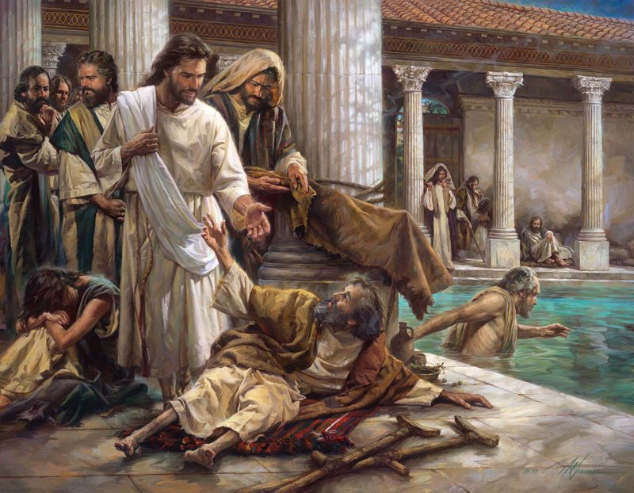
Jesus is Always with Me
by Pastor Fee Soliven
2 Corinthians 4:7-15
Sunday Morning
July 16, 2023

Slide 78
2 Corinthians 4:7-15
7 But we have this treasure in earthen vessels, that the excellence of the power may be of God and not of us. 8 We are hard pressed on every side, yet not crushed; we are perplexed, but not in despair;

Slide 79
9 persecuted, but not forsaken; struck down, but not destroyed-- 10 always carrying about in the body the dying of the Lord Jesus, that the life of Jesus also may be manifested in our body. 11 For we who live are always delivered to death for Jesus' sake, that the life of Jesus also may be manifested in our mortal flesh.

Slide 80
12 So then death is working in us, but life in you. 13 And since we have the same spirit of faith, according to what is written, "I believed and therefore I spoke," we also believe and therefore speak, 14 knowing that He who raised up the Lord Jesus will also raise us up with Jesus, and will present us with you.

Slide 81
15 For all things are for your sakes, that grace, having spread through the many, may cause thanksgiving to abound to the glory of God.

Slide 82
The World in which we Live is Characterized by Adversity

Slide 83
1. But what happens when our view of adversity becomes up close and personal?

Slide 84
2. How does the Lord want us to respond when we come face to face with trials?

Slide 85
3. And what is He trying to teach us through our difficulties?

Slide 86
2 Corinthians 11:23-28
23 Are they ministers of Christ?--I speak as a fool--I am more: in labors more abundant, in stripes above measure, in prisons more frequently, in deaths often. 24 From the Jews five times I received forty stripes minus one.

Slide 87
25 Three times I was beaten with rods; once I was stoned; three times I was shipwrecked; a night and a day I have been in the deep; 26 in journeys often, in perils of waters, in perils of robbers, in perils of my own countrymen, in perils of the Gentiles, in perils in the city, in perils in the wilderness, in perils in the sea, in perils among false brethren;

Slide 88
27 in weariness and toil, in sleeplessness often, in hunger and thirst, in fastings often, in cold and nakedness-- 28 besides the other things, what comes upon me daily: my deep concern for all the churches.

Slide 89
Why would the Lord allow Paul, the man who introduced the Roman world to Jesus Christ, to suffer like this and be killed?

Slide 90
4. All Adversity is not Bad

Slide 91
Characteristics of Adversity

Slide 92
1. Adversity is Universal

Slide 93
2. It’s Impartial

Slide 94
3. Adversity is Painful

Slide 95
4. Sometimes Adversity comes Suddenly

Slide 96
5. Times of Adversity may be Prolonged

Slide 97
6. It may be Intense

Slide 98
7. Adversity is Often Beyond our Control

Slide 99
Questions Regarding Adversity

Slide 100
Why?

Slide 101
Matthew 27:46
And about the ninth hour Jesus cried out with a loud voice, saying, "Eli, Eli, lama sabachthani?" that is, "My God, My God, why have You forsaken Me?"

Slide 102
Who?

Slide 103
Often, the “Who” is Me, Satan, or God

Slide 104
Satan oh Slew Foot

Slide 105
God

Slide 106
2 Corinthians 12:9-10
9 And He said to me, "My grace is sufficient for you, for My strength is made perfect in weakness." Therefore most gladly I will rather boast in my infirmities, that the power of Christ may rest upon me.

Slide 107
10 Therefore I take pleasure in infirmities, in reproaches, in needs, in persecutions, in distresses, for Christ's sake. For when I am weak, then I am strong.

Slide 108
Responses to Adversity

Slide 109
Blame

Slide 110
Escape

Slide 111
Denial

Slide 112
Self-Pity

Slide 113
Seek the Lord

Slide 114
Isaiah 55:6
“Seek the LORD while He may be found, Call upon Him while He is near”

Slide 115
Proverbs 8:17
“I love those who love me, And those who seek me diligently will find me”

Slide 116
Luke 11:9-10
9 "So I say to you, ask, and it will be given to you; seek, and you will find; knock, and it will be opened to you. 10 For everyone who asks receives, and he who seeks finds, and to him who knocks it will be opened.

Slide 117
Adversity is one of God’s most Effective Tools for Strengthening our Faith

Slide 118
The Lord Sends Adversity to Help Us, not to Hurt Us

Slide 119
2 Corinthians 12:7-9
7 And lest I should be exalted above measure by the abundance of the revelations, a thorn in the flesh was given to me, a messenger of Satan to buffet me, lest I be exalted above measure. 8 Concerning this thing I pleaded with the Lord three times that it might depart from me. 9 And He said to me, "My grace is sufficient for you, for My strength is made perfect in weakness."

Slide 120
God is Always with Us

Slide 121
Hebrews 13:5
Let your conduct be without covetousness; be content with such things as you have. For He Himself has said, "I will never leave you nor forsake you."

Slide 122
Adversity can be a Precious
Gift from the Lord

Slide 123
The Guidebook for Adversity

Slide 124
1. As you look back at past adversity, what greater understanding have you gained about God’s character, promises, and purposes?

Slide 125
2. What principles have you learned from God’s Word that will help you respond to your trials as He desires?

Slide 126
1 Thessalonians 4:13-18
13 But I do not want you to be ignorant, brethren, concerning those who have fallen asleep, lest you sorrow as others who have no hope. 14 For if we believe that Jesus died and rose again, even so God will bring with Him those who sleep in Jesus.

Slide 127
15 For this we say to you by the word of the Lord, that we who are alive and remain until the coming of the Lord will by no means precede those who are asleep. 16 For the Lord Himself will descend from heaven with a shout, with the voice of an archangel, and with the trumpet of God. And the dead in Christ will rise first.

Slide 128
17 Then we who are alive and remain shall be caught up together with them in the clouds to meet the Lord in the air. And thus we shall always be with the Lord. 18 Therefore comfort one another with these words.

Slide 129
1 Corinthians 15:50-54
50 Now this I say, brethren, that flesh and blood cannot inherit the kingdom of God; nor does corruption inherit incorruption. 51 Behold, I tell you a mystery: We shall not all sleep, but we shall all be changed-- 52 in a moment, in the twinkling of an eye, at the last trumpet. For the trumpet will sound, and the dead will be raised incorruptible, and we shall be changed.

Slide 130
53 For this corruptible must put on incorruption, and this mortal must put on immortality. 54 So when this corruptible has put on incorruption, and this mortal has put on immortality, then shall be brought to pass the saying that is written: "Death is swallowed up in victory."

Slide 131
20 Again, when a righteous man turns from his righteousness and commits iniquity, and I lay a stumbling block before him, he shall die; because you did not give him warning, he shall die in his sin, and his righteousness which he has done shall not be remembered; but his blood I will require at your hand.

Slide 132
Acts 2:38-39
38 Then Peter said to them, "Repent, and let every one of you be baptized in the name of Jesus Christ for the remission of sins; and you shall receive the gift of the Holy Spirit. 39 For the promise is to you and to your children, and to all who are afar off, as many as the Lord our God will call."

