Slide 1


Slide 2
“I Give You Glory”
(Dennis Campo)

Slide 3
Oh, how beautiful Are You, Lord It's Your words It's Your love Oh, how glorious Are You, Lord It's Your

Slide 4
power It was Your cross That saved me And rescued me Just a moment there Set me free I give You glory,

Slide 5
glory I give You glory, glory I give You glory, glory
Jesus I give You glory, glory I give You glory, glory I

Slide 6
give You glory, glory Jesus Oh, how beautiful Are You, Lord It's Your words It's Your love Oh, how

Slide 7
glorious Are You, Lord It's Your power It was Your cross That saved me And rescued me Just a

Slide 8
moment there Set me free I give You glory, glory I give You glory, glory I give You glory, glory Jesus

Slide 9
I give You glory, glory I give You glory, glory I give You glory, glory Jesus And With a crown of thorns

Slide 10
You became my King forever And With a crown of thorns You became my King forever And With a

Slide 11
crown of thorns You became my King forever And with a crown of thorns You became my king forever

Slide 12
That saved me And rescued me Just a moment there Set me free That saved me And rescued me

Slide 13
Just a moment there Set me free Te doy gloria, gloria
Te doy gloria, gloria Te doy gloria, gloria A ti Hesus

Slide 14
Te doy gloria, gloria Te doy gloria, gloria Te doy gloria, gloria A ti Hesus

Slide 15
“King of Glory”
(The Ramp)

Slide 16
[Verse 1] Your face outshines the brightest sun
Jesus, You're glorious Jesus, You're glorious

Slide 17
And Your eyes they burn like a blazing fire Jesus, You're glorious Jesus, You're glorious

Slide 18
[Verse 2] Said, in Your hand You hold the stars
Jesus, You're powerful Jesus, You're powerful

Slide 19
And Your voice like rushing water sounds Jesus, You're powerful Jesus, You're powerful Come on,

Slide 20
sing that again In Your hand You hold the stars Jesus, You're powerful Hey, You are so powerful And

Slide 21
Your voice like rushing water sounds Jesus, You're powerful Jesus, You're powerful [Chorus] So King of

Slide 22
Glory, have Your glory King of Glory, have Your glory King of Glory, have Your glory King of Glory, have

Slide 23
Your glory [Chorus] And King of Glory, have Your glory King of Glory, have Your glory King of Glory,

Slide 24
have Your glory King of Glory, have Your glory [Outro] Oh, have Your glory, Lord Have Your glory,

Slide 25
Lord Hey, eyes like a fire He's got eyes like a fire He's got eyes like fire He's got eyes like fire Eyes like

Slide 26
fire

Slide 27
“Spirit Break Out”
Jesus Culture

Slide 28
Our Father, all of Heaven roars Your name Sing louder, let this place erupt with praise Can you hear

Slide 29
it, the sound of Heaven touching Earth The sound of Heaven touching Earth Our Father, all of Heaven

Slide 30
roars Your name Sing louder, let this place erupt with praise Can you hear it, the sound of Heaven touching

Slide 31
Earth The sound of Heaven touching Earth Our Father, all of Heaven roars Your name Sing louder,

Slide 32
let this place erupt with praise Can you hear it, the sound of Heaven touching Earth The sound

Slide 33
of Heaven touching Earth Spirit break out Break our walls down Spirit break out Heaven come down Spirit

Slide 34
break out Break our walls down Spirit break out Heaven come down King Jesus You're the name

Slide 35
we're lifting high Your glory shaking up the earth and skies Revival we wanna see Your kingdom here We

Slide 36
wanna see Your kingdom here King Jesus You're the name we're lifting high Your glory shaking up the

Slide 37
earth and skies Revival we wanna see Your kingdom here We wanna see Your kingdom here Spirit break

Slide 38
out Break our walls down Spirit break out Heaven come down Spirit break out Break our walls down

Slide 39
Spirit break out Heaven come down King Jesus You're the name we're lifting high Your glory shaking

Slide 40
up the earth and skies Revival we wanna see Your kingdom here We wanna see Your kingdom here

Slide 41
King Jesus You're the name we're lifting high Your glory shaking up the earth and skies Revival we

Slide 42
wanna see Your kingdom here We wanna see Your kingdom here Spirit break out Break our walls down

Slide 43
Spirit break out Heaven come down Spirit break out
Break our walls down

Slide 44
“Breathe on Me”
(Eddie James)

Slide 45
And on the sixth day made Formed and fashioned in Your hand In Your image created In the likeness of

Slide 46
Thee In Your presence lay The faithful potter's clay
With every part of Adam's being He was crying and

Slide 47
pleading Saying Lord Breathe on me Breathe on me
Fill this place (Fill this place) With the breath (With

Slide 48
the breath of heaven) Eh, eh-eh ye, oh, breathe on me With the breath And when the day of Pentecost

Slide 49
Was fully come They were all with one accord Gathered in the upper room And in Your presence

Slide 50
lay The faithful potter's clay With every part of their being They were crying and pleading Breath!

Slide 51
Breathe on me Would You breath on me Jesus (breathe on me) Fill this place (fill this place) With the

Slide 52
breath of heaven (with the breath of heaven) Lord (breathe on me) Breathe on me (breathe

Slide 53
on me) Fill this place With the breath of heaven And as it was at Pentecost And on the sixth day We are

Slide 54
all in one accord And we are gathered in one place And in Your presence lay You're the potter, we're the

Slide 55
clay And every part of our being Is crying and pleading Breathe on me Lord would You

Slide 56
(Breathe on me) With Your power, with Your anointing (fill this place) With the breath of heaven

Slide 57
Breathe on me Breathe on me (breathe on me) Would You fill this place (fill this place) With the

Slide 58
breath (with the breath of heaven) Lord rain on me (rain on me) Rivers of Your glory say (rain on me) Fill

Slide 59
this place (fill this place) With the rain of heaven (with the rain of heaven) Oh, Lord we ask for the rain

Slide 60
(Rain on me) Rain on me (rain on me) Lord, fill this place (fill this place) With the rain of heaven (with the

Slide 61
rain of heaven) Lord, would You burn in me (Burn in me) Burn in me (burn in me) Fill this place (fill this

Slide 62
place) With the fire from heaven (with the fire of heaven) Would You burn in me (burn in me) Burn in

Slide 63
me Lord (burn in me) Fill this place (fill this place) With the fire of heaven (with the fire of heaven) Send

Slide 64
the fire (send the fire) Send the fire (send the fire) Send the fire (send the fire) Send the fire

Slide 65
(send the fire) Send the fire (send the fire) Send the fire (send the fire) Send the fire (send the fire) Send

Slide 66
the fire (send the fire) Send the fire (send the fire) Consume us (send the fire) Baptize us (send the fire)

Slide 67
Revive us (send the fire) Send Your fire (send the fire) Send Your fire (send the fire) Send Your fire

Slide 68
(send the fire) Send Your fire (send the fire) Fire (send the fire) Send Your fire (send the fire) Release

Slide 69
Your glory (send the fire) Release Your Spirit (send the fire) Lord You will fill us (send the fire) Consume

Slide 70
our heart (send the fire) Consume my mind (send the fire) Consume my soul (send the fire) Release

Slide 71
Your fire (send the fire) Like You did for Elijah (send the fire) We walk with God (send the fire) Who

Slide 72
answers by fire (send the fire) Send Your fire (send the fire) Send Your fire (send the fire) Send Your fire

Slide 73
(send the fire) Let it burn (send the fire) Let it burn (send the fire) Let it burn (send the fire) Let it burn

Slide 74
(send the fire) Let it burn (send the fire) Burn away the atmosphere (send the fire) Burn away their

Slide 75
difference (send the fire) Burn in my heart (send the fire) Burn in my soul (send the fire) Burn in my hands

Slide 76
(send the fire) Burn in my feet (send the fire) Burn in my eyes (send the fire) Burn in my

Slide 77
mouth (send the fire) Send Your fire (send the fire) Send Your fire (send the fire) Send Your fire (send

Slide 78
the fire) Burn in me (send the fire) Burn (burn in me) Lord would You burn in me (burn in me) Fill this

Slide 79
place (fill this place) With the fire of heaven (with the fire of heaven) Oh-oh-oh, would You burn in me

Slide 80
(burn in me) Holy Ghost fire, burn in me (burn in me)
Fill this place (fill this place) With the fire of heaven

Slide 81
(with the fire of heaven) Eh-eh, would You burn in me Burn in me Fill this place With the fire Common I

Slide 82
want to see you left your hands Every hungry person, every thirsty person Would You burn in me

Slide 83
Baptize us afresh again

Slide 84
“Holy”
(Kim Walker)

Slide 85
Just one look on Your face Just one glance of Your eyes My whole world is changed My whole world is

Slide 86
changed Oh I seek only to see Your face I don't wanna go anywhere without You God Without Your

Slide 87
presence Oh let me see Your face The beauty of Your holiness God Take me into the holy place And

Slide 88
only one word comes to mind There's only one word to describe And only one word comes to mind

Slide 89
There's only one word to describe Holy, Holy, Lord God Almighty Holy, Holy, Lord God Almighty And

Slide 90
only one word comes to mind There's only one word to describe And only one word comes to

Slide 91
mind There's only one word to describe And only one word comes to mind There's only one word to

Slide 92
describe And only one word comes to mind There's only one word to describe Holy, Holy, Lord God

Slide 93
Almighty Holy, Holy, Lord God Almighty There is no one like You You are Holy There is no one like You

Slide 94
You are Holy Holy Holy, Holy, Lord God Almighty You are Holy, Holy, Lord God Almighty We join with all of

Slide 95
heaven singing Holy, Holy, Holy Holy, Holy, Holy Holy, Holy, Holy Take us in Take us in Take us in

Slide 96
tonight Holy, Holy, Lord God Almighty Holy, Holy, Lord God Almighty Take us into the holy place Take

Slide 97
us into the holy place tonight Take us into the holy place Take us into the holy place tonight Purify our

Slide 98
hearts Purify our hearts Purify our hearts God Let the flame of Your heart Become a Flame upon our hearts

Slide 99
tonight, God Take us in There is no one like You You are holy, holy There is no one like You You are holy,

Slide 100
holy Just sing out in your own words Just sing out in your own words Let us be a generation marked with

Slide 101
holiness Oh, A generation of people who know Your love Who know Your holiness, God Carriers of your

Slide 102
presence Carriers of your presence, God A generation marked by Your love A Generation

Slide 103
purified, set apart Holy unto You, God Holy, Holy Lord God Almighty Holy, Holy Lord God Almighty

Slide 104


Slide 105

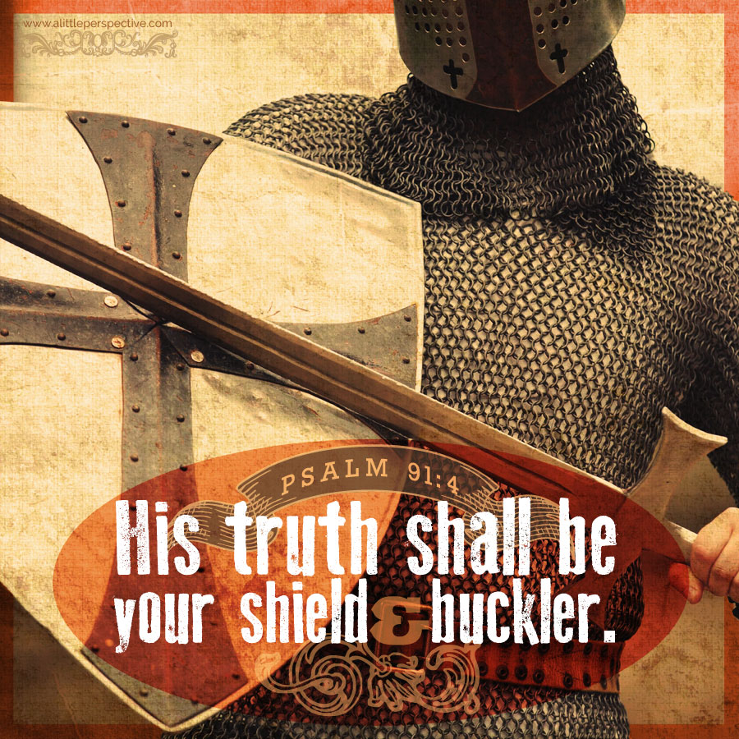
Our Shield and Buckler
by Pastor Fee Soliven
Luke 21:25-28
Sunday Morning
July 30, 2023

Slide 106
Luke 21:25-28
25 "And there will be signs in the sun, in the moon, and in the stars; and on the earth distress of nations, with perplexity, the sea and the waves roaring; 26 men's hearts failing them from fear and the expectation of those things which are coming on the earth, for the powers of heaven will be shaken.

Slide 107
27 Then they will see the Son of Man coming in a cloud with power and great glory. 28 Now when these things begin to happen, look up and lift up your heads, because your redemption draws near."

Slide 108
2 Corinthians 4:7-10
7 But we have this treasure in earthen vessels, that the excellence of the power may be of God and not of us. 8 We are hard pressed on every side, yet not crushed; we are perplexed, but not in despair; 9 persecuted, but not forsaken; struck down, but not destroyed--

Slide 109
10 always carrying about in the body the dying of the Lord Jesus, that the life of Jesus also may be manifested in our body.

Slide 110
1. Know That God is in Total Control!

Slide 111
Psalm 103:19
The LORD has established His throne in heaven, And His kingdom rules over all.

Slide 112
Daniel 4:35
35 All the inhabitants of the earth are reputed as nothing; He does according to His will in the army of heaven And among the inhabitants of the earth. No one can restrain His hand Or say to Him, "What have You done?"

Slide 113
Colossians 1:16-18
16 For by Him all things were created that are in heaven and that are on earth, visible and invisible, whether thrones or dominions or principalities or powers. All things were created through Him and for Him.

Slide 114
17 And He is before all things, and in Him all things consist. 18 And He is the head of the body, the church, who is the beginning, the firstborn from the dead, that in all things He may have the preeminence.

Slide 115
2. Know that Jesus Will Fight Your Battle

Slide 116
Exodus 14:10-14
10 And when Pharaoh drew near, the children of Israel lifted their eyes, and behold, the Egyptians marched after them. So they were very afraid, and the children of Israel cried out to the LORD.

Slide 117
11 Then they said to Moses, "Because there were no graves in Egypt, have you taken us away to die in the wilderness? Why have you so dealt with us, to bring us up out of Egypt?

Slide 118
12 Is this not the word that we told you in Egypt, saying, 'Let us alone that we may serve the Egyptians?' For it would have been better for us to serve the Egyptians than that we should die in the wilderness."

Slide 119
13 And Moses said to the people, "Do not be afraid. Stand still, and see the salvation of the LORD, which He will accomplish for you today. For the Egyptians whom you see today, you shall see again no more forever. 14 The LORD will fight for you, and you shall hold your peace."

Slide 120
2 Chronicles 20:1-4
1 It happened after this that the people of Moab with the people of Ammon, and others with them besides the Ammonites, came to battle against Jehoshaphat.

Slide 121
2 Then some came and told Jehoshaphat, saying, "A great multitude is coming against you from beyond the sea, from Syria; and they are in Hazazon Tamar" (which is En Gedi).

Slide 122
3 And Jehoshaphat feared, and set himself to seek the LORD, and proclaimed a fast throughout all Judah. 4 So Judah gathered together to ask help from the LORD; and from all the cities of Judah they came to seek the LORD.

Slide 123
2 Chronicles 20:14-19
14 Then the Spirit of the LORD came upon Jahaziel the son of Zechariah, the son of Benaiah, the son of Jeiel, the son of Mattaniah, a Levite of the sons of Asaph, in the midst of the assembly.

Slide 124
15 And he said, "Listen, all you of Judah and you inhabitants of Jerusalem, and you, King Jehoshaphat! Thus says the LORD to you: 'Do not be afraid nor dismayed because of this great multitude, for the battle is not yours, but God's.

Slide 125
16 Tomorrow go down against them. They will surely come up by the Ascent of Ziz, and you will find them at the end of the brook before the Wilderness of Jeruel.

Slide 126
17 You will not need to fight in this battle. Position yourselves, stand still and see the salvation of the LORD, who is with you, O Judah and Jerusalem!' Do not fear or be dismayed; tomorrow go out against them, for the LORD is with you."

Slide 127
18 And Jehoshaphat bowed his head with his face to the ground, and all Judah and the inhabitants of Jerusalem bowed before the LORD, worshiping the LORD. 19 Then the Levites of the children of the Kohathites and of the children of the Korahites stood up to praise the LORD God of Israel with voices loud and high.

Slide 128
1 Samuel 17:45-50
45 Then David said to the Philistine, "You come to me with a sword, with a spear, and with a javelin. But I come to you in the name of the LORD of hosts, the God of the armies of Israel, whom you have defied.

Slide 129
46 This day the LORD will deliver you into my hand, and I will strike you and take your head from you. And this day I will give the carcasses of the camp of the Philistines to the birds of the air and the wild beasts of the earth, that all the earth may know that there is a God in Israel.

Slide 130
47 Then all this assembly shall know that the LORD does not save with sword and spear; for the battle is the LORD's, and He will give you into our hands." 48 So it was, when the Philistine arose and came and drew near to meet David, that David hastened and ran toward the army to meet the Philistine.

Slide 131
49 Then David put his hand in his bag and took out a stone; and he slung it and struck the Philistine in his forehead, so that the stone sank into his forehead, and he fell on his face to the earth. 50 So David prevailed over the Philistine with a sling and a stone, and struck the Philistine and killed him. But there was no sword in the hand of David.

Slide 132
3. Know That God Has Not Forgotten You!

Slide 133
Psalm 139:1-10
1 O LORD, You have searched me and known me. 2 You know my sitting down and my rising up; You understand my thought afar off. 3 You comprehend my path and my lying down, And are acquainted with all my ways. 4 For there is not a word on my tongue, But behold, O LORD, You know it altogether.

Slide 134
5 You have hedged me behind and before, And laid Your hand upon me. 6 Such knowledge is too wonderful for me; It is high, I cannot attain it. 7 Where can I go from Your Spirit? Or where can I flee from Your presence?

Slide 135
8 If I ascend into heaven, You are there; If I make my bed in hell, behold, You are there. 9 If I take the wings of the morning, And dwell in the uttermost parts of the sea, 10 Even there Your hand shall lead me, And Your right hand shall hold me.

Slide 136
Hebrews 13:5-6
5 Let your conduct be without covetousness; be content with such things as you have. For He Himself has said, "I will never leave you nor forsake you." 6 So we may boldly say: "The LORD is my helper; I will not fear. What can man do to me?"

Slide 137
4. God Will Take Care of Every Need!

Slide 138
Matthew 6:25-34
25 "Therefore I say to you, do not worry about your life, what you will eat or what you will drink; nor about your body, what you will put on. Is not life more than food and the body more than clothing? 26 Look at the birds of the air, for they neither sow nor reap nor gather into barns; yet your heavenly Father feeds them. Are you not of more value than they?

Slide 139
27 Which of you by worrying can add one cubit to his stature? 28 So why do you worry about clothing? Consider the lilies of the field, how they grow: they neither toil nor spin; 29 and yet I say to you that even Solomon in all his glory was not arrayed like one of these.

Slide 140
30 Now if God so clothes the grass of the field, which today is, and tomorrow is thrown into the oven, will He not much more clothe you, O you of little faith? 31 Therefore do not worry, saying, 'What shall we eat?' or 'What shall we drink?' or 'What shall we wear?'

Slide 141
32 "For after all these things the Gentiles seek. For your heavenly Father knows that you need all these things.33 But seek first the kingdom of God and His righteousness, and all these things shall be added to you. 34 Therefore do not worry about tomorrow, for tomorrow will worry about its own things. Sufficient for the day is its own trouble.

Slide 142
Philippians 4:19-20
19 And my God shall supply all your need according to His riches in glory by Christ Jesus. 20 Now to our God and Father be glory forever and ever. Amen.

Slide 143
5. Never Forget What God Has
Done for You!

Slide 144
Psalm 105:1-6
1 Oh, give thanks to the LORD! Call upon His name; Make known His deeds among the peoples! 2 Sing to Him, sing psalms to Him; Talk of all His wondrous works! 3 Glory in His holy name; Let the hearts of those rejoice who seek the LORD!

Slide 145
4 Seek the LORD and His strength; Seek His face evermore! 5 Remember His marvelous works which He has done, His wonders, and the judgments of His mouth, 6 O seed of Abraham His servant, You children of Jacob, His chosen ones!

Slide 146
Luke 1:68-74
68 "Blessed is the Lord God of Israel, For He has visited and redeemed His people, 69 And has raised up a horn of salvation for us In the house of His servant David, 70 As He spoke by the mouth of His holy prophets, Who have been since the world began,

Slide 147
71 That we should be saved from our enemies And from the hand of all who hate us, 72 To perform the mercy promised to our fathers And to remember His holy covenant, 73 The oath which He swore to our father Abraham: 74 To grant us that we, Being delivered from the hand of our enemies, Might serve Him without fear...

Slide 148
Romans 8:1-2
1 There is therefore now no condemnation to those who are in Christ Jesus, who do not walk according to the flesh, but according to the Spirit. 2 For the law of the Spirit of life in Christ Jesus has made me free from the law of sin and death.

Slide 149
Psalm 103:6-14
6 The LORD executes righteousness And justice for all who are oppressed. 7 He made known His ways to Moses, His acts to the children of Israel. 8 The LORD is merciful and gracious, Slow to anger, and abounding in mercy. 9 He will not always strive with us, Nor will He keep His anger forever.

Slide 150
10 He has not dealt with us according to our sins, Nor punished us according to our iniquities. 11 For as the heavens are high above the earth, So great is His mercy toward those who fear Him;

Slide 151
12 As far as the east is from the west, So far has He removed our transgressions from us. 13 As a father pities his children, So the LORD pities those who fear Him. 14 For He knows our frame; He remembers that we are dust.

Slide 152
Isaiah 41:10
"Fear not, for I am with you; Be not dismayed, for I am your God. I will strengthen you, Yes, I will help you, I will uphold you with My righteous right hand."

Slide 153
Psalm 46:1-7
1 God is our refuge and strength, A very present help in trouble. 2 Therefore we will not fear, Even though the earth be removed, And though the mountains be carried into the midst of the sea;

Slide 154
3 Though its waters roar and be troubled, Though the mountains shake with its swelling. 4 There is a river whose streams shall make glad the city of God, The holy place of the tabernacle of the Most High.

Slide 155
5 God is in the midst of her, she shall not be moved; God shall help her, just at the break of dawn. 6 The nations raged, the kingdoms were moved; He uttered His voice, the earth melted. 7 The LORD of hosts is with us; The God of Jacob is our refuge.

Slide 156
1 Thessalonians 4:13-18
13 But I do not want you to be ignorant, brethren, concerning those who have fallen asleep, lest you sorrow as others who have no hope. 14 For if we believe that Jesus died and rose again, even so God will bring with Him those who sleep in Jesus.

Slide 157
15 For this we say to you by the word of the Lord, that we who are alive and remain until the coming of the Lord will by no means precede those who are asleep. 16 For the Lord Himself will descend from heaven with a shout, with the voice of an archangel, and with the trumpet of God. And the dead in Christ will rise first.

Slide 158
17 Then we who are alive and remain shall be caught up together with them in the clouds to meet the Lord in the air. And thus we shall always be with the Lord. 18 Therefore comfort one another with these words.

Slide 159
1 Corinthians 15:50-54
50 Now this I say, brethren, that flesh and blood cannot inherit the kingdom of God; nor does corruption inherit incorruption. 51 Behold, I tell you a mystery: We shall not all sleep, but we shall all be changed-- 52 in a moment, in the twinkling of an eye, at the last trumpet. For the trumpet will sound, and the dead will be raised incorruptible, and we shall be changed.

Slide 160
53 For this corruptible must put on incorruption, and this mortal must put on immortality. 54 So when this corruptible has put on incorruption, and this mortal has put on immortality, then shall be brought to pass the saying that is written: "Death is swallowed up in victory."

Slide 161

20 Again, when a righteous man turns from his righteousness and commits iniquity, and I lay a stumbling block before him, he shall die; because you did not give him warning, he shall die in his sin, and his righteousness which he has done shall not be remembered; but his blood I will require at your hand.

Slide 162
Acts 2:38-39
38 Then Peter said to them, "Repent, and let every one of you be baptized in the name of Jesus Christ for the remission of sins; and you shall receive the gift of the Holy Spirit. 39 For the promise is to you and to your children, and to all who are afar off, as many as the Lord our God will call."

