Slide 2
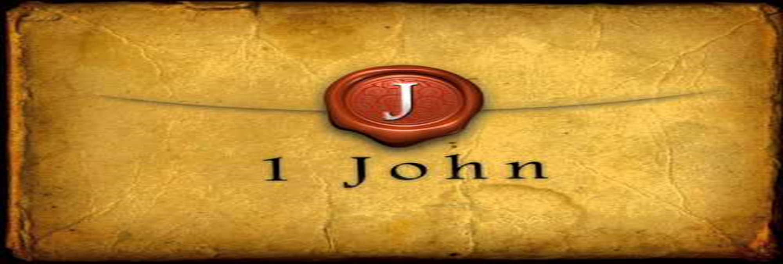
He Who Does the Will of God Abides Forever
by Pastor Fee Soliven
1 John 2:12-17
Wednesday Evening
August 30, 2023

Slide 3
1 John 2:12-17
12 I write to you, little children, Because your sins are forgiven you for His name's sake. 13 I write to you, fathers, Because you have known Him who is from the beginning. I write to you, young men, Because you have overcome the wicked one. I write to you, little children, Because you have known the Father.

Slide 4
14 I have written to you, fathers, Because you have known Him who is from the beginning. I have written to you, young men, Because you are strong, and the word of God abides in you, And you have overcome the wicked one. 15 Do not love the world or the things in the world. If anyone loves the world, the love of the Father is not in him.

Slide 5
16 For all that is in the world--the lust of the flesh, the lust of the eyes, and the pride of life--is not of the Father but is of the world. 17 And the world is passing away, and the lust of it; but he who does the will of God abides forever.

Slide 6
12 I write to you, little children, Because your sins are forgiven you for His name's sake.

Slide 7
John 13:33
“Little children, I shall be with you a little while longer. You will seek Me; and as I said to the Jews, 'Where I am going, you cannot come,' so now I say to you”

Slide 8
Hebrews 8:12
“For I will be merciful to their unrighteousness, and their sins and their lawless deeds I will remember no more."

Slide 9
Isaiah 43:25
"I, even I, am He who blots out your transgressions for My own sake; And I will not remember your sins”

Slide 10
Psalm 103:11-12
11 For as the heavens are high above the earth, So great is His mercy toward those who fear Him; 12 As far as the east is from the west, So far has He removed our transgressions from us.

Slide 11
13 I write to you, fathers, Because you have known Him who is from the beginning. I write to you, young men, Because you have overcome the wicked one. I write to you, little children, Because you have known the Father.

Slide 12
2 Timothy 2:24-26
24 And a servant of the Lord must not quarrel but be gentle to all, able to teach, patient, 25 in humility correcting those who are in opposition, if God perhaps will grant them repentance, so that they may know the truth,

Slide 13
26 and that they may come to their senses and escape the snare of the devil, having been taken captive by him to do his will.

Slide 14
Romans 8:31-39
31 What then shall we say to these things? If God is for us, who can be against us? 32 He who did not spare His own Son, but delivered Him up for us all, how shall He not with Him also freely give us all things?

Slide 15
33 Who shall bring a charge against God's elect? It is God who justifies. 34 Who is he who condemns? It is Christ who died, and furthermore is also risen, who is even at the right hand of God, who also makes intercession for us. 35 Who shall separate us from the love of Christ? Shall tribulation, or distress, or persecution, or famine, or nakedness, or peril, or sword?

Slide 16
36 As it is written: "For Your sake we are killed all day long; We are accounted as sheep for the slaughter." 37 Yet in all these things we are more than conquerors through Him who loved us. 38 For I am persuaded that neither death nor life, nor angels nor principalities nor powers, nor things present nor things to come, 39 nor height nor depth, nor any other created thing, shall be able to separate us from the love of God which is in Christ Jesus our Lord.

Slide 17
Ephesians 6:10-18
10 Finally, my brethren, be strong in the Lord and in the power of His might. 11 Put on the whole armor of God, that you may be able to stand against the wiles of the devil. 12 For we do not wrestle against flesh and blood, but against principalities, against powers, against the rulers of the darkness of this age, against spiritual hosts of wickedness in the heavenly places.

Slide 18
13 Therefore take up the whole armor of God, that you may be able to withstand in the evil day, and having done all, to stand. 14 Stand therefore, having girded your waist with truth, having put on the breastplate of righteousness, 15 and having shod your feet with the preparation of the gospel of peace;

Slide 19
16 above all, taking the shield of faith with which you will be able to quench all the fiery darts of the wicked one. 17 And take the helmet of salvation, and the sword of the Spirit, which is the word of God; 18 praying always with all prayer and supplication in the Spirit, being watchful to this end with all perseverance and supplication for all the saints—

Slide 20
Colossians 2:14-15
14 having wiped out the handwriting of requirements that was against us, which was contrary to us. And He has taken it out of the way, having nailed it to the cross. 15 Having disarmed principalities and powers, He made a public spectacle of them, triumphing over them in it.

Slide 21
14 I have written to you, fathers, Because you have known Him who is from the beginning. I have written to you, young men, Because you are strong, and the word of God abides in you, And you have overcome the wicked one.

Slide 22
15 Do not love the world or the things in the world. If anyone loves the world, the love of the Father is not in him.

Slide 23
James 4:4-8
4 Adulterers and adulteresses! Do you not know that friendship with the world is enmity with God? Whoever therefore wants to be a friend of the world makes himself an enemy of God. 5 Or do you think that the Scripture says in vain, "The Spirit who dwells in us yearns jealously"?

Slide 24
6 But He gives more grace. Therefore He says: "God resists the proud, But gives grace to the humble." 7 Therefore submit to God. Resist the devil and he will flee from you. 8 Draw near to God and He will draw near to you.

Slide 25
16 For all that is in the world--the lust of the flesh, the lust of the eyes, and the pride of life--is not of the Father but is of the world.

Slide 26
1. The Lust for Physical Pleasure

Slide 27
Matthew 5:28
“But I say to you that whoever looks at a woman to lust for her has already committed adultery with her in his heart”

Slide 28
2. The Lust for Everything We See

Slide 29
Hebrews 13:14
“For here we have no continuing city, but we seek the one to come”

Slide 30
1 Peter 2:11 (The Living Bible Version)
“Dear brothers, you are only visitors here. Since your real home is in heaven, I beg you to keep away from the evil pleasures of this world; they are not for you, for they fight against your very souls”

Slide 31
3. Pride in Our Possessions

Slide 32
17 And the world is passing away, and the lust of it; but he who does the will of God abides forever.

Slide 33
1 Thessalonians 4:13-18
13 But I do not want you to be ignorant, brethren, concerning those who have fallen asleep, lest you sorrow as others who have no hope. 14 For if we believe that Jesus died and rose again, even so God will bring with Him those who sleep in Jesus.

Slide 34
15 For this we say to you by the word of the Lord, that we who are alive and remain until the coming of the Lord will by no means precede those who are asleep. 16 For the Lord Himself will descend from heaven with a shout, with the voice of an archangel, and with the trumpet of God. And the dead in Christ will rise first.

Slide 35
17 Then we who are alive and remain shall be caught up together with them in the clouds to meet the Lord in the air. And thus we shall always be with the Lord. 18 Therefore comfort one another with these words.

Slide 36
1 Corinthians 15:50-54
50 Now this I say, brethren, that flesh and blood cannot inherit the kingdom of God; nor does corruption inherit incorruption. 51 Behold, I tell you a mystery: We shall not all sleep, but we shall all be changed-- 52 in a moment, in the twinkling of an eye, at the last trumpet. For the trumpet will sound, and the dead will be raised incorruptible, and we shall be changed.

Slide 37
53 For this corruptible must put on incorruption, and this mortal must put on immortality. 54 So when this corruptible has put on incorruption, and this mortal has put on immortality, then shall be brought to pass the saying that is written: "Death is swallowed up in victory."

Slide 38
20 Again, when a righteous man turns from his righteousness and commits iniquity, and I lay a stumbling block before him, he shall die; because you did not give him warning, he shall die in his sin, and his righteousness which he has done shall not be remembered; but his blood I will require at your hand.

Slide 39
Acts 2:38-39
38 Then Peter said to them, "Repent, and let every one of you be baptized in the name of Jesus Christ for the remission of sins; and you shall receive the gift of the Holy Spirit. 39 For the promise is to you and to your children, and to all who are afar off, as many as the Lord our God will call."

Slide 40
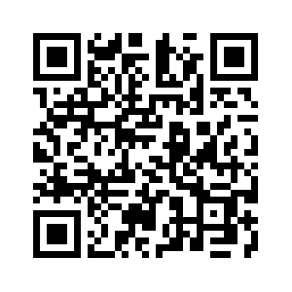
Donate with our QR code app to
Amazing Grace Christian Fellowship
Donations are Deeply Appreciated!

