Slide 2
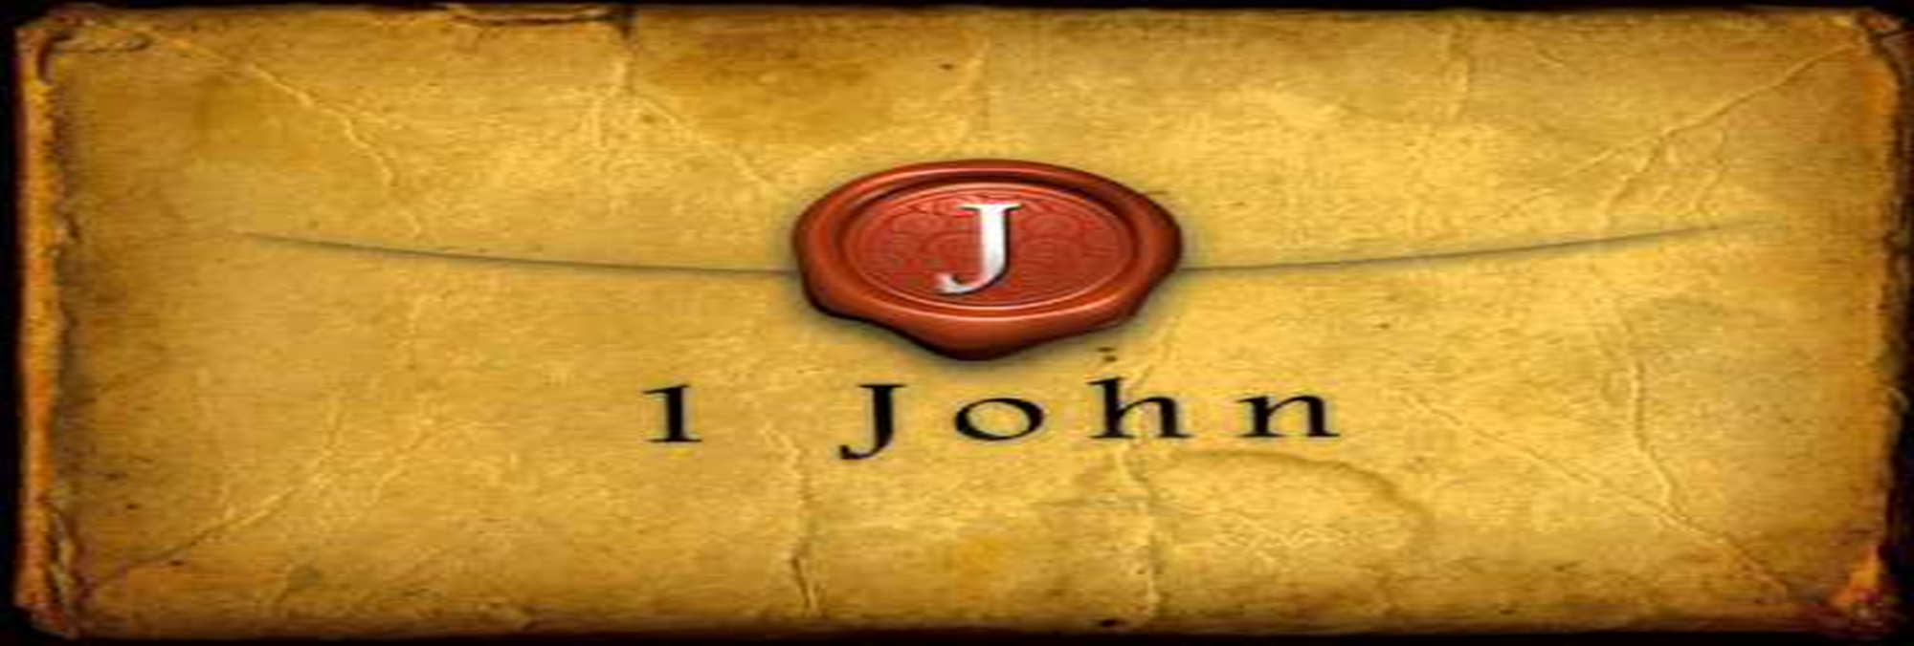
Don’t Be Ashamed of the Appearing of Jesus Christ
by Pastor Fee Soliven
1 John 2:24-29
Wednesday Evening
September 13, 2023

Slide 3
1 John 2:24-29
24 Therefore let that abide in you which you heard from the beginning. If what you heard from the beginning abides in you, you also will abide in the Son and in the Father. 25 And this is the promise that He has promised us--eternal life.

Slide 4
26 These things I have written to you concerning those who try to deceive you. 27 But the anointing which you have received from Him abides in you, and you do not need that anyone teach you; but as the same anointing teaches you concerning all things, and is true, and is not a lie, and just as it has taught you, you will abide in Him.

Slide 5
28 And now, little children, abide in Him, that when He appears, we may have confidence and not be ashamed before Him at His coming. 29 If you know that He is righteous, you know that everyone who practices righteousness is born of Him.

Slide 6
24 Therefore let that abide in you which you heard from the beginning. If what you heard from the beginning abides in you, you also will abide in the Son and in the Father. 25 And this is the promise that He has promised us--eternal life.

Slide 7
John 3:14-15
14 And as Moses lifted up the serpent in the wilderness, even so must the Son of Man be lifted up, 15 that whoever believes in Him should not perish but have eternal life.

Slide 8
John 3:36
“He who believes in the Son has everlasting life; and he who does not believe the Son shall not see life, but the wrath of God abides on him."

Slide 9
John 6:40
And this is the will of Him who sent Me, that everyone who sees the Son and believes in Him may have everlasting life; and I will raise him up at the last day."

Slide 10
John 6:47
“Most assuredly, I say to you, he who believes in Me has everlasting life”

Slide 11
John 6:57
As the living Father sent Me, and I live because of the Father, so he who feeds on Me will live because of Me.

Slide 12
John 17:2-3
2 as You have given Him authority over all flesh, that He should give eternal life to as many as You have given Him. 3 And this is eternal life, that they may know You, the only true God, and Jesus Christ whom You have sent.

Slide 13
26 These things I have written to you concerning those who try to deceive you.

Slide 14
1 John 2:12-14
12 I write to you, little children, Because your sins are forgiven you for His name's sake. 13 I write to you, fathers, Because you have known Him who is from the beginning. I write to you, young men, Because you have overcome the wicked one. I write to you, little children, Because you have known the Father.

Slide 15
14 I have written to you, fathers, Because you have known Him who is from the beginning. I have written to you, young men, Because you are strong, and the word of God abides in you, And you have overcome the wicked one.

Slide 16
1 John 2:21
I have not written to you because you do not know the truth, but because you know it, and that no lie is of the truth.

Slide 17
2 Peter 2:1-3
1 But there were also false prophets among the people, even as there will be false teachers among you, who will secretly bring in destructive heresies, even denying the Lord who bought them, and bring on themselves swift destruction.

Slide 18
2 And many will follow their destructive ways, because of whom the way of truth will be blasphemed. 3 By covetousness they will exploit you with deceptive words; for a long time their judgment has not been idle, and their destruction does not slumber.

Slide 19
27 But the anointing which you have received from Him abides in you, and you do not need that anyone teach you; but as the same anointing teaches you concerning all things, and is true, and is not a lie, and just as it has taught you, you will abide in Him.

Slide 20
John 15:5
I am the vine, you are the branches. He who abides in Me, and I in him, bears much fruit; for without Me you can do nothing.

Slide 21
1 Peter 4:14
If you are reproached for the name of Christ, blessed are you, for the Spirit of glory and of God rests upon you. On their part He is blasphemed, but on your part He is glorified.

Slide 22
Jeremiah 31:34
No longer will each man teach his neighbor or his brother, saying, 'Know the LORD,' because they will all know Me, from the least of them to the greatest, declares the LORD. For I will forgive their iniquities and will remember their sins no more."

Slide 23
Matthew 13:11
He replied, "The knowledge of the mysteries of the kingdom of heaven has been given to you, but not to them.

Slide 24
John 6:45
It is written in the Prophets: 'And they will all be taught by God.' Everyone who has heard the Father and learned from Him comes to Me--

Slide 25
John 14:16
And I will ask the Father, and He will give you another Advocate to be with you forever--

Slide 26
John 14:17
the Spirit of truth. The world cannot receive Him, because it neither sees Him nor knows Him. But you do know Him, for He abides with you and will be in you.

Slide 27
John 14:26
But the Advocate, the Holy Spirit, whom the Father will send in My name, will teach you all things and will remind you of everything I have told you.

Slide 28
28 And now, little children, abide in Him, that when He appears, we may have confidence and not be ashamed before Him at His coming.

Slide 29
Titus 2:11-14
11 For the grace of God that brings salvation has appeared to all men, 12 teaching us that, denying ungodliness and worldly lusts, we should live soberly, righteously, and godly in the present age,

Slide 30
13 looking for the blessed hope and glorious appearing of our great God and Savior Jesus Christ, 14 who gave Himself for us, that He might redeem us from every lawless deed and purify for Himself His own special people, zealous for good works.

Slide 31
29 If you know that He is righteous, you know that everyone who practices righteousness is born of Him.

Slide 32
Ephesians 2:8-9
8 For by grace you have been saved through faith, and that not of yourselves; it is the gift of God, 9 not of works, lest anyone should boast.

Slide 33
James 2:14-17
14 What does it profit, my brethren, if someone says he has faith but does not have works? Can faith save him? 15 If a brother or sister is naked and destitute of daily food, 16 and one of you says to them, "Depart in peace, be warmed and filled," but you do not give them the things which are needed for the body, what does it profit? 17 Thus also faith by itself, if it does not have works, is dead

Slide 34
1 Thessalonians 4:13-18
13 But I do not want you to be ignorant, brethren, concerning those who have fallen asleep, lest you sorrow as others who have no hope. 14 For if we believe that Jesus died and rose again, even so God will bring with Him those who sleep in Jesus.

Slide 35
15 For this we say to you by the word of the Lord, that we who are alive and remain until the coming of the Lord will by no means precede those who are asleep. 16 For the Lord Himself will descend from heaven with a shout, with the voice of an archangel, and with the trumpet of God. And the dead in Christ will rise first.

Slide 36
17 Then we who are alive and remain shall be caught up together with them in the clouds to meet the Lord in the air. And thus we shall always be with the Lord. 18 Therefore comfort one another with these words.

Slide 37
1 Corinthians 15:50-54
50 Now this I say, brethren, that flesh and blood cannot inherit the kingdom of God; nor does corruption inherit incorruption. 51 Behold, I tell you a mystery: We shall not all sleep, but we shall all be changed-- 52 in a moment, in the twinkling of an eye, at the last trumpet. For the trumpet will sound, and the dead will be raised incorruptible, and we shall be changed.

Slide 38
53 For this corruptible must put on incorruption, and this mortal must put on immortality. 54 So when this corruptible has put on incorruption, and this mortal has put on immortality, then shall be brought to pass the saying that is written: "Death is swallowed up in victory."

Slide 39
20 Again, when a righteous man turns from his righteousness and commits iniquity, and I lay a stumbling block before him, he shall die; because you did not give him warning, he shall die in his sin, and his righteousness which he has done shall not be remembered; but his blood I will require at your hand.

Slide 40
Acts 2:38-39
38 Then Peter said to them, "Repent, and let every one of you be baptized in the name of Jesus Christ for the remission of sins; and you shall receive the gift of the Holy Spirit. 39 For the promise is to you and to your children, and to all who are afar off, as many as the Lord our God will call."

Slide 41
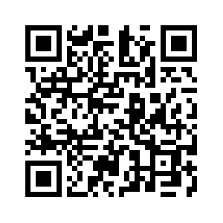
Donate with our QR code app to
Amazing Grace Christian Fellowship
Donations are Deeply Appreciated!

