Slide 2
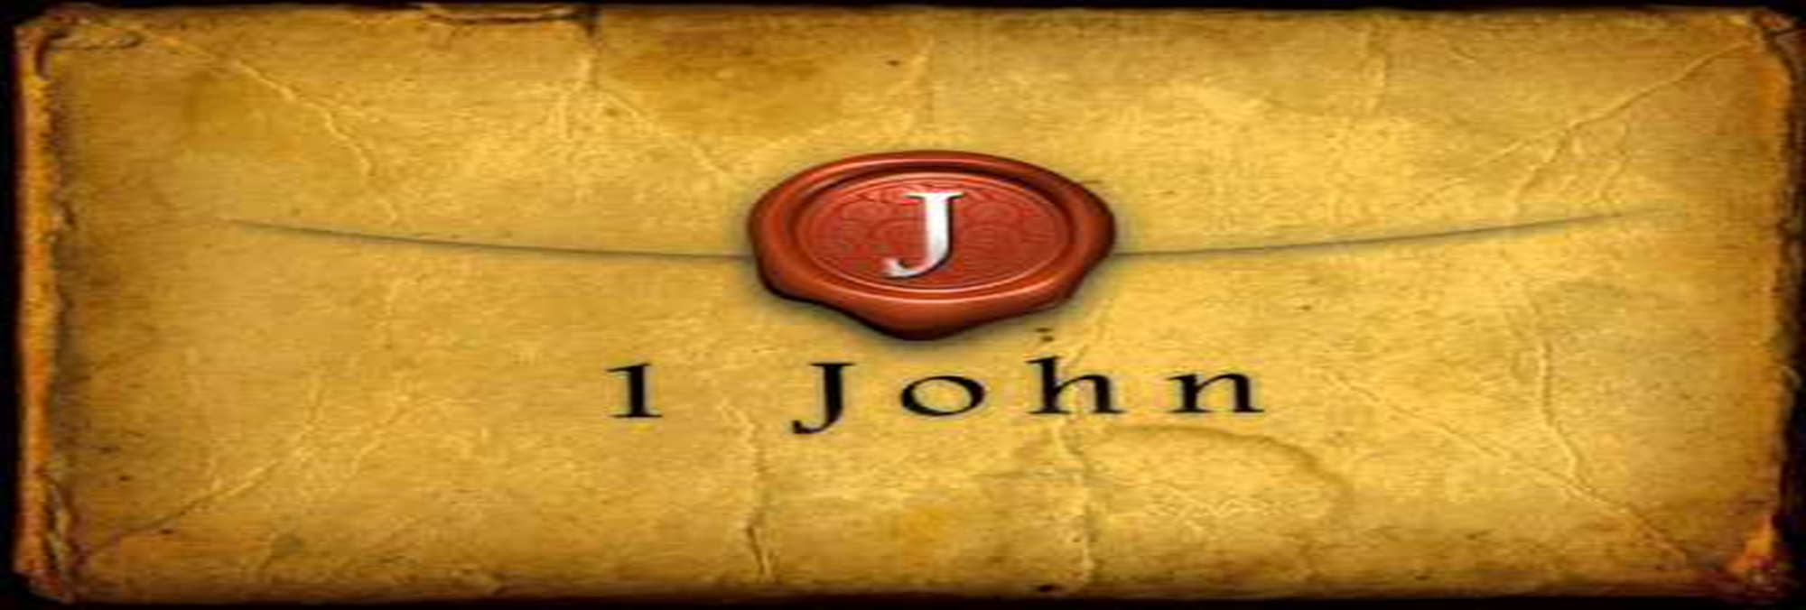
Jesus Christ Destroys the Works of the Devil
by Pastor Fee Soliven
1 John 3:7-13
Wednesday Evening
September 27, 2023

Slide 3
1 John 3:7-13
7 Little children, let no one deceive you. He who practices righteousness is righteous, just as He is righteous. 8 He who sins is of the devil, for the devil has sinned from the beginning. For this purpose the Son of God was manifested, that He might destroy the works of the devil.

Slide 4
9 Whoever has been born of God does not sin, for His seed remains in him; and he cannot sin, because he has been born of God. 10 In this the children of God and the children of the devil are manifest: Whoever does not practice righteousness is not of God, nor is he who does not love his brother.

Slide 5
11 For this is the message that you heard from the beginning, that we should love one another, 12 not as Cain who was of the wicked one and murdered his brother. And why did he murder him? Because his works were evil and his brother's righteous. 13 Do not marvel, my brethren, if the world hates you.

Slide 6
7 Little children, let no one deceive you. He who practices righteousness is righteous, just as He is righteous.

Slide 7
Isaiah 64:6
“But we are all like an unclean thing, And all our righteousnesses are like filthy rags; We all fade as a leaf, And our iniquities, like the wind, Have taken us away”
.

Slide 8
8 He who sins is of the devil, for the devil has sinned from the beginning. For this purpose the Son of God was manifested, that He might destroy the works of the devil

Slide 9
Ephesians 2:14-15
14 For He Himself is our peace, who has made both one, and has broken down the middle wall of separation, 15 having abolished in His flesh the enmity, that is, the law of commandments contained in ordinances, so as to create in Himself one new man from the two, thus making peace…

Slide 10
9 Whoever has been born of God does not sin, for His seed remains in him; and he cannot sin, because he has been born of God.

Slide 11
Do Christians sin or don’t they?

Slide 12
2 Corinthians 5:16-21
16 Therefore, from now on, we regard no one according to the flesh. Even though we have known Christ according to the flesh, yet now we know Him thus no longer. 17 Therefore, if anyone is in Christ, he is a new creation; old things have passed away; behold, all things have become new.

Slide 13
18 Now all things are of God, who has reconciled us to Himself through Jesus Christ, and has given us the ministry of reconciliation, 19 that is, that God was in Christ reconciling the world to Himself, not imputing their trespasses to them, and has committed to us the word of reconciliation.

Slide 14
20 Now then, we are ambassadors for Christ, as though God were pleading through us: we implore you on Christ's behalf, be reconciled to God. 21 For He made Him who knew no sin to be sin for us, that we might become the righteousness of God in Him.

Slide 15
10 In this the children of God and the children of the devil are manifest: Whoever does not practice righteousness is not of God, nor is he who does not love his brother.

Slide 16
1 John 2:1-5
1 My little children, these things I write to you, so that you may not sin. And if anyone sins, we have an Advocate with the Father, Jesus Christ the righteous. 2 And He Himself is the propitiation for our sins, and not for ours only but also for the whole world.

Slide 17
3 Now by this we know that we know Him, if we keep His commandments. 4 He who says, "I know Him," and does not keep His commandments, is a liar, and the truth is not in him. 5 But whoever keeps His word, truly the love of God is perfected in him. By this we know that we are in Him.

Slide 18
11 For this is the message that you heard from the beginning, that we should love one another,

Slide 19
John 13:34-35
34 A new commandment I give to you, that you love one another; as I have loved you, that you also love one another. 35 By this all will know that you are My disciples, if you have love for one another."

Slide 20
John 15:17
“These things I command you, that you love one another”

Slide 21
12 not as Cain who was of the wicked one and murdered his brother. And why did he murder him? Because his works were evil and his brother's righteous.

Slide 22
Hebrews 11:4
“By faith Abel offered to God a more excellent sacrifice than Cain, through which he obtained witness that he was righteous, God testifying of his gifts; and through it he being dead still speaks”

Slide 23
Genesis 4:1-16
1 Now Adam knew Eve his wife, and she conceived and bore Cain, and said, "I have acquired a man from the LORD." 2 Then she bore again, this time his brother Abel. Now Abel was a keeper of sheep, but Cain was a tiller of the ground.

Slide 24
3 And in the process of time it came to pass that Cain brought an offering of the fruit of the ground to the LORD. 4 Abel also brought of the firstborn of his flock and of their fat. And the LORD respected Abel and his offering, 5 but He did not respect Cain and his offering. And Cain was very angry, and his countenance fell. 6 So the LORD said to Cain, "Why are you angry? And why has your countenance fallen?

Slide 25
7 If you do well, will you not be accepted? And if you do not do well, sin lies at the door. And its desire is for you, but you should rule over it." 8 Now Cain talked with Abel his brother; and it came to pass, when they were in the field, that Cain rose up against Abel his brother and killed him.

Slide 26
9 Then the LORD said to Cain, "Where is Abel your brother?" He said, "I do not know. Am I my brother's keeper?" 10 And He said, "What have you done? The voice of your brother's blood cries out to Me from the ground. 11 So now you are cursed from the earth, which has opened its mouth to receive your brother's blood from your hand.

Slide 27
12 When you till the ground, it shall no longer yield its strength to you. A fugitive and a vagabond you shall be on the earth." 13 And Cain said to the LORD, "My punishment is greater than I can bear!

Slide 28
14 Surely You have driven me out this day from the face of the ground; I shall be hidden from Your face; I shall be a fugitive and a vagabond on the earth, and it will happen that anyone who finds me will kill me."

Slide 29
15 And the LORD said to him, "Therefore, whoever kills Cain, vengeance shall be taken on him sevenfold." And the LORD set a mark on Cain, lest anyone finding him should kill him. 16 Then Cain went out from the presence of the LORD and dwelt in the land of Nod on the east of Eden.

Slide 30
John 8:42-44
42 Jesus said to them, "If God were your Father, you would love Me, for I proceeded forth and came from God; nor have I come of Myself, but He sent Me. 43 Why do you not understand My speech? Because you are not able to listen to My word.

Slide 31
44 You are of your father the devil, and the desires of your father you want to do. He was a murderer from the beginning, and does not stand in the truth, because there is no truth in him. When he speaks a lie, he speaks from his own resources, for he is a liar and the father of it.

Slide 32
13 Do not marvel, my brethren, if the world hates you.

Slide 33
John 15:18-19
18 "If the world hates you, you know that it hated Me before it hated you. 19 If you were of the world, the world would love its own. Yet because you are not of the world, but I chose you out of the world, therefore the world hates you.

Slide 34
1 Thessalonians 4:13-18
13 But I do not want you to be ignorant, brethren, concerning those who have fallen asleep, lest you sorrow as others who have no hope. 14 For if we believe that Jesus died and rose again, even so God will bring with Him those who sleep in Jesus.

Slide 35
15 For this we say to you by the word of the Lord, that we who are alive and remain until the coming of the Lord will by no means precede those who are asleep. 16 For the Lord Himself will descend from heaven with a shout, with the voice of an archangel, and with the trumpet of God. And the dead in Christ will rise first.

Slide 36
17 Then we who are alive and remain shall be caught up together with them in the clouds to meet the Lord in the air. And thus we shall always be with the Lord. 18 Therefore comfort one another with these words.

Slide 37
1 Corinthians 15:50-54
50 Now this I say, brethren, that flesh and blood cannot inherit the kingdom of God; nor does corruption inherit incorruption. 51 Behold, I tell you a mystery: We shall not all sleep, but we shall all be changed-- 52 in a moment, in the twinkling of an eye, at the last trumpet. For the trumpet will sound, and the dead will be raised incorruptible, and we shall be changed.

Slide 38
53 For this corruptible must put on incorruption, and this mortal must put on immortality. 54 So when this corruptible has put on incorruption, and this mortal has put on immortality, then shall be brought to pass the saying that is written: "Death is swallowed up in victory."

Slide 39
20 Again, when a righteous man turns from his righteousness and commits iniquity, and I lay a stumbling block before him, he shall die; because you did not give him warning, he shall die in his sin, and his righteousness which he has done shall not be remembered; but his blood I will require at your hand.

Slide 40
Acts 2:38-39
38 Then Peter said to them, "Repent, and let every one of you be baptized in the name of Jesus Christ for the remission of sins; and you shall receive the gift of the Holy Spirit. 39 For the promise is to you and to your children, and to all who are afar off, as many as the Lord our God will call."

Slide 41
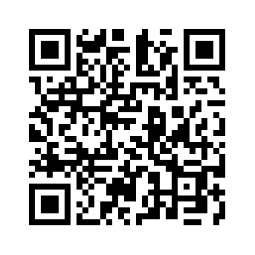
Donate with our QR code app to
Amazing Grace Christian Fellowship
Donations are Deeply Appreciated!

