Slide 1


Slide 2
Stand In Your Love
(Bethel)

Slide 3
When darkness tries to roll over my bones When sorrow comes to steal the joy I own When

Slide 4
brokenness and pain is all I know I won't be shaken, no, I won't be shaken 'Cause my fear doesn't stand a

Slide 5
chance When I stand in Your love My fear doesn't stand a chance When I stand in Your love My fear

Slide 6
doesn't stand a chance When I stand in Your love
Shame no longer has a place to hide And I am not a

Slide 7
captive to the lies I'm not afraid to leave my past behind Oh, I won't be shaken, no, I won't be shaken

Slide 8
My fear doesn't stand a chance When I stand in Your love My fear doesn't stand a chance When I stand in

Slide 9
Your love My fear doesn't stand a chance When I stand in Your love Oh, I'm standing There's power

Slide 10
that can break off every chain There's power that can empty out a grave There's resurrection power that

Slide 11
can save There's power in Your name, power in Your name My fear doesn't stand a chance When I stand

Slide 12
in Your love My fear doesn't stand a chance When I stand in Your love My fear doesn't stand a chance

Slide 13
When I stand in Your love Oh, when, when I'm standing in Your love Oh, my fear doesn't stand a

Slide 14
chance When I stand in Your love My fear doesn't stand a chance When I stand in Your love My fear

Slide 15
chance When I stand in Your love My fear doesn't stand a chance When I stand in Your love My fear

Slide 16
doesn't stand a chance When I stand in Your love
Oh, I standing in Your love Oh, standing on the rock

Slide 17
Oh, I am standing, standing in Your love

Slide 18
Way Maker
(by Michael W. Smith)

Slide 19
You are here, moving in our midst I worship You, I worship You You are here, working in this place I

Slide 20
worship You, I worship You You are here, moving in our midst I worship You, I worship You You are here,

Slide 21
working in this place I worship You, I worship You
Waymaker, miracle worker Promise keeper, light in

Slide 22
the darkness My God, that is who You are Waymaker, miracle worker Promise keeper, light in

Slide 23
the darkness My God, that is who You are You are here, touching every heart I worship You, hold my

Slide 24
hands, I worship You You are here, healing every heart I worship You, I worship You You are here,

Slide 25
turning lives around I worship You, I worship You
You are here, turning lives around I worship You, I

Slide 26
worship You Waymaker, miracle worker Promise keeper, light in the darkness My God, that is who

Slide 27
You are Waymaker, miracle worker Promise keeper, light in the darkness My God, that is who You are

Slide 28
I said that is who You are (that is who You are) That is who You are (that is who You are) That is who You

Slide 29
are (that is who You are) That is who You are (that is who You are) Waymaker, miracle worker Waymaker,

Slide 30
miracle worker Waymaker, miracle worker Waymaker, miracle worker (everybody say)

Slide 31
Waymaker, miracle worker (anybody know He's a waymaker tonight) Waymaker, miracle worker (He's

Slide 32
a miracle worker) Waymaker, miracle worker
Waymaker, miracle worker Even when I don't see it,

Slide 33
You're working Even when I can't feel it, You’re working You never stop, You never stop working You

Slide 34
never stop, You never stop working Even when Ican't see it, You're working Even when I can't feel it,

Slide 35
You're working You never stop, You never stop working You never stop, You never stop working

Slide 36
Even when I don't see it, You're working Even when I can't feel it, You're working You never stop, You

Slide 37
never stop working You never stop, You never stop working Even when I don't see it, You're working

Slide 38
Even when I don't feel it, You're working You never stop, You never stop working You never stop, You

Slide 39
never stop working He never stops working Our God is at work with us here Our God is a healer, He's a

Slide 40
comforter Waymaker, miracle worker Promise Keeper, Light in the darkness My God, that is who

Slide 41
You are (we know, we know, we know who you are)
Waymaker, miracle worker Promise keeper, light in

Slide 42
the darkness My God, that is who You are (ooh)
Waymaker, miracle worker Promise keeper, light in

Slide 43
the darkness My God, that is who You are (everybody lift it up again and say) Waymaker,

Slide 44
miracle worker Promise keeper, light in the darkness
My God, that is who You are Waymaker, miracle

Slide 45
worker Promise keeper, light in the darkness My God, that is who You are Waymaker, miracle worker

Slide 46
Promise keeper, light in the darkness My God, that is who You are

Slide 47
When You Walk Into The Room
(Bryan & Katie Torwalt)

Slide 48
When You walk into the room Everything changes
Darkness starts to tremble At the light that You bring

Slide 49
And when You walk into the room Every heart starts burning And nothing matters more Than just to sit

Slide 50
here at Your feet And worship You We worship You (Oh) We love You We'll never stop We can't live

Slide 51
without You, Jesus We love You And we can't get enough All this is for You, Jesus When You walk into

Slide 52
the room Sickness starts to vanish Every hopeless situation ceases to exist And when You walk into the

Slide 53
room The dead begin to rise 'Cause there is resurrection life In all You do We love You We'll

Slide 54
never stop Can't live without You, Jesus We love You And we can't get enough All this is for You,

Slide 55
Jesus Oh Jesus Come and consume, God All we are We give You permission Our hearts are Yours

Slide 56
We want You We want You Come and consume, God All we are We give You permission Our hearts

Slide 57
are Yours We want You We want You Come and consume, God All we are We give You permission

Slide 58
Our hearts are Yours We want You We want You Come and consume, God All we are We give You

Slide 59
permission Our hearts are Yours We want You We want You We love You We'll never stop Can't live

Slide 60
without You, Jesus We love You And we can't get enough All this is for You, Jesus Oh how we love You

Slide 61
Oh how we love You

Slide 62
Set A Fire
(Jesus Culture)

Slide 63
Set a fire down in my soul That I can't contain and I can't control Cause I want more of you God I want

Slide 64
more of you God Set a fire down in my soul That I can't contain and I can't control Cause I want more of

Slide 65
you God I want more of you God Set a fire down in my soul That I can't contain and I can't control

Slide 66
Cause I want more of you God I want more of you God Set a fire down in my soul That I can't contain

Slide 67
and I can't control Cause I want more of you God I want more of you God Set a fire down in my soul

Slide 68
That I can't contain and I can't control Cause I want more of you God I want more of you God Set a fire

Slide 69
down in my soul That I can't contain and I can't control Cause I want more of you God I want more of

Slide 70
you God Set a fire down in my soul That I can't contain and I can't control Cause I want more of you

Slide 71
God I want more of you God Set a fire down in my soul That I can’t contain and I can't control Cause I

Slide 72
want more of you God I want more of you God Set a fire down in my soul That I can't contain and I can't

Slide 73
control Cause I want more of you God I want more of you God Set a fire down in my soul That I can't

Slide 74
contain and I can't control Cause I want more of you God I want more of you God

Slide 75
“Great Are You Lord”
(All Sons & Daughters)

Slide 76
You give life, You are love You bring light to the darkness You give hope, You restore Every heart

Slide 77
that is broken And great are You, Lord It's Your breath in our lungs So we pour out our praise

Slide 78
We pour out our praise It's Your breath in our lungs So we pour out our praise to You only You give life,

Slide 79
You are love You bring light to the darkness You give hope, You restore (You restore) Every heart that

Slide 80
is broken And great are You, Lord It's Your breath in our lungs So we pour out our praise We pour out our

Slide 81
praise It's Your breath in our lungs So we pour out our praise to You only It's Your breath in our lungs

Slide 82
So we pour out our praise We pour out our praise It's Your breath in our lungs So we pour out our praise to

Slide 83
You only And all the earth will shout Your praise Our hearts will cry, these bones will sing Great are You,

Slide 84
Lord And all the earth will shout Your praise Our hearts will cry, these bones will sing Great are You,

Slide 85
Lord And all the earth will shout Your praise Our hearts will cry, these bones will say Great are You,

Slide 86
Lord It's Your breath in our lungs So we pour out our praise We pour out our praise It's Your breath in our

Slide 87
lungs So we pour out our praise to You only It's Your breath in our lungs So we pour out our praise We

Slide 88
pour out our praise It's Your breath in our lungs So we pour out our praise to You only

Slide 89
“Revelation Song”
(Kari Jobe)

Slide 90
Worthy is the Lamb who was slain. Holy holy is he.Sing a new songto him who sits on Heaven’s

Slide 91
Mercy seat. Worthy is the Lamb who was slain. Holy, holy is he. Sing a new song to him who sits on

Slide 92
Heaven’s mercy seat. Holy, Holy, holy is the Lord God almighty. Who was and is to come. With all

Slide 93
Creation I sing. Praise to the King of Kings. You are my everything and I will Adore you. Clothed in

Slide 94
Rainbows of living color. Flashes of lightning rolls of thunder. Blessing and honor strength and glory and

Slide 95
Power be. To you the only wise King. Holy, holy, holy is the Lord god Almighty. Who was and is to come.

Slide 96
With all Creation I sing praise to the King of Kings. You are my everything and I will adore you. Filled

Slide 97
With wonder. Awe struck Wonder at the mention of your name. Jesus your name is power, breath and

Slide 98
Living water. Such a marvelous mystery. Holy,holy, holy is the Lord God almighty. Who was and is and is

Slide 99
To come. With all creation I sing. Praise to the king of Kings. You are my everything. And I will Adore you.

Slide 101
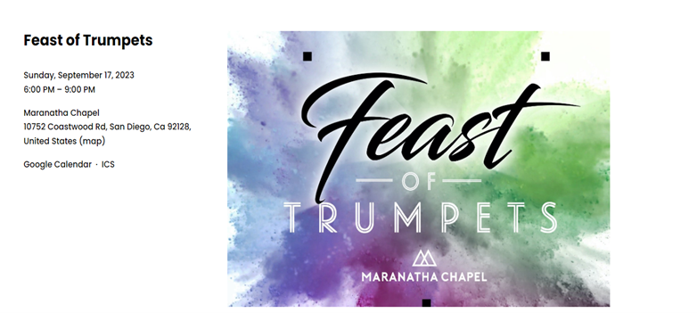
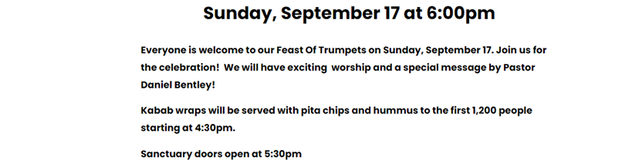

Slide 102


Slide 103
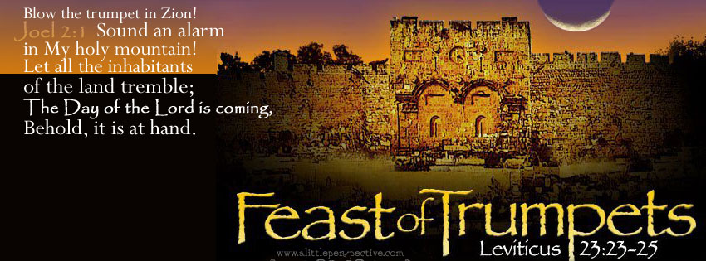

The Feast of Trumpets
By Pastor Fee Soliven
1 Corinthians 15:51-54
Sunday Morning
September 10, 2023

Slide 104
1 Corinthians 15:51-54
51 Behold, I shew you a mystery; We shall not all sleep, but we shall all be changed, 52 In a moment, in the twinkling of an eye, at the last trump: for the trumpet shall sound, and the dead shall be raised incorruptible, and we shall be changed.

Slide 105
53 For this corruptible must put on incorruption, and this mortal must put on immortality.54 So when this corruptible shall have put on incorruption, and this mortal shall have put on immortality, then shall be brought to pass the saying that is written, Death is swallowed up in victory.

Slide 106
Leviticus 23:2
And the LORD spoke to Moses, saying, Speak to the children of Israel, and say to them, Concerning the Feasts of the LORD, which you shall proclaim to be holy convocations, even these are my feasts.

Slide 107
The Hebrew word for Feasts is also MOED meaning appointed times. The Hebrew word for convocation is MIQRA meaning a dress rehearsal.

Slide 108
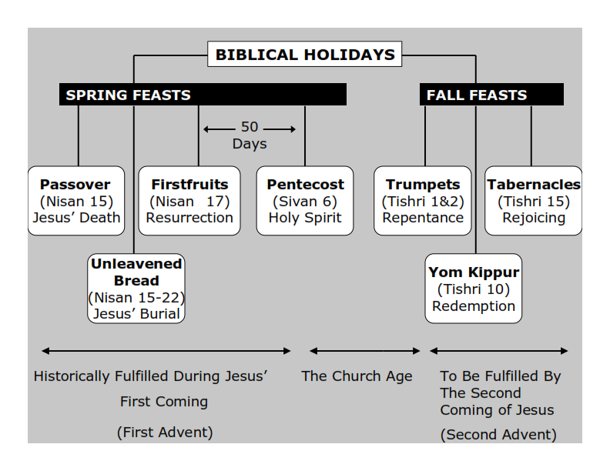
Philippians 3:20-21
20 For our citizenship is in heaven, from which we also eagerly wait for the Savior, the Lord Jesus Christ, 21 who will transform our lowly body that it may be conformed to His glorious body, according to the working by which He is able even to subdue all things to Himself.

Slide 109
Feast of Trumpets : REPENTANCE
Feast of Yom Kippur: REDEMPTION
Feast of Tabernacles: REJOICING

Slide 110
Idioms for the Feast of Yom Teruah:
(The Feast of Trumpets)

Slide 111
(Idioms: Webster Definition)
A construction or expression of one language whose parts correspond to elements in another language but whose total structure is matched in an indirect way.

Slide 112
1. The Time of Jacobs trouble
The 7 Year Tribulation. It will be the beginning of a new 7 year Shemitah cycle.

Slide 113
2. The Day of the Awakening Blast. The Rapture of the Church!

Slide 114
3. Yom HaDin: Day of Judgment, The Opening of the Books, Opening of the Gates

Slide 115
4. Yom HaKeseh: The Hidden Day

Slide 116
5. Ha Kiddushin Nesuin:
Wedding of the Messiah

Slide 117
6. Ha Melech: Coronation of the Messiah

Slide 118
1. The Time of Jacobs trouble

Slide 119
The 7 Year Tribulation. It will be the beginning of a new 7 year Shemitah cycle.

Slide 120
Jeremiah 30:6-7
6 Ask now, and see, Whether a man is ever in labor with child? So why do I see every man with his hands on his loins Like a woman in labor, And all faces turned pale? 7 Alas! For that day is great, So that none is like it; And it is the time of Jacob's trouble, But he shall be saved out of it.

Slide 121
Daniel 12:1-3
1 "At that time Michael shall stand up, The great prince who stands watch over the sons of your people; And there shall be a time of trouble, Such as never was since there was a nation, Even to that time. And at that time your people shall be delivered, Every one who is found written in the book.

Slide 122
2 And many of those who sleep in the dust of the earth shall awake, Some to everlasting life, Some to shame and everlasting contempt. 3 Those who are wise shall shine Like the brightness of the firmament, And those who turn many to righteousness Like the stars forever and ever.

Slide 123
Matthew 24:21-22
21 For then there will be great tribulation, such as has not been since the beginning of the world until this time, no, nor ever shall be. 22 And unless those days were shortened, no flesh would be saved; but for the elect's sake those days will be shortened.

Slide 124
2. The Day of the Awakening Blast
The Rapture of the Church!

Slide 125
On the Feast of Trumpets the Shofar is blown 100 times. There are three sounds made with the shofar:

Slide 126
Tekiah - One long straight blast.
Shevarim - Three shorter blasts.
Teruah – 9 quick blasts in short succession
This series is blown 11 times for a total of 99 blasts and the final blast is known as
“The Last Trump” !

Slide 127
1 Corinthians 15:51-54
51 Behold, I shew you a mystery; We shall not all sleep, but we shall all be changed, 52 In a moment, in the twinkling of an eye, at the last trump: for the trumpet shall sound, and the dead shall be raised incorruptible, and we shall be changed.

Slide 128
53 For this corruptible must put on incorruption, and this mortal must put on immortality. 54 So when this corruptible shall have put on incorruption, and this mortal shall have put on immortality, then shall be brought to pass the saying that is written, Death is swallowed up in victory.

Slide 129
1 Thessalonians 4:16-17
16 For the Lord himself shall descend from heaven with a shout, with the voice of the archangel, and with the trump of God: and the dead in Christ shall rise first: 17 Then we which are alive and remain shall be caught up together with them in the clouds, to meet the Lord in the air: and so shall we ever be with the Lord.

Slide 130
3. Yom HaDin/Day of Judgment/The Opening of the Books/
Opening of the Gates

Slide 131
1 Corinthians 3:13-15
13 each one's work will become clear; for the Day will declare it, because it will be revealed by fire; and the fire will test each one's work, of what sort it is. 14 If anyone's work which he has built on it endures, he will receive a reward. 15 If anyone's work is burned, he will suffer loss; but he himself will be saved, yet so as through fire.

Slide 132
2 Corinthians 5:10-11
10 For we must all appear before the judgment seat of Christ, that each one may receive the things done in the body, according to what he has done, whether good or bad. 11 Knowing, therefore, the terror of the Lord, we persuade men; but we are well known to God, and I also trust are well known in your consciences.

Slide 133
Revelation 20:11-15
11 Then I saw a great white throne and Him who sat on it, from whose face the earth and the heaven fled away. And there was found no place for them. 12 And I saw the dead, small and great, standing before God, and books were opened. And another book was opened, which is the Book of Life. And the dead were judged according to their works, by the things which were written in the books.

Slide 134
13 The sea gave up the dead who were in it, and Death and Hades delivered up the dead who were in them. And they were judged, each one according to his works. 14 Then Death and Hades were cast into the lake of fire. This is the second death. 15 And anyone not found written in the Book of Life was cast into the lake of fire.

Slide 135
Psalm 24:7-10
7 Lift up your heads, O you gates! And be lifted up, you everlasting doors! And the King of glory shall come in. 8 Who is this King of glory? The LORD strong and mighty, The LORD mighty in battle. 9 Lift up your heads, O you gates! Lift up, you everlasting doors! And the King of glory shall come in. 10 Who is this King of glory? The LORD of hosts, He is the King of glory.

Slide 136
Psalm 118:19-21
19 Open to me the gates of righteousness; I will go through them, And I will praise the LORD. 20 This is the gate of the LORD, Through which the righteous shall enter. 21 I will praise You, For You have answered me, And have become my salvation.

Slide 137
4. Yom HaKeseh (The Hidden Day)

Slide 138
Zephaniah 2:1-3
1 Gather yourselves together, yes, gather together, O undesirable nation, 2 Before the decree is issued, Or the day passes like chaff, Before the LORD's fierce anger comes upon you, Before the day of the LORD's anger comes upon you!

Slide 139
3 Seek the LORD, all you meek of the earth, Who have upheld His justice. Seek righteousness, seek humility. It may be that you will be hidden In the day of the LORD's anger.

Slide 140
1 Thessalonians 5:9-11
9 For God did not appoint us to wrath, but to obtain salvation through our Lord Jesus Christ, 10 who died for us, that whether we wake or sleep, we should live together with Him. 11 Therefore comfort each other and edify one another, just as you also are doing.

Slide 141
Psalm 27:5
5 For in the time of trouble He shall hide me in His pavilion; In the secret place of His tabernacle He shall hide me; He shall set me high upon a rock.

Slide 142
Isaiah 26:20-21
20 Come, my people, enter your chambers, And shut your doors behind you; Hide yourself, as it were, for a little moment, Until the indignation is past. 21 For behold, the LORD comes out of His place To punish the inhabitants of the earth for their iniquity; The earth will also disclose her blood, And will no more cover her slain.

Slide 143
Matthew 24:36
"But of that day and hour no one knows, not even the angels of heaven, but My Father only.

Slide 144
So here is the big clue for us:

Slide 145
1 Thessalonians 5:1-9
1 But concerning the times and the seasons, brethren, you have no need that I should write to you. 2 For you yourselves know perfectly that the day of the Lord so comes as a thief in the night. 3 For when they say, "Peace and safety!" then sudden destruction comes upon them, as labor pains upon a pregnant woman. And they shall not escape.

Slide 146
4 But you, brethren, are not in darkness, so that this Day should overtake you as a thief. 5 You are all sons of light and sons of the day. We are not of the night nor of darkness. 6 Therefore let us not sleep, as others do, but let us watch and be sober. 7 For those who sleep, sleep at night, and those who get drunk are drunk at night.

Slide 147
8 But let us who are of the day be sober, putting on the breastplate of faith and love, and as a helmet the hope of salvation. 9 For God did not appoint us to wrath, but to obtain salvation through our Lord Jesus Christ

Slide 148
The Feast of Trumpets is on Tishri 1&2 it's a 2 day feast and no one knew when the sighting of the new moon would be. So when they saw the new moon the feast began!

Slide 149
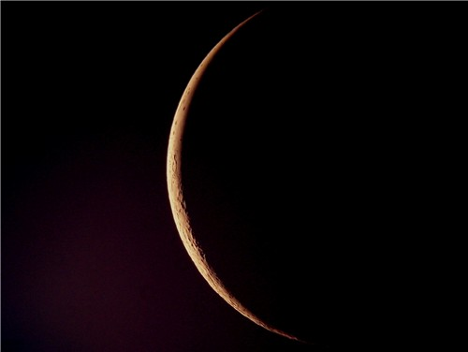
The Great tribulation is going to be a time of horrific trouble this world has never seen nor will it ever see it like that again!

Slide 150
5. Ha Kiddushin/Nesuin
(Wedding of the Messiah)

Slide 151
1. Marriages were arranged by the parents (Abraham for Isaac)
Typically the young man would go to the house of the “bride to be” carrying 3 items A. Large sum of Money B. Betrothal Contract C. Skin of wine. Anyone arriving at a house with these 3 items was definitely considered a prospect.

Slide 152
If the bridal price was approved a glass of wine was poured. If she approved, the betrothal contract became a legal document between the two. Their status was betrothed rather than fully married even though they would be called husband and wife.

Slide 153
Ezekiel 16:8-10
8 When I passed by you again and looked upon you, indeed your time was the time of love; so I spread My wing over you and covered your nakedness. Yes, I swore an oath to you and entered into a covenant with you, and you became Mine," says the Lord GOD. 9 Then I washed you in water; yes, I thoroughly washed off your blood, and I anointed you with oil.

Slide 154
In Jewish tradition The Bridegroom would make the statement “He would go to his Father’s house and prepare a place for her”. This place was known as the chamber.

Slide 155
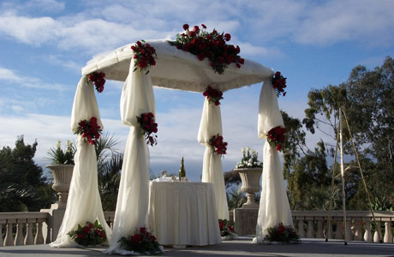
creation." 5 For this they willfully forget: that by the word of God the heavens were of old, and the earth standing out of water and in the water, 6 by which the world that then existed perished, being flooded with water. 7 But the heavens and the earth which are

Slide 156
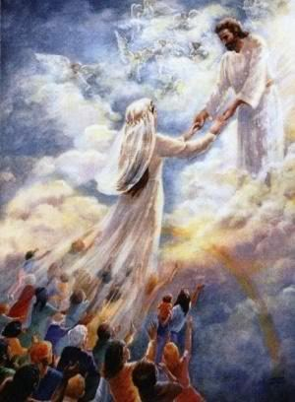

Slide 157
John 14:1-4
1 "Let not your heart be troubled; you believe in God, believe also in Me. 2 In My Father's house are many mansions; if it were not so, I would have told you. I go to prepare a place for you. 3 And if I go and prepare a place for you, I will come again and receive you to Myself; that where I am, there you may be also. 4 And where I go you know, and the way you know."

Slide 158
The Bride has been bought with a price and is to spend her time preparing to live as a wife and mother in Israel. Spending her days learning how to please her husband and waiting for his return.

Slide 159
2. The Bridal price was established for the Bride

Slide 160
1 Peter 1:18-19
18 knowing that you were not redeemed with corruptible things, like silver or gold, from your aimless conduct received by tradition from your fathers, 19 but with the precious blood of Christ, as of a lamb without blemish and without spot.

Slide 161
1 Corinthians 6:19-20
19 Or do you not know that your body is the temple of the Holy Spirit who is in you, whom you have from God, and you are not your own? 20 For you were bought at a price; therefore glorify God in your body and in your spirit, which are God's.

Slide 162
3. Bride and Groom are Betrothed

Slide 163
This legally binds the two together but they don’t live together.

Slide 164
Hosea 2:19-23
9 "I will betroth you to Me forever; Yes, I will betroth you to Me In righteousness and justice, In lovingkindness and mercy; 20 I will betroth you to Me in faithfulness, And you shall know the LORD. 21 "It shall come to pass in that day That I will answer," says the LORD; "I will answer the heavens, And they shall answer the earth.

Slide 165
22 The earth shall answer With grain, With new wine, And with oil; They shall answer Jezreel. 23 Then I will sow her for Myself in the earth, And I will have mercy on her who had not obtained mercy; Then I will say to those who were not My people, 'You are My people!' And they shall say, 'You are my God!' "

Slide 166
4. Written document drawn up called the Ketubah which states the bride price, promises of the groom, and the rights of the bride. The Bible is our Ketubah!

Slide 167
2 Corinthians 1:20-22
20 For all the promises of God in Him are Yes, and in Him Amen, to the glory of God through us. 21 Now He who establishes us with you in Christ and has anointed us is God, 22 who also has sealed us and given us the Spirit in our hearts as a guarantee.

Slide 168
5. The Bride must give her consent
“I do”

Slide 169
Romans 10:9-13
9 that if you confess with your mouth the Lord Jesus and believe in your heart that God has raised Him from the dead, you will be saved. 10 For with the heart one believes unto righteousness, and with the mouth confession is made unto salvation.

Slide 170
11 For the Scripture says, "Whoever believes on Him will not be put to shame." 12 For there is no distinction between Jew and Greek, for the same Lord over all is rich to all who call upon Him. 13 For "whoever calls on the name of the LORD shall be saved."

Slide 171
4. The marriage Supper of the Lamb

Slide 172
Revelation 19:7-9
7 Let us be glad and rejoice and give Him glory, for the marriage of the Lamb has come, and His wife has made herself ready." 8 And to her it was granted to be arrayed in fine linen, clean and bright, for the fine linen is the righteous acts of the saints. 9 Then he said to me, "Write: 'Blessed are those who are called to the marriage supper of the Lamb!' " And he said to me, "These are the true sayings of God."

Slide 173
6. Ha Melech (Coronation of the Messiah)

Slide 174
Psalms 98:6-9
6 With trumpets and the sound of a horn; Shout joyfully before the LORD, the King. 7 Let the sea roar, and all its fullness, The world and those who dwell in it; 8 Let the rivers clap their hands; Let the hills be joyful together before the LORD, 9 For He is coming to judge the earth. With righteousness He shall judge the world, And the peoples with equity.

Slide 175
Hebrews 1:8
8 But to the Son He says: "Your throne, O God, is forever and ever; A scepter of righteousness is the scepter of Your Kingdom.

Slide 176
Psalm 47:1-4
1 Oh, clap your hands, all you peoples! Shout to God with the voice of triumph! 2 For the LORD Most High is awesome; He is a great King over all the earth. 3 He will subdue the peoples under us, And the nations under our feet. 4 He will choose our inheritance for us, The excellence of Jacob whom He loves.

Slide 177
Titus 2:12-15
13 looking for the blessed hope and glorious appearing of our great God and Savior Jesus Christ, 14 who gave Himself for us, that He might redeem us from every lawless deed and purify for Himself His own special people, zealous for good works. 15 Speak these things, exhort, and rebuke with all authority. Let no one despise you.

Slide 178
2 Peter:12-17
¹² looking for and hastening the coming of the day of God, because of which the heavens will be dissolved, being on fire, and the elements will melt with fervent heat? ¹³ Nevertheless we, according to His promise, look for new heavens and a new earth in which righteousness dwells.

Slide 179
¹⁴ Therefore, beloved, looking forward to these things, be diligent to be found by Him in peace, without spot and blameless; ¹⁵ and consider that the longsuffering of our Lord is salvation—as also our beloved brother Paul, according to the wisdom given to him, has written to you,

Slide 180
¹⁶ as also in all his epistles, speaking in them of these things, in which are some things hard to understand, which untaught and unstable people twist to their own destruction, as they do also the rest of the Scriptures.

Slide 181
¹⁷ You therefore, beloved, since you know this beforehand, beware lest you also fall from your own steadfastness, being led away with the error of the wicked; ¹⁸ but grow in the grace and knowledge of our Lord and Savior Jesus Christ. To Him be the glory both now and forever. Amen

Slide 182
1 Thessalonians 4:13-18
13 But I do not want you to be ignorant, brethren, concerning those who have fallen asleep, lest you sorrow as others who have no hope. 14 For if we believe that Jesus died and rose again, even so God will bring with Him those who sleep in Jesus.

Slide 183
15 For this we say to you by the word of the Lord, that we who are alive and remain until the coming of the Lord will by no means precede those who are asleep. 16 For the Lord Himself will descend from heaven with a shout, with the voice of an archangel, and with the trumpet of God. And the dead in Christ will rise first.

Slide 184
17 Then we who are alive and remain shall be caught up together with them in the clouds to meet the Lord in the air. And thus we shall always be with the Lord. 18 Therefore comfort one another with these words.

Slide 185
1 Corinthians 15:50-54
50 Now this I say, brethren, that flesh and blood cannot inherit the kingdom of God; nor does corruption inherit incorruption. 51 Behold, I tell you a mystery: We shall not all sleep, but we shall all be changed-- 52 in a moment, in the twinkling of an eye, at the last trumpet. For the trumpet will sound, and the dead will be raised incorruptible, and we shall be changed.

Slide 186
53 For this corruptible must put on incorruption, and this mortal must put on immortality. 54 So when this corruptible has put on incorruption, and this mortal has put on immortality, then shall be brought to pass the saying that is written: "Death is swallowed up in victory."

Slide 187

20 Again, when a righteous man turns from his righteousness and commits iniquity, and I lay a stumbling block before him, he shall die; because you did not give him warning, he shall die in his sin, and his righteousness which he has done shall not be remembered; but his blood I will require at your hand.

Slide 188
Acts 2:38-39
38 Then Peter said to them, "Repent, and let every one of you be baptized in the name of Jesus Christ for the remission of sins; and you shall receive the gift of the Holy Spirit. 39 For the promise is to you and to your children, and to all who are afar off, as many as the Lord our God will call."

Slide 189
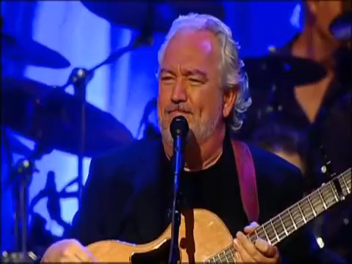
“For the Joy of the Lord is your Strength”
Nehemiah 8:10

