Slide 2
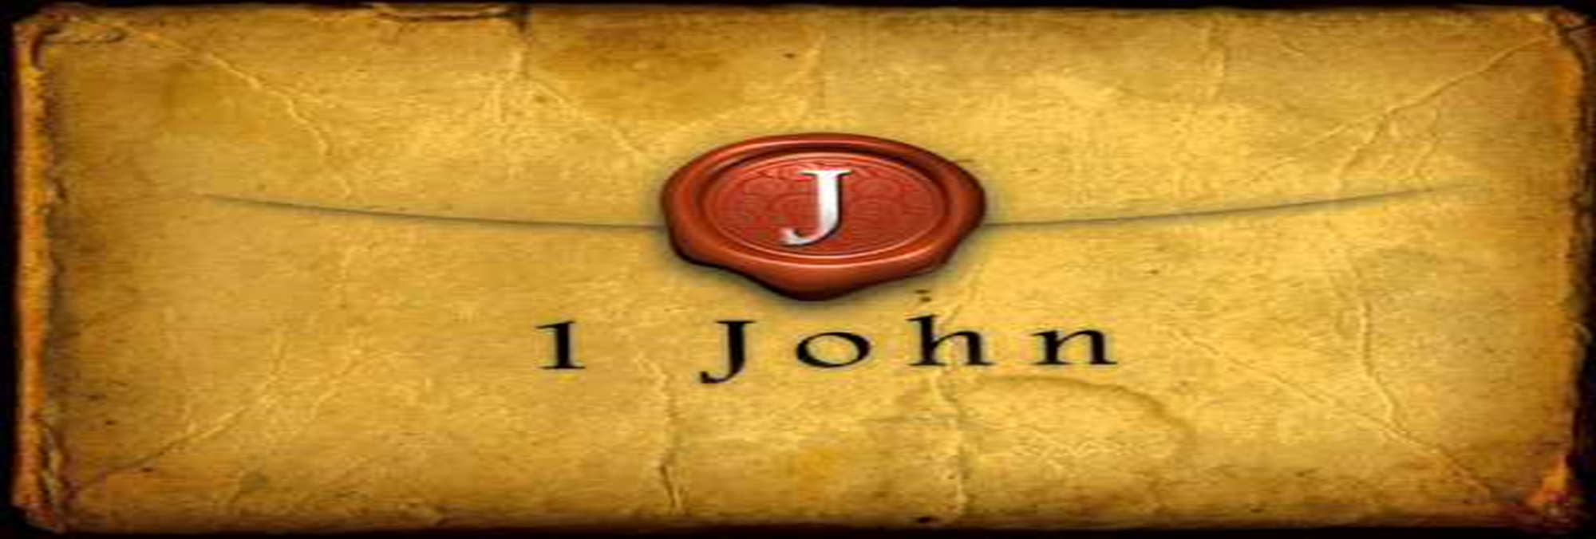
They Were Not of Us
by Pastor Fee Soliven
1 John 2:18-23
Wednesday Evening
September 6, 2023

Slide 3
1 John 2:18-23
18 Little children, it is the last hour; and as you have heard that the Antichrist is coming, even now many antichrists have come, by which we know that it is the last hour. 19 They went out from us, but they were not of us; for if they had been of us, they would have continued with us; but they went out that they might be made manifest, that none of them were of us.

Slide 4
20 But you have an anointing from the Holy One, and you know all things. 21 I have not written to you because you do not know the truth, but because you know it, and that no lie is of the truth. 22 Who is a liar but he who denies that Jesus is the Christ? He is antichrist who denies the Father and the Son.

Slide 5
23 Whoever denies the Son does not have the Father either; he who acknowledges the Son has the Father also

Slide 6
18 Little children, it is the last hour; and as you have heard that the Antichrist is coming, even now many antichrists have come, by which we know that it is the last hour.

Slide 7
Joel 2:28-29
28 "And it shall come to pass afterward That I will pour out My Spirit on all flesh; Your sons and your daughters shall prophesy, Your old men shall dream dreams, Your young men shall see visions. 29 And also on My menservants and on My maidservants
I will pour out My Spirit in those days.

Slide 8
Micah 4:1
“Now it shall come to pass in the latter days That the mountain of the LORD's house Shall be established on the top of the mountains, And shall be exalted above the hills; And peoples shall flow to it”

Slide 9
2 Timothy 3:1-7
1 But know this, that in the last days perilous times will come: 2 For men will be lovers of themselves, lovers of money, boasters, proud, blasphemers, disobedient to parents, unthankful, unholy,

Slide 10
3 unloving, unforgiving, slanderers, without self-control, brutal, despisers of good, 4 traitors, headstrong, haughty, lovers of pleasure rather than lovers of God, 5 having a form of godliness but denying its power. And from such people turn away!

Slide 11
6 For of this sort are those who creep into households and make captives of gullible women loaded down with sins, led away by various lusts, 7 always learning and never able to come to the knowledge of the truth.

Slide 12
2 Thessalonians 2:3-12
3 Let no one deceive you by any means; for that Day will not come unless the falling away comes first, and the man of sin is revealed, the son of perdition, 4 who opposes and exalts himself above all that is called God or that is worshiped, so that he sits as God in the temple of God, showing himself that he is God.

Slide 13
5 Do you not remember that when I was still with you I told you these things? 6 And now you know what is restraining, that he may be revealed in his own time. 7 For the mystery of lawlessness is already at work; only He who now restrains will do so until He is taken out of the way.

Slide 14
8 And then the lawless one will be revealed, whom the Lord will consume with the breath of His mouth and destroy with the brightness of His coming. 9 The coming of the lawless one is according to the working of Satan, with all power, signs, and lying wonders,

Slide 15
10 and with all unrighteous deception among those who perish, because they did not receive the love of the truth, that they might be saved. 11 And for this reason God will send them strong delusion, that they should believe the lie, 12 that they all may be condemned who did not believe the truth but had pleasure in unrighteousness.

Slide 16
Acts 20:29-30
29 For I know this, that after my departure savage wolves will come in among you, not sparing the flock. 30 Also from among yourselves men will rise up, speaking perverse things, to draw away the disciples after themselves.

Slide 17
2 Thessalonians 2:9
“The coming of the lawless one is according to the working of Satan, with all power, signs, and lying wonders”

Slide 18
2 John 7
“For many deceivers have gone out into the world who do not confess Jesus Christ as coming in the flesh. This is a deceiver and an antichrist”

Slide 19
Matthew 24:24
“For false christs and false prophets will rise and show great signs and wonders to deceive, if possible, even the elect”

Slide 20
19 They went out from us, but they were not of us; for if they had been of us, they would have continued with us; but they went out that they might be made manifest, that none of them were of us.

Slide 21
2 John 7
“For many deceivers have gone out into the world who do not confess Jesus Christ as coming in the flesh. This is a deceiver and an antichrist”

Slide 22
John 3:1-8
1 There was a man of the Pharisees named Nicodemus, a ruler of the Jews. 2 This man came to Jesus by night and said to Him, "Rabbi, we know that You are a teacher come from God; for no one can do these signs that You do unless God is with him."

Slide 23
3 Jesus answered and said to him, "Most assuredly, I say to you, unless one is born again, he cannot see the kingdom of God." 4 Nicodemus said to Him, "How can a man be born when he is old? Can he enter a second time into his mother's womb and be born?"

Slide 24
5 Jesus answered, "Most assuredly, I say to you, unless one is born of water and the Spirit, he cannot enter the kingdom of God. 6 That which is born of the flesh is flesh, and that which is born of the Spirit is spirit.

Slide 25
7 Do not marvel that I said to you, 'You must be born again.' 8 "The wind blows where it wishes, and you hear the sound of it, but cannot tell where it comes from and where it goes. So is everyone who is born of the Spirit."

Slide 26
20 But you have an anointing from the Holy One, and you know all things.

Slide 27
John 14:16-17
16 And I will pray the Father, and He will give you another Helper, that He may abide with you forever-- 17 the Spirit of truth, whom the world cannot receive, because it neither sees Him nor knows Him; but you know Him, for He dwells with you and will be in you.

Slide 28
John 15:26
"But when the Helper comes, whom I shall send to you from the Father, the Spirit of truth who proceeds from the Father, He will testify of Me”

Slide 29
1 Corinthians 1:21-23
21 For since, in the wisdom of God, the world through wisdom did not know God, it pleased God through the foolishness of the message preached to save those who believe. 22 For Jews request a sign, and Greeks seek after wisdom…

Slide 30
21 I have not written to you because you do not know the truth, but because you know it, and that no lie is of the truth.

Slide 31
22 Who is a liar but he who denies that Jesus is the Christ? He is antichrist who denies the Father and the Son.

Slide 32
Romans 3:2-4
3 For what if some did not believe? Will their unbelief make the faithfulness of God without effect? 4 Certainly not! Indeed, let God be true but every man a liar. As it is written: "That You may be justified in Your words, And may overcome when You are judged."

Slide 33
John 8:42-44
42 Jesus said to them, "If God were your Father, you would love Me, for I proceeded forth and came from God; nor have I come of Myself, but He sent Me. 43 Why do you not understand My speech? Because you are not able to listen to My word.

Slide 34
44 You are of your father the devil, and the desires of your father you want to do. He was a murderer from the beginning, and does not stand in the truth, because there is no truth in him. When he speaks a lie, he speaks from his own resources, for he is a liar and the father of it.

Slide 35
23 Whoever denies the Son does not have the Father either; he who acknowledges the Son has the Father also

Slide 36
John 3:11
“Most assuredly, I say to you, We speak what We know and testify what We have seen, and you do not receive Our witness”

Slide 37
John 5:37
“And the Father Himself, who sent Me, has testified of Me. You have neither heard His voice at any time, nor seen His form”

Slide 38
John 6:46
“Not that anyone has seen the Father, except He who is from God; He has seen the Father”

Slide 39
John 8:16
“And yet if I do judge, My judgment is true; for I am not alone, but I am with the Father who sent Me”

Slide 40
John 8:38
“I speak what I have seen with My Father, and you do what you have seen with your father."

Slide 41
John 14:8
“Lord, show us the Father and we will be satisfied”

Slide 42
John 14:8
Jesus told Philip, “Anyone who has seen me has seen the Father!”

Slide 43
2 Corinthians 4:4
“whose minds the god of this age has blinded, who do not believe, lest the light of the gospel of the glory of Christ, who is the image of God, should shine on them”

Slide 44
Colossians 1:15
“He is the image of the invisible God, the firstborn over all creation”

Slide 45
Hebrews1:3
“who being the brightness of His glory and the express image of His person, and upholding all things by the word of His power, when He had by Himself purged our sins, sat down at the right hand of the Majesty on high”

Slide 46
1 Thessalonians 4:13-18
13 But I do not want you to be ignorant, brethren, concerning those who have fallen asleep, lest you sorrow as others who have no hope. 14 For if we believe that Jesus died and rose again, even so God will bring with Him those who sleep in Jesus.

Slide 47
15 For this we say to you by the word of the Lord, that we who are alive and remain until the coming of the Lord will by no means precede those who are asleep. 16 For the Lord Himself will descend from heaven with a shout, with the voice of an archangel, and with the trumpet of God. And the dead in Christ will rise first.

Slide 48
17 Then we who are alive and remain shall be caught up together with them in the clouds to meet the Lord in the air. And thus we shall always be with the Lord. 18 Therefore comfort one another with these words.

Slide 49
1 Corinthians 15:50-54
50 Now this I say, brethren, that flesh and blood cannot inherit the kingdom of God; nor does corruption inherit incorruption. 51 Behold, I tell you a mystery: We shall not all sleep, but we shall all be changed-- 52 in a moment, in the twinkling of an eye, at the last trumpet. For the trumpet will sound, and the dead will be raised incorruptible, and we shall be changed.

Slide 50
53 For this corruptible must put on incorruption, and this mortal must put on immortality. 54 So when this corruptible has put on incorruption, and this mortal has put on immortality, then shall be brought to pass the saying that is written: "Death is swallowed up in victory."

Slide 51
20 Again, when a righteous man turns from his righteousness and commits iniquity, and I lay a stumbling block before him, he shall die; because you did not give him warning, he shall die in his sin, and his righteousness which he has done shall not be remembered; but his blood I will require at your hand.

Slide 52
Acts 2:38-39
38 Then Peter said to them, "Repent, and let every one of you be baptized in the name of Jesus Christ for the remission of sins; and you shall receive the gift of the Holy Spirit. 39 For the promise is to you and to your children, and to all who are afar off, as many as the Lord our God will call."

Slide 53
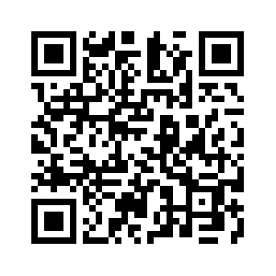
Donate with our QR code app to
Amazing Grace Christian Fellowship
Donations are Deeply Appreciated!

