Slide 2
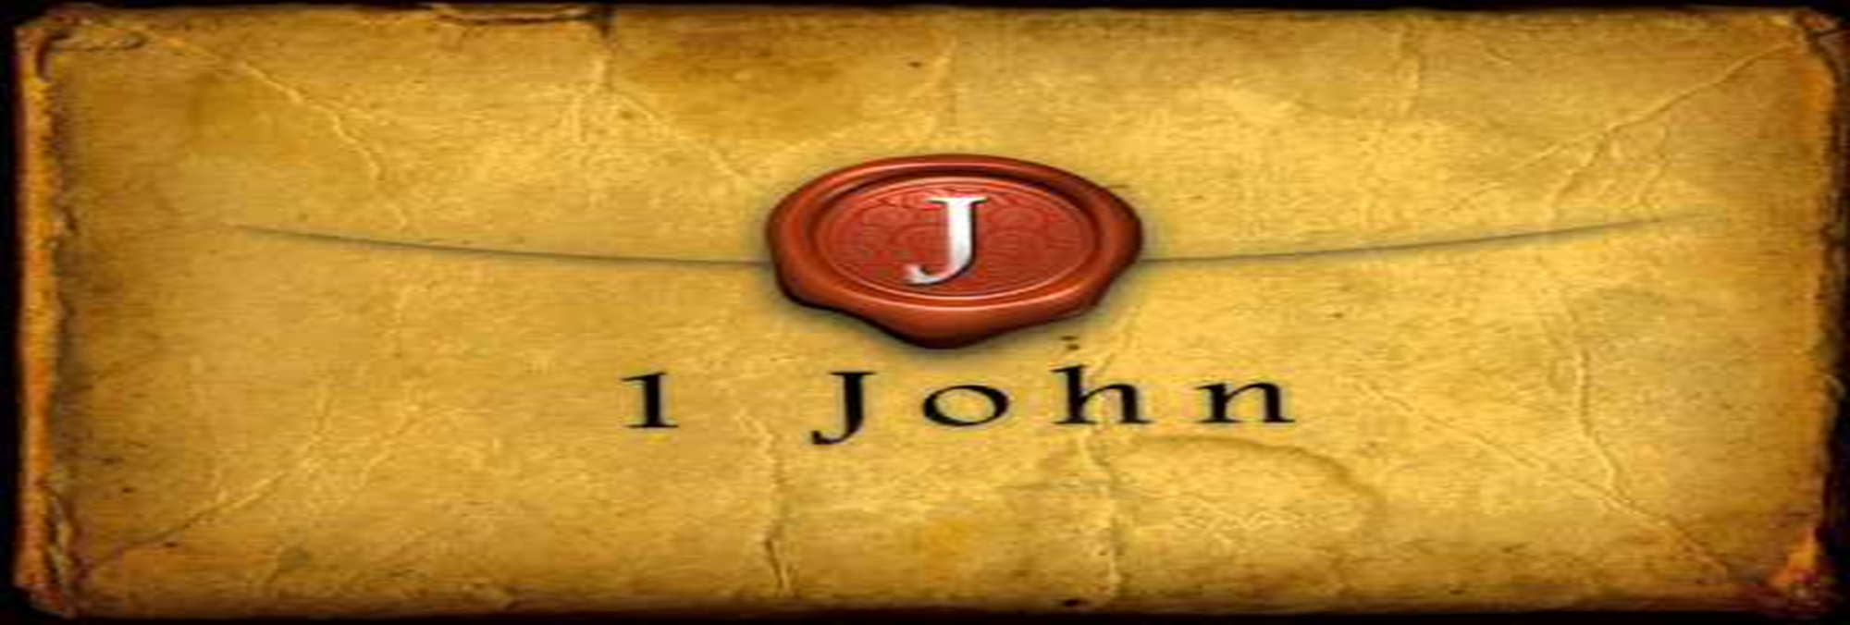
We Are the Children of God
by Pastor Fee Soliven
1 John 3:1-6
Wednesday Evening
September 20, 2023

Slide 3
1 John 3:1-6
1 Behold what manner of love the Father has bestowed on us, that we should be called children of God! Therefore the world does not know us, because it did not know Him. 2 Beloved, now we are children of God; and it has not yet been revealed what we shall be, but we know that when He is revealed, we shall be like Him, for we shall see Him as He is.

Slide 4
3 And everyone who has this hope in Him purifies himself, just as He is pure. 4 Whoever commits sin also commits lawlessness, and sin is lawlessness. 5 And you know that He was manifested to take away our sins, and in Him there is no sin. 6 Whoever abides in Him does not sin. Whoever sins has neither seen Him nor known Him.

Slide 5
1 Behold what manner of love the Father has bestowed on us, that we should be called children of God! Therefore the world does not know us, because it did not know Him.

Slide 6
John 1:10-13
10 He was in the world, and the world was made through Him, and the world did not know Him. 11 He came to His own, and His own did not receive Him. 12 But as many as received Him, to them He gave the right to become children of God, to those who believe in His name: 13 who were born, not of blood, nor of the will of the flesh, nor of the will of man, but of God.

Slide 7
John 15:18-19
18 "If the world hates you, you know that it hated Me before it hated you. 19 If you were of the world, the world would love its own. Yet because you are not of the world, but I chose you out of the world, therefore the world hates you.

Slide 8
2 Beloved, now we are children of God; and it has not yet been revealed what we shall be, but we know that when He is revealed, we shall be like Him, for we shall see Him as He is.

Slide 9
Philippians 3:7-14
7 But what things were gain to me, these I have counted loss for Christ. 8 Yet indeed I also count all things loss for the excellence of the knowledge of Christ Jesus my Lord, for whom I have suffered the loss of all things, and count them as rubbish, that I may gain Christ

Slide 10
9 and be found in Him, not having my own righteousness, which is from the law, but that which is through faith in Christ, the righteousness which is from God by faith; 10 that I may know Him and the power of His resurrection, and the fellowship of His sufferings, being conformed to His death, 11 if, by any means, I may attain to the resurrection from the dead.

Slide 11
12 Not that I have already attained, or am already perfected; but I press on, that I may lay hold of that for which Christ Jesus has also laid hold of me. 13 Brethren, I do not count myself to have apprehended; but one thing I do, forgetting those things which are behind and reaching forward to those things which are ahead, 14 I press toward the goal for the prize of the upward call of God in Christ Jesus.

Slide 12
3 And everyone who has this hope in Him purifies himself, just as He is pure.

Slide 13
1 Timothy 5:22
“Do not lay hands on anyone hastily, nor share in other people's sins; keep yourself pure”

Slide 14
James 4:8
“Draw near to God and He will draw near to you. Cleanse your hands, you sinners; and purify your hearts, you double-minded”

Slide 15
1 Peter 1:22-23
22 Since you have purified your souls in obeying the truth through the Spirit in sincere love of the brethren, love one another fervently with a pure heart, 23 having been born again, not of corruptible seed but incorruptible, through the word of God which lives and abides forever…

Slide 16
4 Whoever commits sin also commits lawlessness, and sin is lawlessness.

Slide 17
1 John 3:1-3
1 Behold what manner of love the Father has bestowed on us, that we should be called children of God! Therefore the world does not know us, because it did not know Him. 2 Beloved, now we are children of God; and it has not yet been revealed what we shall be, but we know that when He is revealed, we shall be like Him, for we shall see Him as He is. 3 And everyone who has this hope in Him purifies himself, just as He is pure.

Slide 18
5 And you know that He was manifested to take away our sins, and in Him there is no sin.

Slide 19
John 1:29
“the Lamb of God who takes away the sin of the world”

Slide 20
6 Whoever abides in Him does not sin. Whoever sins has neither seen Him nor known Him.

Slide 21
John 15:1-8
1 "I am the true vine, and My Father is the vinedresser. 2 Every branch in Me that does not bear fruit He takes away; and every branch that bears fruit He prunes, that it may bear more fruit. 3 You are already clean because of the word which I have spoken to you.

Slide 22
4 Abide in Me, and I in you. As the branch cannot bear fruit of itself, unless it abides in the vine, neither can you, unless you abide in Me. 5 I am the vine, you are the branches. He who abides in Me, and I in him, bears much fruit; for without Me you can do nothing.

Slide 23
6 If anyone does not abide in Me, he is cast out as a branch and is withered; and they gather them and throw them into the fire, and they are burned. 7 If you abide in Me, and My words abide in you, you will ask what you desire, and it shall be done for you. 8 By this My Father is glorified, that you bear much fruit; so you will be My disciples.

Slide 24
1 John 3:8-10
8 He who sins is of the devil, for the devil has sinned from the beginning. For this purpose the Son of God was manifested, that He might destroy the works of the devil. 9 Whoever has been born of God does not sin, for His seed remains in him; and he cannot sin, because he has been born of God.

Slide 25
10 In this the children of God and the children of the devil are manifest: Whoever does not practice righteousness is not of God, nor is he who does not love his brother.

Slide 26
1 John 1:5-7
5 This is the message which we have heard from Him and declare to you, that God is light and in Him is no darkness at all. 6 If we say that we have fellowship with Him, and walk in darkness, we lie and do not practice the truth. 7 But if we walk in the light as He is in the light, we have fellowship with one another, and the blood of Jesus Christ His Son cleanses us from all sin.

Slide 27
1 John 2:1-6
1 My little children, these things I write to you, so that you may not sin. And if anyone sins, we have an Advocate with the Father, Jesus Christ the righteous. 2 And He Himself is the propitiation for our sins, and not for ours only but also for the whole world. 3 Now by this we know that we know Him, if we keep His commandments.

Slide 28
4 He who says, "I know Him," and does not keep His commandments, is a liar, and the truth is not in him. 5 But whoever keeps His word, truly the love of God is perfected in him. By this we know that we are in Him. 6 He who says he abides in Him ought himself also to walk just as He walked.

Slide 29
1 Thessalonians 4:13-18
13 But I do not want you to be ignorant, brethren, concerning those who have fallen asleep, lest you sorrow as others who have no hope. 14 For if we believe that Jesus died and rose again, even so God will bring with Him those who sleep in Jesus.

Slide 30
15 For this we say to you by the word of the Lord, that we who are alive and remain until the coming of the Lord will by no means precede those who are asleep. 16 For the Lord Himself will descend from heaven with a shout, with the voice of an archangel, and with the trumpet of God. And the dead in Christ will rise first.

Slide 31
17 Then we who are alive and remain shall be caught up together with them in the clouds to meet the Lord in the air. And thus we shall always be with the Lord. 18 Therefore comfort one another with these words.

Slide 32
1 Corinthians 15:50-54
50 Now this I say, brethren, that flesh and blood cannot inherit the kingdom of God; nor does corruption inherit incorruption. 51 Behold, I tell you a mystery: We shall not all sleep, but we shall all be changed-- 52 in a moment, in the twinkling of an eye, at the last trumpet. For the trumpet will sound, and the dead will be raised incorruptible, and we shall be changed.

Slide 33
53 For this corruptible must put on incorruption, and this mortal must put on immortality. 54 So when this corruptible has put on incorruption, and this mortal has put on immortality, then shall be brought to pass the saying that is written: "Death is swallowed up in victory."

Slide 34
20 Again, when a righteous man turns from his righteousness and commits iniquity, and I lay a stumbling block before him, he shall die; because you did not give him warning, he shall die in his sin, and his righteousness which he has done shall not be remembered; but his blood I will require at your hand.

Slide 35
Acts 2:38-39
38 Then Peter said to them, "Repent, and let every one of you be baptized in the name of Jesus Christ for the remission of sins; and you shall receive the gift of the Holy Spirit. 39 For the promise is to you and to your children, and to all who are afar off, as many as the Lord our God will call."

Slide 36
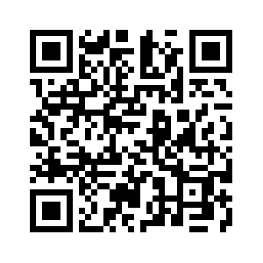
Donate with our QR code app to
Amazing Grace Christian Fellowship
Donations are Deeply Appreciated!

