Slide 1


Slide 2
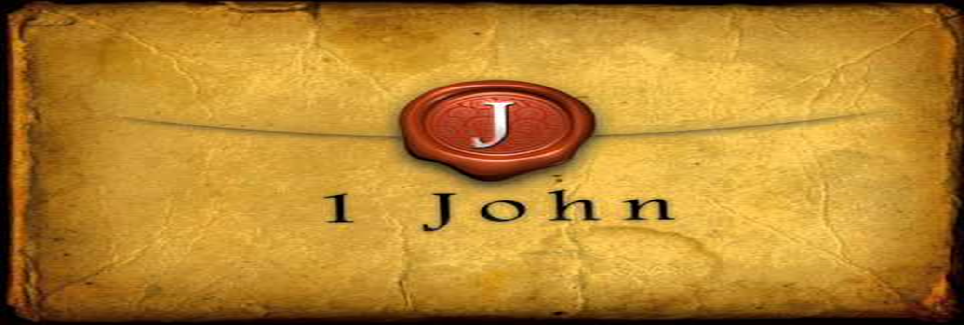

Jesus is God in the Flesh
by Pastor Fee Soliven
1 John 4:1-6
Wednesday Evening
October 11, 2023

Slide 3
1 John 4:1-6
1 Beloved, do not believe every spirit, but test the spirits, whether they are of God; because many false prophets have gone out into the world. 2 By this you know the Spirit of God: Every spirit that confesses that Jesus Christ has come in the flesh is of God,

Slide 4
3 and every spirit that does not confess that Jesus Christ has come in the flesh is not of God. And this is the spirit of the Antichrist, which you have heard was coming, and is now already in the world.

Slide 5
4 You are of God, little children, and have overcome them, because He who is in you is greater than he who is in the world. 5 They are of the world. Therefore they speak as of the world, and the world hears them. 6 We are of God. He who knows God hears us; he who is not of God does not hear us. By this we know the spirit of truth and the spirit of error.

Slide 6
1 Beloved, do not believe every spirit, but test the spirits, whether they are of God; because many false prophets have gone out into the world.

Slide 7
Jeremiah 14:14-16
14 And the LORD said to me, "The prophets prophesy lies in My name. I have not sent them, commanded them, nor spoken to them; they prophesy to you a false vision, divination, a worthless thing, and the deceit of their heart.
.

Slide 8
15 Therefore thus says the LORD concerning the prophets who prophesy in My name, whom I did not send, and who say, 'Sword and famine shall not be in this land'--'By sword and famine those prophets shall be consumed!

Slide 9
16 And the people to whom they prophesy shall be cast out in the streets of Jerusalem because of the famine and the sword; they will have no one to bury them--them nor their wives, their sons nor their daughters--for I will pour their wickedness on them.'

Slide 10
Deuteronomy 13:1-5
1 "If there arises among you a prophet or a dreamer of dreams, and he gives you a sign or a wonder, 2 and the sign or the wonder comes to pass, of which he spoke to you, saying, 'Let us go after other gods'--which you have not known--'and let us serve them,'

Slide 11
3 "you shall not listen to the words of that prophet or that dreamer of dreams, for the LORD your God is testing you to know whether you love the LORD your God with all your heart and with all your soul. 4 You shall walk after the LORD your God and fear Him, and keep His commandments and obey His voice, and you shall serve Him and hold fast to Him.

Slide 12
5 But that prophet or that dreamer of dreams shall be put to death, because he has spoken in order to turn you away from the LORD your God, who brought you out of the land of Egypt and redeemed you from the house of bondage, to entice you from the way in which the LORD your God commanded you to walk. So you shall put away the evil from your midst.

Slide 13
Deuteronomy 18:15-22
15 "The LORD your God will raise up for you a Prophet like me from your midst, from your brethren. Him you shall hear, 16 according to all you desired of the LORD your God in Horeb in the day of the assembly, saying, 'Let me not hear again the voice of the LORD my God, nor let me see this great fire anymore, lest I die.' 17 "And the LORD said to me: 'What they have spoken is good.

Slide 14
18 I will raise up for them a Prophet like you from among their brethren, and will put My words in His mouth, and He shall speak to them all that I command Him. 19 And it shall be that whoever will not hear My words, which He speaks in My name, I will require it of him. 20 But the prophet who presumes to speak a word in My name, which I have not commanded him to speak, or who speaks in the name of other gods, that prophet shall die.'

Slide 15
21 "And if you say in your heart, 'How shall we know the word which the LORD has not spoken?'-- 22 when a prophet speaks in the name of the LORD, if the thing does not happen or come to pass, that is the thing which the LORD has not spoken; the prophet has spoken it presumptuously; you shall not be afraid of him.

Slide 16
2 By this you know the Spirit of God: Every spirit that confesses that Jesus Christ has come in the flesh is of God,

Slide 17
3 and every spirit that does not confess that Jesus Christ has come in the flesh is not of God. And this is the spirit of the Antichrist, which you have heard was coming, and is now already in the world.

Slide 18
Matthew 24:24-26
24 For false christs and false prophets will rise and show great signs and wonders to deceive, if possible, even the elect. 25 See, I have told you beforehand. 26 Therefore if they say to you, 'Look, He is in the desert!' do not go out; or 'Look, He is in the inner rooms!' do not believe it.

Slide 19
2 Peter 3:3-7
3 knowing this first: that scoffers will come in the last days, walking according to their own lusts, 4 and saying, "Where is the promise of His coming? For since the fathers fell asleep, all things continue as they were from the beginning of creation." 5 For this they willfully forget: that by the word of God the heavens were of old, and the earth standing out of water and in the water,

Slide 20
6 by which the world that then existed perished, being flooded with water. 7 But the heavens and the earth which are now preserved by the same word, are reserved for fire until the day of judgment and perdition of ungodly men.

Slide 21
2 Thessalonians 2:7-8
7 For the mystery of lawlessness is already at work; only He who now restrains will do so until He is taken out of the way. 8 And then the lawless one will be revealed, whom the Lord will consume with the breath of His mouth and destroy with the brightness of His coming.

Slide 22
4 You are of God, little children, and have overcome them, because He who is in you is greater than he who is in the world.

Slide 23
1 Timothy 4:1
1 Now the Spirit expressly says that in latter times some will depart from the faith, giving heed to deceiving spirits and doctrines of demons…

Slide 24
5 They are of the world. Therefore they speak as of the world, and the world hears them.

Slide 25
6 We are of God. He who knows God hears us; he who is not of God does not hear us. By this we know the spirit of truth and the spirit of error.

Slide 26
John 14:17
the Spirit of truth, whom the world cannot receive, because it neither sees Him nor knows Him; but you know Him, for He dwells with you and will be in you.

Slide 27
John 14:26
But the Helper, the Holy Spirit, whom the Father will send in My name, He will teach you all things, and bring to your remembrance all things that I said to you.

Slide 28
John 8:44
“You are of your father the devil, and the desires of your father you want to do. He was a murderer from the beginning, and does not stand in the truth, because there is no truth in him. When he speaks a lie, he speaks from his own resources, for he is a liar and the father of it”

Slide 29
1 Thessalonians 4:13-18
13 But I do not want you to be ignorant, brethren, concerning those who have fallen asleep, lest you sorrow as others who have no hope. 14 For if we believe that Jesus died and rose again, even so God will bring with Him those who sleep in Jesus.

Slide 30
15 For this we say to you by the word of the Lord, that we who are alive and remain until the coming of the Lord will by no means precede those who are asleep. 16 For the Lord Himself will descend from heaven with a shout, with the voice of an archangel, and with the trumpet of God. And the dead in Christ will rise first.

Slide 31
17 Then we who are alive and remain shall be caught up together with them in the clouds to meet the Lord in the air. And thus we shall always be with the Lord. 18 Therefore comfort one another with these words.

Slide 32
1 Corinthians 15:50-54
50 Now this I say, brethren, that flesh and blood cannot inherit the kingdom of God; nor does corruption inherit incorruption. 51 Behold, I tell you a mystery: We shall not all sleep, but we shall all be changed-- 52 in a moment, in the twinkling of an eye, at the last trumpet. For the trumpet will sound, and the dead will be raised incorruptible, and we shall be changed.

Slide 33
53 For this corruptible must put on incorruption, and this mortal must put on immortality. 54 So when this corruptible has put on incorruption, and this mortal has put on immortality, then shall be brought to pass the saying that is written: "Death is swallowed up in victory."

Slide 34

20 Again, when a righteous man turns from his righteousness and commits iniquity, and I lay a stumbling block before him, he shall die; because you did not give him warning, he shall die in his sin, and his righteousness which he has done shall not be remembered; but his blood I will require at your hand.

Slide 35
Acts 2:38-39
38 Then Peter said to them, "Repent, and let every one of you be baptized in the name of Jesus Christ for the remission of sins; and you shall receive the gift of the Holy Spirit. 39 For the promise is to you and to your children, and to all who are afar off, as many as the Lord our God will call."

Slide 36

Donate with our QR code app to
Amazing Grace Christian Fellowship
Donations are Deeply Appreciated!

