Slide 1


Slide 2
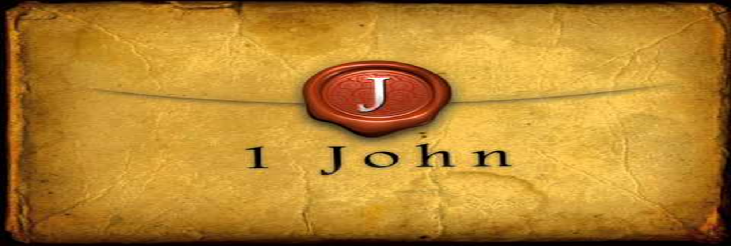

We Have Passed from Death to Life
by Pastor Fee Soliven
1 John 3:14-24
Wednesday Evening
October 4, 2023

Slide 3
1 John 3:14-24
14 We know that we have passed from death to life, because we love the brethren. He who does not love his brother abides in death. 15 Whoever hates his brother is a murderer, and you know that no murderer has eternal life abiding in him. 16 By this we know love, because He laid down His life for us. And we also ought to lay down our lives for the brethren.

Slide 4
17 But whoever has this world's goods, and sees his brother in need, and shuts up his heart from him, how does the love of God abide in him? 18 My little children, let us not love in word or in tongue, but in deed and in truth. 19 And by this we know that we are of the truth, and shall assure our hearts before Him.

Slide 5
20 For if our heart condemns us, God is greater than our heart, and knows all things. 21 Beloved, if our heart does not condemn us, we have confidence toward God. 22 And whatever we ask we receive from Him, because we keep His commandments and do those things that are pleasing in His sight.

Slide 6
23 And this is His commandment: that we should believe on the name of His Son Jesus Christ and love one another, as He gave us commandment. 24 Now he who keeps His commandments abides in Him, and He in him. And by this we know that He abides in us, by the Spirit whom He has given us.

Slide 7
14 We know that we have passed from death to life, because we love the brethren. He who does not love his brother abides in death.

Slide 8
John 5:24
"Most assuredly, I say to you, he who hears My word and believes in Him who sent Me has everlasting life, and shall not come into judgment, but has passed from death into life”

Slide 9
1 John 2:10-11
10 He who loves his brother abides in the light, and there is no cause for stumbling in him. 11 But he who hates his brother is in darkness and walks in darkness, and does not know where he is going, because the darkness has blinded his eyes.

Slide 10
John 13:34-35
34 A new commandment I give to you, that you love one another; as I have loved you, that you also love one another. 35 By this all will know that you are My disciples, if you have love for one another."

Slide 11
1 John 5:1-2
1 Whoever believes that Jesus is the Christ is born of God, and everyone who loves Him who begot also loves him who is begotten of Him. 2 By this we know that we love the children of God, when we love God and keep His commandments.

Slide 12
15 Whoever hates his brother is a murderer, and you know that no murderer has eternal life abiding in him.

Slide 13
Matthew 5:21-22
21 "You have heard that it was said to those of old, 'You shall not murder,' and whoever murders will be in danger of the judgment. 22 But I say to you that whoever is angry with his brother without a cause shall be in danger of the judgment. And whoever says to his brother, 'Raca!' shall be in danger of the council. But whoever says, 'You fool!' shall be in danger of hell fire.

Slide 14
John 8:43-47
43 Why do you not understand My speech? Because you are not able to listen to My word. 44 You are of your father the devil, and the desires of your father you want to do. He was a murderer from the beginning, and does not stand in the truth, because there is no truth in him. When he speaks a lie, he speaks from his own resources, for he is a liar and the father of it.

Slide 15
45 But because I tell the truth, you do not believe Me. 46 Which of you convicts Me of sin? And if I tell the truth, why do you not believe Me? 47 He who is of God hears God's words; therefore you do not hear, because you are not of God."

Slide 16
16 By this we know love, because He laid down His life for us. And we also ought to lay down our lives for the brethren.

Slide 17
Romans 5:6-10
6 For when we were still without strength, in due time Christ died for the ungodly. 7 For scarcely for a righteous man will one die; yet perhaps for a good man someone would even dare to die. 8 But God demonstrates His own love toward us, in that while we were still sinners, Christ died for us.

Slide 18
9 Much more then, having now been justified by His blood, we shall be saved from wrath through Him. 10 For if when we were enemies we were reconciled to God through the death of His Son, much more, having been reconciled, we shall be saved by His life.

Slide 19
17 But whoever has this world's goods, and sees his brother in need, and shuts up his heart from him, how does the love of God abide in him? 18 My little children, let us not love in word or in tongue, but in deed and in truth.

Slide 20
James 2:14-17
14 What does it profit, my brethren, if someone says he has faith but does not have works? Can faith save him? 15 If a brother or sister is naked and destitute of daily food, 16 and one of you says to them, "Depart in peace, be warmed and filled," but you do not give them the things which are needed for the body, what does it profit? 17 Thus also faith by itself, if it does not have works, is dead.

Slide 21
19 And by this we know that we are of the truth, and shall assure our hearts before Him. 20 For if our heart condemns us, God is greater than our heart, and knows all things.

Slide 22
Romans 8:1
“There is therefore now no condemnation to those who are in Christ Jesus, who do not walk according to the flesh, but according to the Spirit”

Slide 23
Hebrews 9:14-15
14 how much more shall the blood of Christ, who through the eternal Spirit offered Himself without spot to God, cleanse your conscience from dead works to serve the living God?

Slide 24
15 And for this reason He is the Mediator of the new covenant, by means of death, for the redemption of the transgressions under the first covenant, that those who are called may receive the promise of the eternal inheritance.

Slide 25
21 Beloved, if our heart does not condemn us, we have confidence toward God. 22 And whatever we ask we receive from Him, because we keep His commandments and do those things that are pleasing in His sight.

Slide 26
John 15:7
“If you abide in Me, and My words abide in you, you will ask what you desire, and it shall be done for you”

Slide 27
23 And this is His commandment: that we should believe on the name of His Son Jesus Christ and love one another, as He gave us commandment.

Slide 28
24 Now he who keeps His commandments abides in Him, and He in him. And by this we know that He abides in us, by the Spirit whom He has given us.

Slide 29
Romans 8:9-11
9 But you are not in the flesh but in the Spirit, if indeed the Spirit of God dwells in you. Now if anyone does not have the Spirit of Christ, he is not His. 10 And if Christ is in you, the body is dead because of sin, but the Spirit is life because of righteousness.

Slide 30
11 But if the Spirit of Him who raised Jesus from the dead dwells in you, He who raised Christ from the dead will also give life to your mortal bodies through His Spirit who dwells in you.

Slide 31
John 14:16-20
16 And I will pray the Father, and He will give you another Helper, that He may abide with you forever-- 17 the Spirit of truth, whom the world cannot receive, because it neither sees Him nor knows Him; but you know Him, for He dwells with you and will be in you.

Slide 32
18 I will not leave you orphans; I will come to you. 19 "A little while longer and the world will see Me no more, but you will see Me. Because I live, you will live also. 20 At that day you will know that I am in My Father, and you in Me, and I in you.

Slide 33
1 Corinthians 15:45
And so it is written, "The first man Adam became a living being." “The last Adam became a life-giving spirit”

Slide 34
2 Corinthians 3:17-18
17 Now the Lord is the Spirit; and where the Spirit of the Lord is, there is liberty. 18 But we all, with unveiled face, beholding as in a mirror the glory of the Lord, are being transformed into the same image from glory to glory, just as by the Spirit of the Lord.

Slide 35
(1) Believe in Christ

Slide 36
(2) Love the Brothers and Sisters

Slide 37
(3) Live Morally Upright Lives

Slide 38
1 Thessalonians 4:13-18
13 But I do not want you to be ignorant, brethren, concerning those who have fallen asleep, lest you sorrow as others who have no hope. 14 For if we believe that Jesus died and rose again, even so God will bring with Him those who sleep in Jesus.

Slide 39
15 For this we say to you by the word of the Lord, that we who are alive and remain until the coming of the Lord will by no means precede those who are asleep. 16 For the Lord Himself will descend from heaven with a shout, with the voice of an archangel, and with the trumpet of God. And the dead in Christ will rise first.

Slide 40
17 Then we who are alive and remain shall be caught up together with them in the clouds to meet the Lord in the air. And thus we shall always be with the Lord. 18 Therefore comfort one another with these words.

Slide 41
1 Corinthians 15:50-54
50 Now this I say, brethren, that flesh and blood cannot inherit the kingdom of God; nor does corruption inherit incorruption. 51 Behold, I tell you a mystery: We shall not all sleep, but we shall all be changed-- 52 in a moment, in the twinkling of an eye, at the last trumpet. For the trumpet will sound, and the dead will be raised incorruptible, and we shall be changed.

Slide 42
53 For this corruptible must put on incorruption, and this mortal must put on immortality. 54 So when this corruptible has put on incorruption, and this mortal has put on immortality, then shall be brought to pass the saying that is written: "Death is swallowed up in victory."

Slide 43

20 Again, when a righteous man turns from his righteousness and commits iniquity, and I lay a stumbling block before him, he shall die; because you did not give him warning, he shall die in his sin, and his righteousness which he has done shall not be remembered; but his blood I will require at your hand.

Slide 44
Acts 2:38-39
38 Then Peter said to them, "Repent, and let every one of you be baptized in the name of Jesus Christ for the remission of sins; and you shall receive the gift of the Holy Spirit. 39 For the promise is to you and to your children, and to all who are afar off, as many as the Lord our God will call."

Slide 45

Donate with our QR code app to
Amazing Grace Christian Fellowship
Donations are Deeply Appreciated!

