Slide 1


Slide 2
Freedom
(by Eddie James)

Slide 3
I wanna clap a little louder than before I wanna sing a little louder than before (Ooh)I wanna jump higher

Slide 4
than before I wanna shout louder than before yeah
Freedom (freedom) Freedom (freedom) Freedom

Slide 5
Freedom (God thank you for freedom!) Freedom (freedom) Freedom (I love you Jesus) Freedom (for

Slide 6
freedom) Freedom I wanna clap a little louder than before I wanna sing a little louder than before (Ooh)

Slide 7
I wanna spin wilder than before I wanna shout louder yeah Freedom (freedom) Freedom (freedom)

Slide 8
Freedom Freedom (freedom) Freedom (freedom)
Freedom (freedom) Freedom (freedom) Freedom

Slide 9
I wanna lift my hands higher than before I want to love you more than before I wanna worship deeper

Slide 10
than before I gotta scream louder yeah yeah Freedom (freedom) Freedom (freedom) Freedom

Slide 11
(freedom) Freedom Freedom (freedom) Freedom (freedom) Freedom (thank you for freedom)

Slide 12
Freedom No more shackles, no more chains No more bondage I am free yeah Lift your hands to the

Slide 13
father I say No more shackles, no more chains No more bondage I am free Come on, lift your hands to

Slide 14
Jesus No more shackles, no more chains No more bondage I am free Now help me dance the dance of

Slide 15
freedom, say Halleluiah Halleluiah Halleluiah Halleluiah Halleluiah Halleluiah Halleluiah Halleluiah

Slide 16
No more shackles Halleluiah No more bondage
Halleluiah No more chains Halleluiah And I'm free

Slide 17
Halleluiah Lift your voice and help me say No more shackles, and no more chains No more bondage I

Slide 18
am fee yeah Lift your hands and help me say No more shackles, no more chains No more bondage I

Slide 19
am fee yeah Come on if you believe it help me say
No more shackles, no more chains No more

Slide 20
bondage I am fee yeah Now if you believe in it sing with me and say

Slide 21
Nothing Else
(Cody Carnes)

Slide 22
I'm caught up in Your presence I just want to sit here at Your feet I'm caught up in this holy moment I never

Slide 23
wanna leave Oh, I'm not here for blessings Jesus, You don't owe me anything More than anything that

Slide 24
You can do I just want You I'm sorry when I've just gone through the motions I'm sorry when I just sang

Slide 25
another song Take me back to where we started I open up my heart to You I'm sorry when I've come

Slide 26
with my agenda I'm sorry when I forgot that You're enough Take me back to where we started I open up

Slide 27
my heart to You I'm caught up in Your presence I just want to sit here at Your feet I'm caught up in this holy

Slide 28
moment I never wanna leave Oh, I'm not here for blessings Jesus, You don't owe me anything And

Slide 29
more than anything that You can do I just want You
I just want You Nothing else, nothing else Nothing

Slide 30
else will do I just want You Nothing else, nothing else
Nothing else will do I just want You Nothing else,

Slide 31
nothing else Nothing else will do I just want You Nothing else, nothing else, Jesus Nothing else will do

Slide 32
I just want You Nothing else, nothing else Nothing else will do I just want You Nothing else, nothing

Slide 33
else, Jesus Nothing else will do I'm coming back to where we started I'm coming back to where we

Slide 34
started When I first felt Your love You're all that matters, Jesus You're all that matters I'm coming

Slide 35
back to what really matters Just Your heart I just wanna bless Your heart, Jesus I'm caught up in

Slide 36
Your presence I just want to sit here at Your feet I'm caught up in this holy moment I never wanna leave

Slide 37
And oh, I'm not here for blessings Jesus, You don't owe me anything More than anything that You can

Slide 38
do Oh, I just want You

Slide 39
Graves into Gardens
(Elevation Worship)

Slide 40
I searched the World but it couldn’t fill me. Man’s empty praise and treasures that fade Are never

Slide 41
Enough. Then you came along and put me back together And every desire Is now satisfied here in

Slide 42
Your love. Oh’ there’s nothing better than you. There’s nothing better than you. Lord there’s nothing

Slide 43
Nothing is better than you. Im not afraid to show you my weakness. My failures and flaws Lord you’ve

Slide 44
Seen them all and you still call me friend.Cause the God of the mountain. Is the God of the Valley.

Slide 45
There’s not a place. Your mercy and grace. Wont find me again. Oh there’s nothing better than you. There’s

Slide 46
Nothing better than you. Lord there’s nothing. Nothing is better than you. Oh there’s nothing better

Slide 47
Better than you. There’s nothing better than you. Lord’ there’s nothing. Nothing is better than you.

Slide 48
You turn mourning to dancing. You give beauty for ashes. You turn shame into glory. You’re the only one

Slide 49
Who can. You turn mourning to dancing. You give beauty for ashes. You turn shame into glory. You’re

Slide 50
The only one who can. You turn graves into gardens. You turn bones into armies. You turn seas into

Slide 51
Highways. You’re the only one who can you’re the only one who can. Oh there’s nothing better than you

Slide 52
There’s nothing better than you. Lord there’s nothing. Nothing is better than you. Oh there’s nothing better

Slide 53
Than you. There’s nothing better than you. Lord, there’s nothing. Nothing is better than you. You turn

Slide 54
Graves into gardens. You turn bones into armies. You turn seas into highways. You’re the only one who

Slide 55
Can. You turn graves into gardens. You turn bones into armies. You turn seas into highways you’re the

Slide 56
Only one who can. You’re the only one who. You’re the only one who can.

Slide 57
above all names Be exalted now in the heavens As Your glory fills this place You alone deserve our

Slide 58
praise You’re the name above all names Worthy is Your name, Jesus You deserve the praise Worthy is

Slide 59
Your name Worthy is Your name, Jesus You deserve the praise Worthy is Your name Worthy is Your

Slide 60
name, Jesus You deserve the praise Worthy is Your name Worthy is Your name, Jesus You deserve the

Slide 61
praise Worthy is Your name Oh, oh

Slide 62
“Good Good Father” (Chris Tomlin)

Slide 63
I’ve heard a thousand stories of what they think you’re like. But I’ve heard the tender whispers of love

Slide 64
In the dead of night. And you tell me that you’re pleased and that I’m never alone. You’re a good

Slide 65
Good Father. It’s who you are, it’s who you are, it’s who you are and I am loved by you. It’s who I am

Slide 66
It’s who I am. It’s who I am. I’ve seen many searching for answers far and wide. But I know we’re

Slide 67
All searching for answers only you provide. Cause you know just what we need before we say a word.

Slide 68
You’re a good good Father. It’s who you are, It’s who you are. It’s who you are. And I’m loved by you. It’s

Slide 69
Who I am, It’s who I am, It’s who I am. You are perfect in all of your ways. You are perfect in all of

Slide 70
Your ways. You are perfect in all of your ways to us. You are perfect in all of your ways. You are perfect in

Slide 71
All of your ways. You are perfect in all of your ways to us. You’re a good good Father. It’s who you are, It’s

Slide 72
who you are, It’s who you are. And I’m loved by you. It’s who I am, it’s who I am, It’s who I am.

Slide 73
Love so undeniable I, I , can hardly speak. Peace so unexplainable I , I , can hardly think. As you call me

Slide 74
Deeper still. As you call me deeper still. As you call me deeper still into Love love love. You’re a good

Slide 75
Good father. It’s who you are, It’s who you are, it’s who you are. And I’m loved by you. It’s who I am,

Slide 76
It’s who I am, It’s who I am.

Slide 77
“His Name is Jesus”
(Jeremy Riddle)

Slide 78
There's only One strong enough to save There's only One who overcame the grave There's only One

Slide 79
who's worthy of all praise And in His hands, the keys of death and hell And in His name, a power that can

Slide 80
heal And by His blood, our sins are washed away His name is Jesus His name is Jesus His name is

Slide 81
Wonderful Counselor, Almighty God! Nations kneel
And glorify the Lord! Let all the earth Tremble for He

Slide 82
comes! And He will judge the living and the dead!
The Son of Man coming on the clouds With trumpet

Slide 83
sound and every knee will bow And tongue confess the Name above all names! His name is Jesus His

Slide 84
name is Jesus His name is Wonderful Counselor, Almighty God! His name is Jesus His name is Jesus

Slide 85
His name is Wonderful Counselor, Almighty God! HE IS COUNSELOR! HE IS MIGHTY GOD! HE'S THE

Slide 86
PRINCE OF PEACE! THE OMNIPOTENT! HE IS WONDERFUL! HE IS RADIANT! THE ALMIGHTY

Slide 87
GOD! His name is Jesus His name is Jesus His name is Wonderful Counselor, Almighty God! His

Slide 88
name is Jesus His name is Jesus His name is Wonderful Counselor, Almighty God! We worship

Slide 89
You We give our lives to You We sing out We cry out
We worship You We give our lives to You Yes, we

Slide 90
sing out Yes, we cry out His name is Jesus His name is Jesus His name is Wonderful Counselor, Almighty

Slide 91
God! His name is Jesus Jesus Wonderful Counselor, Almighty God!

Slide 92


Slide 93
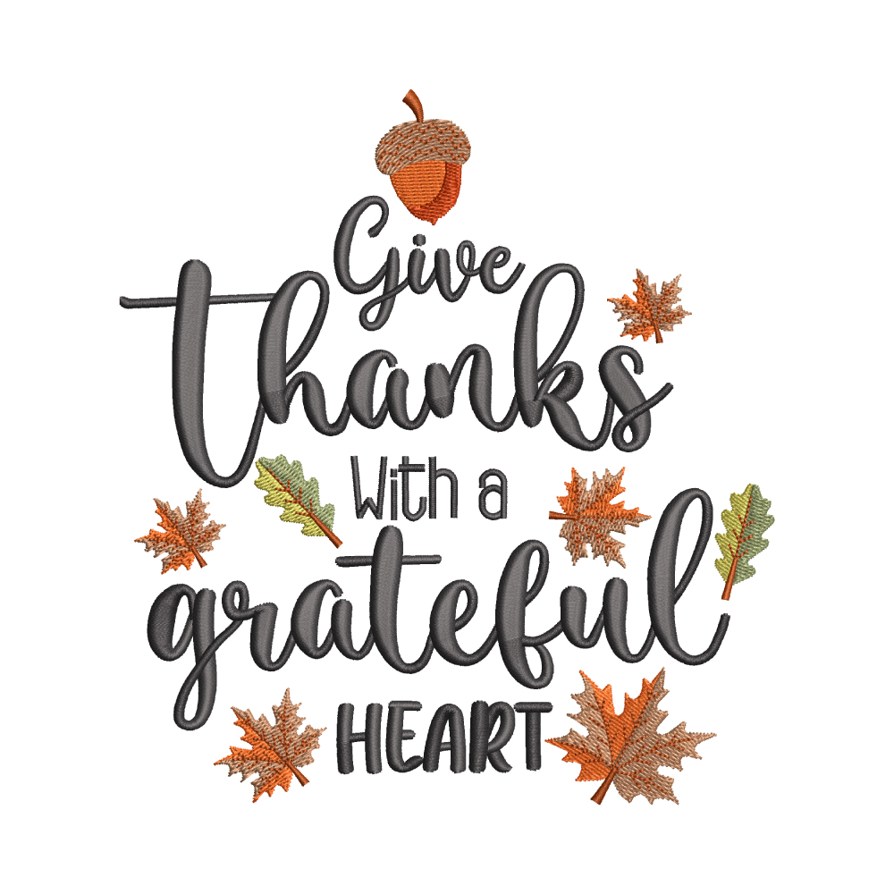

Give Thanks with a Grateful Heart
by Pastor Fee Soliven
Isaiah 12:1-5
Sunday Morning
November 26, 2023

Slide 94
Isaiah 12:1-5
1 And in that day you will say: "O LORD, I will praise You; Though You were angry with me, Your anger is turned away, and You comfort me. 2 Behold, God is my salvation, I will trust and not be afraid; 'For YAH, the LORD, is my strength and song; He also has become my salvation.'"

Slide 95
3 Therefore with joy you will draw water From the wells of salvation. 4 And in that day you will say: "Praise the LORD, call upon His name; Declare His deeds among the peoples, Make mention that His name is exalted. 5 Sing to the LORD, For He has done excellent things; This is known in all the earth.

Slide 96
1 Thessalonians 5:16-18
16 Rejoice always, 17 pray without ceasing, 18 in everything give thanks; for this is the will of God in Christ Jesus for you.

Slide 97
Gratitude to God not only Honors Him,
but is good for Us!

Slide 98
God is Holy
Man is Sinful
Obedience is Essential

Slide 99
Leviticus 22:29-33
29 And when you offer a sacrifice of thanksgiving to the LORD, offer it of your own free will. 30 On the same day it shall be eaten; you shall leave none of it until morning: I am the LORD.

Slide 100
31 "Therefore you shall keep My commandments, and perform them: I am the LORD. 32 You shall not profane My holy name, but I will be hallowed among the children of Israel. I am the LORD who sanctifies you, 33 who brought you out of the land of Egypt, to be your God: I am the LORD."

Slide 101
How can we follow the example taught by the daily sacrifice of thanksgiving?

Slide 102
Having a Grateful Heart Keeps our Minds focused on the Lord Jesus Christ

Slide 103
Gratitude Honors God
Psalm 50:22-23
22 "Now consider this, you who forget God, Lest I tear you in pieces, And there be none to deliver: 23 Whoever offers praise glorifies Me; And to him who orders his conduct aright I will show the salvation of God."

Slide 104
A spirit of thanksgiving is the result of remembering all God has done for us

Slide 105
1. God Chose us Before the Foundation of the World
Ephesians 1:4-5
4 just as He chose us in Him before the foundation of the world, that we should be holy and without blame before Him in love, 5 having predestined us to adoption as sons by Jesus Christ to Himself, according to the good pleasure of His will…

Slide 106
2. We are Indwelt and Sealed by the Holy Spirit
Ephesians 1:13-14
13 In Him you also trusted, after you heard the word of truth, the gospel of your salvation; in whom also, having believed, you were sealed with the Holy Spirit of promise, 14 who is the guarantee of our inheritance until the redemption of the purchased possession, to the praise of His glory

Slide 107
3. We are Eternally Secure
John 10:27-30
27 My sheep hear My voice, and I know them, and they follow Me. 28 And I give them eternal life, and they shall never perish; neither shall anyone snatch them out of My hand. 29 My Father, who has given them to Me, is greater than all; and no one is able to snatch them out of My Father's hand. 30 I and My Father are one."

Slide 108
4. We have been given gifts of the Spirit
Romans 11:28-29
28 Concerning the gospel they are enemies for your sake, but concerning the election they are beloved for the sake of the fathers. 29 For the gifts and the calling of God are irrevocable.

Slide 109
5. We have an intimate relationship with the Lord.
Philippians 4:6-7
6 Be anxious for nothing, but in everything by prayer and supplication, with thanksgiving, let your requests be made known to God; 7 and the peace of God, which surpasses all understanding, will guard your hearts and minds through Christ Jesus.

Slide 110
6. We have the peace of God in our hearts.
Colossians 3:15-16
15 And let the peace of God rule in your hearts, to which also you were called in one body; and be thankful. 16 Let the word of Christ dwell in you richly in all wisdom, teaching and admonishing one another in psalms and hymns and spiritual songs, singing with grace in your hearts to the Lord.

Slide 111
7. The Lord loves us unconditionally.
Romans 8:38-39
38 For I am persuaded that neither death nor life, nor angels nor principalities nor powers, nor things present nor things to come, 39 nor height nor depth, nor any other created thing, shall be able to separate us from the love of God which is in Christ Jesus our Lord.

Slide 112
8. We’re never distant from the presence of God.
Hebrews 13:5
Let your conduct be without covetousness; be content with such things as you have. For He Himself has said, "I will never leave you nor forsake you."

Slide 113
9. The Lord provides for our needs.
Philippians 4:19
And my God shall supply all your need according to His riches in glory by Christ Jesus.

Slide 114
10. We have His divine protection each day.
Psalm 121:7-8
7 The LORD shall preserve you from all evil; He shall preserve your soul. 8 The LORD shall preserve your going out and your coming in From this time forth, and even forevermore.

Slide 115
11. We have the promise of a bodily resurrection.
Romans 8:11
“But if the Spirit of Him who raised Jesus from the dead dwells in you, He who raised Christ from the dead will also give life to your mortal bodies through His Spirit who dwells in you”

Slide 116
12. We have the blessing of God’s atonement through Christ and total forgiveness of our sins.
Colossians 1:13-14
13 He has delivered us from the power of darkness and conveyed us into the kingdom of the Son of His love, 14 in whom we have redemption through His blood, the forgiveness of sins.

Slide 117
13. We have an eternal home in heaven and the promise of the resurrection.
John 14:1-4
1 "Let not your heart be troubled; you believe in God, believe also in Me. 2 In My Father's house are many mansions; if it were not so, I would have told you. I go to prepare a place for you. 3 And if I go and prepare a place for you, I will come again and receive you to Myself; that where I am, there you may be also. 4 And where I go you know, and the way you know."

Slide 118
14. We’ve been given the Word of God, the source of all knowledge and understanding.
2 Timothy 3:16-17
16 All Scripture is given by inspiration of God, and is profitable for doctrine, for reproof, for correction, for instruction in righteousness, 17 that the man of God may be complete, thoroughly equipped for every good work.

Slide 119
True, heartfelt, daily thanksgiving has a powerful impact on our lives.

Slide 120
Gratitude
Keeps us continually aware that we are walking in God’s presence. This contributes to a godly lifestyle.

Slide 121
Gratitude
Motivates us to look for the Lord’s purposes in everything in our lives. Even if we don’t understand what He’s doing, thanking Him lifts the burden.

Slide 122
Gratitude
Helps us bring our will into submission to His when we suffer pain or loss. By thanking Him in the midst of our pain, we acknowledge His loving sovereignty.

Slide 123
Gratitude
Continually reminds us that He is our God and motivates us to tell others about Him.

Slide 124
Gratitude
Reminds us of our continuing dependence on Him.

Slide 125
Gratitude
Helps us trust the Lord. Because He alone knows what’s best, we can thank Him even if we don’t understand why something’s happening. God honors our thanksgiving the most when we feel like we have the least reason for gratitude.

Slide 126
Gratitude
Is essential for rejoicing in the midst of suffering. When the bottom drops out of our lives and everything looks dark, songs of praise and thanksgiving restore our hope, assuring us that God is the Light in our darkness.

Slide 127
Gratitude
Removes anxiety. Gratitude can drive out worry.

Slide 128
Gratitude
Keeps our focus on the Lord. The situation may not change, but our attitude will.

Slide 129
Gratitude
Energizes us physically, mentally, emotionally, and spiritually.

Slide 130
1 Thessalonians 4:13-18
13 But I do not want you to be ignorant, brethren, concerning those who have fallen asleep, lest you sorrow as others who have no hope. 14 For if we believe that Jesus died and rose again, even so God will bring with Him those who sleep in Jesus.

Slide 131
15 For this we say to you by the word of the Lord, that we who are alive and remain until the coming of the Lord will by no means precede those who are asleep. 16 For the Lord Himself will descend from heaven with a shout, with the voice of an archangel, and with the trumpet of God. And the dead in Christ will rise first.

Slide 132
17 Then we who are alive and remain shall be caught up together with them in the clouds to meet the Lord in the air. And thus we shall always be with the Lord. 18 Therefore comfort one another with these words.

Slide 133
1 Corinthians 15:50-54
50 Now this I say, brethren, that flesh and blood cannot inherit the kingdom of God; nor does corruption inherit incorruption. 51 Behold, I tell you a mystery: We shall not all sleep, but we shall all be changed-- 52 in a moment, in the twinkling of an eye, at the last trumpet. For the trumpet will sound, and the dead will be raised incorruptible, and we shall be changed.

Slide 134
53 For this corruptible must put on incorruption, and this mortal must put on immortality. 54 So when this corruptible has put on incorruption, and this mortal has put on immortality, then shall be brought to pass the saying that is written: "Death is swallowed up in victory."

Slide 135

20 Again, when a righteous man turns from his righteousness and commits iniquity, and I lay a stumbling block before him, he shall die; because you did not give him warning, he shall die in his sin, and his righteousness which he has done shall not be remembered; but his blood I will require at your hand.

Slide 136
Acts 2:38-39
38 Then Peter said to them, "Repent, and let every one of you be baptized in the name of Jesus Christ for the remission of sins; and you shall receive the gift of the Holy Spirit. 39 For the promise is to you and to your children, and to all who are afar off, as many as the Lord our God will call."

Slide 137

Donate with our QR code app to
Amazing Grace Christian Fellowship
Donations are Deeply Appreciated!

