Slide 1


Slide 2
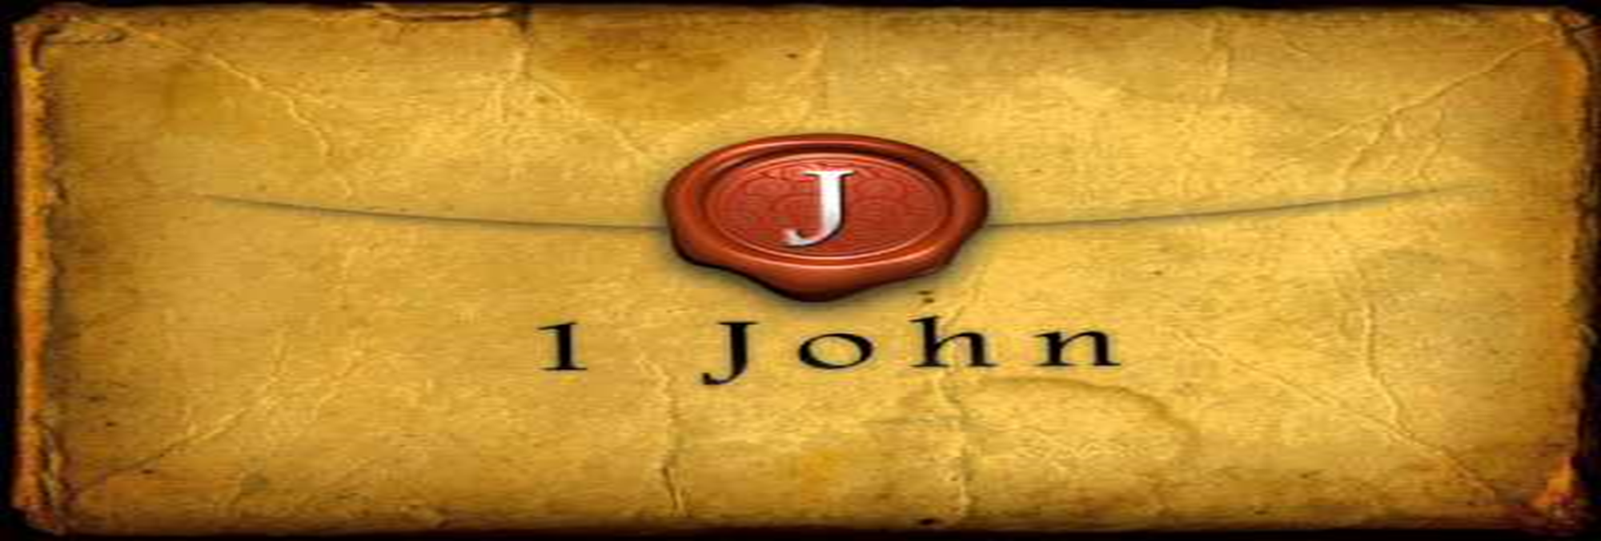

God Does Hear Us
by Pastor Fee Soliven
1 John 5:14-21
Wednesday Evening
November 29, 2023

Slide 3
1 John 5:14-21
14 Now this is the confidence that we have in Him, that if we ask anything according to His will, He hears us. 15 And if we know that He hears us, whatever we ask, we know that we have the petitions that we have asked of Him.

Slide 4
16 If anyone sees his brother sinning a sin which does not lead to death, he will ask, and He will give him life for those who commit sin not leading to death. There is sin leading to death. I do not say that he should pray about that. 17 All unrighteousness is sin, and there is sin not leading to death. 18 We know that whoever is born of God does not sin; but he who has been born of God keeps himself, and the wicked one does not touch him.

Slide 5
19 We know that we are of God, and the whole world lies under the sway of the wicked one. 20 And we know that the Son of God has come and has given us an understanding, that we may know Him who is true; and we are in Him who is true, in His Son Jesus Christ. This is the true God and eternal life. 21 Little children, keep yourselves from idols. Amen.

Slide 6
14 Now this is the confidence that we have in Him, that if we ask anything according to His will, He hears us. 15 And if we know that He hears us, whatever we ask, we know that we have the petitions that we have asked of Him.

Slide 7
Hebrews 4:16
“Let us therefore come boldly to the throne of grace, that we may obtain mercy and find grace to help in time of need”

Slide 8
John 14:13-14
13 And whatever you ask in My name, that I will do, that the Father may be glorified in the Son. 14 If you ask anything in My name, I will do it.

Slide 9
John 14:15-16
15 "If you love Me, keep My commandments. 16 And I will pray the Father, and He will give you another Helper, that He may abide with you forever—

Slide 10
John 16:21-24
21 A woman, when she is in labor, has sorrow because her hour has come; but as soon as she has given birth to the child, she no longer remembers the anguish, for joy that a human being has been born into the world. 22 Therefore you now have sorrow; but I will see you again and your heart will rejoice, and your joy no one will take from you.

Slide 11
23 And in that day you will ask Me nothing. Most assuredly, I say to you, whatever you ask the Father in My name He will give you. 24 Until now you have asked nothing in My name. Ask, and you will receive, that your joy may be full.

Slide 12
So how can believers pray that way?

Slide 13
How do they know what is God’s will?

Slide 14
Romans 8:26-27
26 Likewise the Spirit also helps in our weaknesses. For we do not know what we should pray for as we ought, but the Spirit Himself makes intercession for us with groanings which cannot be uttered. 27 Now He who searches the hearts knows what the mind of the Spirit is, because He makes intercession for the saints according to the will of God.

Slide 15
Matthew 6:10
“Your kingdom come. Your will be done On earth as it is in heaven”

Slide 16
Matthew 26:39-43
39 He went a little farther and fell on His face, and prayed, saying, "O My Father, if it is possible, let this cup pass from Me; nevertheless, not as I will, but as You will." 40 Then He came to the disciples and found them asleep, and said to Peter, "What? Could you not watch with Me one hour?

Slide 17
41 Watch and pray, lest you enter into temptation. The spirit indeed is willing, but the flesh is weak." 42 Again, a second time, He went away and prayed, saying, "O My Father, if this cup cannot pass away from Me unless I drink it, Your will be done."

Slide 18
16 If anyone sees his brother sinning a sin which does not lead to death, he will ask, and He will give him life for those who commit sin not leading to death. There is sin leading to death. I do not say that he should pray about that. 17 All unrighteousness is sin, and there is sin not leading to death.

Slide 19
John 20:23
If you forgive the sins of any, they are forgiven them; if you retain the sins of any, they are retained."

Slide 20
1. A Specific Sin

Slide 21
Numbers 18:22
Hereafter the children of Israel shall not come near the tabernacle of meeting, lest they bear sin and die.

Slide 22
Leviticus 20:1-5
1 Then the LORD spoke to Moses, saying, 2 "Again, you shall say to the children of Israel: 'Whoever of the children of Israel, or of the strangers who dwell in Israel, who gives any of his descendants to Molech, he shall surely be put to death. The people of the land shall stone him with stones.

Slide 23
3 I will set My face against that man, and will cut him off from his people, because he has given some of his descendants to Molech, to defile My sanctuary and profane My holy name. 4 And if the people of the land should in any way hide their eyes from the man, when he gives some of his descendants to Molech, and they do not kill him,

Slide 24
5 then I will set My face against that man and against his family; and I will cut him off from his people, and all who prostitute themselves with him to commit harlotry with Molech.

Slide 25
Acts 5:1-11
1 But a certain man named Ananias, with Sapphira his wife, sold a possession. 2 And he kept back part of the proceeds, his wife also being aware of it, and brought a certain part and laid it at the apostles' feet.

Slide 26
3 But Peter said, "Ananias, why has Satan filled your heart to lie to the Holy Spirit and keep back part of the price of the land for yourself? 4 While it remained, was it not your own? And after it was sold, was it not in your own control? Why have you conceived this thing in your heart? You have not lied to men but to God."

Slide 27
5 Then Ananias, hearing these words, fell down and breathed his last. So great fear came upon all those who heard these things. 6 And the young men arose and wrapped him up, carried him out, and buried him. 7 Now it was about three hours later when his wife came in, not knowing what had happened.

Slide 28
8 And Peter answered her, "Tell me whether you sold the land for so much?" She said, "Yes, for so much." 9 Then Peter said to her, "How is it that you have agreed together to test the Spirit of the Lord? Look, the feet of those who have buried your husband are at the door, and they will carry you out."

Slide 29
10 Then immediately she fell down at his feet and breathed her last. And the young men came in and found her dead, and carrying her out, buried her by her husband. 11 So great fear came upon all the church and upon all who heard these things.

Slide 30
1 Corinthians 5:1-5
1 It is actually reported that there is sexual immorality among you, and such sexual immorality as is not even named among the Gentiles--that a man has his father's wife! 2 And you are puffed up, and have not rather mourned, that he who has done this deed might be taken away from among you.

Slide 31
3 For I indeed, as absent in body but present in spirit, have already judged (as though I were present) him who has so done this deed. 4 In the name of our Lord Jesus Christ, when you are gathered together, along with my spirit, with the power of our Lord Jesus Christ, 5 deliver such a one to Satan for the destruction of the flesh, that his spirit may be saved in the day of the Lord Jesus.

Slide 32
1 Timothy 1:18-20
18 This charge I commit to you, son Timothy, according to the prophecies previously made concerning you, that by them you may wage the good warfare, 19 having faith and a good conscience, which some having rejected, concerning the faith have suffered shipwreck, 20 of whom are Hymenaeus and Alexander, whom I delivered to Satan that they may learn not to blaspheme.

Slide 33
18 We know that whoever is born of God does not sin; but he who has been born of God keeps himself, and the wicked one does not touch him.

Slide 34
19 We know that we are of God, and the whole world lies under the sway of the wicked one.

Slide 35
20 And we know that the Son of God has come and has given us an understanding, that we may know Him who is true; and we are in Him who is true, in His Son Jesus Christ. This is the true God and eternal life.

Slide 36
21 Little children, keep yourselves from idols. Amen.

Slide 37

Donate with our QR code app to
Amazing Grace Christian Fellowship
Donations are Deeply Appreciated!

Slide 38
1 Thessalonians 4:13-18
13 But I do not want you to be ignorant, brethren, concerning those who have fallen asleep, lest you sorrow as others who have no hope. 14 For if we believe that Jesus died and rose again, even so God will bring with Him those who sleep in Jesus.

Slide 39
15 For this we say to you by the word of the Lord, that we who are alive and remain until the coming of the Lord will by no means precede those who are asleep. 16 For the Lord Himself will descend from heaven with a shout, with the voice of an archangel, and with the trumpet of God. And the dead in Christ will rise first.

Slide 40
17 Then we who are alive and remain shall be caught up together with them in the clouds to meet the Lord in the air. And thus we shall always be with the Lord. 18 Therefore comfort one another with these words.

Slide 41
1 Corinthians 15:50-54
50 Now this I say, brethren, that flesh and blood cannot inherit the kingdom of God; nor does corruption inherit incorruption. 51 Behold, I tell you a mystery: We shall not all sleep, but we shall all be changed-- 52 in a moment, in the twinkling of an eye, at the last trumpet. For the trumpet will sound, and the dead will be raised incorruptible, and we shall be changed.

Slide 42
53 For this corruptible must put on incorruption, and this mortal must put on immortality. 54 So when this corruptible has put on incorruption, and this mortal has put on immortality, then shall be brought to pass the saying that is written: "Death is swallowed up in victory."

Slide 43

20 Again, when a righteous man turns from his righteousness and commits iniquity, and I lay a stumbling block before him, he shall die; because you did not give him warning, he shall die in his sin, and his righteousness which he has done shall not be remembered; but his blood I will require at your hand.

Slide 44
Acts 2:38-39
38 Then Peter said to them, "Repent, and let every one of you be baptized in the name of Jesus Christ for the remission of sins; and you shall receive the gift of the Holy Spirit. 39 For the promise is to you and to your children, and to all who are afar off, as many as the Lord our God will call."

