Slide 1


Slide 2
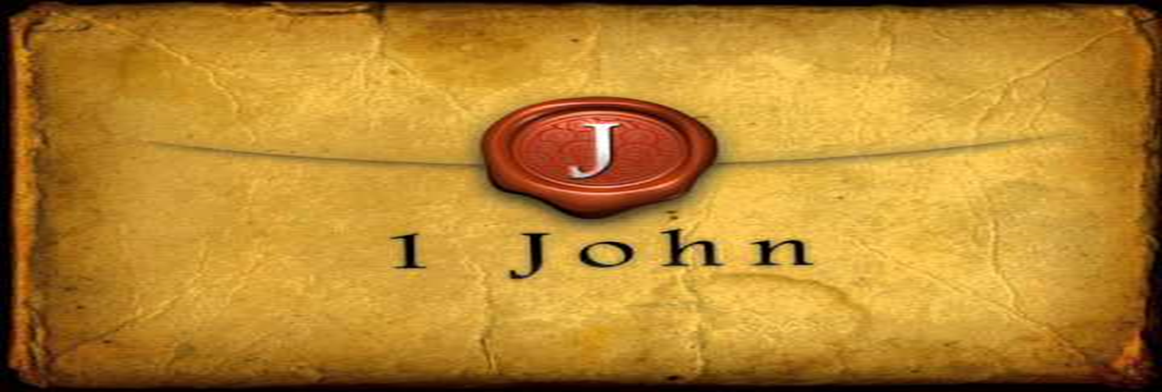

Love Has Been Perfected
by Pastor Fee Soliven
1 John 4:17-21 & 1 John 5:1-4
Wednesday Evening
November 8, 2023

Slide 3
1 John 4:17-21
17 Love has been perfected among us in this: that we may have boldness in the day of judgment; because as He is, so are we in this world. 18 There is no fear in love; but perfect love casts out fear, because fear involves torment. But he who fears has not been made perfect in love. 19 We love Him because He first loved us.

Slide 4
20 If someone says, "I love God," and hates his brother, he is a liar; for he who does not love his brother whom he has seen, how can he love God whom he has not seen? 21 And this commandment we have from Him: that he who loves God must love his brother also.

Slide 5
17 Love has been perfected among us in this: that we may have boldness in the day of judgment; because as He is, so are we in this world.

Slide 6
Romans 3:22-26
22 even the righteousness of God, through faith in Jesus Christ, to all and on all who believe. For there is no difference; 23 for all have sinned and fall short of the glory of God, 24 being justified freely by His grace through the redemption that is in Christ Jesus,

Slide 7
25 whom God set forth as a propitiation by His blood, through faith, to demonstrate His righteousness, because in His forbearance God had passed over the sins that were previously committed, 26 to demonstrate at the present time His righteousness, that He might be just and the justifier of the one who has faith in Jesus.

Slide 8
18 There is no fear in love; but perfect love casts out fear, because fear involves torment. But he who fears has not been made perfect in love.

Slide 9
Romans 8:38-39
38 For I am persuaded that neither death nor life, nor angels nor principalities nor powers, nor things present nor things to come, 39 nor height nor depth, nor any other created thing, shall be able to separate us from the love of God which is in Christ Jesus our Lord.

Slide 10
19 We love Him because He
first loved us

Slide 11
20 If someone says, "I love God," and hates his brother, he is a liar; for he who does not love his brother whom he has seen, how can he love God whom he has not seen?

Slide 12
3 John 9-10
9 I wrote to the church, but Diotrephes, who loves to have the preeminence among them, does not receive us. 10 Therefore, if I come, I will call to mind his deeds which he does, prating against us with malicious words. And not content with that, he himself does not receive the brethren, and forbids those who wish to, putting them out of the church.

Slide 13
21 And this commandment we have from Him: that he who loves God must love his brother also.

Slide 14
1 John 5:1-5
1 Whoever believes that Jesus is the Christ is born of God, and everyone who loves Him who begot also loves him who is begotten of Him. 2 By this we know that we love the children of God, when we love God and keep His commandments.

Slide 15
3 For this is the love of God, that we keep His commandments. And His commandments are not burdensome. 4 For whatever is born of God overcomes the world. And this is the victory that has overcome the world--our faith. 5 Who is he who overcomes the world, but he who believes that Jesus is the Son of God?

Slide 16
1 Whoever believes that Jesus is the Christ is born of God, and everyone who loves Him who begot also loves him who is begotten of Him.

Slide 17
2 By this we know that we love the children of God, when we love God and keep His commandments.

Slide 18
3 For this is the love of God, that we keep His commandments. And His commandments are not burdensome.

Slide 19
John 14:15
“If you love Me, keep My commandments”

Slide 20
John 14:21
He who has My commandments and keeps them, it is he who loves Me. And he who loves Me will be loved by My Father, and I will love him and manifest Myself to him."

Slide 21
John 14:23-24
23 Jesus answered and said to him, "If anyone loves Me, he will keep My word; and My Father will love him, and We will come to him and make Our home with him. 24 He who does not love Me does not keep My words; and the word which you hear is not Mine but the Father's who sent Me.

Slide 22
John 14:31
But that the world may know that I love the Father, and as the Father gave Me commandment, so I do. Arise, let us go from here.

Slide 23
John 13:34
A new commandment I give to you, that you love one another; as I have loved you, that you also love one another.

Slide 24
John 15:17
These things I command you, that you love one another.

Slide 25
Matthew 11:28-30
28 Come to Me, all you who labor and are heavy laden, and I will give you rest. 29 Take My yoke upon you and learn from Me, for I am gentle and lowly in heart, and you will find rest for your souls. 30 For My yoke is easy and My burden is light."

Slide 26
4 For whatever is born of God overcomes the world. And this is the victory that has overcome the world--our faith. 5 Who is he who overcomes the world, but he who believes that Jesus is the Son of God?

Slide 27
John 16:33
“These things I have spoken to you, that in Me you may have peace. In the world you will have tribulation; but be of good cheer, I have overcome the world."

Slide 28

Donate with our QR code app to
Amazing Grace Christian Fellowship
Donations are Deeply Appreciated!

Slide 29
1 Thessalonians 4:13-18
13 But I do not want you to be ignorant, brethren, concerning those who have fallen asleep, lest you sorrow as others who have no hope. 14 For if we believe that Jesus died and rose again, even so God will bring with Him those who sleep in Jesus.

Slide 30
15 For this we say to you by the word of the Lord, that we who are alive and remain until the coming of the Lord will by no means precede those who are asleep. 16 For the Lord Himself will descend from heaven with a shout, with the voice of an archangel, and with the trumpet of God. And the dead in Christ will rise first.

Slide 31
17 Then we who are alive and remain shall be caught up together with them in the clouds to meet the Lord in the air. And thus we shall always be with the Lord. 18 Therefore comfort one another with these words.

Slide 32
1 Corinthians 15:50-54
50 Now this I say, brethren, that flesh and blood cannot inherit the kingdom of God; nor does corruption inherit incorruption. 51 Behold, I tell you a mystery: We shall not all sleep, but we shall all be changed-- 52 in a moment, in the twinkling of an eye, at the last trumpet. For the trumpet will sound, and the dead will be raised incorruptible, and we shall be changed.

Slide 33
53 For this corruptible must put on incorruption, and this mortal must put on immortality. 54 So when this corruptible has put on incorruption, and this mortal has put on immortality, then shall be brought to pass the saying that is written: "Death is swallowed up in victory."

Slide 34

20 Again, when a righteous man turns from his righteousness and commits iniquity, and I lay a stumbling block before him, he shall die; because you did not give him warning, he shall die in his sin, and his righteousness which he has done shall not be remembered; but his blood I will require at your hand.

Slide 35
Acts 2:38-39
38 Then Peter said to them, "Repent, and let every one of you be baptized in the name of Jesus Christ for the remission of sins; and you shall receive the gift of the Holy Spirit. 39 For the promise is to you and to your children, and to all who are afar off, as many as the Lord our God will call."

