Slide 1


Slide 2
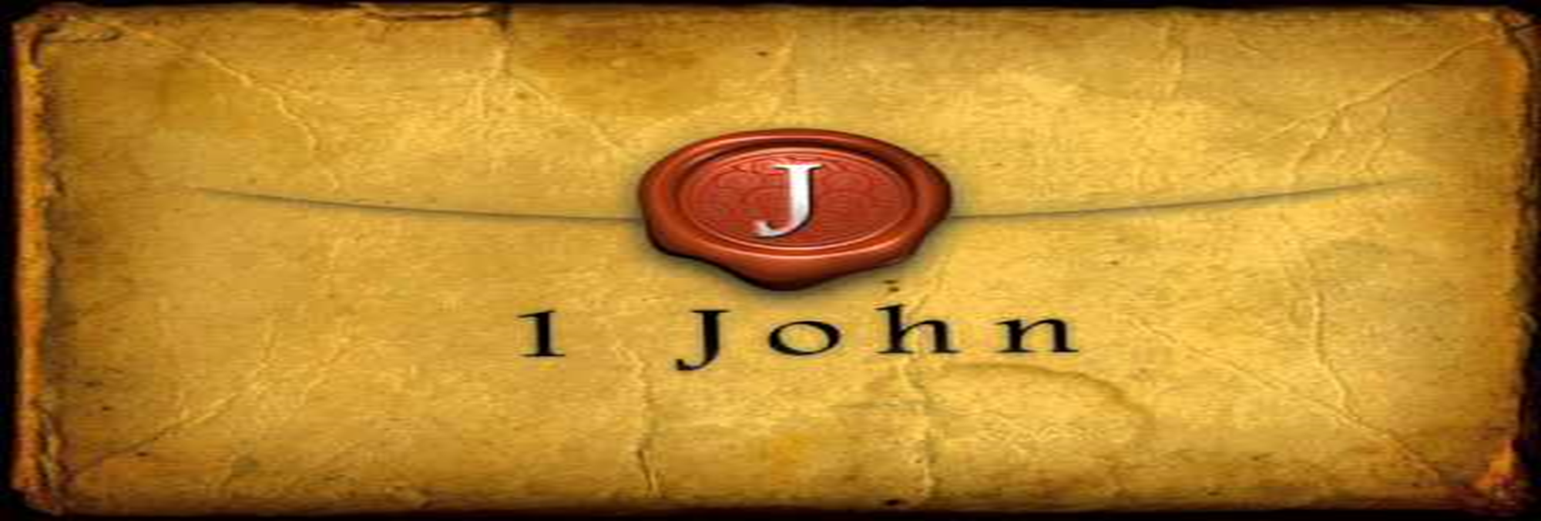

The Spirit bears Witness
by Pastor Fee Soliven
1 John 5:6-13
Wednesday Evening
November 15, 2023

Slide 3
1 John 5:6-13
6 This is He who came by water and blood--Jesus Christ; not only by water, but by water and blood. And it is the Spirit who bears witness, because the Spirit is truth. 7 For there are three that bear witness in heaven: the Father, the Word, and the Holy Spirit; and these three are one.

Slide 4
8 And there are three that bear witness on earth: the Spirit, the water, and the blood; and these three agree as one. 9 If we receive the witness of men, the witness of God is greater; for this is the witness of God which He has testified of His Son. 10 He who believes in the Son of God has the witness in himself; he who does not believe God has made Him a liar, because he has not believed the testimony that God has given of His Son.

Slide 5
11 And this is the testimony: that God has given us eternal life, and this life is in His Son. 12 He who has the Son has life; he who does not have the Son of God does not have life. 13 These things I have written to you who believe in the name of the Son of God, that you may know that you have eternal life, and that you may continue to believe in the name of the Son of God.

Slide 6
6 This is He who came by water and blood--Jesus Christ; not only by water, but by water and blood. And it is the Spirit who bears witness, because the Spirit is truth.

Slide 7
John 1:29-34
29 The next day John saw Jesus coming toward him, and said, "Behold! The Lamb of God who takes away the sin of the world! 30 This is He of whom I said, 'After me comes a Man who is preferred before me, for He was before me.' 31 "I did not know Him; but that He should be revealed to Israel, therefore I came baptizing with water."

Slide 8
32 And John bore witness, saying, "I saw the Spirit descending from heaven like a dove, and He remained upon Him. 33 I did not know Him, but He who sent me to baptize with water said to me, 'Upon whom you see the Spirit descending, and remaining on Him, this is He who baptizes with the Holy Spirit.' 34 "And I have seen and testified that this is the Son of God."

Slide 9
John 19:28-37
28 After this, Jesus, knowing that all things were now accomplished, that the Scripture might be fulfilled, said, "I thirst!" 29 Now a vessel full of sour wine was sitting there; and they filled a sponge with sour wine, put it on hyssop, and put it to His mouth. 30 So when Jesus had received the sour wine, He said, "It is finished!" And bowing His head, He gave up His spirit.

Slide 10
31 Therefore, because it was the Preparation Day, that the bodies should not remain on the cross on the Sabbath (for that Sabbath was a high day), the Jews asked Pilate that their legs might be broken, and that they might be taken away. 32 Then the soldiers came and broke the legs of the first and of the other who was crucified with Him. 33 But when they came to Jesus and saw that He was already dead, they did not break His legs.

Slide 11
34 But one of the soldiers pierced His side with a spear, and immediately blood and water came out. 35 And he who has seen has testified, and his testimony is true; and he knows that he is telling the truth, so that you may believe. 36 For these things were done that the Scripture should be fulfilled, "Not one of His bones shall be broken." 37 And again another Scripture says, "They shall look on Him whom they pierced."

Slide 12
7 For there are three that bear witness in heaven: the Father, the Word, and the Holy Spirit; and these three are one.8 And there are three that bear witness on earth: the Spirit, the water, and the blood; and these three agree as one.

Slide 13
Matthew 3:16-17
16 When He had been baptized, Jesus came up immediately from the water; and behold, the heavens were opened to Him, and He saw the Spirit of God descending like a dove and alighting upon Him. 17 And suddenly a voice came from heaven, saying, "This is My beloved Son, in whom I am well pleased."

Slide 14
Mark 15:39
So when the centurion, who stood opposite Him, saw that He cried out like this and breathed His last, he said, "Truly this Man was the Son of God!"

Slide 15
Romans 1:3-4
3 concerning His Son Jesus Christ our Lord, who was born of the seed of David according to the flesh, 4 and declared to be the Son of God with power according to the Spirit of holiness, by the resurrection from the dead.

Slide 16
9 If we receive the witness of men, the witness of God is greater; for this is the witness of God which He has testified of His Son.

Slide 17
Deuteronomy 17:6
Whoever is deserving of death shall be put to death on the testimony of two or three witnesses; he shall not be put to death on the testimony of one witness.

Slide 18
Deuteronomy 19:15
"One witness shall not rise against a man concerning any iniquity or any sin that he commits; by the mouth of two or three witnesses the matter shall be established”

Slide 19
Matthew 3:16-17
16 When He had been baptized, Jesus came up immediately from the water; and behold, the heavens were opened to Him, and He saw the Spirit of God descending like a dove and alighting upon Him. 17 And suddenly a voice came from heaven, saying, "This is My beloved Son, in whom I am well pleased."

Slide 20
Matthew 17:5
While he was still speaking, behold, a bright cloud overshadowed them; and suddenly a voice came out of the cloud, saying, "This is My beloved Son, in whom I am well pleased. Hear Him!"

Slide 21
10 He who believes in the Son of God has the witness in himself; he who does not believe God has made Him a liar, because he has not believed the testimony that God has given of His Son.

Slide 22
Romans 8:16
The Spirit Himself bears witness with our spirit that we are children of God…

Slide 23
Galatians 4:6
And because you are sons, God has sent forth the Spirit of His Son into your hearts, crying out, "Abba, Father!"

Slide 24
John 14:26
But the Helper, the Holy Spirit, whom the Father will send in My name, He will teach you all things, and bring to your remembrance all things that I said to you.

Slide 25
John 15:26
"But when the Helper comes, whom I shall send to you from the Father, the Spirit of truth who proceeds from the Father, He will testify of Me.

Slide 26
John 16:7-13
7 Nevertheless I tell you the truth. It is to your advantage that I go away; for if I do not go away, the Helper will not come to you; but if I depart, I will send Him to you. 8 And when He has come, He will convict the world of sin, and of righteousness, and of judgment: 9 of sin, because they do not believe in Me;

Slide 27
10 of righteousness, because I go to My Father and you see Me no more; 11 of judgment, because the ruler of this world is judged. 12 I still have many things to say to you, but you cannot bear them now. 13 However, when He, the Spirit of truth, has come, He will guide you into all truth; for He will not speak on His own authority, but whatever He hears He will speak; and He will tell you things to come.

Slide 28
11 And this is the testimony: that God has given us eternal life, and this life is in His Son.

Slide 29
John 1:4
In Him was life, and the life was the light of men

Slide 30
John 14:6
Jesus said to him, "I am the way, the truth, and the life. No one comes to the Father except through Me.

Slide 31
2 Timothy 1:10
but has now been revealed by the appearing of our Savior Jesus Christ, who has abolished death and brought life and immortality to light through the gospel…

Slide 32
12 He who has the Son has life; he who does not have the Son of God does not have life.

Slide 33
Romans 8:8-11
8 So then, those who are in the flesh cannot please God. 9 But you are not in the flesh but in the Spirit, if indeed the Spirit of God dwells in you. Now if anyone does not have the Spirit of Christ, he is not His.

Slide 34
10 And if Christ is in you, the body is dead because of sin, but the Spirit is life because of righteousness. 11 But if the Spirit of Him who raised Jesus from the dead dwells in you, He who raised Christ from the dead will also give life to your mortal bodies through His Spirit who dwells in you.

Slide 35
13 These things I have written to you who believe in the name of the Son of God, that you may know that you have eternal life, and that you may continue to believe in the name of the Son of God.

Slide 36
Romans 10:9-13
9 that if you confess with your mouth the Lord Jesus and believe in your heart that God has raised Him from the dead, you will be saved. 10 For with the heart one believes unto righteousness, and with the mouth confession is made unto salvation. 11 For the Scripture says, "Whoever believes on Him will not be put to shame."

Slide 37
12 For there is no distinction between Jew and Greek, for the same Lord over all is rich to all who call upon Him. 13 For "whoever calls on the name of the LORD shall be saved."

Slide 38

Donate with our QR code app to
Amazing Grace Christian Fellowship
Donations are Deeply Appreciated!

Slide 39
1 Thessalonians 4:13-18
13 But I do not want you to be ignorant, brethren, concerning those who have fallen asleep, lest you sorrow as others who have no hope. 14 For if we believe that Jesus died and rose again, even so God will bring with Him those who sleep in Jesus.

Slide 40
15 For this we say to you by the word of the Lord, that we who are alive and remain until the coming of the Lord will by no means precede those who are asleep. 16 For the Lord Himself will descend from heaven with a shout, with the voice of an archangel, and with the trumpet of God. And the dead in Christ will rise first.

Slide 41
17 Then we who are alive and remain shall be caught up together with them in the clouds to meet the Lord in the air. And thus we shall always be with the Lord. 18 Therefore comfort one another with these words.

Slide 42
1 Corinthians 15:50-54
50 Now this I say, brethren, that flesh and blood cannot inherit the kingdom of God; nor does corruption inherit incorruption. 51 Behold, I tell you a mystery: We shall not all sleep, but we shall all be changed-- 52 in a moment, in the twinkling of an eye, at the last trumpet. For the trumpet will sound, and the dead will be raised incorruptible, and we shall be changed.

Slide 43
53 For this corruptible must put on incorruption, and this mortal must put on immortality. 54 So when this corruptible has put on incorruption, and this mortal has put on immortality, then shall be brought to pass the saying that is written: "Death is swallowed up in victory."

Slide 44

20 Again, when a righteous man turns from his righteousness and commits iniquity, and I lay a stumbling block before him, he shall die; because you did not give him warning, he shall die in his sin, and his righteousness which he has done shall not be remembered; but his blood I will require at your hand.

Slide 45
Acts 2:38-39
38 Then Peter said to them, "Repent, and let every one of you be baptized in the name of Jesus Christ for the remission of sins; and you shall receive the gift of the Holy Spirit. 39 For the promise is to you and to your children, and to all who are afar off, as many as the Lord our God will call."

