Slide 1


Slide 2
“Battle Belongs”
(Phil Wickham)CCLI #7148126

Slide 3
When all I see is battle, you see my victory.When all I see is mountain, You see a mountain move. And as

Slide 4
I walk through the shadow, Your love surrounds me. There’s nothing to fear now for I am safe with you.

Slide 5
So when I fight, I’ll fight on my knees. With my hands lifted high. Oh God, the battle belongs to you. And

Slide 6
Every fear I lay at your feet. I’ll sing through the night. Oh God, the battle belongs to you. And if you

Slide 7
Are for me, who can stand against me, who can be against me? Yeah for Jesus, there’s nothing

Slide 8
Impossible for you. When all I see are the ashes., You see the beauty. Thank you God. When all I see

Slide 9
Is the cross, God, You see the empty tomb. So when I fight, I’ll fight on my knees. With my hands lifted

Slide 10
High. Oh God, the battle belongs to you. And every fear I lay at your feet. I’ll sing through the night.

Slide 11
Oh, God, the battle belongs to you. Almighty fortress, You go before us. Nothing can stand against the

Slide 12
power of our God. You shine in the shadow, You win every battle. Nothing can stand against the power

Slide 13
Of our God. All mighty fortress, you go before us. Nothing can stand against the power of our God. You

Slide 14
Shine in the shadows. You win every battle. Nothing can stand against the power of our God. So when I

Slide 15
Fight, I’ll fight on my knees. With my hands lifted high. Oh’ god, the battle belongs to you. And every

Slide 16
Fear I lay at your feet. I’ll sing through the night. Oh God, the battle belongs to you.

Slide 17
Worthy
(Elevation Worship)

Slide 18
It was my cross You bore So I could live in the freedom You died for And now my life is Yours And I

Slide 19
will sing of Your goodness forevermore Worthy is Your name, Jesus You deserve the praise Worthy is

Slide 20
Your name Worthy is Your name, Jesus You deserve the praise Worthy is Your name And now my shame

Slide 21
is gone I stand amazed in Your love undeniable Your grace goes on and on And I will sing of Your

Slide 22
goodness forevermore Worthy is Your name, Jesus
You deserve the praise Worthy is Your name Worthy

Slide 23
is Your name, Jesus You deserve the praise Worthy is Your name Worthy is Your name, Jesus You

Slide 24
deserve the praise Worthy is Your name Worthy is Your name, Jesus You deserve the praise Worthy is

Slide 25
Your name Be exalted now in the heavens As Your glory fills this place You alone deserve our praise

Slide 26
You're the name above all names Be exalted now in the heavens As Your glory fills this place You alone

Slide 27
deserve our praise You're the name above all names
Be exalted now in the heavens As Your glory fills this

Slide 28
place You alone deserve our praise You're the name above all names Be exalted now in the heavens As

Slide 29
Your glory fills this place You alone deserve our praise You're the name above all names Be exalted

Slide 30
now in the heavens As Your glory fills this place You alone deserve our praise You're the name above all

Slide 31
names Be exalted now in the heavens As Your glory fills this place You alone deserve our praise You're

Slide 32
the name above all names Worthy is Your name, Jesus You deserve the praise Worthy is Your name

Slide 33
Worthy is Your name, Jesus You deserve the praise
Worthy is Your name Worthy is Your name, Jesus

Slide 34
You deserve the praise Worthy is Your name Worthy is Your name, Jesus You deserve the praise Worthy

Slide 35
is Your name Oh, oh praise Worthy is
Your name Oh, oh

Slide 36
Champion
(Bethel Music)

Slide 37
I've tried so hard to see it Took me so long to believe it That You'd choose someone like me To carry Your

Slide 38
victory Perfection could never earn it You give what we don't deserve and You take the broken things

Slide 39
And raise them to glory You are my champion Giants fall when You stand Undefeated Every battle

Slide 40
You've won I am who You say I am You crown me with confidence I am seated In the Heavenly place

Slide 41
Undefeated With the One who has conquered it all
Now I can finally see it You're teaching me how to

Slide 42
receive it So let all the striving cease, oh This is my victory You are my champion Giants fall when You

Slide 43
stand Undefeated Every battle You've won I am who You say I am You crown me with confidence I am

Slide 44
seated In the Heavenly place Undefeated With the One who has conquered it all It all, it all, it

Slide 45
all, it all When I lift my voice and shout Every wall comes crashing down I have the authority Jesus has

Slide 46
given me When I open up my mouth Miracles start breaking out I have the authority Jesus has given me

Slide 47
When I lift my voice and shout Every wall comes crashing down I have the authority (yes, I do) Jesus

Slide 48
has given me When I open up my mouth Miracles start breaking out I have the authority Jesus has

Slide 49
given me You are my champion Giants fall when You stand Undefeated Every battle You've won I am

Slide 50
who You say I am You crown me with confidence I am seated In the Heavenly place Undefeated By the

Slide 51
power of Your name I am seated in the Heavenly place Undefeated With the One who has conquered

Slide 52
it all I know who I am, because I know whose I am, Hallelujah There's nothing left to prove There’s

Slide 53
nothing left to prove He freely gave it to us Rejoice, rejoice, rejoice Freely He gave When I-,

Slide 54
come on sing When I lift up my voice and shout (come on) Every wall comes crashing down I have

Slide 55
the authority (Jesus has) Jesus has given me When I open up my mouth Miracles start breaking out (it

Slide 56
starts to break out) I have the authority Jesus has given me (when I lift) When I lift my voice and shout

Slide 57
(come on) Every wall comes crashing down I have the authority Jesus has given me (now declare it,

Slide 58
when I) When I open up my mouth Miracles start breaking out I have the authority Jesus has given me

Slide 59
You are my champion (Sing it out, come on, giants) Giants fall when You stand Undefeated Every battle

Slide 60
You've won (I am) I am who You say I am (You crown me) You crown me with confidence I am seated In

Slide 61
the Heavenly place Undefeated (by the power, come on) By the power of Your name I am seated (in

Slide 62
Heaven) In the Heavenly place Undefeated With the One who has conquered it all

Slide 63
“Do It Again”
(Elevation Worship)

Slide 64
Walking around these walls I thought by now they'd fall But You have never failed me yet Waiting for

Slide 65
change to come Knowing the battle's won For You have never failed me yet Your promise still stands

Slide 66
Great is Your faithfulness, faithfulness I'm still in Your hands This is my confidence You've never failed me

Slide 67
yet I know the night won't last Your word will come to pass My heart will sing Your praise again Jesus

Slide 68
You're still enough Keep me within Your love, oh My heart will sing Your praise again (Oh, yes, it will) Your

Slide 69
promise still stands Great is Your faithfulness, faithfulness I'm still in Your hands This is my

Slide 70
confidence You've never failed Your promise still stands Great is Your faithfulness, faithfulness I'm still

Slide 71
in Your hands This is my confidence You've never failed me yet Never failed me yet Oh, oh-oh I've

Slide 72
seen You move, You move the mountains And I believe I'll see You do it again You made a way,

Slide 73
where there was no way And I believe I'll see You do it again I've seen You move, You move the

Slide 74
mountains And I believe I'll see You do it again
You made a way, where there was no way And I

Slide 75
believe I'll see You do it again I've seen You move, You move the mountains And I believe I'll see You do

Slide 76
it again You made a way, where there was no way
And I believe I'll see You do it again I'll see You do it

Slide 77
again Your promise still stands Great is Your faithfulness, faithfulness I'm still in Your hands This is

Slide 78
my confidence You've never failed Your promise still stands Great is Your faithfulness, faithfulness I'm still

Slide 79
in Your hands This is my confidence You've never failed me yet Oh, You've never failed me yet And I

Slide 80
never will forget You've never failed me yet And I never will forget

Slide 81
“Holy Water”
(We The Kingdom)

Slide 82
God, I'm on my knees again God, I'm begging please again I need you Oh, I need you Walking down these

Slide 83
desert roads Water for my thirsty soul I need you Oh, I need you Your forgiveness Is like sweet, sweet

Slide 84
honey on my lips Like the sound of a symphony to my ears Like Holy water on my skin Dead man

Slide 85
walking, slave to sin I wanna know about being born again I need you Oh, God, I need you So, take me to

Slide 86
the riverside Take me under, baptize I need you Oh, God I need you Your forgiveness Is like sweet, sweet

Slide 87
honey on my lips Like the sound of a symphony to my ears Like holy water on my skin (On my skin) I

Slide 88
don't wanna abuse your grace God, I need it every day It's the only thing that ever really makes me

Slide 89
wanna change I don't wanna abuse your grace God, I need it every day It's the only thing that ever really

Slide 90
makes me wanna change I don't wanna abuse your grace God, I need it every day It's the only thing that

Slide 91
ever really makes me wanna change I don't wanna abuse your grace God, I need it every day It's the

Slide 92
only thing that ever really makes me wanna change
Your forgiveness Is like sweet, sweet honey on my

Slide 93
lips (yes, it is) Like the sound of a symphony to my ears It's like holy water Your forgiveness Is like

Slide 94
sweet, sweet honey on my lips Like the sound of a symphony on my ears It's like holy water on my skin

Slide 95
It's like holy water on my skin It's like holy water.

Slide 97


Slide 98
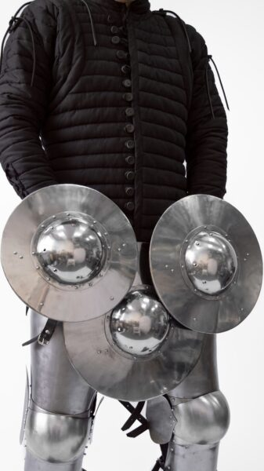
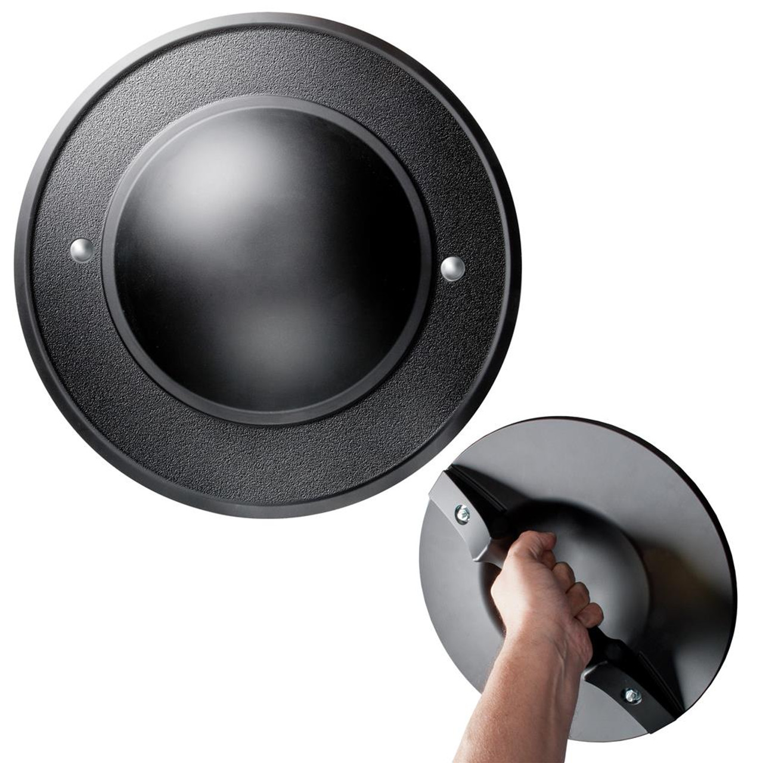

El Gibor Our Mighty and Strong God
by Pastor Fee Soliven
Psalm 18:1-6
Sunday Morning
February 18, 2024

Slide 99
Psalm 18:1-6
1 I will love You, O LORD, my strength. 2 The LORD is my rock and my fortress and my deliverer; My God, my strength, in whom I will trust; My shield and the horn of my salvation, my stronghold. 3 I will call upon the LORD, who is worthy to be praised; So shall I be saved from my enemies.

Slide 100
4 The pangs of death surrounded me, And the floods of ungodliness made me afraid. 5 The sorrows of Sheol surrounded me; The snares of death confronted me. 6 In my distress I called upon the LORD, And cried out to my God; He heard my voice from His temple, And my cry came before Him, even to His ears.

Slide 101
Psalm 91:3-6
3 Surely He shall deliver you from the snare of the fowler And from the perilous pestilence. 4 He shall cover you with His feathers, And under His wings you shall take refuge; His truth shall be your shield and buckler.

Slide 102
5 You shall not be afraid of the terror by night, Nor of the arrow that flies by day, 6 Nor of the pestilence that walks in darkness, Nor of the destruction that lays waste at noonday.

Slide 103
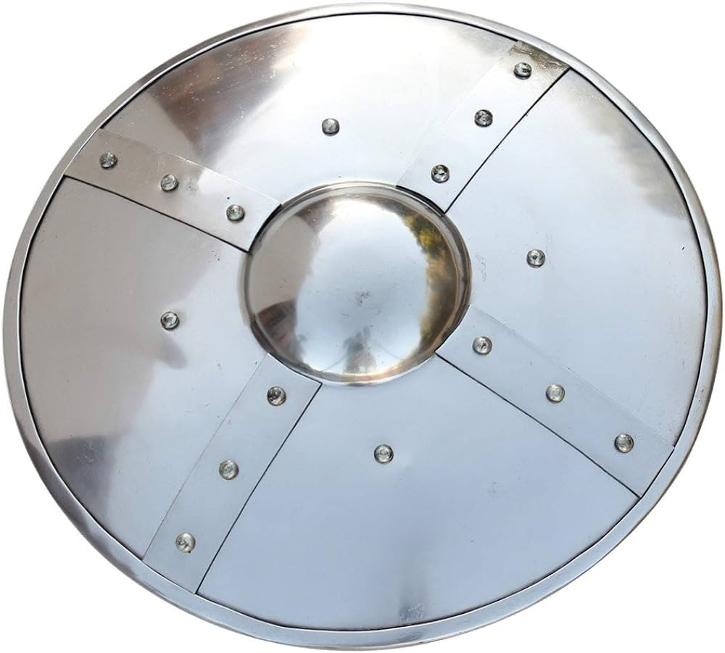
Photo Slide>

Slide 104
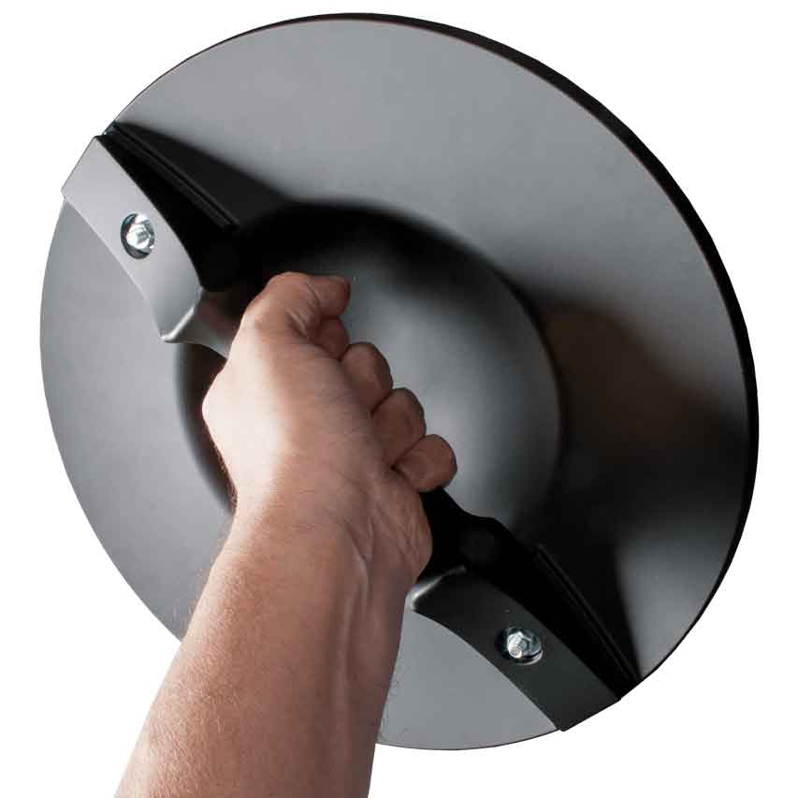
Why should we care what the Old Testament has to say?

Slide 105
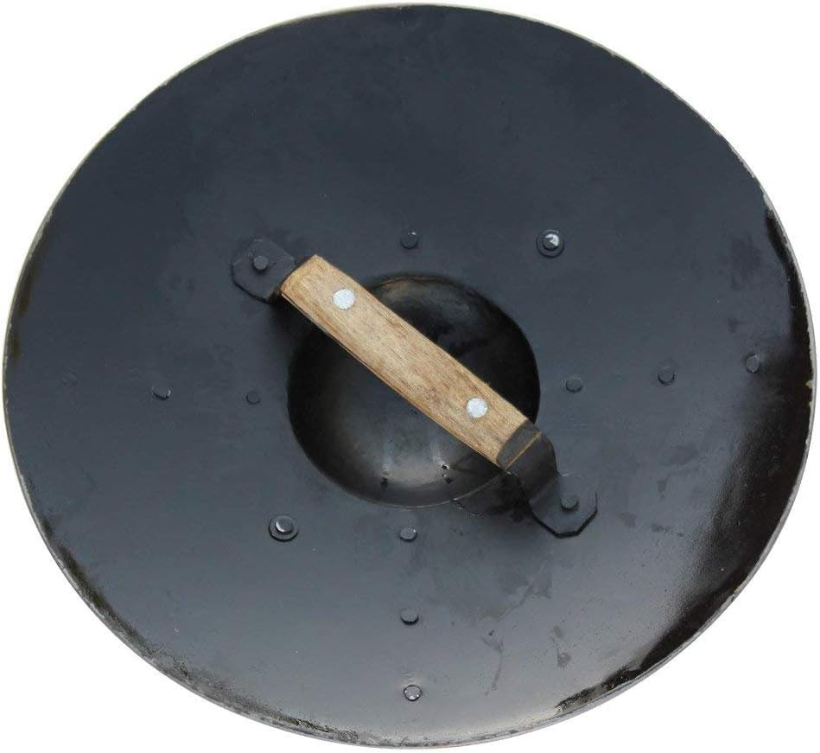
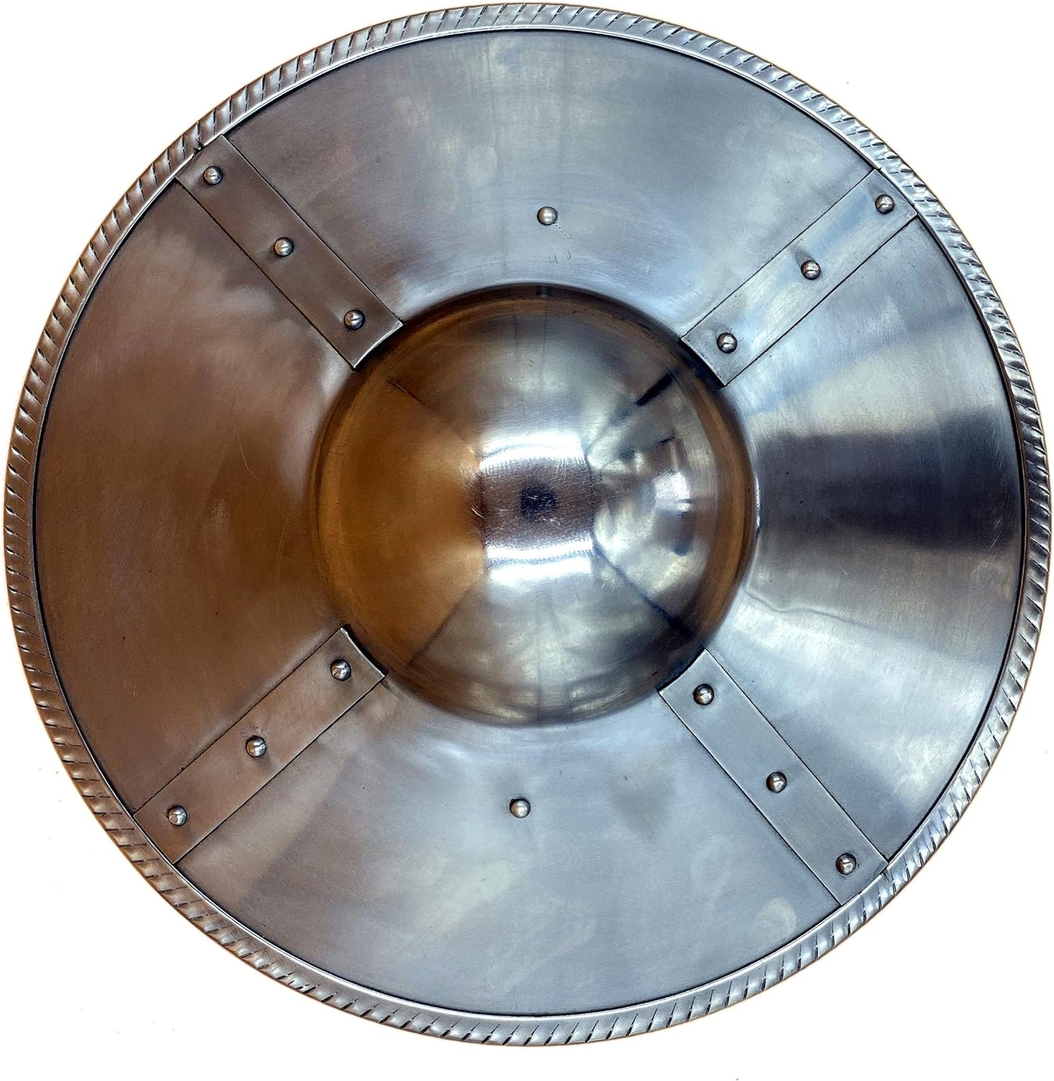
Romans 15:4
“For whatever things were written before were written for our learning, that we through the patience and comfort of the Scriptures might have hope”

Slide 106
David's Declaration

Slide 107
1. David's Love for God

Slide 108
Psalm 18:35-36
35 You have also given me the shield of Your salvation; Your right hand has held me up, Your gentleness has made me great. 36 You enlarged my path under me; So my feet did not slip.

Slide 109
2 Samuel 5:9-10
9 Then David dwelt in the stronghold, and called it the City of David. And David built all around from the Millo and inward. 10 So David went on and became great, and the LORD God of hosts was with him.

Slide 110
2 Samuel 7:9-11
9 And I have been with you wherever you have gone, and have cut off all your enemies from before you, and have made you a great name, like the name of the great men who are on the earth.

Slide 111
10 Moreover I will appoint a place for My people Israel, and will plant them, that they may dwell in a place of their own and move no more; nor shall the sons of wickedness oppress them anymore, as previously,

Slide 112
11 since the time that I commanded judges to be over My people Israel, and have caused you to rest from all your enemies. Also the LORD tells you that He will make you a house.

Slide 113
2. God is My Rock

Slide 114
Psalm 18:1-2
1 I will love You, O LORD, my strength. 2 The LORD is my rock and my fortress and my deliverer; My God, my strength, in whom I will trust; My shield and the horn of my salvation, my stronghold.

Slide 115
Psalm 61:2
"From the end of the earth I will cry to You, When my heart is overwhelmed; Lead me to the rock that is higher than I."

Slide 116
3. God Is My Fortress

Slide 117
Psalm 31:1-5
1 In You, O LORD, I put my trust; Let me never be ashamed; Deliver me in Your righteousness. 2 Bow down Your ear to me, Deliver me speedily; Be my rock of refuge, A fortress of defense to save me.

Slide 118
3 For You are my rock and my fortress; Therefore, for Your name's sake, Lead me and guide me. 4 Pull me out of the net which they have secretly laid for me, For You are my strength. 5 Into Your hand I commit my spirit; You have redeemed me, O LORD God of truth.

Slide 119
4. God is My Deliverer

Slide 120
Psalm 32:7-8
7 You are my hiding place; You shall preserve me from trouble; You shall surround me with songs of deliverance. Selah 8 I will instruct you and teach you in the way you should go; I will guide you with My eye.

Slide 121
5. God is My God

Slide 122
Psalm 18:25-31
25 With the merciful You will show Yourself merciful; With a blameless man You will show Yourself blameless; 26 With the pure You will show Yourself pure; And with the devious You will show Yourself shrewd.

Slide 123
27 For You will save the humble people, But will bring down haughty looks. 28 For You will light my lamp; The LORD my God will enlighten my darkness. 29 For by You I can run against a troop, By my God I can leap over a wall.

Slide 124
30 As for God, His way is perfect; The word of the LORD is proven; He is a shield to all who trust in Him. 31 For who is God, except the LORD? And who is a rock, except our God?

Slide 125
David's Distress

Slide 126
1. Sorrows of Death

Slide 127
Psalm 91:5-8
5 You shall not be afraid of the terror by night, Nor of the arrow that flies by day, 6 Nor of the pestilence that walks in darkness, Nor of the destruction that lays waste at noonday.

Slide 128
7 A thousand may fall at your side, And ten thousand at your right hand; But it shall not come near you. 8 Only with your eyes shall you look, And see the reward of the wicked.

Slide 129
2. The Sorrows of Hell

Slide 130
Psalm 18:4-6
4 The pangs of death surrounded me, And the floods of ungodliness made me afraid. 5 The sorrows of Sheol surrounded me; The snares of death confronted me. 6 In my distress I called upon the LORD, And cried out to my God; He heard my voice from His temple, And my cry came before Him, even to His ears.

Slide 131
3. The Snares of Death

Slide 132
2 Timothy 2:25-26
25 in humility correcting those who are in opposition, if God perhaps will grant them repentance, so that they may know the truth, 26 and that they may come to their senses and escape the snare of the devil, having been taken captive by him to do his will.

Slide 133
Psalm 124:6-8
6 Blessed be the LORD, Who has not given us as prey to their teeth. 7 Our soul has escaped as a bird from the snare of the fowlers; The snare is broken, and we have escaped. 8 Our help is in the name of the LORD, Who made heaven and earth.

Slide 134
David's Deliverance

Slide 135
1. Memory of Past Deliverance

Slide 136
Psalm 18:16-19
16 He sent from above, He took me; He drew me out of many waters. 17 He delivered me from my strong enemy, From those who hated me, For they were too strong for me. 18 They confronted me in the day of my calamity, But the LORD was my support. 19 He also brought me out into a broad place; He delivered me because He delighted in me.

Slide 137
2. Assurance of Present Deliverance

Slide 138
Romans 8:37-39
37 Yet in all these things we are more than conquerors through Him who loved us. 38 For I am persuaded that neither death nor life, nor angels nor principalities nor powers, nor things present nor things to come,

Slide 139
39 nor height nor depth, nor any other created thing, shall be able to separate us from the love of God which is in Christ Jesus our Lord.

Slide 140
3. Hope of Future Deliverance

Slide 141
Jeremiah 29:11-13
11 For I know the thoughts that I think toward you, says the LORD, thoughts of peace and not of evil, to give you a future and a hope. 12 Then you will call upon Me and go and pray to Me, and I will listen to you. 13 And you will seek Me and find Me, when you search for Me with all your heart.

Slide 142
1 Thessalonians 4:13-18
13 But I do not want you to be ignorant, brethren, concerning those who have fallen asleep, lest you sorrow as others who have no hope. 14 For if we believe that Jesus died and rose again, even so God will bring with Him those who sleep in Jesus.

Slide 143
15 For this we say to you by the word of the Lord, that we who are alive and remain until the coming of the Lord will by no means precede those who are asleep. 16 For the Lord Himself will descend from heaven with a shout, with the voice of an archangel, and with the trumpet of God. And the dead in Christ will rise first.

Slide 144
17 Then we who are alive and remain shall be caught up together with them in the clouds to meet the Lord in the air. And thus we shall always be with the Lord. 18 Therefore comfort one another with these words.

Slide 145
1 Corinthians 15:50-54
50 Now this I say, brethren, that flesh and blood cannot inherit the kingdom of God; nor does corruption inherit incorruption. 51 Behold, I tell you a mystery: We shall not all sleep, but we shall all be changed-- 52 in a moment, in the twinkling of an eye, at the last trumpet. For the trumpet will sound, and the dead will be raised incorruptible, and we shall be changed.

Slide 146
53 For this corruptible must put on incorruption, and this mortal must put on immortality. 54 So when this corruptible has put on incorruption, and this mortal has put on immortality, then shall be brought to pass the saying that is written: "Death is swallowed up in victory."

Slide 147

20 Again, when a righteous man turns from his righteousness and commits iniquity, and I lay a stumbling block before him, he shall die; because you did not give him warning, he shall die in his sin, and his righteousness which he has done shall not be remembered; but his blood I will require at your hand.

Slide 148
Acts 2:38-39
38 Then Peter said to them, "Repent, and let every one of you be baptized in the name of Jesus Christ for the remission of sins; and you shall receive the gift of the Holy Spirit. 39 For the promise is to you and to your children, and to all who are afar off, as many as the Lord our God will call."

Slide 149

Donate with our QR code app to
Amazing Grace Christian Fellowship
Donations are Deeply Appreciated!

